Slide 1
Quicken Bank Marketing Case Study Presentation
Preston Countryman
21/06/20

Slide 2
Outline
Review of bank marketing case study
Data interpretation and preprocessing
Modeling results
Recommendations moving forward
Notes:
CLEARLY STATE THE METRIC FOR THE PROBLEM

Slide 3
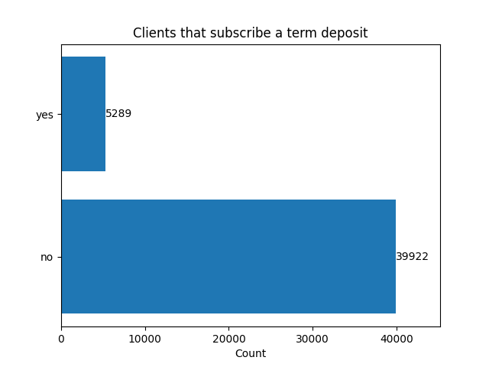
Goal: determine whether a client will subscribe a term deposit
All information obtained from phone calls
16 input variables:
Classifiers: job, marital status, education, contact type, month last contacted, outcome of previous calling campaigns
Boolean: credit in default, house loan, personal loan
Numeric: age, average yearly balance (euro), day of month last contacted, duration of last call, contacts made during previous campaign, contacts made during active campaign
Only one target variable: did client subscribe a term deposit

Slide 4
Data interpretation and preprocessing
Removed all punctuation from strings, renamed variables for legibility
OneHotEncoding for classifier variables
Convert Boolean variables to binary
Check data fidelity (very clean, no problems)
Changed “-1” entry in ‘pdays’ variable to ‘NaN’ that indicated client was not contacted previously for standardization
Removed ‘contactsduringcampaign’ for possible data leakage
Notes:
(add variable to OneHotEncoding classifier to avoid duplicate columns)
‘contactsduringcampaign’: OK to use for making predictions within a campaign; Not OK to use for making predictions on new campaign

Slide 5
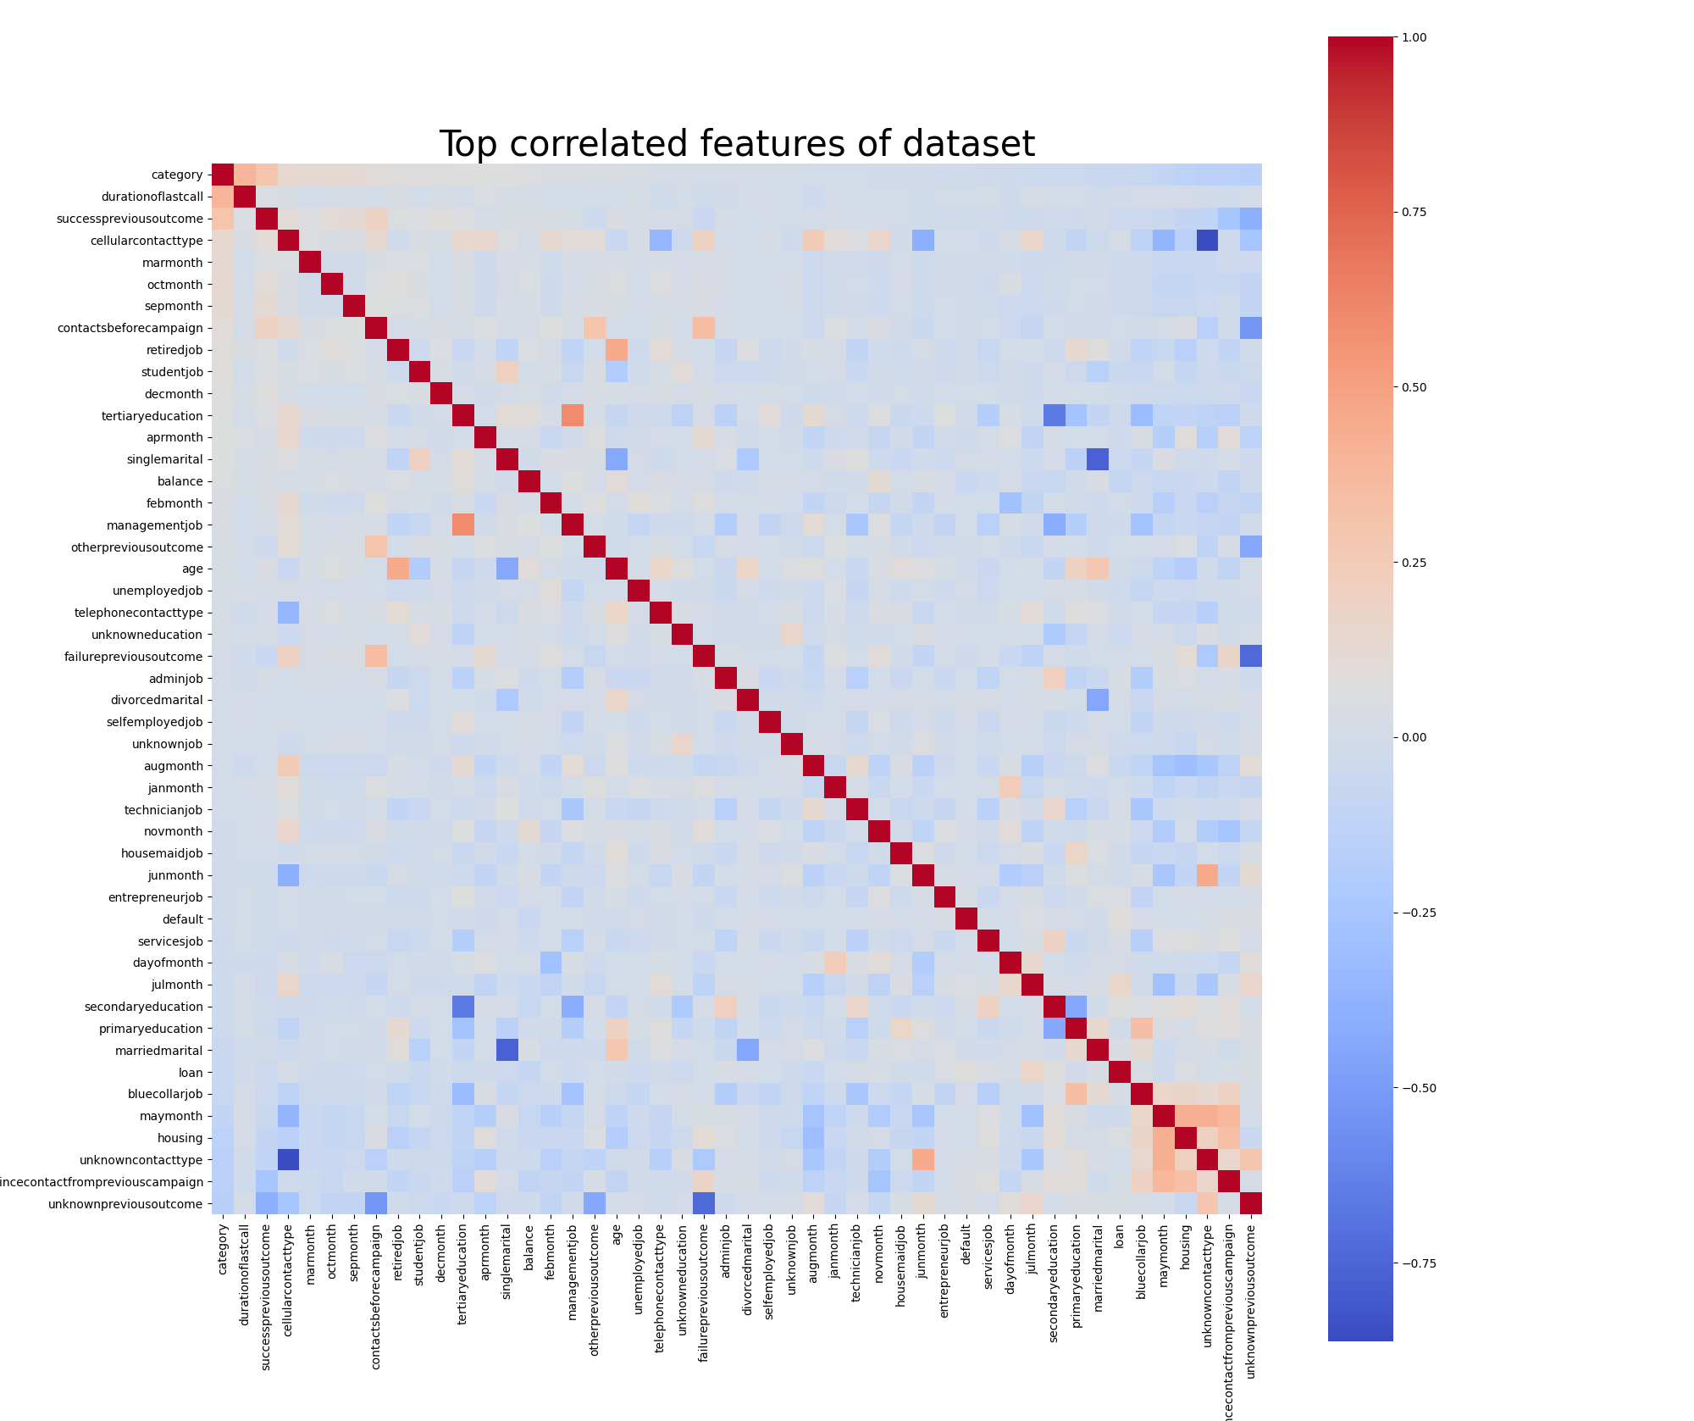
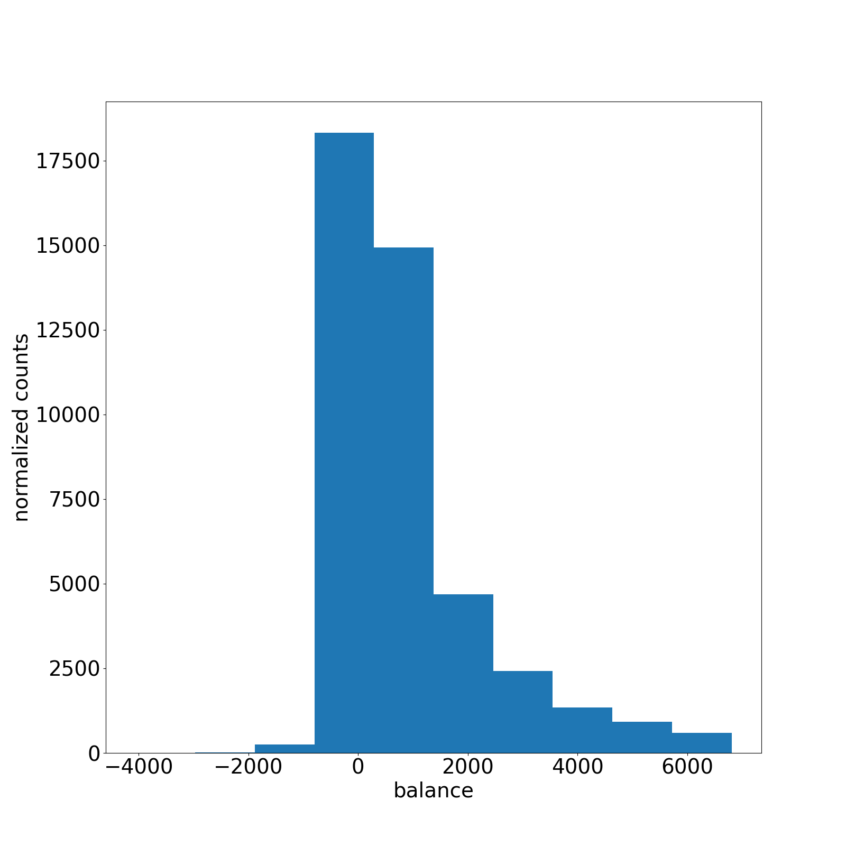
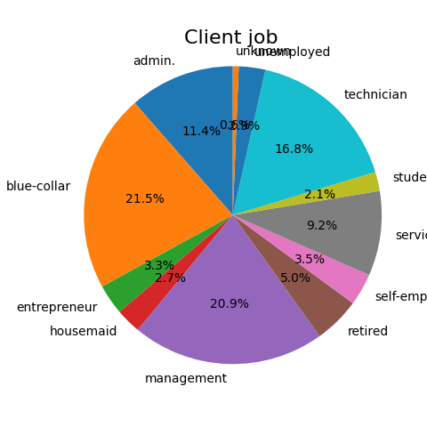
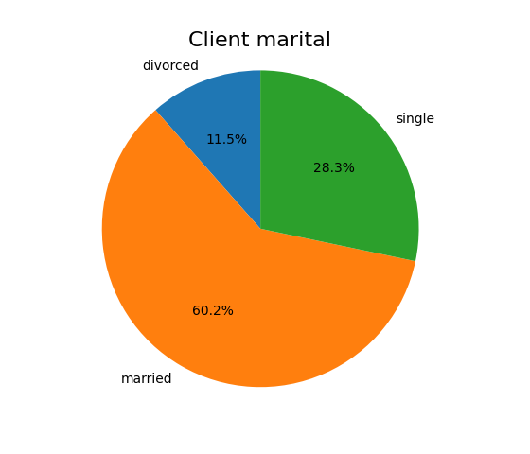
Data had high fidelity, high variance
Some classifier variables (marital status) had good distribution of results
Other classifier variables (client job) had little data on some results
Numerical data generally well behaved (even distribution or gaussian)
Variables had little correlation to each other
Pipeline to standardize and fit models (logistic regression, random forest, SVC)

Slide 6
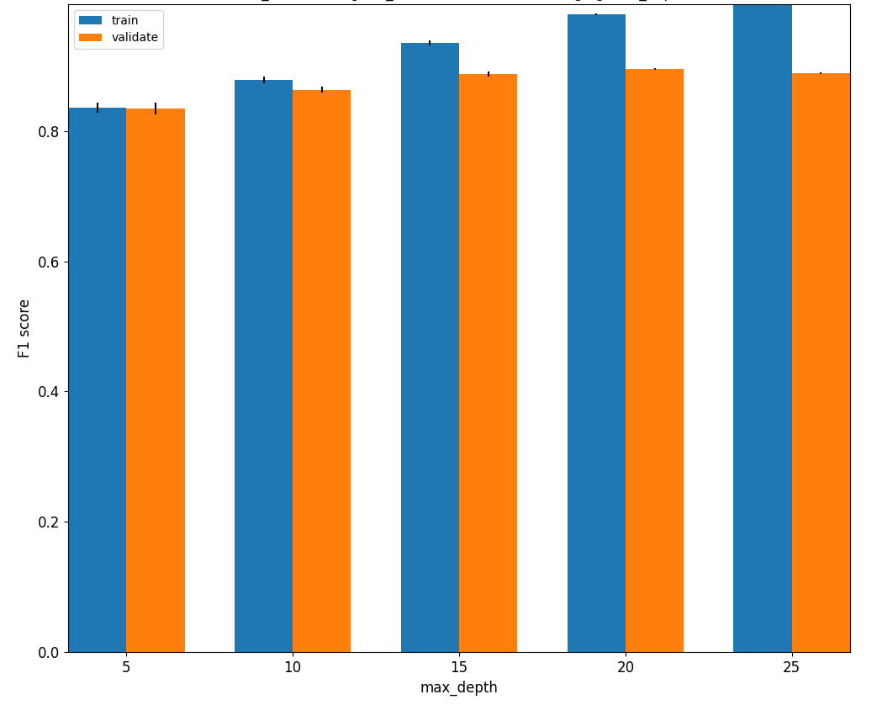
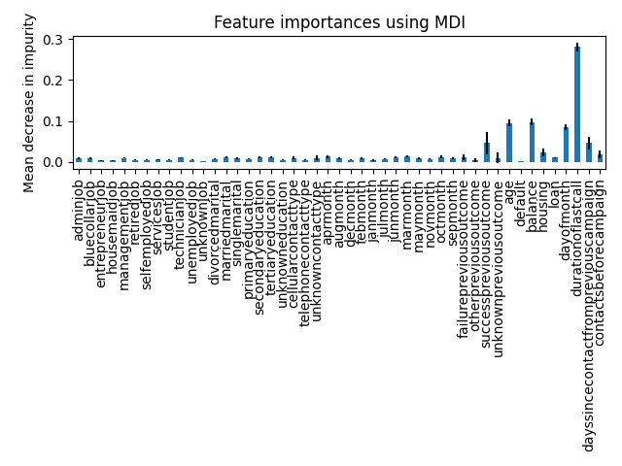
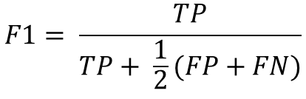
Regulating overfitting and feature engineering
GridSearchCV to explore hyperparameters:
NuSVC (nu, kernel, gamma)
RF (max features, n_estimators, max_depth)
Logistic regression (penalty, solver, C)
$$F1= \frac{TP}{TP+ \frac{1}{2}(FP+FN)}$$
Notes:
Accuracy poorly predicted TP
Precision made all predictions positive, huge FN values
Recall performed about as well as F1
RF bar plot (n_estimators = 15, max_features = log2)
Test performance plateauts, train continues to improve, increasing further would lead to overfitting model on training data
NuSVC (nu, kernel, gamma)
RF (max features, n_estimators, max_depth) and class_weight=balanced to give more weight to underrepresented loan getters
Logistic regression (penalty, solver, C)

Slide 7
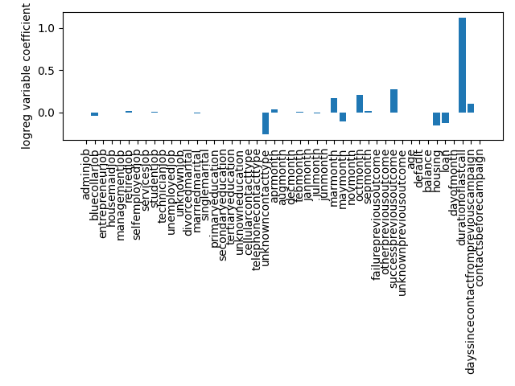
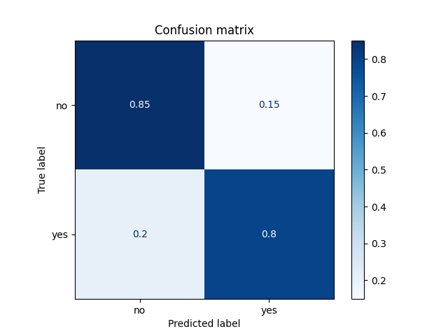
Metric: strongly correlated variable coefficients in logistic regression
 | CV results | Test results
Random forest | 0.90 +/- 0.002 | 0.70
NuSVC (small dataset) | 0.87 +/- 0.009 | 0.63
Logistic regression | 0.86 +/- 0.002 | 0.82

Slide 8
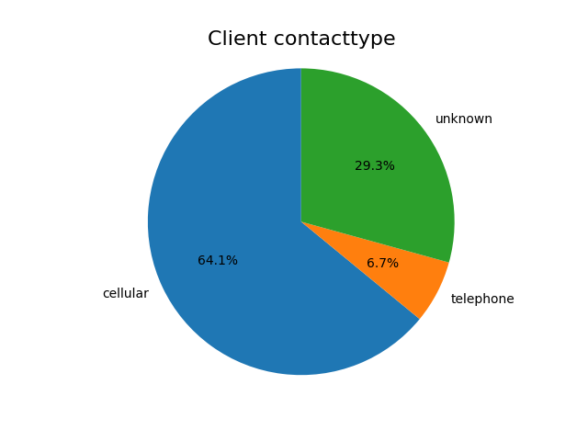
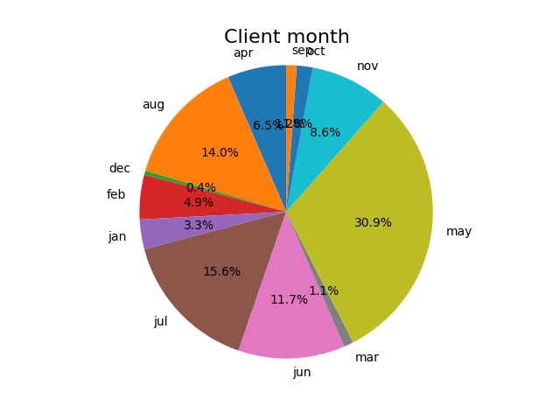
Unreliable weakly correlated logreg coefs

Slide 9
Recommendations moving forward
Banking institution:
A/B Testing for new practices at beginning of phone call to increase duration of last call
Examine previous campaign data (March/October positive coef, unknown contact type negative coef)
Provide regional information (area code in U.S. for example), day of the week (days after payday)
Modeling/analysis:
Run SVC on cluster, vary Nu more, include variables of smaller impact (category variables)
Alternate feature engineering methods (filter, wrapper)
Strongest indicators of success across all models: previous success and duration of last phone call

Slide 10
Extra slides

