Slide 1
Programming Bootcamp
Lecture 2 – Good coding practices: performance and version control

Slide 2
Why doing things properly matters
In an extended project, you’ll likely be revisiting and editing the same piece of code over and over.
Putting effort into making your code clear will make editing considerably easier.
Fast code saves times for obvious reasons.
Proper version control will allow you to easily backtrack and experiment with program features.
All of this becomes exponentially more important when you are collaborating with somebody else.
Overall: saves enormous amounts of time in the long run.

Slide 3
Good coding practices
Consistent indentation
Avoid repetition
Split up big files into smaller chunks
Use intuitive variable names
Aim for simplicity
Use comments
If possible to reduce line count without reducing readability, do so

Slide 4
Performance
How long a program takes to run can depend significantly on how well it is optimized.
Proper performance optimization can speed up a program by an order of magnitude or more.
For a complex economic model, this can make a difference of days or weeks.
First, it is helpful to understand why performance can differ so dramatically.

Slide 5
Machine Code
Code performance generally depends on how directly it talks to your computer.
At basic level, computers communicate in zeros and ones.
Humans are bad at writing in zeros and ones, so we instead write in symbolic representations of them.
The symbolic representation that corresponds most directly to machine code is called assembly.

Slide 6
Do not write in assembly.
“Hello World” in assembly: org 0x100 ; .com files always start 256 bytes into the segment mov dx, msg ; the address of or message in dx mov ah, 9 ; ah=9 - "print string" sub-function int 0x21 ; call dos services mov ah, 0x4c ; "terminate program" sub-function int 0x21 ; call dos services msg db 'Hello, World!', 0x0d, 0x0a, '$' ; $-terminated message

Slide 7
Compilation
Most languages achieve high performance by converting the language into assembly before running it.
This process is called compilation.
This process is most obvious in languages like FORTRAN or C, where you have to compile the code manually before running it.
Languages that don’t convert their code into assembly are typically called interpreted languages.
For the computer, this is like executing directions in Spanish if the computer only knew English.
Note: this is often a false dichotomy: many languages have options to be interpreted or compiled

Slide 8
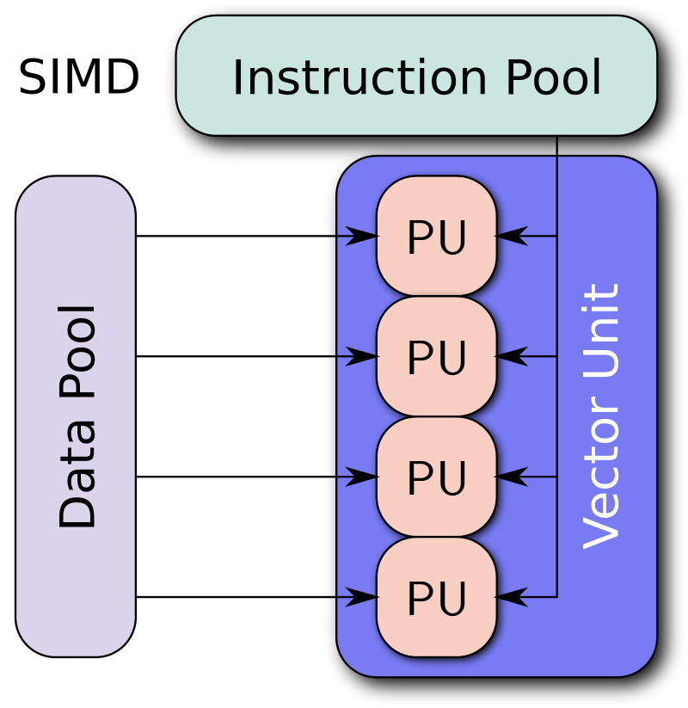
Vectorization
Two meanings to this
First: conversion of a computer program from scalar implementation to vector implementation (i.e.: operating on a single data point at a time to multiple).
Typically done automatically when code is compiled.

Slide 9
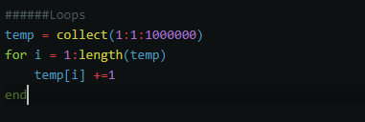

Vectorization
Second meaning: ditching loops in favor of matrix operations.
This is very important in languages like Matlab and R
Reason: matrix operations in these languages are typically written in C.

Slide 10
More on Vectorization
In simple cases, vectorization is easy and intuitive.
Vectorizing complex loops and functions, however, can be extremely difficult and detract considerably from readability.
Vectorization is not required in Julia for performance.

Slide 11
Julia performance tips
Julia compiles functions when run for the first time – JIT (just in time) compilation.
An upshot of this is that anything substantial in your program should be housed in a function so that it can be turned into assembly.
In particular, avoid global variables.
Type declarations are also helpful.
Julia’s profiler also allows you to hunt for bottlenecks.

Slide 12
Version control
Economists complain frequently about how hard it is to maintain good version control, especially in collaborative projects.
Computer scientists figured out a good system for version control in 2005.
This system is called Git.
Main features
Can be used for any text-based file type.
Never have to have a file name like “draft_v3_final_FINAL” ever again
COMPLETE documentation of changes made (and when)
Easily allows for multiple people to work on the same file simultaneously.

Slide 13
Basic Terminology
Softwares
Git: basic software. Can be run entirely locally
Github: Online application that allows Git to update and pull repositories from the cloud
Github desktop: GUI application for Git
Commands
Commit: essentially, an approved change to some code.
Push: apply code changes to a repository (requires writing privileges)
Pull: retrieve changes from a repository (allows collaboration across machines)
Pull Request: Request that somebody else incorporate changes suggested by you.
Fork: Copy somebody else’s repository on Github to your own Github page.
Clone: Copy somebody else’s repository to your local machine.
Branch: Create a working copy of repository to make changes that will eventually be merged back into the master code (think: testing out new feature).

