Slide 1
Programming Bootcamp
Lecture 5 – Dynamic Programming

Slide 2
Two Properties of Computing Problems
Overlapping Subproblems
Can the problem be broken down into subproblems which can be reused?
Fibonacci example: break F(n) into F(n-1) and F(n-2). Since F(n-1) can be broken down into F(n-2) and F(n-3), the solution to F(n-2) can be reused.
Optimal Substructure
Can the optimal solution be constructed from the optimal solutions of its subproblems?
If it can, often use a greedy algorithm.

Slide 3
Note on Greedy Algorithms
Simple heuristic: make locally optimal choice at each stage.
Examples
Travelling Salesman problem (minimize the distance travelled in order to visit a bunch of cities): “At each step of the journey, visit the nearest unvisited city.
Minimum number of coins to give when making change: “At each step, give largest-value coin that does not exceed the sum.”
Generally rare for a global optimum to be guaranteed via this method
Travelling salesman: generally fails
Change-making: actually works with US-valued coins (1, 5, 10, 25).
But fails with other values. Ex: (1, 5, 10, 20, 25) and making change for 40 cents.
Greedy solution: (25, 10, 5). Optimal: (20, 20).
Main limitation: never reconsiders its choices. Dynamic programming is exhaustive.

Slide 4
What is dynamic programming?
Compute programming method.
General theme:
Break down a problem into smaller sub-problems.
Store results/answers of subproblems for later use.
Start with the easiest subproblems
Often an improvement over plain recursion.
Today, we’re going to review some classic dynamic programming problems to build intuition for the method.
You will be solving more of these problems on PS3 (just tweaked)
They are challenging, but answers can be found online in Python (note: Python indexing vectors starts at 0!)

Slide 5
First Example: Egg-Dropping Problem
Absolutely beautiful problem
Setup:
Say we have n eggs and are in a building with k floors.
Our goal is to figure out the exact floor from which an egg breaks if dropped (if any).
Possible for egg to survive drop from floor k or break on floor 1.
Additional rules:
An egg that survives a fall can be used again.
A broken egg must be discarded.
The effect of a fall is the same for all eggs.
If an egg breaks when dropped, then it would break if dropped from a higher floor.
If an egg survives a fall then it would survive a shorter fall.

Slide 6
The Goal
Essentially a minimax.
The problem: what is the minimum number of egg-droppings that can guarantee we find the critical floor exactly?
Example
36 floors, one egg.
If drop egg at floor 18 and breaks, then don’t know critical floor → have to start at floor 1 and go up.
Could take up to 36 trials, so that’s the answer.
Essentially trying to minimize the worst-case scenario.
What if you have two eggs???

Slide 7
Expressing this Recursively
Say have n eggs and k floors and drop an egg from floor j.
If egg breaks: have n-1 eggs and j-1 floors to search.
If egg does not break: have n eggs and k-j floors to search.
So, optimize the problem by choosing the best floor to drop from:
E(n, k) = min_j [max(E(n-1, j-1), E(n, k-j)]

Slide 8
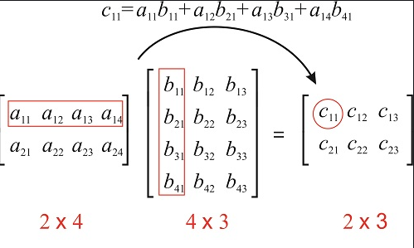
Example 3 – Matrix Chain Multiplication
Given a sequence of matrices, find the most efficient way to multiply these matrices together.
Wait, what does this mean?
Matrix multiplication is associative: (AB)C = A(BC)
How many operations (multiplications) needed to multiply two matrices?

Slide 9
Matrix Chain Multiplication
General formula: to multiply an AxB matrix with a BxC matrix, you need to run A*B*C multiplications.
So what if we have three matrices: A (10x30), B(30x5), C(5x60).
Then (AB)C requires (10*30*5) + (10*5*60) = 1500 + 3000 = 4500 multiplications
A(BC): (30*5*60) + (10*30*60) = 9000 + 18000 = 27000 multiplications!
Number of operations can vary substantially despite associativity.
Question: what is the minimum number of operations required to multiply an arbitrary set of matrices?

