Slide 1
Programming Bootcamp
Lecture 8 – Monte-Carlo

Slide 2
Background
Forming the PDF (or a feature of it) of something features heavily in solving economic models
Forming expected continuation values
Computing probabilities of certain decisions being made
Sometimes, deriving closed-form representations of these things is possible, but very difficult.
We can instead approximate them with computers
Discretize possible stochastic realizations and average
If there are many stochastic realizations, dimensionality becomes problematic
Simulate stochastic outcomes repeatedly and average – Monte Carlo

Slide 3
Example – Birthday Problem
Say you have N people together in a room. What is the probability that at least two of them share the same birthday?
Assume all days equally likely
Ignore leap days
Can derive closed-form solutions/approximations, but they’re a mess of binomials and other nasty stuff.
However, extremely easy to simulate!

Slide 4

Example: Distance of Points in Cube
Pick two points at random within a unit cube. On average, what is the distance between them?
Algebraic solution:
All you have to do is solve this six-layered integral!

Slide 5

More serious example: labor supply
Consider the following very basic setup.
In period 1, an agent faces a schooling decision.

Slide 6
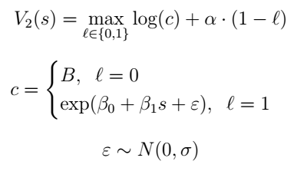
More serious example: labor supply
In period 2, agent chooses whether to supply labor:

Slide 7
More serious example: labor supply
Challenge is to form
Why this is hard: stochastic wage offer affects utility from working AND whether the agent works in the first place
So, doing this algebraically requires solving cutoff values that govern labor supply and then taking expectations of wage shocks conditional on being above threshold.
Gets even worse because utility over consumption is log instead of linear.
But hey, we have computers, so let’s just skip the algebra entirely!
See Keane and Wolpin for a (much) richer version of this.

Slide 8
Wrapping up
What this course has focused on
Doing things with a computer that you can’t do with algebra
Approximating and optimizing unknown functions
Doing these things quickly
Dynamic programming, parallelization, etc.
Speed matters!
Focused on techniques that feature heavily when solving economic models
You’ll actually be working through such models in 2nd-year and your own research
Complementary with Econ 899!
Goal of the course: save you time in learning the computational methods so that you can spend more time on the economics.
Another goal: enabling you all to include computational stuff in your research if you want to.

Slide 9
Happy coding!
And good luck on prelims/field papers!
And thank you all for participating.

