Slide 1
Group 1 Feature Engineer and Machine Learning for Stock Market Analysis and Prediction
Group 1: Paul Phillips, Qi Cai, Xin Gao
GitHub at pcp0019/CSCE-5222-Group-1 (github.com)

Slide 2
Introduction
Objective: Use feature engineering and machine learning algorithms to make a program to predict stock price
Obtain data involving information on a company’s stock price
Perform feature engineering to alter and add relevant features
Perform machine learning to make predictions on stock price

Slide 3
Dataset Information
Our dataset was downloaded from Yahoo finance
Includes High, Low, Open, Close, Adj Close, Volume
Covers the time span from 2013-1-1 to 2023-11-1
Performed calculations to add extra features
Daily Value Proportion

Slide 4
Dataset Feature Engineering
Calculates H-L, high price of the day – low price of the day
Calculates O-C, opening price – closing price
Calculates Daily Value Proportion
(Daily Close Price – 25th percentile price)/(75 percentile price – 25th percentile price)

Slide 5
Feature Engineering Normalization
One of the issues with our dataset is that the data had no normalization.
Normalization prevents certain values that are too large or small from skewing the dataset
Open, High, and Low had values that could range to over 100.
High Low difference, open close difference, and Daily Value Proportion tended to range between -2 and 2.

Slide 6
Z score Normalization
One of the ways to normalize data is to calculate the Z scores for the datapoints instead of using the raw values.
Z scores tend to put data in a single digit range, with 0 being the mean value of a feature.
This would normalize all the feature values

Slide 7
Z score Calculations
The Z score formula is
Z = (feature data point – mean(feature) )/(standard deviation of feature)
First, we calculate the standard mean and standard deviation of our features

Slide 8
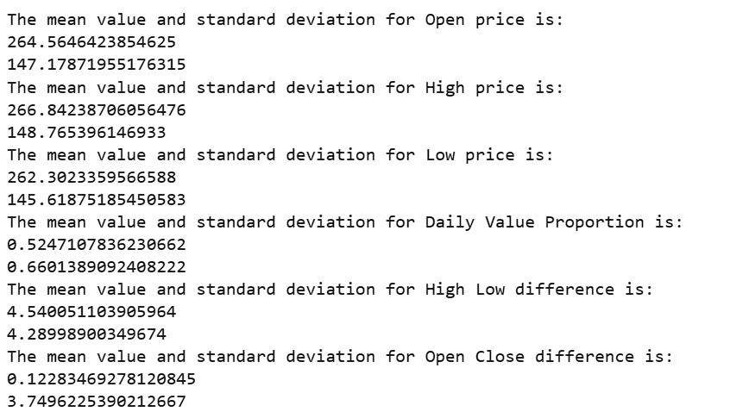
Mean and Standard Deviation
These values could range in the hundreds for some features, or less than 10 for other features.

Slide 9
Dataset Adjustments
Close is the target variable, so it was not normalized.
Adjusted Close was dropped as it is too similar to Close.
Volume was dropped as it lack relevance.

Slide 10
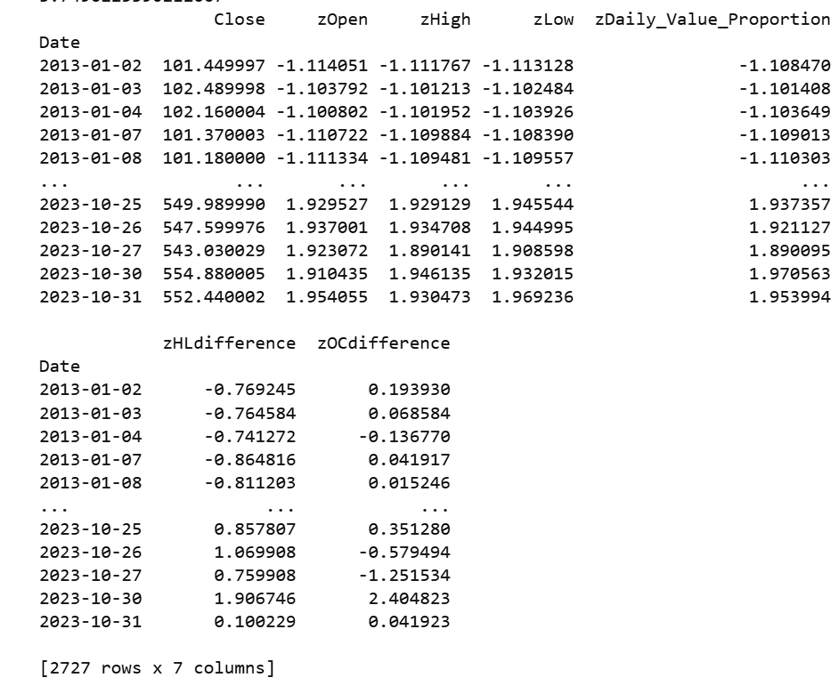
Z score for Features

Slide 11
KNN Regression for Price Prediction
Trained a K Nearest Neighbor regression model on the new feature set with Z scores.
Used 4 neighbors to do the K Nearest Neighbor calculations
Train/Test split of the data was at 70% reserved for training, 30% reserved for testing
Close price was set to y in the model
Predictions made, and R2 score is 0.9976

Slide 12
Random Forest for Price Prediction
In addition to KNN, there are other regression models to test out.
Random Forest is a decision tree based regression model
Used 80 trees as estimators with maximum tree depth of 4 to predict
R2 score is 0.9981

Slide 13
Bagging with Random Forest for Price Prediction
The Bagging model will fit a model on to random subsets of the data set to introduce randomness into the training.
The Random Forest Regressors here uses 20 decision trees
Each of the 10 subsets uses 20% of the whole data
Takes an average of the results of multiple subsets to make the prediction
R2 score is 0.9998

Slide 14
Support Vector Regression for Prediction
Support Vectors are commonly used in machine learning
Based on way the feature types relate to one the data is probably linearly separable to a significant degree.
Will use a linear kernel function in this case to do the prediction
R2 score is 0.9998

Slide 15
Naïve Bayes for Price Prediction
Created a new feature called Rise or Fall
Represented by either a 0 or a 1
It is 1 if the price rose, and 0 if it fell from the last day
With this feature as our new target, trained and tested Naïve Bayes

Slide 16
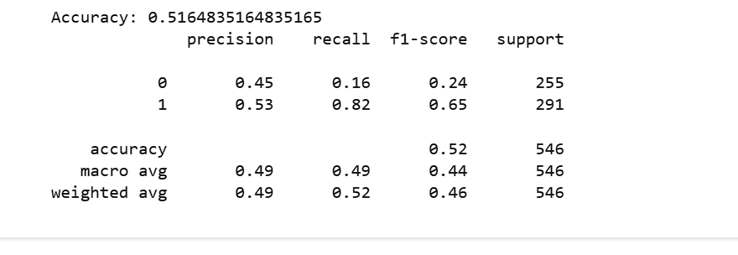
Naïve Bayes Results
Accuracy of 0.51
F1 score was 0.21 in predicting fall
F1 score was much higher, 0.65 in predicting a rise
Differences in Recall, 0.84 in rise prediction, 0.14 in fall prediction

Slide 17
Gradient Boosting Regressor
Raised the test fraction of the data to 0.3 from 0.2
Using 100 estimators
Learning rate set to 0.1
Decision tree depth set to 3

Slide 18
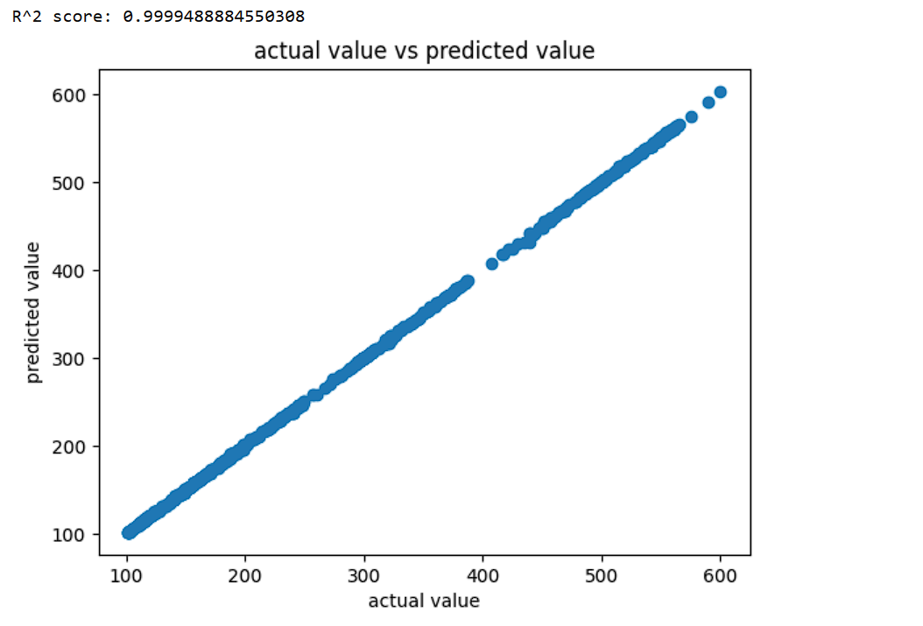
Gradient Boosting Results
R2 score was very high at 0.9999
Linear relationship
Matches very close

Slide 19
Conclusion
Most of the models had high R2 scores, showing they were predicting very close to the actual values.
The exception is Naïve Bayes, probably because the features are related to one another
The Gradient Boosting Regressor had the highest scores at 0.9999

