Slide 1
Pointers in C
Prabodh C P
Asst. Professor,
Dept of CSE,
PESSE
prabodhcp@pes.edu

Slide 2
Importance of Pointers
C uses pointers to create dynamic data structures -- data structures built up from blocks of memory allocated from the heap at run-time.
C uses pointers to handle variable parameters passed to functions.
Pointers in C provide an alternative way to access information stored in arrays. Pointer techniques are especially valuable when you work with strings.
There is an intimate link between arrays and pointers in C.
Making the code efficient.

Slide 3
An Example
Designing a Text editor, gedit, vi or notepad.
Decide on the data structure.
How to store the document you are editing in memory so that you can manipulate it in your program?
1000 lines of 80 char width
char doc[1000][80];
80000 bytes

Slide 4
continued...
Some documents are long lists. Every line is short, but there are thousands of lines.
Some special-purpose text files have very long lines. For example, a certain data file might have lines containing 542 characters, with each character representing the amino acid pairs in segments of DNA.
In most modern editors, you can open multiple files at one time.

Slide 5
continued...
Let's say you set a maximum of 10 open files at once, a maximum line length of 1,000 characters and a maximum file size of 50,000 lines. Your declaration now looks like this:
char doc[50000][1000][10];
500 million characters!
Not enough RAM on even modern machines!
What if you want to run multiple instances?
Even if available results in an extravagant waste.

Slide 6
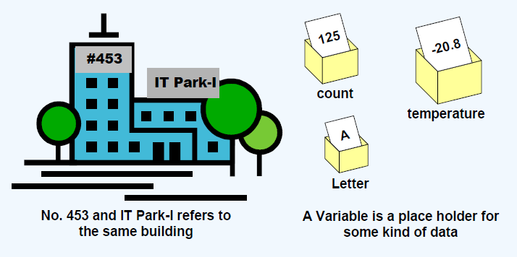
What is a Variable?
Variable is the name of a location in memory whose contents can change over time.

Slide 7
Pointer Basics
A pointer is a variable that points to another variable. This means that a pointer holds the memory address of another variable.
Because a pointer holds an address rather than a value, it has two parts. The pointer itself holds the address. That address points to a value. There is the pointer and the value pointed to.

Slide 8
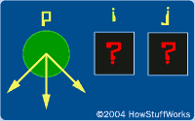
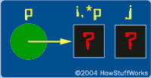
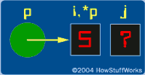
int i,j,*p;
p = &i;
*p = 5;

Slide 9
The main feature of a pointer is its two-part nature. The pointer itself holds an address. The pointer also points to a value of a specific type - the value at the address the point holds. The pointer itself, in this case, is p. The value pointed to is *p.
& - address of
* - value at address

Slide 10
Understanding Memory
RAM (random access memory).
RAM holds the programs that your computer is currently running along with the data they are currently manipulating.
Memory can be thought of simply as an array of bytes. In this array, every memory location has its own address -- the address of the first byte is 0, followed by 1, 2, 3, and so on.

Slide 11
Understanding Memory
Bytes can be grouped together as it needs to to form larger variables, arrays, and structures.....
float f;
"Declare a location named f that can hold one floating point value." When the program runs, the computer reserves space for the variable f somewhere in memory.

Slide 12
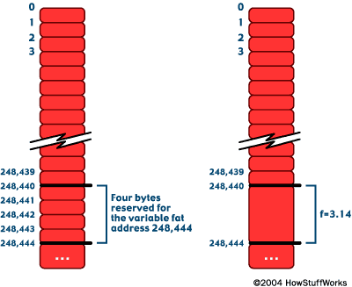
Understanding Memory
float f;

Slide 13
f = 3.14;
The compiler might translate that into, "Load the value 3.14 into memory location 248,440."
The computer is always thinking of memory in terms of addresses and values at those addresses.

Slide 14
Interesting!
pointer2.c
s:t
4:0
1:1
2:2
3:3
4:4
u = 4
Why are t[0] and u incorrect?

Slide 15
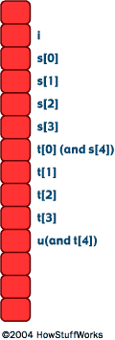
~Array Bound Checking

Slide 16
What might happen if
s[1000000] = 5;
Undefined behaviour
  Crash
  Do nothing
  Corrupt some other variable;

Slide 17
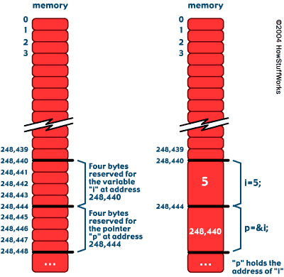
Image 6

Slide 18
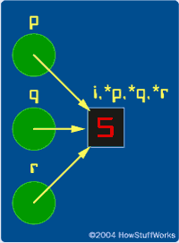
IMAGE 7

Slide 19
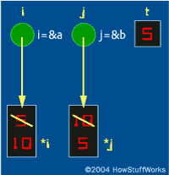
SWAP

Slide 20
Use pointers with care!

