Slide 1
Adult Census Income Level Prediction

Slide 2
Problem Statement
Input:
Demographic and employment-related features from the UCI Adult dataset
Output:
Binary classification – whether income > $50K or ≤ $50K
Example:
Input: 32,"Private",396745,"Bachelors",13,"Married-civ-spouse","Prof-specialty","Husband","White","Male",0,2415,48,"United-States"
Output: 1
Goal:
Predict income level from structured attributes using ML with maximum accuracy

Slide 3
Brief explanation of problem:
​The paper titled "A Statistical Approach to Adult Census Income Level Prediction" by Navoneel Chakrabarty and Sanket Biswas addresses the issue of income inequality, particularly in the United States. The authors aim to utilize machine learning and data mining techniques to predict an individual's annual income based on various demographic and employment attributes. By accurately classifying individuals into income categories (greater than $50K or less than or equal to $50K), the study seeks to identify key factors influencing income levels, which can inform policies aimed at reducing economic disparities to work on which factor.
The model developed in this study employs the Gradient Boosting Classifier, achieving a better accuracy than previous traditional classifiers, surpassing previous benchmarks in similar research. This approach demonstrates the potential of machine learning in addressing complex social issues like income inequality.

Slide 4
Motivation
Income prediction has implications in policymaking and socioeconomic analysis.
Real-world impact in tax modeling, job market analysis.
This is a very good example of knowing how data processing and ML techniques can actually made use in real life decisions.
Gaps: Previous models underperform due to poor preprocessing or outdated algorithms. In this paper Gradient Boosting is used, which is an technique that combines the predictions of many weak learners in a sequential way. We added XGBoost , LightGBM also along with Voting Classifier

Slide 5
Literature Review
Key Prior Work:
Decision Trees: Commonly used for classification but prone to overfitting.
Support Vector Machines (SVM): Effective for high-dimensional data but require careful tuning.
Logistic Regression: Basic model for income prediction but lacks the ability to capture complex patterns.
Ensemble Methods(GradientBoostingClassifier): Previously, methods like Random Forest have been applied, but they often underperform compared to more advanced boosting techniques.

Slide 6
Inspired Approaches:
Gradient Boosting (XGBoost): Focuses on iteratively improving model accuracy through boosting, making it less prone to overfitting.
Lightgbm: Uses Gradient-based One-Side Sampling (GOSS) and exclusive Feature Building (EFB) to optimize training speed and memory usage.
Enhancement Over Traditional Methods: XGBoost improves upon decision trees and SVMs, handling complex data and reducing bias and variance more effectively, LightGBM shines where performance and scalability matter, while XGBoost offers robustness for smaller datasets. Both outperform traditional Gradient Boosting in most scenarios
Objective: Outperform previous benchmarks, showcasing the potential of modern machine learning techniques for socio-economic prediction tasks.

Slide 7
Dataset
Example Data Instance:
34,"Private",203034,"Bachelors",13,"Separated","Sales","Not-in-family","White","Male",0,2824,50,"United-States",">50K"
Statistics:
Number of Samples: 32562 (total dataset size) Number of Classes: 2 (Income categories: <=50K and >50K) Number of Features: 14 (including categorical and continuous variables like age, workclass, education, etc.
Preprocessing:
Converted categorical variables using label encoding or one-hot encoding, Filled missing values in numeric columns (e.g., age, hours_per_week) with the mean.
Renamed columns, Removed race and native_country based on ExtraTreesClassifier feature importance
Train-test split: 80-20%

Slide 8
Method/Technique used in paper
Paper relies on scikit-learn’s GBC.
Intuition: Sequential Error correction, Weighted voting of Weak learners, Gradient Optimization GBC builds decision trees sequentially (not independently), where each new tree corrects errors made by the previous ones. Combines multiple weak learners into a strong ensemble by assigning higher weights to trees with better performance. Minimizes loss function using gradient descent, adjusting tree parameters to reduce errors directionally.
Paper’s Use: The model iteratively fits residuals (errors) of the prior tree, refining predictions step-by-step. This reduces bias and improves accuracy (achieving 88% approxTrees with lower error (ϵₜ) contribute more to the final prediction. Employs grid search to tune hyperparameters (n_estimators=250, max_depth=4), balancing underfitting and overfitting.

Slide 9
Improvements over the paper
XGBoost Implementation : Regularisation, Parallel Processing, Handling missing values, Tree Pruning
XGBoost includes L1/L2 regularization to reduce overfitting (unlike traditional GBC). Builds trees in parallel (faster than GBC’s sequential approach). Automatically learns to impute missing data during training. Uses depth-first tree growth with backward pruning (more efficient than GBC’s greedy approach).
2. LightGBM Implementation :
Uses Gradient-Based One-Side Sampling (GOSS) and Exclusive Feature Bundling (EFB) to optimize training speed and memory usage. GOSS keeps data instances with large gradients (hard-to-predict samples) and randomly drops others . Leaf-wise growth Expands the tree by splitting the leaf that reduces loss the most, leading to higher accuracy but slightly higher risk of overfitting on small datasets.Best for large datasets (e.g., >10K rows) where speed is critical.

Slide 10
3. Voting Classifier :
Our idea was to combine all the predictors we have implemented till now and use a combined probabilistic prediction.
Combines predictions from 6 different classifiers (logistic_regression, decision_tree, random_forest, best_gbc, best_xgb, best_lgbm) into a single consensus prediction. Uses soft voting (weighted by predicted probabilities) for nuanced decisions, especially useful when models disagree.
Mitigates individual model biases by leveraging the "wisdom of the crowd." Even if one model (e.g., decision_tree) overfits, others (e.g., random_forest or logistic_regression) balance it out, improving generalization (evidenced by AUROC in results).
The ensemble often outperforms any single model (e.g., your accuracy/AUROC will likely surpass individual classifiers).

Slide 11
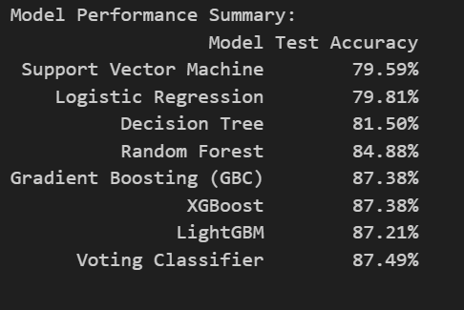
Results
By using voting classifier we could increase the accuracy from 87.38% of GBC(mentioned in paper) to 87.49%

Slide 12
Analysis
Qualitative Insights from the Results
Occupation and Education Trends: Individuals with higher education levels (e.g., Bachelor's, Master's) and professional occupations were more likely to earn above $50K. This pattern was consistent across different models.
Gender Disparity: A noticeable trend was the gender imbalance—a significantly higher proportion of males were classified into the >$50K income group, highlighting potential societal income gaps
Marital Status Signal: "Married-civ-spouse" status had a strong correlation with higher income, indicating that marital stability might coincide with economic stability in this dataset.
Work Hours Influence: Those working more than 40 hours per week were more likely to belong to the higher income category, though there were diminishing returns beyond a certain threshold.
.

Slide 13
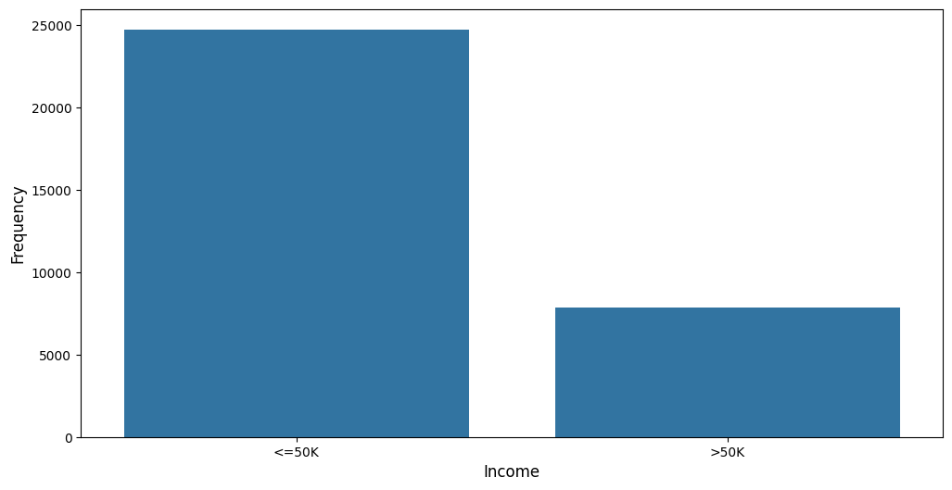
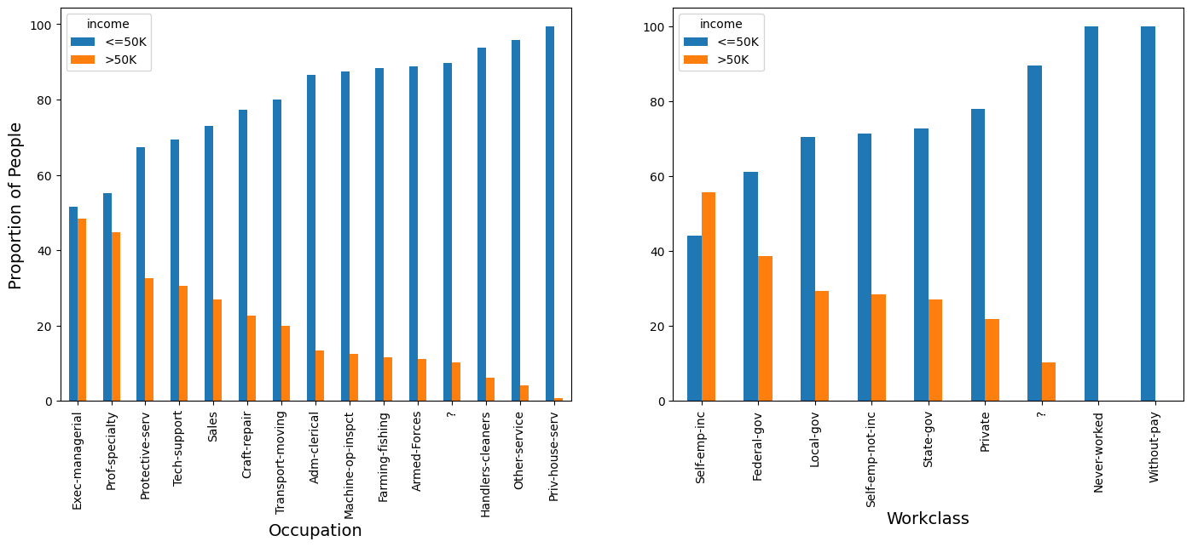

Slide 14
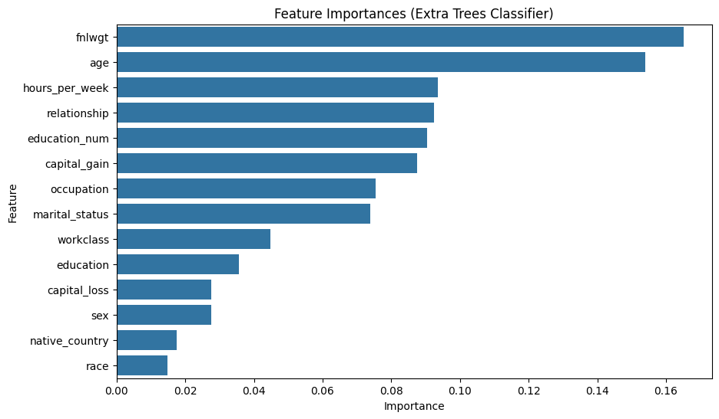
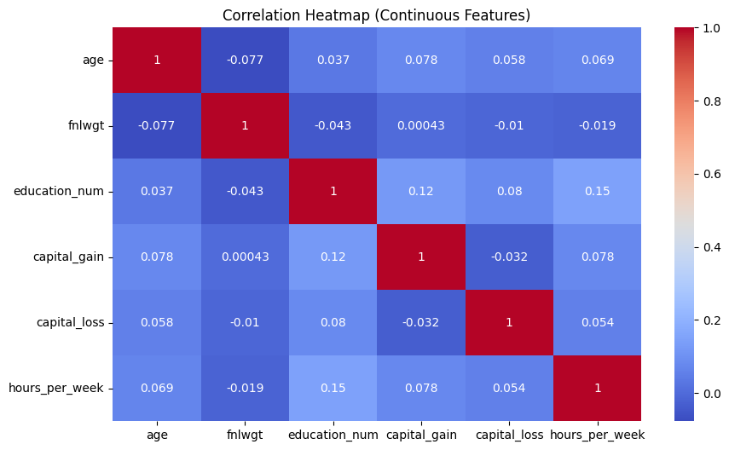

Slide 15
Error analysis
1.Educated but Low Income Some people with higher education (like a Bachelor's or Master's) were predicted to earn >$50K but didn’t. The model likely assumed education always leads to high income, ignoring factors like part-time work or low-paying jobs.
2. Long Hours, Still Low Pay A few people working 60+ hours a week were wrongly classified as high earners. But working long hours in a low-wage job doesn’t guarantee high income — something the model didn’t fully capture.
3. Capital Loss Confusion People with significant capital losses were sometimes predicted as high earners. The model may have been overly influenced by other features and didn't weigh losses heavily enough.
Why These Errors Happen
The model may rely too much on a few "strong" features like education or hours worked.
The dataset is a bit imbalanced, with more low-income examples.
It misses context like job type or location, which are big factors in real life.

Slide 16
Learnings
Key Takeaways from the Project
Data preprocessing is critical. Cleaning the dataset (e.g., handling missing values and encoding categorical features) directly impacted model performance.
Model comparison revealed the strengths and weaknesses of different classifiers. Logistic regression was interpretable but had limited capacity for complex patterns, while Gradient Boosting performed best overall.
Feature selection helped reduce overfitting and improved computation time without significant performance loss.
Technical Learnings
Gained practical experience with scikit-learn tools such as:
StandardScaler for feature scaling,
LabelEncoder and OneHotEncoder for categorical features,
Model APIs like LogisticRegression, SVC, DecisionTreeClassifier, and GradientBoostingClassifier.

Slide 17
Learned how to perform hyperparameter tuning using GridSearchCV and how it affects model performance.
Understood the importance of cross-validation to avoid overfitting and ensure model generalization.
Applied ensemble learning using VotingClassifier to combine predictions from multiple models for better accuracy.
Problem-Solving & Teamwork
Followed a structured pipeline from data cleaning to evaluation and iteration.
Identified data imbalances and experimented with techniques like stratified sampling to preserve class distributions during training/testing
Collaborated efficiently by dividing tasks and maintaining clear communication and version control, discussed findings collaboratively.

Slide 18
Demo
A GUI demo for classifying a new incoming data input to predict whether given input has above $50k or below $50k.
On the terminal run the following command :
‘Streamlit run demo.py’
The interface takes input various demographic details of an individual and predict if his income is less or more than $50k

Slide 19
Summary and Conclusion
Problem Recap
The goal of this project was to predict whether an individual earns more than $50K annually using demographic and work-related attributes from the UCI Adult Census dataset. This classification task involved data cleaning, feature engineering, model training, and evaluation.
Main Findings
Among all models tested, Gradient Boosting consistently delivered the best performance, outperforming logistic regression, SVM, and decision trees.
Features like education level, hours-per-week, and capital gain had the most predictive power.
Ensemble methods (e.g., VotingClassifier) slightly improved overall accuracy by combining multiple models.
Class imbalance and overlapping feature distributions posed challenges for perfect accuracy.`

