Slide 1
Equilibria Inefficiency of Parking
Peter Glennon
Advisor: Christine Chung

Slide 2
Previous Work
Examined the inefficiency of the self-interested commuter
Greedy Online Algorithm
Opposed to an Optimal average-distance matching
Simple Grid Model with randomly placed parking spots (server nodes) and destinations (request nodes)

Slide 3
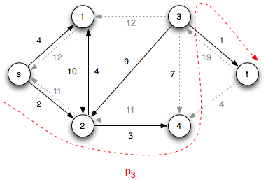
Optimal Average-Distance Matching
The Ford-Fulkerson Max-Flow Algorithm applied to a bipartite set

Slide 4
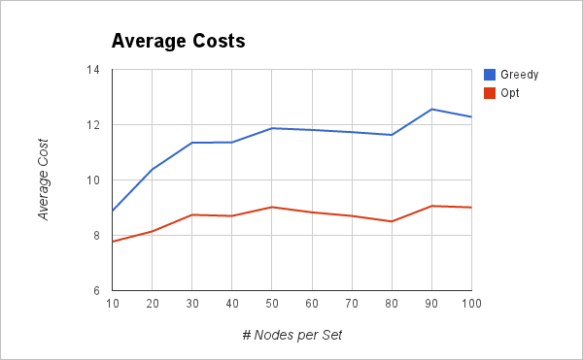
Previous Results

Slide 5
New Goals
Bottleneck Objective
Minimize the maximum distance
New Online Algorithms
Possible alternatives to Greedy
Experiment on Alternative Models
Simple representations of parking layouts

Slide 6
Bottleneck Objective
Average goal: minimize average distance
OPT Average: Max-Flow
Bottleneck goal: minimize the maximum individual distance
OPT Bottleneck: Gross' Algorithm

Slide 7
Gross' Algorithm for Bottleneck Obj.
n x n cost matrix C, with c_{ij} representing the distance from spot i to destination j
Begin w/ feasible matching, then repeatedly cycle through, decreasing bottleneck cost w/ each cycle
3 | 2 | 4
8 | 5 | 1
6 | 4 | 7
3 | 2 | 4
8 | 5 | 1
6 | 4 | 7
3 | 2 | 4
8 | 5 | 1
6 | 4 | 7

Slide 8
New Algorithms
Permutation
Online algorithm which computes optimal matching with each new arrival
In each iteration i, run Max-Flow on all arrivals a₀ through a_{i} to get partial matching M_{i}, match a_{i} to the spot not matched in M_{i-1}
Khuller, Mitchell, and Vazirani
Kalyanasundaram and Pruhs

Slide 9
New Algorithms (cont.)
Greedy Threshold Algorithms (GT1, GT2)
Calculate the "Desirability Score" of a spot as the average distance to all destinations
GT2 - update the Desirability Scores after each driver-spot match is made
With each arrival, calculate two closest spots, and choose the closer one unless its desirability score is below a given threshold
Determination of optimal threshold
Requires destination info beforehand, but not order of arrivals
Only suitable for the Parking Models

Slide 10
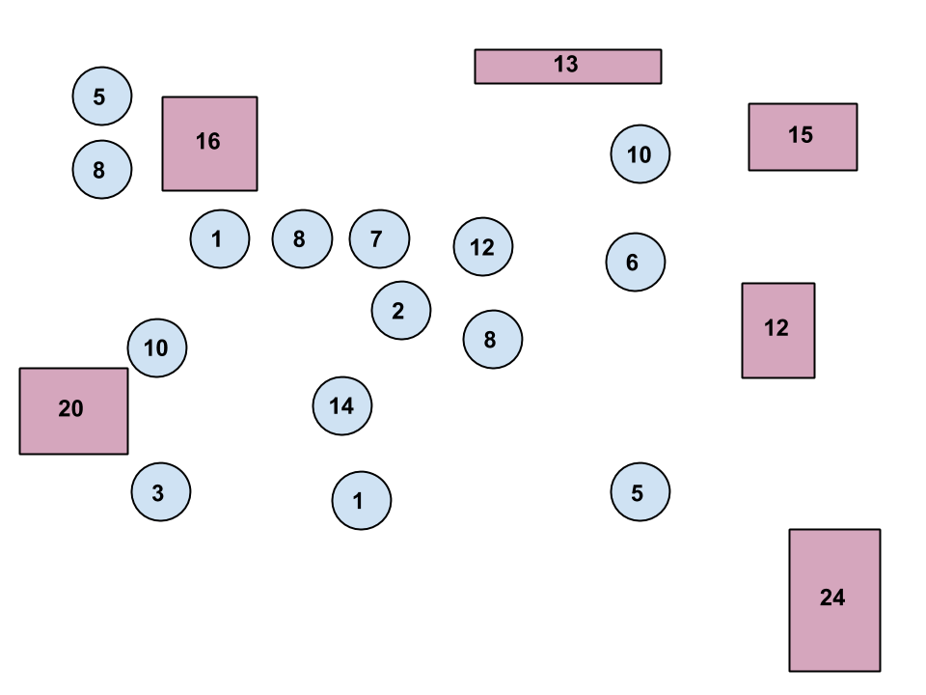
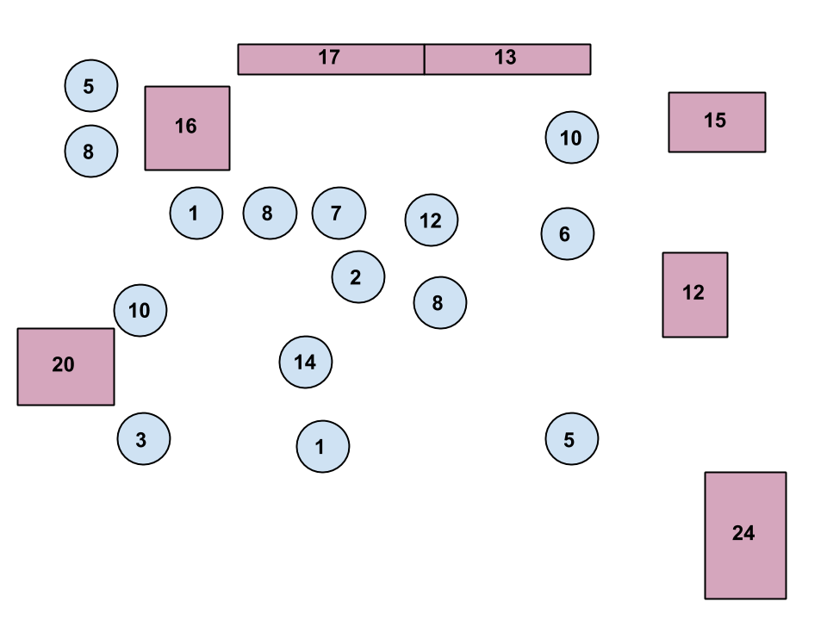
Parking Models
Campus Model One
Campus Model One w/ Extra Capacity

Slide 11
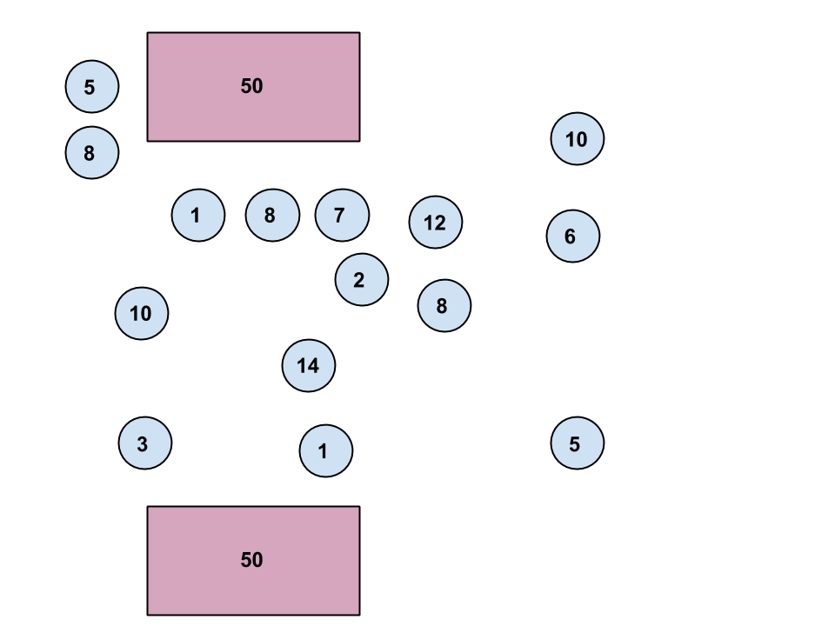
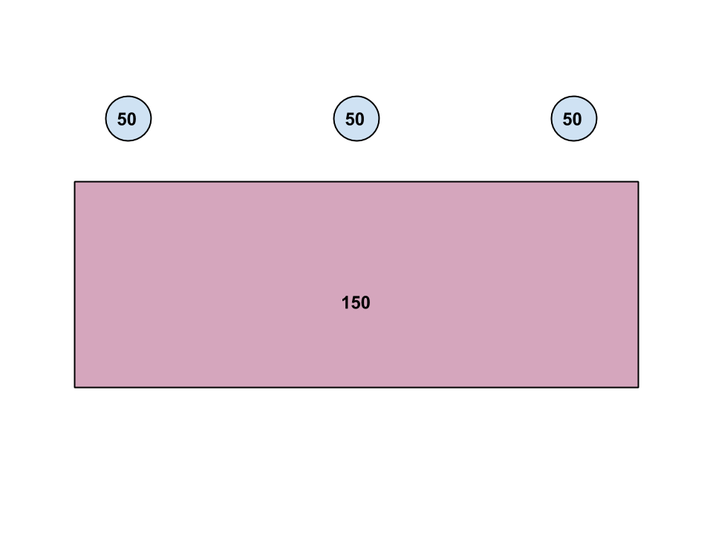
Parking Models (cont.)
Campus Model Two
Office Model

Slide 12
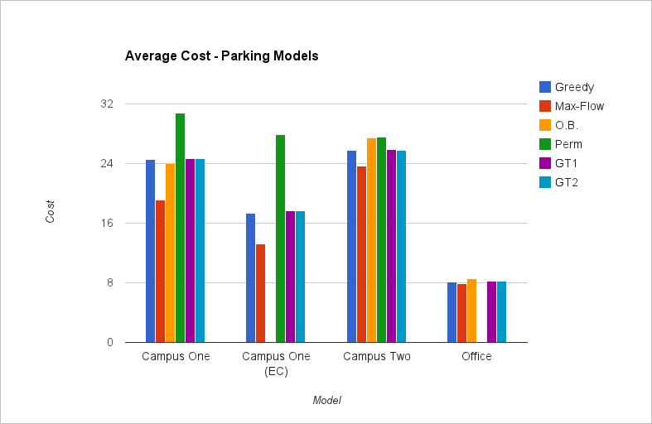
Results

Slide 13
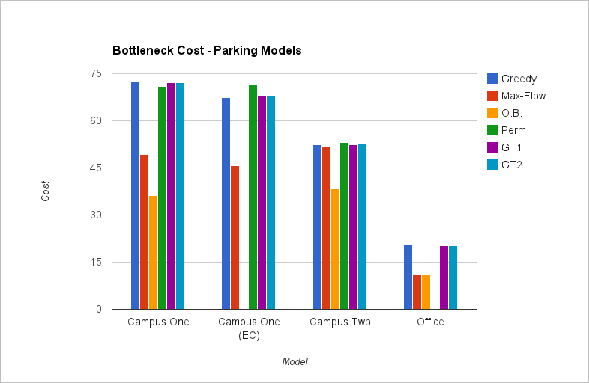
Results (cont.)

Slide 14
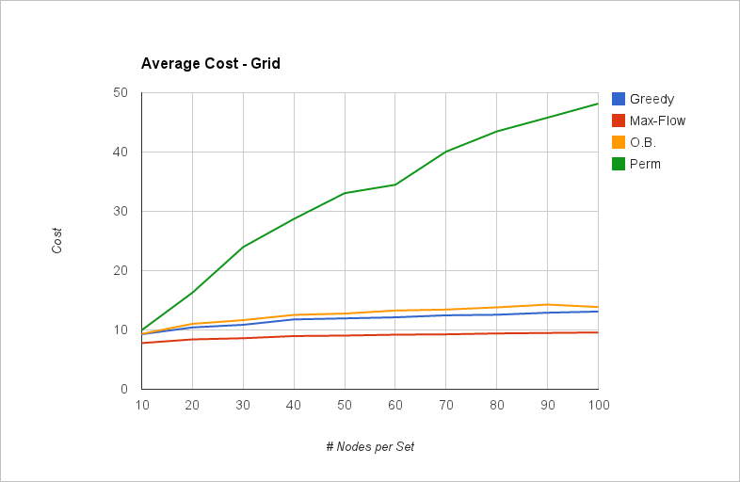
Results (cont.)

Slide 15
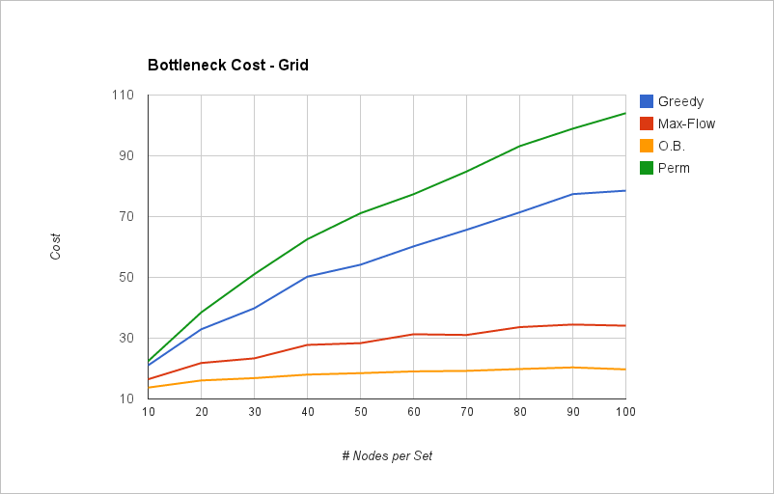
Results (cont.)

Slide 16
Concessions / Future Improvement
Simplicity of the cost function
Other factors besides distance
Parking Model layouts
Small size
Testing time limitations
Arbitrary Layouts
Model real parking layouts

Slide 17
Questions

