Slide 1

AL Reporting
Introduction

Slide 2



Prerequisite
Use Workshop-VM / Workshop-Computer follow the instructions of the Boarding Pass
Additional Material inside the [WORKSHOP] Folder
Visual Studio Code
https://code.visualstudio.com
Competence Team DevTech
Microsoft AL

Slide 3
Agenda
TBD

Slide 4

Indroducing reporting in AL
Reportobject
Dataset
Layout
Requestpage

Slide 5
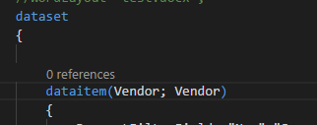
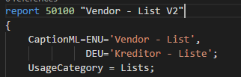
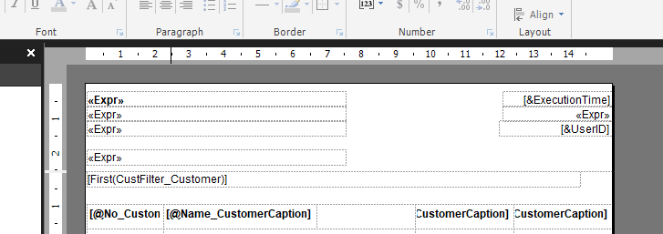
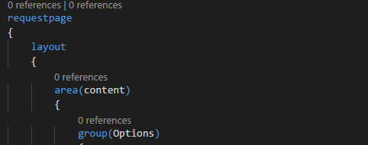
Introducing
Report Object
Dataset
Layout
Request Page

Slide 6
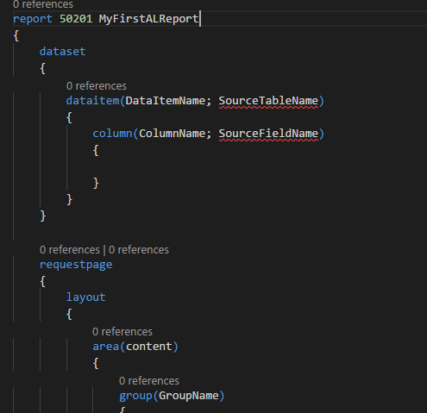
Report Object
Consists of
Properties
Dataset
Request Page
Trigger on report level
Vars
Default template “treport”

Slide 7
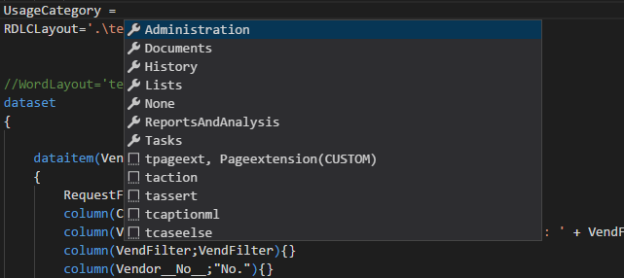
Report Object
Properties
Same as in C/AL
Some new properties
UsageCategory
RDLCLayout
WordLayout
etc..

Slide 8
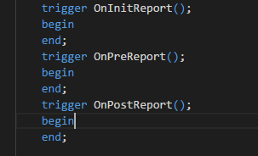
Report Object
Trigger on Report level
OnInitReport
OnPreReport
OnPostReport

Slide 9
Report Object
report 50200 "AL Customer Top 10 List„ { //Properties //.... Dataset { //... } requestpage { //... } //Report Level triggers trigger OnInitReport(); begin end; var //Global variables }
The order of the elements is relevant

Slide 10
Dataset
Defines the data for the report
One or more DataItems could be included
Has no own properties

Slide 11
Dataset – DataItem
Adds a new sourcetable to the report
Nested DataItems
„Item“ and „Item Ledger Entry“
„Sales Header“ and „Sales Lines“
etc.
Sequentiell DataItems

Slide 12
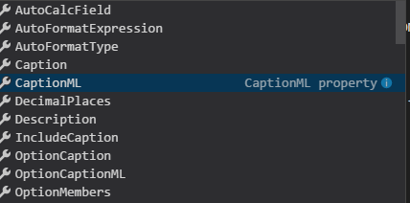
Dataset – DataItem – Columns
Needed to Print fields of the DataItem
Name
Source Expression
Global variable
Field from sourcetable
Function
Textconstant
No Triggers on column level

Slide 13
Dataset – DataItem
Trigger on DataItem
OnPreDataItem
OnAfterGetRecord
OnPostDataItem

Slide 14
Layout
Define the Layout
Create Layout CTRL+SHIFT+B
Supported files
.rdlc (Visual Studio)
.rdl (SQL Report Builder)
.docx (Word Layout)
Designing the Layout not part of this workshop
Don’t worry the designing part is still the same

Slide 15
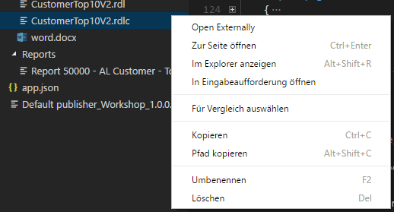
Layout
Set Default Layout
Open files from Visual Studio Code

Slide 16
Request Page
The same process as creating a normal pageobject
The keyword has changed to „requestpage“

Slide 17



Hands On!
Now you create your first AL Report on your own – step by step

Slide 18
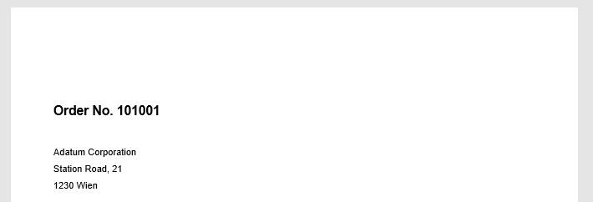
Hands On!
Build a small Report 50130 “Simple Document”
Use with some fields from Sales Header:
No.
Selt-To Customer Name
Selt-To Customer Address
Selt-To Customer Post Code
Selt-To Customer City

Slide 19
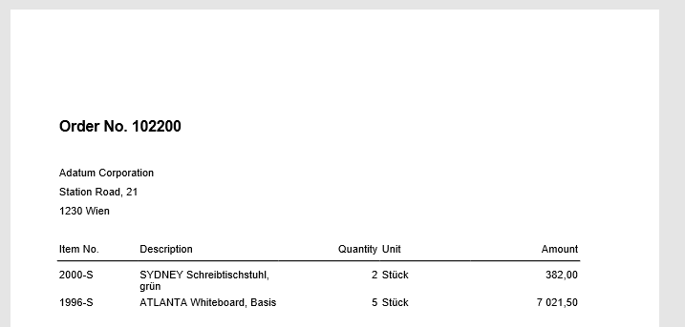
Hands On!
Add sales Lines to the Report „Simple Document“

Slide 20
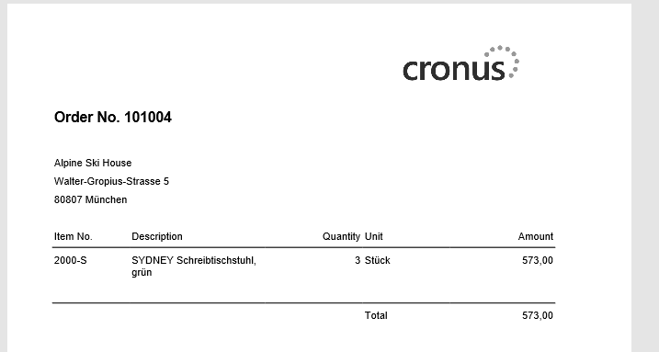
Hands On!
Add a picture and totals

Slide 21
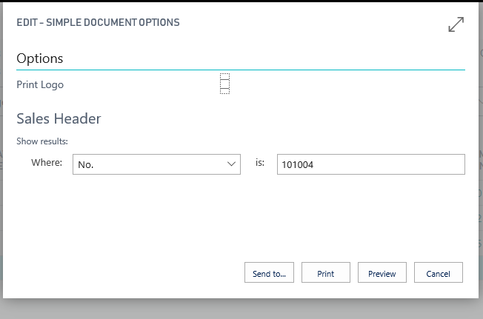
Hands On!
Make Request page with an option “Print logo”

Slide 22
Hands On!
Make a report for “Sales Quotes” using the same layout

Slide 23
Customizations

Slide 24
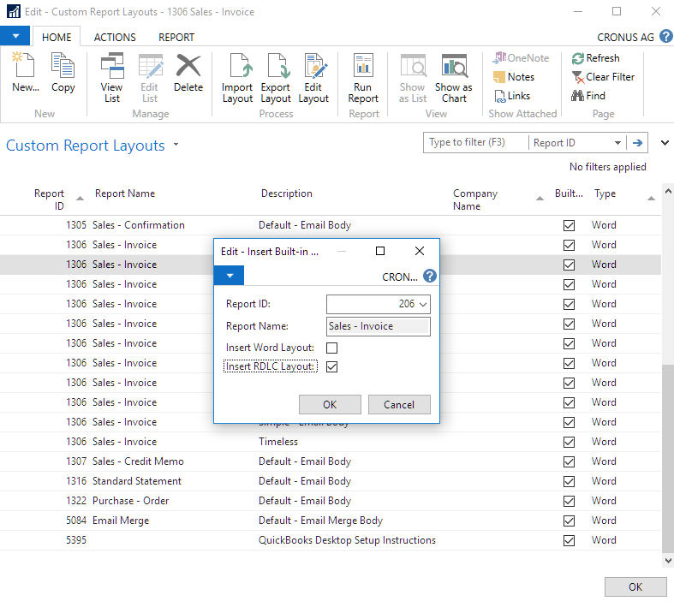
Customizations
Not “really” possible now
If the report has event publishers you could subscribe to them
You could define a Custom Layout
Replace a whole report with the report selection table
Only possible for some documents

Slide 25
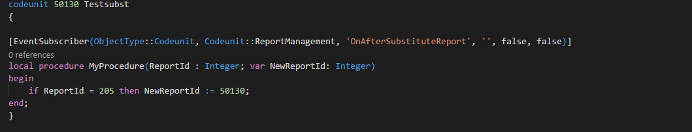
Customizations
Replace a Report with the new global Event publisher
Only if the Report is called by Objectname/ID e.g Report.RUN(206) or for RunObject on action
If you generate a variable of report 206 the event is not fired

Slide 26
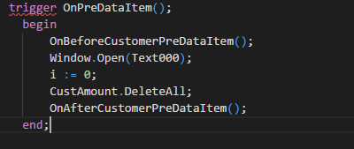
Make reports extensible
Place an event publisher on beginning and ending of every trigger and procedure
Product developer should do this in every report

Slide 27

Q & A
Visual Studio Code
https://code.visualstudio.com
Competence Team DevTech
Channel Microsoft AL

