Slide 1

Day 4 - IT Business Vocabulary

Slide 2
IT Business Vocabulary
Purpose:
Equip interns with essential IT terms used in business communication.
Why it matters:
Understanding IT vocabulary improves communication with technical teams, clients, and project partners.
IT Business Vocabulary refers to common technology-related words and concepts used in business environments that help bridge the gap between IT professionals and business stakeholders.

Slide 3

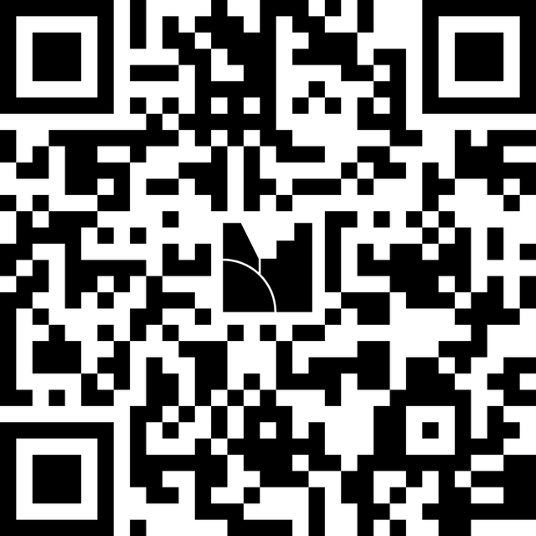


Knowledge Quiz
https://www.menti.com/alwchri6v6jh
https://www.mentimeter.com/
code 6540 6670

Slide 4
IT Business Vocabulary
Why IT Vocabulary Matters in Business
  Helps business teams communicate clearly with IT
  Reduces misunderstandings and errors
  Speeds up decision-making and project delivery
  Ensures better alignment across departments

Slide 5

Let’s Learn Vocabulary
Access Point
A device that allows wireless devices (computers, tablets, phones) to connect to a network. It differs from a router as it primarily serves wireless connections.
Bandwidth
The amount of data that can be transmitted over a network in a given time.
Higher bandwidth means faster data transfer.
Authentication
The process of confirming a user’s identity, such as through usernames, passwords, or biometrics.

Slide 6
Let’s Learn Vocabulary
Cloud Computing
Using internet-based servers to store, manage, and process data instead of local computers.
Includes services like SaaS (Software as a Service), PaaS (Platform as a Service), and IaaS (Infrastructure as a Service).
Backup
A copy of data stored separately to protect against loss or corruption. Important for restoring systems after a failure.
Disaster Recovery
Plans and tools to restore data and systems after a significant disruption, keeping business operations resilient.

Slide 7
Let’s Learn Vocabulary
API
A set of rules that allows different software applications to communicate with each other.
APIs enable services like payment gateways, maps, or social login.
Endpoint
Any device (laptop, smartphone, tablet) connected to a network.
Important in security and IT management.
Cybersecurity
The practices and tools for protecting systems and data from unauthorized access or attacks.

Slide 8
Let’s Learn Vocabulary
Internet Protocol (IP)
A set of rules for sending data online, where each device has a unique address.
Database
Structured storage of organized data that can be easily accessed and managed.
Backup
Copies of data created to protect against loss.

Slide 9
Let’s Learn Vocabulary
User Interface (UI)
The part of a system a person interacts with directly (buttons, menus, screens).
User Experience (UX)
The overall experience of a user interacting with a product or service.
Help Desk
Service that offers support and troubleshooting for technology issues.

Slide 10

Assignment 1: Practice IT Vocabulary
Objective - Practice IT Vocabulary
Task - Pick 10 terms, apart from this deck and write:
  Short definition in your own words
  One example of use in workplace communication
  Why it matters in business context (Use clear business language, not technical complexity)

Slide 11

Please share your learnings with Ravi Gupta in a brief way, following the format below:
  1 key learning from today’s session
  1 key learning from yesterday’s assignment
  1 challenge faced
  1 improvement or action you will apply next time

Slide 12

🙏 Thank You
Great Learning today!
Your participation and reflections added real value to the session.
🔁 Keep applying today’s learnings in your daily communication, meetings and documentation.
📅 Day 5 – Focus Areas:
• Calendar & Scheduling
See you tomorrow. Keep growing! 🚀

