Slide 1

Day 9 - Weekly Status Reports

Slide 2

Weekly Status Report
A weekly status report is a concise update summarizing what was achieved, current progress, challenges faced, and plans for the next week, helping managers and teams stay aligned, track goals (KPIs) and address issues proactively through key sections like accomplishments, blockers and next steps, often using simple templates for clarity.

Slide 3

Quick Self-Reflection
  How confident are you in summarizing your entire week into one clear status update?
  How clearly does your weekly update communicate progress and outcomes
  Which part of your weekly update needs the most improvement?
__________
What one change will you apply next week to make your status update more effective?

Slide 4

Office - Treasure Hunt
  Something that can become blunt, but it’s not a knife. It contains lead, but it’s not metallic.
Pick it up and Show us in the camera
  I can be long or I can be short.
I can be grown, and I can be bought.
I can be painted, or left bare.
I can be round, or square.
What am I?
Pick it up and Show us in the camera

Slide 5

Office - Treasure Hunt
  I sit on your desk and follow your hand.
I help you move, but I never stand.
I have a tail, but I’m not alive.
Pick it up and Show us in the camera
  I sit in your hand but control things far away.
I help you switch, but I never stay.
Buttons are my language, not my voice.
Pick it up and Show us in the camera

Slide 6


Weekly Status Update - PPP
🟢 PLAN (What was planned for the week)
  Key goals and deliverables planned at the start of the week
  Milestones or targets agreed with stakeholders
🔵 PROGRESS (What was achieved)
  Major tasks completed
  Milestones achieved
  Value delivered during the week
🔴 PROBLEMS (What needs attention)
  Challenges, blockers, or risks
  Dependencies or delays
  Support or decisions required
https://youtu.be/a77p1Dx0JHQ
2 Minutes Video

Slide 7
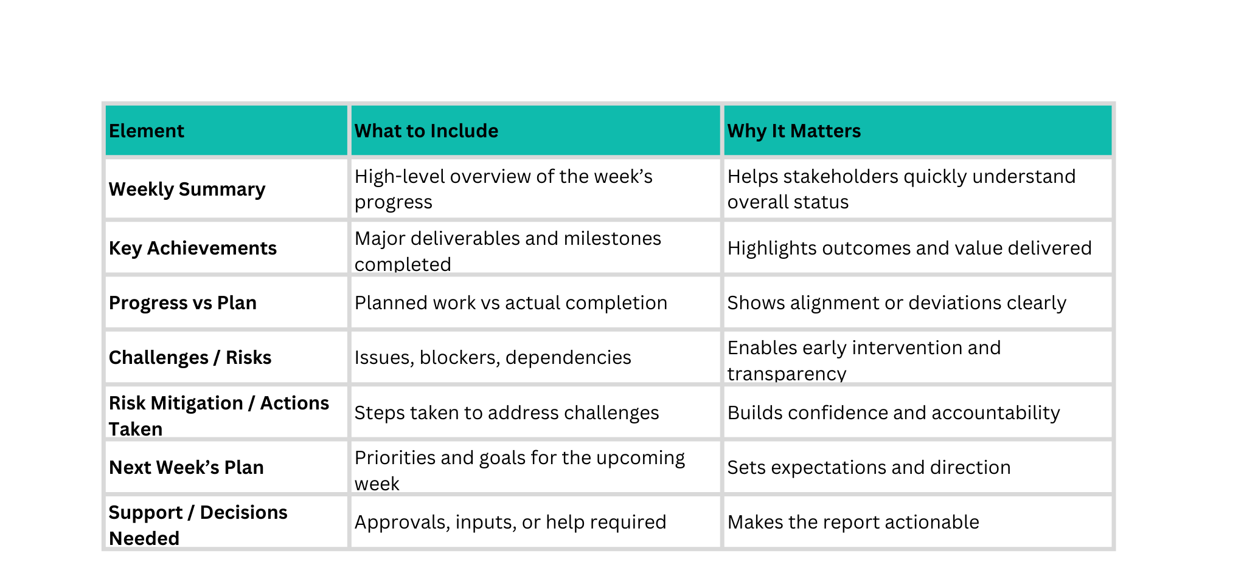
Elements of Weekly Status Reports

Slide 8
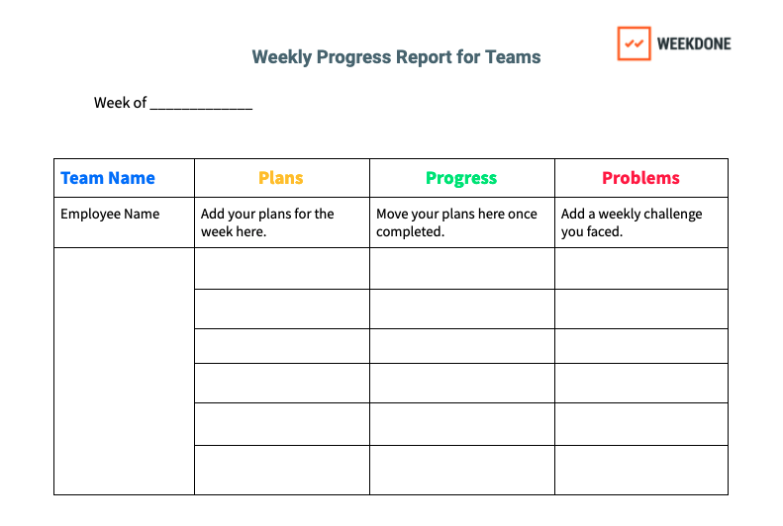
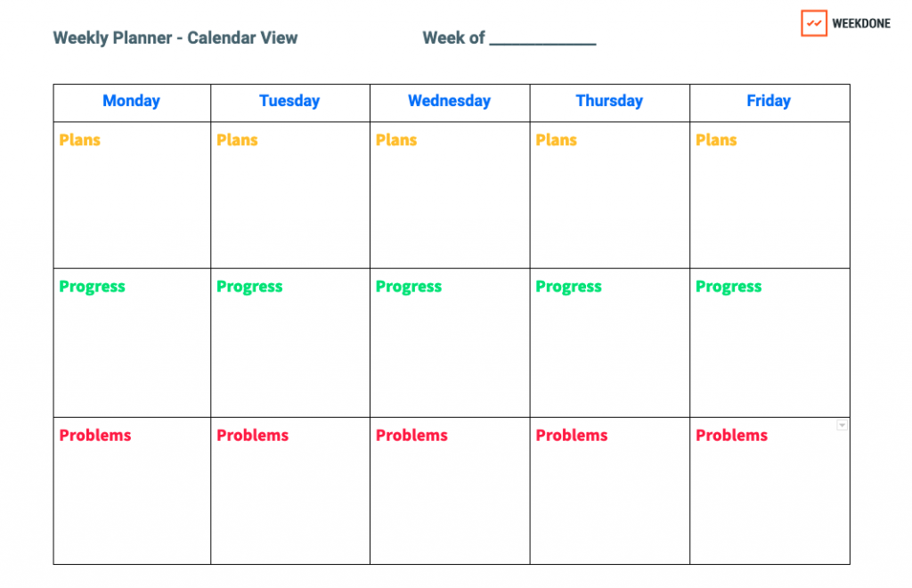

Weekly Status Report - Template
Refer the Template:
https://weekdone.com/resources/templates/progress-report-templates

Slide 9

How to make Weekly Progress/Status Reports?
https://youtu.be/yQTje_GYhb4?si=PwUkjgc4BAG8bvWN
14 Minutes Video

Slide 10

Pronunciation Tip:
  Summary - SUM-muh-ree
  Outcome - OUT-kum
  Alignment - uh-LINE-ment
  Mitigation - mit-i-GAY-shun
  Forecast - FOR-kast
  Escalation - es-kuh-LAY-shun
  Decision - di-SI-zhun
  Achievement - uh-CHEEV-ment
  Deviation - dee-vee-AY-shun

Slide 11


Assessment 1: Weekly Status Report Creation
🎯 Objective - Practice creating a clear, business-focused weekly status report.
📌 Task - Prepare one Weekly Status Report for:
  Your current project
  Your role
  Your stakeholders (Manager / Client)
📝 Include:
  Weekly Summary
  Key Achievements
  Progress vs Plan
  Risks / Challenges
  Next Week’s Plan
  Support / Decisions Needed
🧠 Reflection (3–4 lines) - Explain why this report is effective and how it helps stakeholders.
📄 Format: Word / Excel / PPT (Use real content)

Slide 12

Assessment 2: Weekly Status Insight (Video-Based)
📺 Watch the Video
🔗 https://www.youtube.com/watch?v=yQTje_GYhb4
📌 Task
  Write 3 key takeaways from the video
  Rewrite the following into a professional weekly status update:
“Worked on multiple items this week. Some issues were there. Progress is happening. Will continue next week.”
Submit as Word Document

Slide 13

Let’s Hear from Everyone - 1 min (per head)
Each participant will briefly share:
  1 key learning from today’s session
  1 key learning from yesterday’s assignment
  1 challenge faced
  1 improvement or action you will apply next time

Slide 14

🙏 Thank You
Great discussion today!
Your participation and reflections added real value to the session.
🔁 Keep applying today’s learnings in your daily communication and documentation.
📅 Tomorrow’s Focus:
Email Chains & Thread Management
See you tomorrow. Keep growing! 🚀

