Slide 1

Day 6 - Professional Presence

Slide 2

Quick Self-Reflection
  Rate your on-camera confidence:
  What makes you feel confident on video?
  Biggest video recording fear:
__________
__________
Think of someone with strong professional presence. What specific qualities do they exhibit?

Slide 3

A Quick Warm-up
Let’s Practice the following Articulations:
  "Hello, my name is [Your Name]"
  "I'm passionate about technology and innovation"
  "I help organizations solve complex challenges"
  "Thank you for your time and consideration"

Slide 4
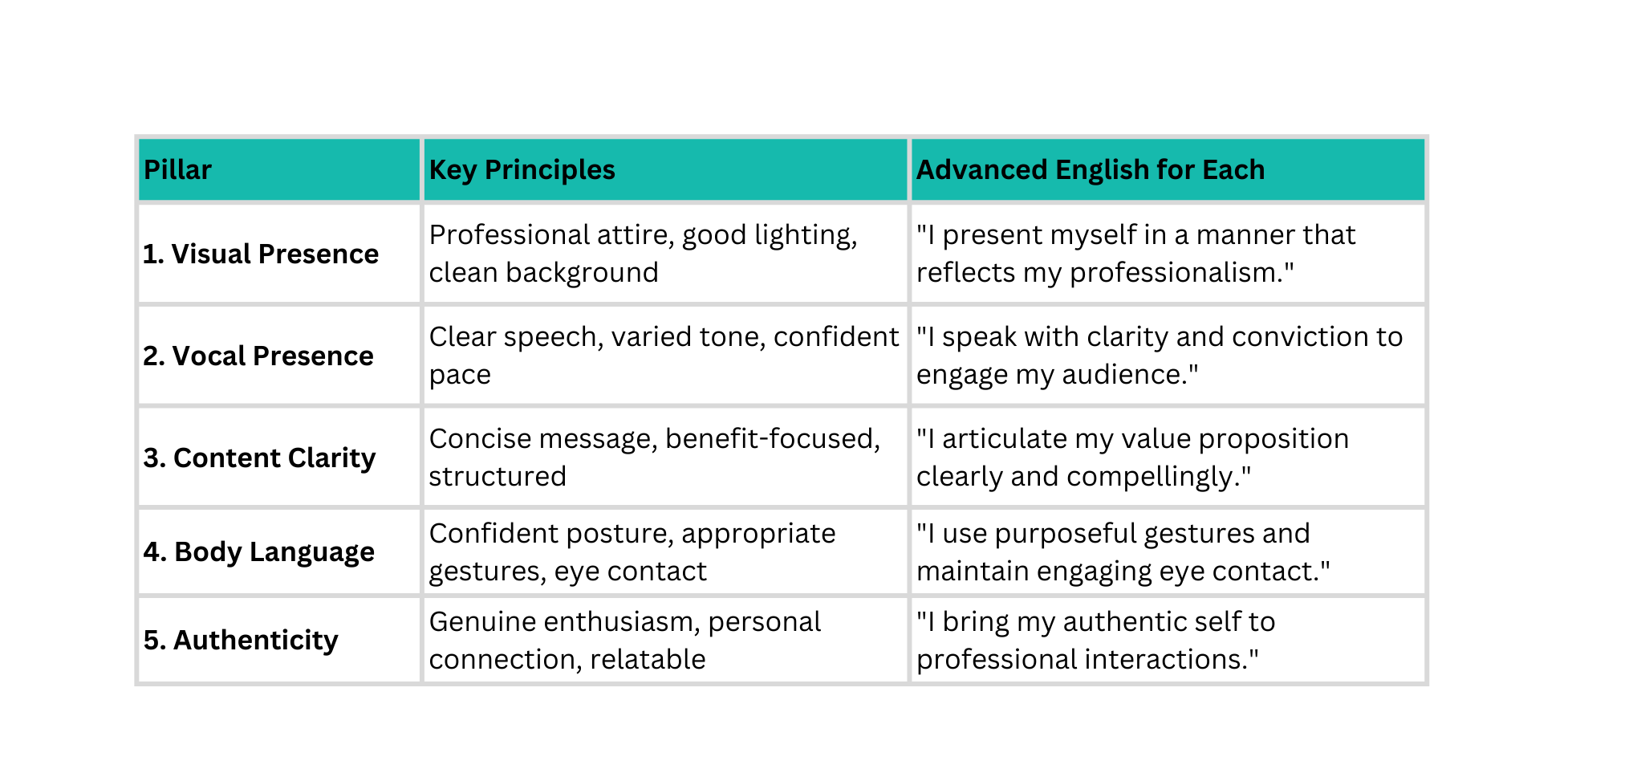
5 Elements of Professional Presence:

Slide 5
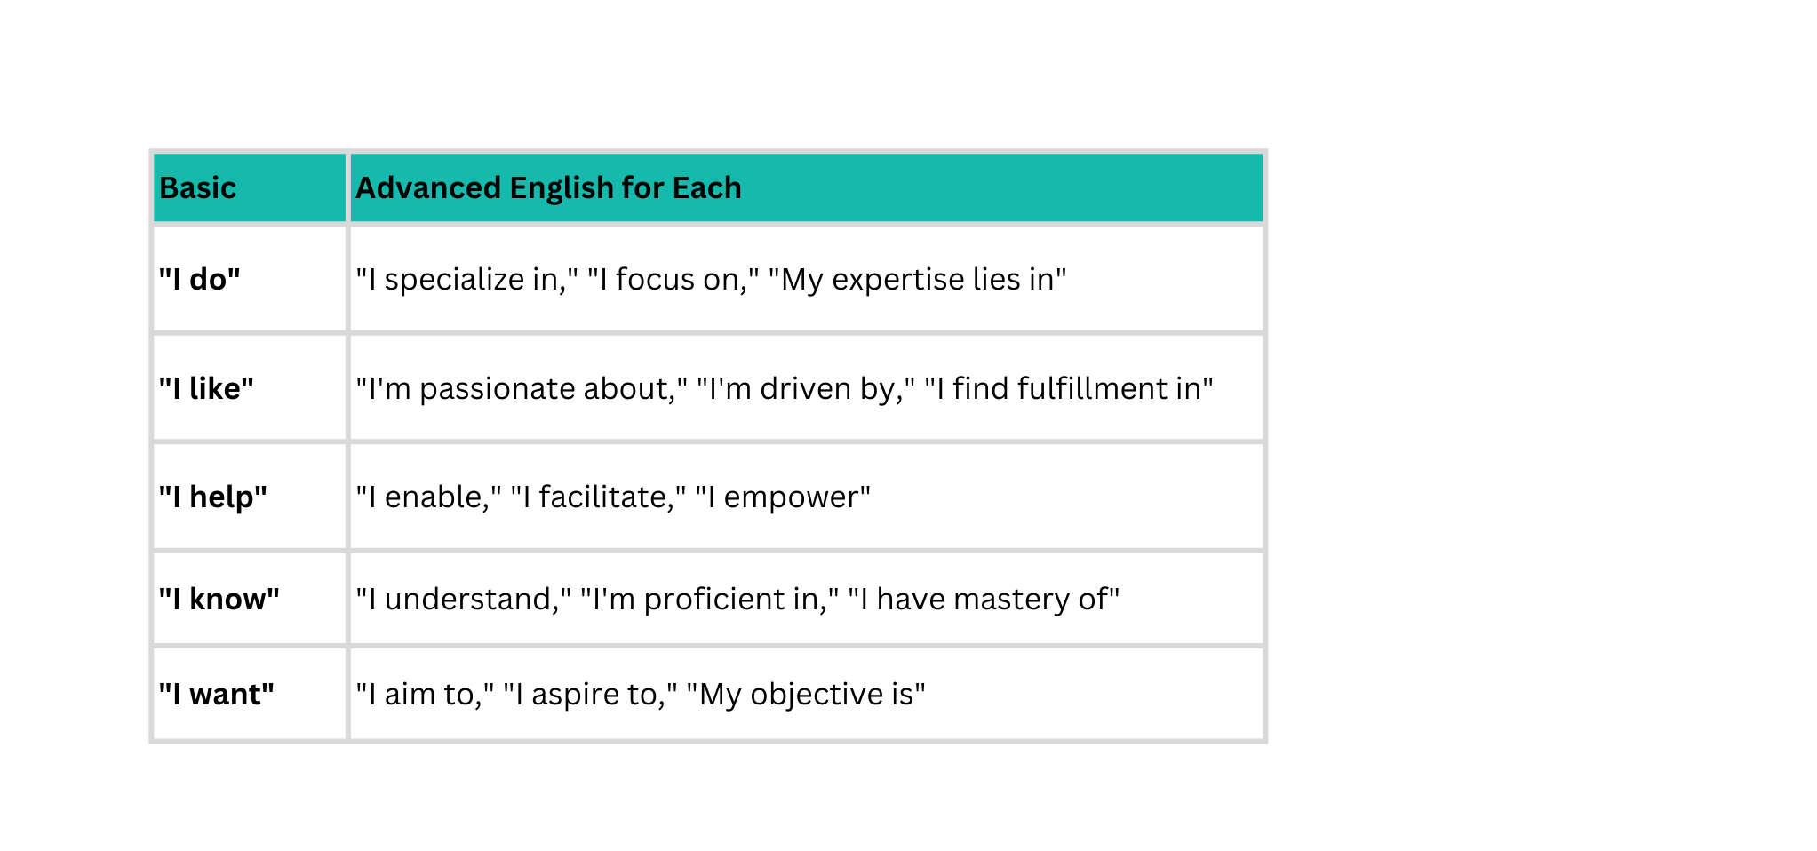
Advanced English for Professional Introductions:

Slide 6


Sentence Structures for Impact:
Weak Sentences
Strong Sentences
"I'm a developer who codes stuff."
"As a software engineer, I architect solutions that transform business challenges into technical opportunities."
"I work with AI."
"I leverage artificial intelligence to create intelligent systems that enhance operational efficiency."
"I make apps."
"I develop innovative applications that solve real-world problems and deliver measurable value."

Slide 7




Tone Control: Let’s Match
  "I bring expertise in..."
  "I'm passionate about..."
  "My approach combines..."
  "What excites me about this field is..."
-
-
-
-
Authentic (not casual)
Professional (not stiff)
Enthusiastic (not exaggerated)
Confident (not arrogant)

Slide 8

Analyze These Introduction Scripts
Script A
Script B
"Uh, hi. I'm [Name]. I, um, do coding and stuff. I work with computers. Yeah, that's about it."
  "Hello, I'm [Your Name]. I'm a full-stack software engineer specializing in AI-integrated applications.
  I help businesses transform their operations through innovative technology solutions. With expertise in machine learning, cloud architecture, and scalable system design, I bridge the gap between complex technical requirements and practical business outcomes.
  I'm passionate about creating technology that makes a tangible difference."
List 7 differences between Script A and B

Slide 9
Analyze These Introduction Scripts
  Opening
  Clarity
  Specialization
  Value proposition
  Expertise
  Benefit focus
  Passion statement
List 7 differences between Script A and B

Slide 10




Let’s Creare your Professional Introduction
https://coastalseventechnologies-my.sharepoint.com/:w:/g/personal/subramanianr_coastalseven_com/IQC6JoUoho3RQ4rzPe9UQp3SATzUeyJObGGe6VA48v5TB5I?e=tafqrI

Slide 11

Pronunciation Drills for Key Phrases:
"I specialize in innovative technology solutions"
Pronunciation: Emphasis on "specialize" and "innovative"
"My expertise lies at the intersection of technology and business"
Pronunciation: Clear "intersection," emphasis on "expertise"
"I'm passionate about creating meaningful impact"
Pronunciation: Strong "passionate," clear "meaningful impact"
"I help organizations transform through digital innovation"
Pronunciation: Connected "transform through," emphasis on "innovation"
"Let's connect to explore potential collaborations"
Pronunciation: Clear "connect," emphasis on "collaborations"

Slide 12

Pronunciation Tip:
  Introduction: in-tro-DUK-shun
  Professional: pro-FESH-nul
  Expertise: EKS-per-teez
  Specialize: SPESH-ul-ize
  Innovative: IN-o-vay-tiv
  Solution: so-LOO-shun
  Collaborate: ko-LAB-o-rate
  Transform: trans-FORM
  Impact: IM-pact
  Opportunity: op-er-TOO-ni-tee

Slide 13

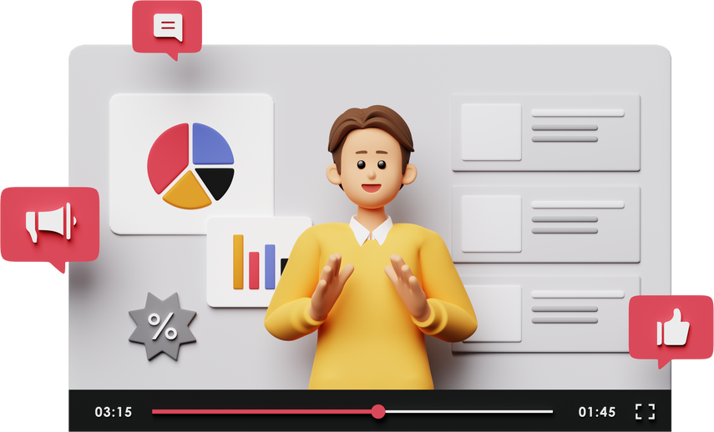
Assessment 1: Create Your Introduction Video
1. Create your 30-second script using templates
2. Record 5 takes with different deliveries
3. Choose best take and edit if needed
4. Upload to Mail
5. Share with 3 people for feedback

Slide 14

Let’s Hear from Everyone - 1 min (per head)
Each participant will briefly share:
  1 key learning from today’s session
  1 key learning from yesterday’s assignment
  1 challenge faced
  1 improvement or action you will apply next time

Slide 15

🙏 Thank You
Great discussion today!
Your participation and reflections added real value to the session.
🔁 Keep applying today’s learnings in your daily communication and documentation.
📅 Tomorrow’s Focus:
Daily Status Updates
See you tomorrow. Keep growing! 🚀

