Slide 1

Name:Pavan

Slide 2
What are Email Threads?
  A collection of messages (original + replies/forwards) on the same topic, linked chronologically by subject line.
  An email thread is a series of related emails that are grouped together, most often by the topic of conversation or the subject line. Email threads allow you to follow a conversation through a series of connected replies. They make it easier to track the progression of a conversation, especially in long email chains involving many participants.

Slide 3
What are Email Chain?
  An "Email chain" (or email chain/thread) is a series of connected emails, often growing long as recipients reply and forward, forming a continuous conversation, but it can also refer to chain emails, which are messages urging mass forwarding, sometimes containing hoaxes or spam, linking back to old chain letters. In simple terms, it's a group discussion via email, whether for work, personal updates, or potentially unwanted messages.

Slide 4
Email Thread Vs Email Chain?
Aspect | Email Thread | Email Chain
Definition | A structured group of related emails linked to one original message | A sequence of emails passed along without strict topic control
Topic Focus | Stays focused on a single topic or discussion | Often drifts into multiple or unrelated topics
Structure | Organized in a hierarchical or tree layout | Linear and unstructured
Conversation Flow | Clear flow showing who replied to whom and when | Flow becomes confusing due to multiple forwards and replies
Reply Behavior | Replies stay relevant to the original subject | Frequent Reply All and forwards
Clarity | High clarity and easy to follow | Low clarity; context gets lost
Searchability | Easy to search and review later | Difficult to search and understand
Best Use Case | Professional discussions, decision tracking | Casual sharing or poorly managed conversations
Risk Level | Low risk of confusion | High risk of miscommunication

Slide 5

Best Practices – Email Chains & Threads
  Use clear, action-oriented subject lines
  Avoid unnecessary Reply All
  Fork the conversation when topic changes
  Trim old or irrelevant content
  Use CC and BCC responsibly
📌 One email = one purpose

Slide 6

What are Escalation Email?
  An escalation email is a formal communication sent to raise an issue to a higher authority or seek intervention when initial attempts at resolution have failed.
  For example, you might write to your manager about a recurring technical problem impacting your team’s productivity or to a customer service manager about a product defect that hasn’t been satisfactorily resolved.
Learning Resource
https://hiverhq.com/blog/escalation-email-templates-and-best-practices

Slide 7
When Should You Escalate?
Learning Resource
How to Escalate Professionally
A good escalation email includes:
  Clear subject line
  Brief context
  Business impact
  Actions taken so far
  Support or decision required
  Professional tone
  https://hiverhq.com/blog/escalation-email-templates-and-best-practices

Slide 8
What Are Follow-up Emails?
  A follow-up email is a brief, polite message sent after an initial contact (email, meeting, call) to remind someone, prompt a response, add value, or keep a conversation going, serving as a "friendly nudge" to move things forward in job applications, sales, networking, or customer service.
  It's concise, personalized and aims to reignite interest or get clarity without being pushy.

Slide 9
Accountability emails
  Accountability emails are structured communications for tracking progress, ensuring transparency, and fostering responsibility, often used in teams or coaching to align on goals, share updates (progress, challenges, next steps), and maintain momentum by documenting commitments and outcomes clearly, using formats like weekly check-ins or formal progress reports
  Clarity, Commitment and Consequences - 3C’s of Accountability Emails

Slide 10

The 3-Email Rule
If an issue:
  Is not resolved within 3 email exchanges
➡ Switch to:
  Call
  Meeting
  Direct discussion
📌 Emails should enable decisions, not delay them.

Slide 11
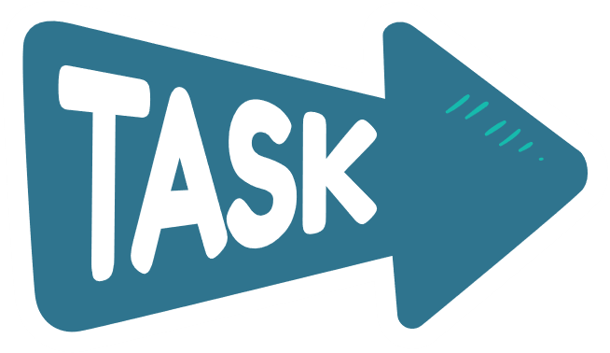
Assessment : Professional Email Communication
📌 Task 3: Follow-up & Accountability Email
  Write one follow-up email for a pending action
  Clearly mention:
    Previous reference
    Owner of the action
    Timeline or deadline
    Next steps
📌 Task 1: Email Thread vs Email Chain
  Explain the difference between an Email Thread and an Email Chain in 5–6 lines
  Mention one best practice to avoid email chain confusion
📌 Task 2: Escalation Email
  Write one escalation email for a work-related issue
  Include:
    Clear subject line
    Brief context
    Business impact
    Action taken so far
    Support or decision required
📌 Keep the tone professional and solution-oriented
📄 Submission Format
  Submit all three tasks in one Word document
  Use clear headings for each task
  Use real or realistic scenarios

Slide 12
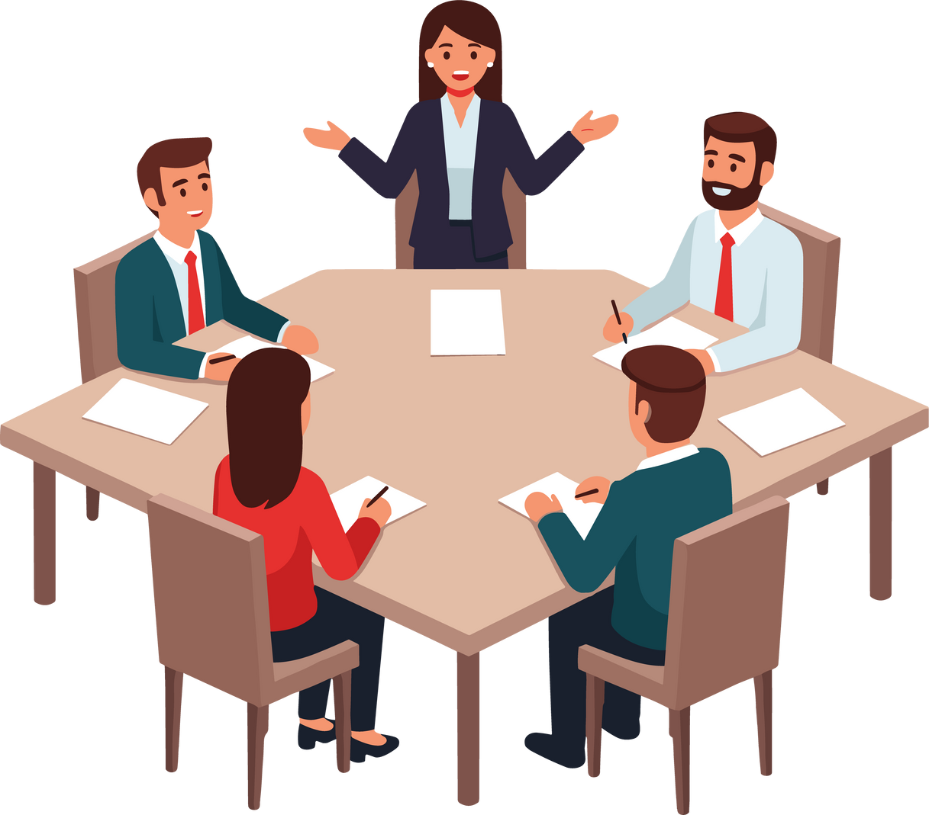
Let’s Hear from Everyone - 1 min (per head)
Each participant will briefly share:
  1 key learning from today’s session
  1 key learning from yesterday’s assignment
  1 challenge faced
  1 improvement or action you will apply next time

Slide 13

🙏 Thank You
Great discussion today!
Your participation and reflections added real value to the session.
🔁 Keep applying today’s learnings in your daily communication and documentation.
📅 Tomorrow’s Focus:
Email Portfolio Review & Weekly Evaluation
See you tomorrow. Keep growing! 🚀

