Slide 1

Professional Communication: Bridging IT and Non-IT Worlds
IT Communication
Non-IT Communication
The Bridge
Technical jargon, precise specifications, and system-focused language dominate IT conversations. Deep expertise assumed.
Clear, jargon-free language prioritizing outcomes and business impact over technical details. Accessibility is key.
Adapt your message to your audience's knowledge level. Translate technical concepts into business value for maximum understanding.
Real-world example: Explaining a software update to IT peers involves version numbers and API changes, while end-users need to know how it improves their workflow and what actions they must take.

Slide 2
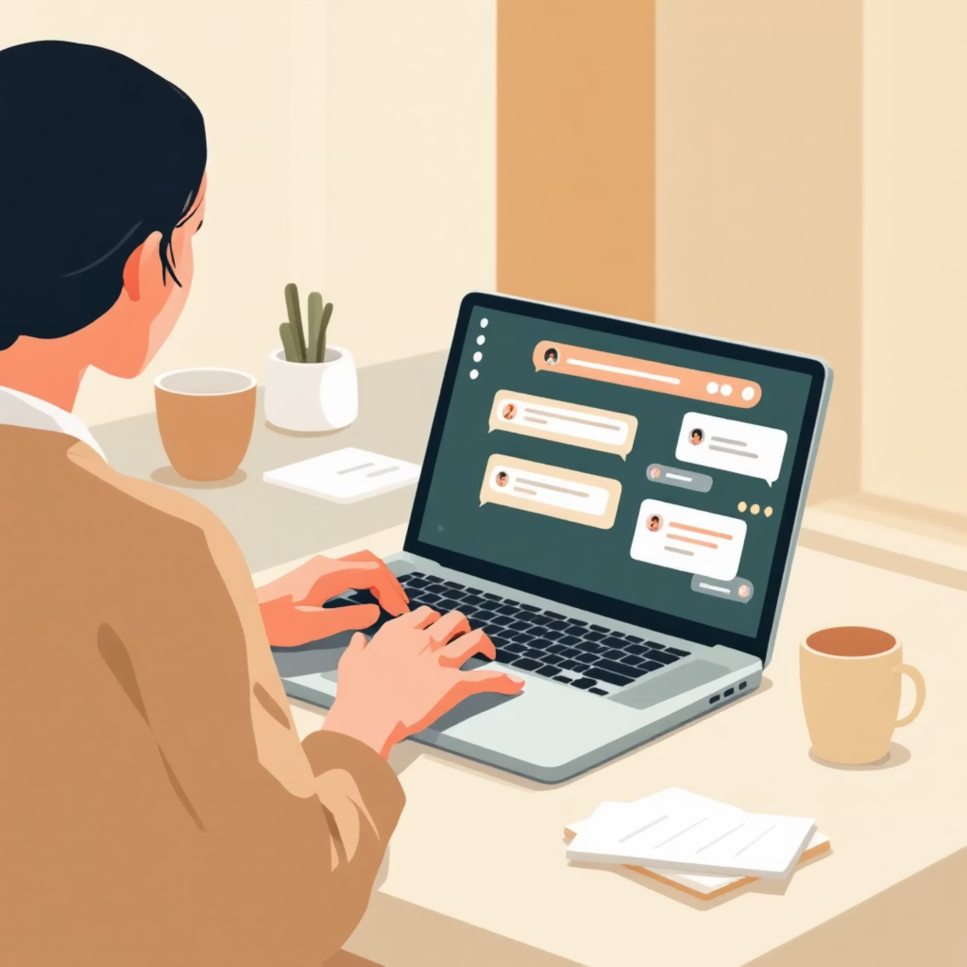


Communication Channels & Styles in IT vs. Non-IT
IT Preferences
Non-IT Preferences
Email threads for documentation
Face-to-face meetings for relationship building
Instant messaging (Slack, Teams) for quick problem-solving
Phone calls for urgent matters
Technical documentation and wikis
Formal reports and presentations
Code repositories and tickets
Scheduled check-ins and status updates
Both styles require active listening, timely feedback, and confirmation of understanding to avoid costly misunderstandings and project delays.

Slide 3
Professional Presence: Commanding Meetings & Office Spaces
Dress for Success
Master Body Language
Command Your Voice
First impressions form within seconds. Dress appropriately for your company culture—whether business formal, business casual, or smart casual. Your appearance signals respect and professionalism.
Maintain steady eye contact, sit upright with shoulders back, and use purposeful gestures. Your non-verbal communication often speaks louder than words, conveying confidence and engagement.
Speak clearly and project confidence. Modulate your tone to emphasize key points and pace your speech deliberately. Avoid filler words and rushing—strategic pauses add gravitas.

Slide 4
Email Mastery
Follow-up Emails
Purpose: Gentle reminders that keep projects moving
1
Provide clear context and reference previous communication
Include specific deadlines or timeframes
Offer assistance and maintain a collaborative tone
Keep subject lines specific and actionable
Accountability Emails
Purpose: Demonstrate ownership and transparency
2
Report progress honestly and proactively
Own mistakes without making excuses
Outline challenges encountered and solutions attempted
Set clear expectations for next steps
Escalation Emails
Purpose: Elevate urgent issues requiring higher-level attention
3
Maintain factual, professional, respectful tone
Clearly state the problem and its business impact
Document previous resolution attempts
Specify the action or decision needed

Slide 5

Examples of Effective Email Phrasing
Follow-up Template
Accountability Template
Escalation Template
"I wanted to check in on the status of the Q4 budget proposal we discussed last week. The deadline is approaching on Friday, March 15th. Please let me know if you need any additional information or support to move this forward."
"I completed the client report as scheduled and submitted it this morning. However, I encountered challenges with the data visualization that required additional time. I've addressed this and implemented a solution to prevent similar delays in future reports."
"I'm escalating the server downtime issue affecting our customer portal. Despite three attempts to resolve it with the IT team over 48 hours, the problem persists, now impacting 500+ customer transactions. I request urgent executive attention to authorize additional resources for immediate resolution."

