Slide 1

Day 3 - Professional Email Basics

Slide 2

Quick Self-Reflection
  How many emails do you write daily?
  Rate your email confidence (1 to 5)
  What's your biggest email challenge?
__________
__________
Think of the most effective professional email you've received. What made it effective? - Explain!

Slide 3
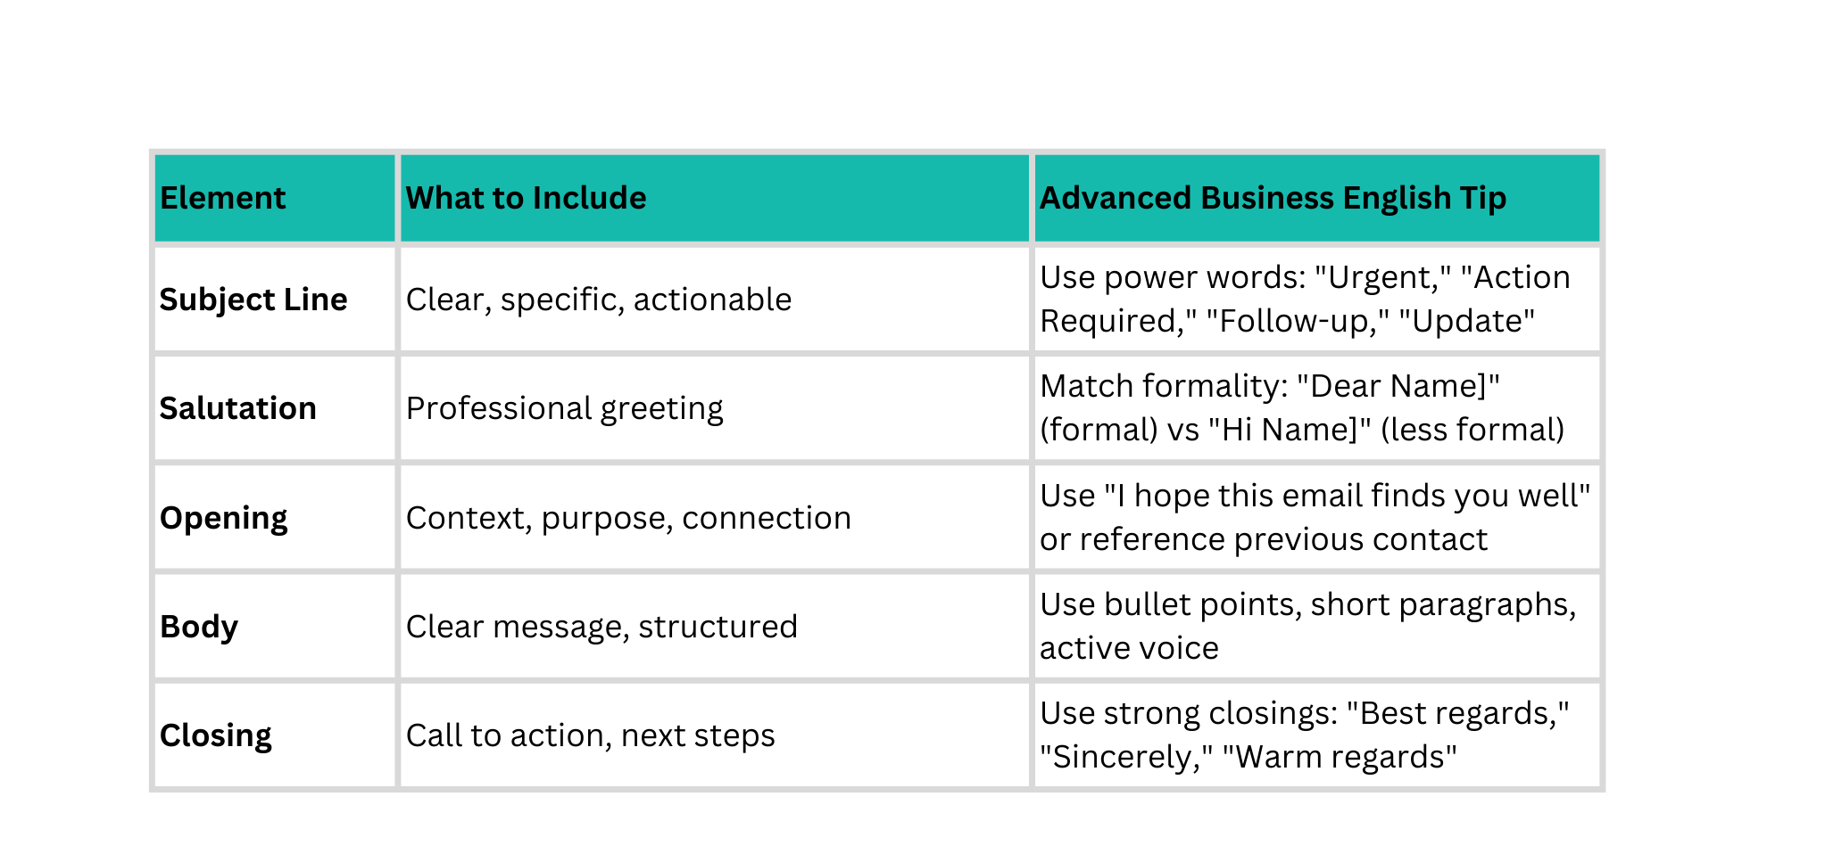
5 Core Elements of Professional Emails

Slide 4



Analyze These Emails
Email 1
Email 2
Hey,
need that report asap. its important. send it to me today.
thx
Subject: Request for Q3 Performance Report
Dear (Recipient Name),
I hope this email finds you well. I'm writing to request the Q3 Performance Report that we discussed in yester day's meeting. This report is essential for our upcoming board presentation on Friday.
Could you please send it to me by end of day today? If you encounter any issu es, please let me know so I can assist.
Thank you for your prompt attention to this matter.
Best regards,
(Your Name)
(Your Position)
List 5 differences between Email 1 and 2

Slide 5
Analyze These Emails
  Subject Line
  Salutation
  Tone
  Structure
  Professionalism
List 5 differences between Email 1 and 2

Slide 6
Pre-Read
Why Professional Emails Matter?
  Clear subject lines set expectations and save time
  Polite openings build rapport and respect
  Context clarity avoids confusion and follow-ups
  Specific deadlines drive accountability
  Supportive language reflects collaboration
  Professional closing reinforces credibility

Slide 7

https://youtu.be/pIHRGFN-mXI?si=HPqqNKnrWTP2Nsff
17 Minutes Video
Watch these video on how to write A Professional Email, by not making these common mistakes! Note down the Takeaways, add them to the Assessment Report!

Slide 8
Escalation Email?
What is an Escalation Email?
An escalation email is a professional communication used to:
  Highlight critical technical issues
  Seek urgent attention or decision
  Minimize business impact
When to Escalate a Technical Issue
  Issue impacts production / business operations
  SLA or deadline is at risk
  Issue is blocked or unresolved
  Customer / management visibility is required
  Dependency failure affecting deliverables

Slide 9
Escalation Email?
Don’ts
Do’s
❌ Don’ts
  Use emotional or aggressive language
  Blame individuals or teams
  Write long technical dumps
  Escalate without attempting resolution
✅ Do’s
  Be factual and concise
  Highlight impact, not blame
  Maintain professional tone
  Suggest next steps

Slide 10

Assignment 1: Technical Issue Escalation Email
Objective - Practice writing a clear and professional technical issue escalation email.
Task - Draft a technical issue escalation email addressed to Ravi Gupta (Manager). Ensure all the aspects of professional email are covered. (refer to the previous decks)
Scenario:
During deployment of the Internship Management Portal, the production deployment failed due to a CI/CD pipeline configuration error, resulting in:
  Deployment failure
  Testing and release being blocked
  Risk of delay in planned timelines

Slide 11
Assignment 2: Video Review, Mistake Identification & Follow-up Email
Step 1: Video Review - Watch the following YouTube video carefully:
https://youtu.be/pIHRGFN-mXI?si=HPqqNKnrWTP2Nsff
17 minutes video
Step 2: Identify the Common Mistakes (Explain in the video)
  Identify the communication mistakes shown in the video
  For each mistake, write a short passage explaining:
    What the mistake is
    Why it should be avoided in a professional environment
Step 3: Holiday Follow-up Email (Ensuring the mistakes are avoided)
Write a professional follow-up email to Ravi Gupta:
  Christmas Holiday – 25th December
  New Year Holiday – 1st January

Slide 12

Please share your learnings with Ravi Gupta in a brief way, following the format below:
  1 key learning from today’s session
  1 key learning from yesterday’s assignment
  1 challenge faced
  1 improvement or action you will apply next time

Slide 13

🙏 Thank You
Great Learning today!
Your participation and reflections added real value to the session.
🔁 Keep applying today’s learnings in your daily communication, meetings, and documentation.
Day 4 – Focus Areas: IT Business Vocabulary
See you tomorrow. Keep growing! 🚀

