Slide 1
Diving Deep into Real Estate in the Alameda County
Team member: Priyanka Singh, Shrikirti Vijayendra,
Pranjali Desai, Garima Vijay, Vinmathi Iyappan,
Sri Tejaswi Kaparaboina, Tia Cao

Slide 2
Contents
Introduction to the data
Web Scraping
Data preprocessing
Research Questions
Data Visualization
Linear Regression
Price Prediction
Clustering

Slide 3

Data Source
The MLS (Multiple Listing Service) is a widely used platform in the real estate industry that compiles comprehensive listings of properties for sale or rent. It's a centralized database accessible to real estate professionals, agents, and public.

Slide 4
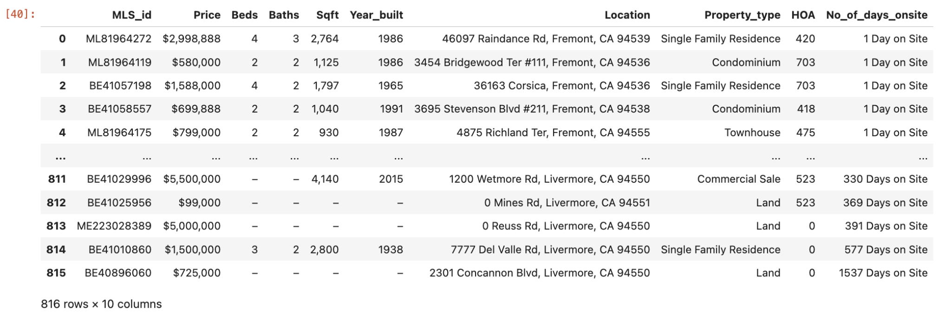
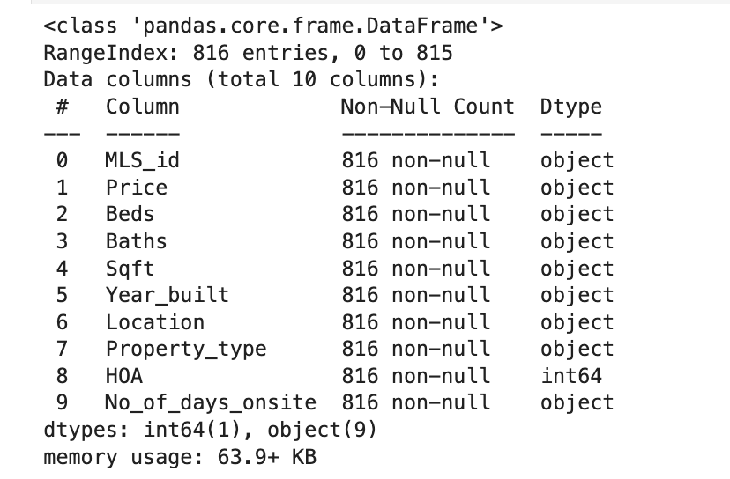
About the Data

Slide 5







Tools and Packages

Slide 6
Web scraping
1.Hayward
2.Fremont
.
.
.
1
2
3
4
Get Property details / City
Parse HTML / Property
Scrape data
Data.csv
Loop through each City URL to get URL link for each property in that city.
For each property: Sent a request to the URL and parsed the HTML content using BeautifulSoup
For each property HTML: Scraped the desired data from the html content and parsed to pandas DataFrame
Saved dataframe as CSV file.

Slide 7
Data preprocessing
Once the data was collected, we preprocessed it for better efficiency.
Some processing include:
Dropped rows where there were null values (for any field)
Converted the data types (for most codes, it was important for the dtype to be in int)
Split the location to 3 columns (Address, City, Zip Code)
Price $ removal (for smooth analysis)

Slide 8
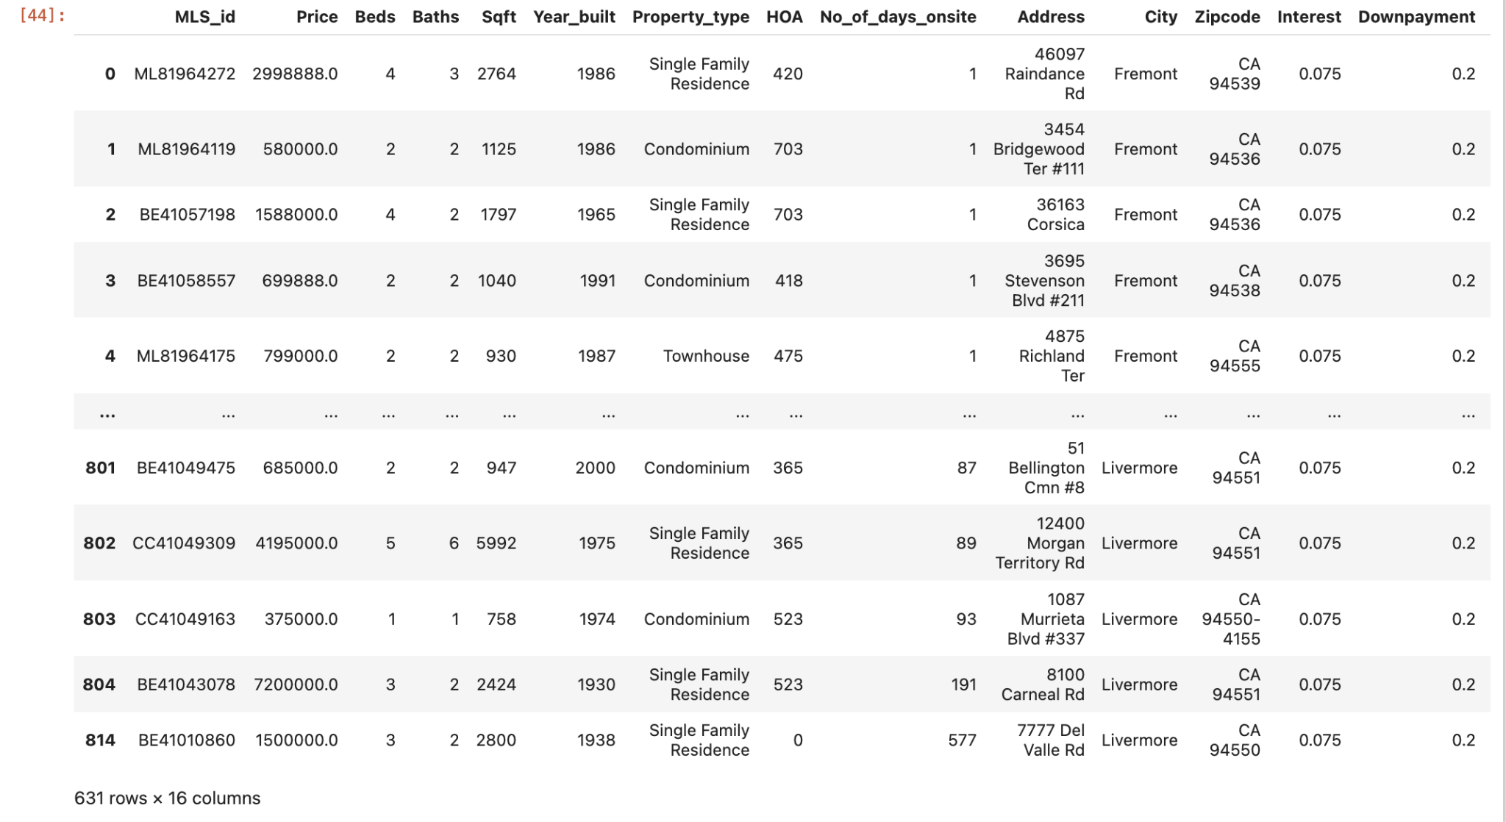
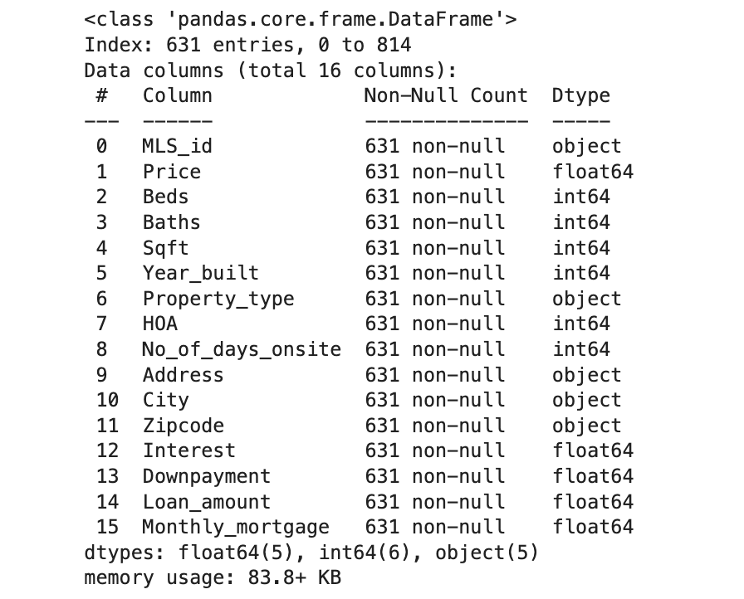
Data after pre processing

Slide 9
Our research questions:
What property types are prevalent in Alameda County?
What are the recent trends in selling prices across different property types and neighborhoods?
How do property prices differ based on factors like property type, size, and the number of bedrooms and bathrooms?
What is the average mortgage amount in Alameda County?
Can we predict the prices of houses in Alameda County?
What does the simple linear regression between price and square footage reveal ?
How can clustering analysis assist in identifying unique neighborhood clusters?
Notes:
Our research questions essentially answer the existing trends in alameda county. This would be helpful for buyers who have different needs. They can use this data to start their research about the price, neighbourhood etc.

Slide 10
Data Decoded: Unlocking Insights with Visualizations

Slide 11
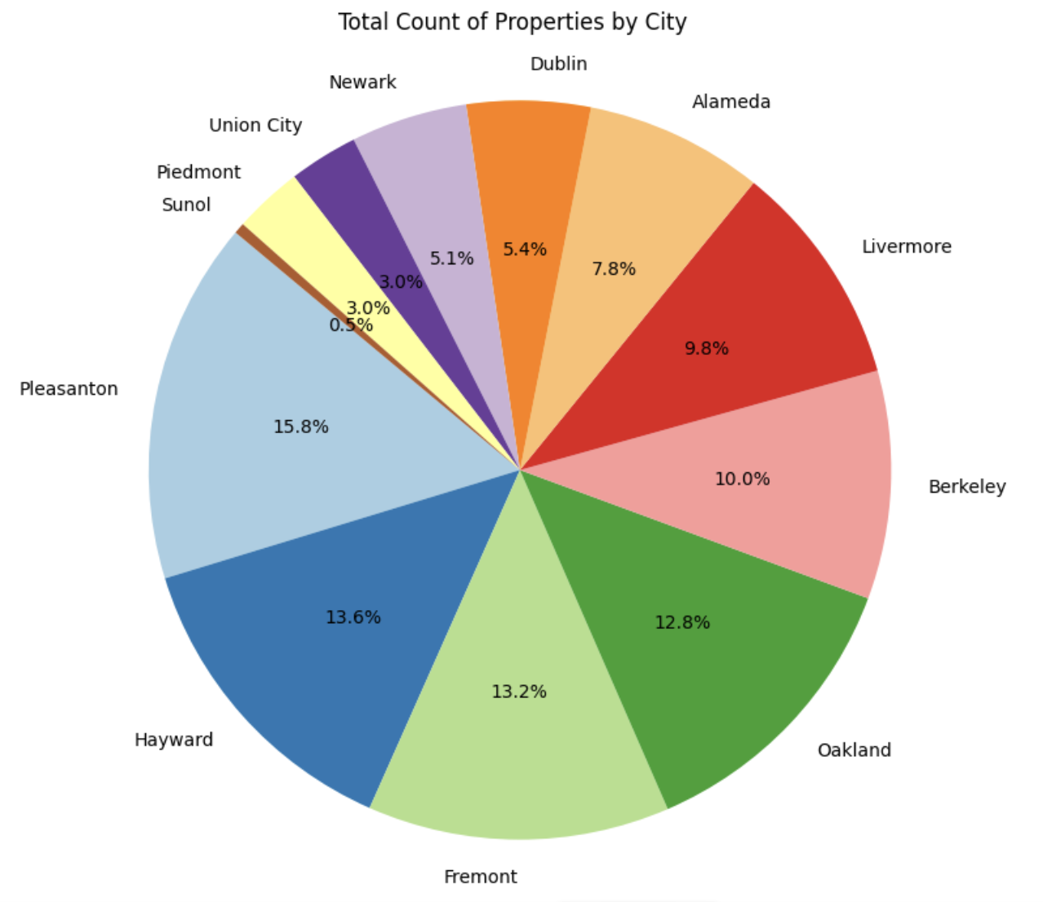
Almost 56% of the homes to be sold belongs to Pleasanton, Hayward, Fremont and Oakland
Pleasanton: 100
Fremont: 83
Hayward: 82
Oakland: 80
Livermore: 62:
Berkeley: 61
Alameda: 49
Dublin: 34
Newark: 32
Union city: 19
Piedmont: 19
Sunol: 3

Slide 12
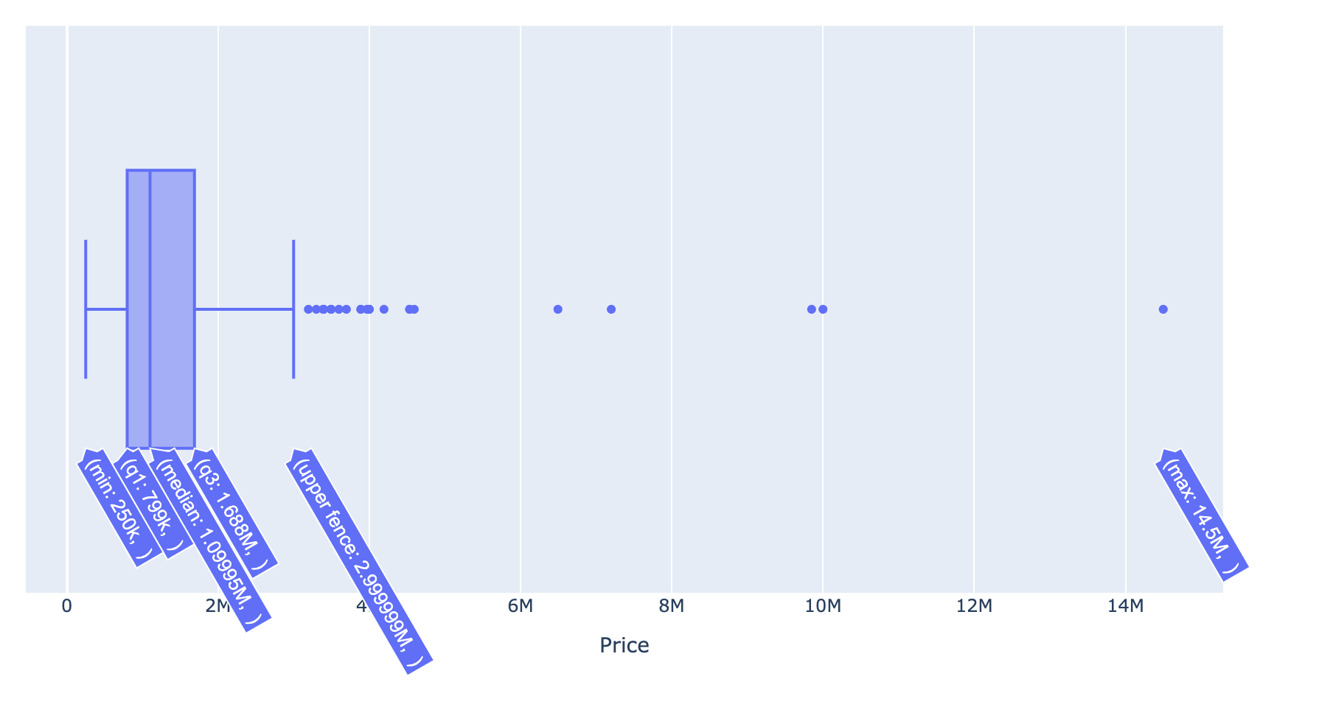
Most of the houses are below $3 million, with only few making exception
Prices for 75% of the homes are under $2 million, with not much variation
Minimum = $250K & Upper fence = $3 million
Piedmont

Slide 13
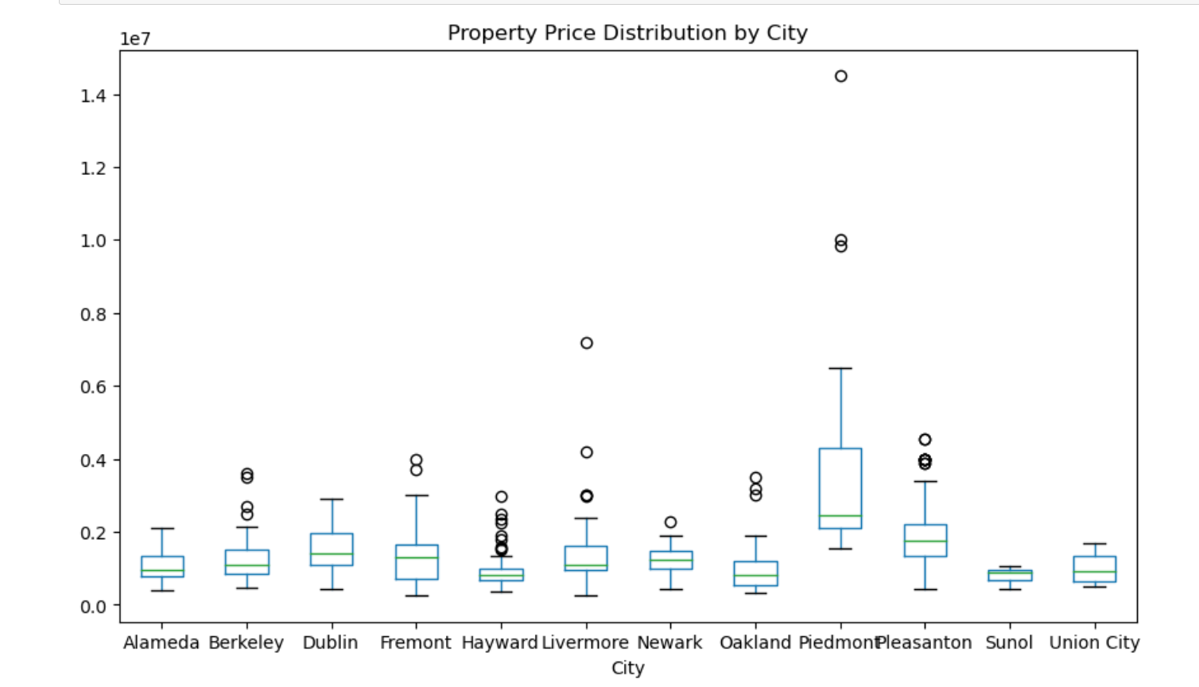
While Piedmont shows the greatest price fluctuations, other cities shows the most consistent pricing

Slide 14
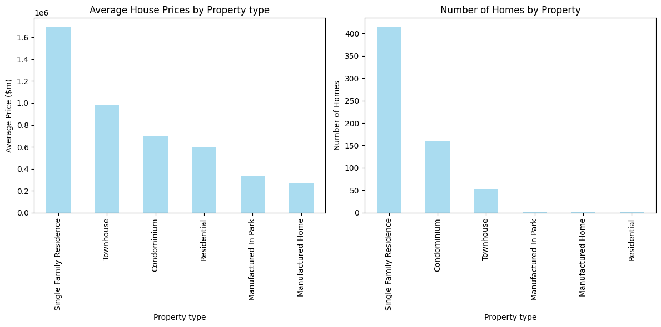
Single family residence leads the chart by average price and number of homes

Slide 15
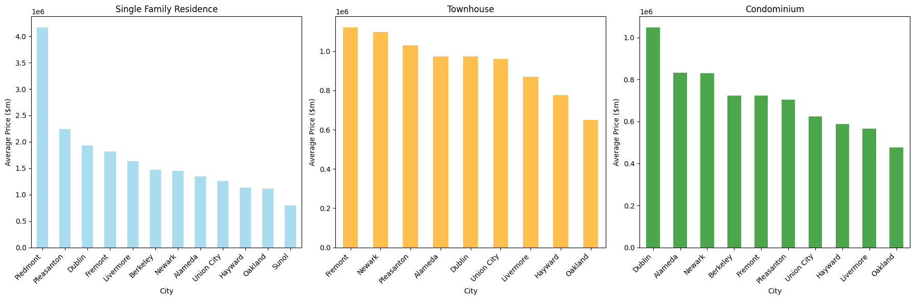
Piedmont dominates the price range in single family residence, with Fremont leading in Townhouse and Dublin in Condos

Slide 16
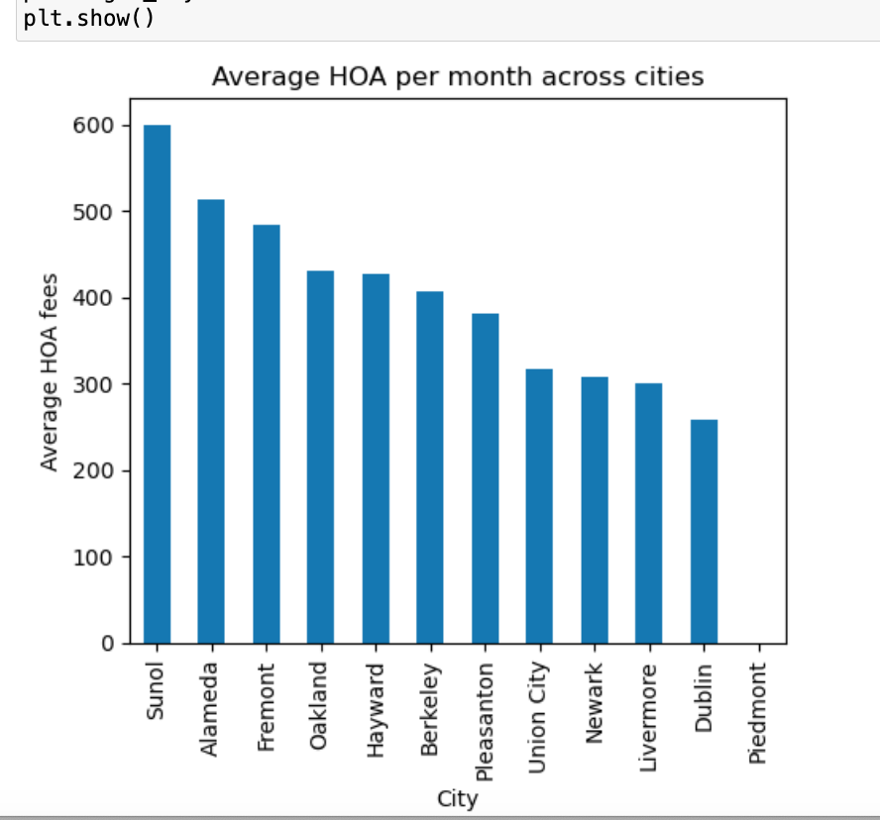
Average HOA per month across cities

Slide 17
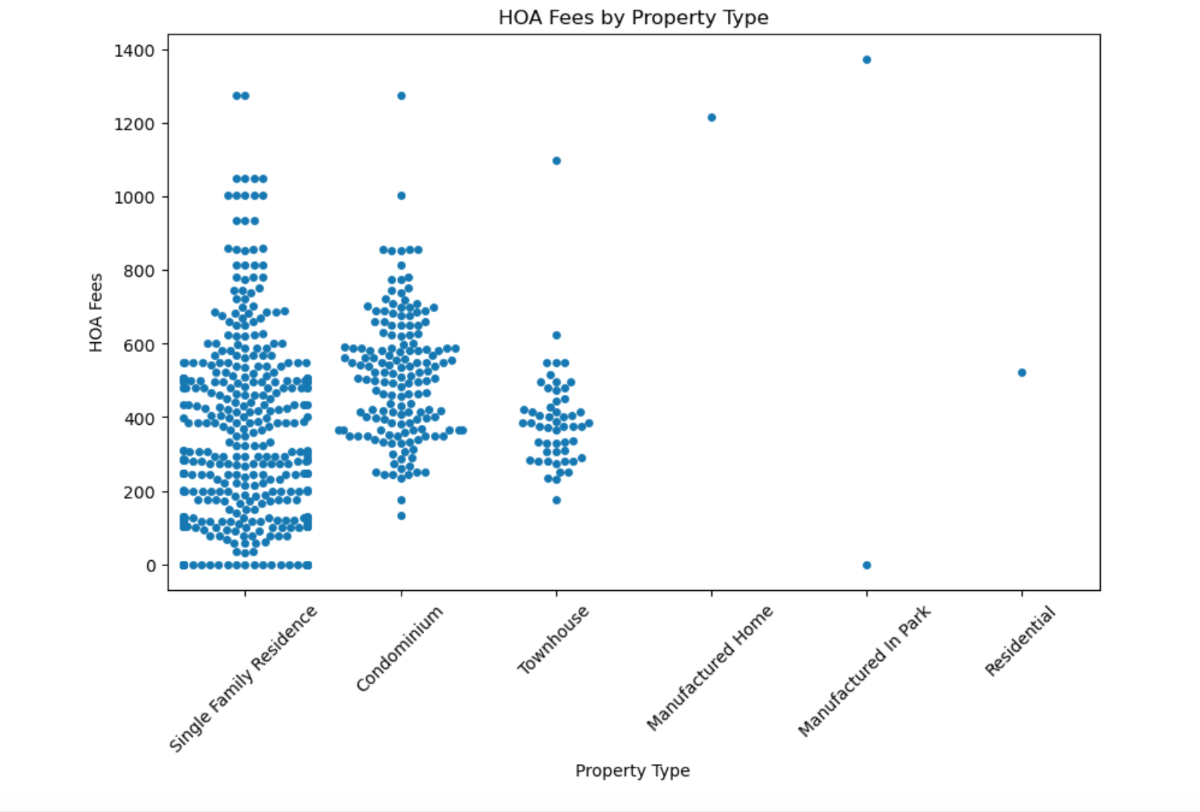
HOA Fees by Property Type

Slide 18
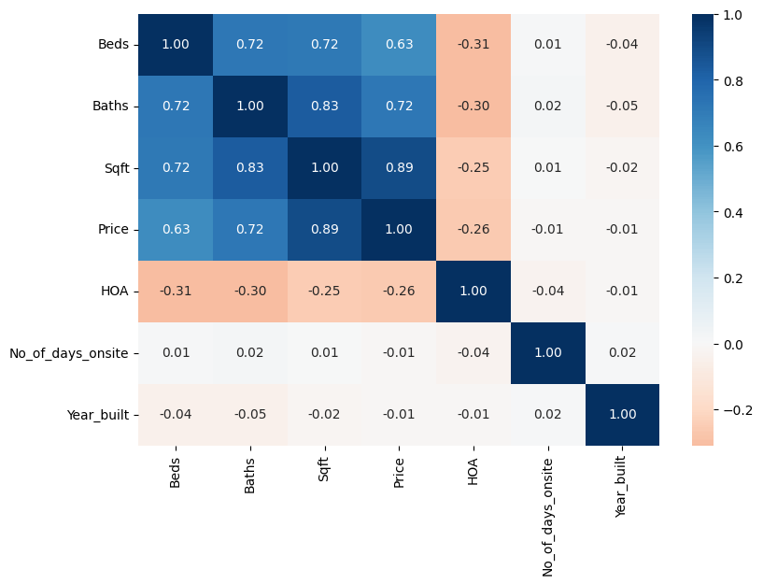
Correlation Matrix

Slide 19
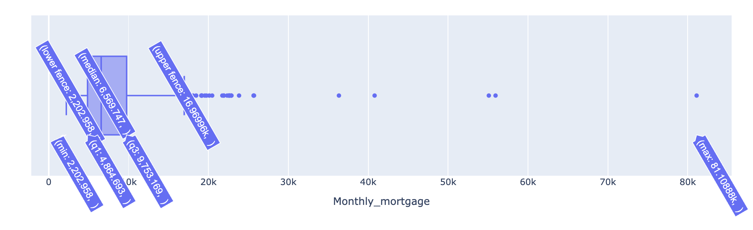
Monthly mortgage suggestion
Formula for term = 30 years, Int = 7.5% p.a and downpayment = 20%
mortgage = loan_amount * (monthly_interest_rate * (1 + monthly_interest_rate) ** loan_term) / ((1 + monthly_interest_rate) ** loan_term - 1)
Notes:
To calculate the monthly mortgage, we have taken term as 30 years, down payment as 20% and interest as 7.5%.
As we can see from the box plot that the median monthly mortgage payment is around $6500. The minimum mortgage to own a house would start at $2200. We can also see a lot of outliers.

Slide 20
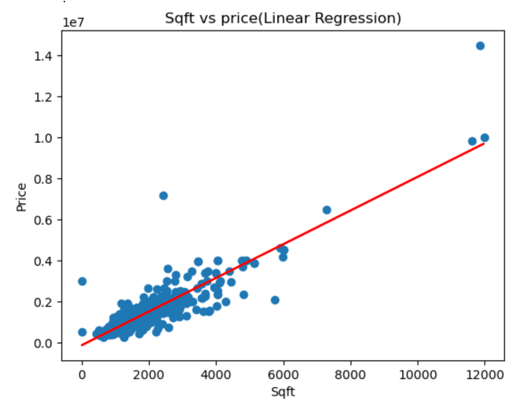
Simple Linear Regression
Simple Linear Regression:
•The goal of Simple Linear Regression is to fit a linear equation to the data points, allowing us to make predictions about the dependent variable based on the independent variable.
•Feature Selection:
•Independent Variable: Square footage (Sqft) of a home Dependent Variable: Price (Price) of the home
•Model Evaluation:
•y=t0x+t1 is the Simple Linear Regression equation
•Least Squares Method
•Scatter Plot Analysis:
•The general trend is clear: as Sqft increases, Price tends to increase too.

Slide 21
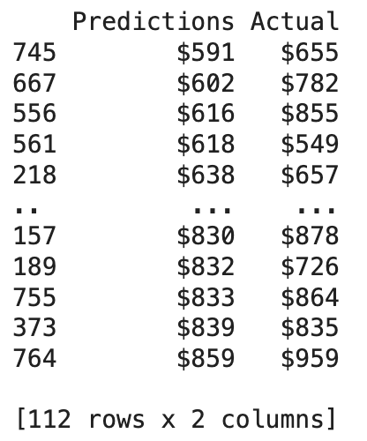
Multiple Regression
Feature Selection: Chose relevant numerical features (Beds, Baths, Sqft, HOA) for modeling
Data Cleaning: Removed outliers using the Interquartile Range (IQR) method
Data Scaling: Employed Min-Max scaling and Standard scaling for feature normalization
Model Evaluation:
Root Mean Squared Error (RMSE): 170.39
Sample Predictions vs. Actual:
Prediction values range from $591 to $859.
Actual values range from $549 to $959.
Notes:
Let's start by setting the stage realistically. Predicting housing prices is not straightforward and involves a lot of market dynamics and fluctuations. It's complex, and our model's performance needs to be seen in that light.
Speaking of our model, we carefully handpicked features like Beds, Baths, Sqft, and HOA that we thought would give us a good grip on price trends. They're valuable, but we know they don't cover every factor influencing prices.
We also got rid of outliers using the IQR method.
And to make sure our features play fair and square, we scaled them using Min-Max and Standard scaling.
Our RMSE is around 170.39 showing how much our predicted prices might differ from the actual price on average and gives us a better idea of how far off our predictions could be.
Looking at R-squared, it tells us that about 5.52% of the price per sqft variations can be explained by the features we chose. While our model's R-squared value may seem modest but it tells us the proportion of variability in Price per Sqft that is accounted for by our features.
Also let's compare our model's predictions with actual prices. From $591 to $859 in predictions and $549 to $959 in reality, that does show a bit of a difference but still could be realistic.
While our model shines a light on housing price dynamics, we know it's not perfect but it's a valuable compass in the real estate landscape. There's always room to fine-tune and expand.

Slide 22
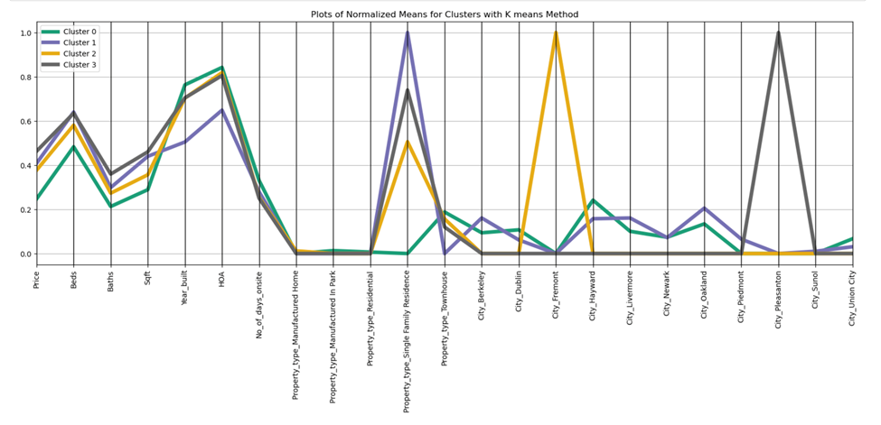
Cluster model
Notes:
This is the Kmeans cluster model that we created using price , bed , bath , sqft,hoa and categorical variable such as property type and city.
We created dummies for the categorical variables and used log transformation as the data was highly skewed and mix mix transformation to bring everything in the range of 0 and 1.
We used elbow chart to come up with the optimal number of clusters.
We found out 4 different clusters that will be highly helpful to make purchase decisions based on the characteristics.

Slide 23
Neighbourhood Chronicles
Cluster 0 (green): Affordable compact homes : This includes New, affordable, and compact townhouses in Hayward, Union City, and Newark offering modern living at a budget-friendly price. But watch out for the HOA fees—they're a bit steep.
Cluster 1 (Purple): Vintage family homes : In Berkeley, Livermore, Newark, Oakland, and Piedmont, you'll find charming old homes with premium price. They might not be the newest, but they are with low HOA fees.

Slide 24
Neighbourhood Chronicles
Cluster 2 (Yellow): The Balanced Borough: Fremont strikes a balance between affordability and comfort, with homes that offer just the right amount of space and style. HOA fees are a bit higher here, whether you prefer a single-family home or a townhouse.
Cluster 3 (Black): The Elite: Pleasanton boasts the height of luxury, with spacious, modern homes that spare no expense. They're the priciest on the block, but with high HOA fees, you'll enjoy top-notch amenities and pristine surroundings. Whether you're into single-family living or townhouses, this neighborhood oozes sophistication.

Slide 25
Thank you 😊
We are now open for any questions

