Slide 1
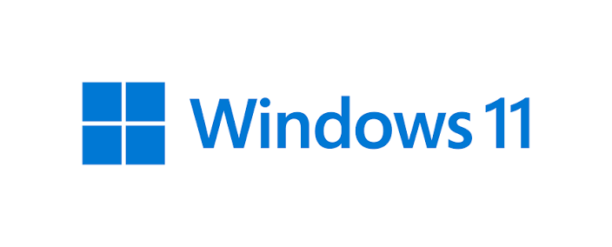

Linux vs Windows
A practical comparison of two operating system philosophies
EASE OF USE
PERFORMANCE
SECURITY
SOFTWARE + GAMING
CUSTOMIZATION
WINDOWS
LINUX
Familiar
Compatible
Gaming-focused
Open source
Flexible
Highly customizable
Notes:
SPEAKER SCRIPT
Good morning everyone. Today, I want to talk about two of the most popular operating systems in the world: Linux and Windows. Most of us use an operating system every day. It helps us run programs, use the internet, play games, manage files, and communicate with other people. Windows and Linux can do many of the same things, but they are very different in the way they work. So today, I will compare them in five main areas: ease of use, performance, security, software and gaming, and customization.
MOTION / DELIVERY
Title reveals first; Linux and Windows marks enter from opposite sides, then the comparison line fades in.

Slide 2
What are Windows and Linux?
One familiar platform vs many open-source choices.
WINDOWS
Developed by Microsoft. Common in homes, schools, offices, and businesses.
LINUX
Open source, with many distributions and different desktop experiences.
THE PHILOSOPHY
Windows: one main experience. Linux: many choices.
Notes:
SPEAKER SCRIPT
First, let's talk about what they are. Windows is an operating system developed by Microsoft. It is very popular on personal computers and is commonly used in homes, schools, offices, and businesses. Linux is different. Linux is an open-source operating system. There are many different versions of Linux, called distributions, such as Ubuntu, Fedora, and Linux Mint. Windows usually gives users one main experience, while Linux gives users many different choices.
MOTION / DELIVERY
Windows card appears first, then Linux card; final philosophy line fades in.

Slide 3
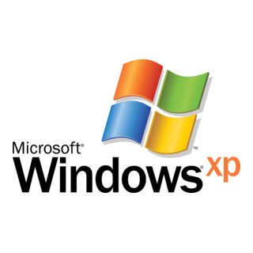
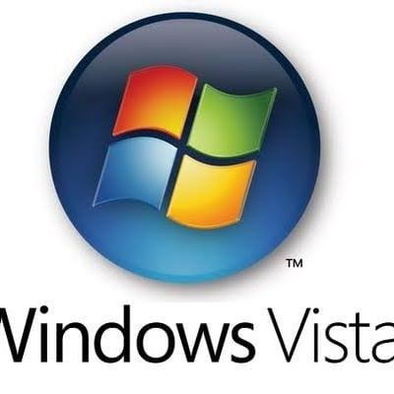
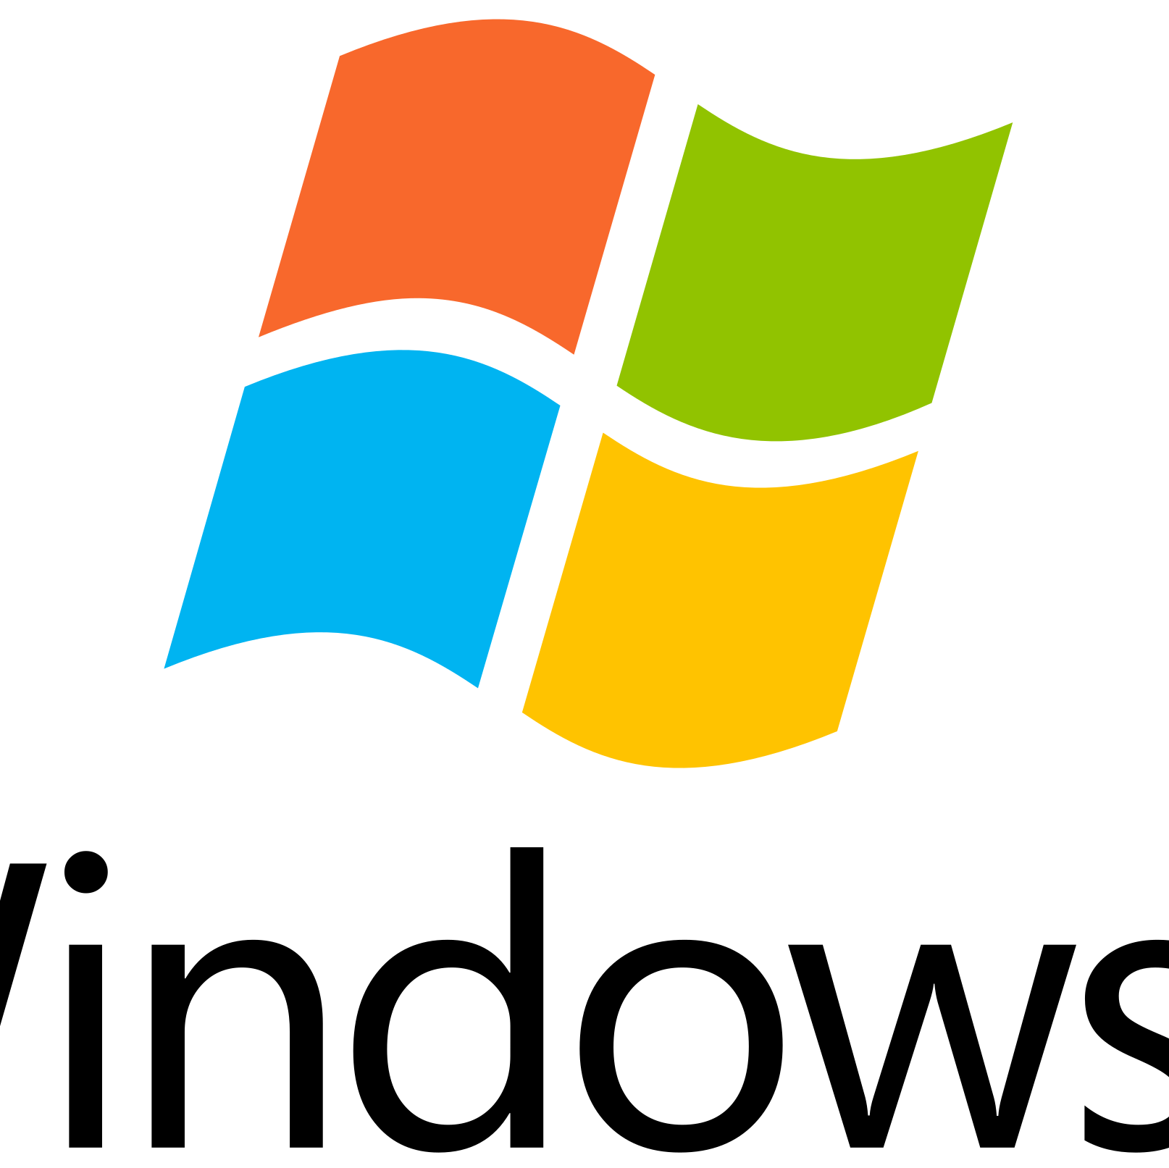
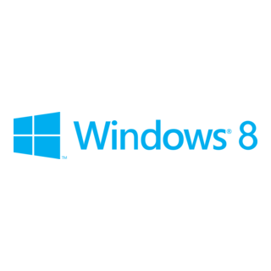
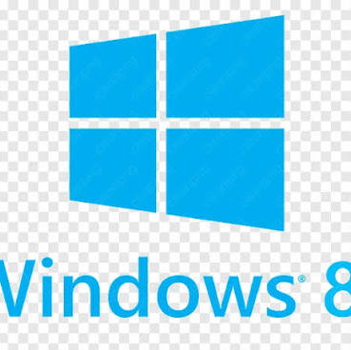
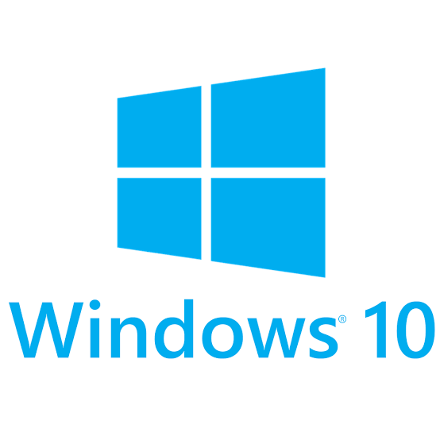






Distributions of Linux VS Windows Versions
Linux families and the Windows timeline.
LINUX FAMILIES
WINDOWS VERSIONS
Debian-based
XP
Vista
7
8
8.1
10
11
Debian • Ubuntu • Linux Mint
Red Hat-based
RHEL • Fedora • Rocky • AlmaLinux
ONE KERNEL • MANY CHOICES
Arch-based
Linux branches into distributions;
Windows evolves through releases.
Arch Linux • Manjaro
Notes:
SPEAKER SCRIPT
Now, let's look at some of the different Linux distributions and Windows versions. Linux has many different distributions. Some important Linux families include Debian-based distributions and Red Hat-based distributions. For example, Debian-based distributions include Debian, Ubuntu, and Linux Mint. Red Hat-based distributions include Red Hat Enterprise Linux, Fedora, Rocky Linux, and AlmaLinux. There are also other Linux families, such as Arch-based distributions, including Arch Linux and Manjaro. So, Linux is not just one version. It has many different distributions, and each one can be designed for different users and purposes. Windows has a different approach. Instead of many distributions, Microsoft has released different versions of Windows over the years. Some important versions are Windows XP, Windows Vista, Windows 7, Windows 8, Windows 8.1, Windows 10, and Windows 11. So, the main difference is that Linux has many distributions, while Windows has different versions of the same operating system.
MOTION / DELIVERY
Timeline draws left-to-right; Linux family labels appear first, then the Windows version path.

Slide 4
Ease of Use
Familiarity matters most for beginners.
WINDOWS
LINUX
TERMINAL
VERDICT
Familiar interface
Simple setup
Ubuntu / Mint
Beginner friendly
More learning
for some tasks
Windows usually
easier for beginners
START MENU • TASKBAR • FILE EXPLORER • SETTINGS
Notes:
SPEAKER SCRIPT
The first important difference is ease of use. Windows is generally very easy for beginners. Most computers already have Windows installed, and many people are familiar with its interface. For example, we have the Start menu, the taskbar, File Explorer, and simple settings. Linux can also be very easy to use, especially with distributions like Ubuntu or Linux Mint. However, Linux sometimes requires users to learn more about the system. Some tasks may require using the terminal, which can be difficult for a beginner. So, for a person who wants a simple and familiar experience, Windows is usually easier.
MOTION / DELIVERY
Four comparison cards fade in in sequence; winner card gets a subtle emphasis.

Slide 5
Performance
Resource use depends on the system and workload.
WINDOWS
LINUX
THE REALITY
More background services can increase resource use.
Strong performance on modern hardware.
Often lighter with a lightweight desktop.
Can be excellent on older hardware.
Hardware + distribution + desktop + software all matter.
OLDER HARDWARE ← LINUX ADVANTAGE | MODERN HARDWARE → BOTH CAN PERFORM WELL
Notes:
SPEAKER SCRIPT
Now let's talk about performance. Windows has many features and services running in the background. Because of this, it can sometimes use more RAM and system resources. Linux is often lighter, especially when we use a lightweight desktop environment. This can be useful on older or less powerful computers. For example, a computer that struggles with a modern version of Windows may still work well with a lightweight Linux distribution. However, performance depends on the hardware, the Linux distribution, and the programs we use. So Linux can have an advantage on older hardware, but Windows can also perform very well on modern computers.
MOTION / DELIVERY
Resource cards enter from alternating sides; the older-hardware point is highlighted last.

Slide 6
Security
Both can be secure; user behavior still matters.
WINDOWS
NO PERFECT OS
Common malware target • Windows Defender
Updates
Strong passwords
Safe downloads
Careful user behavior
SECURE
LINUX
Permissions • administrator controls • open source
Notes:
SPEAKER SCRIPT
Another important area is security. Both Windows and Linux can be secure, but they use different approaches. Windows is a very popular operating system, so it is also a common target for malware and viruses. Microsoft includes security tools such as Windows Defender to protect users. Linux has a different security model. Users normally have limited permissions, and administrative actions usually require special permission. Linux is also open-source, which means its source code can be examined by developers around the world. But this does not mean Linux is completely safe. No operating system is completely secure. Good security also depends on software updates, strong passwords, safe downloads, and user behavior.
MOTION / DELIVERY
Shield motif fades in; security points appear one by one, ending on the no-perfect-OS message.

Slide 7
Software and Gaming
Windows leads on compatibility; Linux is catching up.
WINDOWS
LINUX
LIMITATIONS
Broad software compatibility
Large PC game library
Professional applications
Steam + Proton
Many Windows games run
Compatibility keeps improving
Some anti-cheat systems
Some professional apps
Windows remains the easy choice
SOFTWARE COMPATIBILITY + GAMING → WINDOWS ADVANTAGE
Notes:
SPEAKER SCRIPT
Now let's compare software and gaming. Windows has a major advantage when it comes to software compatibility. Many popular programs are designed specifically for Windows. Windows is also very popular for gaming. Most PC games are released for Windows first, and many games work very well with Windows. Linux has improved a lot in gaming. Tools such as Steam and Proton allow many Windows games to run on Linux. However, some games, especially games with certain anti-cheat systems, may still have problems on Linux. For professional software, Windows also has an advantage because many popular applications are officially designed for it. So if gaming and maximum software compatibility are important, Windows is usually the easier choice.
MOTION / DELIVERY
Windows compatibility card enters first; Steam/Proton appears next; anti-cheat limitation fades in as a small warning.

Slide 8
Customization
Linux gives users deeper control over the desktop and system.
DESKTOP
APPEARANCE
Change the desktop environment
Themes, panels, icons, layout
SYSTEM
DISTRIBUTIONS
Change behavior and core tools
Different choices for different users
MORE CONTROL → MORE FREEDOM → MORE LEARNING
Notes:
SPEAKER SCRIPT
One area where Linux is especially strong is customization. Linux gives users a lot of control over their operating system. Users can change the desktop environment, appearance, system behavior, and many other parts of the system. There are also many different Linux distributions designed for different types of users. Windows also allows customization, but it gives users less control over the core system. So, if you like experimenting and changing your computer to work exactly the way you want, Linux can be a better choice.
MOTION / DELIVERY
Customization keywords appear around the Linux mark; Windows remains visually simpler.

Slide 9
Price
Open source changes the cost model.
FREE
COMMERCIAL
LINUX
WINDOWS
Usually no license purchase
Often bundled with a PC
For students and tight budgets, Linux can be attractive.
Notes:
SPEAKER SCRIPT
Another difference is price. Linux is generally free and open-source. Most Linux distributions can be downloaded and used without paying for a license. Windows is commercial software developed by Microsoft. Many computers include a Windows license when they are purchased, but Windows itself is not completely open-source. For students or people with a limited budget, Linux can therefore be an attractive option.
MOTION / DELIVERY
Linux 100% ring completes first; Windows ring follows at a smaller value.

Slide 10
Which One Is Better?
There is no universal winner.
WINDOWS
LINUX
CHOOSE WINDOWS
CHOOSE LINUX
Easy installation • maximum compatibility • strong gaming
Customization • control • free • older hardware
THE BEST OS = THE ONE THAT FITS YOUR NEEDS
Notes:
SPEAKER SCRIPT
So, which operating system is better? The answer depends on the user. If you want easy installation, maximum software compatibility, and strong gaming support, Windows is probably the better choice. If you want more customization, more control, and a free operating system that can work well on older hardware, Linux may be better. There is no operating system that is perfect for everyone. The best choice depends on what you need to do with your computer.
MOTION / DELIVERY
Windows and Linux cards slide toward the center; the 'No universal winner' statement appears last.

Slide 11
Conclusion
Choose the operating system that fits your needs.
WINDOWS
LINUX
Different strengths. Different priorities.
One choice: what works best for you.
Thank you for listening.
Notes:
SPEAKER SCRIPT
To conclude, Windows and Linux are both powerful operating systems, but they have different strengths. Windows is easy to use, has excellent software compatibility, and is very strong for gaming. Linux is free, highly customizable, and can be a great choice for users who want more control over their system. Personally, I think the most important thing is not choosing the operating system that is more popular. The important thing is choosing the one that fits your needs. Thank you for listening.
MOTION / DELIVERY
Both marks settle side-by-side; the final message fades in, then the deck holds for the closing sentence.

