Slide 1
ATTesa Presentation
Presented By:
Anthony Paccito [PCTN0007]
Dariusz Kulpinski [N01164025]
Winson Vuong [N01104944]

Slide 2
Introduction
There are always a huge line of people whenever you go to a clinic, and one reason why is because of registration process.
The purpose of this app was to provide an easy and quick way to register for a clinic appointment even from the comfort of your own home
Uses a login system so if you accidentally remove the app you can still later use that account

Slide 3
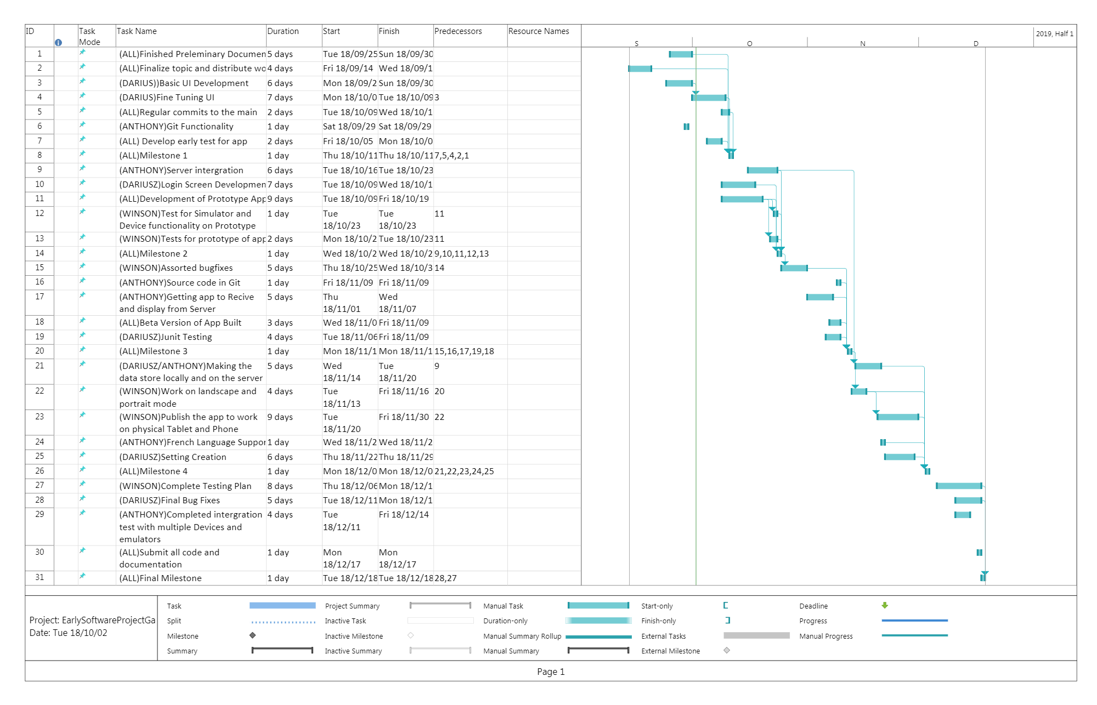

Slide 4
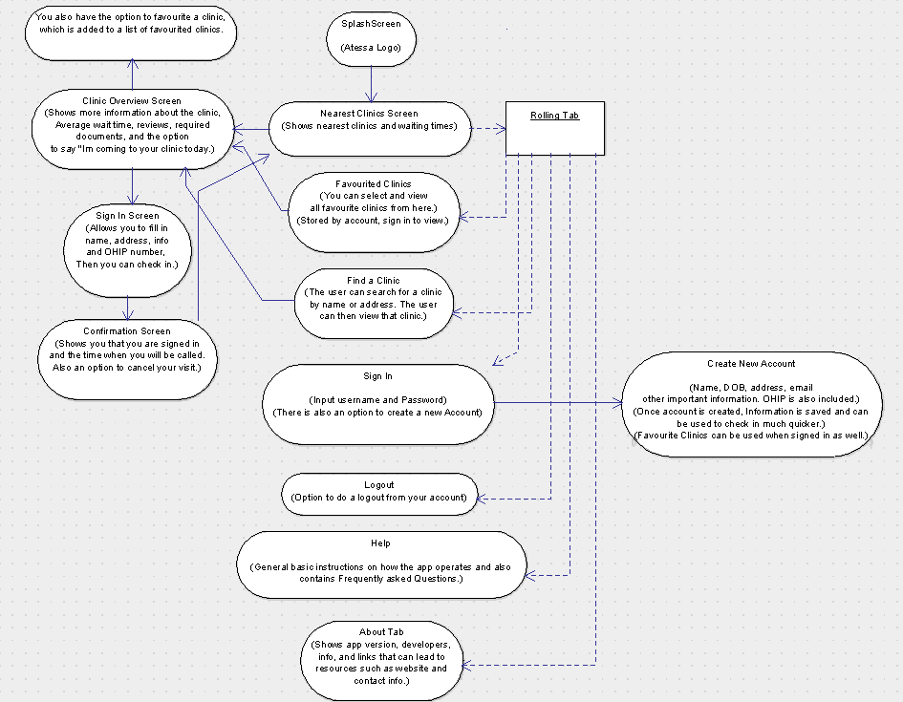
FLow Chart

Slide 5
Example use cases
If you have an appointment to go to and you still need to go to the clinic on that day
Look at the queue time for a clinic at home
Check to see if a clinic is open

Slide 6
Workload Distribution
Anthony handled the early database work but he moved switched to work on the clinic portion
Dariusz worked on the early clinic portion but he switched to work on the database
Winson worked on helping both portions and a lot of other things such as the menus and UI designs
We all mostly worked on each things together

Slide 7
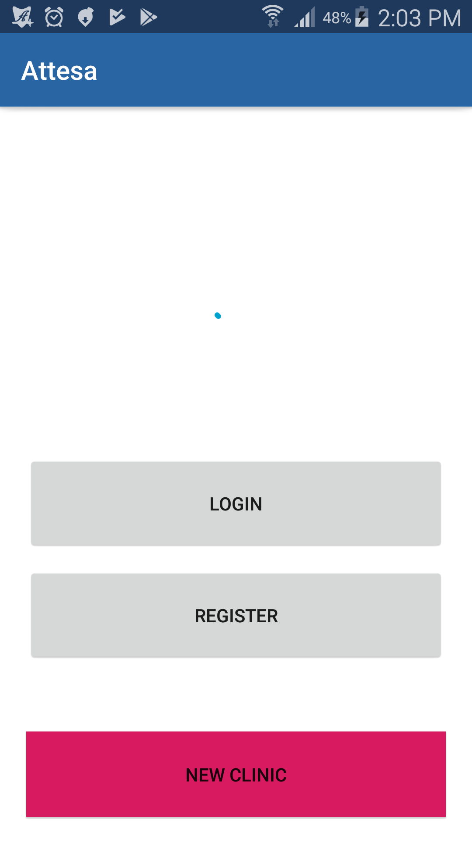
Sample Images
Here are a series of images that show our app in action

Slide 8
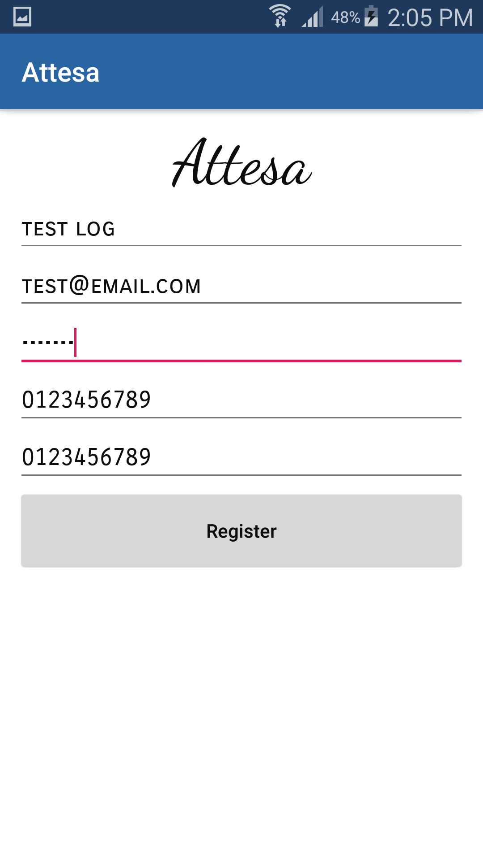
Account Registration Screen

Slide 9
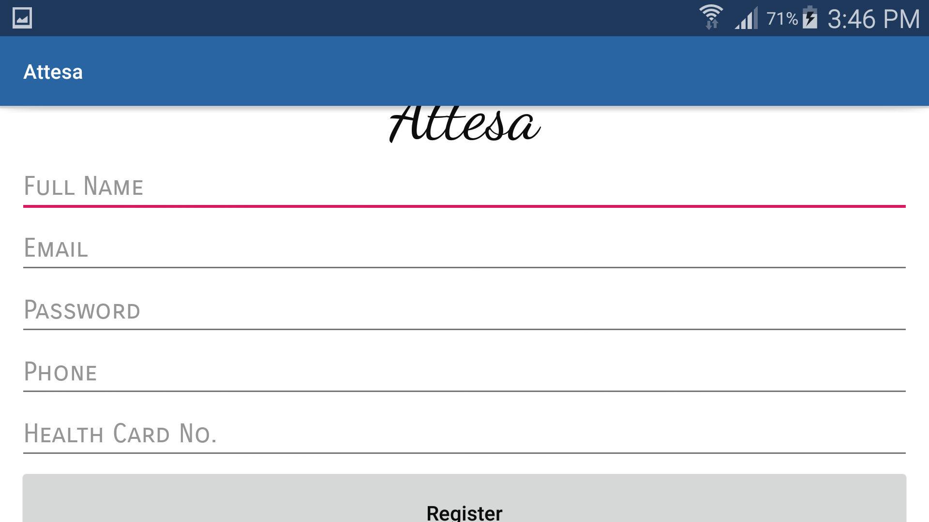

Slide 10
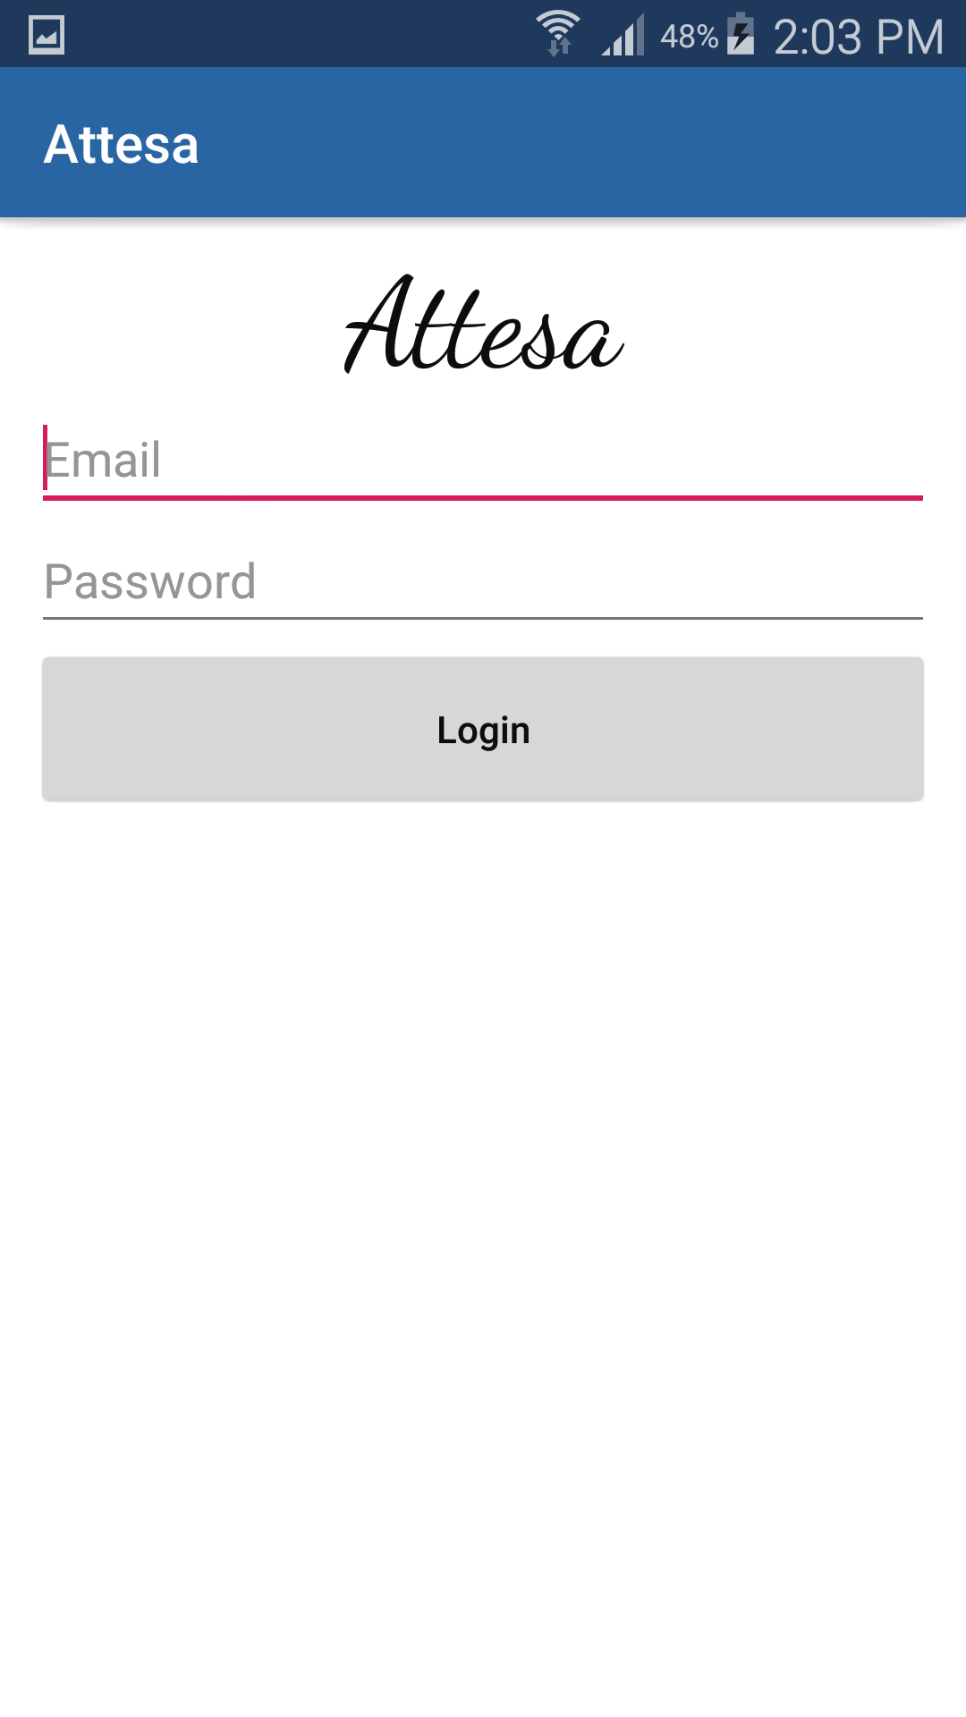

Slide 11
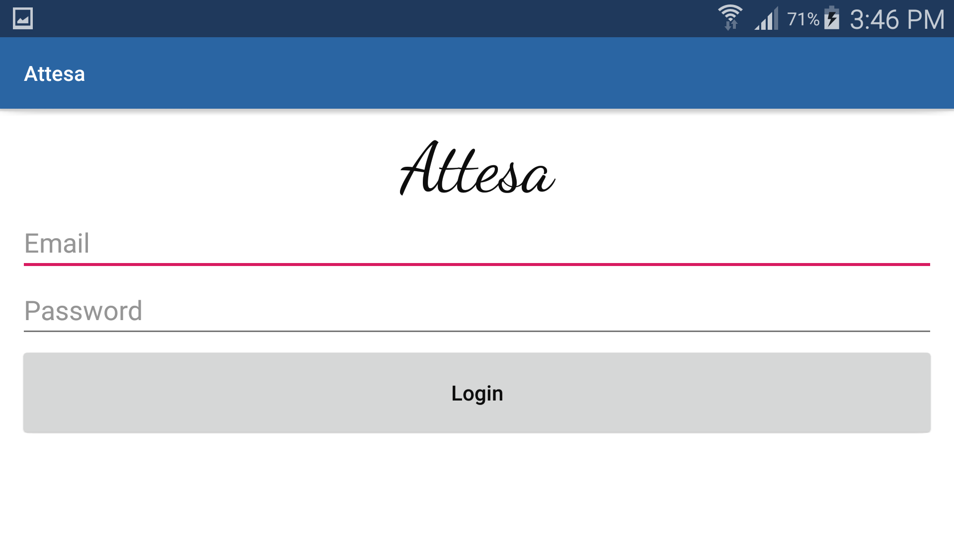

Slide 12
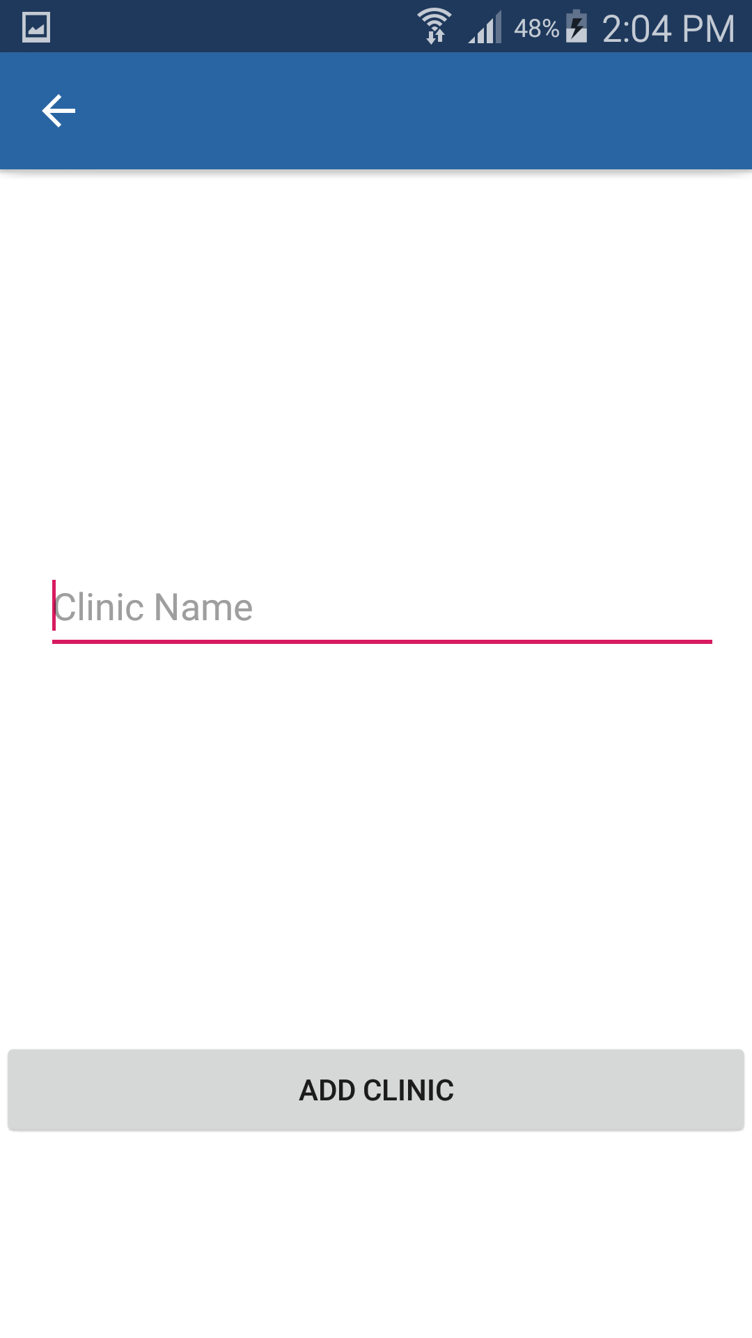

Slide 13
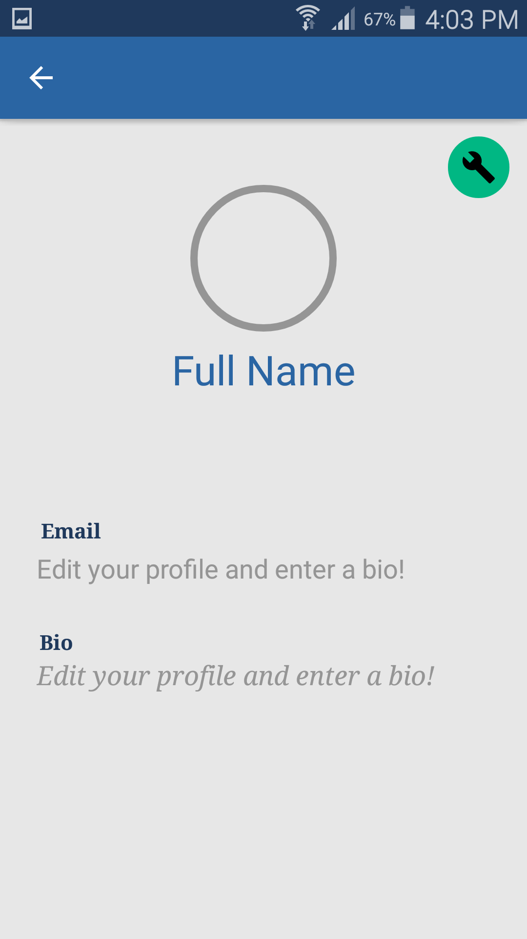

Slide 14
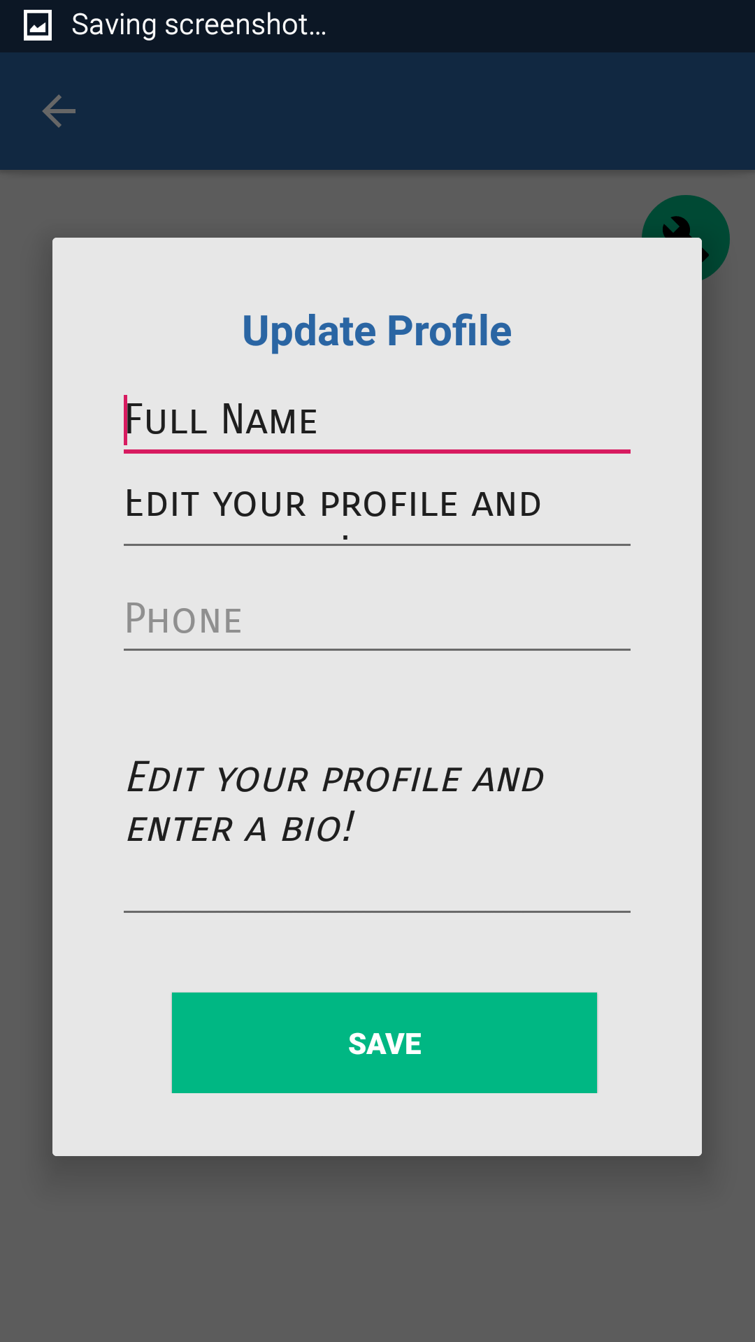

Slide 15
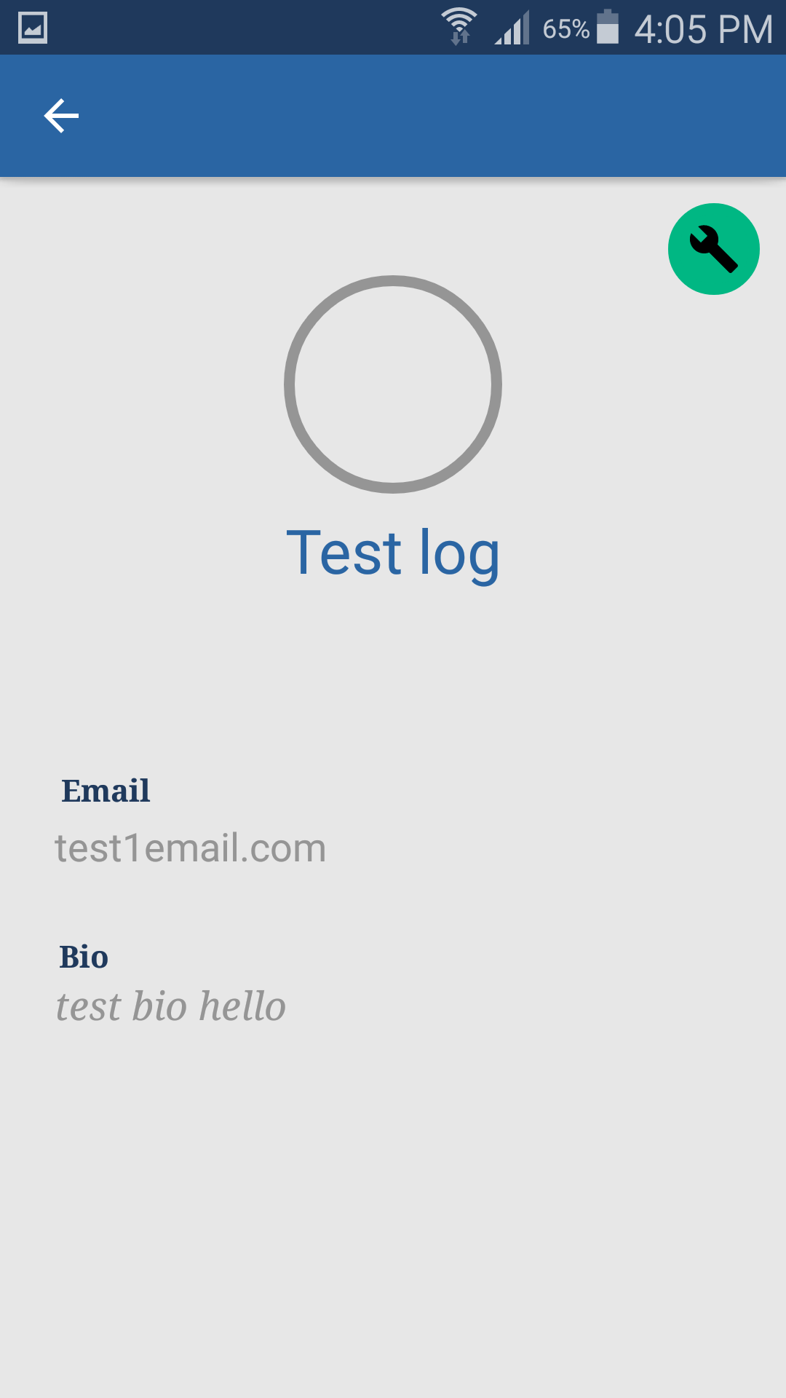

Slide 16
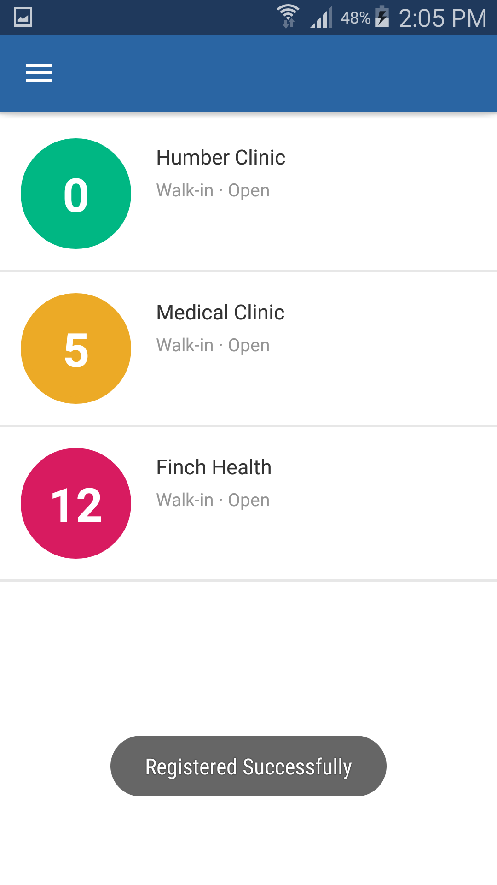

Slide 17
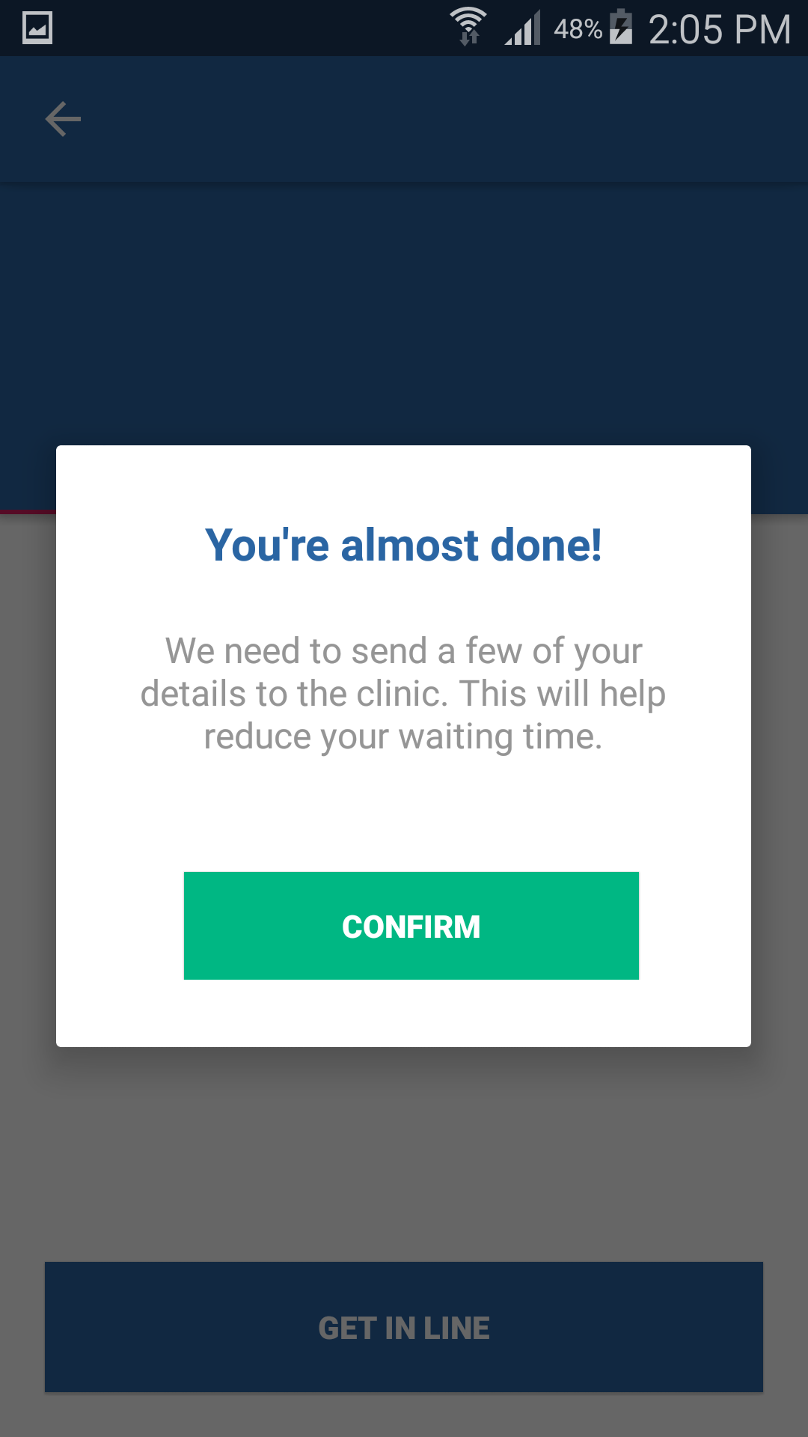

Slide 18
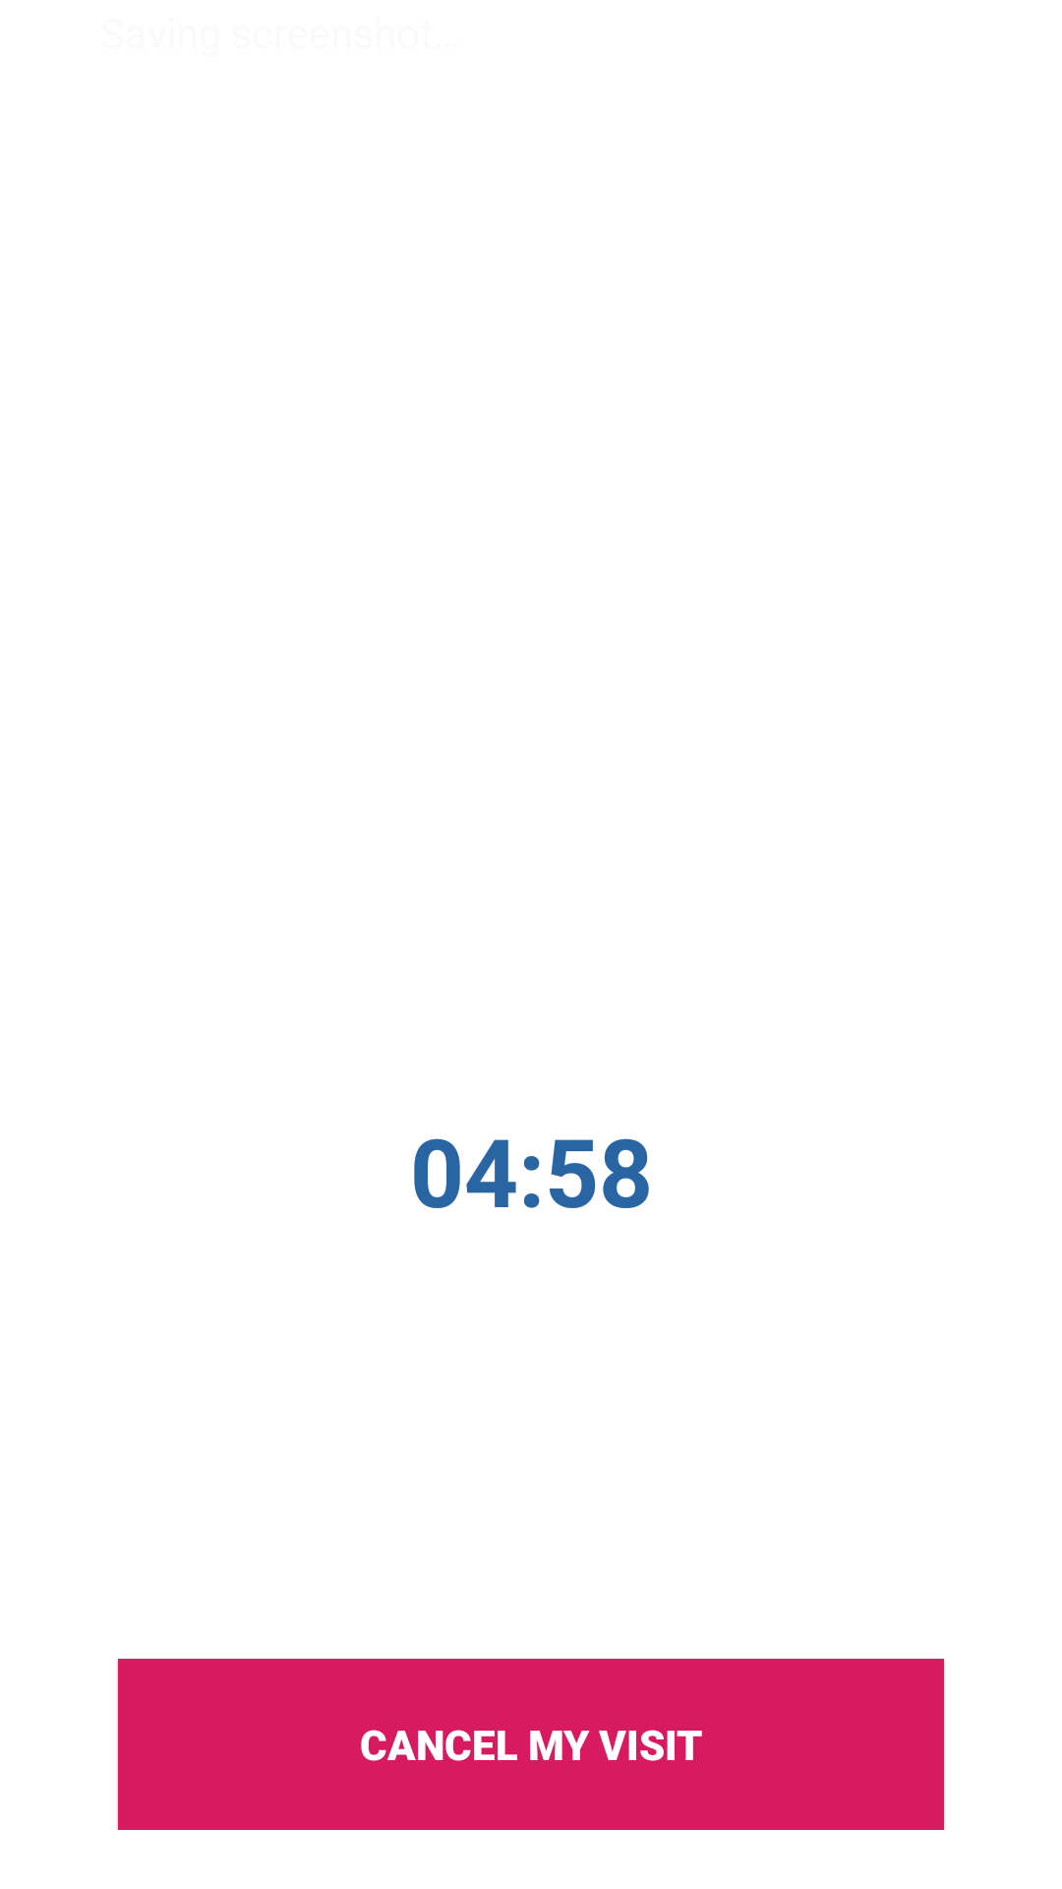

Slide 19
THAnk you for listening

