Slide 1
mySafeUV
(VEML6070 UV Light sensor)
By: Anthony Pacitto

Slide 2
Introduction
The Problem
Natural exposure to UV radiation is the primary factor that causes skin cells to become cancerous in nature. Most common skin non-melanoma skin cancers are caused by too much UV.
Proposal
The development of a portable device that will monitor real-time UV Index readings in order to aid scientists when attempting to monitor subject-to-UV exposure relationships.
Planned Purchases
Raspberry Pi 3 B+, VEML6070 UV Index (0x39) sensor, hardware casing
Planned Solution
The device does NOT produce any noticeable warnings to the subject when high UV exposure s are detected in order to prevent “rigged” data. Instead, the device provides all recorded data to scientists once the device is hardwired to a PC. A mobile application that works in sync with the device will be available for patient use.

Slide 3
Budget
Item | Source | Unit Cost (CAD$) | Qty. | Subtotal (CAD$) | Shipping (CAD$) | Tax (CAD$)
Raspberry Pi 3 B+ | CanaKit | $119.99 | 1 | $119.99 | $0.00 | $0.00
Adafruit VEML6070 UV Index Sensor | Adafruit | $7.70 | 2 | $15.40 | $13.50 | $1.00
3D Acrylic (12x24) | Humber | $0.00 | 1 | $0.00 | $0.00 | $0.00
Total (CAD):
$148.90
* Total for parts from all sources used CAD$1=US$0.77

Slide 4
Schedule

Slide 5
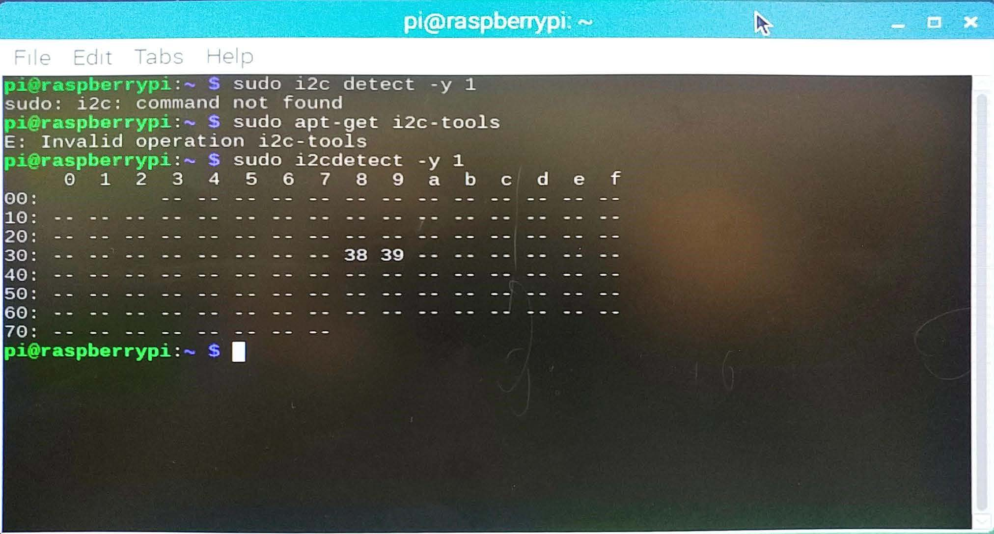
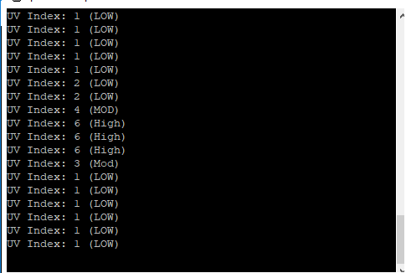
Samples

Slide 6
Course Utilization
Course knowledge utilized via previous courses:
CENG 150: Electronic Circuits
Assisted with basic electrical circuit setup and precautionary measures (e.g. Correct voltages to avoid hardware damage)
Interpretation of sensor datasheets
CENG 153: Programming in C
Fundamentals of standard input/output
Working with files for saving input data
CENG 252: Embedded Systems
Implementation of Raspberry Pi with other sensors
Understanding how various light-based sensors work
How to communicate between hardware using C and JSON

