Slide 1
mySafeUV
(VEML6070 UV Light sensor)
By: Anthony Pacitto

Slide 2
Introduction

Slide 3
Budget

Slide 4
Schedule

Slide 5
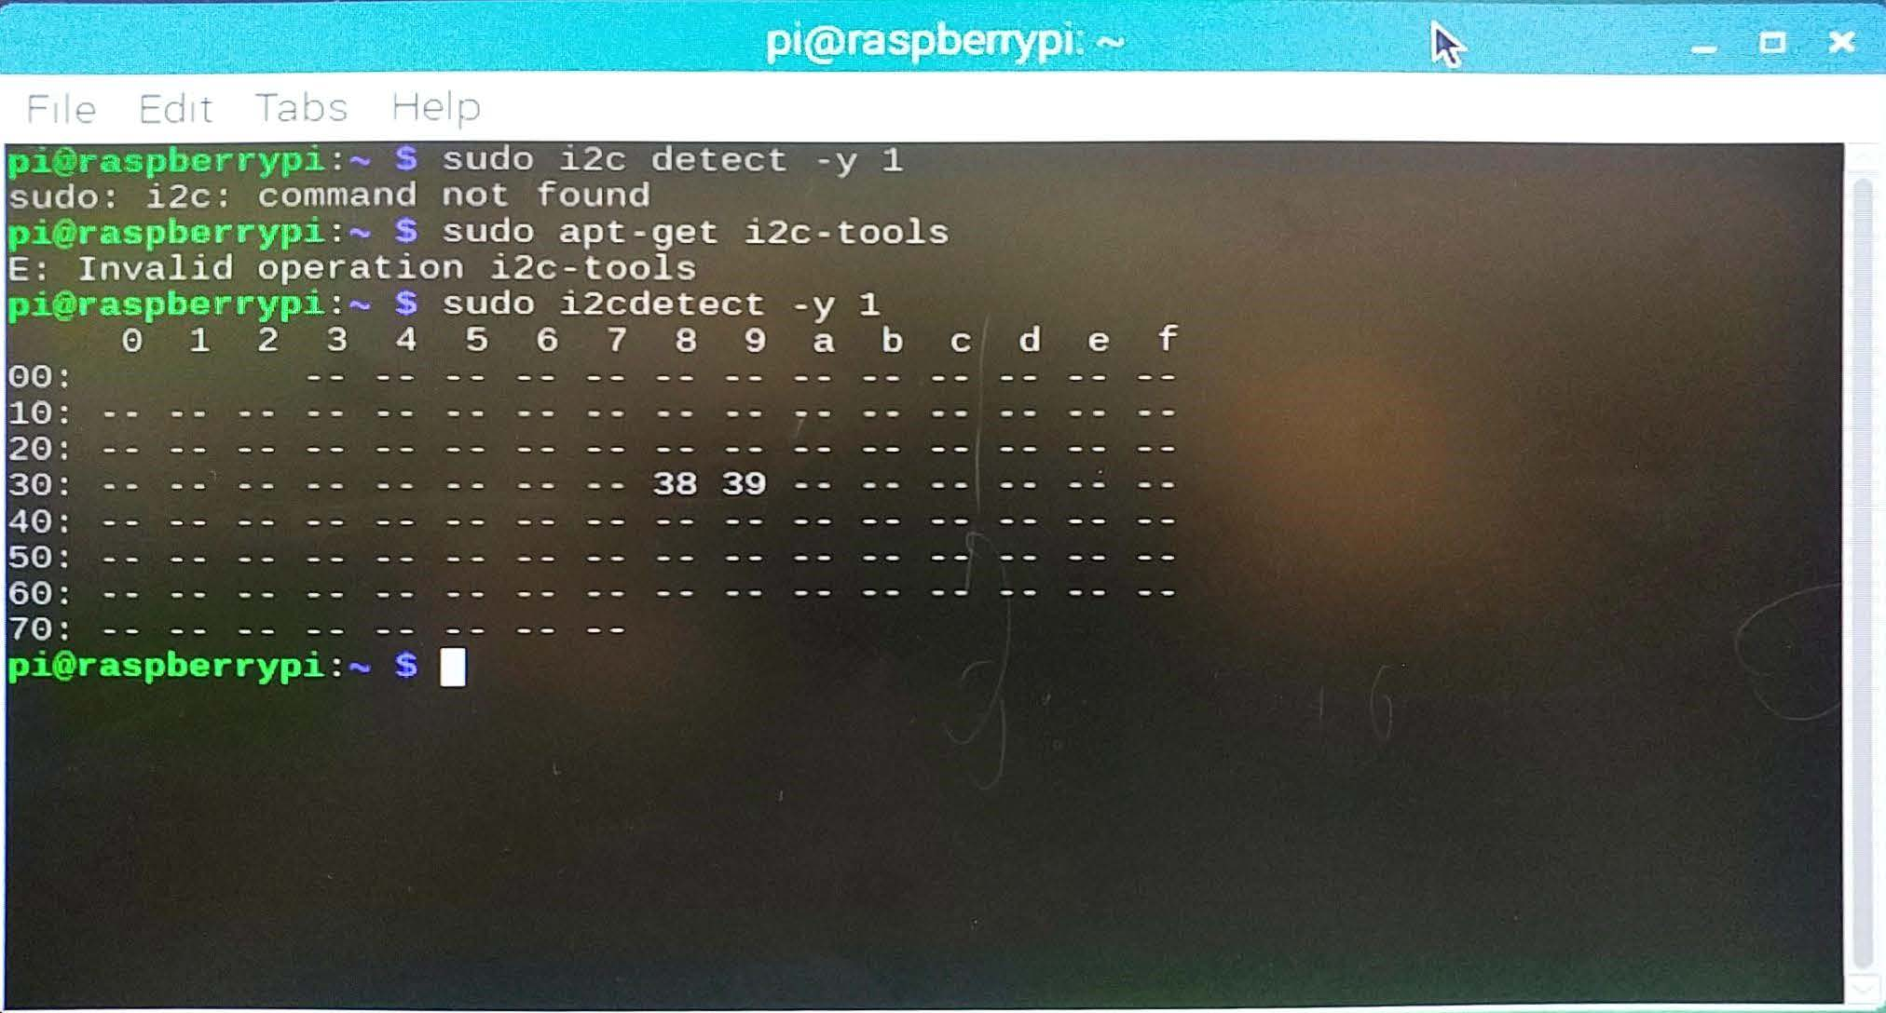
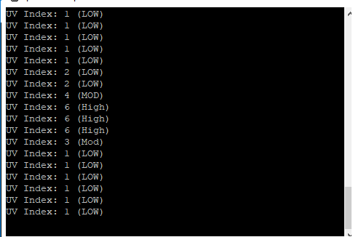
Samples

Slide 6
Course Utilization
Course knowledge utilized via previous courses:
CENG 150: Electronic Circuits
Assisted with basic electrical circuit setup and precautionary measures (e.g. Correct voltages to avoid hardware damage)
Interpretation of sensor datasheets
CENG 153: Programming in C
Fundamentals of standard input/output
Working with files for saving input data
CENG 252: Embedded Systems
Implementation of Raspberry Pi with other sensors
How to communicate between hardware using C and JSON

