Slide 1
mySafeUV
(VEML6070 UV Light sensor)
By: Anthony Pacitto

Slide 2
Introduction
The Problem
Natural exposure to UV radiation is the primary factor that causes skin cells to become cancerous in nature. Most common skin non-melanoma skin cancers are caused by too much UV.
Proposal
The development of a portable device that will monitor real-time UV Index readings in order to aid scientists when attempting to monitor subject-to-UV exposure relationships.
Planned Purchases
Raspberry Pi 3 B+, VEML6070 UV Index (0x39) sensor, hardware casing
Planned Solution
The device will NOT produce any noticeable warning signs (flashing lights, alerts, etc.) to the subject when high UV exposures are detected; reducing the chance of “rigged” data.
The device provides all recorded data to scientists once the device is hardwired to a PC. A mobile application that works in sync with the device will be available for patient use.

Slide 3
Budget
Item | Source | Unit Cost (CAD$) | Qty. | Subtotal (CAD$) | Shipping (CAD$) | Tax (CAD$)
Raspberry Pi 3 B+ | CanaKit | $119.99 | 1 | $119.99 | $0.00 | $0.00
Adafruit VEML6070 UV Index Sensor | Adafruit | $7.70 | 2 | $15.40 | $13.50 | $2.00
3D Acrylic (12x24) | Humber | $0.00 | 1 | $0.00 | $0.00 | $0.00
Total (CAD):
$149.90
* Total for parts from all sources used CAD$1=US$0.77

Slide 4
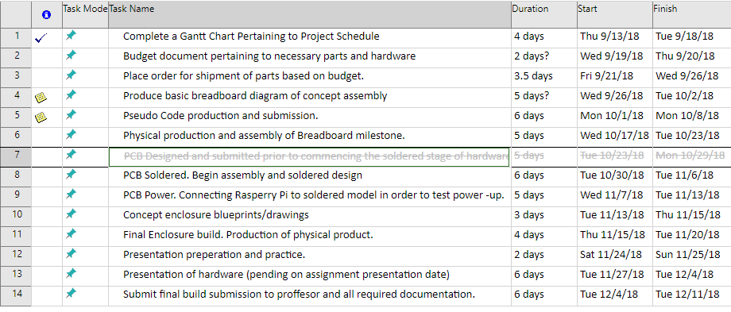
Schedule
Weeks 8 and 9 reversed due to absence (implemented all C and Java source code).
Used up 1 sensor, having me to re-solder on week 12.
Week 12 task pushed to week 13.
* Next semester schedule is pending.

Slide 5
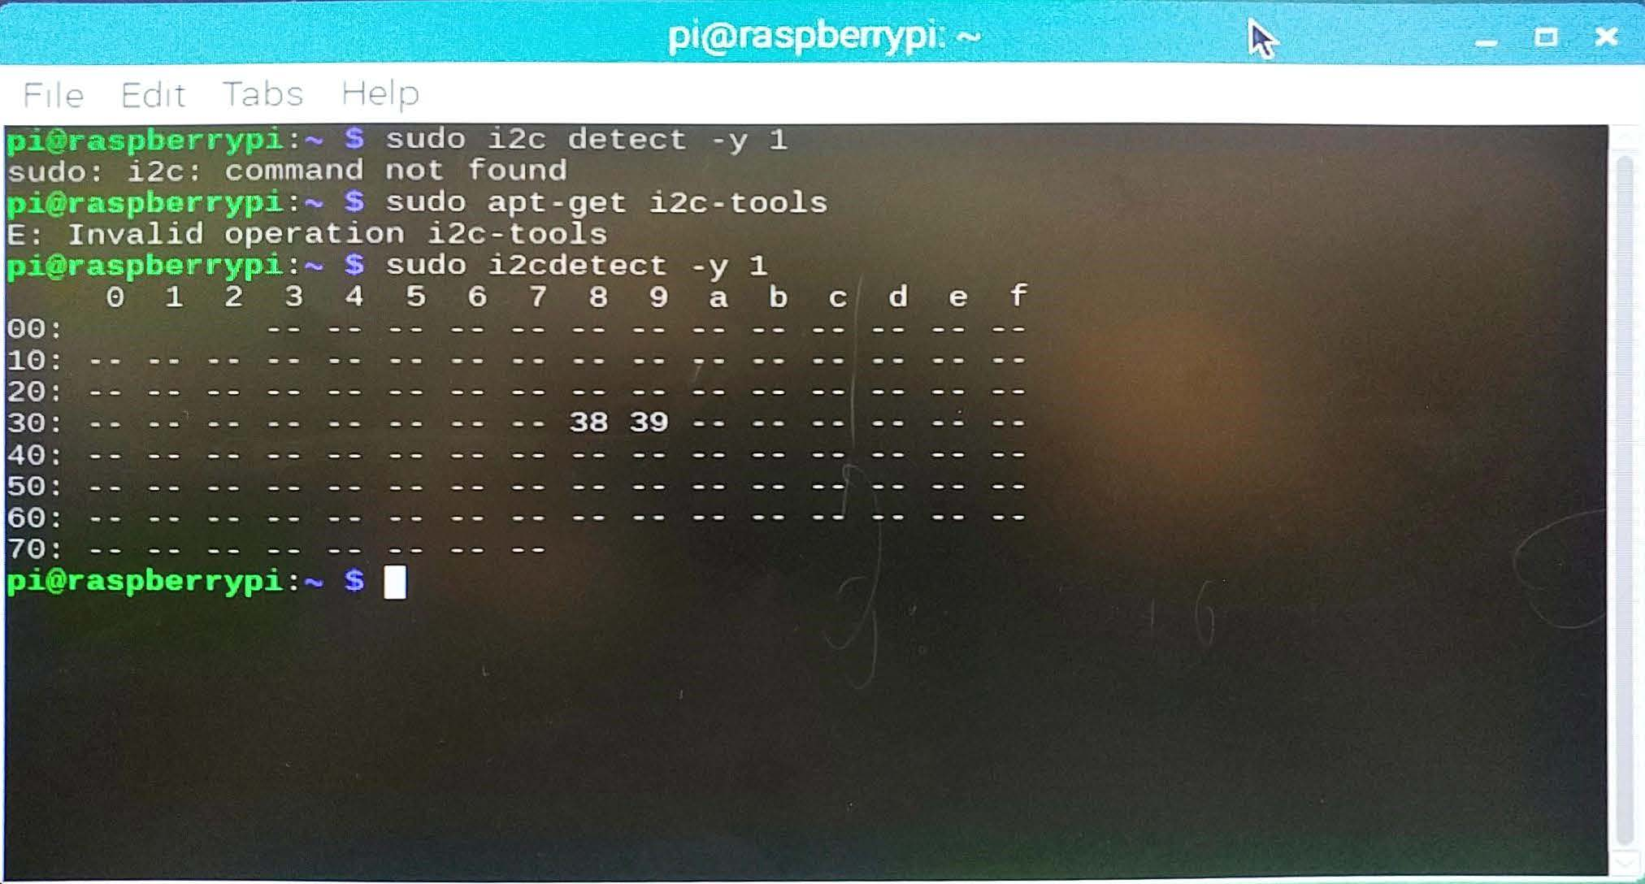
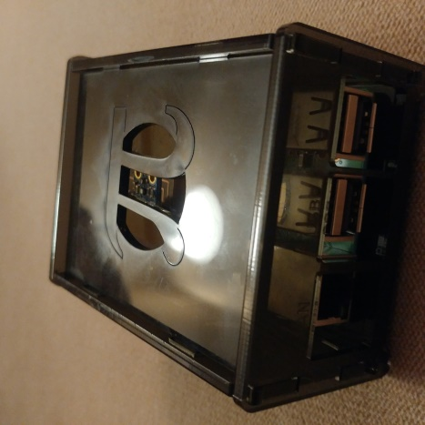
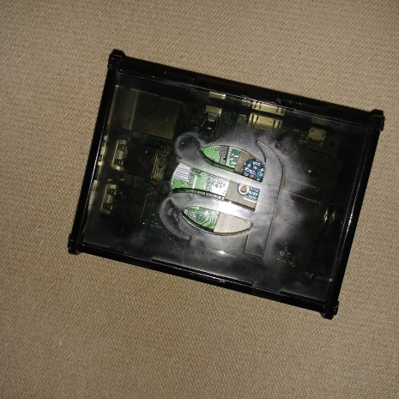
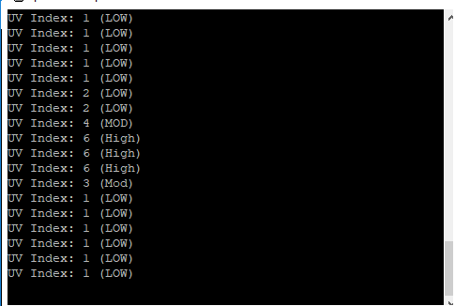
Samples

Slide 6
Course Utilization
Course knowledge utilized via previous courses:
CENG 150: Electronic Circuits
Assisted with basic electrical circuit setup and precautionary measures (e.g. Correct voltages to avoid hardware damage)
Interpretation of sensor datasheets
CENG 153: Programming in C
Fundamentals of standard input/output
Working with files for saving input data
CENG 252: Embedded Systems
Implementation of Raspberry Pi with other sensors
Understanding how various light-based sensors work
How to communicate between hardware using C and JSON

