Slide 1
WEB 335
Week 1 – Database Technologies

Slide 2
Agenda
Data Models
One-to-Many Relationships
Many-to-Many Relationships
One-to-One Relationships
NoSQL Data Structure
ORD to Business Rules Translation

Slide 3
Data Models
Relational databases have been a successful technology for over twenty years, providing persistence, concurrency control, and an integration mechanism (Fowler & Sadalage, 2012)
Data persistence, as the name suggests, is the process of “persisting” data to some physical location.
The popularity of relational databases derives from its ability to “make-sense” of complex data structures. Data is categorized into tables, columns, and rows. Tables represent the entities (think JavaScript classes), columns represent the Meta data (think JavaScript properties), and rows are the raw data elements (think values).

Slide 4
Data Models
There are three types of relationships in a relational database system, One-to-Many, Many-to-Many, and One-to-One. Business rules are brief, precise, and unambiguous descriptions of a policy, procedure, or principle within an organization.
Diagrams are used to graphically illustrate these business rules and their associated relationships.

Slide 5
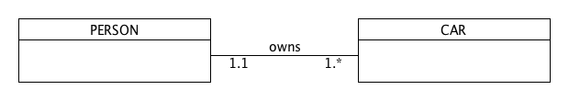
One-to-Many Relationships
Business Rule:
a PERSON can own many CARs
ORD:

Slide 6
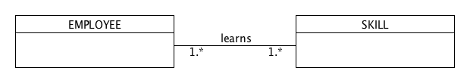
Many-to-Many Relationships
Business Rule:
an EMPLOYEE can learn many SKILLs
ORD:

Slide 7
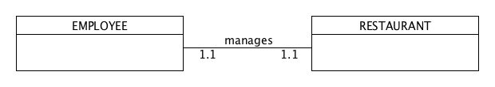
One-to-One Relationship
Business Rule:
an EMPLOYEE manages one RESTAURANT
ORD:

Slide 8
NoSQL Data Structure
There is a movement away from using databases as integration points towards encapsulating databases within applications and integrating through services (Fowler & Sadalage, 2012).
This gravitation has resulted in the adoption and evolution of NoSQL database structures.
Web communications and transmissions are unstructured data components that require a mechanism for dealing with their complexities.
NoSQL technologies bridge this gap by not forcing developers into specific paradigms, rather allowing them to keep the data generic and language agnostic.

Slide 9
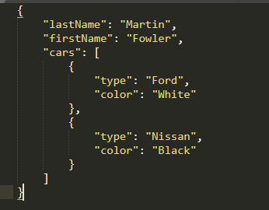
NoSQL Data Structure
In a NoSQL world, one-to-many relationships are represented as embedded arrays.
Business Rule: a PERSON can own many CARs

Slide 10
ORD to Business Rules Translation
Business Rule: a PERSON has many DEPENDENT

Slide 11
ORD to Business Rules Translation
Business Rule: a STORE has many PRODUCT

