Slide 1

Waste Segregation
Swadheenta ( Hack Infinity 2.0)
Team: One Last Time

Slide 2
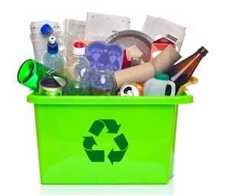
Problem Statement
A smart system which uses Deep Learning (CNN ) to segregate paper and plastic waste.

Slide 3
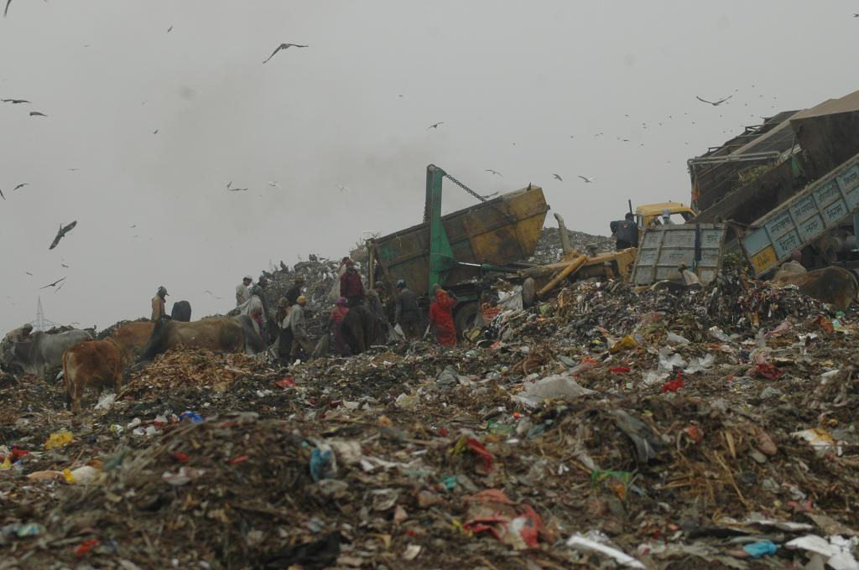
Motivation
Pollution
Not enough recycling
Waste of money and resources
Harmful effect on people living near the dumping yards
Climate Change
https://www.downtoearth.org.in/blog/waste/india-s-challenges-in-waste-management-56753

Slide 4
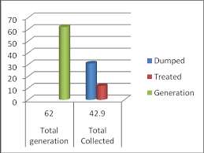
Current Scenario Of Waste Management in India
India generates 62 million tonnes of solid waste each year, of this about 43 million tonnes (70%) is collected and 11.9 million tonnes (20%) is treated. About 31 million tonnes (50%) is dumped in landfill sites. ^{[1]}
[1] “Government notifies new solid waste management rules". www.downtoearth.org.in. Retrieved 26 March 2019.
Notes:
adasdasj

Slide 5
Target Places
Office campus
Colleges
Movie Theatres
Malls.

Slide 6
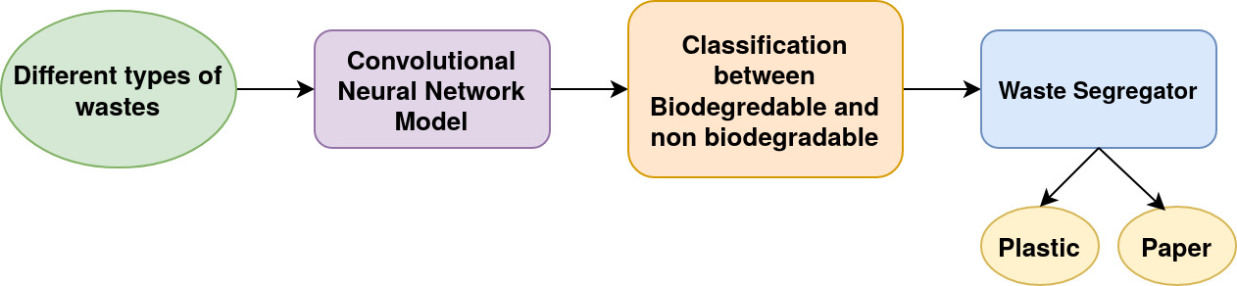
System Workflow

Slide 7
Components
Arduino Uno Board - Manages the action based on produced CNN output
Servo Motor - Rotate the plank
IR sensor - To detect weather dustbin is full or not
Camera - To capture photo of waste

Slide 8
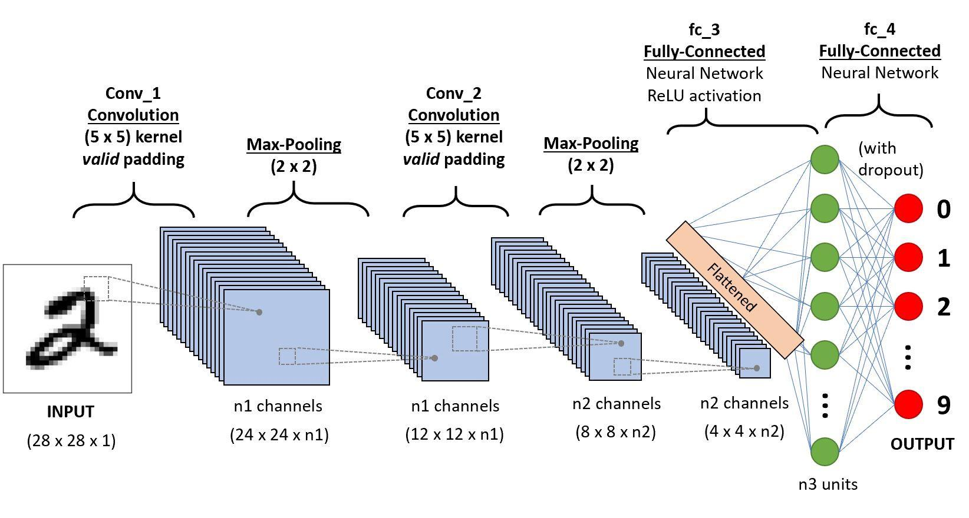
Working Principle

Slide 9
Libraries and Modules used
For Deep learning, we have used Keras (with backend Tensorflow)
Flask and python to communicate between Arduino Uno and local machine
An Android app for capturing garbage photo

Slide 10
Future Add-ons
With use of Raspberry-pi module and a simple camera we can avoid using phone and make more feasible product
Reward based system
Dustbin complaint service, by which user can register a complaint against any smart dustbin when he/she is near it.

Slide 11
References
Waste Management Initiatives in India for Human Well Being: http://home.iitk.ac.in/~anubha/H16.pdf
Waste management in India: https://en.wikipedia.org/wiki/Waste_management_in_India

Slide 12
Thank You !

