Slide 1
The Internationally Changing Trend of Netflix
Chaewon Park, Jimin Jeon
CDS 301-K01

Slide 2
Contents
Visualizations
Remaining Challenges
Further Suggestions

Slide 3
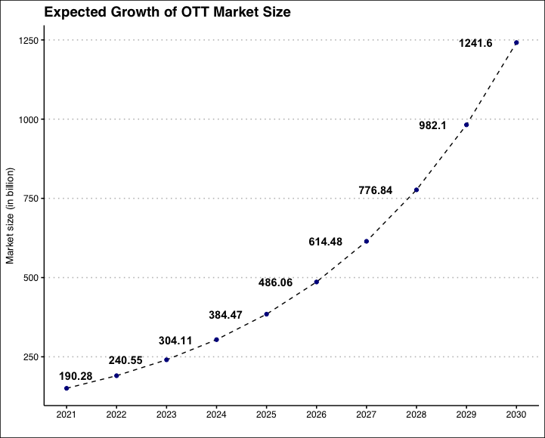
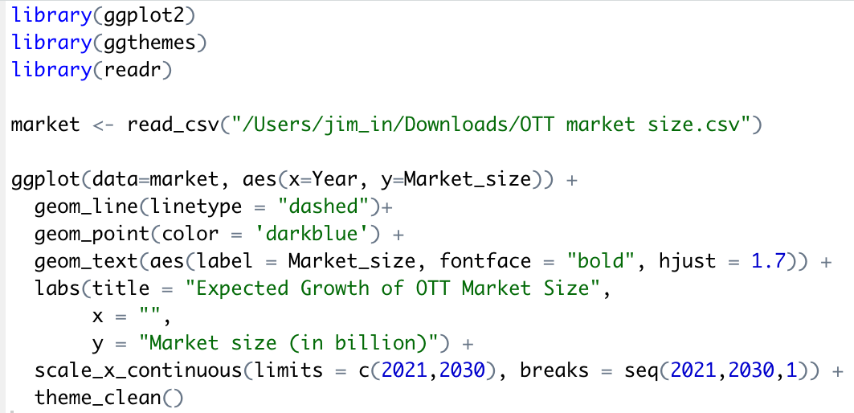
Visualization 1 - Expected OTT Market Size

Slide 4
Main Reasons for Growth of OTT Market Size
Various kinds of contents with proper price
Can enjoy regardless of place and time

Slide 5
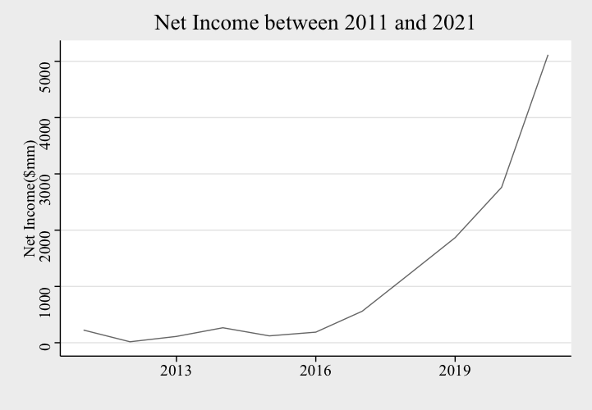
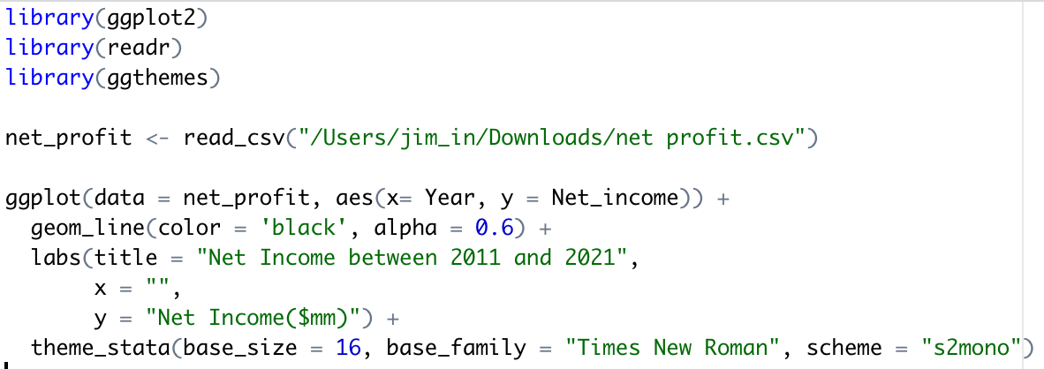
Visualization 2 - Net Income

Slide 6
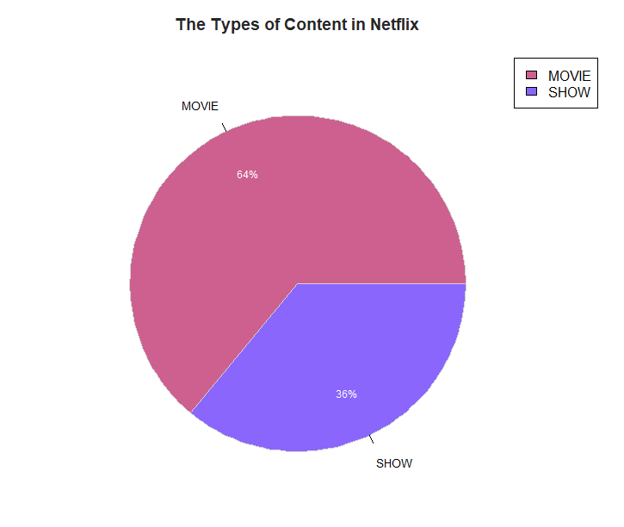
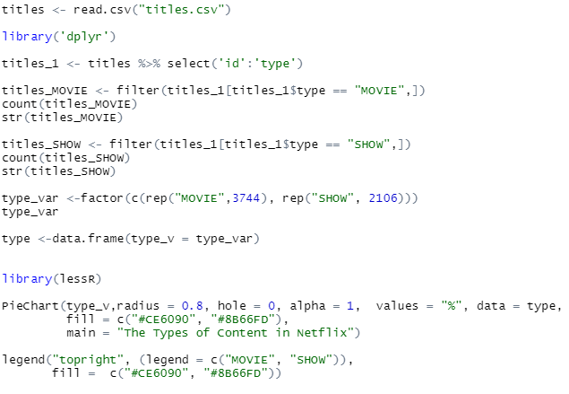
Visualization 3 - Types of Content

Slide 7
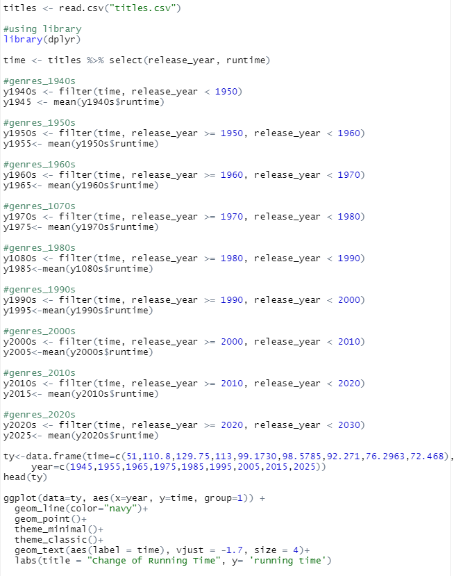
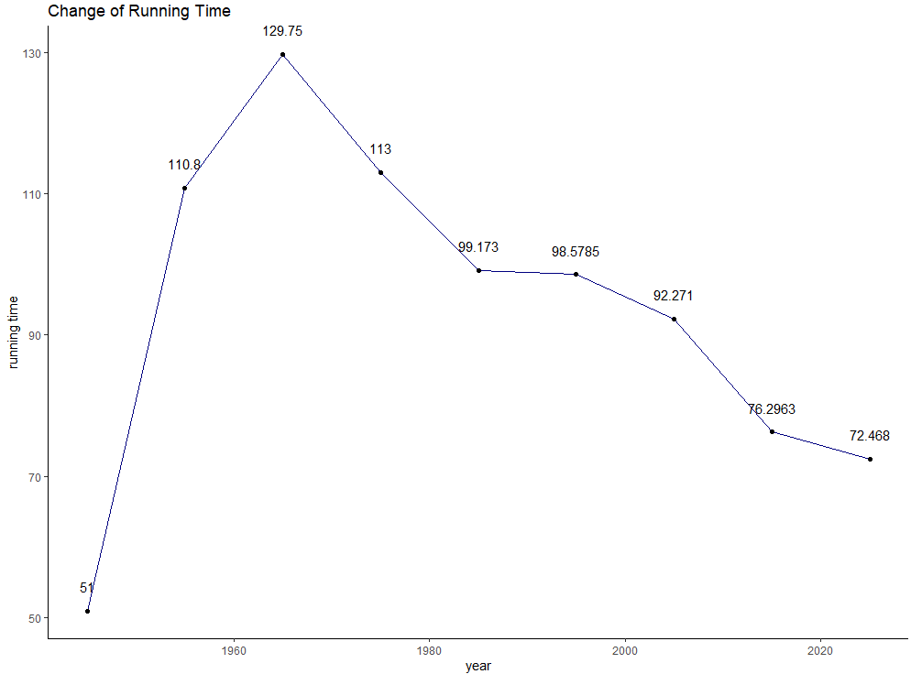
Visualization 4 - Running Time Trend

Slide 8
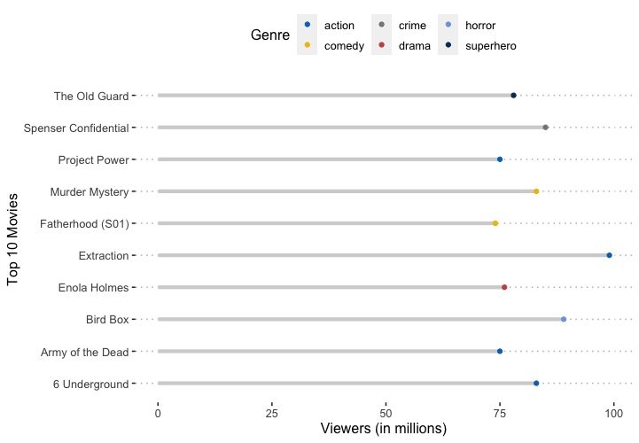
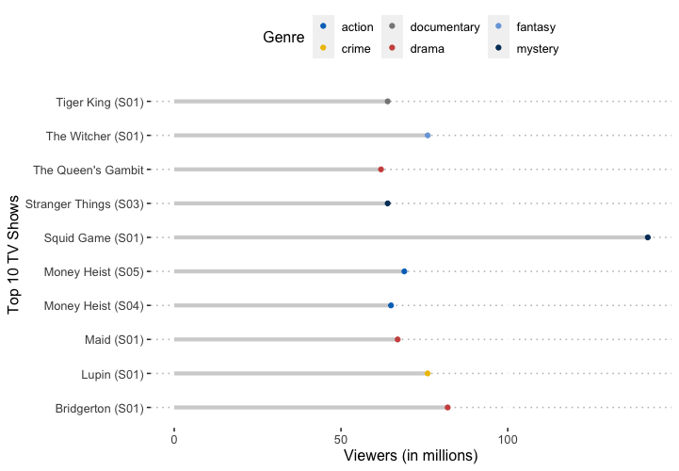
Visualization 5 - Top 10 Most Viewed Movies/TV Shows
Top 10 most viewed movies
Top 10 most viewed TV shows

Slide 9
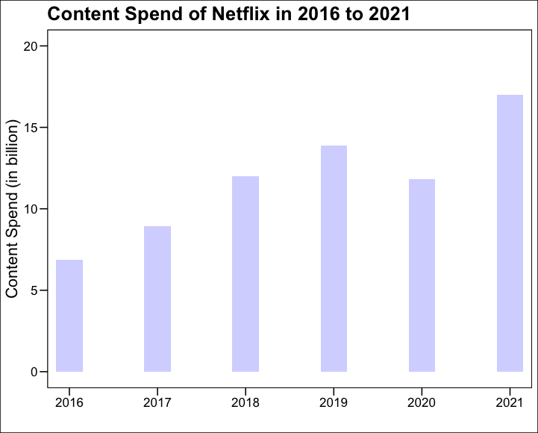
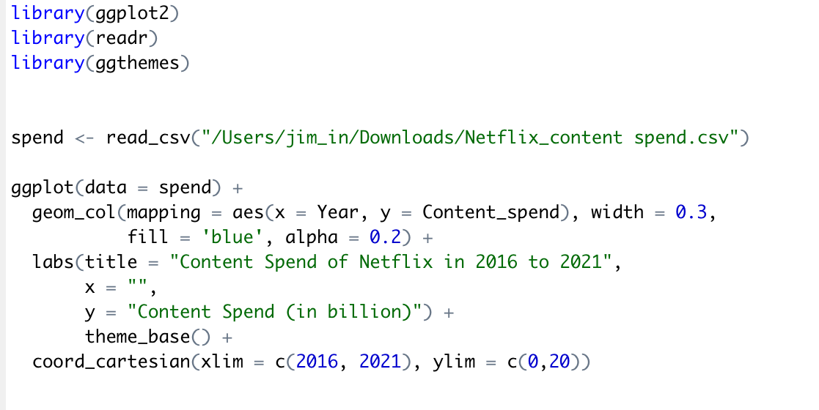
Visualization 6 - Content Spend

Slide 10
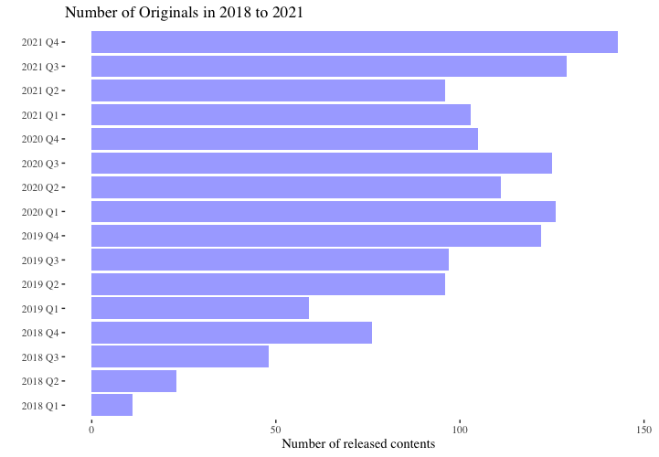
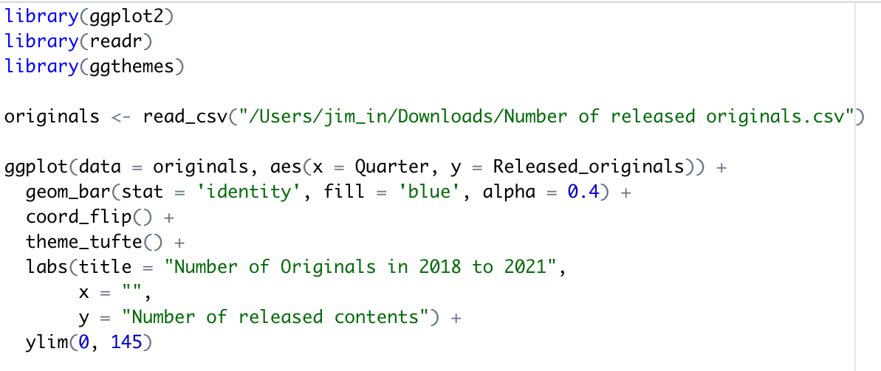
Visualization 7 - Number of Released Original Content

Slide 11
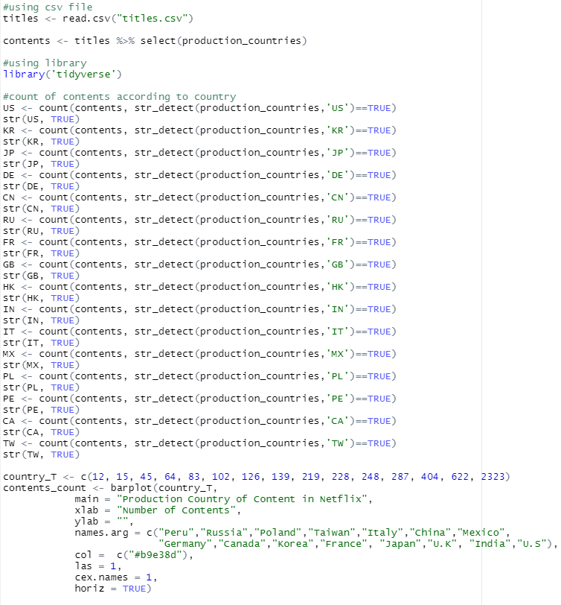
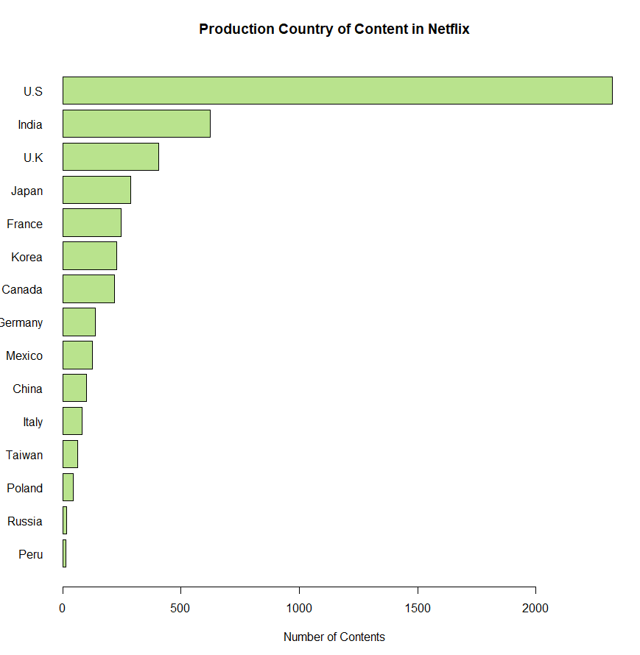
Visualization 8 - Production Country of Content

Slide 12
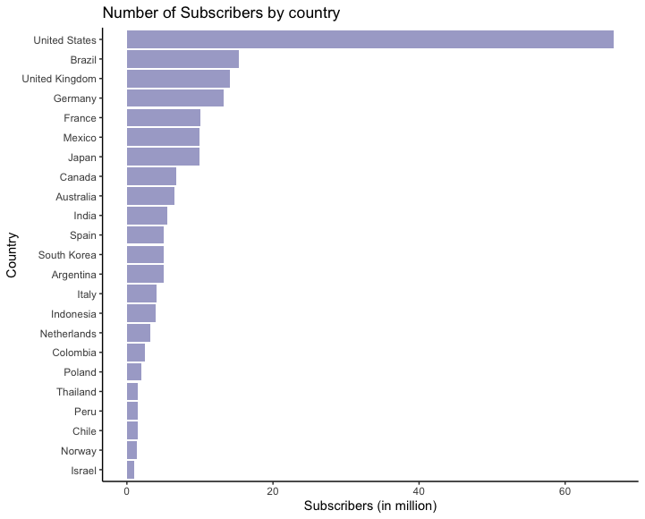
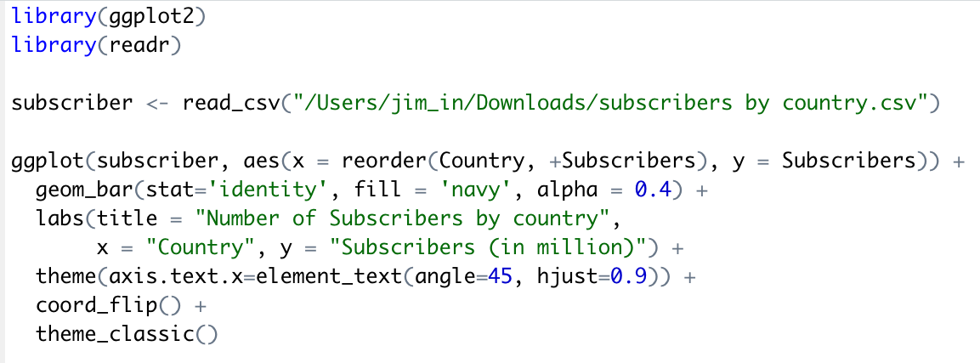
Visualization 9 - Number of Subscribers by Country

Slide 13
Remaining Challenges
In second quarter of 2022, Netflix lost 970,000 subscribers
Losing $6 billion due to sharing passwords
Low Quality of Contents
Too many streaming services
: Disney+, Apple TV+, etc.

Slide 14
Further Suggestions
More focus on quality than popularity of cast
Have an interest in the minor genre
Maintain a fixed subscriber

Slide 15
Thank you

