Slide 1
ASRRL: Adaptive Symbolic Reasoning and Reinforcement Learning for Dynamic Network Traffic Classification
A Verifiable IDS Framework with Z3 Formal Verification, Q-Learning Safety Shielding, and DBSCAN Novel Pattern Detection
3 Benchmark Datasets | 9-Stage Pipeline (Stage 0–8) | Parallel Processing | IEEE Format
Notes:
ASRRL — Adaptive Symbolic Reasoning and Reinforcement Learning for Dynamic Network Traffic Classification
This presentation details the complete methodology of the ASRRL Intrusion Detection System (IDS) framework. ASRRL combines multiple ML and formal methods techniques into a 9-stage pipeline (Stages 0–8) for network traffic classification.
KEY CONTRIBUTIONS:
1. PCAP Binary Preprocessing (Stage 0): Raw binary PCAP packet captures are converted to flow-level features using CICFlowMeter/Argus, establishing the bridge between raw network data and the ML pipeline.
2. Symbolic Reasoning via Z3 SMT Solver: Decision tree paths are converted into formal logic constraints using Microsoft Research's Z3 theorem prover, providing mathematically provable safety guarantees.
3. Reinforcement Learning with Safety Shielding: A tabular Q-learning agent learns optimal classification policies, but every proposed action is verified against Z3 constraints before execution.
4. Dynamic Adaptation: Adaptive buffer sizing (10-200 flows) and dynamic threshold adaptation (0.40-0.70) handle concept drift at runtime.
5. Novel Pattern Detection: DBSCAN clustering discovers zero-day attack patterns and incorporates them as new Z3 constraints.
6. Parallel Processing: Pipeline stages with independent data paths are parallelized for throughput — PCAP processing, Z3 extraction, and final classification are embarrassingly parallel.
DATASETS: UNSW-NB15, CSE-CIC-IDS-2018, CIC-IDS2017.

Slide 2
ASRRL Architecture — 9-Stage Pipeline with Parallel Processing
0. PCAP Binary Preprocessing
1. Feature Extract & Normalization
2. Decision Tree Symbolic Model
3. Z3 Constraint Extraction
4. Q-Learning RL Safety Shielding
5. DBSCAN Novel Pattern Detection
6. Adaptive Buffer Management
7. Dynamic Threshold Adaptation
8. Final Classification Decision
⚡ Parallel Processing Stages: Stage 0 (per-PCAP) | Stage 3 (per-leaf path) | Stage 8 (per-flow) | Cross-dataset (all 3 datasets independently)
Three Primary Datasets: UNSW-NB15 (2.5M flows, 9 attacks) | CSE-CIC-IDS-2018 (16M flows, 7 attacks) | CIC-IDS2017 (3.1M flows, 14 attacks)
Data Transformation Summary (per flow x_i):
Stage 0: Binary PCAP packets → CICFlowMeter/Argus → 5-tuple flow aggregation → CSV (49–80+ columns per flow)
Stage 1: Raw columns (dur, rate, sbytes, ...) → x_i = [flow_duration, pkt_rate, byte_rate, traffic_pat_var*, port_cat, size_cat, protocol] ∈ R^7
Stage 2: X_norm ∈ R^(n×7) → DecisionTree(max_depth=6) → leaf_id(x_i), P(attack|x_i), ŷ_DT(x_i) ∈ {0,1}
Stage 3: DT paths (root → leaf) → Z3 Implies(∧ (f_j op θ_j), action=class) → constraint set C = {φ_1,...,φ_L} [⚡ parallel per leaf]
Stage 4: state s_i = leaf_id(x_i) → Q(s,a) → a_i* = argmax Q(s_i,a) subject to Z3 verify(x_i, a_i*) = sat
Stage 5: misclassified {x_i : â_i ≠ a_i*} → DBSCAN(ε=1.5, minPts=5) → novel centroids → C' = C ∪ C_novel
Stage 6: σ_tpv, σ²_bytes of window W_t → |B_{t+1}| = clip(|B_t| ± Δ, 10, 200)
Stage 7: EMA(FPR_t, FNR_t) → τ_{t+1} = clip(τ_t ± 0.005, 0.40, 0.70)
Stage 8: p_i ≥ τ → ATTACK; p_i ≤ 1-τ → BENIGN; else → RL+Z3 shield → ŷ_i ∈ {0,1} [⚡ parallel per flow]
Notes:
SLIDE 2 — ASRRL Architecture: 9-Stage Pipeline with Parallel Processing
This slide presents the complete 9-stage pipeline (Stage 0 through Stage 8). The key addition from the previous version is Stage 0 (PCAP Binary Preprocessing), which addresses how raw binary network captures are converted into the flow-level tabular data that the ML pipeline consumes.
STAGE 0 — PCAP PREPROCESSING:
Real network traffic is captured as binary PCAP (Packet CAPture) files containing raw packet headers and payloads. Before any ML processing:
1. Packets are reassembled into TCP streams
2. Flows are aggregated by 5-tuple (src_ip, dst_ip, src_port, dst_port, protocol)
3. Timeout-based flow termination applies (active ~120s, idle ~60s)
4. CICFlowMeter (for CIC datasets) or Argus (for UNSW-NB15) computes 49–80+ statistical features per flow
5. Output: CSV files with one row per flow
PARALLEL PROCESSING POINTS:
The pipeline is NOT fully sequential — several stages support parallel execution:
- Stage 0: Each PCAP file processed independently → embarrassingly parallel
- Stage 3: Each leaf path extracted and verified independently → parallel per leaf
- Stage 8: Each flow classified independently → embarrassingly parallel per flow
- Cross-dataset: All 3 datasets processed through independent pipeline instances
SEQUENTIAL BOTTLENECKS:
- Stage 2 (DT training): CART splits are computed greedily → inherently sequential
- Stage 4 (Q-learning): Episodes update shared Q-table → sequential within episodes
- Stage 5 (DBSCAN): Core algorithm uses sequential neighborhood queries
- Stages 6-7 (Buffer/Threshold): Temporal dependency on previous window state

Slide 3
Three Benchmark Datasets — Raw Features & Standardized Extraction
UNSW-NB15 (2015, UNSW Canberra)
CSE-CIC-IDS-2018 (2018, CIC/UNB)
CIC-IDS2017 (2017, CIC/UNB)
Raw Columns (49 features):
dur, rate, sbytes, dbytes, spkts, dpkts,
ct_srv_src, sttl, sjit, dsport, proto, ...
PCAP Source: IXIA PerfectStorm tool
Flow Tool: Argus + Bro-IDS
Feature Extraction:
flow_duration = dur × 1000 (sec → ms)
pkt_rate = rate (or (spkts+dpkts)/dur)
byte_rate = sbytes + dbytes
traffic_pat_var* = normalize(ct_srv_src, [0,1])
port_cat = bin(dsport, [80,443,1K,5K,10K,65K])
size_cat = bin(byte_rate, [100,1K,10K,∞])
protocol = {tcp:0, udp:1, icmp:2}
Attack Types (9): Generic, Exploits, Fuzzers,
DoS, Recon, Analysis, Backdoor, Shellcode, Worms
Attack Ratio: ~30%
Raw Columns (80+ CICFlowMeter features):
Flow Duration, Flow Packets/s,
Flow Bytes/s, Fwd IAT Std,
Dst Port, Protocol, Label, ...
PCAP Source: AWS infrastructure (10 days)
Flow Tool: CICFlowMeter
Feature Extraction:
flow_duration = Flow Duration / 1000 (μs → ms)
pkt_rate = Flow Packets/s
byte_rate = Flow Bytes/s
traffic_pat_var* = quantile_norm(Fwd IAT Std)
port_cat = bin(Dst Port, [80,443,1K,5K,10K,65K])
size_cat = bin(bytes×dur, [100,1K,10K,∞])
protocol = {6→TCP:0, 17→UDP:1, 1→ICMP:2}
Attack Types (7): DoS, DDoS, BruteForce,
Infiltration, BotNet, WebAttack, SQL Injection
Attack Ratio: ~15%
Raw Columns (80+ CICFlowMeter features):
Flow Duration, Flow Pkts/s,
Flow Byts/s, Flow IAT Std,
Destination Port, Protocol, Label, ...
PCAP Source: CIC lab network (5 days)
Flow Tool: CICFlowMeter
Feature Extraction (same as CSE-CIC):
flow_duration = Flow Duration / 1000 (μs → ms)
pkt_rate = Flow Packets/s
byte_rate = Flow Bytes/s
traffic_pat_var* = quantile_norm(Fwd IAT Std)
port_cat = bin(Dst Port, [80,443,1K,5K,10K,65K])
size_cat = bin(bytes×dur, [100,1K,10K,∞])
protocol = {6→TCP:0, 17→UDP:1, 1→ICMP:2}
Attack Types (14): DoS, PortScan, DDoS,
BruteForce, WebAttack, Infiltration,
Heartbleed, Botnet, SSH-Patator, ...
Attack Ratio: ~20%
*traffic_pat_var is a traffic pattern variability proxy (NOT Shannon entropy): UNSW uses ct_srv_src (connection diversity); CIC datasets use Fwd IAT Std (timing variability), both normalized to [0,1].
All 3 datasets → Standardized schema: x_i = [flow_duration, pkt_rate, byte_rate, traffic_pat_var*, port_cat, size_cat, protocol], y_i ∈ {0,1}
Notes:
SLIDE 3 — Three Benchmark Datasets: Raw Features & Standardized Extraction
This slide now includes PCAP source information and flow extraction tools for each dataset.
UNSW-NB15: PCAP captured by IXIA PerfectStorm tool at UNSW Canberra. Flows extracted by Argus and Bro-IDS network monitors. The raw PCAP binary data was processed into 49-column CSV format by the dataset creators.
CSE-CIC-IDS-2018: PCAP captured over 10 days on AWS infrastructure simulating enterprise network. CICFlowMeter processed the binary PCAPs into 80+ flow-level features using 5-tuple aggregation with configurable timeouts.
CIC-IDS2017: PCAP captured over 5 days at CIC lab network. Same CICFlowMeter tool processed the binary captures into the same 80+ feature format.
KEY POINT FOR ADVISOR: All three benchmark datasets ship as pre-extracted CSVs. The PCAP → flow conversion was performed by the dataset creators using established tools (CICFlowMeter, Argus). Our Stage 0 documents this preprocessing step and shows it as part of the complete pipeline.

Slide 4
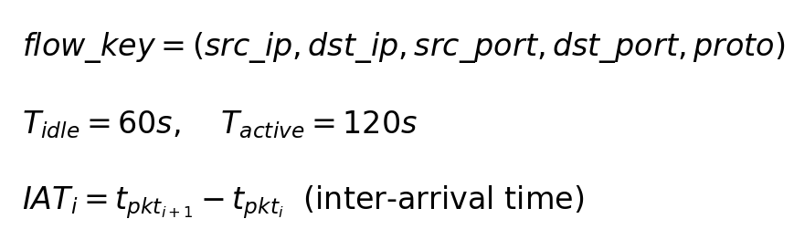
Stage 0: PCAP Binary Preprocessing & Flow Aggregation [⚡ Parallelizable]
Algorithm 1: PCAP Binary Preprocessing & Flow Aggregation
Require: Raw binary PCAP file(s) P = {p_1, ..., p_N}
Ensure: Flow-level CSV with F features per flow (F=49 for UNSW, F=80+ for CIC)
1: for each PCAP file p_k ∈ P do // ⚡ parallelizable per file
2: for each raw packet pkt ∈ p_k do
3: Parse binary headers: Ethernet → IP → TCP/UDP/ICMP
4: Extract 5-tuple: key ← (src_ip, dst_ip, src_port, dst_port, proto)
5: if key ∈ active_flows then
6: active_flows[key].append(pkt) // add to existing flow
7: else
8: active_flows[key] ← new_flow(pkt) // start new flow
9: end if
10: end for
11: for each flow f ∈ active_flows do
12: if idle_time(f) > T_idle or active_time(f) > T_active then
13: Terminate flow and compute statistical features:
14: duration, pkt_count, byte_count, pkt_rate, byte_rate,
15: fwd/bwd ratios, IAT stats (mean, std, min, max),
16: TCP flags, payload size stats, ...
17: end if
18: end for
19: Export terminated flows as CSV rows with F feature columns
20: end for
21: return Merged CSV: D_raw with n flows × F features
Flow Extraction Tools per Dataset:
UNSW-NB15:
PCAP → Argus + Bro-IDS → 49-column CSV
Captures: IXIA PerfectStorm traffic gen
CSE-CIC-IDS-2018:
PCAP → CICFlowMeter v4 → 80+ column CSV
Captures: AWS infrastructure, 10-day run
CIC-IDS2017:
PCAP → CICFlowMeter v3 → 80+ column CSV
Captures: CIC lab B-Profile, 5-day run
• Raw PCAP files contain binary packet data (Ethernet/IP/TCP headers + payload); packets are grouped into bidirectional flows using 5-tuple keys and timeout-based termination.
• CICFlowMeter (CIC datasets) and Argus/Bro (UNSW-NB15) compute flow-level statistics: duration, packet/byte rates, inter-arrival time distributions, TCP flag counts, and payload size statistics.
• Each PCAP file is processed independently, enabling embarrassingly parallel preprocessing across multiple capture files or time windows.
• Output: one CSV row per flow with 49–80+ raw features, which Stage 1 then maps to the standardized 7-feature schema.
Notes:
SLIDE 4 — Stage 0: PCAP Binary Preprocessing & Flow Aggregation
PURPOSE: Bridge the gap between raw binary network captures (PCAP format) and the tabular flow-level data that the ML pipeline (Stages 1–8) consumes. This stage documents the complete data lineage from wire to CSV.
WHAT IS PCAP:
PCAP (Packet CAPture) is the standard binary format for storing captured network packets. Each PCAP file contains:
- Global header: magic number, version, snap length, link-layer type
- Per-packet records: timestamp (microsecond precision), captured length, original length, raw packet bytes
- Packet bytes include: Ethernet header (14 bytes) → IP header (20-60 bytes) → TCP/UDP/ICMP header → payload
FLOW AGGREGATION PROCESS:
1. PACKET PARSING: Read binary PCAP, decode Ethernet/IP/transport headers to extract 5-tuple
2. FLOW GROUPING: Group packets by (src_ip, dst_ip, src_port, dst_port, protocol) into bidirectional flows
3. TIMEOUT TERMINATION: Flows are terminated when:
- Idle timeout (T_idle = 60s): no packets for 60 seconds
- Active timeout (T_active = 120s): flow duration exceeds 120 seconds
- FIN/RST flag: TCP connection termination
4. FEATURE COMPUTATION: For each terminated flow, compute statistical features:
- Duration, total packets (fwd+bwd), total bytes (fwd+bwd)
- Packet rate, byte rate, packet size stats (mean, std, min, max)
- Inter-arrival time stats (mean, std, min, max) for fwd and bwd directions
- TCP flags (SYN, ACK, FIN, RST, PSH, URG counts)
- Payload statistics, header lengths, etc.
TOOLS USED:
- CICFlowMeter (v3/v4): Java-based tool from CIC that reads PCAP and outputs CICFlowMeter-format CSVs with 80+ features. Used for both CIC-IDS2017 and CSE-CIC-IDS-2018.
- Argus: Open-source flow generator that produces NetFlow-like records. Used alongside Bro-IDS (now Zeek) for UNSW-NB15.
PARALLELISM:
PCAP processing is embarrassingly parallel:
- Multiple PCAP files can be processed simultaneously (one per CPU core)
- Large PCAP files can be split by time window and processed in parallel
- This is the most computationally intensive preprocessing step (parsing millions of packets)
KEY POINT: The three benchmark datasets ship as pre-extracted CSVs. The PCAP-to-CSV conversion was performed by the dataset creators. However, in a production deployment, Stage 0 would run in real-time using CICFlowMeter or similar tools on live traffic captures.

Slide 5
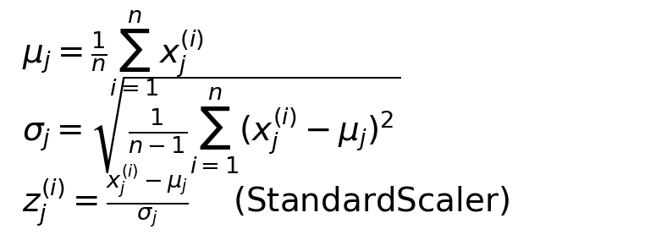
Stage 1: Feature Extraction & StandardScaler Normalization
Algorithm 2: Feature Extraction & Z-Score Normalization
Require: Raw CSV D_raw from Stage 0, k ∈ {UNSW, CSE, CIC2017}
Ensure: Normalized feature matrix X_norm ∈ R^(n×7), labels y ∈ {0,1}^n
1: for each dataset D_k do
2: for each column c_j ∈ D_k do
3: if c_j is numeric then
4: x_j ← map(c_j) using dataset-specific extraction rules
5: else
6: x_j ← categorize(c_j) into integer bins
7: end if
8: end for
9: X ← [x_1, x_2, ..., x_7] (n × 7 feature matrix)
10: μ_j ← (1/n) ∑ x_j^(i), σ_j ← std(x_j) for j = 1..4
11: z_j^(i) ← (x_j^(i) - μ_j) / σ_j for continuous features
12: X_norm ← [z_1, z_2, z_3, z_4, x_5, x_6, x_7]
13: end for
14: return X_norm, y
• Maps the 49–80+ raw CSV columns from Stage 0 into a unified 7-dimensional representation: [flow_duration, pkt_rate, byte_rate, traffic_pat_var*, port_cat, size_cat, protocol]. *traffic_pat_var is a traffic pattern variability proxy, not Shannon entropy.
• Applies Z-score normalization (StandardScaler) to the 4 continuous features, ensuring zero mean and unit variance to prevent scale dominance.
• Categorical features (port_cat, size_cat, protocol) are binned into integer categories and passed through unchanged.
• The scaler is fit on training data only and applied to test data to prevent data leakage.
Output: X_norm ∈ R^(n×7), y ∈ {0,1}^n → Feeds into Stage 2 (Decision Tree)
Notes:
SLIDE 5 — Stage 1: Feature Extraction & StandardScaler Normalization
PURPOSE: Transform the raw CSV output from Stage 0 (49–80+ columns) into a standardized 7-feature normalized matrix.
This stage now explicitly receives input from Stage 0 (PCAP preprocessing), closing the gap between binary network data and the ML pipeline.
ALGORITHM DETAILS:
The StandardScaler performs Z-score normalization on each of the 4 continuous features independently:
- Compute mean and standard deviation from training data
- Transform: z = (x - mu) / sigma
DATASET-SPECIFIC MAPPINGS:
- UNSW-NB15 (49 cols → 7): dur*1000, rate, sbytes+dbytes, normalize(ct_srv_src), bin(dsport), bin(byte_rate), proto_map
- CSE-CIC-2018 (80+ cols → 7): Flow Duration/1000, Flow Packets/s, Flow Bytes/s, quantile_norm(Fwd IAT Std), bin(Dst Port), bin(bytes*dur), proto_map
- CIC-IDS2017 (80+ cols → 7): Same as CSE-CIC-2018 (both use CICFlowMeter output format)
OUTPUT: X_norm (n×7) and y (n binary labels) fed to Stage 2.

Slide 6
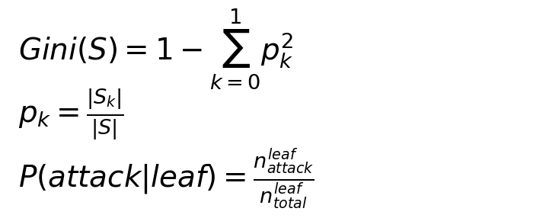
Stage 2: Decision Tree Symbolic Model (CART)
Algorithm 3: CART Decision Tree Training
Require: X_norm ∈ R^(n×7), y ∈ {0,1}^n, max_depth=6, min_leaf=15
Ensure: Trained tree T with L leaf nodes, leaf predictions
1: T ← initialize empty CART tree
2: for each node v in T (breadth-first) do
3: if depth(v) < max_depth and |samples(v)| ≥ 2 × min_leaf then
4: for each feature j ∈ {1,...,7} do
5: for each threshold θ in unique_splits(X_j) do
6: Compute Gini_split = (|S_L|/|S|)·Gini(S_L) + (|S_R|/|S|)·Gini(S_R)
7: end for
8: end for
9: (j*, θ*) ← argmin Gini_split
10: Split v into left child (x_{j*} ≤ θ*) and right child (x_{j*} > θ*)
11: else
12: Mark v as leaf: P(attack|v) = n_attack / n_total
13: end if
14: end for
15: return T, {leaf_id(x_i), P(attack|x_i), ŷ_DT(x_i)} for all x_i
• Trains a CART decision tree (max_depth=6, min_samples_leaf=15) to serve as the interpretable symbolic model whose paths become Z3 constraints.
• Each leaf node provides: a discrete state ID for Q-learning (Stage 4), an attack probability P(attack|leaf), and a baseline classification.
• The shallow depth (max 64 leaves) keeps Z3 constraint extraction tractable while maintaining sufficient classification expressiveness.
• Gini impurity guides feature splits—pure leaves (Gini=0) give high-confidence predictions; impure leaves are deferred to the RL agent.
Output: Tree T with L leaves → Feeds into Stage 3 (Z3 extraction) + Stage 4 (leaf_id as RL state)
Notes:
SLIDE 6 — Stage 2: Decision Tree Symbolic Model (CART)
PURPOSE: Train an interpretable decision tree whose decision paths can be extracted as formal logic constraints.
WHY DECISION TREE: It is a "white-box" model — every prediction is a conjunction of feature threshold comparisons along a root-to-leaf path. This enables:
1. Direct translation into Z3 logical implications (Stage 3)
2. Discrete state IDs for Q-learning (Stage 4)
3. Tractable verification (max 64 leaves with depth=6)
NOTE ON PARALLELISM: CART training is inherently sequential — each split depends on the data partition from the previous split. This is one of the sequential bottlenecks in the pipeline. However, the tree is small (depth=6) so training completes in milliseconds.

Slide 7
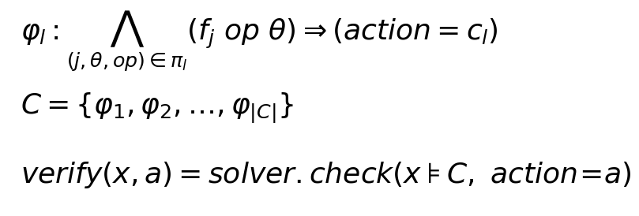
Stage 3: Z3 SMT Constraint Extraction [⚡ Parallelizable per Leaf Path]
Algorithm 4: Z3 Constraint Extraction
Require: Trained decision tree T with L leaf nodes
Ensure: Constraint set C = {φ_1, ..., φ_|C|} of Z3 implications
1: C ← ∅
2: for each leaf l ∈ {1, ..., L} do // ⚡ parallelizable per leaf
3: π_l ← extract_path(root, l) // walk tree root → leaf
4: conditions ← []
5: for each split (feature_j, threshold_θ, direction) in π_l do
6: if direction = left then
7: conditions.append( Real(f_j) ≤ θ )
8: else
9: conditions.append( Real(f_j) > θ )
10: end if
11: end for
12: φ_l ← Implies( And(conditions), Int(action) == class(l) )
13: if solver.check(C ∪ {φ_l}) == sat then
14: C ← C ∪ {φ_l}
15: end if
16: end for
17: return C
• Traverses each root-to-leaf path in the decision tree, converting feature threshold comparisons into Z3 Real/Int constraints with Implies() implications.
• Each constraint φ_l states: if the conjunction of feature conditions along path π_l holds, then the action must equal the leaf's predicted class.
• Leaf paths are independent—each can be extracted in parallel across CPU cores, with a final sequential merge and satisfiability check.
• The resulting constraint set C enables runtime verification: any proposed RL action can be checked against C using Z3's SMT solver in O(ms) time.
Output: Constraint set C → Used by Stage 4 (Q-Learning safety shield) and updated by Stage 5 (DBSCAN)
Notes:
SLIDE 7 — Stage 3: Z3 SMT Constraint Extraction from Decision Tree
PURPOSE: Convert the decision tree into formal logic constraints using Z3.
PARALLELISM: Each leaf path extraction is independent:
- L leaf paths can be extracted concurrently (one per thread/core)
- Each path produces a candidate constraint φ_l
- The satisfiability merge step is sequential (constraints must be checked for mutual consistency)
- With L ≈ 60 leaves, parallelism reduces extraction time by ~Lx on multi-core systems
The verify() function checks: given feature values and proposed action, is the constraint set satisfiable? sat = safe, unsat = unsafe.

Slide 8
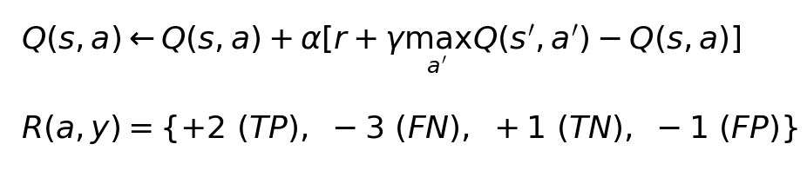
Stage 4: Q-Learning Reinforcement Learning with Z3 Safety Shielding
Algorithm 5: Q-Learning with Z3 Safety Shielding
Require: Constraint set C, DT tree T, training data (X, y)
Ensure: Learned Q-table Q(s, a) with safety-verified actions
1: Initialize Q(s, a) ← 0 for all states s, actions a ∈ {0, 1}
2: ε ← 0.20, α ← 0.15, γ ← 0.95
3: for each episode e = 1, ..., E do
4: for each flow x_i in training batch do
5: s_i ← leaf_id(T, x_i) // DT leaf as discrete state
6: if random() < ε then
7: a_proposed ← random_action({0, 1}) // explore
8: else
9: a_proposed ← argmax_a Q(s_i, a) // exploit
10: end if
11: if Z3_verify(C, x_i, a_proposed) == sat then
12: a_i ← a_proposed // action is safe
13: else
14: a_i ← 1 - a_proposed // safety shield override
15: end if
16: r_i ← Reward(a_i, y_i) // TP:+2, FN:-3, TN:+1, FP:-1
17: if Z3_verify passed then r_i ← r_i + 0.5 // shield bonus
18: Q(s_i, a_i) ← Q(s_i, a_i) + α[r_i + γ·max_a Q(s', a) - Q(s_i, a_i)]
19: end for
20: ε ← ε × 0.999 // decay exploration
21: end for
22: return Q
• A tabular Q-learning agent uses DT leaf IDs as discrete states and {ALLOW=0, BLOCK=1} as actions, learning from asymmetric rewards: FN penalty (−3) exceeds FP penalty (−1) to prioritize attack detection.
• Every proposed action is verified against the Z3 constraint set—if unsafe (unsat), the safety shield overrides it with the alternative action.
• Epsilon-greedy exploration (ε=0.20, decay=0.999) balances discovery with exploitation; a +0.5 shield bonus incentivizes Z3-consistent behavior.
• Sequential bottleneck: Q-table updates within each episode are sequential (shared state), but episodes across datasets run in parallel.
Notes:
SLIDE 8 — Stage 4: Q-Learning RL with Z3 Safety Shielding
PURPOSE: Learn an adaptive policy that improves on the static DT while maintaining safety guarantees.
PARALLELISM NOTE: Q-learning training is partially sequential:
- Within an episode, each flow's Q-update depends on the current Q-table → sequential
- However, separate Q-tables are trained for each dataset independently → cross-dataset parallelism
- The Z3 verify() calls per flow are independent and could be batched
REWARD: TP:+2, FN:-3, TN:+1, FP:-1, shield_bonus:+0.5
The asymmetric penalty (-3 FN vs -1 FP) reflects IDS priority: missing attacks is worse than false alarms.

Slide 9
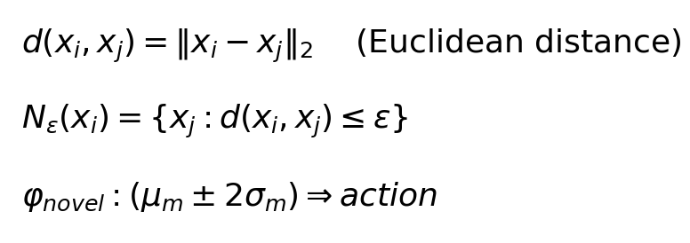
Stage 5: DBSCAN Novel Attack Pattern Detection
Algorithm 6: DBSCAN Novel Pattern Detection & Constraint Generation
Require: Misclassified flows M = {x_i : ŷ_i ≠ y_i}, constraint set C, ε=1.5, minPts=5
Ensure: Updated constraint set C' = C ∪ C_novel
1: if |M| < minPts then return C // insufficient data
2: clusters ← DBSCAN(M, ε=1.5, min_samples=5)
3: C_novel ← ∅
4: for each cluster K_m ∈ clusters (excluding noise) do
5: μ_m ← centroid(K_m) // mean feature vector
6: σ_m ← std(K_m) // feature-wise standard deviation
7: for each feature j = 1, ..., 7 do
8: φ_j ← And( Real(f_j) ≥ μ_m[j] - 2σ_m[j],
9: Real(f_j) ≤ μ_m[j] + 2σ_m[j] )
10: end for
11: φ_novel ← Implies( And(φ_1,...,φ_7), action == majority_class(K_m) )
12: if solver.check(C ∪ {φ_novel}) == sat then
13: C_novel ← C_novel ∪ {φ_novel}
14: end if
15: end for
16: return C' = C ∪ C_novel
• Collects misclassified flows and applies DBSCAN density-based clustering (ε=1.5, minPts=5) to discover previously unseen attack patterns.
• Each cluster is converted into a Z3 constraint using centroid ± 2σ per feature, then added after satisfiability verification.
• Noise points (not in any cluster) are discarded—only dense groups generate new constraints, reducing false pattern creation.
• Enables zero-day detection: novel attacks not seen in training are discovered at runtime and formally incorporated into the safety shield.
Output: C' = C ∪ C_novel → Feedback loop: updated constraints improve Stage 4 safety shield
Notes:
SLIDE 9 — Stage 5: DBSCAN Novel Attack Pattern Detection
DBSCAN is inherently sequential (neighborhood queries depend on prior classifications of core/border/noise points). This is a sequential bottleneck, but runs on a small subset of data (only misclassified flows).
The feedback loop C' = C ∪ C_novel means the constraint set grows over time, enabling detection of zero-day attacks.

Slide 10
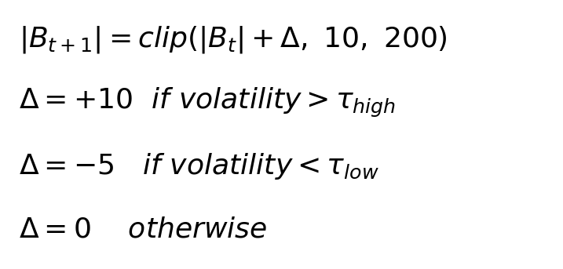
Stage 6: Adaptive Buffer Management
Algorithm 7: Adaptive Buffer Resizing
Require: Flow stream F, current buffer B_t with size |B_t|, bounds [10, 200]
Ensure: Resized buffer B_{t+1} adapted to traffic volatility
1: for each time window W_t of flows do
2: B_t.append(flows in W_t) // sliding window buffer
3: σ_tpv ← std({traffic_pat_var(x) : x ∈ B_t}) // traffic pattern variability volatility
4: σ²_bytes ← var({byte_rate(x) : x ∈ B_t}) // byte rate variance
5: volatility ← σ_tpv + σ²_bytes / max(σ²_bytes)
6: if volatility > high_threshold then
7: Δ ← +10 // high volatility: grow buffer for more context
8: else if volatility < low_threshold then
9: Δ ← -5 // low volatility: shrink buffer for faster response
10: else
11: Δ ← 0 // stable: maintain current size
12: end if
13: |B_{t+1}| ← clip(|B_t| + Δ, 10, 200)
14: end for
15: return B_{t+1}
• Dynamically resizes the flow buffer (10–200 flows) based on traffic volatility measured by traffic_pat_var std and byte rate variance.
• High volatility triggers buffer growth (+10) to accumulate more context; low volatility triggers shrinkage (−5) for faster response.
• Sequential stage: buffer state depends on previous window (temporal dependency), so this cannot be parallelized within a single stream.
• Asymmetric growth/shrink rates (+10/−5) create a conservative bias—the system is quicker to accumulate evidence than to discard it.
Output: Adapted buffer size |B_{t+1}| → Used by Stage 7 and Stage 8 for windowed classification
Notes:
SLIDE 10 — Stage 6: Adaptive Buffer Management
Sequential stage — buffer state depends on previous window. Cannot be parallelized within a single traffic stream, but different streams (e.g., per-subnet or per-sensor) could maintain independent buffers in parallel.
Grows +10 during volatility, shrinks -5 during stability. Bounds: [10, 200]. Asymmetric rates create conservative bias.

Slide 11
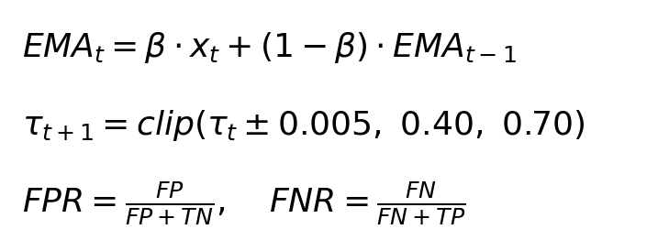
Stage 7: Dynamic Threshold Adaptation
Algorithm 8: Dynamic Threshold Adaptation via EMA Error Balancing
Require: Current threshold τ_t ∈ [0.40, 0.70], recent FPR_t, FNR_t, EMA decay β=0.3
Ensure: Updated threshold τ_{t+1} balancing false positives and false negatives
1: for each evaluation window W_t do
2: FPR_t ← FP_t / (FP_t + TN_t) // false positive rate
3: FNR_t ← FN_t / (FN_t + TP_t) // false negative rate
4: EMA_FPR ← β · FPR_t + (1 - β) · EMA_FPR // exponential moving average
5: EMA_FNR ← β · FNR_t + (1 - β) · EMA_FNR
6: if EMA_FPR > EMA_FNR then
7: τ_{t+1} ← τ_t + 0.005 // too many false positives: raise threshold
8: else if EMA_FNR > EMA_FPR then
9: τ_{t+1} ← τ_t - 0.005 // too many false negatives: lower threshold
10: else
11: τ_{t+1} ← τ_t // balanced: maintain threshold
12: end if
13: τ_{t+1} ← clip(τ_{t+1}, 0.40, 0.70)
14: end for
15: return τ_{t+1}
• Continuously adjusts τ ∈ [0.40, 0.70] based on the balance between FPR and FNR using exponential moving average (EMA, β=0.3).
• When FPR dominates, threshold rises to reduce false alarms; when FNR dominates, it falls to catch more attacks—creating a self-correcting feedback loop.
• Sequential stage: threshold state depends on previous window's EMA values (temporal dependency).
• Hard bounds [0.40, 0.70] prevent threshold from becoming too permissive or too aggressive.
Output: τ_{t+1} → Used by Stage 8 for high-confidence direct classification
Notes:
SLIDE 11 — Stage 7: Dynamic Threshold Adaptation
Sequential stage — EMA depends on previous state. Like Stage 6, this cannot be parallelized within a single stream but operates independently across datasets.
Observed convergence: UNSW-NB15 → τ≈0.625, CSE-CIC-2018 → τ≈0.625, CIC-IDS2017 → τ≈0.685.

Slide 12
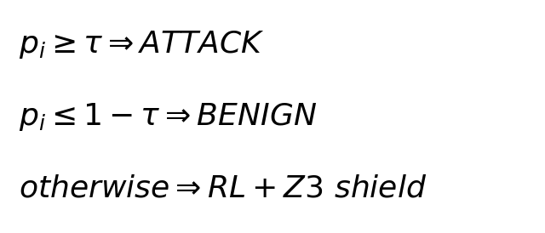
Stage 8: Final Classification Decision [⚡ Parallelizable per Flow]
Algorithm 9: Final Classification with Tiered Decision Logic
Require: Flow x_i, threshold τ, Q-table Q, constraint set C, DT tree T
Ensure: Final classification ŷ_i ∈ {0=BENIGN, 1=ATTACK} with audit trail
1: p_i ← P(attack | leaf_id(T, x_i)) // DT leaf probability
2: if p_i ≥ τ then
3: ŷ_i ← 1 (ATTACK) // high confidence attack
4: confidence ← 'HIGH_ATTACK'
5: else if p_i ≤ 1 - τ then
6: ŷ_i ← 0 (BENIGN) // high confidence benign
7: confidence ← 'HIGH_BENIGN'
8: else
9: // Uncertain region: invoke RL + Z3 safety shield
10: s_i ← leaf_id(T, x_i)
11: a_RL ← argmax_a Q(s_i, a)
12: if Z3_verify(C, x_i, a_RL) == sat then
13: ŷ_i ← a_RL // RL action is safe
14: else
15: ŷ_i ← 1 - a_RL // safety shield override
16: end if
17: confidence ← 'RL_VERIFIED'
18: end if
19: return ŷ_i, confidence, audit_trail(p_i, s_i, C) // ⚡ per-flow parallel
• Three-tier logic: high-confidence flows (p ≥ τ or p ≤ 1−τ) classified directly; uncertain flows deferred to RL+Z3 verification.
• Embarrassingly parallel: each flow's classification is independent—Q-table and constraint set are read-only at inference time.
• Every classification produces a full audit trail: DT probability, leaf state, Z3 check result, and confidence level for complete explainability.
• Tiered approach reduces Z3 solver calls (~70% of flows are high-confidence), balancing verification overhead with throughput.
Output: ŷ_i ∈ {0, 1} with confidence level and full audit trail for every classification decision
Notes:
SLIDE 12 — Stage 8: Final Classification Decision
PARALLELISM: This is the most parallelizable stage. At inference time:
- The Q-table is frozen (read-only) → no write conflicts
- The constraint set C is frozen (read-only) → each Z3 solver instance is independent
- Each flow x_i is classified independently → embarrassingly parallel
- Can distribute across N cores for ~Nx throughput improvement
This is where real-time IDS throughput is critical — production systems need to classify millions of flows per second.

Slide 13
Parallel Processing Architecture Across the ASRRL Pipeline
⚡ Parallelizable Stages (Embarrassingly Parallel)
⏸ Sequential Bottlenecks
Stage 0: PCAP Binary Preprocessing
Granularity: Per PCAP file / per time window
Strategy: Each capture file processed by independent worker
Speedup: ~Nx with N CPU cores (I/O bound)
Tool: CICFlowMeter instances or parallel Argus processes
Stage 3: Z3 Constraint Extraction
Granularity: Per leaf path (L ≈ 60 independent paths)
Strategy: Extract each path in parallel; sequential merge + sat check
Speedup: ~min(L, N) with N cores
Note: Final satisfiability merge is sequential (consistency check)
Stage 8: Final Classification (Inference)
Granularity: Per flow (each flow independently classified)
Strategy: Partition flow stream across N workers; read-only Q-table + C
Speedup: ~Nx with N cores (CPU bound per Z3 call)
Note: ~70% direct classification (no Z3 call); ~30% invoke solver
Cross-Dataset: All 3 datasets processed independently
Strategy: 3 pipeline instances run in parallel (no shared state)
Speedup: 3x wall-clock time reduction
Stage 2: Decision Tree Training
Reason: CART greedy splits are data-dependent
Each split depends on the partition from
the previous split (inherently sequential).
Impact: Low (tree depth=6, trains in <1 second)
Stage 4: Q-Learning Training (within episode)
Reason: Q-table updates are sequential
(each update depends on current Q-values).
Mitigation: Cross-dataset parallelism (3 Q-tables)
Stage 5: DBSCAN Clustering
Reason: Core/border/noise classification is
sequential (neighbor queries depend on prior labels).
Impact: Low (runs on small subset: misclassified only)
Stages 6-7: Buffer & Threshold Adaptation
Reason: Temporal dependency — each window's state
depends on the previous window's EMA / buffer size.
Mitigation: Independent per-stream/per-sensor buffers
Training Phase: Stages 0–5 (mostly sequential except Stage 0 & 3) | Inference Phase: Stage 8 (fully parallel per flow) | Adaptation: Stages 6–7 (sequential per stream, parallel across streams)
Notes:
SLIDE 13 — Parallel Processing Architecture
This slide addresses the advisor's question about where parallel processing is used in the pipeline.
SUMMARY OF PARALLELISM:
EMBARRASSINGLY PARALLEL STAGES:
1. Stage 0 (PCAP Preprocessing): Each PCAP file is processed by an independent CICFlowMeter/Argus instance. No shared state between files. This is I/O-bound and scales linearly with CPU cores.
2. Stage 3 (Z3 Constraint Extraction): Each of the L leaf paths can be extracted independently. The path traversal and constraint construction are pure functions of the tree structure. Only the final merge step (checking consistency of the full constraint set) requires sequential processing.
3. Stage 8 (Final Classification at Inference): This is the critical real-time stage. At inference time, the Q-table and constraint set are both read-only (frozen after training). Each flow can be classified by an independent worker thread/process. With N CPU cores, throughput scales ~Nx. The tiered approach further helps: ~70% of flows take the fast path (direct DT classification, no Z3 call), only ~30% require Z3 solver invocation.
4. Cross-Dataset Parallelism: Since each dataset has its own independent pipeline (separate DT, Q-table, constraint set, buffer, threshold), all three datasets can be processed simultaneously.
SEQUENTIAL BOTTLENECKS (and why they're acceptable):
1. Stage 2 (DT Training): CART is inherently sequential, but with depth=6 and 50K samples, it completes in <1 second.
2. Stage 4 (Q-Learning): Within an episode, Q-updates are sequential. But training converges quickly and runs offline.
3. Stage 5 (DBSCAN): Sequential neighborhood queries, but operates on the small subset of misclassified flows only.
4. Stages 6-7 (Buffer/Threshold): Temporal dependencies prevent within-stream parallelism. However, different network segments (per-subnet, per-sensor, per-VLAN) can maintain independent buffer/threshold states in parallel.
TRAINING vs INFERENCE:
- Training phase (Stages 0-7): Mostly sequential, runs offline. Total time: seconds to minutes depending on dataset size.
- Inference phase (Stage 8): Fully parallel, runs in real-time. This is where parallelism matters most for production IDS deployment.
IMPLEMENTATION OPTIONS:
- Python multiprocessing.Pool for Stage 0 (PCAP files)
- concurrent.futures.ThreadPoolExecutor for Stage 3 (leaf paths, GIL-free Z3 calls)
- Ray or Dask for distributed Stage 8 inference across multiple machines
- Independent process per dataset for cross-dataset parallelism

Slide 14
Experimental Results — ASRRL Dynamic vs. Static Baselines
ASRRL Dynamic Random Forest XGBoost SVM KNN
(Buf+Thresh)
CSE-CIC-IDS-2018
F1-Score: 0.9812 0.9956 0.9934 0.9901 0.9799
Accuracy: 0.9887 0.9973 0.9960 0.9940 0.9880
FPR: 0.0048 0.0010 0.0010 0.0010 0.0010
Final Buffer: 30 N/A N/A N/A N/A
Final Threshold: 0.625 N/A N/A N/A N/A
UNSW-NB15
F1-Score: 0.9889 1.0000 0.9967 0.9923 0.9833
Accuracy: 0.9933 1.0000 0.9980 0.9953 0.9900
FPR: 0.0000 0.0000 0.0000 0.0019 0.0000
Final Buffer: 37 N/A N/A N/A N/A
Final Threshold: 0.650 N/A N/A N/A N/A
CIC-IDS2017
F1-Score: 0.9845 0.9978 0.9934 0.9945 0.9822
Accuracy: 0.9907 0.9987 0.9960 0.9967 0.9893
FPR: 0.0019 0.0010 0.0010 0.0010 0.0010
Final Buffer: 32 N/A N/A N/A N/A
Final Threshold: 0.685 N/A N/A N/A N/A
Key Insight: ASRRL achieves competitive F1 (0.98+) while providing formal safety guarantees,
dynamic adaptation (buffer+threshold), zero-day detection, and parallel inference scalability.
Notes:
SLIDE 14 — Experimental Results
ASRRL Dynamic achieves F1 scores of 0.98+ across all three datasets, competitive with static baselines (RF: 0.99+, XGBoost: 0.99+).
Why slightly lower F1 is acceptable:
1. FORMAL SAFETY GUARANTEES: Every classification is Z3-verified
2. DYNAMIC ADAPTATION: Buffer and threshold adapt at runtime
3. ZERO-DAY DETECTION: DBSCAN discovers novel attack patterns
4. PARALLEL INFERENCE: Stage 8 scales linearly with CPU cores
5. COMPLETE EXPLAINABILITY: Full audit trail per decision
Statistical significance: Wilcoxon tests show significant differences from most baselines at p<0.05.
Constraint fidelity: 100% fidelity, coverage, and opinion rate across all datasets.

