Slide 1
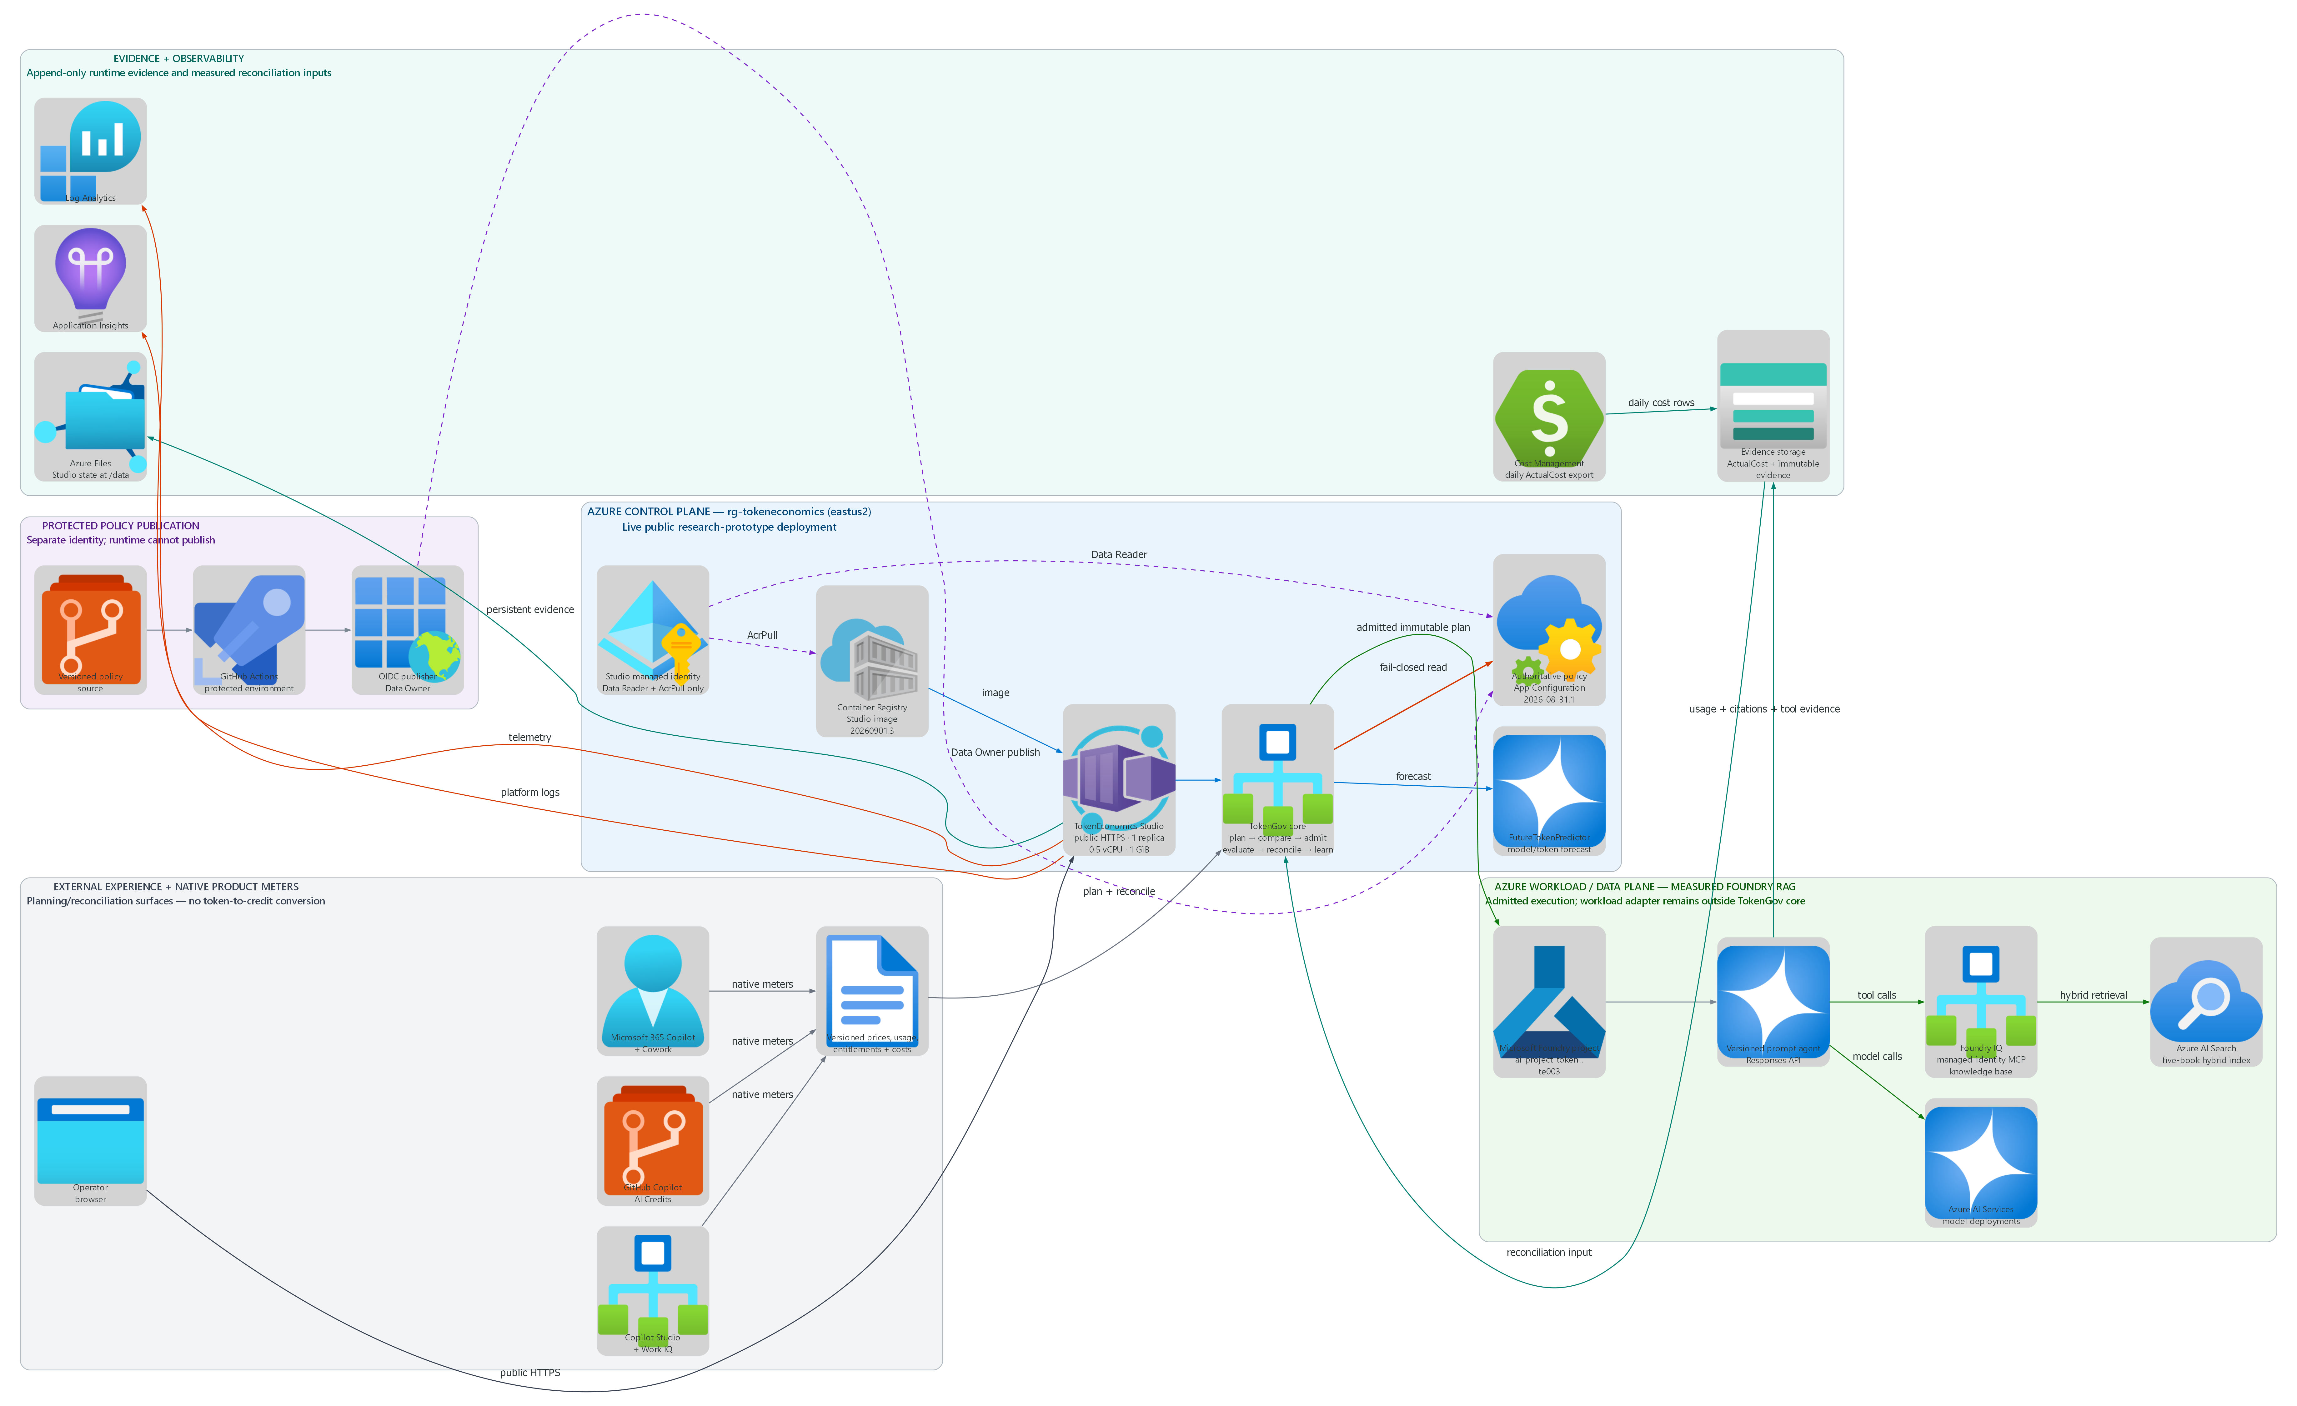
TokenEconomics Azure reference architecture
RESEARCH PROTOTYPE
Live Azure deployment in rg-tokeneconomics · external Copilot/GitHub domains remain native-meter planning and reconciliation surfaces

