Slide 1
Digital Portfolio
STUDENT NAME: P.PRIYADHARSHINI
REGISTER NO AND NMI2428c0459 & asbru3124aiml02
DEPARTMENT: B.Sc., AI&ML
COLLEGE: COLLEGE/ UNIVERSITY CHERRAN ARTS SCIENCE COLLEGE ,KANGEYAM,THIRUPPUR.AFFLIATED TO BHARATHIYAR UNIVERSITY,COIMBATORE.

Slide 2
PROJECT TITLE: This is a simple digital portfolio for P.Priyadharshini.The website introduces her interest and the skills in some programming languages (such as C,C++,PYTHON,Java,JavaScript,Cascading Styling Sheet(css) and HTML) displays her certificates, and mentions her interests in sports such as badminton and volleyball. KEY SECTION: 1.Introduction and CV download 2. About Me (education and interests) 3. Skills displayed with icons 4.Certificates with details. 5.Sports interests. 6.Contact information (email, Linkedin, GitHub) This portfolio is useful to share her profile, achievements, and contact details with others in a modern and organized way.

Slide 3
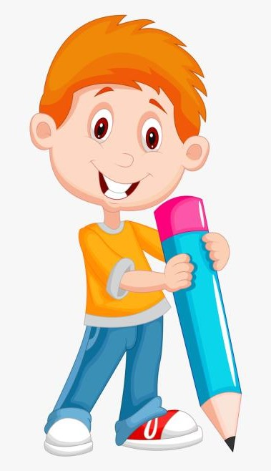

AGENDA
Problem Statement
Project Overview
End Users
Tools and Technologies
Portfolio design and Layout
Features and Functionality
Results and Screenshots
Conclusion
Github Link
3/21/2024 Annual Review

Slide 4

PROBLEM STATEMENT: Students often struggle to present their skills, achievements, and projects in a professional manner.Traditional resumes are static and lack interactivity. A personal portfolio website helps in showcasing technical skills, certificates, and extracurricular activities dynamically, increasing opportunities for internships and jobs.

Slide 5
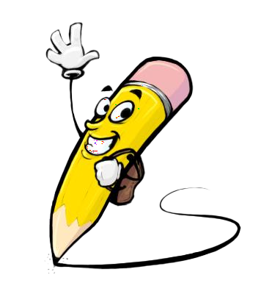
PROJECT OVERVIEW: This project is a personal portfolio website developed for P.Priyadharshini. It highlights education skills, certificates, extracurricular achievements, and contact information in an interactive and visually appealing design. The portfolio is fully responsive and deployed on GitHub Pages for public access.

Slide 6

WHO Are the end users?: i.Recruiters - To evaluate skills, certificates, and academic achievements. ii.Faculty / College evaluators - For project assessment and showcasing student achievements. iii.Peers and collaborators -To connect and collaborate on projects. iv.General audience -To know about Priyadharshini 's journey and capabilities.

Slide 7

TOOLS AND TECHNIQUES: Frontend Framework: React.js. Styling: CSS, animations. Other Libraries: react-icons, typed.js, AOS animations. Version Control: Git & GitHub. Deployment: GitHub Pages. Design Tolls :canva and layout inspiration.

Slide 8
POTFOLIO DESIGN AND LAYOUT:
I.The portfolio follows a modern single-page scrolling layout with sections:
II.Home (Hero)- Animated introduction with glowing effects and profile photo.
III.About -Personal introduction, education details, and career goal.
IV.Skills -Display of technical skills with logos and animations.
V.Certificates- Achievements displayed with pop-up view and download option.
VI.Sports -Section highlighting extracurricular activities with images.
VII.Contact- Direct links to email, GitHub, and Linkedin.
VIII.Footer -Clean copyright and quick links.
8

Slide 9
FEATURES AND FUNCTIONALITY 1. Animated typing effect for introduction. 2. Floating glowing decorations for modern design. 3. Profile photo with animated circular border. 4. Certificates displayed as cards with pop-up view and download option. 5. Sports achievements showcased with images and descriptions. 6. Smooth scroll navigation with navbar. 7. Fully responsive (works on desktop and mobile).

Slide 10
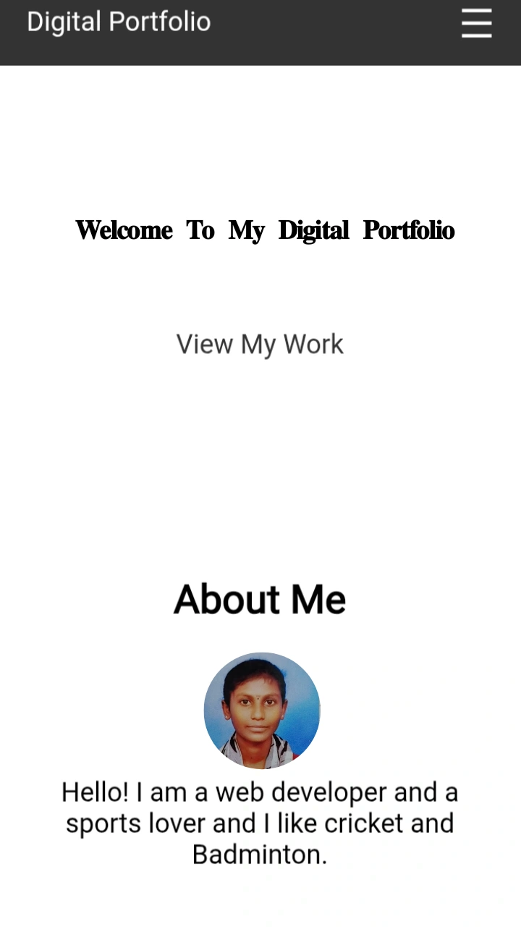

RESULTS AND SCREENSHOTS
3/21/2024 Annual Review
10

Slide 11
CONCLUSION
The project successfully demonstrated the working of a My digital portfolio .
It shows the Skills and leaning experience of Priyadharshini.
11

