Slide 1
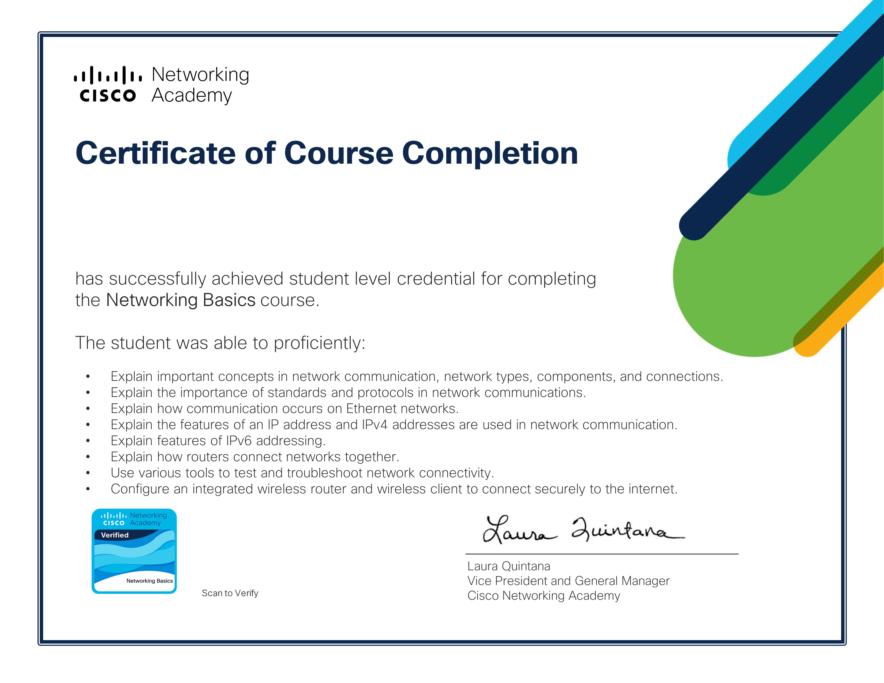
Varun Prakash
November 08, 2024
Powered by PDF Generator API

