Slide 1
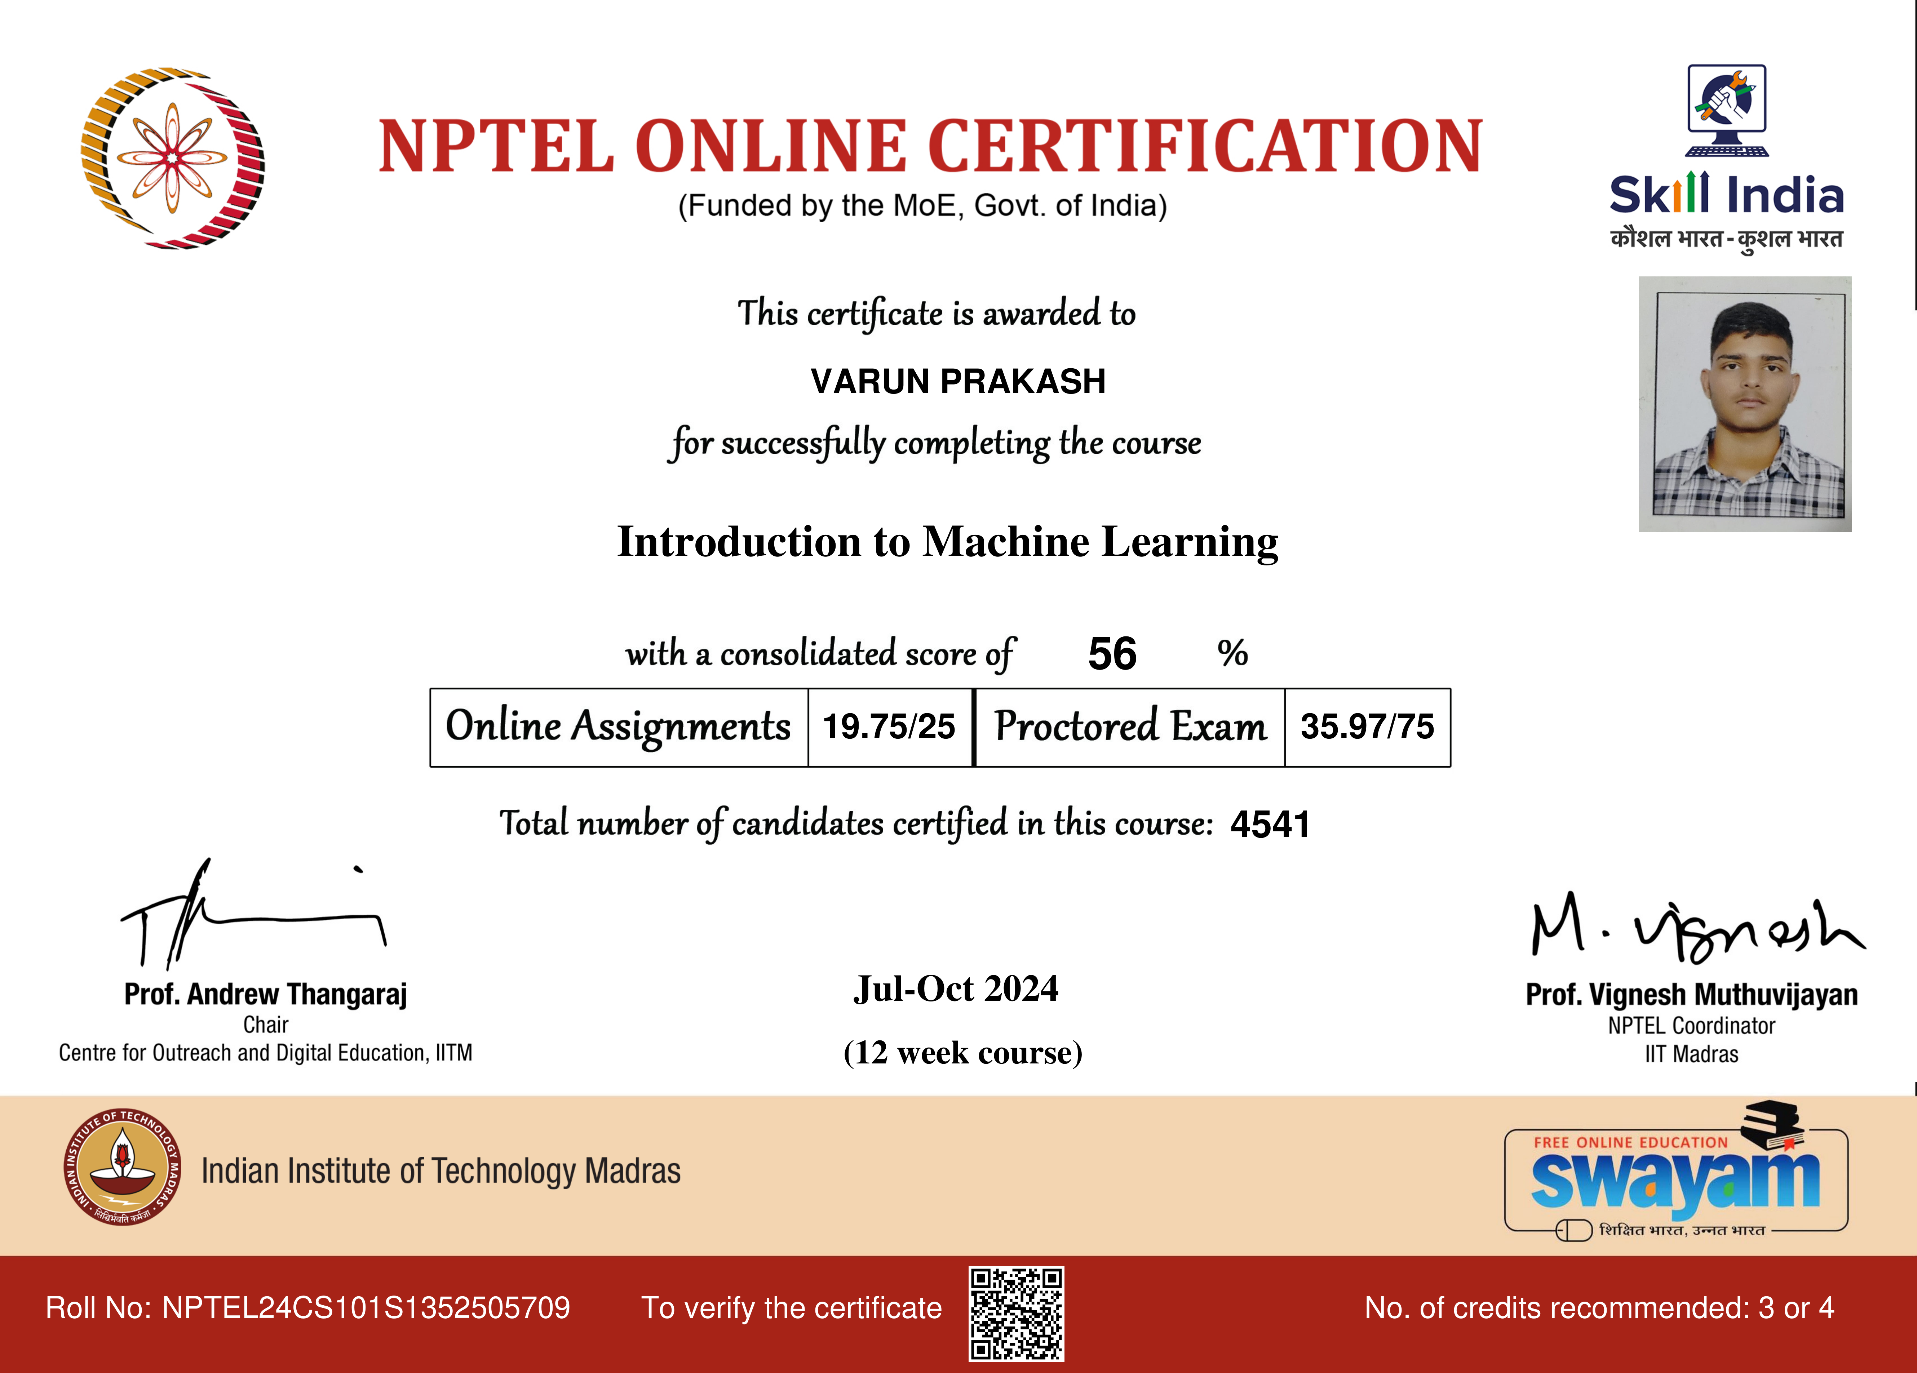
No. of credits recommended: 3 or 4 To verify the certificate Roll No:Jul-Oct 2024
(12 week course)
Introduction to Machine LearningVARUN PRAKASH
19.75/25 35.97/7556
4541
NPTEL24CS101S1352505709

