Slide 1
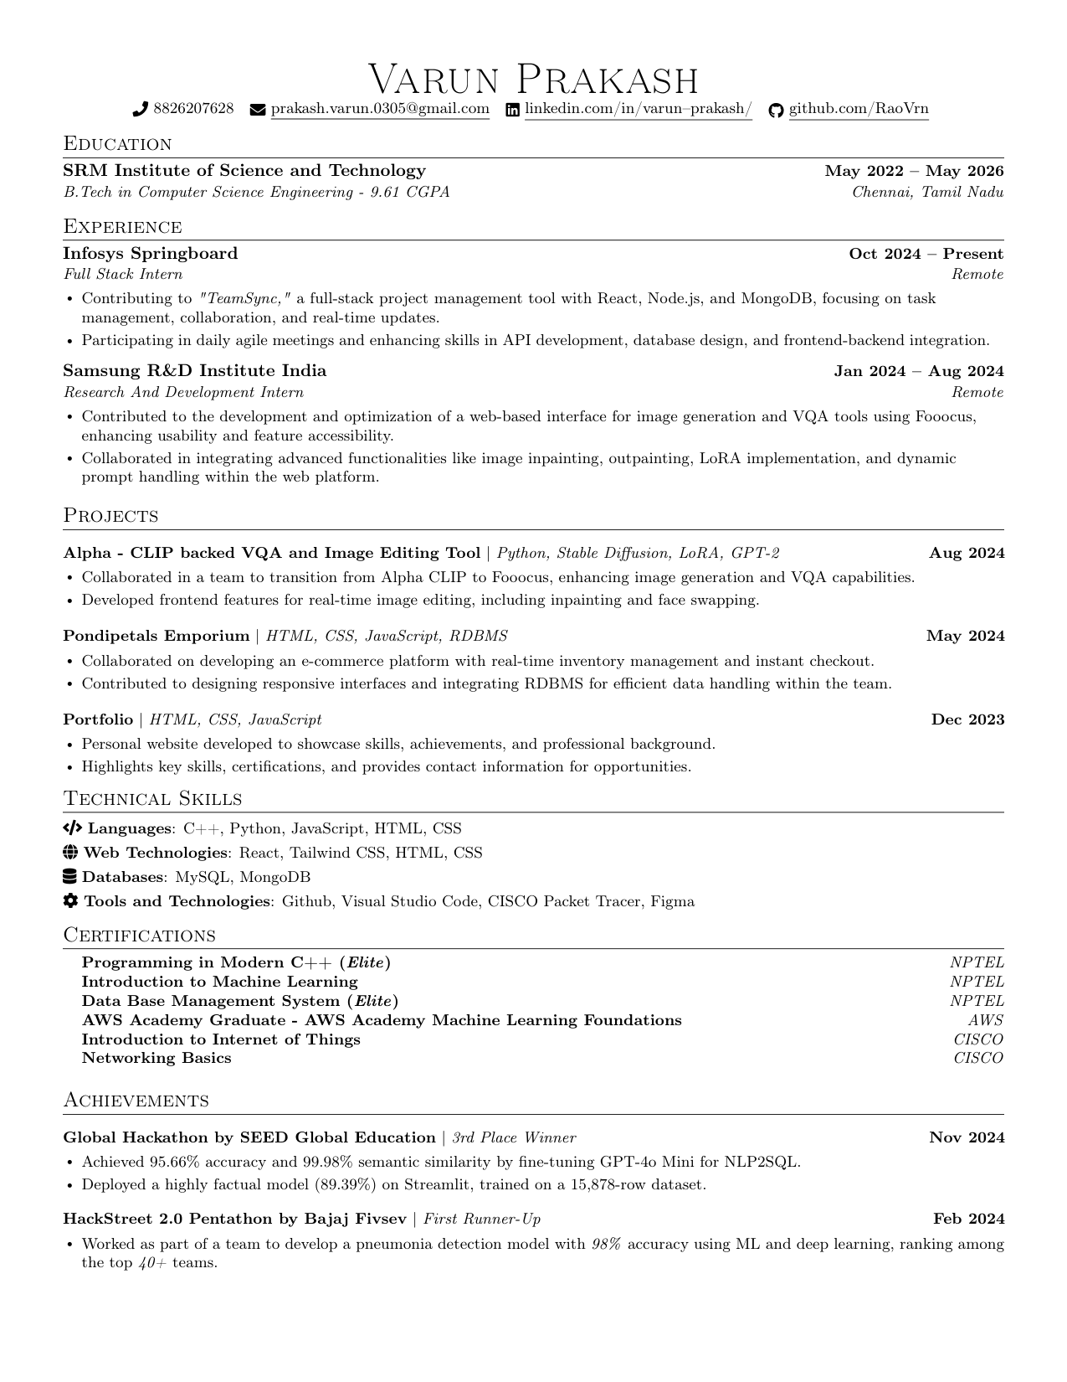
Varun Prakash
♂phone8826207628 /envel⌢peprakash.varun.0305@gmail.com /linkedinlinkedin.com/in/varun–prakash/ /githubgithub.com/RaoVrn
Education
SRM Institute of Science and Technology May 2022 – May 2026
B.Tech in Computer Science Engineering - 9.61 CGPA Chennai, Tamil Nadu
Experience
Infosys Springboard Oct 2024 – Present
Full Stack Intern Remote
•Contributing to "TeamSync," a full-stack project management tool with React, Node.js, and MongoDB, focusing on task
management, collaboration, and real-time updates.
•Participating in daily agile meetings and enhancing skills in API development, database design, and frontend-backend integration.
Samsung R&D Institute India Jan 2024 – Aug 2024
Research And Development Intern Remote
•Contributed to the development and optimization of a web-based interface for image generation and VQA tools using Fooocus,
enhancing usability and feature accessibility.
•Collaborated in integrating advanced functionalities like image inpainting, outpainting, LoRA implementation, and dynamic
prompt handling within the web platform.
Projects
Alpha - CLIP backed VQA and Image Editing Tool |Python, Stable Diffusion, LoRA, GPT-2 Aug 2024
•Collaborated in a team to transition from Alpha CLIP to Fooocus, enhancing image generation and VQA capabilities.
•Developed frontend features for real-time image editing, including inpainting and face swapping.
Pondipetals Emporium |HTML, CSS, JavaScript, RDBMS May 2024
•Collaborated on developing an e-commerce platform with real-time inventory management and instant checkout.
•Contributed to designing responsive interfaces and integrating RDBMS for efficient data handling within the team.
Portfolio |HTML, CSS, JavaScript Dec 2023
•Personal website developed to showcase skills, achievements, and professional background.
•Highlights key skills, certifications, and provides contact information for opportunities.
Technical Skills
/codeLanguages : C++, Python, JavaScript, HTML, CSS
/gl⌢beWeb Technologies : React, Tailwind CSS, HTML, CSS
/da◎abaseDatabases : MySQL, MongoDB
/cogTools and Technologies : Github, Visual Studio Code, CISCO Packet Tracer, Figma
Certifications
Programming in Modern C++ ( Elite) NPTEL
Introduction to Machine Learning NPTEL
Data Base Management System ( Elite) NPTEL
AWS Academy Graduate - AWS Academy Machine Learning Foundations AWS
Introduction to Internet of Things CISCO
Networking Basics CISCO
Achievements
Global Hackathon by SEED Global Education |3rd Place Winner Nov 2024
•Achieved 95.66% accuracy and 99.98% semantic similarity by fine-tuning GPT-4o Mini for NLP2SQL.
•Deployed a highly factual model (89.39%) on Streamlit, trained on a 15,878-row dataset.
HackStreet 2.0 Pentathon by Bajaj Fivsev |First Runner-Up Feb 2024
•Worked as part of a team to develop a pneumonia detection model with 98%accuracy using ML and deep learning, ranking among
the top40+teams.

