Slide 1


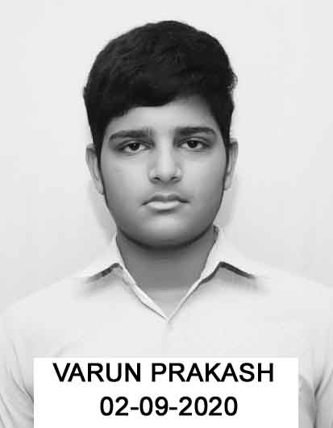
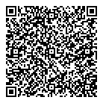


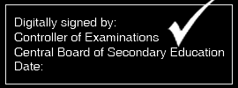

dsUæh; ek/;fed f'k{kk cksMZ
CENTRAL BOARD OF SECONDARY EDUCATION
vad foojf.kdk lg çek.k i=
MARKS STATEMENT CUM CERTIFICATE
lhfu;j Ldwy lfVZfQdsV ijh{kk, 2022
SENIOR SCHOOL CERTIFICATE EXAMINATION, 2022
;g çekf.kr fd;k tkrk gS fd This is to certify that
VARUN PRAKASH
vuqØekad Roll No.
17629695
ekrk dk uke Mother's Name
JYOTI DEVI
firk/laj{kd dk uke Father's/Guardian's Name
NIRMAL PRAKASH
fo|ky; School
COLONEL`S CENTRAL ACADEMY U E GURGAON HRY (40134)
fo"k; dksM
SUBJECT
CODE
fo"k;
SUBJECT NAME
fyf[kr
THEORY
çk;ksfxd
PRACTICAL
;ksx
TOTAL
;ksx ('kCnksa esa)
TOTAL (IN WORDS)
fLFkrh; xzsM
POSITIONAL
GRADE
301
ENGLISH CORE
063
019
082
EIGHTY TWO
B2
042
PHYSICS
057
030
087
EIGHTY SEVEN
A2
043
CHEMISTRY
065
030
095
NINETY FIVE
A1
041
MATHEMATICS
072
020
092
NINETY TWO
A1
048
PHYSICAL EDUCATION
068
030
098
NINETY EIGHT
A1
065
INFORMATICS PRAC. (NEW)
067
030
097
NINETY SEVEN
A1
500
Work Experience
---
B2
502
Health & Physical Education
---
B2
503
General Studies
---
B2
ifj.kke RESULT: PASS
fnYyh Delhi
Date of declaration of result : 22/07/2022
Note:
1. This mark sheet is generated by DigiLocker (https://digilocker.gov.in) directly from CBSE’s Database.
2. This digitally signed document is legally valid as per the IT Act, 2000 when used electronically.
3. To verify this mark sheet, download DigiLocker Android application from Google Play and scan the QR code on the mark sheet.
4. Abbreviations:
AB - Absent
EX - Exempted
RP - Repeat in Practical
RT - Repeat in Theory
RB - Repeat in Both
15/06/2023 13:15:00 IST
Powered by TCPDF (www.tcpdf.org)

