Slide 1
Out-of-date Version (Nginx)
Domain :- http://testhtml5.vulnweb.com/

Slide 2
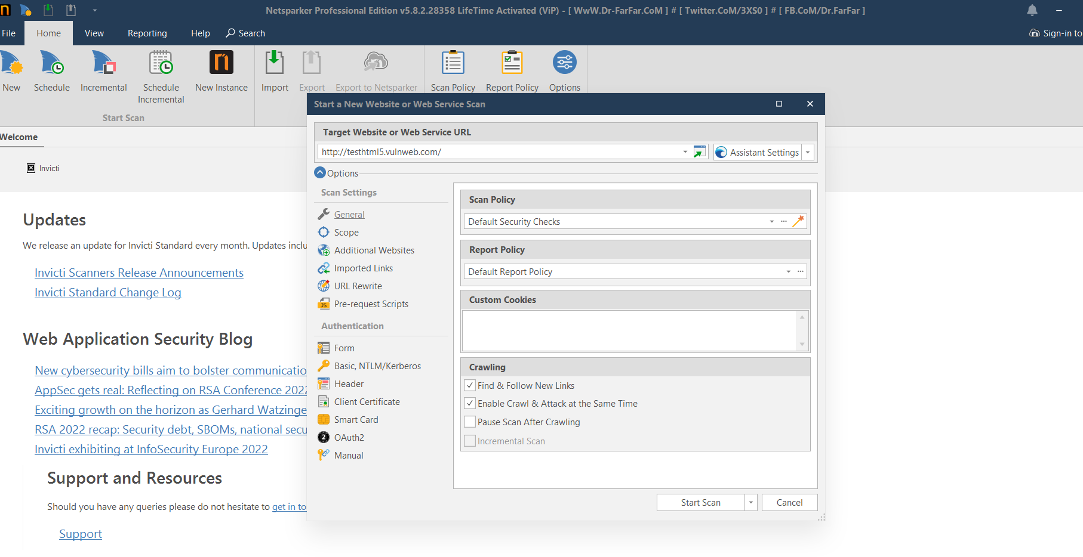
Scan Website: http://testhtml5.vulnweb.com/

Slide 3
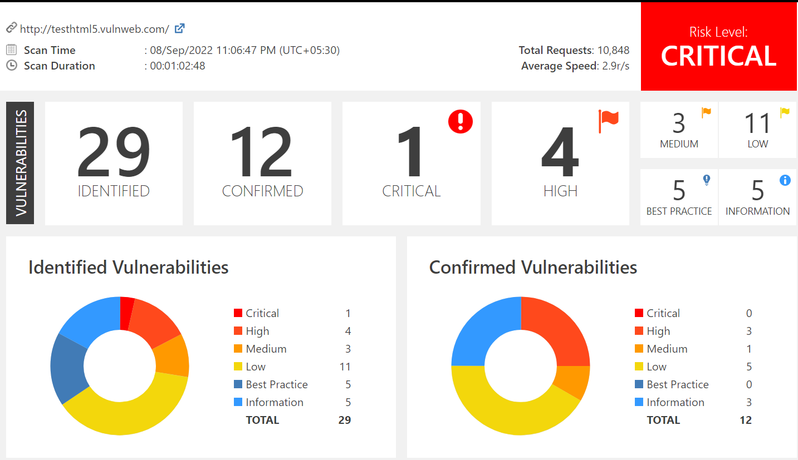
Vulnerabilities graph:

Slide 4
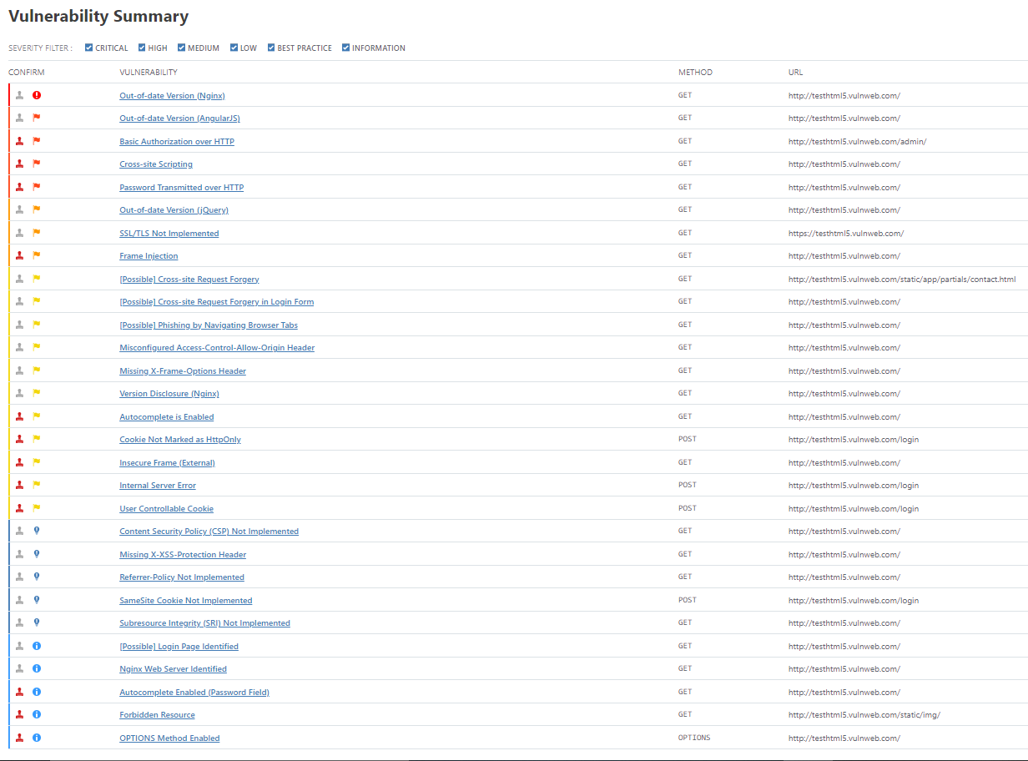

Slide 5
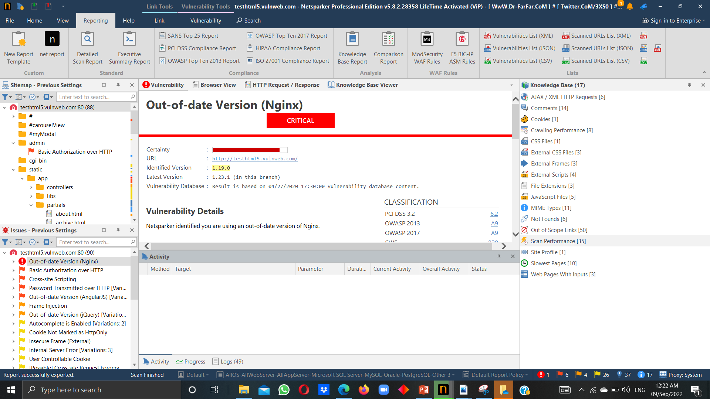
1. Out-of-date Version (Nginx) :

Slide 6
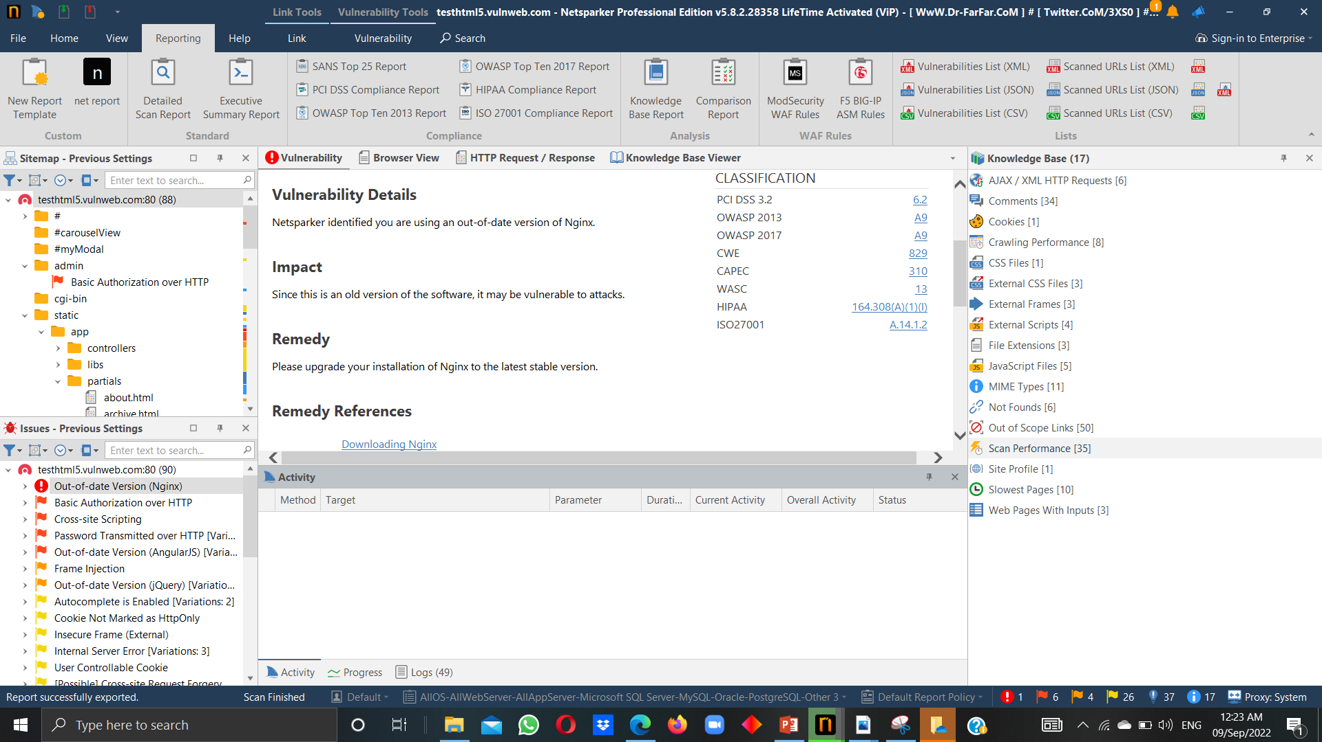

Slide 7
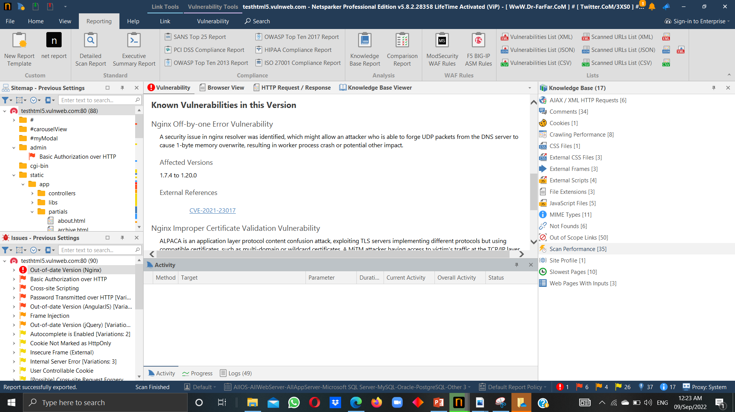

Slide 8
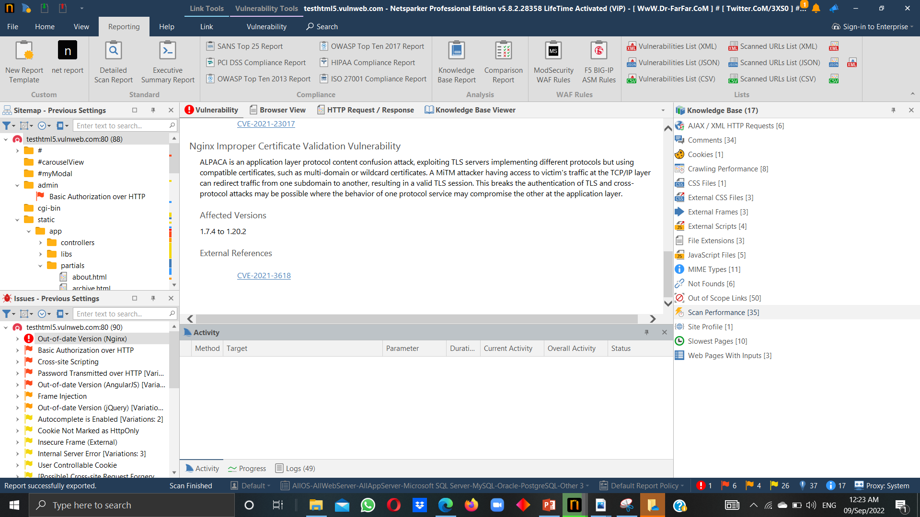

Slide 9
Title : Out-Of-Date Version (Nginx)
Domain : Vulnweb.com
Subdomain : testhtml5.vulnweb.com
Step To Reproduce :
Step 1 : Visit http://vulnweb.com
Step 2 : Copy the one of this link http://testhtml5.vulnweb.com below shown in it.
Step 3 :Open the Netsparker for scan the vulnerability in this link .
Step 4 : Click on new scan paste the link and press on the start scan.
Step 5 : Netsparker scan the website and show critical vulnerability
Vulnerability Details :
You are using Out-of-Date Version (Nginx) identified by Netsparker.
Nginx is open source software for web serving, reverse proxying, coaching,load
balancing and more

Slide 10
Impact :
Out-of-Date version of Nginx can be harmful for your website/company. Since this is an identifie old version of software (1.19.0) . It may cause vulnerable in attack .
Mitigation : If you want to prevent your website from unathorize access then Please Upgrade your Installation of Nginx software in latest stable version (1.23.1).

