Slide 1
Title : Cross Site Scripting (XSS)
Domain : Vulnweb.com
Subdomain : https://testphp.vulnweb.com
Vulnerability Details :
Cross-site Scripting (XSS) is a client-side code injection attack. The attacker
aims to execute malicious scripts in a web browser of the victim by including
malicious code in a legitimate web page or web application. The attack occurs
when the victim visits the web page or web application that executes the
malicious code. The web page or web application becomes a vehicle to deliver
the malicious script to the user’s browser.

Slide 2
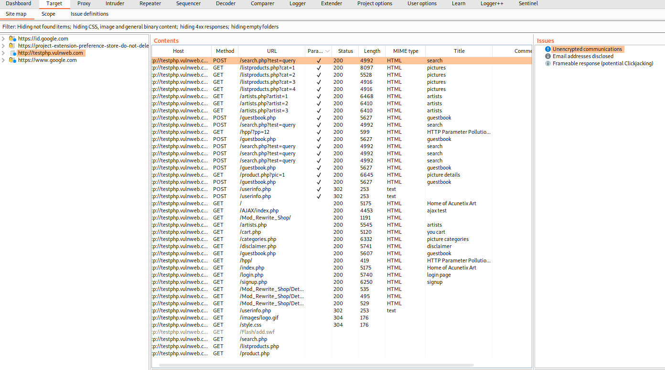
Step To Reproduce :
Step 1 : Visit the Link https://testphp.vulnweb.com
Step 2 : Open the Burp Suite and intercept the request is on.
Step 3 : Scan the different vulnerable parameter.

Slide 3
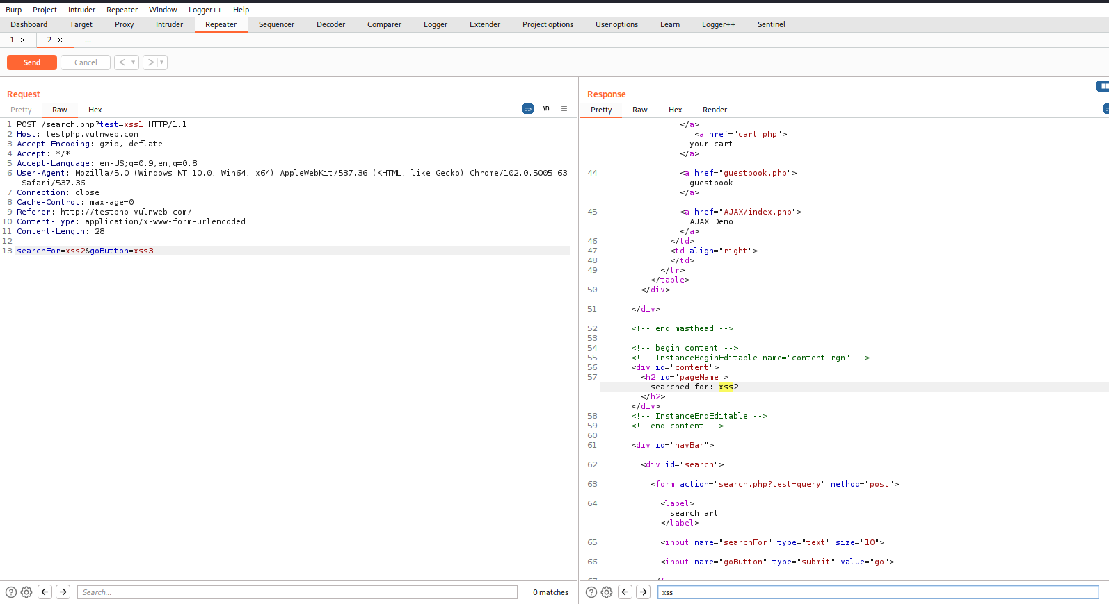
Step 4 : Send the request to repeater and find vulnerable parameter.

Slide 4
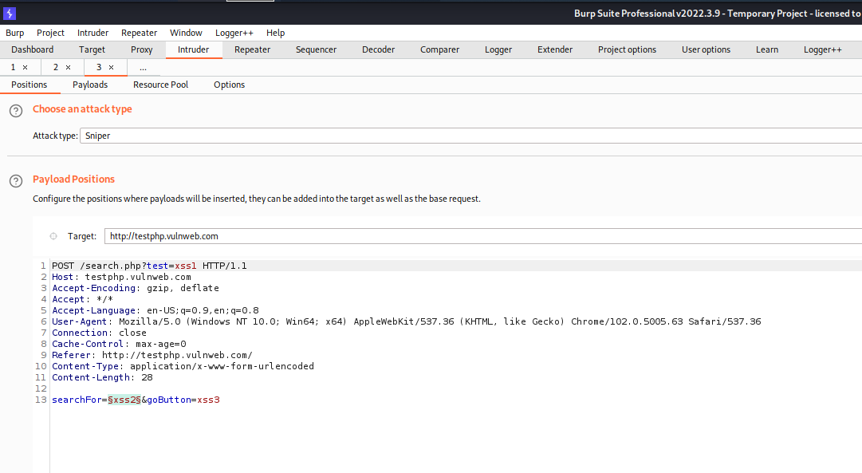
Step 5 : Now try to find out the payload for xss.
Step 6 : Send the request to Intruder And paste all the payloads.

Slide 5
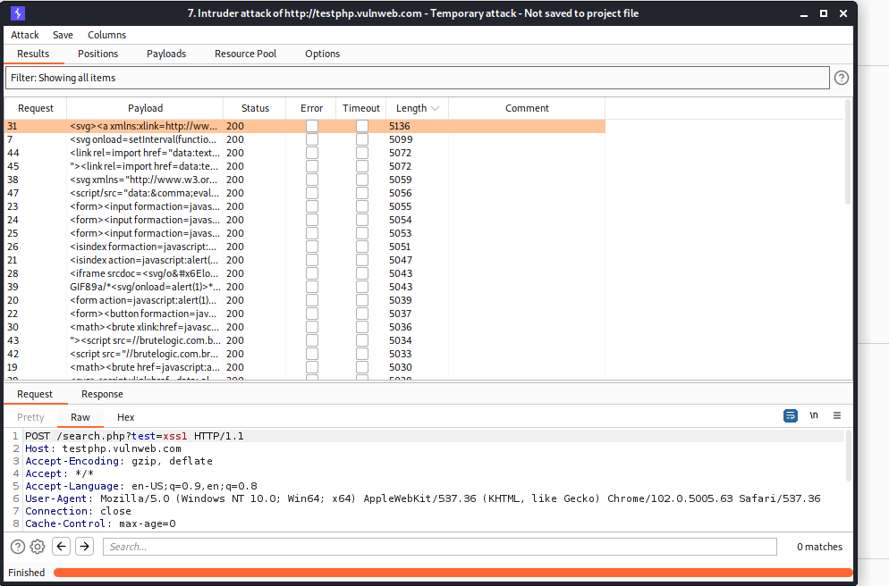
Step 7 : Try to find a successful payload for xss.

Slide 6
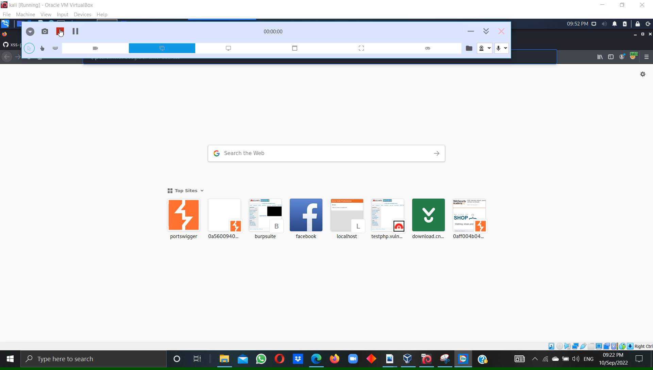
Step 8 : Then Show response in browser and Copy the link.
Step 9 : Open the new tab in browser and paste the copy link and press enter
Step10 : Click on image. alert notification pop up is shown

Slide 7
Impact :
The impact of cross-site scripting vulnerabilities can vary from one web application to another. It
ranges from session hijacking to credential theft and other security vulnerabilities. By exploiting
a cross-site scripting vulnerability, an attacker can impersonate a legitimate user and take over their
account.
Mitigation :
There are a number of precautions you can take to prevent XSS attacks.
1) Keep Software Up-To-Date.
2) Sanitize And Validate Input Fields.
3) Web Application Firewall.
4) Content Security Policy.

Slide 8
POC including screenshot/screen recording is included in the report which is attached below :
Image : parameter.PNG
Image : Repeater.PNG
Image : Intruder. PNG
Image : Payload.PNG
Video : Payload.mp4

