Slide 1
ICCV25: PDAF teaser

Slide 2
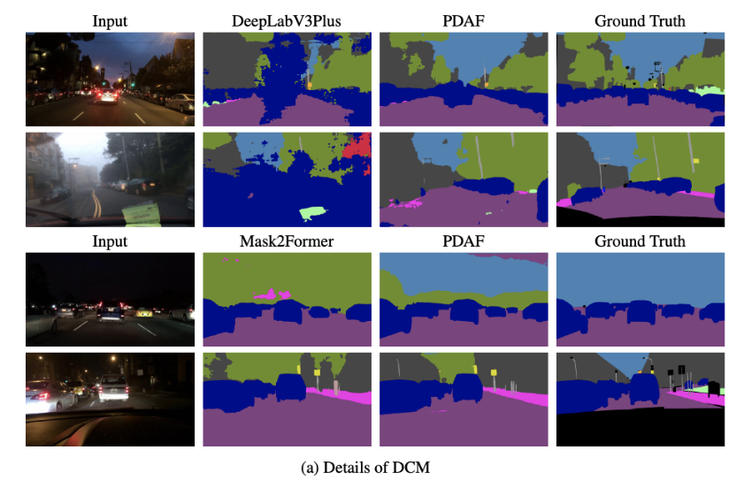
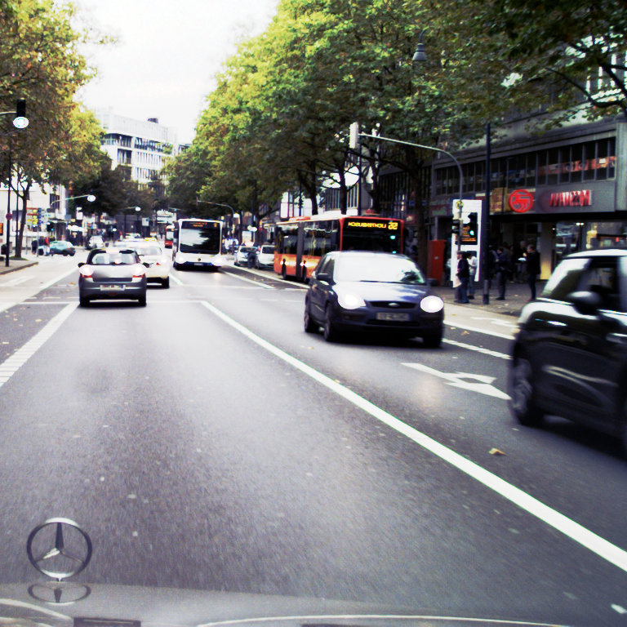
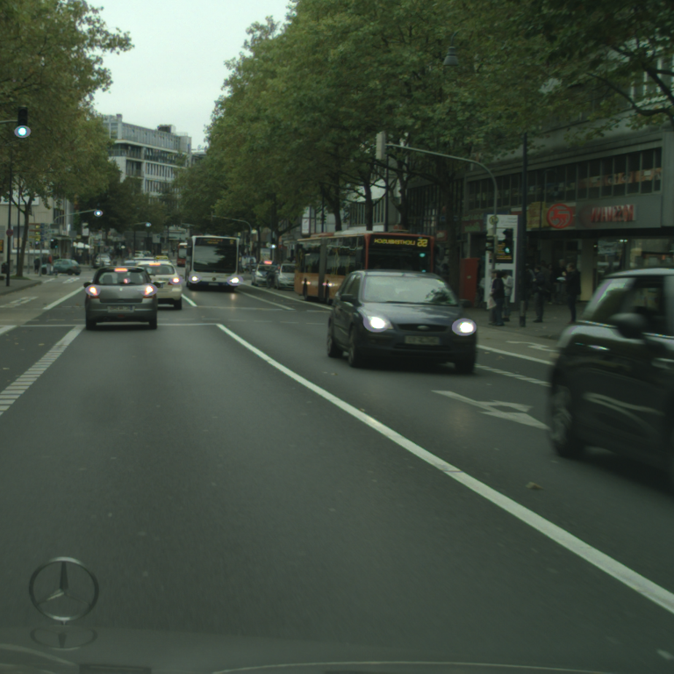
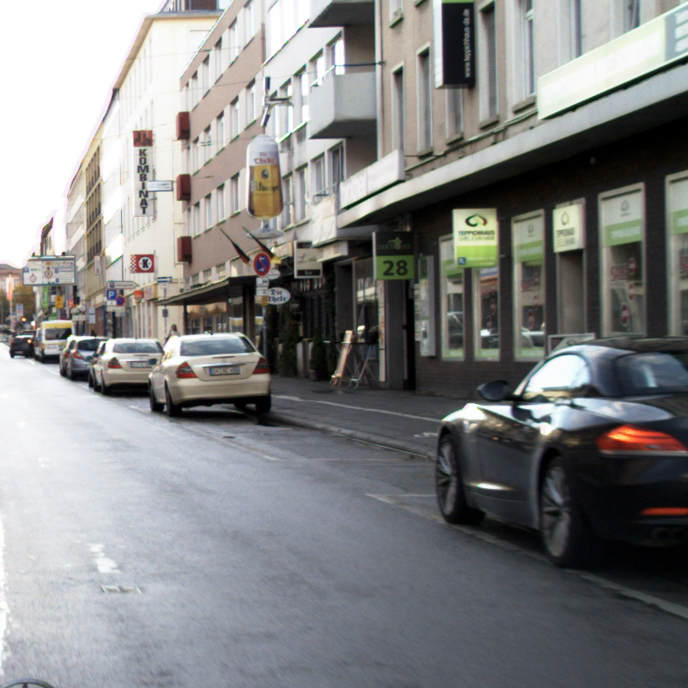
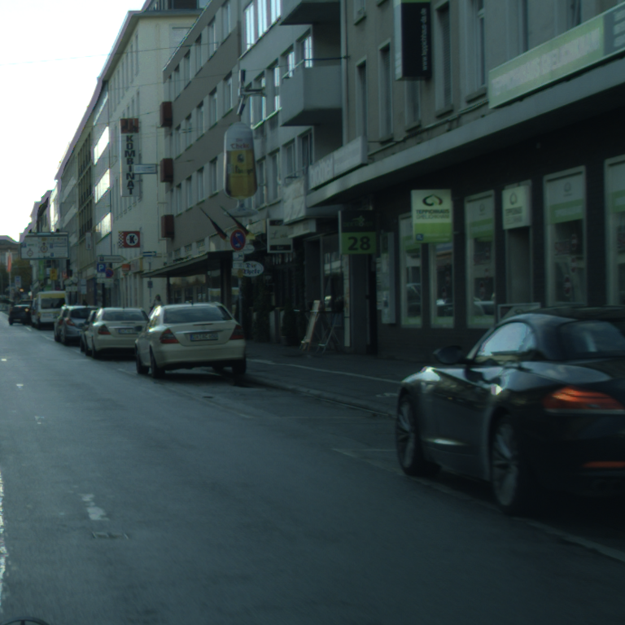
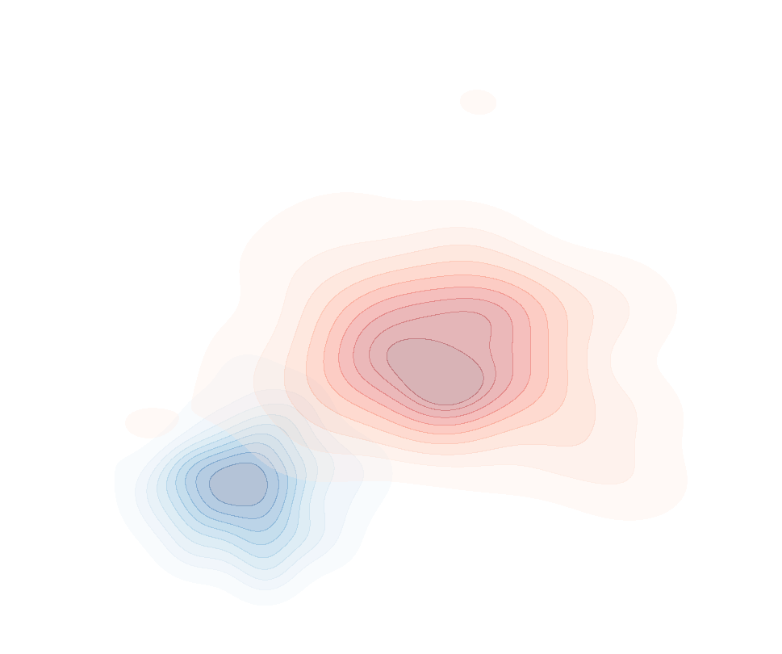
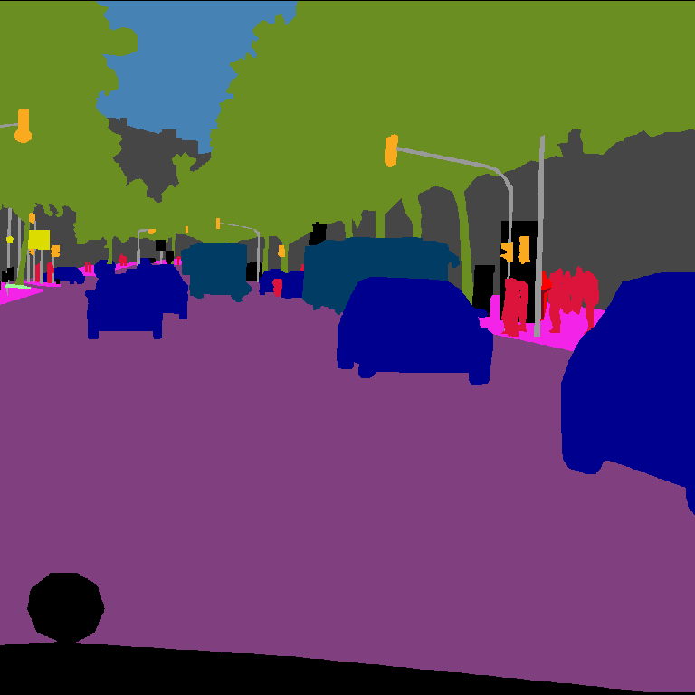
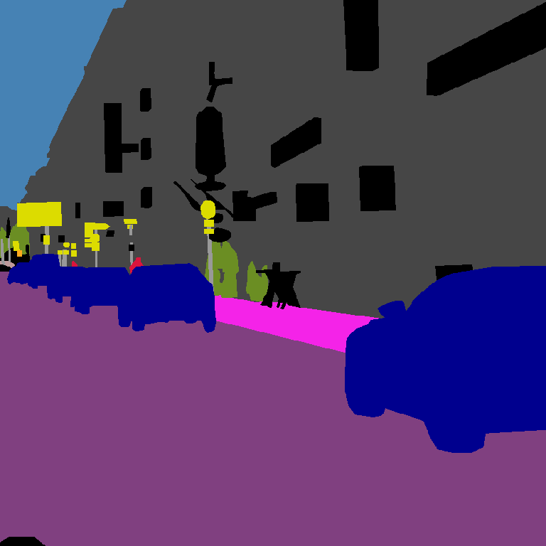

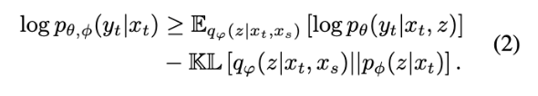




Source (s)
Target (t)
Source (s)
Target (t)
Image
Image
Encoder
Encoder
LDP Modeling
LDP Modeling
$$z$$
$$x_{t}$$
$$p_{φ}(z|x_{t})$$
$$z$$
$$x_{t}$$
$$p_{φ}(z|x_{t})$$
Latent Domain
Latent Domain
$$x_{s}$$
Domain-
Compensation
$$x_{s}$$
Domain-
Compensation
Decoder
Decoder
Segmentation
Segmentation

Slide 3
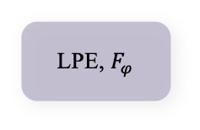


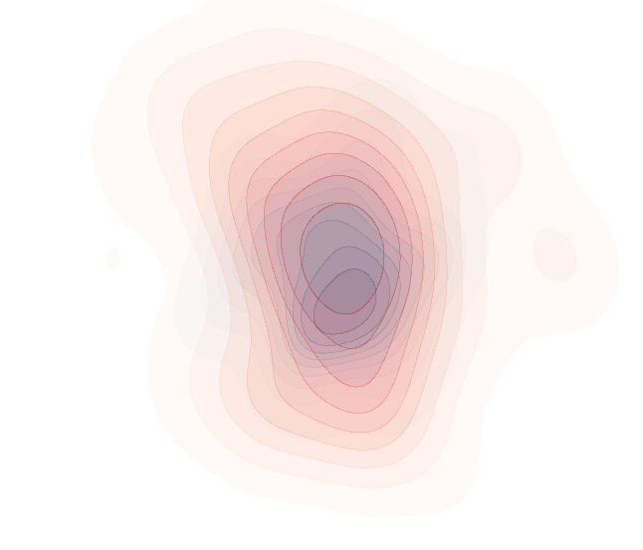








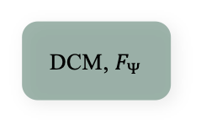









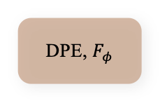


Pseudo Target Image, $x_{t^{′}}$
Prior $p_{φ}(.)$ & Prediction Model $p_{θ}(.)$
Pseudo Target Predictions,
$${\hat{y}}_{t^{′}},{\tilde{y}}_{t^{′}}$$
$h_{θ,t^{′}}$
${\hat{h}}_{θ,t^{′}}$
Encoder
$$E_{θ}$$
DPE, $F_{φ}$
DCM, $F_{Ψ}$
Decoder
$$D_{θ}$$
$${\hat{z}}_{0}$$
${\tilde{h}}_{θ,t^{′}}$
$${\hat{z}}_{T}$$
T steps
LDPs
Condition
Pseudo Target Domain
Semantic Consistency
LDP
Modelng
Estimated LDP
Prior Constraint
Loss
Feature
Alignment
Augmentation
Optimal LDP
Task-specific
Loss
Source Domain
Feature Space
$h_{θ,t^{′}}$
Encoder
$$E_{θ}$$
LPE, $F_{φ}$
Decoder
$$D_{θ}$$
$h_{θ,s}$
$$\tilde{z}$$
Source Image, $x_{s}$
Variational Posterior $q_{φ}(.)$
Source Prediction, $y_{s}$
Ground Truth, $y_{t^{′}}$
Trainable Module
Frozen Module
Loss Function
Image Sampling
Probabilistic Modeling
Features
LDPs
L
Pre-trained Segmentation Model
Notes:
CVPR

