Slide 1

Project Large-scale Data Engineering (LDE)
Kick-off Meeting
Dr.-Ing. Patrick Damme
Technische Universität Berlin
Berlin Institute for the Foundations of Learning and Data
Big Data Engineering (DAMS Lab)
Last update: Oct 11, 2026

Slide 2

Announcements/Org
Hybrid Purely Virtual Setting with Optional Attendance
  In-person in MAR 0.015
  Virtual via zoom
  https://tu-berlin.zoom-x.de/j/67376691490?pwd=NmlvWTM5VUVWRjU0UGI2bXhBVkxzQT09

Slide 3








About Me
Since 10/2022: Postdoc at TU Berlin, Germany
  FG Big Data Engineering (DAMS Lab) headed by Prof. Matthias Böhm
  Continuing work on integrated data analysis pipelines
  Research interests in the fields of database and ML systems
  (especially compiler & runtime techniques, extensibility, adaptive proc)
2021-2022: Postdoc at TU Graz & Know-Center GmbH, Austria
  Data Management group headed by Prof. Matthias Böhm
  Started work on integrated data analysis pipelines
2015-2020: PhD student at TU Dresden, Germany
  Dresden Database Research Group headed by Prof. Wolfgang Lehner
  PhD thesis on making complex analytical database queries more efficient
  through lightweight compression of intermediate results
MorphStore
& TVL

Slide 4
FG Big Data Engineering (DAMS Lab) – Teaching
Successfully Established TUB Teaching Portfolio (modules, slides)
Architecture of
Database Systems
(ADBS, WiSe)
DB system internals
+ prog. project
Architecture of
ML Systems
(AMLS, SoSe)
ML system internals,
data science lifecycle
+ prog. project
PR Project
ML Systems
(PMLS, WiSe)
Architecture of
ML Systems
(AMLS, SoSe)
SE Joint ML and DM (MLDM, SoSe+WiSe)
Master
Data Integration and Large-Scale Analysis
(DIA, WiSe)
Data Integration and Large-Scale Analysis
(DIA, WiSe)
Distributed
Data Management
SE/PR Large-scale Data Engineering
(LDE, SoSe+WiSe)
Bachelor
Intro to Scientific Methods (WiSe)
Data Management and Systems
(DMS, WiSe)
Data Management / Databases
(DM, SoSe+WiSe)
Data management from user/application perspective
PP Prog.-Practicals Data Systems
(PPDS, SoSe+WiSe)

Slide 5
Agenda
Course Organization, Outline, and Deliverables
How to Approach the Project
Projects in DAPHNE and Apache SystemDS
List of Project Topics

Slide 6
Course Organization, Outline, and Deliverables

Slide 7
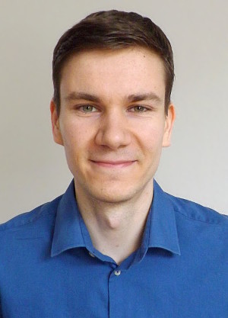
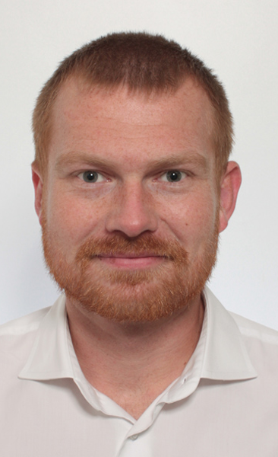
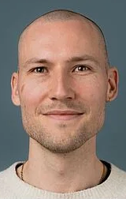
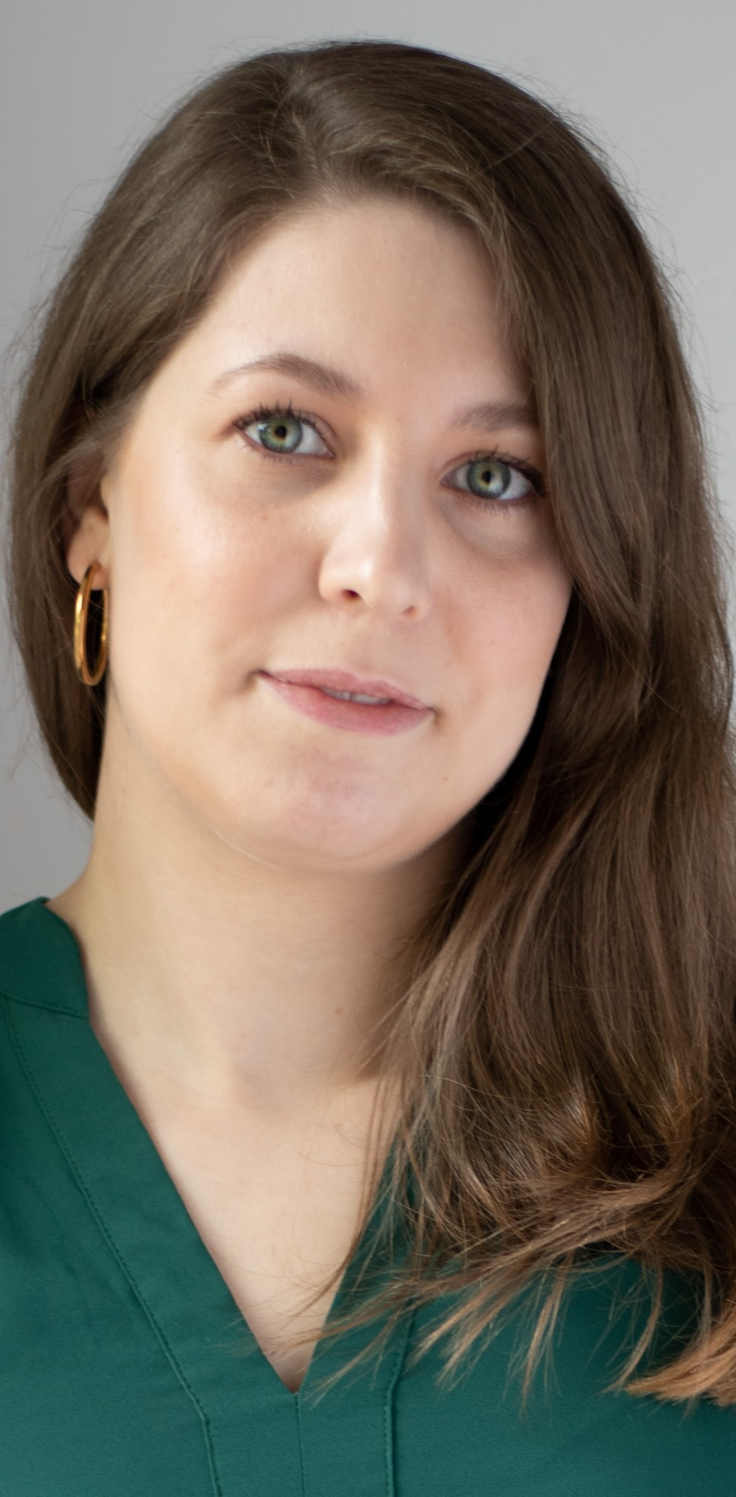
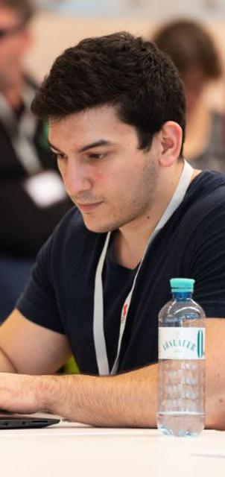
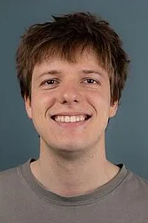
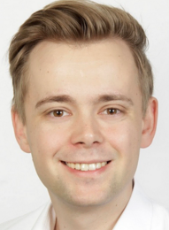
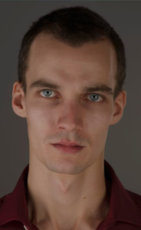
Large-scale Data Engineering: Module Overview
20+1 seats in total
master + bachelor
#41086: LDE Seminar + Project (12 ECTS)
10+1 students
10 students
#41095: Seminar LDE (3)
#41183: Project LDE (9 ECTS)
10 students
bachelor-only
bachelor-only
Mon, 14:00-16:00
MAR 0.015 & zoom
Seminar LDE
Reading & writing scientific papers
Giving presentations on papers
Summary paper
Presentation
Lecturer & seminar mentors
Project LDE
Building & evaluating prototypes
Giving presentations on prototypes
Prototype design/impl/tests/doc/eval
Presentation
Project mentors
Mon, 16:00-18:00
MAR 0.015 & zoom
…
In the context of systems for data engineering, data management, machine learning
In combination: Ideal preparation for a bachelor/master thesis with our group

Slide 8
Course Organization
People
  Lecturer (+organizational matters): Dr.-Ing. Patrick Damme (patrick.damme@tu-berlin.de)
  Individual project mentors (project-topic-related matters): Members of our group
Course Website
  https://pdamme.github.io/teaching/2026-27_winter/lde/lde_winter2026-27.html
  One site for seminar and project; all material, schedule, deadlines
ISIS course
  https://isis.tu-berlin.de/course/view.php?id=49696
  Announcements, discussion forum, topic selection poll, submission of summary paper and presentation slides
Language
  Lectures and slides: English
  Communication: English/German
  Submitted paper and presentation: English
  Informal language (first name is fine), immediate feedback is welcome

Slide 9
Semester Schedule & Deadlines
Kick-off Meeting Oct 12 (optional)
Recommended Introductory Lecture (optional)
  Oct 26, 14:00: Experiments, Reproducibility,
  and Giving Presentations
Self-organized Project Work
  Consultation hours for any questions (optional)
Intermediate Presentations (prerequisite)
  Jan 18, 16:00-18:00, MAR 0.017: All students
Final Presentations (mandatory)
  Feb 22, 14:00-18:00, MAR 0.017: All students
Code and Result Discussion (mandatory)
  Deep discussion with project mentor
  Within 2-3 weeks after final presentation
List of Project Topics
  Presented today, take your time to select afterwards
Topic Selection
  Deadline: Oct 23, 23:59 (in 1½ weeks)
  Ranked list of 5 topics via poll on the ISIS course
  + pref on individual/team work [+ team members]
  Global topic assignment based on preferences
  Notification of assigned topics: Nov 02 (in 3 weeks)
Submission of Initial Prototype (prerequisite)
  Implementation and tests
  Deadline: Jan 17, 23:59 (in 14 weeks)
  As a pull request on GitHub (exceptionally by email)
Submission of Final Prototype (mandatory)
  Implementation, tests, docs, experiments
  Deadline: Feb 21, 23:59 (in 19 weeks)
  As a pull request on GitHub (exceptionally by email)
Submission of Pres. Slides (Intermediate & Final Pres.)
  Deadline: The day before the presentation, 23:59
  Upload PDF in the ISIS course

Slide 10
Portfolio Exam Registration
Registration: Nov 02 – Nov 30
  Binding registration in Moses/MTS
  Including selection of seminar presentation date
  (first-come-first-serve)
De-registration
  Until 3 days before the first graded exam part
    De-register yourself in Moses/MTS
    Modules “LDE”/”Seminar LDE”: until Jan 08
    Module “Project LDE”: until Feb 18
  With sufficient reason: Until the day of the exam
    In case of sickness etc.
    Modules “LDE”/”Seminar LDE”:
    until Jan 11/Jan 25/Feb 01
    Module “Project LDE”: until Feb 21/Feb 22
Missing Deadlines/Exam Without De-registration
  Zero points in the respective exam part (!)
  Approach us early in case of problems
If You Don’t Want to Take LDE Anymore
  Let me know asap to give students in the queue
  a chance to fill in

Slide 11
LDE Project Goals and Mindset
Goals
  Design/implement a prototype in DAPHNE/SystemDS
  AND prove it is a valuable contribution to the system/library
  (tests, documentation, experiments)
  Present and defend your work in presentations & discussions
Focus on Methodology
  LDE as a preparation for a bachelor/master thesis at the DAMS Lab
Mindset: Be Open Learn New Things and to Work on Any Part of the System
  Whatever it takes to fulfill the task
  Self-guided acquisition of required technical skills
Grading Criteria
  Design/implementation (functionality)
  Code quality + tests + documentation
  Experiments
High-quality and
convincing contribution
to an open-source system

Slide 12
LDE Project Characteristics
Individual/Team Project Work
  Teams of up to 3 students strongly encouraged
  Unique topic for each individual/team
Ambitious Projects
  9 ECTS (~270 h of work)
  ≈6.75 weeks of full-time work
Potential for Impact
  Real open issues in existing systems
  If successful: meaningful contributions
  that will be used by others
Remarks on Topic Descriptions
  Many open topics in DAPHNE and SystemDS
  Initial topic descriptions of varying level of detail
  During topic selection: Approach project mentor directly if interested in more details
  After topic assignment: More detailed descriptions where necessary
  We’re open to alternative topic proposals

Slide 13
Project Deliverables: Initial Prototype & Intermediate Presentation
Introduced in Response to Students’ Feedback (Course Evaluation)
Initial Prototype
  ≈80% functionally complete prototype including good set of test cases
  Basis for further improvements driven by experiments and feedback
Intermediate Presentation
  Slide presentation of 5-10 min per individual/team
  Briefly present the problem you work on to your fellow students
  Give an overview of your initial prototype
  (concepts and crucial changes to the code base)
  Outline your planned experiments
  Should be the result of prior discussions with your project mentor
Benefits for You
  Improved time management (retain enough time for experiments)
  Exchange with the other students in the project
  Get feedback by project mentors and other students for improving the quality of your prototype
Ungraded prerequisites
for the portfolio exam
to be allowed make mistakes
and learn from them

Slide 14
Project Deliverables: Final Prototype & Final Presentation
Final Prototype
  100% functionally complete prototype
  including good set of test cases
  Efficiency confirmed by experiments
Final Presentation
  Summarize the problem and give an overview of your final prototype to your fellow students
  Present your experimental results
  1 student: 10 min talk + 5 min discussion = 15 min
  2 students: 13+7=20 min, 3 students: 16+9= 25 min
  Audience: Engage in the discussion
Code and Result Discussion
  Detailed discussion of project outcome (source code and experiments) with project mentor
  Show that you deeply understand your contribution
Academic Honesty / No Plagiarism
  Develop your own coding/experimentation skills
  Use of generative AI (ChatGPT etc.) is prohibited
Graded Portfolio Exam
  #41086 (seminar + project)
    25 pts: summary paper
    15 pts: presentation
    50 pts: design/impl/tests/doc
    10 pts: presentation
  #41183 (project-only)
    85 pts: implementation/tests/documentation
    15 pts: presentation

Slide 15
How to Approach the Project

Slide 16
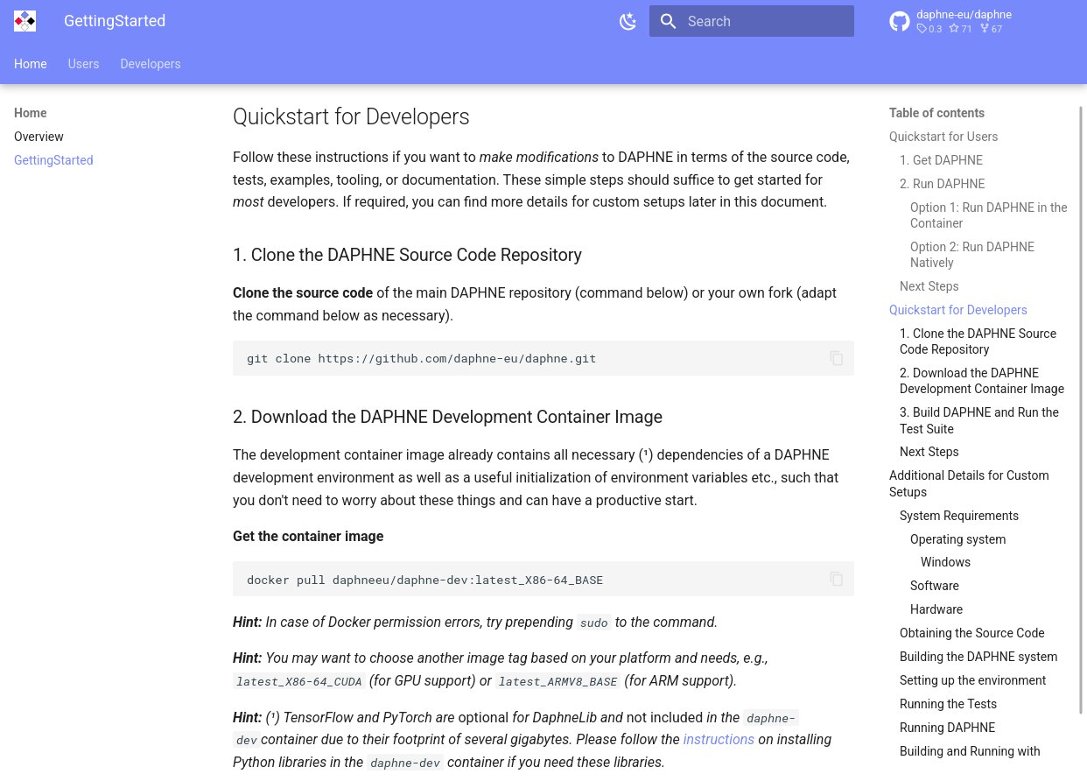
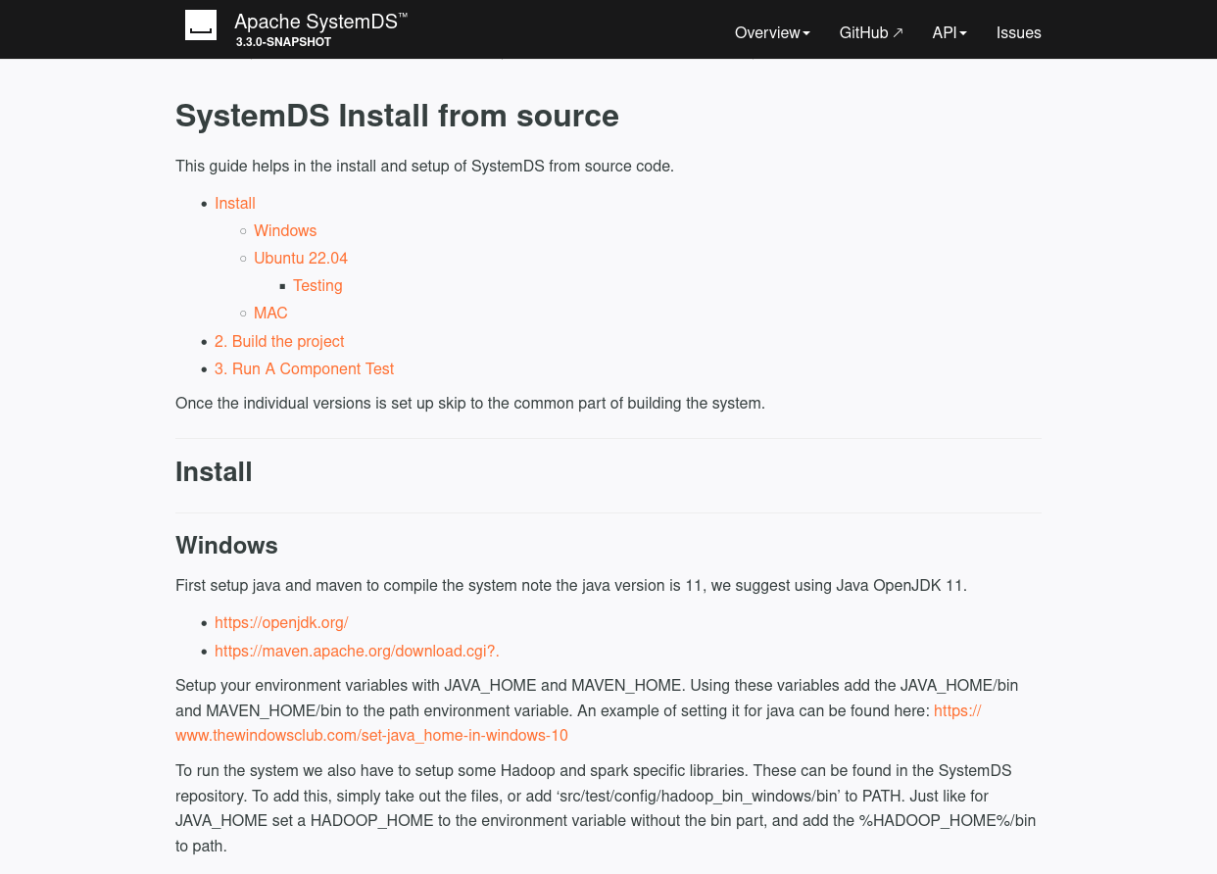
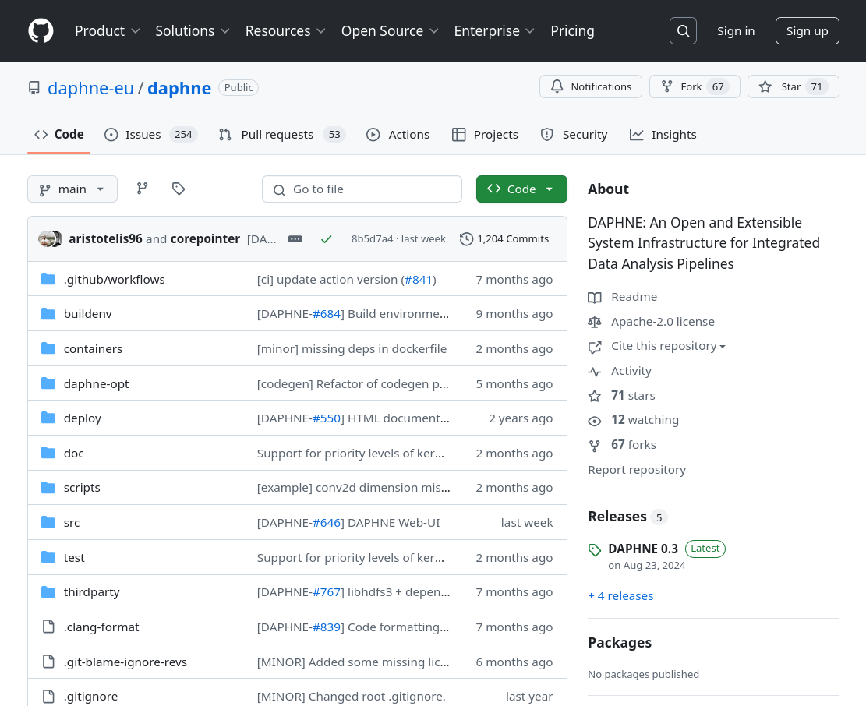
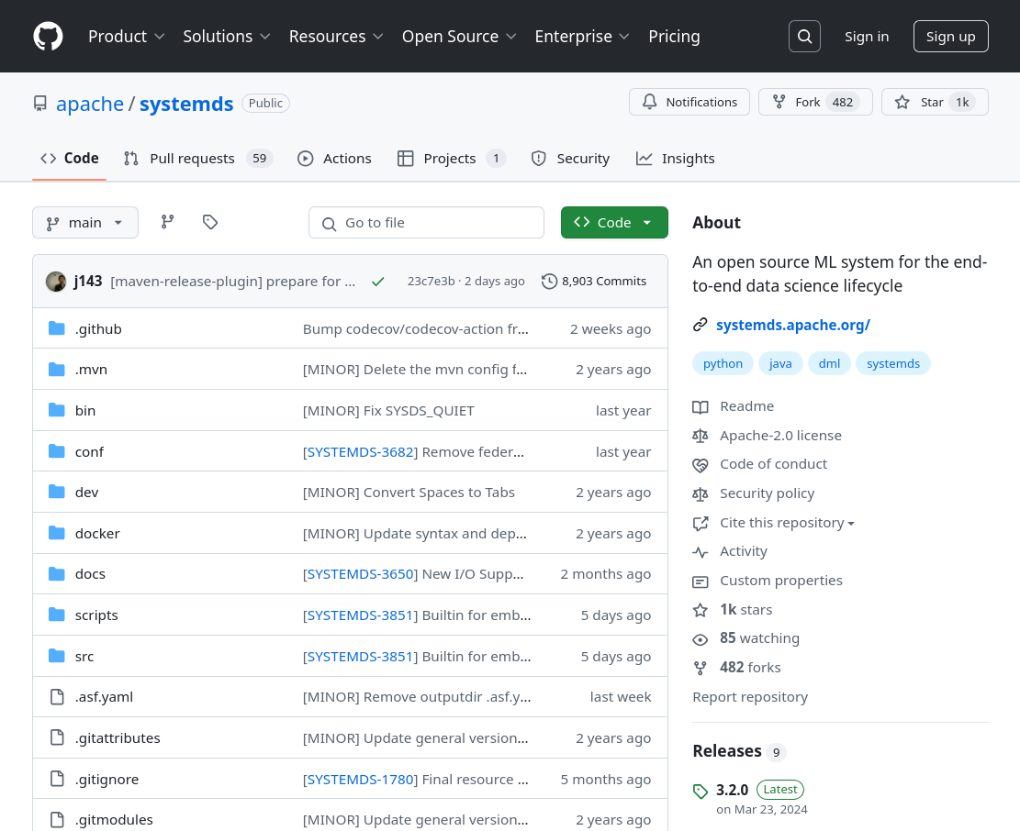
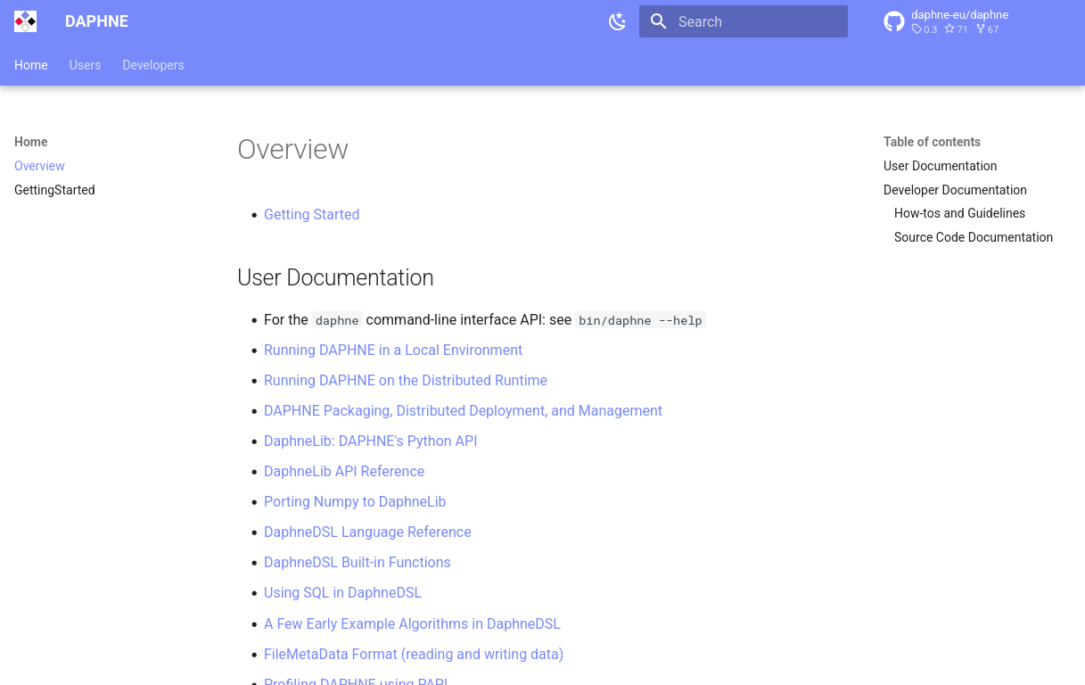
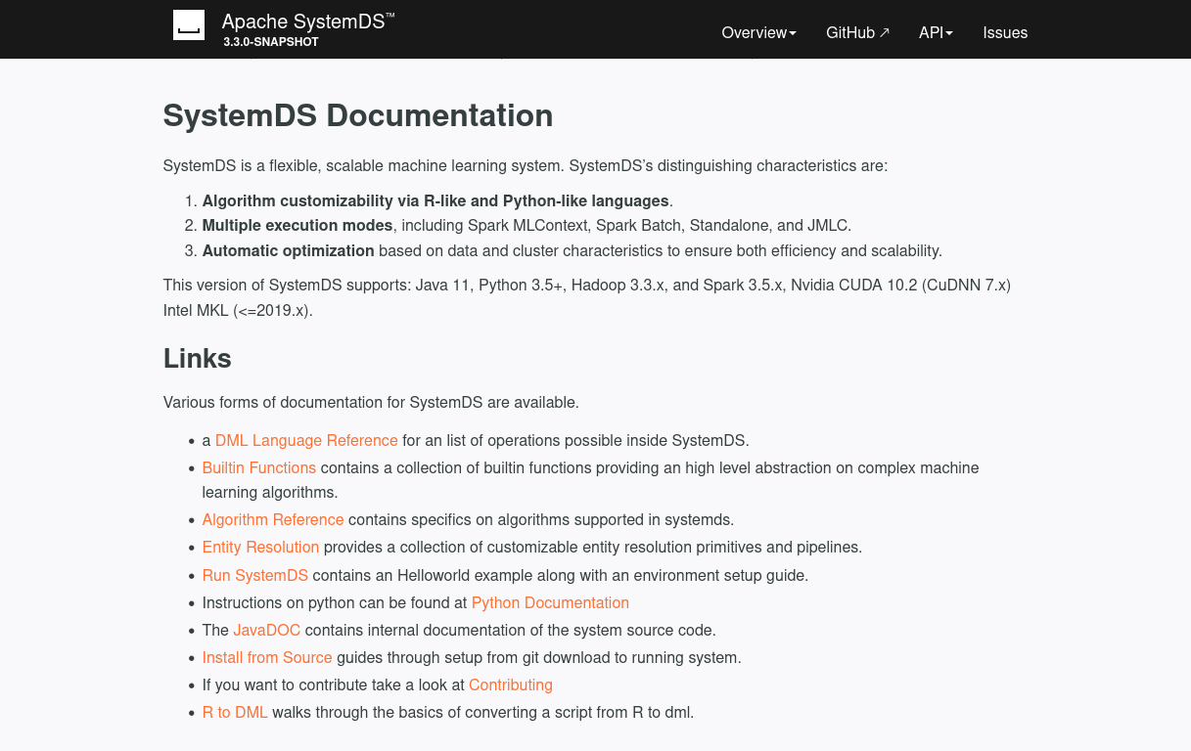
Getting Started: Setting Up Your Development Environment
Goals
  Build the system from source
  Successfully run the test suite
Navigate to the GitHub Repos
Know Where to Find the Documentation
Clone, Build, Test According to the Documentation
https://daphne-project.github.io/daphne/
GettingStarted/#quickstart-for-developers
https://apache.github.io/systemds/
site/install.html
https://github.com/daphne-eu/daphne
https://github.com/apache/systemds
https://daphne-project.github.io/daphne/
https://apache.github.io/systemds/

Slide 17
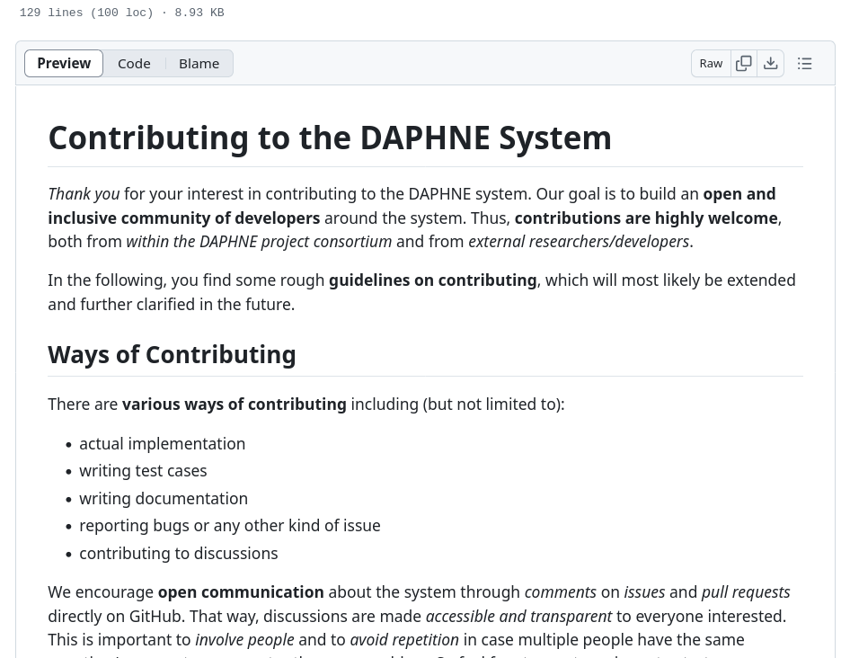
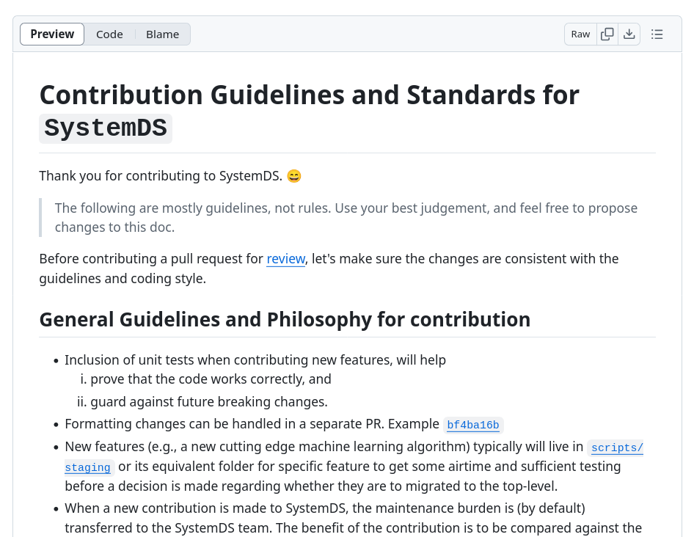
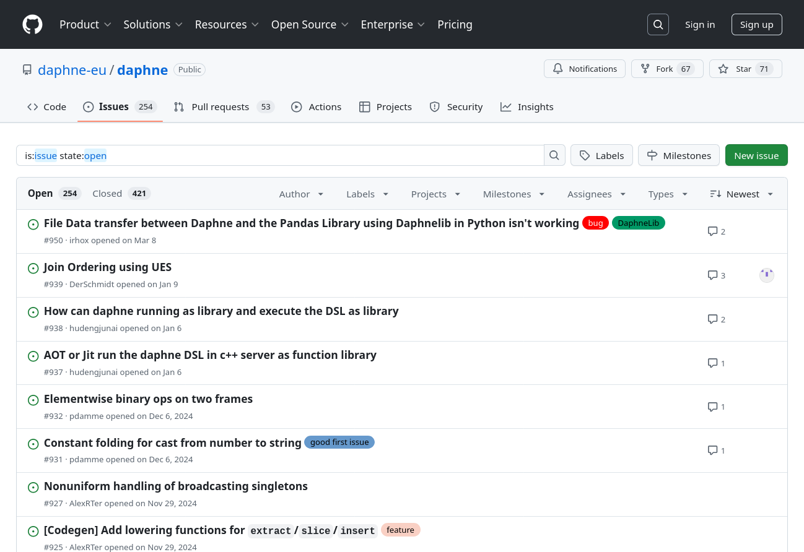
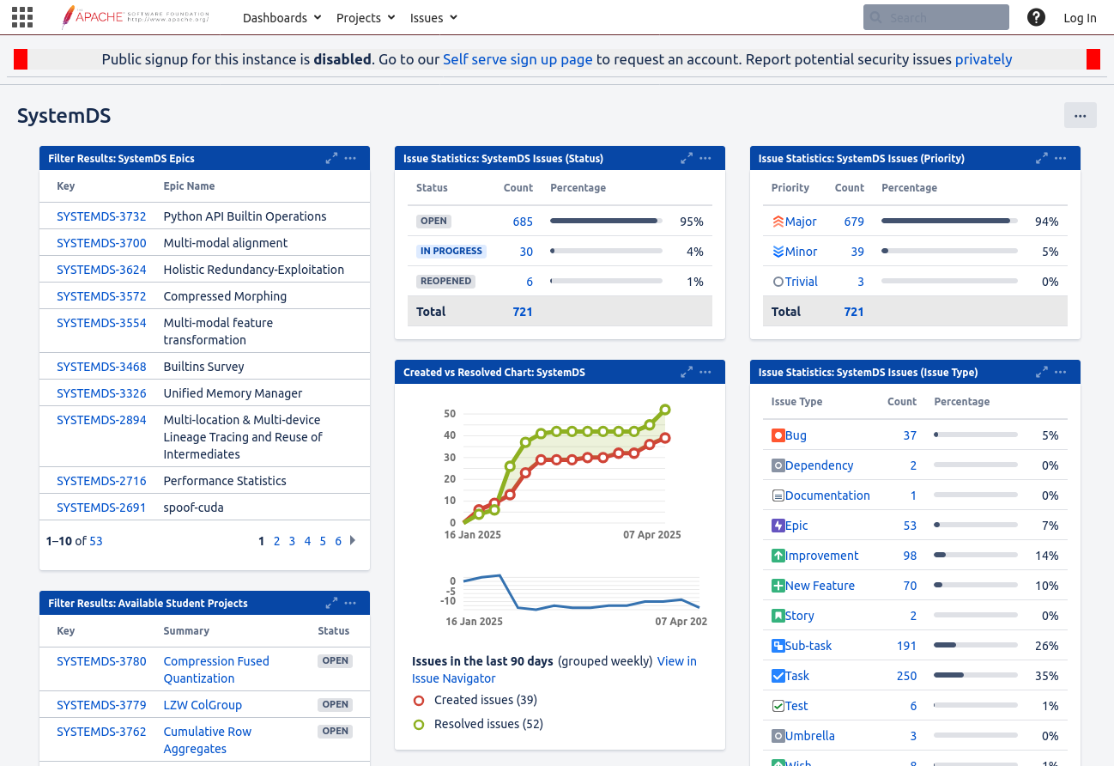
Getting Started: Preparing Your First Contribution
Goals
  Ability to modify the source code and run/test it
  Initial overview of relevant part of the code base
Set Up Your Editor/IDE etc.
Issue Tracking
Make Your First Modifications to the Code
  DAPHNE: “good first issues”
  SystemDS: Write initial test cases for your task
Read the Contribution Guidelines
https://github.com/daphne-eu/daphne/
blob/main/CONTRIBUTING.md
https://github.com/apache/systemds/
blob/main/CONTRIBUTING.md
https://github.com/daphne-eu/
daphne/issues
https://issues.apache.org/jira/secure/
Dashboard.jspa?selectPageId=12335852

Slide 18
Towards the Initial Prototype: Design/Implementation/Tests
(≈2/3 of the Semester)
Recap: Goals
  ≈80% functionally complete prototype
  including good set of test cases
  Basis for further improvements driven by experiments and feedback
Mindset
  Understand the topic
  (task description, mentor, additional material)
  Understand the code base
  (overview and relevant parts)
  Understand the employed libraries/frameworks
  Design and implement step-by-step
  Not always “the” right solution: explore alternatives
Recommendations
  Start as soon as possible
  → Don’t underestimate the ramp-up effort
  Actively approach your project mentor
  → Your mentor can give you valuable guidance

Slide 19
Towards the Final Prototype: Creating a Convincing Contribution
(≈1/3 of the Semester)
  .
Recap: Goals
  High-quality code contribution whose value
  can easily be appreciated and understood
Recommendations
  Submit tidy, well documented, extensively tested code
  View experiments as equally important as features,
  → Start initial experiments as soon as possible
  → Focus primarily on investigating and improving your initial prototype
  → after the intermediate presentation
  → Experiments show the value of your contribution
  → You need time to incorporate your insights
  Actively approach your project mentor
  → Your mentor can give you valuable guidance

Slide 20
Final Prototype: Code Quality
Goals
  Make your code easy to read/understand
  Others will have to maintain it after your contribution is merged
General Guidelines
  Clearly structure your code into meaningful units (classes, functions, etc.)
  Use clear yet concise identifiers (variable/function/class names)
  Stay consistent with the existing code base (e.g., use the same patterns) OR refactor if necessary
  Adhere to the code base’s coding style/formatting
Keep Your Pull Request Tidy
  Stay focused: Avoid changes unrelated to your task (can be contributed as individual small pull requests)
  Don’t submit anything that’s useless for others (e.g., build artifacts, generated files (e.g., logs), IDE projects)
  Exclude specifics of your local setup: Avoid local paths, usernames, passwords, IP addresses etc.
  Read your own pull request on GitHub (changed files)

Slide 21
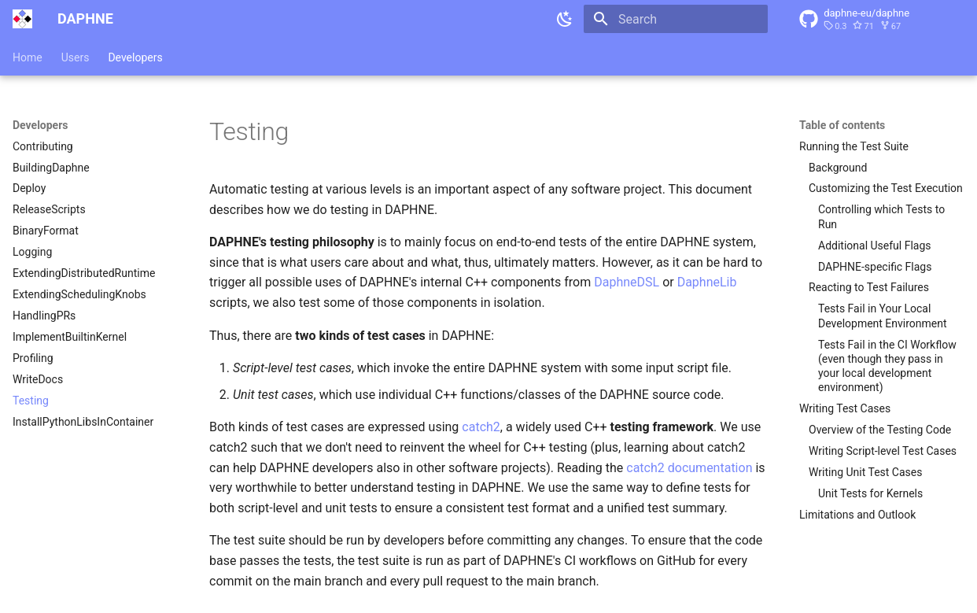
Final Prototype: Tests
Goals
  Show functionally correct behavior
  Experiments don’t make sense
  if prototype doesn’t do what it should
General Hints
  Unit tests and script-level tests
  Test cases that should work
  Test cases that should not work
  (e.g., invalid DSL scripts, invalid input data, …)
  Construct simple and complex scenarios
  Think of corner cases
  Small input data is often fine
  (but some bugs only triggered by large inputs)
Integrate with the Existing Test Suite
  DAPHNE
  → directory: test/
  → see the documentation on writing test cases
  SystemDS
  → directory: src/test/
https://daphne-project.github.io/daphne/
development/Testing/

Slide 22
Final Prototype: Documentation
Goals
  Make your contribution understandable for users and developers
User Documentation
  What’s not documented doesn’t exist
  Add high-level explanation of features and concepts behind them
  Update documentation of language abstractions (e.g., new DSL built-in functions, new types, …)
  Update documentation of user APIs (e.g., new command-line arguments)
Developer Documentation
  Negative example: “The code is the documentation”
  High-level explanation of your contribution; justify design decisions
  API documentation of classes, functions, members, etc.
  (integrate with the existing source code documentation of the system, e.g., doxygen or javadoc style)
  Comments within function bodies (e.g., high-level steps of an algorithm)

Slide 23
Final Prototype: Experiments
Goals
  Understand your prototype to discover potential for improvement (e.g., performance bottlenecks)
  Demonstrate functional improvements (new features)
  Showcase non-functional improvements (performance compared to status quo and state-of-the-art baselines)
Design Experiments
  Don’t just conduct any random experiments
  Think about which questions you want/need to answer, design experiments accordingly
  Types of experiments: Exploratory, micro benchmarks, benchmarks, end-to-end applications
  Aspects of an experiment: Data, workload, baselines, hardware & software stack, metrics
Conduct Experiments
  Automate as much as possible for repeatability (shell scripts etc.)
Visualize and Interpret the Results
  Automate the visualization based on raw experimental data
  Draw conclusions and react
See 3rd seminar intro lecture on
“Experiments, Reproducibility”

Slide 24
Projects in DAPHNE and Apache SystemDS

Slide 25




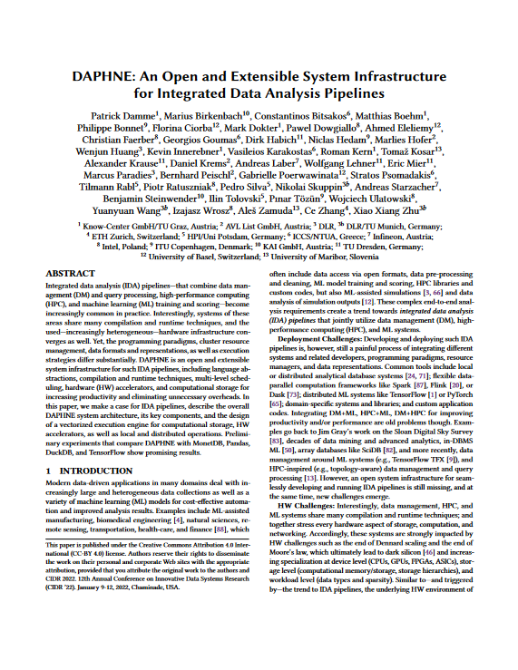
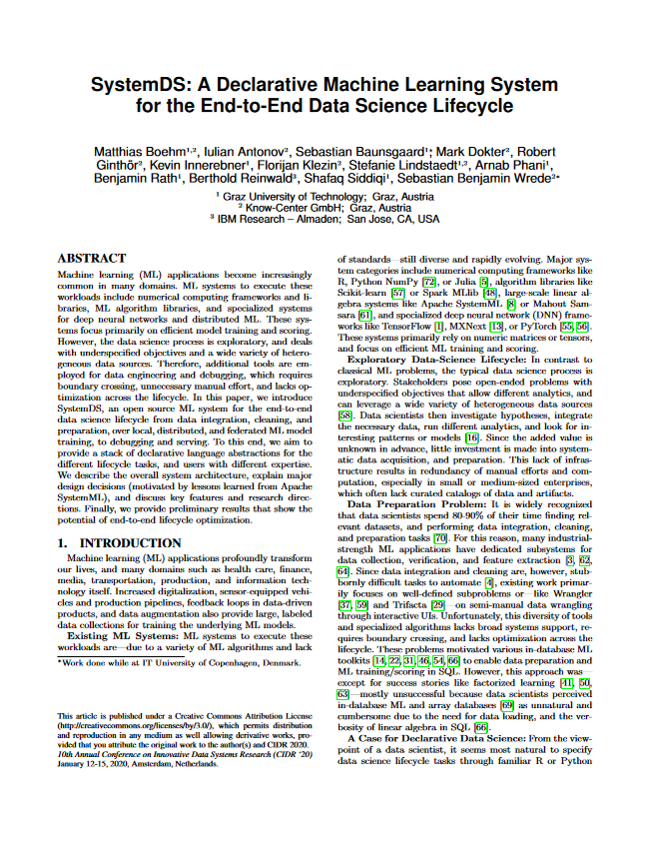
Overview: Two Systems Developed at the DAMS Lab
An Open and Extensible System Infrastructure
for Integrated Data Analysis Pipelines
  Intersection of data management,
  machine learning, high-performance computing
  Open-source (Apache v2 license)
  https://github.com/daphne-eu/daphne
  Originated from DAPHNE EU-project
  Written mostly in C++, Python, DaphneDSL
  Since 2020 (open-source since 2022)
A Declarative ML System for the
End-to-End Data Science Lifecycle
  Data integration/cleaning/prep, model selection/
  training/validation/debugging/deployment/scoring
  Open-source (Apache v2 license)
  https://github.com/apache/systemds
  Originated from Apache SystemML (started at IBM)
  Written mostly in Java, Python, and DML
  Since 2010 (open-source since 2015) (as SystemML)
[Patrick Damme et al.: DAPHNE: An Open and Extensible System Infrastructure for Integrated Data Analysis Pipelines. CIDR 2022]
[Matthias Boehm et al.: SystemDS: A Declarative Machine Learning System for the End-to-End Data Science Lifecycle. CIDR 2020]

Slide 26






Simplified High-level Architecture of DAPHNE and SystemDS
…
neural networks
clustering
Program
matrix/frame data types
linear/relational algebra ops
complex control flow
Input Data
open file formats
data exchange with other systems/libs
regression
…
classification
…
relational queries
System
Language Abstractions & APIs
Domain-specific language (DSL), Python API
Optimizing Compiler
DSL parser, Intermediate representation (IR),
Compiler passes (lowering and optimization)
Architecture of ML Systems
(AMLS): Lecture + Exercise
by Prof. Matthias Böhm
(every summer semester)
Other such systems (examples)
Runtime
Parallel local & distributed execution,
Hardware accelerators (e.g., GPU)
Output Data

Slide 27
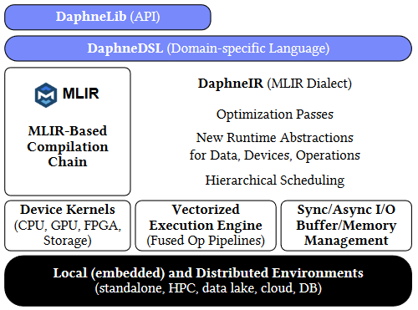
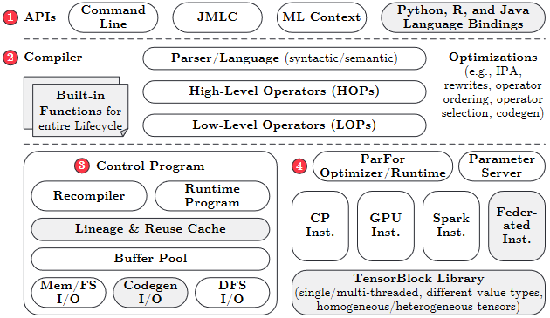
Simplified High-level Architecture of DAPHNE and SystemDS
Program
matrix/frame data types
linear/relational algebra ops
complex control flow
Input Data
open file formats
data exchange with other systems/libs
Language Abstractions & APIs
Domain-specific language (DSL), Python API
Optimizing Compiler
DSL parser, Intermediate representation (IR),
Compiler passes (lowering and optimization)
Runtime
Parallel local & distributed execution,
Hardware accelerators (e.g., GPU)
Output Data

Slide 28
Kinds of LDE Project Topics in Daphne and SystemDS
End-to-end Experiments
typically required in any project topic
Reusable Data Science Primitives
Data analysis algorithms/applications
Mostly in DaphneDSL/DML
Program
Input Data
Language Abstractions & APIs
System Internals
Optimization and efficient execution
of input programs (various aspects)
Mostly in C++/Java, some also in Python
External Tooling
Helpers in the ecosystem
Any suitable prog. lang.
Optimizing Compiler
Runtime
Openness to All Levels of the Stack
to fulfill the task
Choose topic based on your interests
and technical skills
Output Data

Slide 29
List of Project Topics (Proposals)
See list at https://pdamme.github.io/teaching/2026-27_winter/lde/ProjectTopics.pdf

Slide 30
Summary and Q&A
Course Organization, Outline, and Deliverables
How to Approach the Project
Projects in DAPHNE and Apache SystemDS
List of Project Topics (Topic Selection by Oct 23)
Remaining Questions?
Reminder: Seminar Introductory Lecture Recommended for the Project
  03 Experiments, Reproducibility, and Giving Presentations [Oct 26, 14:00]
See you during the consultation hours and intermediate presentations ☺

