Slide 1


Seminar Large-scale Data Engineering (LDE)
01 Structure of Scientific Papers
Dr.-Ing. Patrick Damme
Technische Universität Berlin
Berlin Institute for the Foundations of Learning and Data
Big Data Engineering (DAMS Lab)
[Credit: Based on “Introduction to Scientific Writing”/
”01 Structure of Scientific Papers” by Matthias Boehm
(TU Graz, winter 2021/22)]
Last update: Oct 11, 2026

Slide 2

Announcements/Org
Hybrid Purely Virtual Setting with Optional Attendance
  In-person in MAR 0.015
  Virtual via zoom
  https://tu-berlin.zoom-x.de/j/67376691490?pwd=NmlvWTM5VUVWRjU0UGI2bXhBVkxzQT09

Slide 3








About Me
Since 10/2022: Postdoc at TU Berlin, Germany
  FG Big Data Engineering (DAMS Lab) headed by Prof. Matthias Böhm
  Continuing work on integrated data analysis pipelines
  Research interests in the fields of database and ML systems
  (especially compiler & runtime techniques, extensibility, adaptive proc)
2021-2022: Postdoc at TU Graz & Know-Center GmbH, Austria
  Data Management group headed by Prof. Matthias Böhm
  Started work on integrated data analysis pipelines
2015-2020: PhD student at TU Dresden, Germany
  Dresden Database Research Group headed by Prof. Wolfgang Lehner
  PhD thesis on making complex analytical database queries more efficient
  through lightweight compression of intermediate results
MorphStore
& TVL

Slide 4
FG Big Data Engineering (DAMS Lab) – Teaching
Successfully Established TUB Teaching Portfolio (modules, slides)
Architecture of
Database Systems
(ADBS, WiSe)
DB system internals
+ prog. project
Architecture of
ML Systems
(AMLS, SoSe)
ML system internals,
data science lifecycle
+ prog. project
PR Project
ML Systems
(PMLS, WiSe)
Architecture of
ML Systems
(AMLS, SoSe)
SE Joint ML and DM (MLDM, SoSe+WiSe)
Master
Data Integration and Large-Scale Analysis
(DIA, WiSe)
Data Integration and Large-Scale Analysis
(DIA, WiSe)
Distributed
Data Management
SE/PR Large-scale Data Engineering
(LDE, SoSe+WiSe)
Bachelor
Intro to Scientific Methods (WiSe)
Data Management and Systems
(DMS, WiSe)
Data Management / Databases
(DM, SoSe+WiSe)
Data management from user/application perspective
PP Prog.-Practicals Data Systems
(PPDS, SoSe+WiSe)

Slide 5
Agenda
Course Organization, Outline, and Deliverables
Structure of Scientific Papers
List of Seminar Topics

Slide 6
Course Organization, Outline, and Deliverables

Slide 7
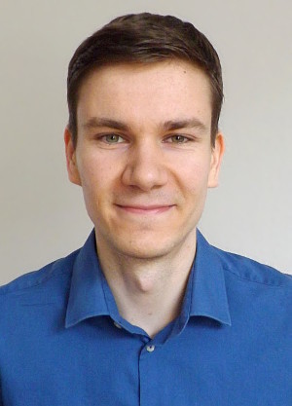
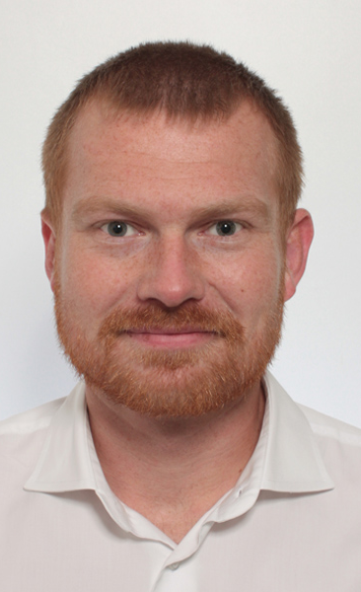
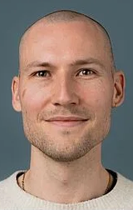
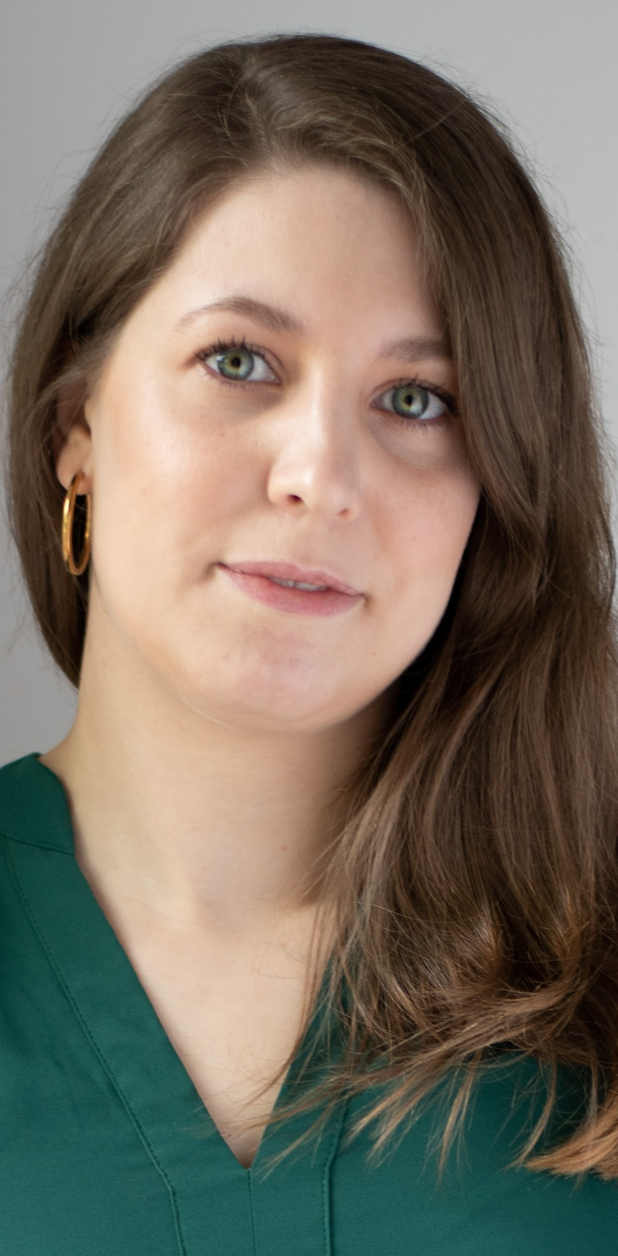
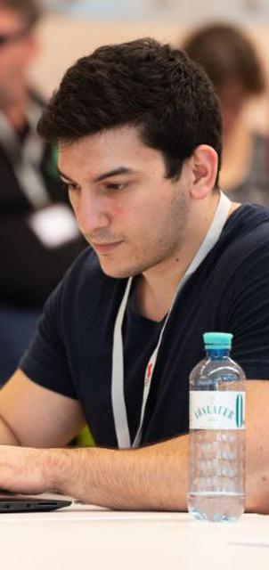
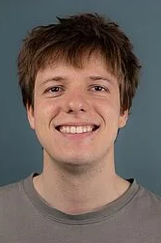
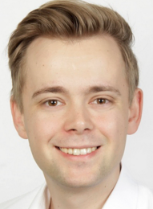
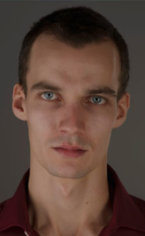
Large-scale Data Engineering: Module Overview
20+1 seats in total
master + bachelor
#41086: LDE Seminar + Project (12 ECTS)
10+1 students
10 students
#41095: Seminar LDE (3)
#41183: Project LDE (9 ECTS)
10 students
bachelor-only
bachelor-only
Mon, 14:00-16:00
MAR 0.015 & zoom
Seminar LDE
Reading & writing scientific papers
Giving presentations on papers
Summary paper
Presentation
Lecturer & seminar mentors
Project LDE
Building & evaluating prototypes
Giving presentations on prototypes
Prototype design/impl/tests/doc/eval
Presentation
Project mentors
Mon, 16:00-18:00
MAR 0.015 & zoom
…
In the context of systems for data engineering, data management, machine learning
In combination: Ideal preparation for a bachelor/master thesis with our group

Slide 8
Course Organization
People
  Lecturer (+organizational matters): Dr.-Ing. Patrick Damme (patrick.damme@tu-berlin.de)
  Teaching assistant (+seminar-topic-related matters): Dominic Stöcker, M.Sc. (d.stoecker@campus.tu-berlin.de)
Course Website
  https://pdamme.github.io/teaching/2026-27_winter/lde/lde_winter2026-27.html
  One site for seminar and project; all material, schedule, deadlines
ISIS course
  https://isis.tu-berlin.de/course/view.php?id=49696
  Announcements, discussion forum, topic selection poll, submission of summary paper and presentation slides
Language
  Lectures and slides: English
  Communication: English/German
  Submitted paper and presentation: English
  Informal language (first name is fine), immediate feedback is welcome

Slide 9
Semester Schedule & Deadlines
Three Introductory Lectures (optional)
  Oct 12: Structure of Scientific Papers
  Oct 19: Scientific Reading and Writing
  Oct 26: Experiments, Reproducibility,
  and Giving Presentations
Self-organized Seminar Work
  Consultation hours for any questions (optional)
  (FR 768 and zoom)
Final Presentations (mandatory, in-person)
  Jan 25, 14:00-18:00: Session #1
  Feb 01, 14:00-18:00: Session #2
List of Seminar Topics
  Presented today, take your time to select afterwards
Topic Selection
  Deadline: Oct 23, 23:59 (in 1½ weeks)
  Ranked list of 5 topics via poll on the ISIS course
  Global topic assignment based on preferences
  Notification of assigned topics: Oct 26 (in 2 weeks)
Submission of Summary Paper
  Deadline: Jan 11, 23:59 (in 13 weeks)
  Upload PDF in the ISIS course
Submission of Presentation Slides
  Deadline: The day before you present, 23:59
  Upload PDF in the ISIS course

Slide 10
Portfolio Exam Registration
Registration: Nov 02 – Nov 30
  Binding registration in Moses/MTS
  Including selection of seminar presentation date
  (first-come-first-serve)
De-registration
  Until 3 days before the first graded exam part
    De-register yourself in Moses/MTS
    Modules “LDE”/”Seminar LDE”: until Jan 08
    Module “Project LDE”: until Feb 18
  With sufficient reason: Until the day of the exam
    In case of sickness etc.
    Modules “LDE”/”Seminar LDE”:
    until Jan 11/Jan 25/Feb 01
    Module “Project LDE”: until Feb 21/Feb 22
Missing Deadlines/Exam Without De-registration
  Zero points in the respective exam part (!)
  Approach us early in case of problems
If You Don’t Want to Take LDE Anymore
  Let me know asap to give students in the queue
  a chance to fill in

Slide 11
Seminar Deliverables: Summary Paper
Individual Seminar Work
  1 student = 1 paper, no teamwork
Step 1: Understand the Topic
  Read and understand your selected paper
  Read up on any unclear concepts
  Search for related work to understand the context
  (at least 3-5 more papers, at least skim them)
Step 2: How Would You Explain the Topic?
  How would you structure the information?
  Which helpful illustrations would you draw?
  What key take-aways do you want to convey?
Step 3: Write the Summary Paper
  English, full text (sentences/paragraphs)
  4 pages + unlimited references
FAQ
  Title of the summary paper?
  => Feel free to choose your own (e.g., “A Summary of XYZ”)
  Author(s) of the summary paper?
  => Just you (not the original authors)
  Structure of the summary paper: Stick with the given paper’s?
  => Use your own, but adhere to the prototypical paper structure
  Summary == copy the most important sentences?
  => No, use your own words!
  Summary == slightly rephrase the text?
  => No, present the topic in your own way!
  Writing perspective?
  => “we” + ”the authors”
  Where to reference the given paper?
  => Reference after each sentence/paragraph usually unnecessary
  => Ensure that source of information is always clear,
  => e.g., ref once at the beginning of the section
  Copying figures, tables, listings, etc. from the given paper?
  => Create your own illustrations, tables, listings etc.
  => Exception (if necessary for accuracy): reuse plots (with ref)

Slide 12
Seminar Deliverables: Summary Paper: LaTeX Paper Template
Obtain the Template
  https://www.acm.org/publications/proceedings-template
  Download the ZIP archive acmart-primary.zip and unpack it
Select the Right Template
  The archive contains all ACM templates
  Use the sigconf document class
The Easiest Way to Set up Your Own Document
  Copy just the required files to a new directory
  Rename the .tex and .bib file as you like
  (and adapt the \bibliography{})
  Open the .tex file in a text/LaTeX editor
  Remove example contents, replace it by yours
  (title, authors, sections, paragraphs, figures, etc.)
  Replace the .bib contents by your BibTeX entries
acmart-primary/
samples/
sample-base.bib
sample-sigconf.tex
…
acmart.cls
ACM-Reference-Format.bst
…
lde-summary-paper/
literature.bib
summary-paper.tex
acmart.cls
ACM-Reference-Format.bst

Slide 13
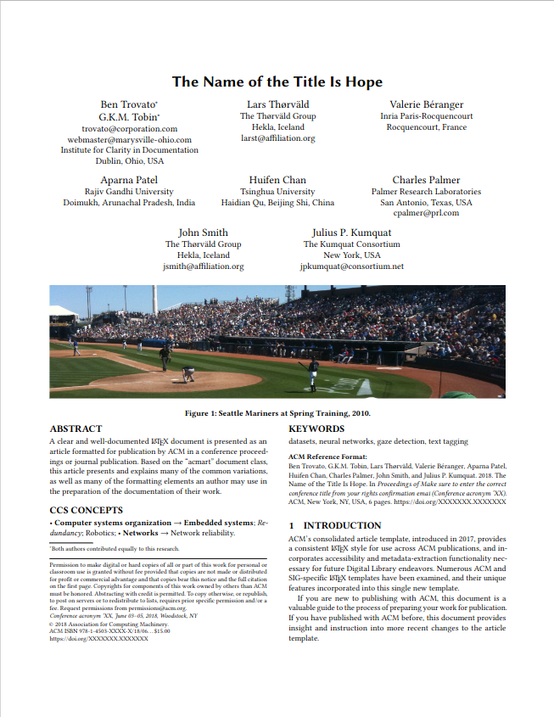
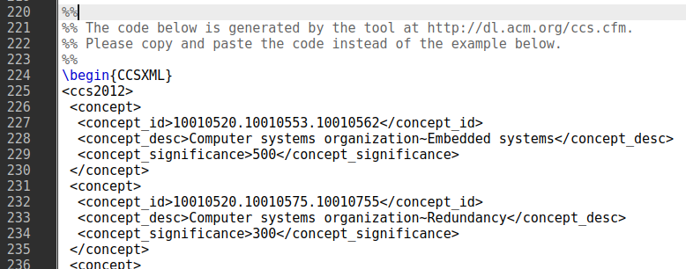
Seminar Deliverables: Summary Paper: LaTeX Paper Template
ACM acmart template
document class sigconf (double-column)
CCS concepts
(ACM Computing Classification System)
Select concepts at https://dl.acm.org/ccs
and insert generated code:
Teaser image
Not required (especially no photograph)
Keywords
Specify meaningful keywords
ACM reference format
Just keep as it is (ignore the dummy data)
Copyright notice
Just keep as it is (ignore the dummy data)

Slide 14
Seminar Deliverables: Presentation & Grading
Presentation
  Speaker: Explain the topic to your fellow students,
  such that they can understand it
  Create appropriate slide deck
  Clear motivation, background, approach, experiments, conclusions, etc.
  15 min talk + 5 min discussion (stay in time)
  Audience: engage in the discussion
Academic Honesty / No Plagiarism
  Develop your own reading/writing/pres skills
  Use of generative AI (ChatGPT etc.) is prohibited
Graded Portfolio Exam
  #41086 (seminar + project)
    25 pts: summary paper
    15 pts: presentation
    50 pts: design/impl/tests/doc/exps
    10 pts: presentation
  #41095 (seminar-only)
    65 pts: summary paper
    35 pts: presentation

Slide 15
Structure of Scientific Papers
In Computer Science (Data Management)
[Credit: Based on “Introduction to Scientific Writing”/
”01 Structure of Scientific Papers” by Matthias Boehm
(TU Graz, winter 2021/22)]

Slide 16
Overview Types of Scientific Writing
Classification of Scientific/Technical Documents
  Formal vs informal writing, cumulative?, single vs multi-author, archival vs non-archival publications
Scientific Reading/Writing Skills Are Crucial
  Different types of docs share many similarities
/
Monographs
Scientific Papers
Others
BS Thesis
by pub. channel
by contents
Grant Proposal
Preprint
Research
MS Thesis
Design doc
Conference
Industry
PhD Thesis
White Paper
Journal
Survey
Habilitation
Blog
Tech Report
E&A
Website
Vision
Demo

Slide 17



Paper Writing and Publication Process
Research – Writing Cycle
  Read lots of papers
  Idea → Research → Writing → Document
  Idea → Writing/Research → Document
  Incremental refinement of drafts
Paper Submission Cycle
  Blind vs double-blind submission
  Revisions and Camera-ready
  Similar: bachelor/master thesis
  → drafts to advisor / final version
Example: SIGMOD 2025: Paper Submission Round 4
  Oct 10, 2024: Abstract Submission & Declaration of COIs
  Oct 17, 2024: Paper Submission
  Nov 28, 2024: Notification of Accept/Review/Reject
  Dec 05, 2024: Submission of Revision Plan
  Dec 19, 2024: Revision Feedback
  Submission of Revised Paper
  Jan 30, 2025: Final Notification
  Submission of Camera-ready Version
[Eamonn Keogh: How to do good research, get it published in SIGKDD and get it cited!, KDD 2009]
[Simon Peyton Jones: How to write a great research paper, MSR Cambridge]

Slide 18
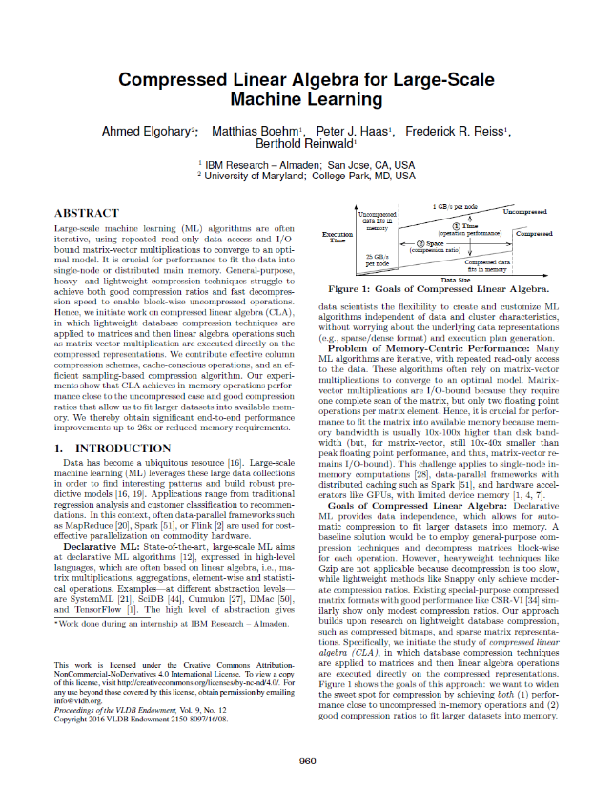
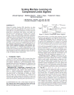

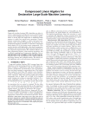
Running Example
Example paper used in the following
  Ahmed Elgohary, Matthias Boehm, Peter J. Haas, Frederick R. Reiss, Berthold Reinwald: Compressed Linear Algebra for Large-Scale Machine Learning. PVLDB 2016
[Ahmed Elgohary, Matthias Boehm, Peter J. Haas, Frederick R. Reiss, Berthold Reinwald: Scaling Machine Learning via Compressed Linear Algebra. SIGMOD Record 2017 46(1)]
[Ahmed Elgohary, Matthias Boehm, Peter J. Haas, Frederick R. Reiss, Berthold Reinwald: Compressed Linear Algebra for Large-Scale Machine Learning. VLDB Journal 2018 27(5)]
[Ahmed Elgohary, Matthias Boehm, Peter J. Haas, Frederick R. Reiss, Berthold Reinwald: Compressed Linear Algebra for Large-Scale Machine Learning. Commun. ACM 2019 62(5)]

Slide 19
Prototypical Structure of a Scientific Paper
Title & Authors
Sections and Subsections
  Abstract → short overview of problem and solution (part of meta data)
  Introduction → context, problem, contributions
  Background / Preliminaries → necessary background for understanding
  Main Part → technical core contributions
  Main Part 2
  Experiments → setting, micro benchmarks, end-to-end benchmarks
  Related Work → areas of related work, differences to your own work
  Conclusions → summary, conclusions, and future work
  Acknowledgments → funding agencies, helpful people beyond co-authors
  References → list of other works referenced throughout the paper
  (Appendix) → any additional contents (e.g., proves of theorems, more results)

Slide 20
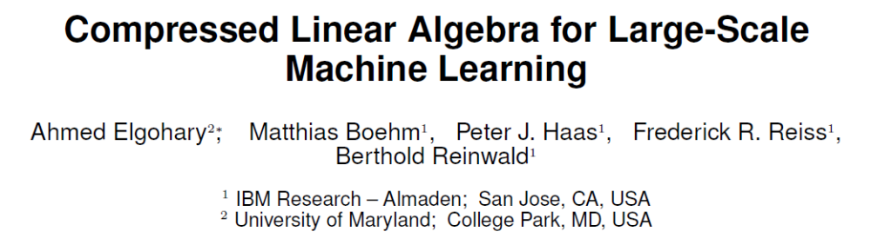
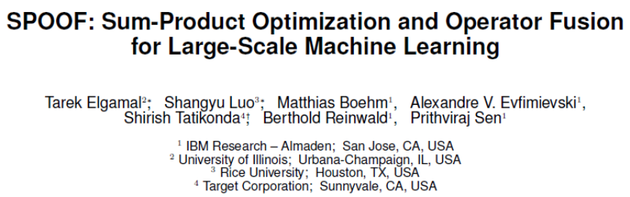
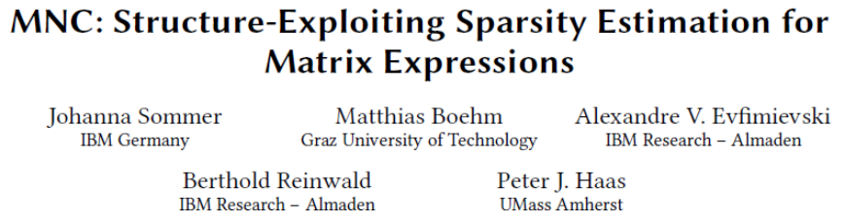
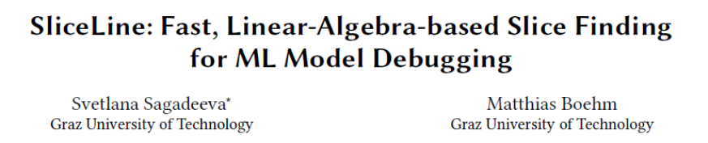

Title and Authors
Title
  Descriptive yet concise
  Short name if possible → easier to cite and discuss
List of Authors
  E.g., by contribution (main, …, advisor)
  E.g., by last name
  Affiliations, contact (corresponding author)
[Credit: sliceline,
Silicon Valley, HBO]

Slide 21
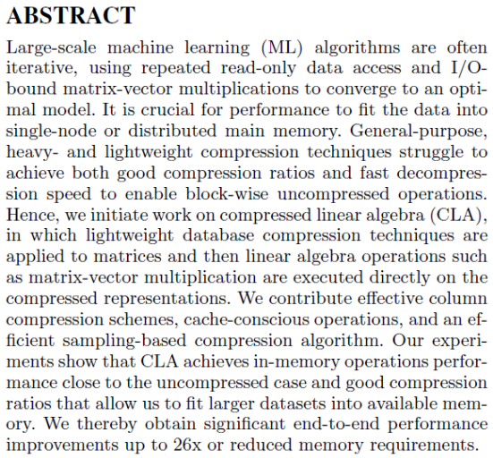
Abstract
% 1. State the problem
Large-scale machine learning (ML) algorithms are often iterative, using repeated read-only data access and I/O-bound matrix-vector multiplications to converge to an optimal model. It is crucial for performance to fit the data into single-node or distributed main memory.
% 2. Say why it's an interesting problem
General-purpose, heavy- and lightweight compression techniques struggle to achieve both good compression ratios and fast decompression speed to enable block-wise uncompressed operations.
% 3. Say what your solution achieves
Hence, we initiate work on compressed linear algebra (CLA), in which lightweight database compression techniques are applied to matrices and then linear algebra operations such as matrix-vector multiplication are executed directly on the compressed representations. We contribute effective column compression schemes, cache-conscious operations, and an efficient sampling-based compression algorithm. Our experiments show that CLA achieves in-memory operations performance close to the uncompressed case and good compression ratios that allow us to fit larger datasets into available memory.
% 4. Say what follows from your solution
We thereby obtain significant end-to-end performance improvements up to 26x or reduced memory requirements.
[Simon Peyton Jones: How to write a great research paper, MSR Cambridge]

Slide 22
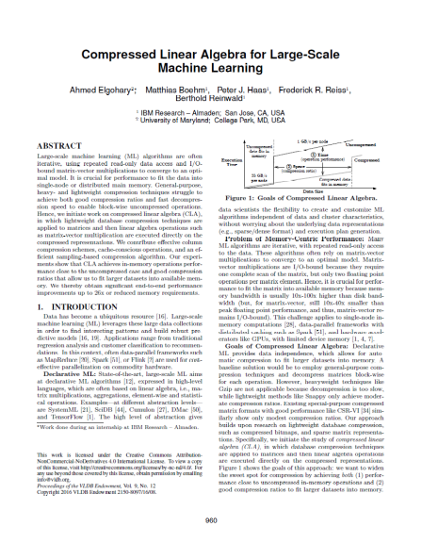
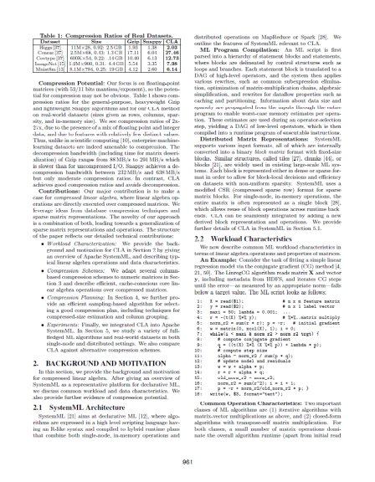
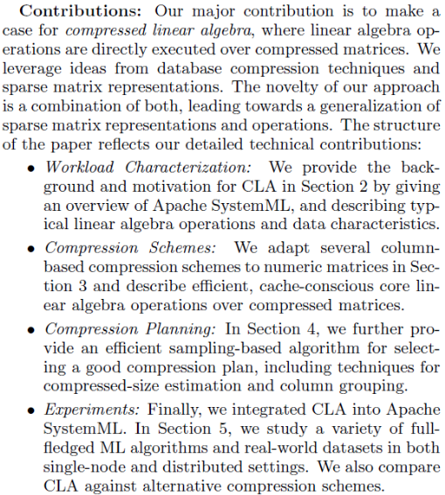
Introduction
Prototypical Structure
  Context (1 paragraph)
  Problems (1-3 paragraphs)
  [Existing Work (1 paragraph)]
  [Idea (1 paragraph)]
  Contributions (1 paragraph)
Introduction Matters
  Anchoring: most reviewers reach their opinion after reading introduction and motivation and then look for evidence
[Eamonn Keogh: How to do good research, get it published in SIGKDD and get it cited!, KDD 2009]

Slide 23
Main Part & Experiments
Main Part: Core Technical Contributions
  Make it easy to skim the paper
  → paragraph labels, self-explanatory figures (close to text), and structure
  Avoid unnecessary formalism → as simple as possible
  Shortening the text in favor of structure improves readability
Solid, Reproducible Experiments
  Experimental setup and methodology
  Experimental results (visual presentation, interpretation/conclusions)
  Different kinds of experiments for different aspects of the problem
02 Scientific Reading and Writing
03 Experiments, Reproducibility,
and Giving Presentations

Slide 24
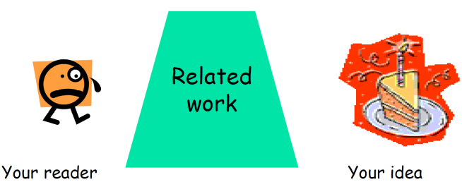
Related Work
Purpose of a “Related Work”-Section
  Not a mandatory task or to show you know the field
  Put you work in context of related areas (~ 1 paragraph each)
  Discuss closely related work
  Crisp separation from existing work (what are the differences)
Placement
  Section 2 or Section n-1
  Throughout the paper
Give Credit
  Cite broadly, give credit to inspiring ideas, create connections
  Honestly acknowledge limitations of your approach
[Simon Peyton Jones: How to write a great research paper, MSR Cambridge]

Slide 25
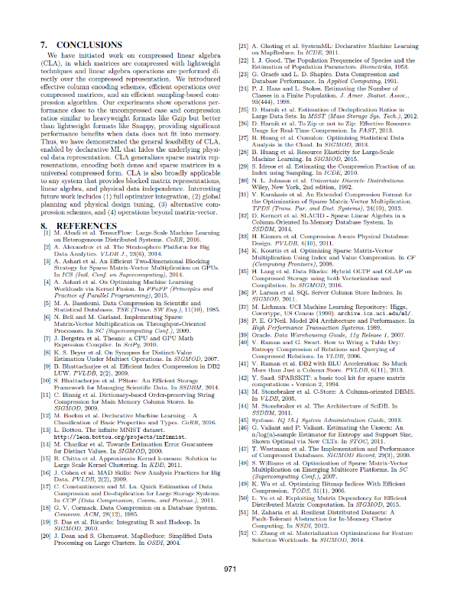
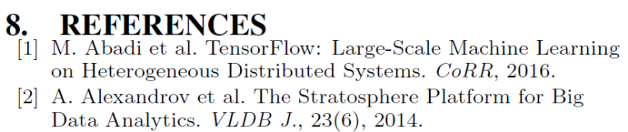
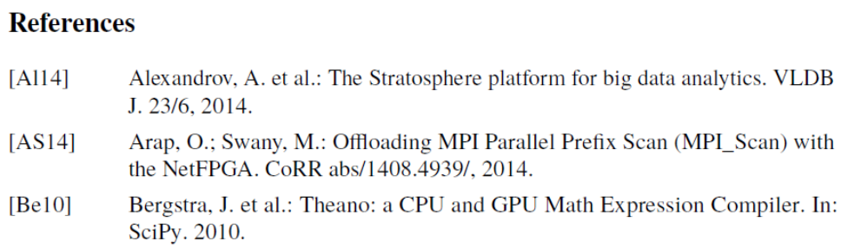
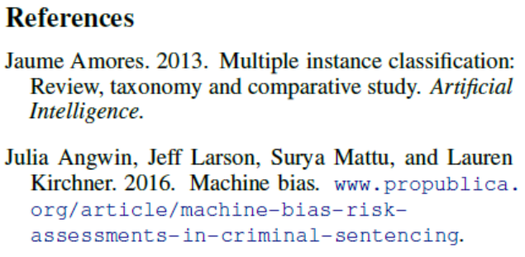
References
Setup
  Use LaTeX \cite{} and BibTeX
  Use a consistent source of bibtex entries (e.g., DBLP)
Different References Styles
  But, not in footnotes (unless required)
inproceedings{StonebrakerBPR11,
author = {Michael {Stonebraker et al.}},
title = {{The Architecture of SciDB}},
booktitle = {{SSDBM}},
year = {2011}
}
\bibliographystyle{abbrv}
\bibliography{VLDB2016}
VLDB2016.bib

Slide 26
List of Seminar Topics
See list at https://pdamme.github.io/teaching/2026-27_winter/lde/SeminarTopics.pdf

Slide 27
Summary and Q&A
Course Organization, Outline, and Deliverables
Structure of Scientific Papers
List of Seminar Topics (Topic Selection by Oct 23)
Remaining Questions?
Next Lectures
  Hopefully back to hybrid setup…
  02 Scientific Reading and Writing [Oct 19]
  03 Experiments, Reproducibility, and Giving Presentations [Oct 26]

