Slide 1

Project Large-scale Data Engineering (LDE)
Project Kick-off Meeting
Dr.-Ing. Patrick Damme
Technische Universität Berlin
Berlin Institute for the Foundations of Learning and Data
Big Data Engineering (DAMS Lab)
Last update: Oct 16, 2023

Slide 2

Announcements/Org
Hybrid Setting with Optional Attendance
In-person in TEL 811 (~20 seats)
Virtual via zoom https://tu-berlin.zoom.us/j/67376691490?pwd=NmlvWTM5VUVWRjU0UGI2bXhBVkxzQT09

Slide 3








About Me
Since 10/2022: Postdoc at TU Berlin, Germany
FG Big Data Engineering (DAMS Lab) headed by Prof. Matthias Böhm
Continuing work on integrated data analysis pipelines
Research interests in the fields of database and ML systems (especially compiler & runtime techniques, extensibility)
2021-2022: Postdoc at TU Graz & Know-Center GmbH, Austria
Data Management group headed by Prof. Matthias Böhm
Started work on integrated data analysis pipelines
2015-2020: PhD student at TU Dresden, Germany
Dresden Database Research Group headed by Prof. Wolfgang Lehner
PhD thesis on making complex analytical database queries more efficient through lightweight compression of intermediate results
MorphStore & TVL

Slide 4
FG Big Data Engineering (DAMS Lab) – Teaching
Architecture of Database Systems (ADBS, WiSe)
DB system internals + prog. project
Architecture of ML Systems (AMLS, SoSe)
ML system internals, data science lifecycle + prog. project
Architecture of ML Systems (AMLS, SoSe)
SE Joint ML and DM (MLDM, SoSe+WiSe)
Master
Data Integration and Large-Scale Analysis (DIA, WiSe)
SE/PR Large-scale Data Engineering (LDE, SoSe+WiSe)
Data Integration and Large-Scale Analysis (DIA, WiSe)
Distributed Data Management
Bachelor
Intro to Scientific Methods (WiSe)
Data Management / Databases (DM, SoSe+WiSe)
Data management from user/application perspective
PP Prog.-Practicals Data Systems (PPDS, SoSe+WiSe)

Slide 5
Agenda
Course Organization, Outline, and Deliverables
Apache SystemDS and DAPHNE
List of Project Topics (Proposals)

Slide 6
Course Organization, Outline, and Deliverables

Slide 7
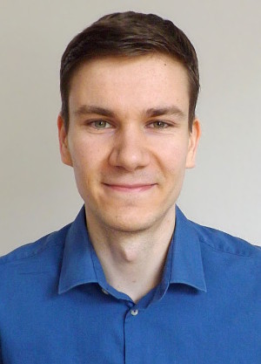
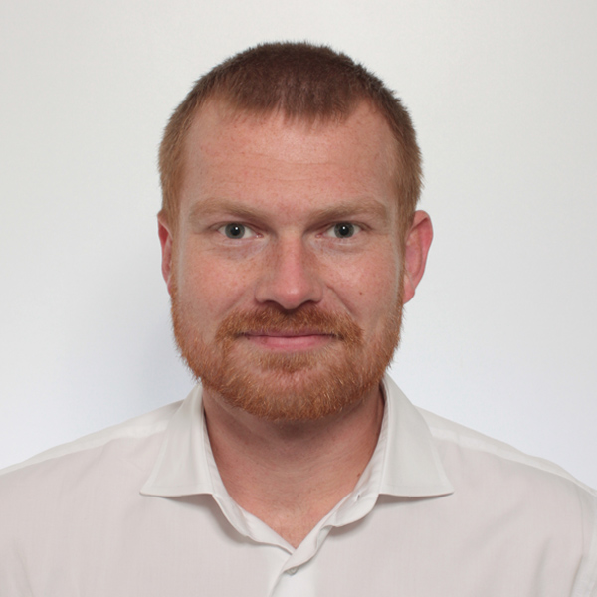
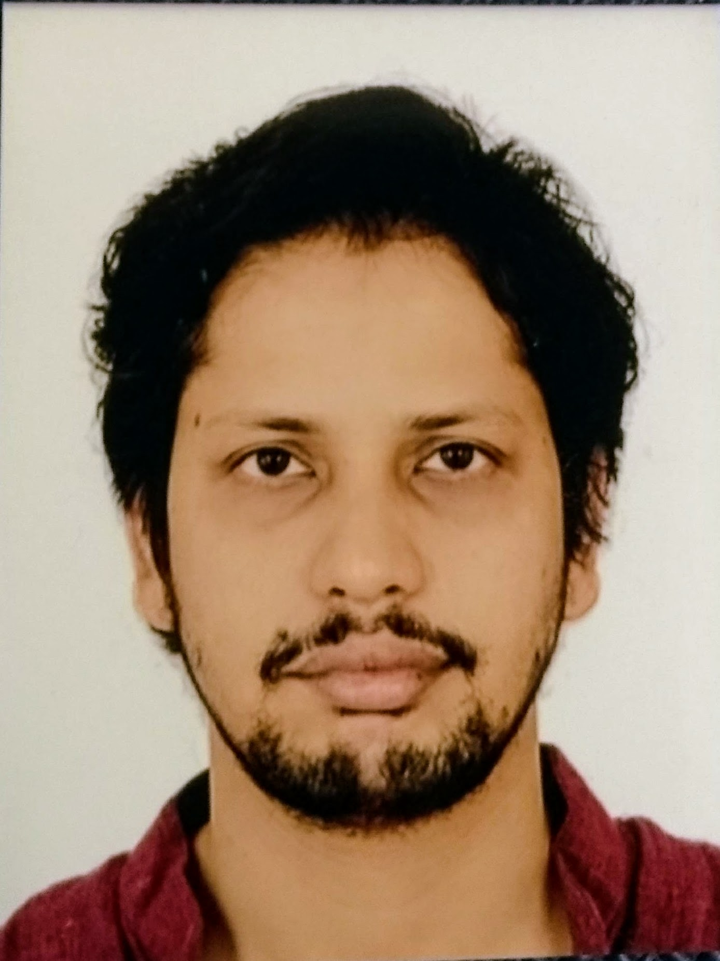
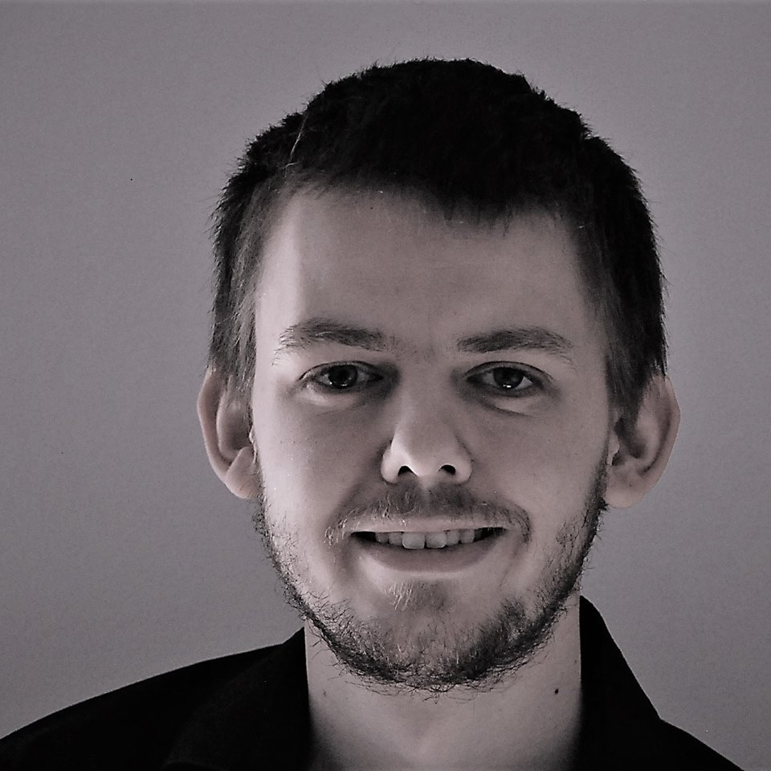
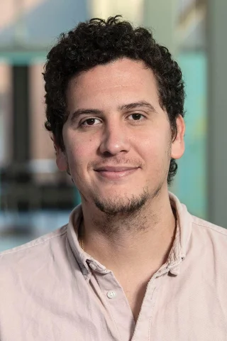
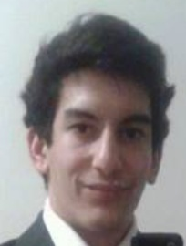
Large-scale Data Engineering: Module Overview
20+5 places in total
bachelor + master
#41086: LDE Seminar + Project (12 ECTS)
13 students
12 students
#41095: Seminar LDE (3)
#41094: Project LDE (9 ECTS)
6 students
bachelor-only
bachelor-only
Mon, 14:00-16:00
TEL 811 & zoom
Seminar LDE
Reading & writing scientific papers
Giving presentations on papers
Summary paper
Presentation
Lecturer & seminar mentor
Project LDE
Building & evaluating prototypes
Giving presentations on prototypes
Prototype design/impl/tests/doc
Presentation
Project mentors
Mon, 16:00-18:00
TEL 811 & zoom
In the context of systems for data engineering, data management, machine learning
In combination: Ideal preparation for a bachelor/master thesis with our group

Slide 8
Course Organization
General Contact Person
Dr.-Ing. Patrick Damme (patrick.damme@tu-berlin.de)
Course Website
https://pdamme.github.io/teaching/2023-24_winter/lde/lde_winter2023-24.html
One site for seminar and project
All material, schedule, deadlines
ISIS course
https://isis.tu-berlin.de/course/view.php?id=35039
Announcements, discussion forum, polls
Language
Lectures and slides: English
Communication: English/German
Submitted paper and presentation: English
Informal language (first name is fine), immediate feedback is welcome

Slide 9
Semester Schedule & Deadlines
Kick-off Meeting Oct 16 (optional)
Recommended Introductory Lecture (optional)
Oct 30, 14:00: Experiments, Reproducibility, and Giving Presentations
Self-organized Project Work
Office hours for any questions (optional)
Recommendation:
Basic prototype working by end of Dec
Focus on incorporating feedback and conducting experiments afterwards
Final Presentations (mandatory)
Feb 26, 14:00-18:00: Session #1
Mar 04, 14:00-18:00: Session #2
List of Project Topics
Presented today, take your time to select afterwards
Topic Selection
Deadline: Oct 30, 23:59 CET (in 2 weeks)
Email to Patrick Damme
Ranked list of ~5 topics
Individual work / team work / open to both
Feel free to approach us as a team
Global topic assignment based on preferences
Notification of assigned topics: Nov 06 (in 3 weeks)
Submission of Impl/Tests/Doc
Deadline: Feb 19, 23:59 CET (in 18 weeks)
As a pull request on GitHub (exceptionally by email)
Submission of Presentation Slides
Deadline: The day before you present, 23:59 CET
Presentation slides (PDF) to PD and project mentor

Slide 10
Project Deliverables
Individual/Team Project Work
Teams of up to 3 students strongly encouraged
Design/Implementation/Tests/Documentation
Get familiar with the given task/problem
Develop an initial design for discussion
Discuss the design during the office hours
Implement your design, plus tests and docs
Conduct experiments and analyze/visualize results
Presentation
Summarize the problem and your solution (design, implementation, experimental results)
1 student: 10 min talk + 5 min discussion = 15 min
2 students: 13 min + 7 min = 20 min
3 students: 16 min + 9 min = 25 min
Audience: engage in the discussion
Grading
#41086 (seminar + project)
Graded portfolio exam
25 pts: summary paper
15 pts: presentation
50 pts: design/impl/tests/doc
10 pts: presentation
#41094 (project-only)
Ungraded portfolio exam
85 pts: implementation/tests/documentation
15 pts: presentation
Academic Honesty / No Plagiarism (incl LLMs like ChatGPT)

Slide 11
Portfolio Exam Registration
Portfolio exam registration: Nov 06 – Dec 04
Binding registration in Moses/MTS
Including selection of project presentation date
Members of a team register for the same date (agree on the date within your team first)
Portfolio exam de-registration
Until 3 days before the first graded exam part
Modules “LDE”/”Seminar LDE”: until Jan 05
Module “Project LDE”: until Feb 16
De-register yourself in Moses/MTS
With sufficient reason: Until the day of the exam
In case of sickness etc.
Modules “LDE”/”Seminar LDE”: until Jan 08
Module “Project LDE”: until Feb 19
Missing deadlines/exam without de-registration
Zero points in the respective exam part
Approach us early in case of problems
If you don’t want to take LDE anymore
Let me know asap to give students in the queue a chance to fill in

Slide 12
LDE Project Characteristics
Unique Characteristics
Each student/team gets a different topic
Advantages
Topics are real open issues in existing systems
Meaningful contributions to open-source systems
Your work will be used by others (impact)
You earn 9 ECTS (~270 h of work)
~6.75 weeks of full-time work
Practice Open-source Processes
Breakdown into subtasks
Code/tests/docs
Pull requests
Code review
Incorporate feedback to improve code
Remarks on Topic Descriptions
Lots of open topics to work on in the two systems we develop in our group
Initial topic descriptions of varying level of detail
If there is interest in a specific topic, we will provide more detailed descriptions with some pointers (please approach project mentors directly)
Open to alternative topic proposals

Slide 13




LDE Projects in the Context of Two Open-source Systems
DAPHNE EU-project https://github.com/daphne-eu/daphne
Focus on integrated data analysis pipelines
Project implementation in C++ and Python
Apache SystemDS https://github.com/apache/systemds
Focus on the end-to-end data science lifecycle
Project implementation in Java, Python, and DML

Slide 14

Apache SystemDS: A Declarative ML System for the End-to-End Data Science Lifecycle
https://github.com/apache/systemds

Slide 15














Landscape of ML Systems
Existing ML Systems
#1 Numerical computing frameworks
#2 ML Algorithm libraries (local, large-scale)
#3 Linear algebra ML systems (large-scale)
#4 Deep neural network (DNN) frameworks
#5 Model management, and deployment
Exploratory Data-Science Lifecycle
Open-ended problems w/ underspecified objectives
Hypotheses, data integration, run analytics
Unknown value → lack of system infrastructure → Redundancy of manual efforts and computation
Data Preparation Problem
80% Argument: 80-90% time for finding, integrating, cleaning data
Diversity of tools ➔ boundary crossing, lack of optimization
“Take these datasets and show value or competitive advantage”
[NIPS 2015]
[DEBull 2018]

Slide 16


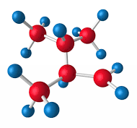

The Data Science Lifecycle
(aka KDD Process, aka CRISP-DM)
Data extraction, schema alignment, entity resolution, data validation, data cleaning, outlier detection, missing value imputation, semantic type detection, data augmentation, feature selection, feature engineering, feature transformations
Key observation: SotA data integration/cleaning based on ML
Data Scientist
Data Integration Data Cleaning Data Preparation
Data Integration Data Cleaning Data Preparation
Model Selection Training Hyper-parameters
Validate & Debug Deployment Scoring & Feedback
Exploratory Process (experimentation, refinements, ML pipelines)
Data/SW Engineer
DevOps Engineer

Slide 17
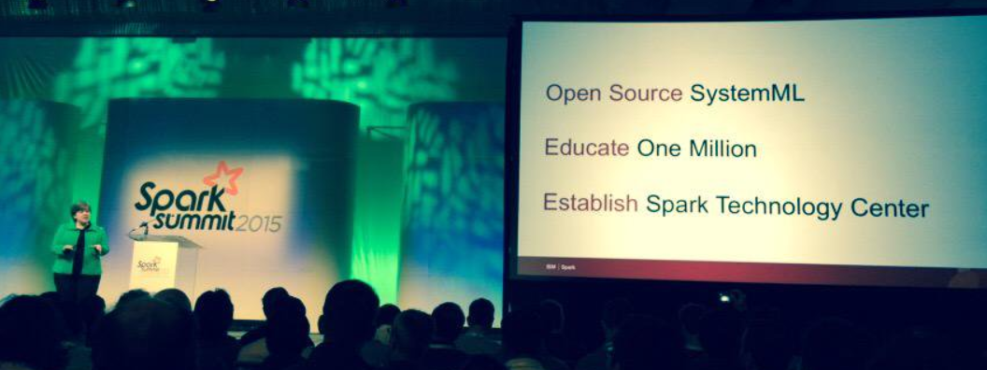




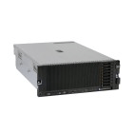
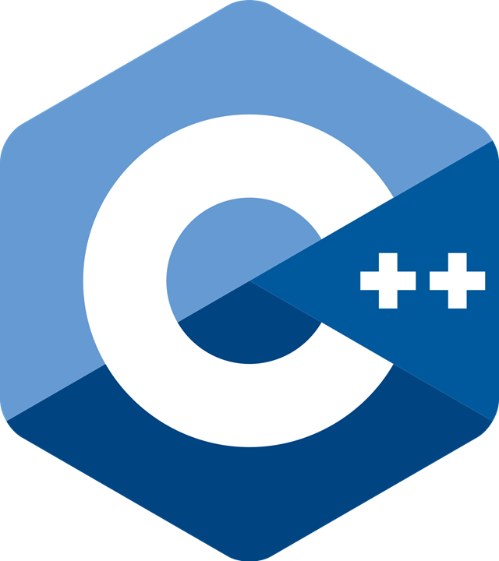
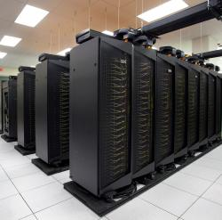
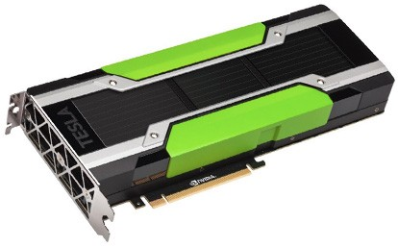
Apache SystemDS [https://github.com/apache/systemds]
DML Scripts
APIs: Command line, JMLC, Python Spark MLContext, Spark ML, (Scalable Algorithms + Primitives)
Language
Compiler
07/2020 Renamed to Apache SystemDS 05/2017 Apache Top-Level Project 11/2015 Apache Incubator Project
08/2015 Open Source Release
[SIGMOD’15,’17,’19,’21abc,’23abc]
[PVLDB’14,’16ab,’18,’22]
[ICDE’11,’12,’15]
[CIDR’17,’20]
[VLDBJ’18]
[CIKM’22] [DEBull’14]
[PPoPP’15]
Runtime
Write Once, Run Anywhere
In-Memory Single Node (scale-up)
Hadoop or Spark Cluster (scale-out)
Federated (LA progs, PS)
In-Progress:
GPU
since 2019
since 2014/16
since 2012
since 2010/11
since 2015

Slide 18
Language Abstractions and APIs
Data Independence + Impl-Agnostic Ops ➔ “Separation of Concerns”
User Script
Built-in Functions
Example: Stepwise Linear Regression
X = read(‘features.csv’)
Y = read(‘labels.csv’)
[B,S] = steplm(X, Y,
icpt=0, reg=0.001)
write(B, ‘model.txt’)
m_steplm = function(...) {
while( continue ) {
parfor( i in 1:n ) {
if( !fixed[1,i] ) {
Xi = cbind(Xg, X[,i])
B[,i] = lm(Xi, y, ...)
} }
# add best to Xg # (AIC)
} }
m_lmCG = function(...) {
while( i<maxi&nr2>tgt ) {
q = (t(X) %*% (X %*% p)) + lambda * p
beta = ... }
}
m_lm = function(...) {
if( ncol(X) > 1024 )
B = lmCG(X, y, ...)
else
B = lmDS(X, y, ...)
}
Linear Algebra Programs
Feature Selection
Facilitates optimization across data science lifecycle tasks
ML Algorithms
m_lmDS = function(...) {
l = matrix(reg,ncol(X),1)
A = t(X) %*% X + diag(l)
b = t(X) %*% y
beta = solve(A, b) ...}

Slide 19
Basic HOP and LOP DAG Compilation
LinregDS (Direct Solve)
X = read($1);
y = read($2);
intercept = $3;
lambda = 0.001;
...
if( intercept == 1 ) {
ones = matrix(1, nrow(X), 1);
X = append(X, ones);
}
I = matrix(1, ncol(X), 1);
A = t(X) %*% X + diag(I)*lambda;
b = t(X) %*% y;
beta = solve(A, b); ...
write(beta, $4);
HOP DAG (after rewrites)
8KB
Cluster Config:
driver mem: 20 GB
exec mem: 60 GB
CP
write
Scenario: X: 10⁸ x 10³, 10¹¹ y: 10⁸ x 1, 10⁸
8MB
16MB
CP
b(solve)
CP
172KB
b(+)
1.6TB
CP
SP
800GB
r(diag)
ba(+*)
ba(+*)
SP
1.6TB
r(t)
8KB
SP
CP
800GB
800MB
dg(rand) (10³x1,10³)
X
(10⁸x10³,10¹¹)
y (10⁸x1,10⁸)
Distributed Matrices
Fixed-size matrix blocks
Data-parallel operations
LOP DAG (after rewrites)
16KB
r’(CP)
mapmm(SP)
tsmm(SP)
X_{1,1}
Hybrid Runtime Plans:
Size propagation / memory estimates
Integrated CP / Spark runtime
Dynamic recompilation during runtime
800MB
1.6GB
X_{2,1}
r’(CP)
X
(persisted in MEM_DISK)
X_{m,1}
y

Slide 20















DAPHNE: An Open and Extensible System Infrastructure for Integrated Data Analysis Pipelines
https://github.com/daphne-eu/daphne

Slide 21
Integrated Data Analysis (IDA) Pipelines
DM
ML
HPC
+
+
Data Management
Machine Learning
High-Perf. Computing
Example: ML-assisted Simulation
HPC, custom codes, and simulations
Data preprocessing and cleaning
Query processing
Small-Scale Simulation w/ diff. params
Featurization and Random Reshuffling
ML Model Training
ML-assisted Full-Scale Simulation
Data-Analysis Pipeline
M
ML model training and scoring
D’’
D
D’
Open data formats

Slide 22
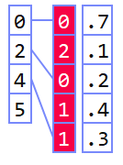

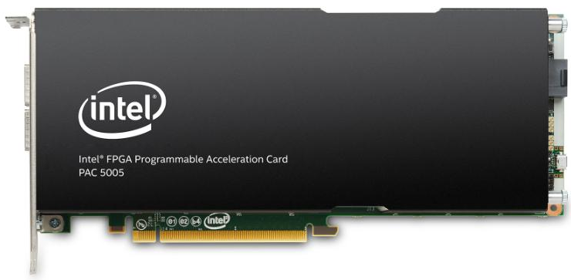
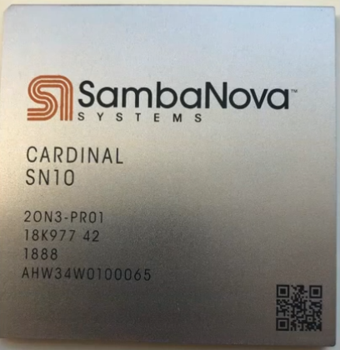
Challenges
Deployment Challenges
Hardware Challenges
DM+ML+HPC share compilation and runtime techniques / converging cluster hardware
End of Dennard scaling
End of Moore’s law
Amdahl’s law
Dev Teams
Programming Models
DAPHNE: An open and extensible system infrastructure for IDA pipelines
Different Systems/ Libraries
Cluster Under-utilization
Data/File Exchange
Resource Managers
Increasing Specialization
Data Representations
Data Placement
Data (Value) Types
graph
Local vs distributed
FP32, FP64, INT8,
INT32, INT64, UINT8, BF16, TF32, FlexPoint
CPUs/ NUMA
dense
sparse
compressed
GPUs
Sparsity Exploitation from Algorithms to HW
FPGAs/ ASICs
[NVIDIA A100]

Slide 23
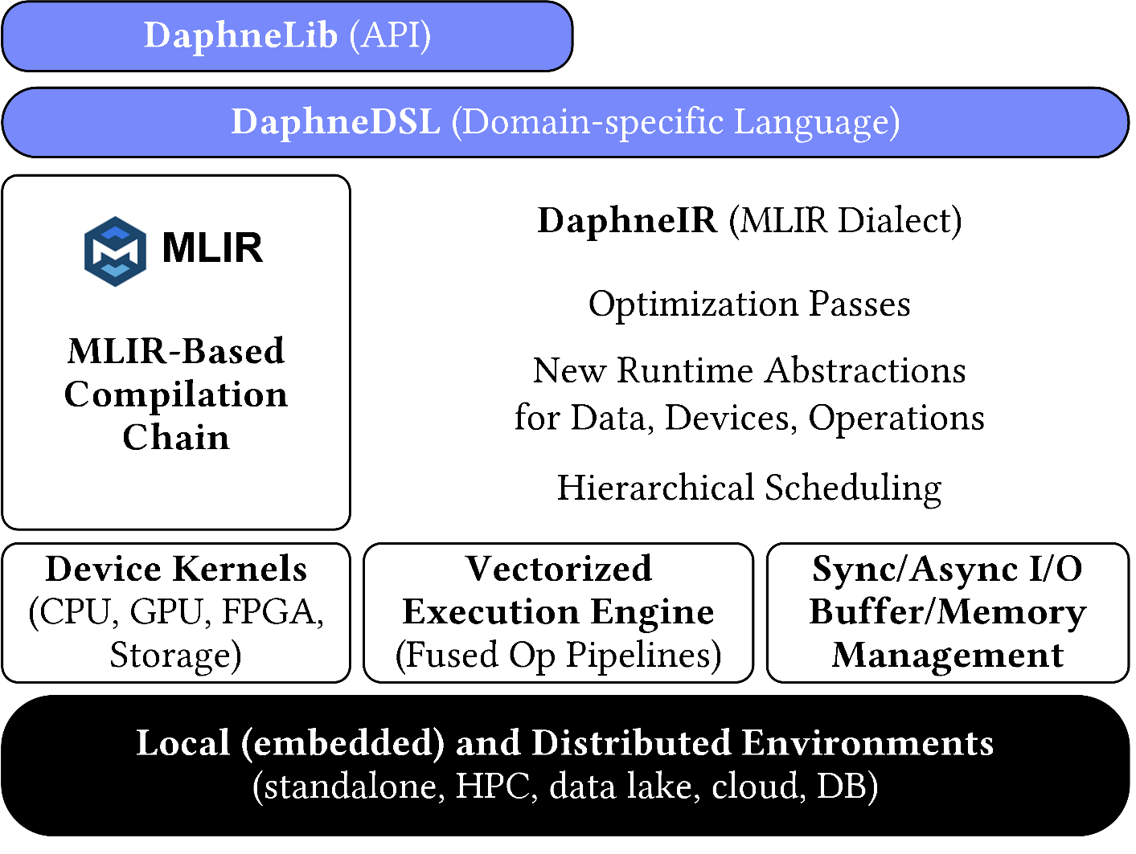
System Architecture
System Architecture
Python API w/ lazy evaluation

Slide 24
Language Abstractions
DSL for linear and relational algebra
Coarse-grained matrix/frame operations
Built-in operations for linear and relational algebra
High-level operations (e.g., SQL, parameter servers, map)
Conditional control flow (branches, loops)
Typed and untyped user-defined functions
Hierarchy of primitives for data science tasks
Physical data independence
System Architecture
Python API w/ lazy evaluation
Example: linear regression model training (simplified)
def lm(X, y) { // X feature matrix, y labels
colmu = mean(X, 1); // column means
colsd = stddev(X, 1); // column stddevs
X = (X – colmu) / colsd; // shift and scale
X = cbind(X, 1); // append column of ones
A = t(X) @ X; // t for transpose
b = t(X) @ y; // @ for matrix mult
return solve(A, b); // system of linear eq
}
my_model = lm(my_X, my_y);

Slide 25
Optimizing Compiler
MLIR-based Optimizing Compiler
Intermediate representation DaphneIR (MLIR dialect)
Systematic lowering from domain-specific operations to calls to pre-compiled kernels for heterogeneous hardware
Traditional programming language rewrites
Type & property inference, inter-procedural analysis
Domain-specific rewrites from linear and relational algebra
Memory management & garbage collection
Device placement & physical operator selection
System Architecture
Python API w/ lazy evaluation
Example: linear regression model training (simplified)
%10:2 = "daphne.vectorizedPipeline"(%5, %colmu, %colsd, %7, %6) ({
^bb0(%arg0: ..., %arg1: ..., %arg2: ..., %arg3: ..., %arg4: ...):
%12 = "daphne.ewSub"(%arg0, %arg1) : ...
%13 = "daphne.ewDiv"(%12, %arg2) : ...
%14 = "daphne.colBind"(%13, %arg3) : ...
%15 = "daphne.gemv"(%14, %arg4) : ... // rewritten from matmul/@
%16 = "daphne.syrk"(%14) : ... // rewritten from matmul/@
"daphne.return"(%15, %16) : ...
}, ...

Slide 26
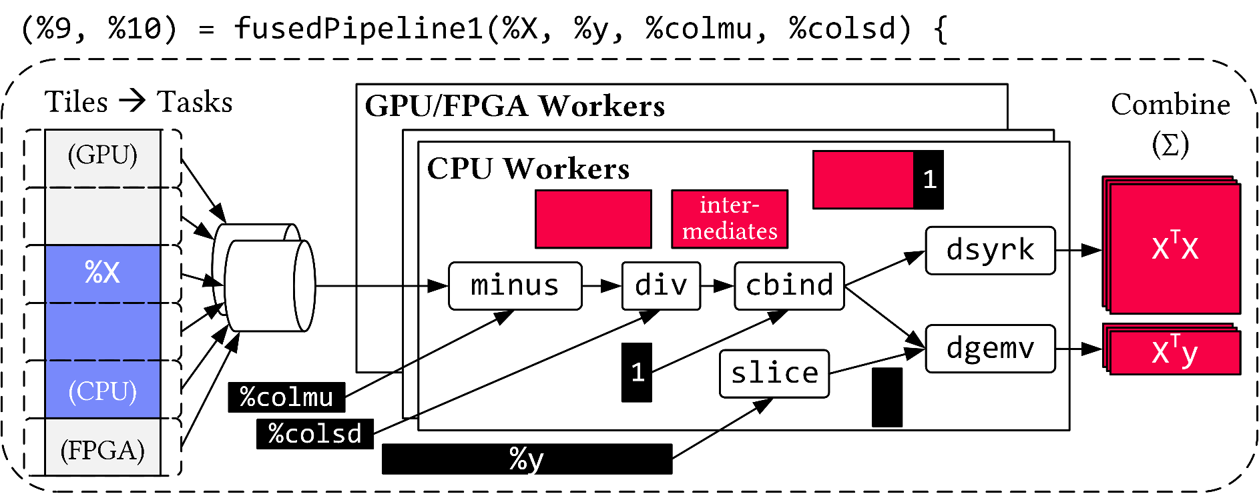
Runtime
Distributed and Local Vectorized Execution
Fused operator pipelines on tiles/vectors of data
Coarse-grained tasks and cache-conscious data binding
Device kernels for heterogeneous hardware
Integration of computational storage (e.g., eBPF programs)
Scheduling for load balancing (e.g., for ops on sparse data)
Different distributed backends (e.g., gRPC, OpenMPI)
System Architecture
Python API w/ lazy evaluation
Example: linear regression model training (simplified)

Slide 27
Which System to Choose for Your LDE Project: SystemDS or DAPHNE?
Lot’s of Similarities
Open-source systems, with major influence of our research group
Declarative DSL for linear (and relational) algebra
Domain-specific compiler
Runtime with local and distributed execution, hardware accelerators
Focus on efficient and effective execution of machine learning and data science tasks
…
Some Differences
SystemDS
More mature system (since 2010, including history from SystemML)
Mainly written in Java and Python
Tasks in system internals and DSL scripts
DAPHNE
Younger system (since 2021)
Mainly written in C++ and Python
Tasks in system internals
Based on MLIR (compiler framework)

Slide 28
How to Get Started
Suggested Initial Steps
Navigate to the GitHub repo of the respective system
Browse the documentation
Set up your development environment and try to build and run the system
Browse the source code, identify the points related to your task
Read the contribution guidelines
Start early to identify blocking issues

Slide 29
List of Project Topics (Proposals)
See list at https://pdamme.github.io/teaching/2023-24_winter/lde/ProjectTopics.pdf

Slide 30
Summary and Q&A
Course Organization, Outline, and Deliverables
Apache SystemDS and DAPHNE
List of Project Topics (Proposals)
Remaining Questions?
See you during the office hours ☺

