Slide 1

Project Large-scale Data Engineering (LDE)
Kick-off Meeting
Dr.-Ing. Patrick Damme
Technische Universität Berlin
Berlin Institute for the Foundations of Learning and Data
Big Data Engineering (DAMS Lab)
Last update: Apr 18, 2023

Slide 2

Announcements/Org
Hybrid Setting with Optional Attendance
In-person in TEL 811 (~20 seats)
Virtual via zoom https://tu-berlin.zoom.us/j/67376691490?pwd=NmlvWTM5VUVWRjU0UGI2bXhBVkxzQT09

Slide 3
Agenda
FG Big Data Engineering (DAMS Lab)
Course Organization, Outline, and Deliverables
Apache SystemDS
DAPHNE
List of Project Topics (Proposals)

Slide 4
FG Big Data Engineering (DAMS Lab)
https://www.tu.berlin/dams

Slide 5
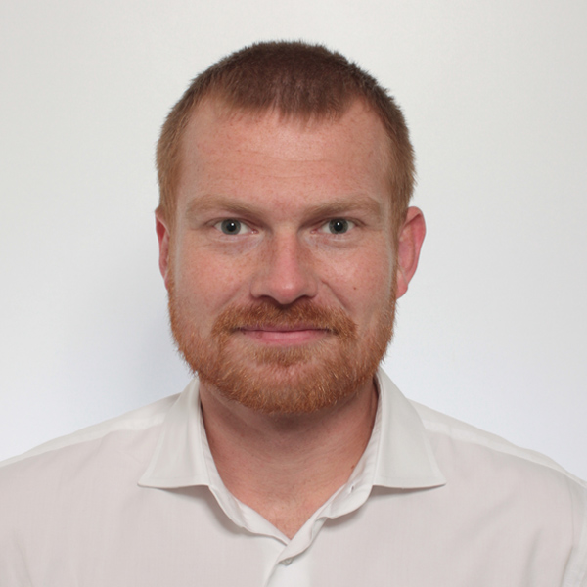
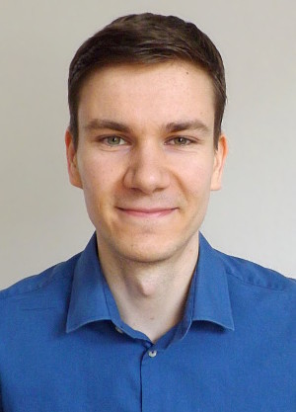
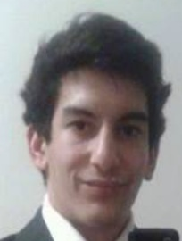


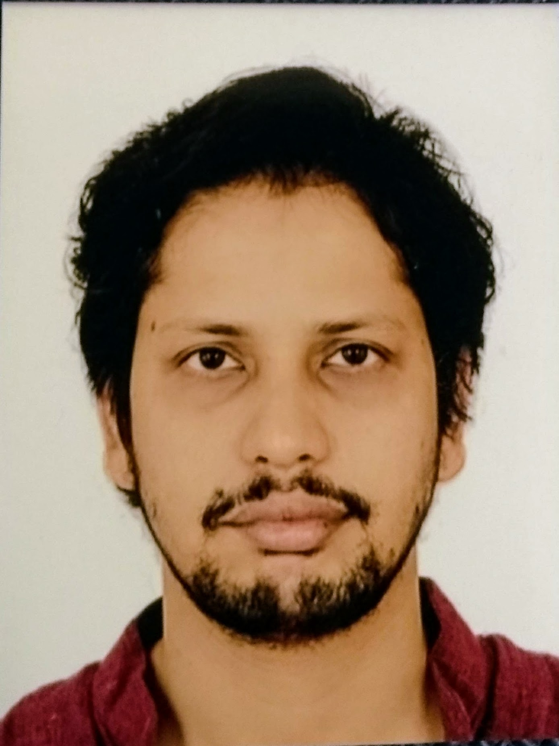

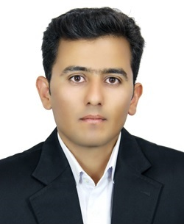


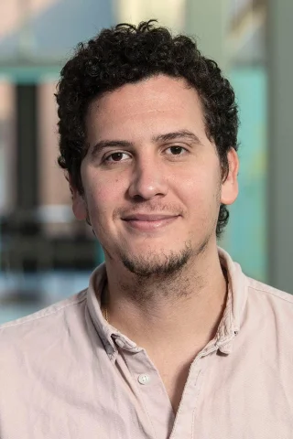

FG Big Data Engineering (DAMS Lab) – Team
Head of the Group Matthias Boehm
Postdoc (01/2021) Patrick Damme
PhD Student (04/2019) Arnab Phani
PhD Student (01/2020) Sebastian Baunsgaard
PhD Student (06/2023) Christina Dionysio
PhD Student (06/2023) Philipp Ortner
PhD Student (03/2023) David Justen
PhD Student (02/2023) Carlos E. Muniz Cuza [visitor Aalborg University]
PhD Student (09/2019) Shafaq Siddiqi
PhD Student (04/2021) Saeed Fathollahzadeh
3x Student Assistants N.N. (1x ~06/2023)
Bachelor & Master Students

Slide 6







About Me
Since 10/2022: Postdoc at TU Berlin, Germany
FG Big Data Engineering (DAMS Lab) headed by Prof. Matthias Böhm
Continuing work on integrated data analysis pipelines
Research interests in the fields of database and ML systems (especially compiler & runtime techniques, extensibility)
2021-2022: Postdoc at TU Graz & Know-Center GmbH, Austria
Data Management group headed by Prof. Matthias Böhm
Started work on integrated data analysis pipelines
2015-2020: PhD student at TU Dresden, Germany
Dresden Database Research Group headed by Prof. Wolfgang Lehner
PhD thesis on making complex analytical database queries more efficient through lightweight compression of intermediate results
MorphStore & TVL

Slide 7
FG Big Data Engineering (DAMS Lab) – Teaching
Architecture of Database Systems (ADBS, WS)
DB system internals + prog. project
Architecture of ML Systems (AMLS, SoSe)
ML system internals, data science lifecycle + prog. project
Architecture of ML Systems (AMLS, SS)
Master
Data Integration and Large-Scale Analysis (DIA, WS)
SE/PR Large-scale Data Engineering (LDE, SoSe+WiSe)
Data Integration and Large-Scale Analysis (DIA, WiSe)
Distributed Data Management
Bachelor
Intro to Scientific Methods (WS)
Supervision of bachelor/master theses (currently 3+12)
Data Management / Databases (DM, SS+WS)
Data management from user/application perspective

Slide 8
Course Organization, Outline, and Deliverables

Slide 9
Large-scale Data Engineering: Module Overview
20+5 places in total
bachelor + master
#41086: LDE Seminar + Project (12 ECTS)
13–2 students
12 students
#41095: Seminar LDE (3)
#41094: Project LDE (9 ECTS)
12+2 students
bachelor-only
bachelor-only
Mon, 14:00-16:00
TEL 811 & zoom
Seminar LDE
Reading & writing scientific papers
Giving presentations on papers
Summary paper
Presentation
Lecturer & seminar mentor
Project LDE
Building & evaluating prototypes
Giving presentations on prototypes
Prototype design/impl/tests/doc
Presentation
Project mentors
Mon, 16:00-18:00
TEL 811 & zoom
In the context of systems for data engineering, data management, machine learning
In combination: Ideal preparation for a bachelor/master thesis with our group

Slide 10
Course Organization
General Contact Person
Dr.-Ing. Patrick Damme (patrick.damme@tu-berlin.de)
Course Website
https://pdamme.github.io/teaching/2023_summer/lde/lde_summer2023.html
One site for seminar and project
All material, news, deadlines, …
Language
Lectures and slides: English
Communication: English/German
Submitted paper and presentation: English
Informal language (first name is fine), immediate feedback is welcome

Slide 11
Semester Schedule & Deadlines
Kick-off Meeting Apr 17 (optional)
Self-organized Project Work
Office hours for any questions (optional)
Final Presentations (mandatory)
Individual appointments per student/team
Programmierpraktikum: Poster (optional)
Centrally organized poster session in June
Each module will send 1-3 student teams
Great chance to showcase your work to your fellow students and future participants
List of Project Topics
Presented today, take your time to select afterwards
Topic Selection
Deadline: May 1, 23:59 CEST (in 2 weeks)
First-come-first-serve or team building
List of preferences by email to Patrick Damme
Feel free to approach us as a team
Submission of Impl/Tests/Doc
Deadline: Jul 24 (soft deadline)
As a pull request on GitHub (exceptionally by email)
Submission of Presentation Slides
Deadline: The day before you present, 23:59 CEST
Presentation slides (PDF) by email to Patrick Damme

Slide 12
Project Deliverables
Individual/Team Project Work
Teams of up to 3 students
Design/Implementation/Tests/Documentation
Get familiar with the given task/problem
Develop an initial design for discussion
Discuss the design during the office ours (strongly recommended)
Implement your design, plus tests and docs
Conduct experiments and analyze/visualize results
Presentation
Summarize the problem and your solution (design, implementation, experimental results)
10 min talk + 5 min discussion
Grading
#41086 (seminar + project)
Graded portfolio exam
25 pts: summary paper
15 pts: presentation
50 pts: design/impl/tests/doc
10 pts: presentation
#41094 (project-only)
Ungraded portfolio exam
85 pts: implementation/tests/documentation
15 pts: presentation

Slide 13
LDE Project Characteristics
Unique Characteristics
Each student/team gets a different topic
Advantages
Topics are real open issues in existing systems
Meaningful contributions to open-source systems
Your work will be used by others (impact)
You earn 9 ECTS (~270 h of work) Programmierpraktikum: more than the usual 6 ECTS
Practice Open-source Processes
Breakdown into subtasks
Code/tests/docs
Pull requests
Code review
Incorporate feedback to improve code
Remarks on Topic Descriptions
Lots of open topics to work on in the two systems we develop in our group
Initial topic descriptions of varying level of detail
If there is interest in a specific topic, we will provide more detailed descriptions with some pointers
Open to alternative topic proposals

Slide 14




LDE Projects in the Context of Two Open-source Systems
DAPHNE EU-project https://github.com/daphne-eu/daphne
Focus on integrated data analysis pipelines
Project implementation in C++ and Python
Apache SystemDS https://github.com/apache/systemds
Focus on the end-to-end data science lifecycle
Project implementation in Java, Python, and DML

Slide 15

Apache SystemDS: A Declarative ML System for the End-to-End Data Science Lifecycle
https://github.com/apache/systemds

Slide 16

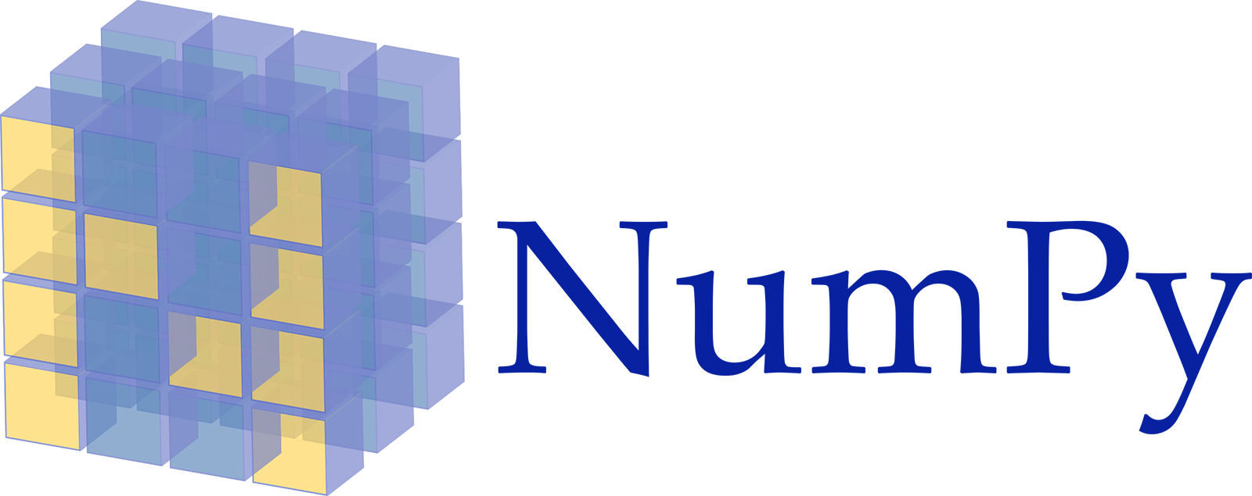












Landscape of ML Systems
Existing ML Systems
#1 Numerical computing frameworks
#2 ML Algorithm libraries (local, large-scale)
#3 Linear algebra ML systems (large-scale)
#4 Deep neural network (DNN) frameworks
#5 Model management, and deployment
Exploratory Data-Science Lifecycle
Open-ended problems w/ underspecified objectives
Hypotheses, data integration, run analytics
Unknown value → lack of system infrastructure → Redundancy of manual efforts and computation
Data Preparation Problem
80% Argument: 80-90% time for finding, integrating, cleaning data
Diversity of tools ➔ boundary crossing, lack of optimization
“Take these datasets and show value or competitive advantage”
[NIPS 2015]
[DEBull 2018]

Slide 17


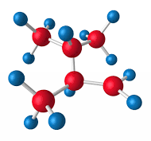

The Data Science Lifecycle
(aka KDD Process, aka CRISP-DM)
Data extraction, schema alignment, entity resolution, data validation, data cleaning, outlier detection, missing value imputation, semantic type detection, data augmentation, feature selection, feature engineering, feature transformations
Key observation: SotA data integration/cleaning based on ML
Data Scientist
Data Integration Data Cleaning Data Preparation
Data Integration Data Cleaning Data Preparation
Model Selection Training Hyper-parameters
Validate & Debug Deployment Scoring & Feedback
Exploratory Process (experimentation, refinements, ML pipelines)
Data/SW Engineer
DevOps Engineer

Slide 18
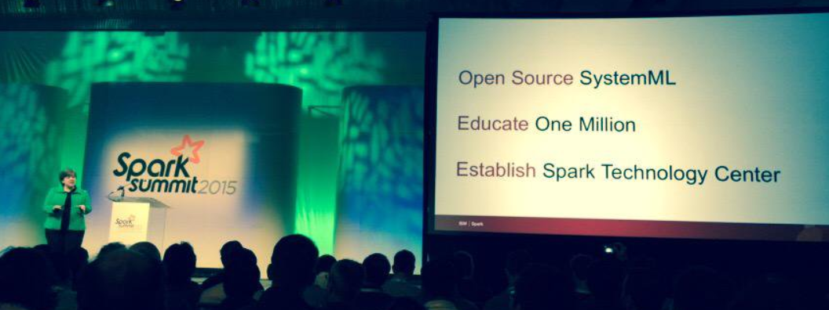




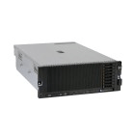
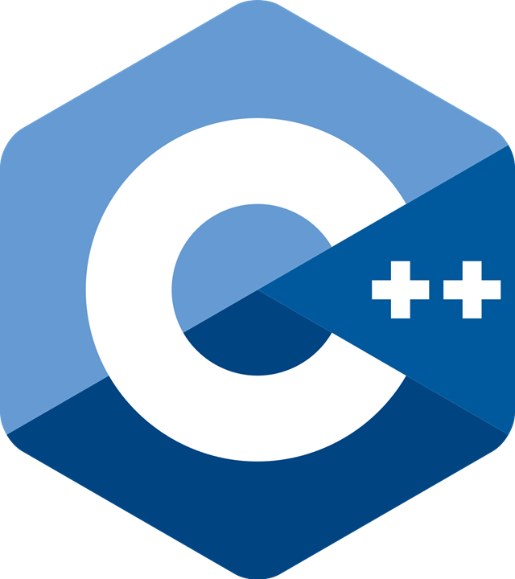
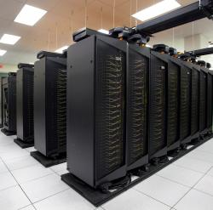
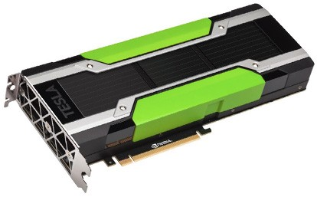
Apache SystemDS [https://github.com/apache/systemds]
DML Scripts
APIs: Command line, JMLC, Python Spark MLContext, Spark ML, (Scalable Algorithms + Primitives)
Language
Compiler
07/2020 Renamed to Apache SystemDS 05/2017 Apache Top-Level Project 11/2015 Apache Incubator Project
08/2015 Open Source Release
[SIGMOD’15,’17,’19,’21abc,’23abc]
[PVLDB’14,’16ab,’18,’22]
[ICDE’11,’12,’15]
[CIDR’17,’20]
[VLDBJ’18]
[CIKM’22] [DEBull’14]
[PPoPP’15]
Runtime
Write Once, Run Anywhere
In-Memory Single Node (scale-up)
Hadoop or Spark Cluster (scale-out)
Federated (LA progs, PS)
In-Progress:
GPU
since 2019
since 2014/16
since 2012
since 2010/11
since 2015

Slide 19
Language Abstractions and APIs
Data Independence + Impl-Agnostic Ops ➔ “Separation of Concerns”
User Script
Built-in Functions
Example: Stepwise Linear Regression
X = read(‘features.csv’)
Y = read(‘labels.csv’)
[B,S] = steplm(X, Y,
icpt=0, reg=0.001)
write(B, ‘model.txt’)
m_steplm = function(...) {
while( continue ) {
parfor( i in 1:n ) {
if( !fixed[1,i] ) {
Xi = cbind(Xg, X[,i])
B[,i] = lm(Xi, y, ...)
} }
# add best to Xg # (AIC)
} }
m_lmCG = function(...) {
while( i<maxi&nr2>tgt ) {
q = (t(X) %*% (X %*% p)) + lambda * p
beta = ... }
}
m_lm = function(...) {
if( ncol(X) > 1024 )
B = lmCG(X, y, ...)
else
B = lmDS(X, y, ...)
}
Linear Algebra Programs
Feature Selection
Facilitates optimization across data science lifecycle tasks
ML Algorithms
m_lmDS = function(...) {
l = matrix(reg,ncol(X),1)
A = t(X) %*% X + diag(l)
b = t(X) %*% y
beta = solve(A, b) ...}

Slide 20
Basic HOP and LOP DAG Compilation
LinregDS (Direct Solve)
X = read($1);
y = read($2);
intercept = $3;
lambda = 0.001;
...
if( intercept == 1 ) {
ones = matrix(1, nrow(X), 1);
X = append(X, ones);
}
I = matrix(1, ncol(X), 1);
A = t(X) %*% X + diag(I)*lambda;
b = t(X) %*% y;
beta = solve(A, b); ...
write(beta, $4);
HOP DAG (after rewrites)
8KB
Cluster Config:
driver mem: 20 GB
exec mem: 60 GB
CP
write
Scenario: X: 10⁸ x 10³, 10¹¹ y: 10⁸ x 1, 10⁸
8MB
16MB
CP
b(solve)
CP
172KB
b(+)
1.6TB
CP
SP
800GB
r(diag)
ba(+*)
ba(+*)
SP
1.6TB
r(t)
8KB
SP
CP
800GB
800MB
dg(rand) (10³x1,10³)
X
(10⁸x10³,10¹¹)
y (10⁸x1,10⁸)
Distributed Matrices
Fixed-size matrix blocks
Data-parallel operations
LOP DAG (after rewrites)
16KB
r’(CP)
mapmm(SP)
tsmm(SP)
X_{1,1}
Hybrid Runtime Plans:
Size propagation / memory estimates
Integrated CP / Spark runtime
Dynamic recompilation during runtime
800MB
1.6GB
X_{2,1}
r’(CP)
X
(persisted in MEM_DISK)
X_{m,1}
y

Slide 21















DAPHNE: An Open and Extensible System Infrastructure for Integrated Data Analysis Pipelines
https://github.com/daphne-eu/daphne

Slide 22
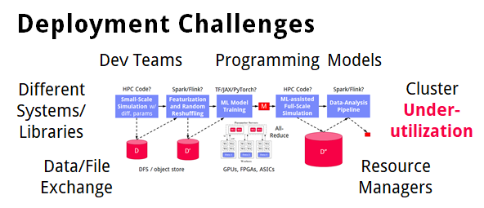
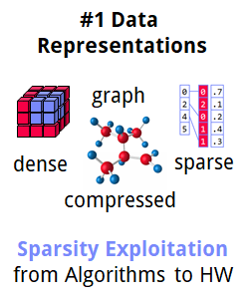
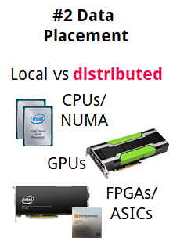
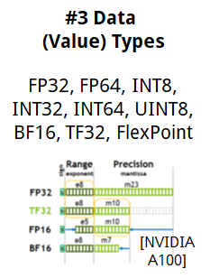
➔ DAPHNE Overall Objective:
Open and extensible system infrastructure
Motivation
Integrated Data Analysis Pipelines
Open data formats, query processing
Data preprocessing and cleaning
ML model training and scoring
HPC, custom codes, and simulations
Hardware Challenges
DM+ML+HPC share compilation and runtime techniques / converging cluster hardware
End of Dennard scaling: P = α CFV² (power density 1)
End of Moore’s law
Amdahl’s law: sp = 1/s
➔ Increasing Specialization

Slide 23




DAPHNE Use Cases
[Xiao Xiang Zhu et al: So2Sat LCZ42: A Benchmark Dataset for the Classification of Global Local Climate Zones. GRSM 8(3) 2020]
[So2Sat LC42: https://mediatum.ub.tum.de/1454690]
DLR Earth Observation
ESA Sentinel-1/2 datasets → 4PB/year
Training of local climate zone classifiers on So2Sat LCZ42 (15 experts, 400K instances, 10 labels each, 85% confidence, ~55GB H5)
ML pipeline: preprocessing, ResNet20, climate models
IFAT Semiconductor Ion Beam Tuning
KAI Semiconductor Material Degradation
AVL Vehicle Development Process (ejector geometries, KPIs)
ML-assisted simulations, data cleaning, augmentation

Slide 24


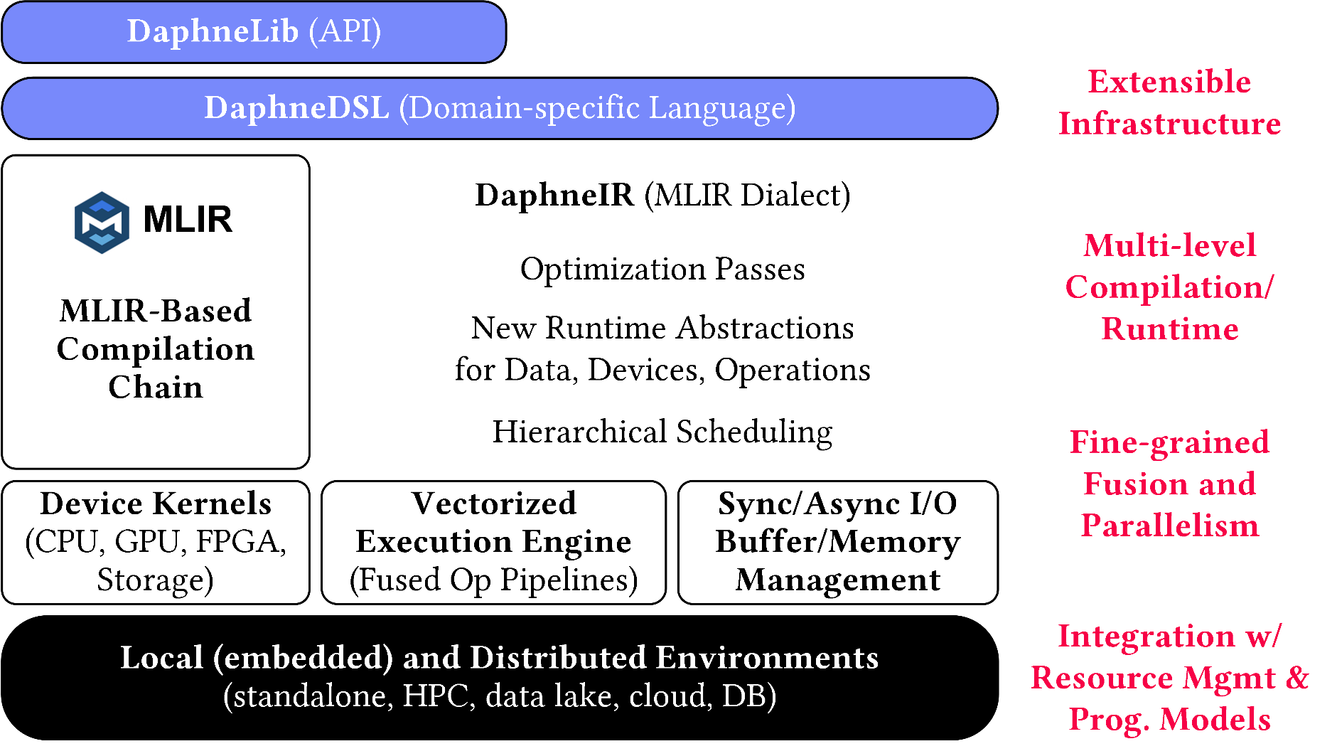
DAPHNE System Architecture
AH
[CIDR’22]
AK
Python API w/ lazy evaluation
MLIR Dialects, Extension Catalog (new data types, kernels, scheduling algs)
Sideways Entry, DSL-level constraints (e.g., data/op placement)
LLVM

Slide 25
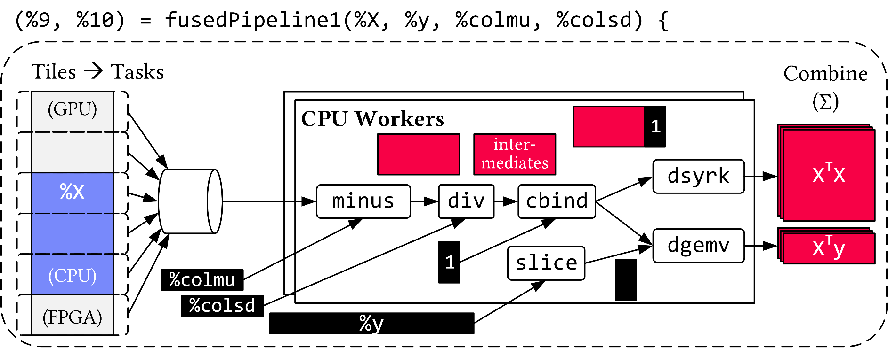
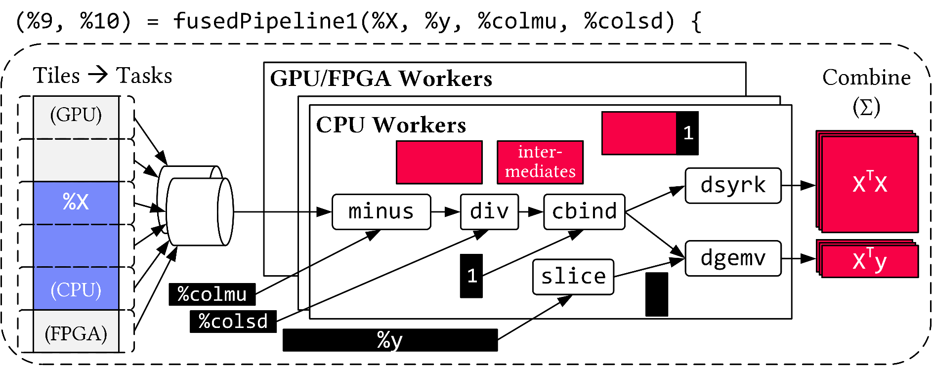
Vectorized (Tiled) Execution
Default Parallelization
Frame & Matrix Ops
Locality-aware, Multi-device Scheduling
Fused Operator Pipelines on Tiles/Scalars + Codegen

Slide 26
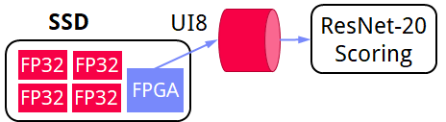
Vectorized (Tiled) Execution, cont.
#1 Zero-copy Input Slicing
Create view on sliced input (no-op)
All kernels work on views
#2 Sparse Intermediates
Reuse dense/sparse kernels
Sparse pipeline intermediates for free
#3 Fine-grained Control
Task sizes (dequeue, data access) vs data binding (cache-conscious ops)
Scheduling for load balance (e.g., sparse operations)
#4 Computational Storage
Task queues connect eBPF programs, async I/O into buffers, and op pipelines

Slide 27
List of Project Topics (Proposals)
Last update: Apr 17, 2023

Slide 28
#497 dml2daphnedsl: Translation of Domain-specific Languages
Motivation
DAPHNE has a domain-specific language DaphneDSL for linear/relational algebra on matrices and frames, great for building complex data analysis algorithms
BUT: Data scientists prefer working at a higher abstraction level with primitives for common analytics tasks (e.g., data cleaning, clustering, …)
SystemDS has a powerful library of such primitives written in its domain-specific language DML
Task (in Python or another suitable language)
Make SystemDS’s library of ML primitives available to DAPHNE users
In that context: Stand-alone tool translating scripts written in SystemDS’s DML to DAPHNE’s DaphneDSL
shiftAndScale = function(Matrix[Double] X)
return (Matrix[Double] R)
{
R = (X - rowMeans(X)) / rowSds(X);
}
automatic translation
def shiftAndScale(X:matrix<f64>) -> matrix<f64> {
return (X - mean(X, 1)) / stddev(X, 1);
}
More information & hints
https://github.com/daphne-eu/daphne/issues/497

Slide 29
#498 Update-in-place Operations
Motivation
DAPHNE maps logical ops from linear/relational algebra to calls to kernels (C++ functions consuming and producing DAPHNE matrices/frames)
Kernels always create a new data object for their output, causing additional memory accesses
Under certain conditions, the input data objects could be reused to improve memory consumption and performance
Task (in C++)
Enable update-in-place optimizations in DAPHNE
Concerns DAPHNE compiler, runtime infra, kernels
More information & hints
https://github.com/daphne-eu/daphne/issues/498
example: evaluation of sqrt(X+1) on matrix X
Status quo
In-place updates
sqrt(X+1)
+
sqrt
sqrt
X+1
1
X
+
X+1
sqrt(X+1)
X
1
Newly created matrix after each operation
Reusing matrix X for both ops

Slide 30




#499 Connecting DAPHNE to the Data Science Ecosystem: Efficient Data Exchange with Popular Python Libs
Motivation
Data scientists prefer Python nowadays
DAPHNE has a Python API (DaphneLib)
Efficient data exchange is required to successfully integrate DAPHNE with the data science ecosystem
Task (in Python and C++)
Extend existing infra for efficient data exchange between DAPHNE and numpy by additional Python libraries such as pandas, TensorFlow, and PyTorch
More information & hints
https://github.com/daphne-eu/daphne/issues/499
tf.Tensor
torch.Tensor
numpy
np.ndarray
pd.Series pd.DataFrame
daphne.Matrix/daphne.Frame
DaphneLib (Python API)
DaphneDSL
DAPHNE compiler & runtime

Slide 31
#500 End-to-end Sparsity Exploitation in DaphneDSL
Motivation
Sparse matrices (most cells are zero) are commonplace in data science applications
DAPHNE supports a CSR (compressed sparse row) representation, but support is still a proof-of-concept
Task (in C++)
Enable end-to-end sparsity exploitation (sparsity estimation, sparse kernels, dense/sparse selection, integration into DAPHNE’s vectorized engine)
More information & hints
https://github.com/daphne-eu/daphne/issues/500

Slide 32
#501 Additional Sparse Matrix Representations: MCSR, CSC, COO
dense
Motivation
Sparse matrices (most cells zero) are commonplace in data science applications
Various sparse matrix representations with different characteristics, pros, and cons
So far, DAPHNE supports only CSR, would benefit from rich choice of representations to better adapt to various situations
Task (in C++)
Extend DAPHNE by additional sparse matrix data types (e.g., MSCR, CSC, COO)
Add kernels (physical operators) with efficient algorithms specialized for these sparse formats
Devise selection of a suitable representation
0 0 0 2 0 0 1 0 0
0 0 4 0 0 0 0 0 0
0 0 0 0 0 2 0 0 0
0 0 1 1 0 0 0 0 0
0 0 0 0 0 0 0 7 0
CSR
MSCR
CSC
COO
compressed sparse row
modified CSR
compressed sparse column
coordinate-based
colIdx
colOffset
rowIdx
colIdx
value
value
colIdx
rowIdx
rowOffset
rowOffset
value
value
value
colIdx
More information & hints
https://github.com/daphne-eu/daphne/issues/501

Slide 33

#502 Apache Arrow for Data Frames in DAPHNE
Motivation
DAPHNE supports relational operations on frames, and offers a column-major frame representation
Apache Arrow is a widely used framework and exchange format for columnar data; supporting its memory layout in DAPHNE would improve the interoperability with other libraries and tools
In particular, reading Arrow files could become more efficient by avoiding unnecessary conversions
Task (in C++)
Extend DAPHNE by a new frame data type which uses the memory layout of Apache Arrow
Add kernels for a few relational operations on the Arrow-based frame representation
Add a file reader for Arrow avoiding conversions
process
process
DAPHNE frame
Arrow frame
read & convert
read & no convert
file on disk (Arrow format)
file on disk (Arrow format)
More information & hints
https://github.com/daphne-eu/daphne/issues/502

Slide 34
More Topics in DAPHNE
Improvements to Vectorized Engine and Operator Fusion
DaphneDSL UDFs in Other Languages (e.g., Python, C++)
Comprehensive Test Suite (Unit Tests and Script-Level Tests, DSL Fuzzing)

Slide 35
Graph Convolutional Layers in SystemDS
Motivation
GCLs are the building blocks of many Graph Convolutional Networks (class of neural network for processing unstructured data representable as a graph)
Applications in social networks, molecular biology, multivariate timeseries
Key design element: pairwise message passing between neighbor nodes
Multiple types of mechanisms for pairwise message passing
Task (in DML)
Implement the most relevant GCLs in SystemDS
Benchmark their performance on real-life data
More information & hints
tba

Slide 36
DAG Visualizer for Machine Learning Workloads
A typical machine learning (ML) system compiles a high-level script into hybrid execution plans of local, distributed and GPU operations. Understanding these plans are absolutely necessary to implement features in the compilation and runtime stacks. This project aims to build a toolkit that takes an execution plan of Apache SystemDS as input and produce a visual structure of the operations. A good example is TensorFlow’s TensorBoard. However, unlike TensorBoard, this project aims to help the ML system researchers. The visualization may include various metadata associated with the operations such as predicted compute and memory costs, execution modes and instruction order. This visualization will allow the researchers to reason about alternative plans with multiple backends and devices. Furthermore, the toolkit should expose an API to add or remove metadata easily to support future work.

Slide 37
#3430: Query Interface over Lineage Traces
Task
Build a query interface over many text-based lineage traces from various ML workloads. A lineage trace is a serialized DAG of the operations without any control flows. The task is to deserialize the traces into in-memory formats and answer queries regarding the workload characteristics. The in-memory format could be tabular or semi-structured. The internal representation should preserve the structure of the DAGs and the operators' properties to answer all kinds of queries. One possible way would be to represent each DAG by multiple relations – one for each operator with the corresponding attributes, and one for preserving the structure with attributes including output nodes for each operator. Existing libraries (e.g., Pandas) can be used to define the query interface. Example queries include: Find all DAGs with a convolution operation that takes more than 20ms to execute. Compare the total number of operations between two DAGs. Group DAGs by the type of non-linear operation used and calculate the average execution time for each group. Compare the memory usage of the matrix multiplication between two DAGs. Find similar DAGs on different datasets.
More information & hints
https://issues.apache.org/jira/browse/SYSTEMDS-3430

Slide 38
#3151/#3163: Missing Value Imputation & Amputation
Motivation
Missing data values are a typical issue encountered in real-world data sets
Task
Given a data set with missing values
Classify the missing values as Missing Completely at Random (MCAR), Not Missing at Random (NMAR), and Missing not at Random (MNAR)
If NMAR: Impute the missing values
Given a dataset without missing values: ampute a part of the values with various techniques
More information & hints
https://issues.apache.org/jira/browse/SYSTEMDS-3151
https://issues.apache.org/jira/browse/SYSTEMDS-3163

Slide 39
#3178: Tuple Deduplication
Motivation
Deduplication is an important data cleaning/preprocessing step
Task (in DML)
Implement a dedup() built-in function in SystemDS
Challenge: Make pairwise comparison efficient (e.g., clustering/blocking, hashing, sorting)
More information & hints
https://issues.apache.org/jira/browse/SYSTEMDS-3178

Slide 40
More Topics in Apache SystemDS
Alternative Linear Algebra Kernels
E.g., transposition-aware matrix multiplications
E.g., Intel OneAPI instead of Intel MKL
Extended Matrix Multiplication Chain Optimization
Federated/Distributed Frame Operations
Additional GPU Kernels (e.g., remove empty rows, cumsum)
Auto Differentiation
Loop Vectorization
Extended Common Subexpression Elimination
Extended I/O Framework: Readers/Writers for More File Formats (NetCDF, HDF5, Arrow)

Slide 41
Alternativ: Propose Your Own Topic Idea
We are open to additional topic proposals
In the context of data engineering, data management, and machine learning systems
If you are passionate about your idea
More topics in SystemsDS and DAPHNE
Other open-source systems possible, but contributions might be more difficult to get accepted

Slide 42
Summary and Q&A
FG Big Data Engineering (DAMS Lab)
Course Organization, Outline, and Deliverables
Apache SystemDS
DAPHNE
List of Project Topics (Proposals)
Remaining Questions?
See you during the office hours ☺

