Slide 1


Seminar Large-scale Data Engineering (LDE)
01 Structure of Scientific Papers
Dr.-Ing. Patrick Damme
Technische Universität Berlin
Berlin Institute for the Foundations of Learning and Data
Big Data Engineering (DAMS Lab)
[Credit: Based on “Introduction to Scientific Writing”/ ”01 Structure of Scientific Papers” by Matthias Boehm (TU Graz, winter 2021/22)]
Last update: Apr 16, 2023

Slide 2

Announcements/Org
Hybrid Setting with Optional Attendance
In-person in TEL 811 (~20 seats)
Virtual via zoom https://tu-berlin.zoom.us/j/67376691490?pwd=NmlvWTM5VUVWRjU0UGI2bXhBVkxzQT09

Slide 3
Agenda
FG Big Data Engineering (DAMS Lab)
Course Organization, Outline, and Deliverables
Structure of Scientific Papers
List of Seminar Topics (Proposals)

Slide 4
FG Big Data Engineering (DAMS Lab)
https://www.tu.berlin/dams

Slide 5
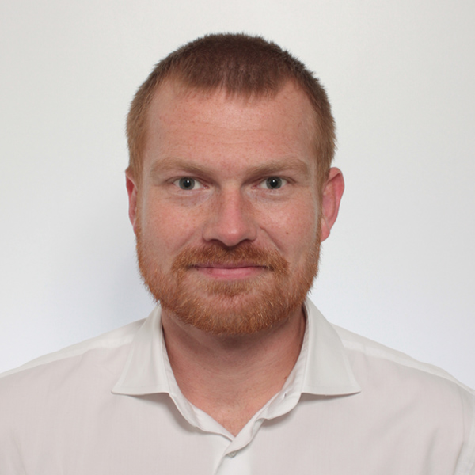
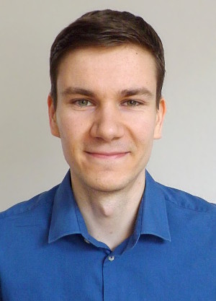
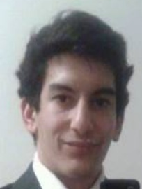


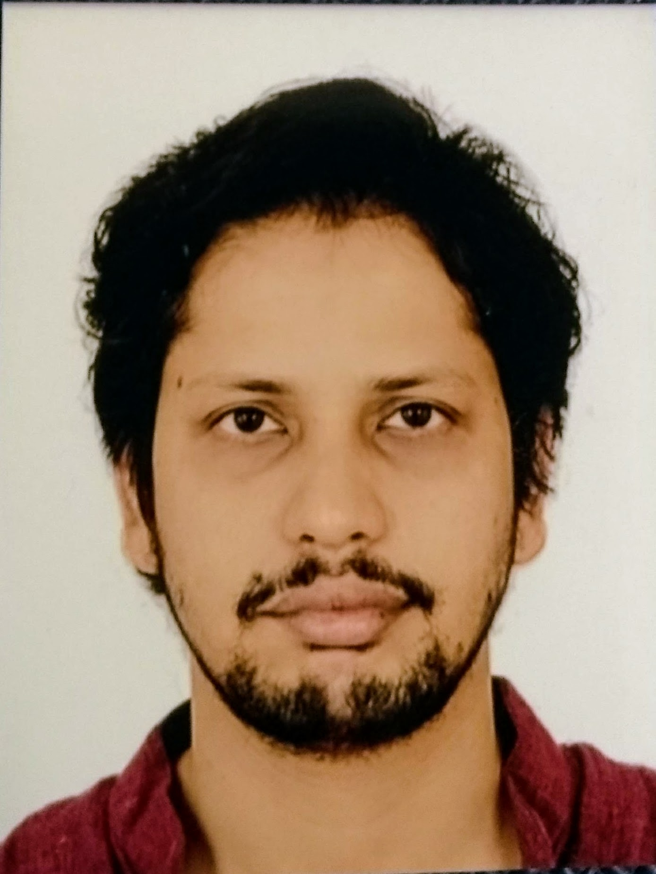

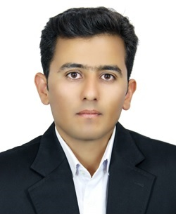


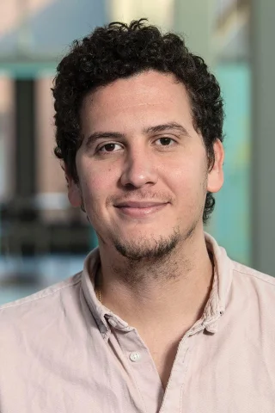

FG Big Data Engineering (DAMS Lab) – Team
Head of the Group Matthias Boehm
Postdoc (01/2021) Patrick Damme
PhD Student (04/2019) Arnab Phani
PhD Student (01/2020) Sebastian Baunsgaard
PhD Student (06/2023) Christina Dionysio
PhD Student (06/2023) Philipp Ortner
PhD Student (03/2023) David Justen
PhD Student (02/2023) Carlos E. Muniz Cuza [visitor Aalborg University]
PhD Student (09/2019) Shafaq Siddiqi
PhD Student (04/2021) Saeed Fathollahzadeh
3x Student Assistants N.N. (1x ~06/2023)
Bachelor & Master Students

Slide 6







About Me
Since 10/2022: Postdoc at TU Berlin, Germany
FG Big Data Engineering (DAMS Lab) headed by Prof. Matthias Böhm
Continuing work on integrated data analysis pipelines
Research interests in the fields of database and ML systems (especially compiler & runtime techniques, extensibility)
2021-2022: Postdoc at TU Graz & Know-Center GmbH, Austria
Data Management group headed by Prof. Matthias Böhm
Started work on integrated data analysis pipelines
2015-2020: PhD student at TU Dresden, Germany
Dresden Database Research Group headed by Prof. Wolfgang Lehner
PhD thesis on making complex analytical database queries more efficient through lightweight compression of intermediate results
MorphStore & TVL

Slide 7
FG Big Data Engineering (DAMS Lab) – Teaching
Architecture of Database Systems (ADBS, WS)
DB system internals + prog. project
Architecture of ML Systems (AMLS, SoSe)
ML system internals, data science lifecycle + prog. project
Architecture of ML Systems (AMLS, SS)
Master
Data Integration and Large-Scale Analysis (DIA, WS)
SE/PR Large-scale Data Engineering (LDE, SoSe+WiSe)
Data Integration and Large-Scale Analysis (DIA, WiSe)
Distributed Data Management
Bachelor
Intro to Scientific Methods (WS)
Supervision of bachelor/master theses (currently 3+12)
Data Management / Databases (DM, SS+WS)
Data management from user/application perspective

Slide 8
Course Organization, Outline, and Deliverables

Slide 9
Large-scale Data Engineering: Module Overview
20+5 places in total
bachelor + master
#41086: LDE Seminar + Project (12 ECTS)
13–2 students
12 students
#41095: Seminar LDE (3)
#41094: Project LDE (9 ECTS)
12+2 students
bachelor-only
bachelor-only
Mon, 14:00-16:00
TEL 811 & zoom
Seminar LDE
Reading & writing scientific papers
Giving presentations on papers
Summary paper
Presentation
Lecturer & seminar mentor
Project LDE
Building & evaluating prototypes
Giving presentations on prototypes
Prototype design/impl/tests/doc
Presentation
Project mentors
Mon, 16:00-18:00
TEL 811 & zoom
In the context of systems for data engineering, data management, machine learning
In combination: Ideal preparation for a bachelor/master thesis with our group

Slide 10
Course Organization
General Contact Person
Dr.-Ing. Patrick Damme (patrick.damme@tu-berlin.de)
Course Website
https://pdamme.github.io/teaching/2023_summer/lde/lde_summer2023.html
One site for seminar and project
All material, news, deadlines, …
Language
Lectures and slides: English
Communication: English/German
Submitted paper and presentation: English
Informal language (first name is fine), immediate feedback is welcome

Slide 11
Semester Schedule & Deadlines
Three Introductory Lectures (optional)
Apr 17: Structure of Scientific Papers
Apr 24: Scientific Reading and Writing
May 8: Experiments, Reproducibility, and Giving Presentations
Self-organized Seminar Work
Office hours for any questions (optional)
Final Presentations (mandatory)
Jun 26: Session #1
Jul 03 : Session #2
Jul 10 : Session #3
Jul 17 : Session #4
List of Seminar Topics
Presented today, take your time to select afterwards
Topic Selection
Deadline: May 1, 23:59 CEST (in 2 weeks)
First-come-first-serve
List of preferences by email to Patrick Damme
Submission of Summary Paper
Deadline: Jun 19, 23:59 CEST (in 9 weeks)
Summary paper (PDF) by email to Patrick Damme
Submission of Presentation Slides
Deadline: The day before you present, 23:59 CEST
Presentation slides (PDF) by email to Patrick Damme

Slide 12
Seminar Deliverables
Individual Seminar Work
1 student = 1 paper, no team work
Summary Paper
Read and understand selected paper
Search for related work for some context
Write summary paper (6 pages, excl. references) - including related work - make sure relation to umbrella is conveyed
LaTeX with ACM acmart template (document class sigconf, link on course website)
Presentation
Summarize your paper
15 min talk + 5 min discussion (stay in time)
Audience: engage in the discussion
Grading
Graded portfolio exam
#41086 (seminar + project)
25 pts: summary paper
15 pts: presentation
50 pts: design/impl/tests/doc
10 pts: presentation
#41095 (seminar-only)
65 pts: summary paper
35 pts: presentation

Slide 13
Structure of Scientific Papers
In Computer Science (Data Management)
[Credit: Based on “Introduction to Scientific Writing”/ ”01 Structure of Scientific Papers” by Matthias Boehm (TU Graz, winter 2021/22)]

Slide 14
Overview Types of Scientific Writing
Classification of Scientific/Technical Documents
Formal vs informal writing, cumulative?, single vs multi-author, archival vs non-archival publications
Scientific Writing Skills are crucial
Different types of docs share many similarities
/
Monographs
Scientific Papers
Others
BS Thesis
by pub. channel
by contents
Grant Proposal
Preprint
Research
MS Thesis
Design doc
Conference
Industry
PhD Thesis
White Paper
Journal
Survey
Habilitation
Blog
Tech Report
E&A
Website
Vision

Slide 15
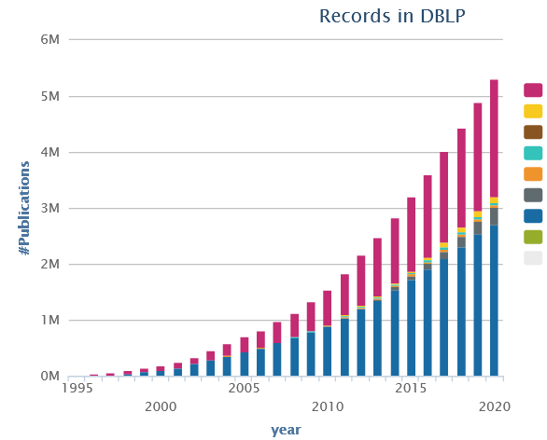
Preparation
Know your Audience
Get your Workflow in Order
Writing: LaTeX (e.g., Overleaf, TeXnicCenter), versioning (e.g., git), templates
Plotting: R (e.g., plot, ggplot), Python (e.g., matplotlib, seaborn), Gnuplot, LaTeX (e.g., pgfplots)
Figures: e.g., MS Visio/MS Powerpoint, Inkscape → pdf, eps, svg (vector graphics)
Mindset: Quality over Quantity
Aim for top-tier conferences/journals (act as filter)
Make the paper useful for others (ideas, evidence, code)

Slide 16
Paper Writing and Publication Process
Research – Writing Cycle
Read lots of papers
Idea → Research → Writing → Document
Idea → Writing/Research → Document
Incremental refinement of drafts
Paper Submission Cycle
Blind vs double-blind submission
Revisions and Camera-ready
Similar: bachelor/master thesis → drafts to advisor / final version
Example: SIGMOD 2024: Paper Submission Round 2
April 15, 2023: Paper submission
May 26 - 28, 2023: Author feedback phase
June 20, 2023: Notification of accept/reject/review again
July 20, 2023: Revised paper submission
August 23, 2023: Final notification of accept/reject
tba, 2023: Camera ready due
[Recommended Reading]
[Eamonn Keogh: How to do good research, get it published in SIGKDD and get it cited!, KDD 2009]
[Simon Peyton Jones: How to write a great research paper, MSR Cambridge]

Slide 17
Running Example
Example paper used in the following
Ahmed Elgohary, Matthias Boehm, Peter J. Haas, Frederick R. Reiss, Berthold Reinwald: Compressed Linear Algebra for Large-Scale Machine Learning. PVLDB 2016
[Ahmed Elgohary, Matthias Boehm, Peter J. Haas, Frederick R. Reiss, Berthold Reinwald: Scaling Machine Learning via Compressed Linear Algebra. SIGMOD Record 2017 46(1)]
[Ahmed Elgohary, Matthias Boehm, Peter J. Haas, Frederick R. Reiss, Berthold Reinwald: Compressed Linear Algebra for Large-Scale Machine Learning. VLDB Journal 2018 27(5)]
[Ahmed Elgohary, Matthias Boehm, Peter J. Haas, Frederick R. Reiss, Berthold Reinwald: Compressed Linear Algebra for Large-Scale Machine Learning. Commun. ACM 2019 62(5)]

Slide 18
Ideas and Topic Selection
Problem-Oriented Research
Focus on problem/observation first, not your solution
Discuss early ideas with collaborators and friends
Develop your taste for good research topics
Topic selection needs time → pipeline model
Ex. Compressed Linear Algebra
Problem: Iterative ML algorithms + memory-bandwidth-bound operations → crucial to fit data in memory → automatic lossless compression
Sub-problems: #rows>>#cols, column correlation, column characteristics → column-wise compression w/ heterogeneous encoding formats
Progress
Time

Slide 19
Prototypes and Experiments
Worst Mistake: Schrödinger's Results
Postpone implementation and experiments till last before the deadline
No feedback, no reaction time (experiments require many iterations)
Karl Popper: falsifiability of scientific results
Continuous Experiments
Run experiments during survey / prototype building
Systematic experiments → observations and ideas for improvements
Don’t be afraid of throw away prototypes that don’t work
Ex. Compressed Linear Algebra
Data characteristics inspired overall design of encoding schemes
Initially slow compression → dedicated sampling schemes and estimators
Initially slow compressed operations → cache-conscious operations, selected operations with better asymptotic behavior

Slide 20
Prototypical Structure of a Scientific Paper
Title & Authors
Sections and Subsections
Abstract → short overview of problem and solution (part of meta data)
Introduction → context, problem, contributions
Background / Preliminaries → necessary background for understanding
Main Part → your technical core contributions
Main Part 2
Experiments → setting, micro benchmarks, end-to-end benchmarks
Related Work → areas of related work, differences to your own work
Conclusions → summary, conclusions, and future work
Acknowledgments → funding agencies, helpful people beyond co-authors
References → list of other works referenced throughout the paper
(Appendix) → any additional contents (e.g., proves of theorems, more results)

Slide 21

Title and Authors
List of Authors
E.g., by contribution (main, …, advisor)
E.g., by last name
Affiliations, contact (corresponding author)
Title
Descriptive yet concise
Short name if possible → easier to cite and discuss
[Credit: sliceline, Silicon Valley, HBO]

Slide 22
Abstract
% 1. State the problem
Large-scale machine learning (ML) algorithms are often iterative, using repeated read-only data access and I/O-bound matrix-vector multiplications to converge to an optimal model. It is crucial for performance to fit the data into single-node or distributed main memory.
% 2. Say why it's an interesting problem
General-purpose, heavy- and lightweight compression techniques struggle to achieve both good compression ratios and fast decompression speed to enable block-wise uncompressed operations.
% 3. Say what your solution achieves
Hence, we initiate work on compressed linear algebra (CLA), in which lightweight database compression techniques are applied to matrices and then linear algebra operations such as matrix-vector multiplication are executed directly on the compressed representations. We contribute effective column compression schemes, cache-conscious operations, and an efficient sampling-based compression algorithm. Our experiments show that CLA achieves in-memory operations performance close to the uncompressed case and good compression ratios that allow us to fit larger datasets into available memory.
% 4. Say what follows from your solution
We thereby obtain significant end-to-end performance improvements up to 26x or reduced memory requirements.
[Simon Peyton Jones: How to write a great research paper, MSR Cambridge]

Slide 23
Introduction
Prototypical Structure
Context (1 paragraph)
Problems (1-3 paragraphs)
[Existing Work (1 paragraph)]
[Idea (1 paragraph)]
Contributions (1 paragraph)
Introduction Matters
Anchoring: most reviewers reach their opinion after reading introduction and motivation and then look for evidence
[Eamonn Keogh: How to do good research, get it published in SIGKDD and get it cited!, KDD 2009]

Slide 24
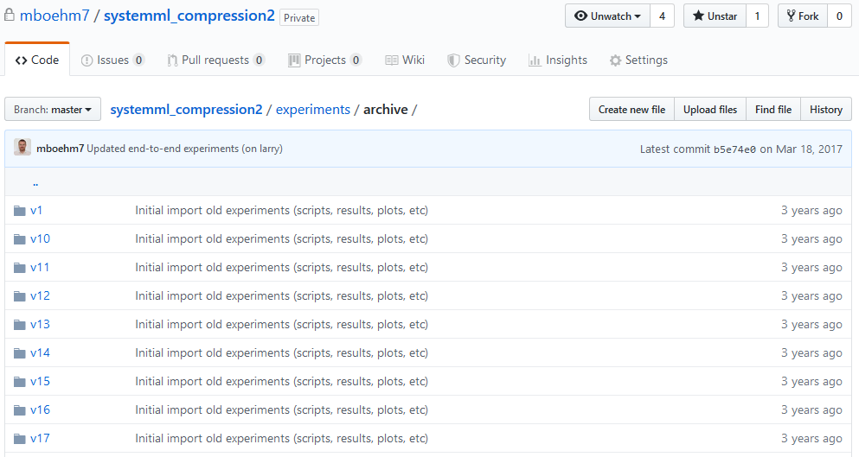
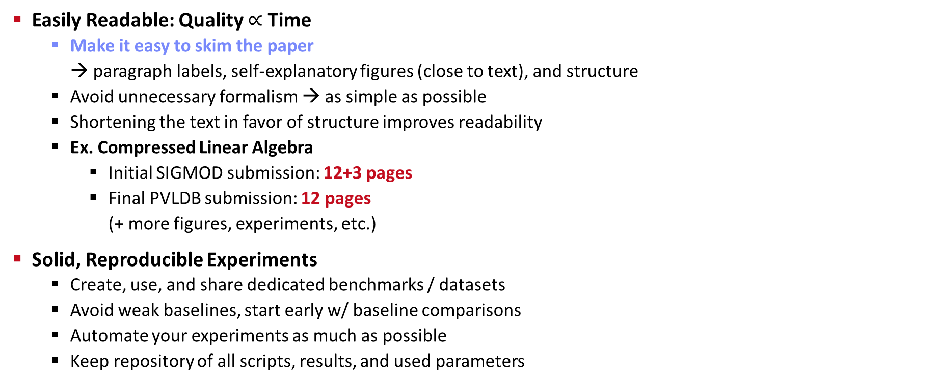
Writing the Paper (and more Experiments)
Easily Readable: Quality $∝$ Time
Make it easy to skim the paper → paragraph labels, self-explanatory figures (close to text), and structure
Avoid unnecessary formalism → as simple as possible
Shortening the text in favor of structure improves readability
Ex. Compressed Linear Algebra
Initial SIGMOD submission: 12+3 pages
Final PVLDB submission: 12 pages (+ more figures, experiments, etc.)
Solid, Reproducible Experiments
Create, use, and share dedicated benchmarks / datasets
Avoid weak baselines, start early w/ baseline comparisons
Automate your experiments as much as possible
Keep repository of all scripts, results, and used parameters
02 Scientific Reading and Writing
03 Experiments, Reproducibility, and Giving Presentations
https://github.com/damslab/ reproducibility

Slide 25
Related Work
Purpose of a “Related Work”-Section
Not a mandatory task or to show you know the field
Put you work in context of related areas (~ 1 paragraph each)
Discuss closely related work
Crisp separation from existing work (what are the differences)
Placement
Section 2 or Section n-1
Throughout the paper
Give Credit
Cite broadly, give credit to inspiring ideas, create connections
Honestly acknowledge limitations of your approach
[Simon Peyton Jones: How to write a great research paper, MSR Cambridge]

Slide 26
References
Setup
Use LaTeX \cite{} and BibTeX
Use a consistent source of bibtex entries (e.g., DBLP)
Different References Styles
But, not in footnotes (unless required)
inproceedings{StonebrakerBPR11,
author = {Michael {Stonebraker et al.}},
title = {{The Architecture of SciDB}},
booktitle = {{SSDBM}},
year = {2011}
}
\bibliographystyle{abbrv}
\bibliography{VLDB2016}
VLDB2016.bib

Slide 27
Dealing with Feedback / Criticism
Different Kinds of Feedback
Casual discussion of early ideas
Comments on paper drafts
Reviewer comments (good and bad)
Example Compressed Linear Algebra
SIGMOD Reviewer 2 (REJECT)
“The rewriting for q=Xv seems wrong: To compute q, one takes each row of the matrix X and multiplies it with the vector v.”
PVLDB Reviewer 3 (WEAK ACCEPT)
“I kinda disagree with the broad definition of declarative ML […].”
Paper Rebuttal and/or Revision
Rebuttal: seriously consider all feedback (in doubt agree), and answer with facts / ideas how to address the comments
Revision (conditional accept): address all revision requests
Always welcome feedback/criticism
Address all feedback w/ sincere effort
[Matthias Boehm et al.: Declarative Machine Learning - A Classification of Basic Properties and Types. CoRR 2016.]

Slide 28
List of Seminar Topics (Proposals)
Last update: Apr 16, 2023

Slide 29
Seminar Umbrella Topic
Papers in the fields of systems for data engineering, data management, and machine learning
This Semester’s Umbrella Topic: “Extensible Data Systems”
Motivation
Meet requirements of emerging applications (multimedia, machine learning, domain-specific, …)
Enable the timely adoption of novel techniques and technologies (algorithms, hardware, …)
Handle the increasing specialization (data models, data representations, algorithms, hardware, …)
Facilitate research at systems and algorithms level
Active field of research for decades (at least 1980s till today)
Interesting challenges
Which abstractions are needed?
How to enable users to extend the system?
How to reach efficiency in spite of these abstractions?
Concepts have been proposed at all levels of the system stack

Slide 30
Seminar Topics (1/4)
Extensible Database Management Systems
Implementation of Data Abstraction in the Relational Database System Ingres (SIGMOD Rec, 1984)
The Design of POSTGRES (SIGMOD, 1986)
Design and Implementation of an Extensible Database Management System Supporting User Defined Data Types and Functions (VLDB, 1988)
Starburst Mid-Flight: As the Dust Clears (IEEE Trans. Knowl. Data Eng., 1990)
MIL Primitives for Querying a Fragmented World (VLDBJ, 1999)
Hyrise Re-engineered: An Extensible Database System for Research in Relational In-Memory Data Management (EDBT, 2019)
Extensible Machine Learning Systems
TensorFlow: A System for Large-Scale Machine Learning (OSDI, 2016)
BAGUA: Scaling up Distributed Learning with System Relaxations (PVLDB, 2022)

Slide 31
Seminar Topics (2/4)
Component-based Database/ML Systems
Flashlight: Enabling Innovation in Tools for Machine Learning (PMLR, 2022)
mutable: A Modern DBMS for Research and Fast Prototyping (CIDR, 2023)
Optimizer Generators / Compiler Frameworks
GENESIS: An Extensible Database Management System (IEEE Trans. Software Eng., 1988)
The Volcano Optimizer Generator: Extensibility and Efficient Search (ICDE, 1993)
MLIR: Scaling Compiler Infrastructure for Domain Specific Computation (CGO, 2021)
Efficient Handling of User-defined Functions
Opening the Black Boxes in Data Flow Optimization (PVLDB, 2012)
Extending database task schedulers for multi-threaded application code (SSDBM, 2015)
Processing Java UDFs in a C++ Environment (SOCC, 2017)

Slide 32
Seminar Topics (3/4)
Extensibility of Hardware Backends
Voodoo - A Vector Algebra for Portable Database Performance on Modern Hardware (PVLDB, 2016)
TVM: An Automated End-to-End Optimizing Compiler for Deep Learning (OSDI, 2018)
Hardware-Oblivious SIMD Parallelism for In-Memory Column-Stores (CIDR, 2020)
Extensible Data Analytics
Towards a unified architecture for in-RDBMS analytics (SIGMOD, 2012)
MLbase: A Distributed Machine-learning System (CIDR, 2013)
Disclaimer: Co-authored by the lecturer

Slide 33
Seminar Topics (4/4)
Miscellaneous
MorphStore: Analytical Query Engine with a Holistic Compression-Enabled Processing Model (PVLDB, 2020)
User-Defined Operators: Efficiently Integrating Custom Algorithms into Modern Databases (PVLDB, 2022)
Alternative: Propose yet another topic/paper
Should be related to the umbrella topic of extensible data systems
Disclaimer: Co-authored by the lecturer

Slide 34
Summary and Q&A
FG Big Data Engineering (DAMS Lab)
Course Organization, Outline, and Deliverables
Structure of Scientific Papers
List of Seminar Topics (Proposals)
Remaining Questions?
Next Lectures
02 Scientific Reading and Writing [Apr 24]
03 Experiments, Reproducibility, and Giving Presentations [May 8]

