Slide 1

Project Large-scale Data Engineering (LDE)
Kick-off Meeting
Dr.-Ing. Patrick Damme
Technische Universität Berlin
Berlin Institute for the Foundations of Learning and Data
Big Data Engineering (DAMS Lab)
Last update: Apr 14, 2025

Slide 2

Announcements/Org
Hybrid Setting with Optional Attendance
In-person in MAR 0.010
Virtual via zoom https://tu-berlin.zoom.us/j/67376691490?pwd=NmlvWTM5VUVWRjU0UGI2bXhBVkxzQT09

Slide 3








About Me
Since 10/2022: Postdoc at TU Berlin, Germany
FG Big Data Engineering (DAMS Lab) headed by Prof. Matthias Böhm
Continuing work on integrated data analysis pipelines
Research interests in the fields of database and ML systems (especially compiler & runtime techniques, extensibility)
2021-2022: Postdoc at TU Graz & Know-Center GmbH, Austria
Data Management group headed by Prof. Matthias Böhm
Started work on integrated data analysis pipelines
2015-2020: PhD student at TU Dresden, Germany
Dresden Database Research Group headed by Prof. Wolfgang Lehner
PhD thesis on making complex analytical database queries more efficient through lightweight compression of intermediate results
MorphStore & TVL

Slide 4
FG Big Data Engineering (DAMS Lab) – Teaching
Successfully Established TUB Teaching Portfolio (modules, slides)
Architecture of Database Systems (ADBS, WiSe)
DB system internals + prog. project
Architecture of ML Systems (AMLS, SoSe)
ML system internals, data science lifecycle + prog. project
Architecture of ML Systems (AMLS, SoSe)
SE Joint ML and DM (MLDM, SoSe+WiSe)
Master
Data Integration and Large-Scale Analysis (DIA, WiSe)
SE/PR Large-scale Data Engineering (LDE, SoSe+WiSe)
Data Integration and Large-Scale Analysis (DIA, WiSe)
Distributed Data Management
Bachelor
Intro to Scientific Methods (WiSe)
Data Management / Databases (DM, SoSe+WiSe)
Data management from user/application perspective
PP Prog.-Practicals Data Systems (PPDS, SoSe+WiSe)

Slide 5
Agenda
Course Organization, Outline, and Deliverables
Projects in DAPHNE and Apache SystemDS
How to Approach the Project
List of Project Topics (Proposals)

Slide 6
Course Organization, Outline, and Deliverables

Slide 7
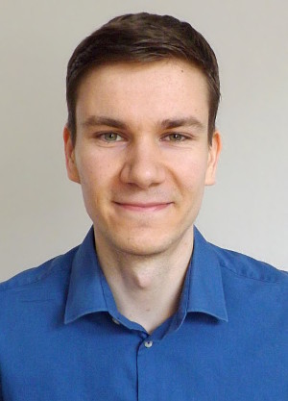
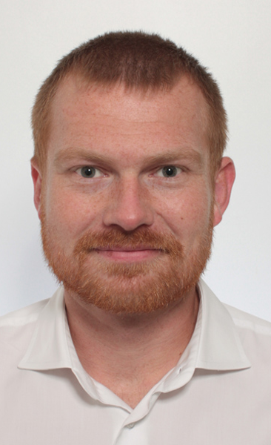
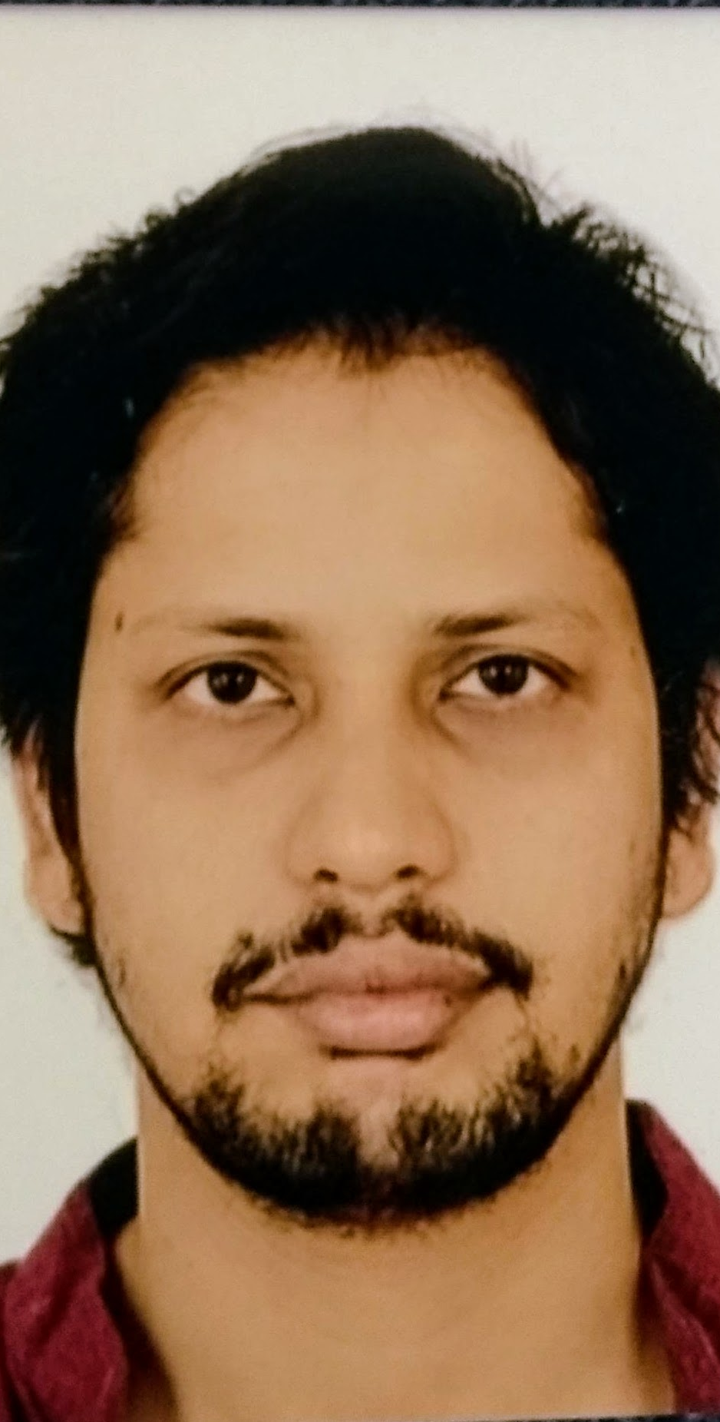
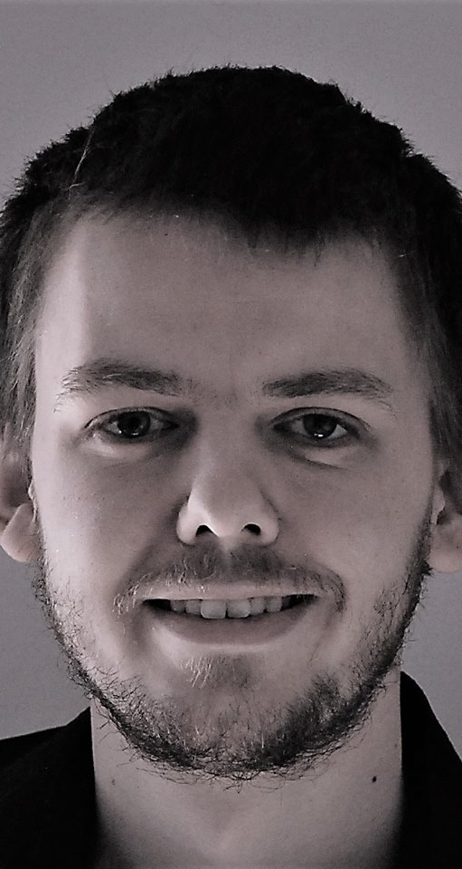
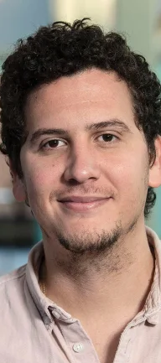
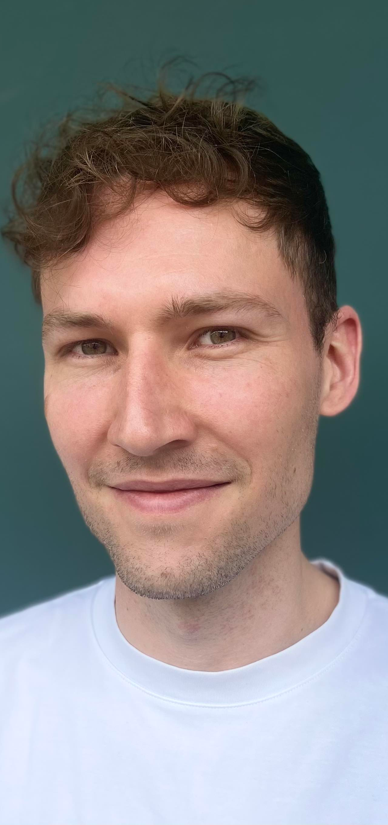
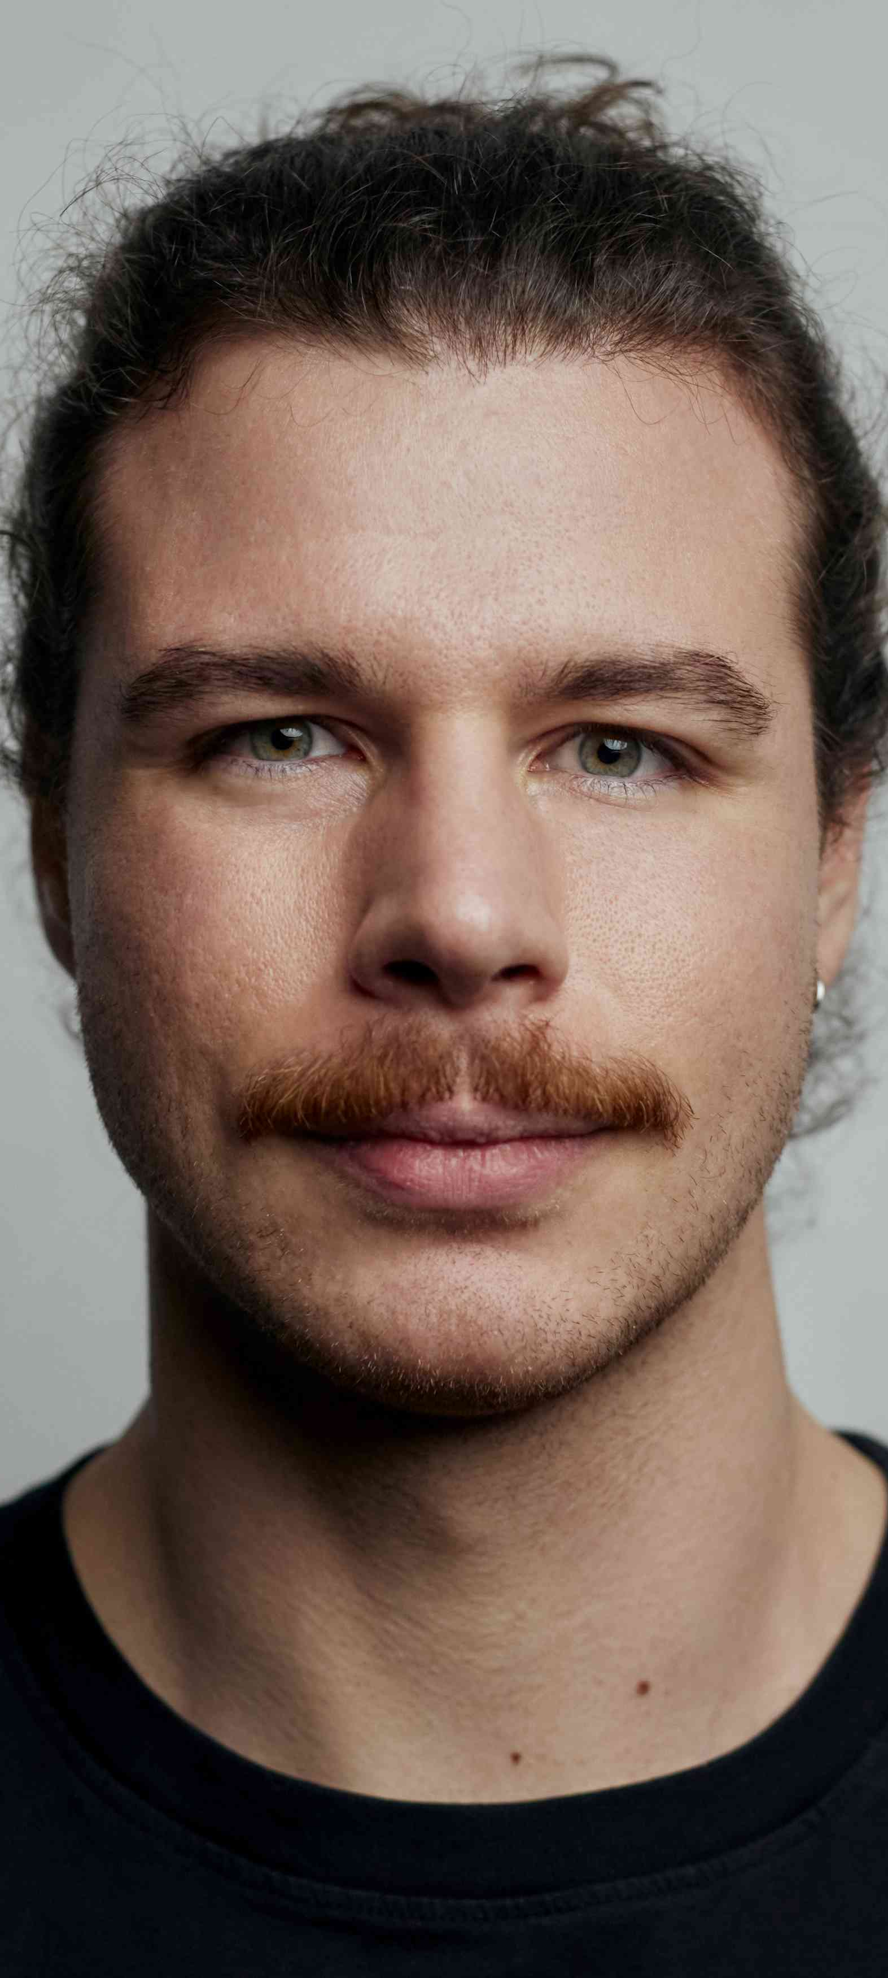
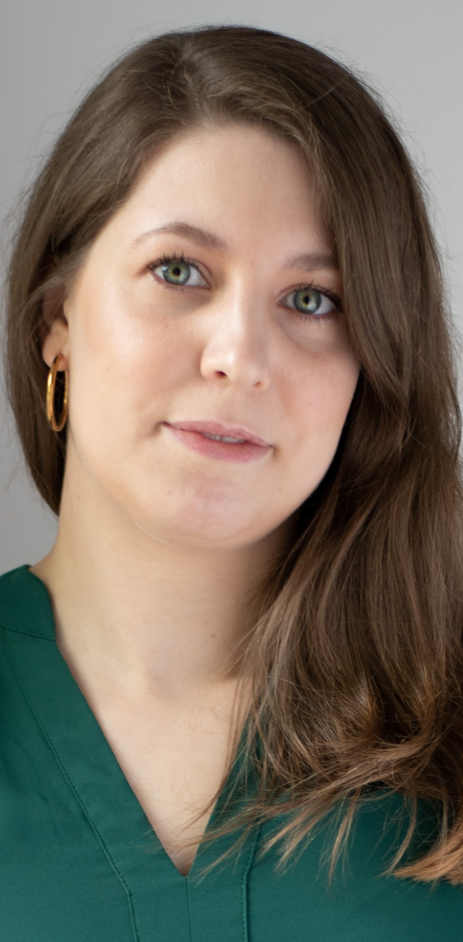
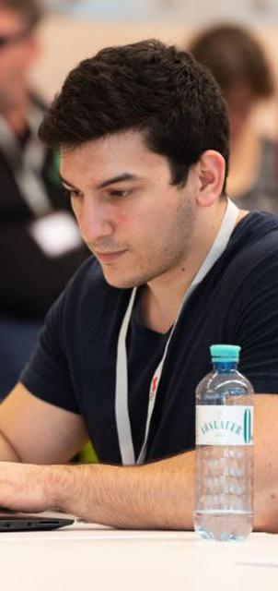

Large-scale Data Engineering: Module Overview
20 seats in total
bachelor + master
#41086: LDE Seminar + Project (12 ECTS)
10 students
10 students
#41095: Seminar LDE (3)
#41183: Project LDE (9 ECTS)
7 students
bachelor-only
bachelor-only
Mon, 14:00-16:00
MAR 0.010 & zoom
Seminar LDE
Reading & writing scientific papers
Giving presentations on papers
Summary paper
Presentation
Lecturer & seminar mentor
Project LDE
Building & evaluating prototypes
Giving presentations on prototypes
Prototype design/impl/tests/doc/eval
Presentation
Project mentors
Mon, 16:00-18:00
MAR 0.010 & zoom
In the context of systems for data engineering, data management, machine learning
In combination: Ideal preparation for a bachelor/master thesis with our group

Slide 8
Course Organization
General Contact Person
Dr.-Ing. Patrick Damme (patrick.damme@tu-berlin.de)
Course Website
https://pdamme.github.io/teaching/2025_summer/lde/lde_summer2025.html
One site for seminar and project
All material, schedule, deadlines
ISIS course
https://isis.tu-berlin.de/course/view.php?id=41969
Announcements, discussion forum, topic selection poll, submission of summary paper and presentation slides
Language
Lectures and slides: English
Communication: English/German
Submitted paper and presentation: English
Informal language (first name is fine), immediate feedback is welcome

Slide 9
Semester Schedule & Deadlines
Kick-off Meeting Apr 14 (optional)
Recommended Introductory Lecture (optional)
May 05, 14:00: Experiments, Reproducibility, and Giving Presentations
Self-organized Project Work
Consultation hours for any questions (optional)
Intermediate Presentations (prerequisite)
Jun 30, 16:00-18:00, B 106: All teams/individuals
Final Presentations (mandatory)
Aug 04, 14:00-18:00, FH 301: All teams/individuals
List of Project Topics
Presented today, take your time to select afterwards
Topic Selection
Deadline: May 02, 23:59 CEST (in 2½ weeks)
Ranked list of 5 topics via poll on the ISIS course + pref on individual/team work [+ team members]
Global topic assignment based on preferences
Notification of assigned topics: May 12 (in 4 weeks)
Submission of Initial Prototype (prerequisite)
Implementation and tests
Deadline: Jun 29, 23:59 CEST (in 11 weeks)
As a pull request on GitHub (exceptionally by email)
Submission of Final Prototype (mandatory)
Implementation, tests, docs, experiments
Deadline: Jul 28, 23:59 CEST (in 15 weeks)
As a pull request on GitHub (exceptionally by email)
Submission of Pres. Slides (Intermediate & Final Pres.)
Deadline: The day before the presentation, 23:59 CEST
Upload PDF in the ISIS course

Slide 10
Project Deliverables: Initial Prototype & Intermediate Presentation
Introduced in Response to Students’ Feedback (Course Evaluation)
Initial Prototype
80% functionally complete prototype including good set of test cases
Basis for further improvements driven by experiments and feedback
Intermediate Presentation
Slide presentation of 5-10 min per individual/team
Briefly present the problem you work on
Give an overview of your initial prototype (concepts and crucial changes to the code base)
Outline your planned experiments
Should be the result of prior discussions with your project mentor
Benefits for You
Improved time management (retain enough time for experiments)
Exchange with the other students in the project
Get feedback by project mentors and other students for improving the quality of your prototype
Ungraded Prerequisites for the Portfolio Exam to be allowed make mistakes and learn from them

Slide 11
Project Deliverables: Final Prototype & Final Presentation
Final Prototype
100% functionally complete prototype including good set of test cases
Efficiency (confirmed by experiments)
Final Presentation
Summarize the problem and give an overview of your final prototype
Present your experimental results
1 student: 10 min talk + 5 min discussion = 15 min
2 students: 13 min + 7 min = 20 min
3 students: 16 min + 9 min = 25 min
Audience: engage in the discussion
Grading
#41086 (seminar + project)
Graded portfolio exam
25 pts: summary paper
15 pts: presentation
50 pts: design/impl/tests/doc
10 pts: presentation
#41183 (project-only)
Graded portfolio exam
85 pts: implementation/tests/documentation
15 pts: presentation
Academic Honesty / No Plagiarism implies that use of LLMs like ChatGPT is prohibited

Slide 12
Portfolio Exam Registration
Portfolio exam registration: May 12 – Jun 09
Binding registration in Moses/MTS
Including selection of seminar presentation date (first-come-first-serve)
Portfolio exam de-registration
Until 3 days before the first graded exam part
Modules “LDE”/”Seminar LDE”: until Jun 20
Module “Project LDE”: until Jul 25
De-register yourself in Moses/MTS
With sufficient reason: Until the day of the exam
In case of sickness etc.
Modules “LDE”/”Seminar LDE”: until Jun 23/Jul 07/Jul 14
Module “Project LDE”: until Jul 28/Aug 04
Missing deadlines/exam without de-registration
Zero points in the respective exam part (!)
Approach us early in case of problems
If you don’t want to take LDE anymore
Let me know asap to give students in the queue a chance to fill in

Slide 13
LDE Project Goals and Mindset
Goals
Design/implement a prototype in DAPHNE/SystemDS
AND prove it is a valuable contribution to the system (tests, documentation, experiments)
Present and defend your work in a presentation & discussion
Focus on Methodology
LDE as a preparation for a bachelor/master thesis at the DAMS Lab
Mindset: Be Open Learn New Things and to Work on Any Part of the System
Whatever it takes to fulfill the task
Self-guided acquisition of required technical skills
Grading Criteria
Design/implementation (functionality)
Code quality + tests + documentation
Experiments
High-quality and convincing contribution to an open-source system

Slide 14
Projects in DAPHNE and Apache SystemDS

Slide 15




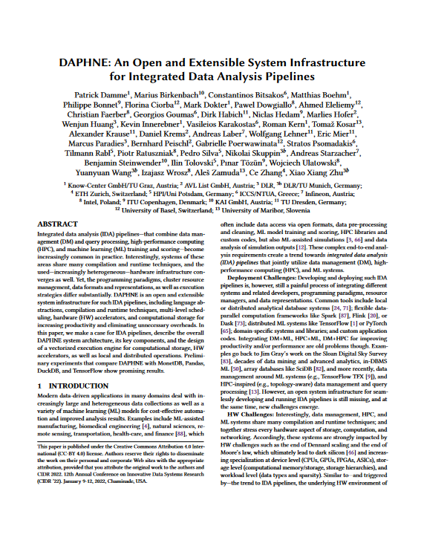
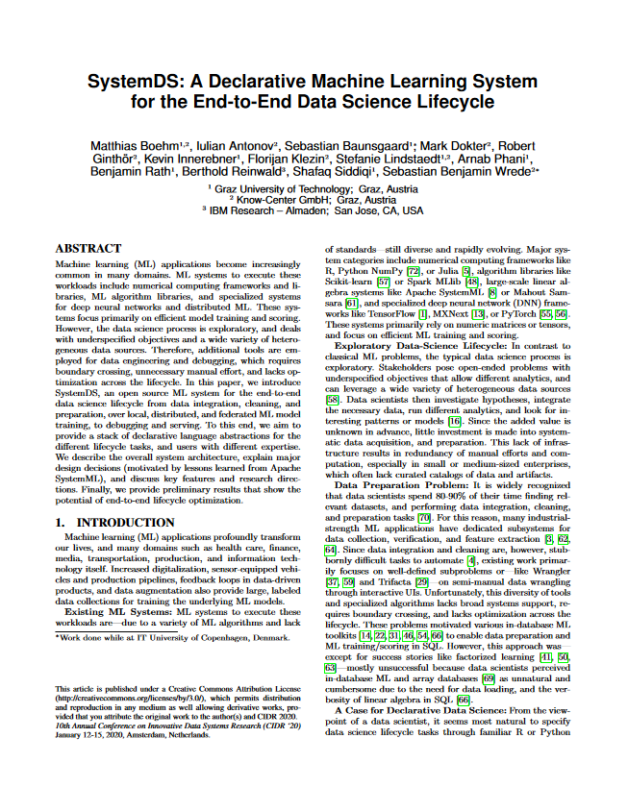
Overview: Two Systems Developed at the DAMS Lab
An Open and Extensible System Infrastructure for Integrated Data Analysis Pipelines
Intersection of data management, machine learning, high-performance computing
Open-source (Apache v2 license) https://github.com/daphne-eu/daphne
Originated from DAPHNE EU-project
Written mostly in C++, Python, DaphneDSL
Since 2020 (open-source since 2022)
A Declarative ML System for the End-to-End Data Science Lifecycle
Data integration/cleaning/prep, model selection/ training/validation/debugging/deployment/scoring
Open-source (Apache v2 license) https://github.com/apache/systemds
Originated from Apache SystemML (started at IBM)
Written mostly in Java, Python, and DML
Since 2010 (open-source since 2015) (as SystemML)
[Patrick Damme et al.: DAPHNE: An Open and Extensible System Infrastructure for Integrated Data Analysis Pipelines. CIDR 2022]
[Matthias Boehm et al.: SystemDS: A Declarative Machine Learning System for the End-to-End Data Science Lifecycle. CIDR 2020]

Slide 16






Simplified High-level Architecture of DAPHNE and SystemDS
…
neural networks
clustering
Program matrix/frame data types linear/relational algebra ops complex control flow
Input Data open file formats
data exchange with other systems/libs
regression
…
classification
…
relational queries
System
Language Abstractions & APIs
Domain-specific language (DSL), Python API
Optimizing Compiler DSL parser, Intermediate representation (IR), Compiler passes (lowering and optimization)
Architecture of ML Systems (AMLS): Lecture + Exercise by Prof. Matthias Böhm Thu 16:00-18:00
Other such systems (examples)
Runtime
Parallel local & distributed execution, Hardware accelerators (e.g., GPU)
Output Data

Slide 17
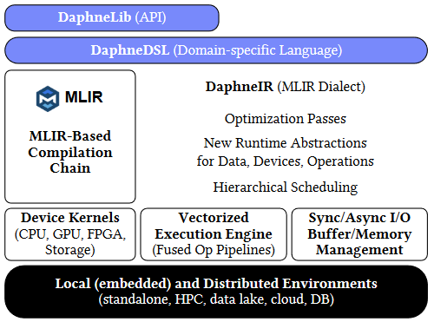
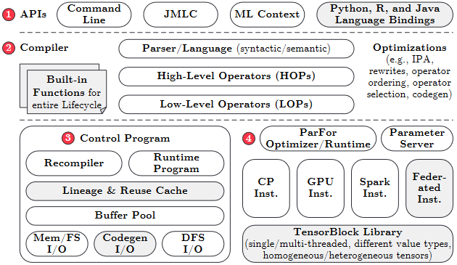
Simplified High-level Architecture of DAPHNE and SystemDS
Program matrix/frame data types linear/relational algebra ops complex control flow
Input Data open file formats
data exchange with other systems/libs
Language Abstractions & APIs
Domain-specific language (DSL), Python API
Optimizing Compiler DSL parser, Intermediate representation (IR), Compiler passes (lowering and optimization)
Runtime
Parallel local & distributed execution, Hardware accelerators (e.g., GPU)
Output Data

Slide 18
Kinds of LDE Project Topics
End-to-end Experiments
typically required in any project topic
Reusable Data Science Primitives
Data analysis algorithms/applications
Mostly in DaphneDSL/DML
Program
Input Data
Language Abstractions & APIs
System Internals
Optimization and efficient execution of input programs (various aspects)
Mostly in C++/Java, some also in Python
External Tooling
Helpers in the ecosystem
Any suitable prog. lang.
Optimizing Compiler
Runtime
Openness to All Levels of the Stack to fulfill the task
Choose topic based on your interests and technical skills
Output Data

Slide 19
LDE Project Characteristics
Individual/Team Project Work
Teams of up to 3 students strongly encouraged
Unique topic for each individual/team
Ambitious Projects
9 ECTS (~270 h of work)
≈6.75 weeks of full-time work
Potential for Impact
Real open issues in existing systems
If successful: meaningful contributions that will be used by others
Remarks on Topic Descriptions
Many open topics in DAPHNE and SystemDS
Initial topic descriptions of varying level of detail
During topic selection: Approach project mentor directly if interested in more details
After topic assignment: More detailed descriptions where necessary
We’re open to alternative topic proposals

Slide 20
How to Approach the Project

Slide 21
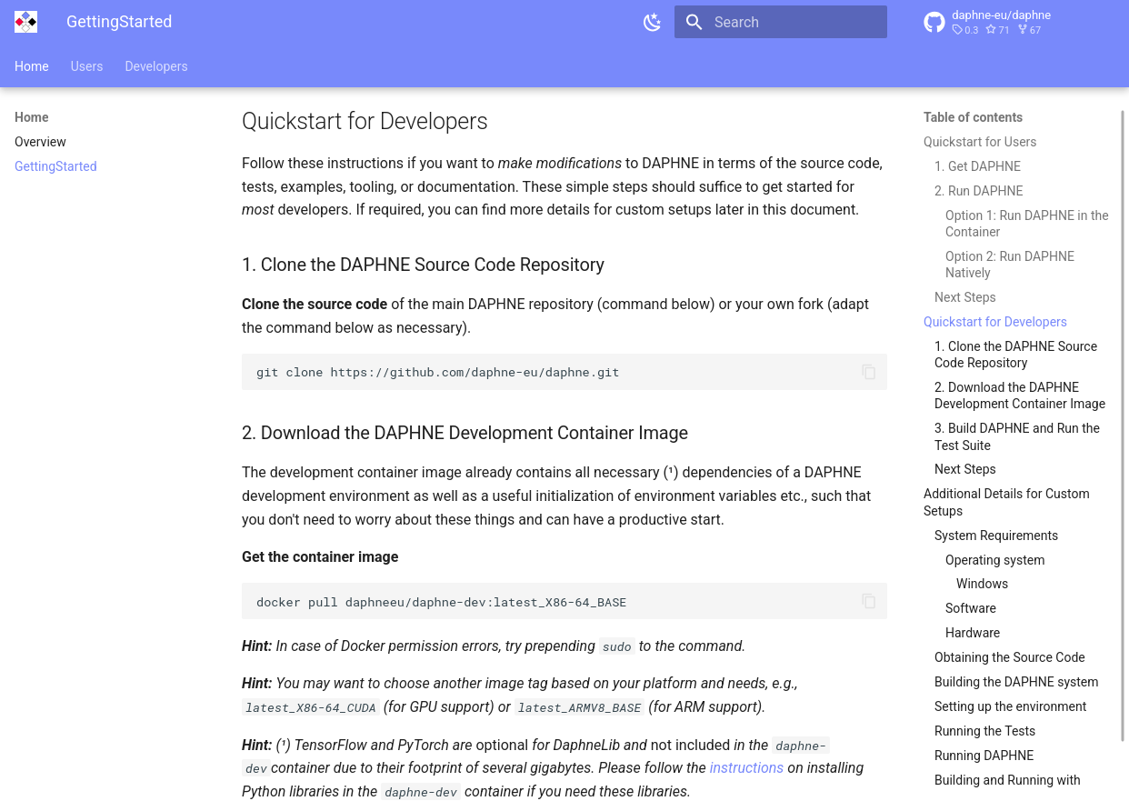
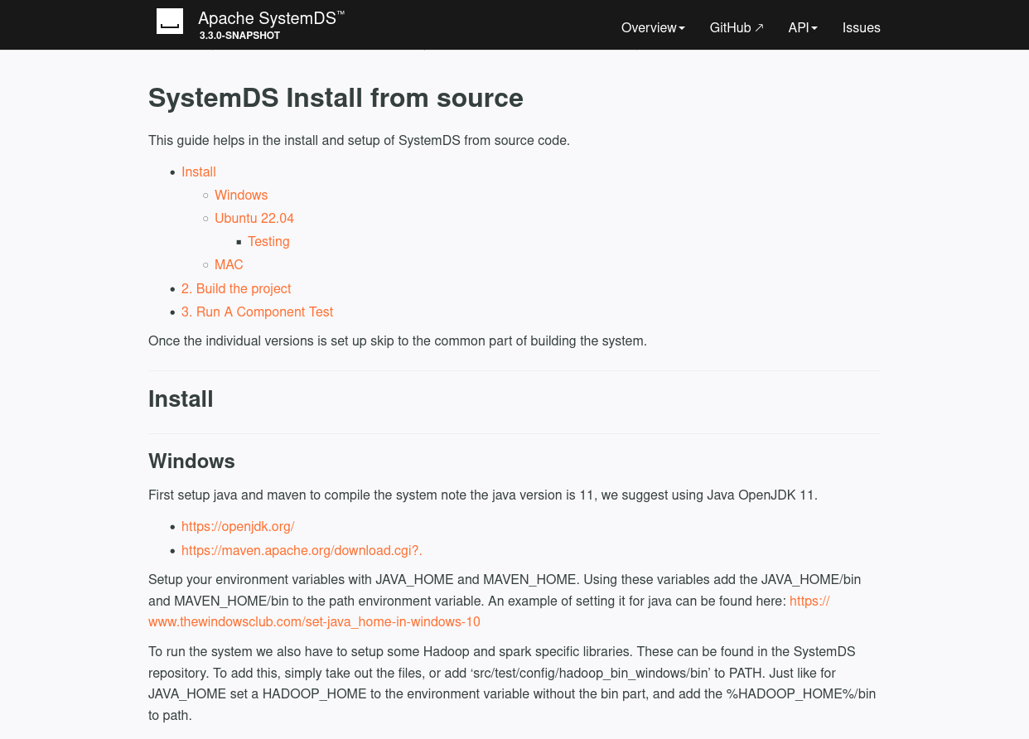
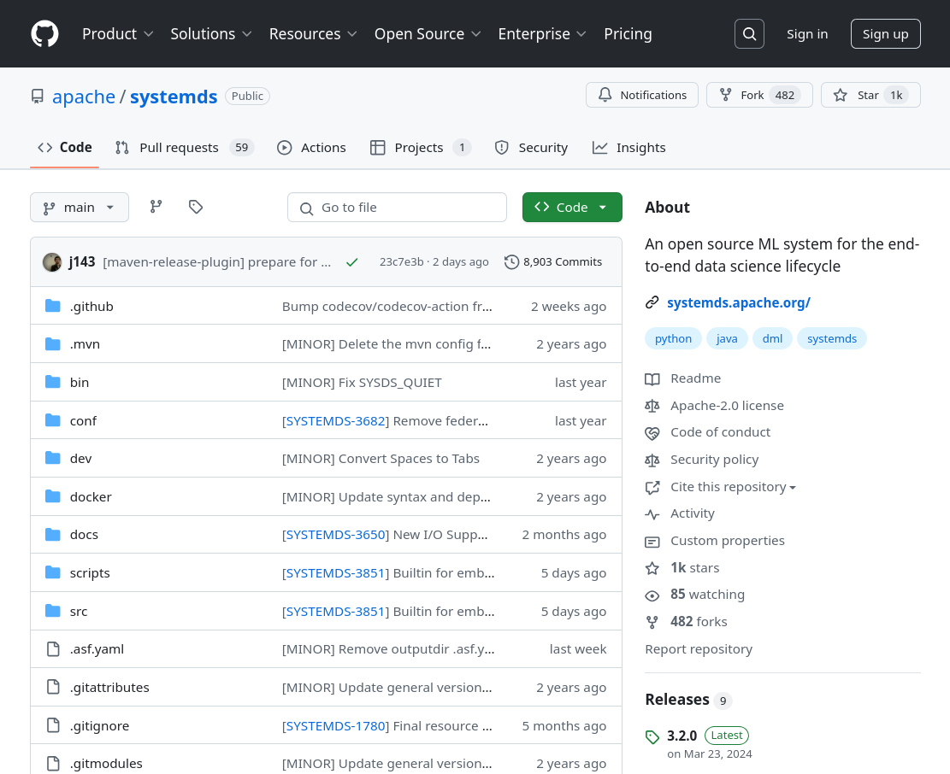
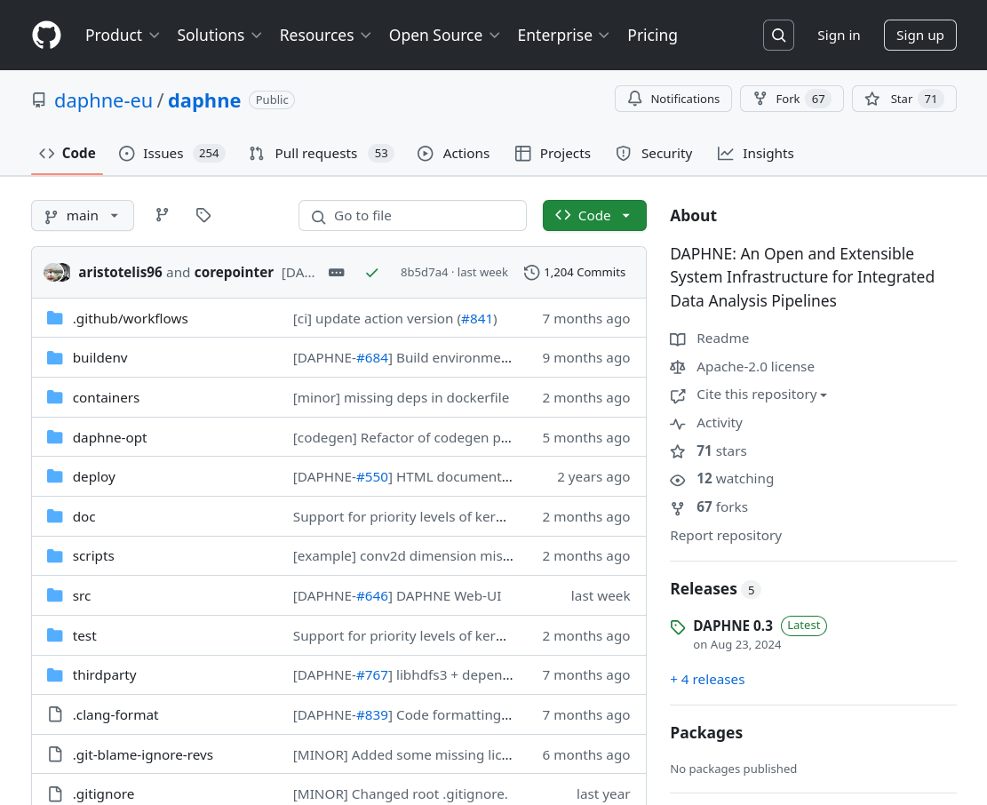
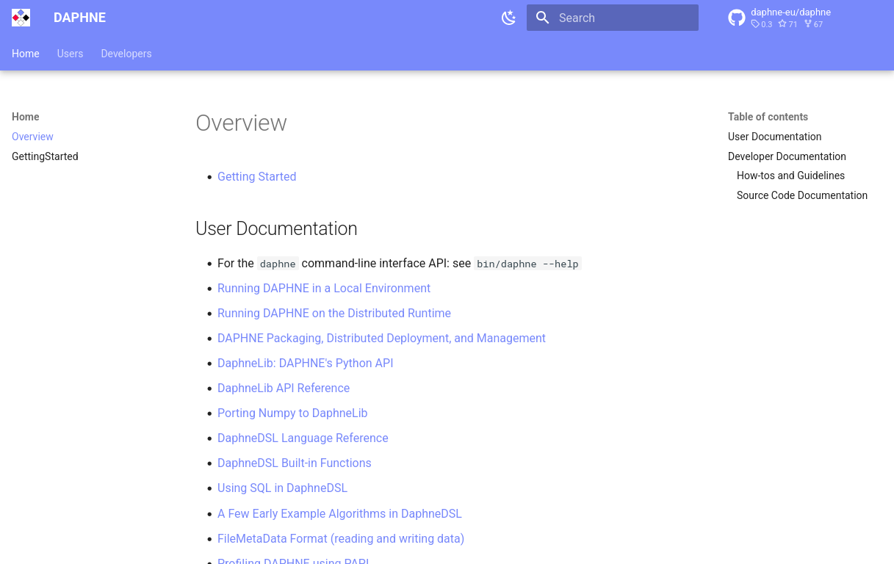
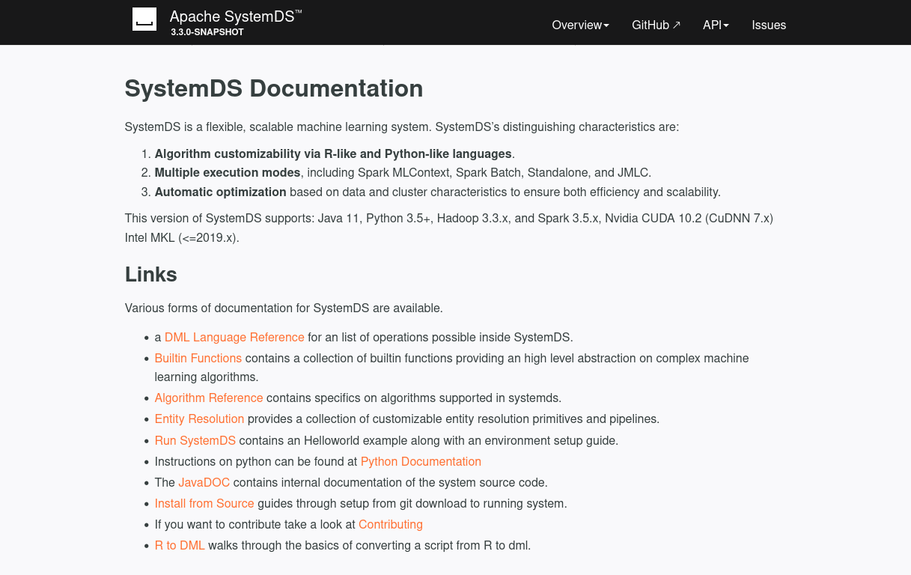
Getting Started: Setting Up Your Development Environment
Goals
Build the system from source
Successfully run the test suite
Navigate to the GitHub Repos
Know Where to Find the Documentation
Clone, Build, Test According to the Documentation
https://daphne-eu.github.io/daphne/ GettingStarted/#quickstart-for-developers
https://apache.github.io/systemds/ site/install.html
https://github.com/apache/systemds
https://github.com/daphne-eu/daphne
https://daphne-eu.github.io/daphne/
https://apache.github.io/systemds/

Slide 22
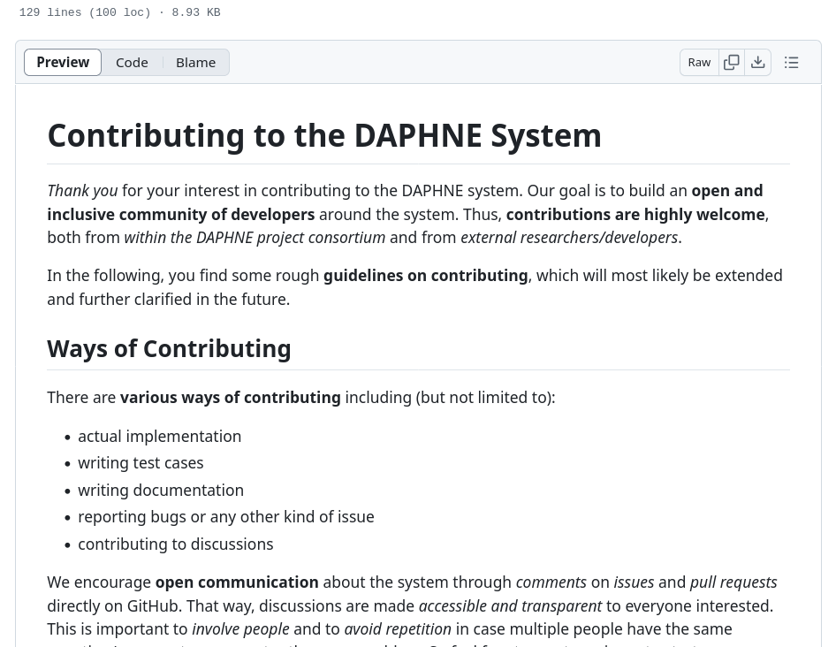
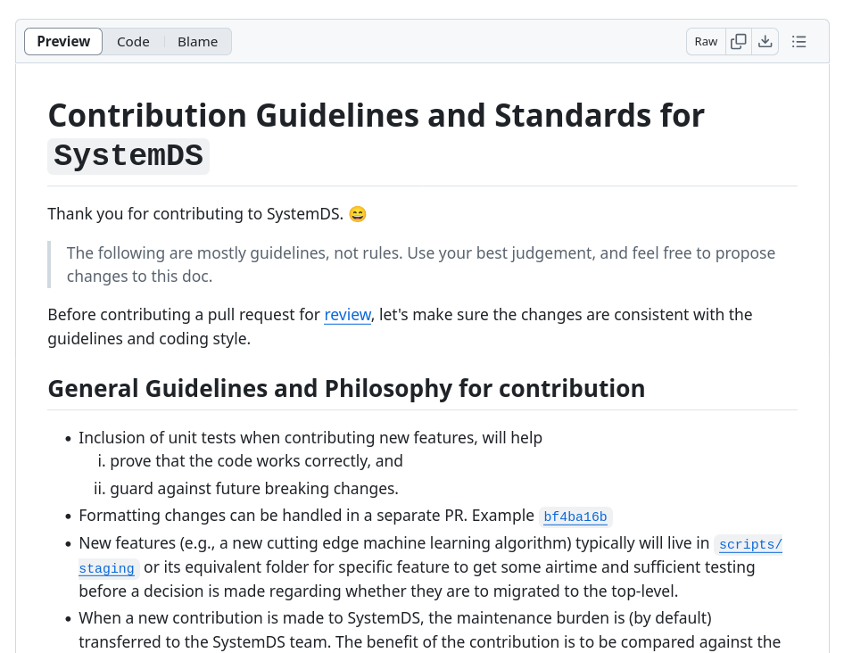
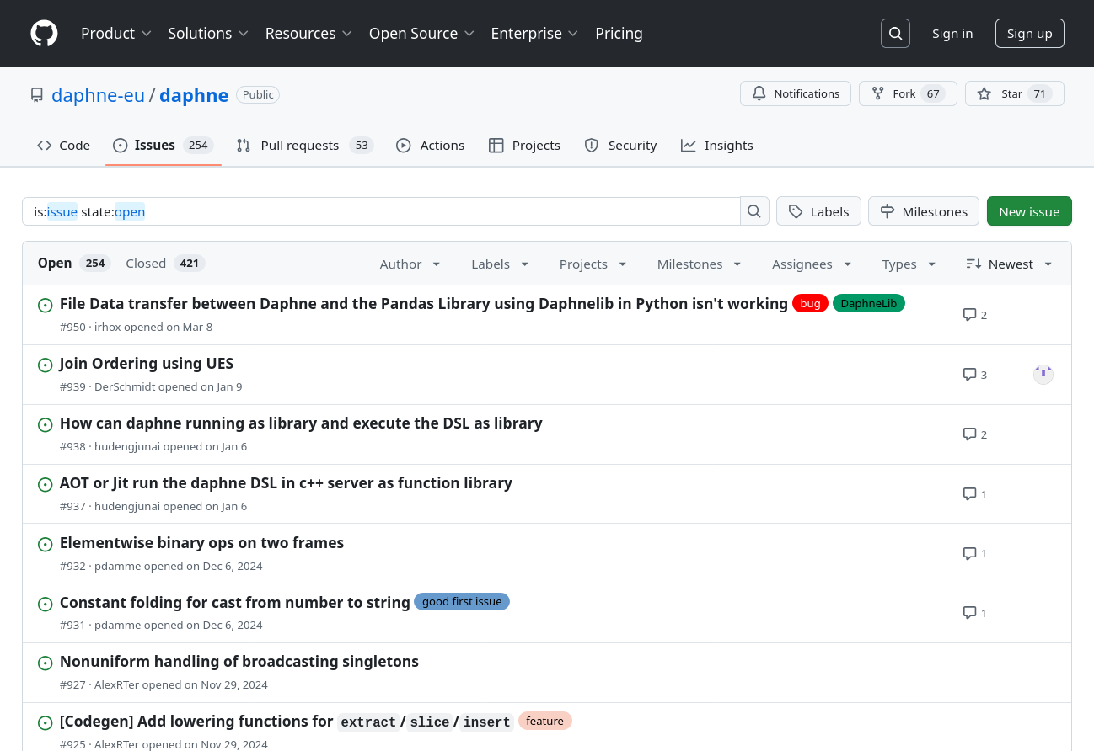
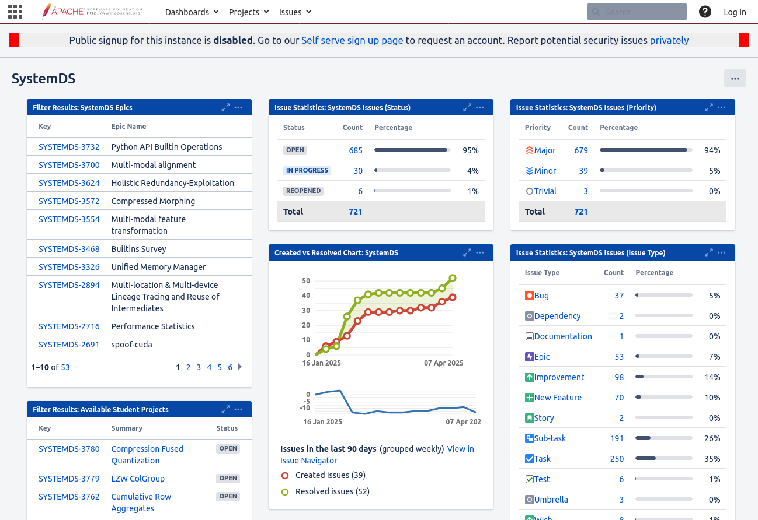
Getting Started: Preparing Your First Contribution
Goals
Ability to modify the source code and run/test it
Initial overview of relevant part of the code base
Set Up Your Editor/IDE etc.
Issue Tracking
Make Your First Modifications to the Code
DAPHNE: “good first issues”
SystemDS: Write initial test cases for your task
Read the Contribution Guidelines
https://github.com/daphne-eu/daphne/ blob/main/CONTRIBUTING.md
https://github.com/apache/systemds/ blob/main/CONTRIBUTING.md
https://github.com/daphne-eu/ daphne/issues
https://issues.apache.org/jira/secure/ Dashboard.jspa?selectPageId=12335852

Slide 23
Initial Prototype: Design/Implementation/Tests (≈2/3 of the semester)
Goals
80% functionally complete prototype including good set of test cases
Basis for further improvements driven by experiments and feedback
Mindset
Understand the topic (task description, mentor, additional material)
Understand the code base (overview and relevant parts)
Understand the employed libraries/frameworks
Design and implement step-by-step
Not always “the” right solution: explore alternatives
Typical Pitfalls
Start as the deadline approaches -> don’t underestimate the effort, start immediately
Don’t talk to project mentor -> your mentor can give you valuable guidance

Slide 24
Final Prototype: Creating a Convincing Contribution (≈1/3 of the semester)
.
Goals
High-quality code contribution whose value can easily be appreciated and understood
Typical Pitfalls
Untidy, hardly documented, hardly tested code
View experiments as nice-to-have addendum, start them as the deadline approaches -> experiments show the value of your contribution -> you need time to incorporate your insights
Don’t talk to project mentor -> your mentor can give you valuable guidance
Countermeasures
Focus primarily on investigating and improving your initial prototype after the intermediate presentation

Slide 25
Final Prototype: Code Quality
Goals
Make your code easy to read/understand
Others will have to maintain it after your contribution is merged
General Guidelines
Clearly structure your code into meaningful units (classes, functions, etc.)
Use clear yet concise identifiers (variable/function/class names)
Stay consistent with the existing code base (e.g., use the same patterns) OR refactor if necessary
Adhere to the code base’s coding style/formatting
Keep Your Pull Request Tidy
Stay focused: Avoid changes unrelated to your task (can be contributed as individual small pull requests)
Don’t submit anything that’s useless for others (e.g., build artifacts, generated files (e.g., logs), IDE projects)
Exclude specifics of your local setup: Avoid local paths, usernames, passwords, IP addresses etc.

Slide 26
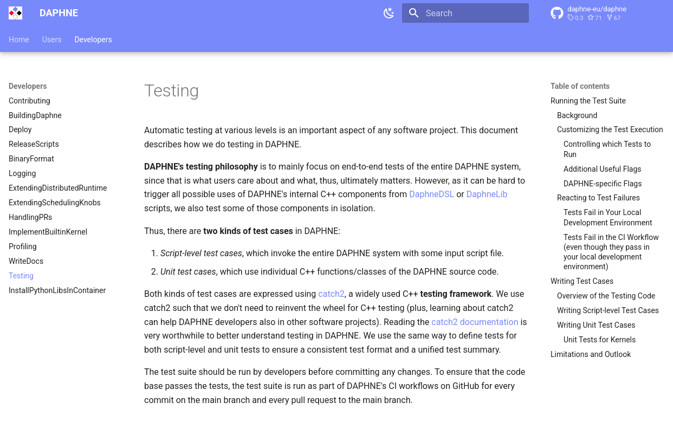
Final Prototype: Tests
Goals
Show functionally correct behavior
Experiments don’t make sense if prototype doesn’t do what it should
General Hints
Unit tests and script-level tests
Test cases that should work
Test cases that should not work (e.g., invalid DSL scripts, invalid input data, …)
Construct simple and complex scenarios
Think of corner cases
Small input data is often fine (but some bugs only triggered by large inputs)
Integrate with the Existing Test Suite
DAPHNE -> directory: test/ -> see the documentation on writing test cases
SystemDS -> directory: src/test/
https://daphne-eu.github.io/daphne/ development/Testing/

Slide 27
Final Prototype: Documentation
Goals
Make your contribution understandable for users and developers
User Documentation
What’s not documented doesn’t exist
Add high-level explanation of features and concepts behind them
Update documentation of language abstractions (e.g., new DSL built-in functions, new types, …)
Update documentation of user APIs (e.g., new command-line arguments)
Developer Documentation
Negative example: “The code is the documentation”
High-level explanation of your contribution; justify design decisions
API documentation of classes, functions, members, etc. (integrate with the existing source code documentation of the system, e.g., doxygen or javadoc style)
Comments within function bodies (e.g., high-level steps of an algorithm)

Slide 28
Final Prototype: Experiments
Goals
Understand your prototype to discover potential for improvement (e.g., performance bottlenecks)
Demonstrate functional improvements (new features)
Showcase non-functional improvements (performance compared to status quo and state-of-the-art baselines)
Design Experiments
Don’t just conduct any random experiments
Think about which questions you want/need to answer, design experiments accordingly
Types of experiments: Exploratory, micro benchmarks, benchmarks, end-to-end applications
Aspects of an experiment: Data, workload, baselines, hardware & software stack, metrics
Conduct Experiments
Automate as much as possible for repeatability (shell scripts etc.)
Visualize and Interpret the Results
Automate the visualization based on raw experimental data
Draw conclusions and react
See 3rd seminar intro lecture on “Experiments, Reproducibility”

Slide 29
List of Project Topics (Proposals)
See list at https://pdamme.github.io/teaching/2025_summer/lde/ProjectTopics.pdf

Slide 30
Summary and Q&A
Course Organization, Outline, and Deliverables
Projects in DAPHNE and Apache SystemDS
How to Approach the Project
List of Project Topics (Proposals)
Remaining Questions?
Reminder: Seminar Introductory Lecture Recommended for the Project
03 Experiments, Reproducibility, and Giving Presentations [May 05, 14:00]
See you during the consultation hours and intermediate presentations ☺

Slide 31

Apache SystemDS: A Declarative ML System for the End-to-End Data Science Lifecycle
https://github.com/apache/systemds

Slide 32








Landscape of ML Systems
Existing ML Systems
#1 Numerical computing frameworks
#2 ML Algorithm libraries (local, large-scale)
#3 Linear algebra ML systems (large-scale)
#4 Deep neural network (DNN) frameworks
#5 Model management, and deployment
Exploratory Data-Science Lifecycle
Open-ended problems w/ underspecified objectives
Hypotheses, data integration, run analytics
Unknown value → lack of system infrastructure → Redundancy of manual efforts and computation
Data Preparation Problem
80% Argument: 80-90% time for finding, integrating, cleaning data
Diversity of tools ➔ boundary crossing, lack of optimization
“Take these datasets and show value or competitive advantage”
[NIPS 2015]
[DEBull 2018]

Slide 33


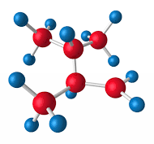

The Data Science Lifecycle
(aka KDD Process, aka CRISP-DM)
Data extraction, schema alignment, entity resolution, data validation, data cleaning, outlier detection, missing value imputation, semantic type detection, data augmentation, feature selection, feature engineering, feature transformations
Key observation: SotA data integration/cleaning based on ML
Data Scientist
Data Integration Data Cleaning Data Preparation
Data Integration Data Cleaning Data Preparation
Model Selection Training Hyper-parameters
Validate & Debug Deployment Scoring & Feedback
Exploratory Process (experimentation, refinements, ML pipelines)
Data/SW Engineer
DevOps Engineer

Slide 34
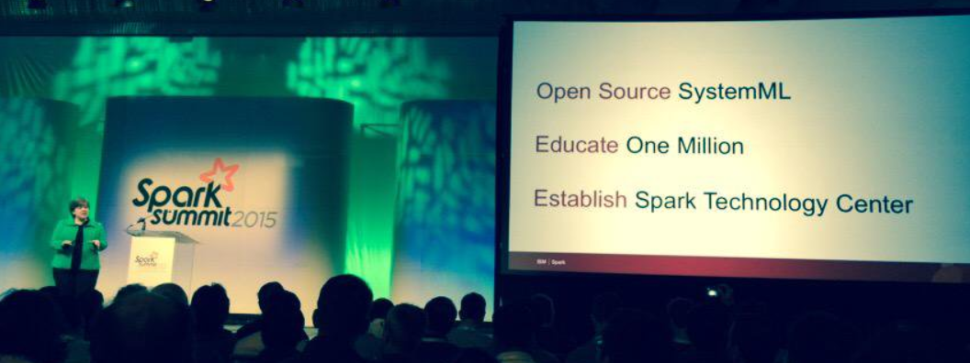




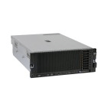
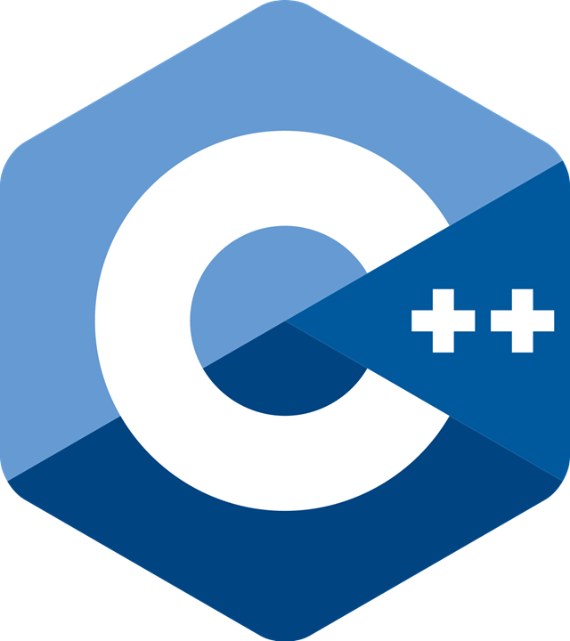
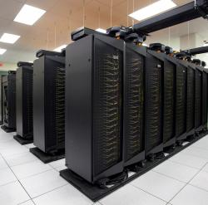
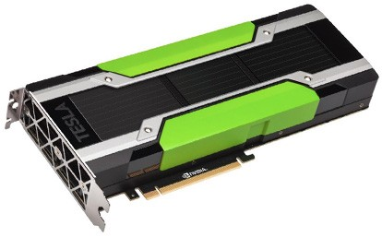
Apache SystemDS [https://github.com/apache/systemds]
DML Scripts
APIs: Command line, JMLC, Python Spark MLContext, Spark ML, (Scalable Algorithms + Primitives)
Language
Compiler
07/2020 Renamed to Apache SystemDS 05/2017 Apache Top-Level Project 11/2015 Apache Incubator Project
08/2015 Open Source Release
[SIGMOD’15,’17,’19,’21abc,’23abc]
[PVLDB’14,’16ab,’18,’22]
[ICDE’11,’12,’15]
[CIDR’17,’20]
[VLDBJ’18]
[CIKM’22] [DEBull’14]
[PPoPP’15]
Runtime
Write Once, Run Anywhere
In-Memory Single Node (scale-up)
Hadoop or Spark Cluster (scale-out)
Federated (LA progs, PS)
In-Progress:
GPU
since 2019
since 2014/16
since 2012
since 2010/11
since 2015

Slide 35
Language Abstractions and APIs
Data Independence + Impl-Agnostic Ops ➔ “Separation of Concerns”
User Script
Built-in Functions
Example: Stepwise Linear Regression
X = read(‘features.csv’)
Y = read(‘labels.csv’)
[B,S] = steplm(X, Y,
icpt=0, reg=0.001)
write(B, ‘model.txt’)
m_steplm = function(...) {
while( continue ) {
parfor( i in 1:n ) {
if( !fixed[1,i] ) {
Xi = cbind(Xg, X[,i])
B[,i] = lm(Xi, y, ...)
} }
# add best to Xg # (AIC)
} }
m_lmCG = function(...) {
while( i<maxi&nr2>tgt ) {
q = (t(X) %*% (X %*% p)) + lambda * p
beta = ... }
}
m_lm = function(...) {
if( ncol(X) > 1024 )
B = lmCG(X, y, ...)
else
B = lmDS(X, y, ...)
}
Linear Algebra Programs
Feature Selection
Facilitates optimization across data science lifecycle tasks
ML Algorithms
m_lmDS = function(...) {
l = matrix(reg,ncol(X),1)
A = t(X) %*% X + diag(l)
b = t(X) %*% y
beta = solve(A, b) ...}

Slide 36
Basic HOP and LOP DAG Compilation
LinregDS (Direct Solve)
X = read($1);
y = read($2);
intercept = $3;
lambda = 0.001;
...
if( intercept == 1 ) {
ones = matrix(1, nrow(X), 1);
X = append(X, ones);
}
I = matrix(1, ncol(X), 1);
A = t(X) %*% X + diag(I)*lambda;
b = t(X) %*% y;
beta = solve(A, b); ...
write(beta, $4);
HOP DAG (after rewrites)
8KB
Cluster Config:
driver mem: 20 GB
exec mem: 60 GB
CP
write
Scenario: X: 10⁸ x 10³, 10¹¹ y: 10⁸ x 1, 10⁸
8MB
16MB
CP
b(solve)
CP
172KB
b(+)
1.6TB
CP
SP
800GB
r(diag)
ba(+*)
ba(+*)
SP
1.6TB
r(t)
8KB
SP
CP
800GB
800MB
dg(rand) (10³x1,10³)
X
(10⁸x10³,10¹¹)
y (10⁸x1,10⁸)
Distributed Matrices
Fixed-size matrix blocks
Data-parallel operations
LOP DAG (after rewrites)
16KB
r’(CP)
mapmm(SP)
tsmm(SP)
X_{1,1}
Hybrid Runtime Plans:
Size propagation / memory estimates
Integrated CP / Spark runtime
Dynamic recompilation during runtime
800MB
1.6GB
X_{2,1}
r’(CP)
X
(persisted in MEM_DISK)
X_{m,1}
y

Slide 37















DAPHNE: An Open and Extensible System Infrastructure for Integrated Data Analysis Pipelines
https://github.com/daphne-eu/daphne

Slide 38
Integrated Data Analysis (IDA) Pipelines
DM
ML
HPC
+
+
Data Management
Machine Learning
High-Perf. Computing
Example: ML-assisted Simulation
HPC, custom codes, and simulations
Data preprocessing and cleaning
Query processing
Small-Scale Simulation w/ diff. params
Featurization and Random Reshuffling
ML Model Training
ML-assisted Full-Scale Simulation
Data-Analysis Pipeline
M
ML model training and scoring
D’’
D
D’
Open data formats

Slide 39
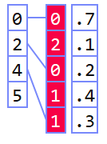

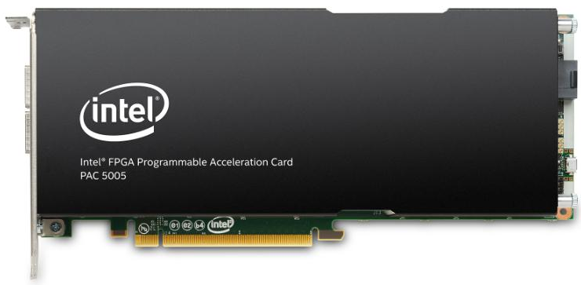
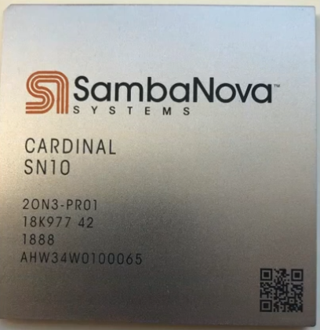
Challenges
Deployment Challenges
Hardware Challenges
DM+ML+HPC share compilation and runtime techniques / converging cluster hardware
End of Dennard scaling
End of Moore’s law
Amdahl’s law
Dev Teams
Programming Models
DAPHNE: An open and extensible system infrastructure for IDA pipelines
Different Systems/ Libraries
Cluster Under-utilization
Data/File Exchange
Resource Managers
Increasing Specialization
Data Representations
Data Placement
Data (Value) Types
graph
Local vs distributed
FP32, FP64, INT8,
INT32, INT64, UINT8, BF16, TF32, FlexPoint
CPUs/ NUMA
dense
sparse
compressed
GPUs
Sparsity Exploitation from Algorithms to HW
FPGAs/ ASICs
[NVIDIA A100]

Slide 40
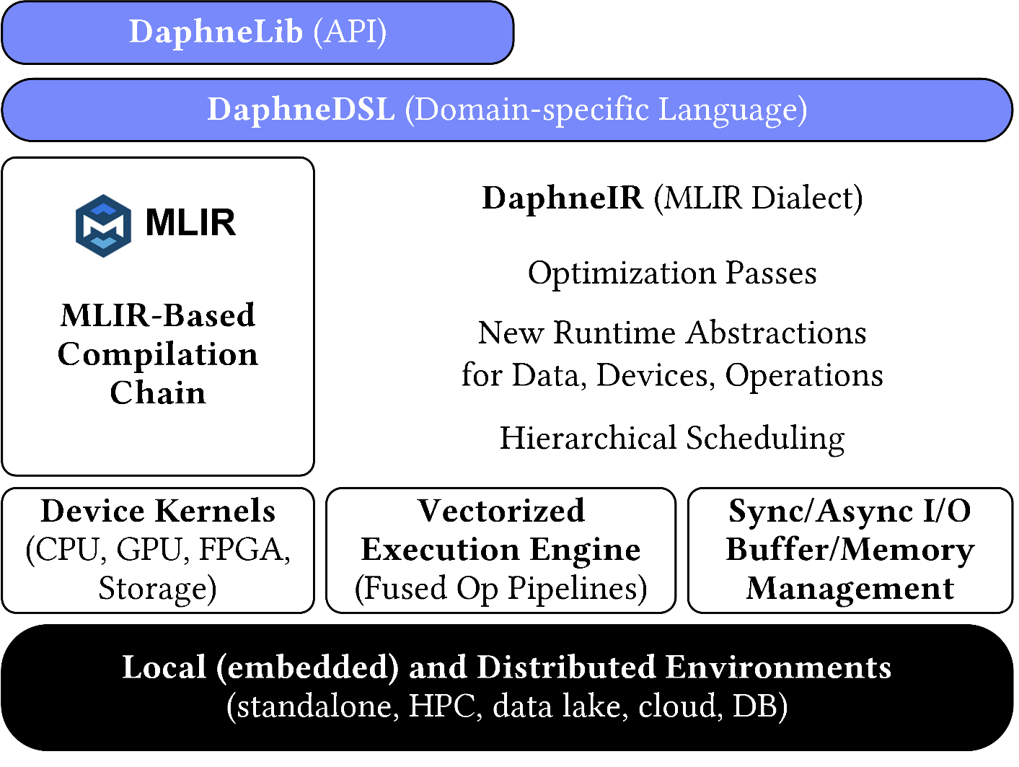
System Architecture
System Architecture
Python API w/ lazy evaluation

Slide 41
Language Abstractions
DSL for linear and relational algebra
Coarse-grained matrix/frame operations
Built-in operations for linear and relational algebra
High-level operations (e.g., SQL, parameter servers, map)
Conditional control flow (branches, loops)
Typed and untyped user-defined functions
Hierarchy of primitives for data science tasks
Physical data independence
System Architecture
Python API w/ lazy evaluation
Example: linear regression model training (simplified)
def lm(X, y) { // X feature matrix, y labels
colmu = mean(X, 1); // column means
colsd = stddev(X, 1); // column stddevs
X = (X – colmu) / colsd; // shift and scale
X = cbind(X, 1); // append column of ones
A = t(X) @ X; // t for transpose
b = t(X) @ y; // @ for matrix mult
return solve(A, b); // system of linear eq
}
my_model = lm(my_X, my_y);

Slide 42
Optimizing Compiler
MLIR-based Optimizing Compiler
Intermediate representation DaphneIR (MLIR dialect)
Systematic lowering from domain-specific operations to calls to pre-compiled kernels for heterogeneous hardware
Traditional programming language rewrites
Type & property inference, inter-procedural analysis
Domain-specific rewrites from linear and relational algebra
Memory management & garbage collection
Device placement & physical operator selection
System Architecture
Python API w/ lazy evaluation
Example: linear regression model training (simplified)
%10:2 = "daphne.vectorizedPipeline"(%5, %colmu, %colsd, %7, %6) ({
^bb0(%arg0: ..., %arg1: ..., %arg2: ..., %arg3: ..., %arg4: ...):
%12 = "daphne.ewSub"(%arg0, %arg1) : ...
%13 = "daphne.ewDiv"(%12, %arg2) : ...
%14 = "daphne.colBind"(%13, %arg3) : ...
%15 = "daphne.gemv"(%14, %arg4) : ... // rewritten from matmul/@
%16 = "daphne.syrk"(%14) : ... // rewritten from matmul/@
"daphne.return"(%15, %16) : ...
}, ...

Slide 43
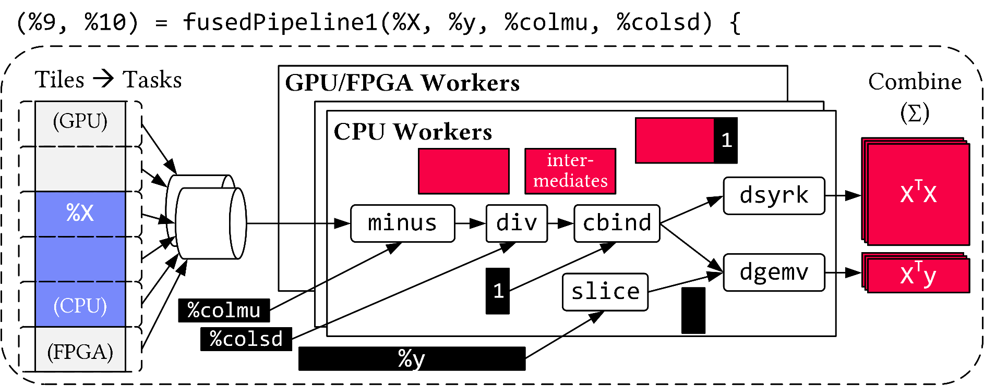
Runtime
Distributed and Local Vectorized Execution
Fused operator pipelines on tiles/vectors of data
Coarse-grained tasks and cache-conscious data binding
Device kernels for heterogeneous hardware
Integration of computational storage (e.g., eBPF programs)
Scheduling for load balancing (e.g., for ops on sparse data)
Different distributed backends (e.g., gRPC, OpenMPI)
System Architecture
Python API w/ lazy evaluation
Example: linear regression model training (simplified)

