Slide 1


Seminar Large-scale Data Engineering (LDE)
01 Structure of Scientific Papers
Dr.-Ing. Patrick Damme
Technische Universität Berlin
Berlin Institute for the Foundations of Learning and Data
Big Data Engineering (DAMS Lab)
[Credit: Based on “Introduction to Scientific Writing”/ ”01 Structure of Scientific Papers” by Matthias Boehm (TU Graz, winter 2021/22)]
Last update: Apr 14, 2025

Slide 2

Announcements/Org
Hybrid Setting with Optional Attendance
In-person in MAR 0.010
Virtual via zoom https://tu-berlin.zoom.us/j/67376691490?pwd=NmlvWTM5VUVWRjU0UGI2bXhBVkxzQT09

Slide 3








About Me
Since 10/2022: Postdoc at TU Berlin, Germany
FG Big Data Engineering (DAMS Lab) headed by Prof. Matthias Böhm
Continuing work on integrated data analysis pipelines
Research interests in the fields of database and ML systems (especially compiler & runtime techniques, extensibility)
2021-2022: Postdoc at TU Graz & Know-Center GmbH, Austria
Data Management group headed by Prof. Matthias Böhm
Started work on integrated data analysis pipelines
2015-2020: PhD student at TU Dresden, Germany
Dresden Database Research Group headed by Prof. Wolfgang Lehner
PhD thesis on making complex analytical database queries more efficient through lightweight compression of intermediate results
MorphStore & TVL

Slide 4
FG Big Data Engineering (DAMS Lab) – Teaching
Successfully Established TUB Teaching Portfolio (modules, slides)
Architecture of Database Systems (ADBS, WiSe)
DB system internals + prog. project
Architecture of ML Systems (AMLS, SoSe)
ML system internals, data science lifecycle + prog. project
Architecture of ML Systems (AMLS, SoSe)
SE Joint ML and DM (MLDM, SoSe+WiSe)
Master
Data Integration and Large-Scale Analysis (DIA, WiSe)
SE/PR Large-scale Data Engineering (LDE, SoSe+WiSe)
Data Integration and Large-Scale Analysis (DIA, WiSe)
Distributed Data Management
Bachelor
Intro to Scientific Methods (WiSe)
Data Management / Databases (DM, SoSe+WiSe)
Data management from user/application perspective
PP Prog.-Practicals Data Systems (PPDS, SoSe+WiSe)

Slide 5
Agenda
Course Organization, Outline, and Deliverables
Structure of Scientific Papers
List of Seminar Topics

Slide 6
Course Organization, Outline, and Deliverables

Slide 7
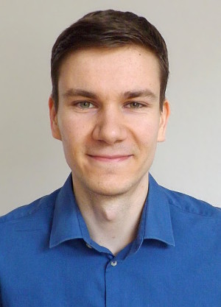
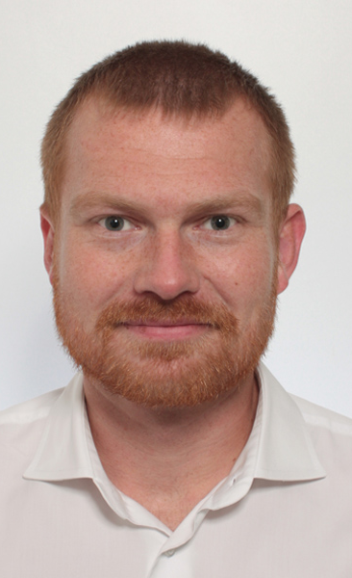
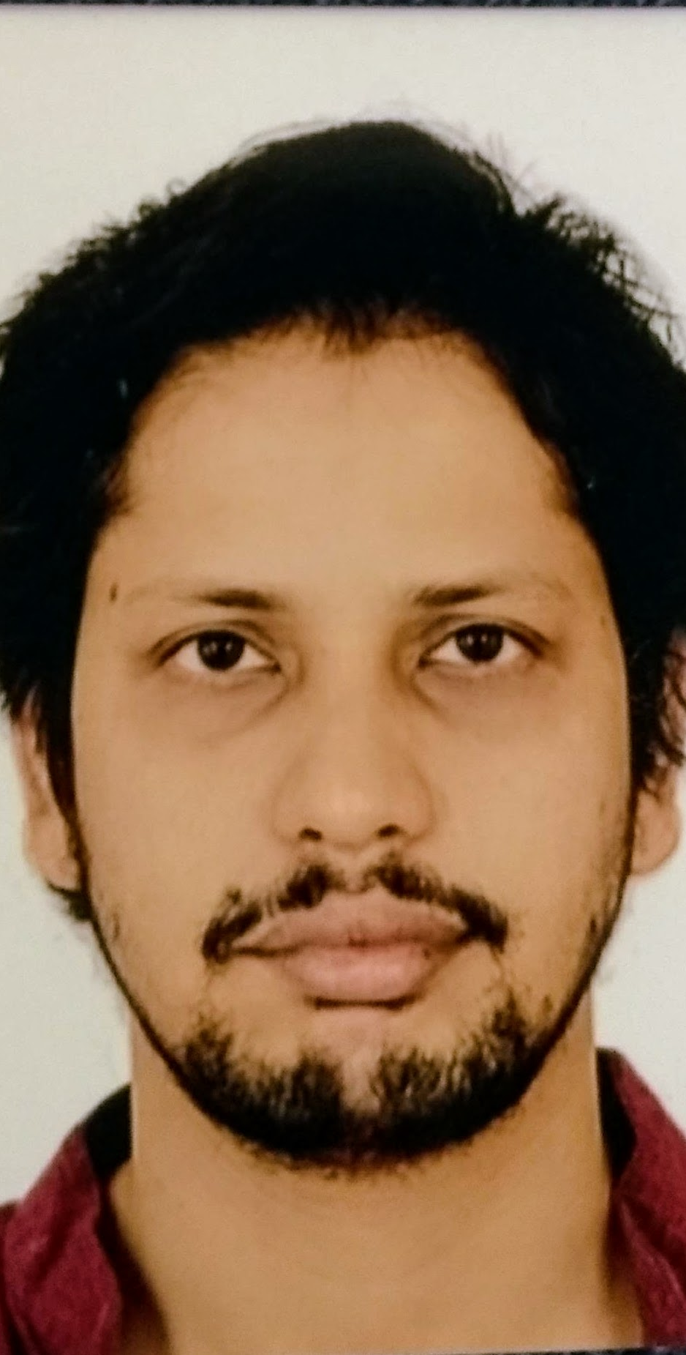
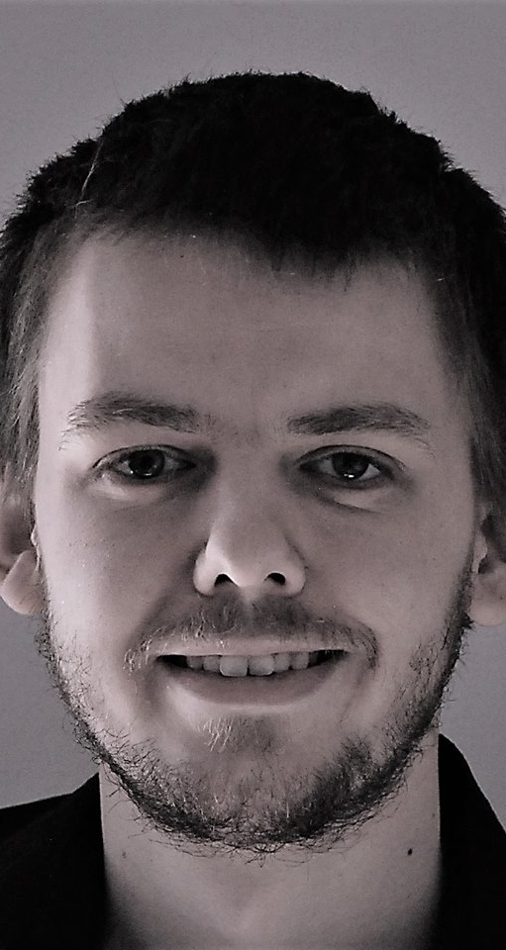
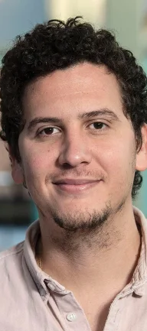

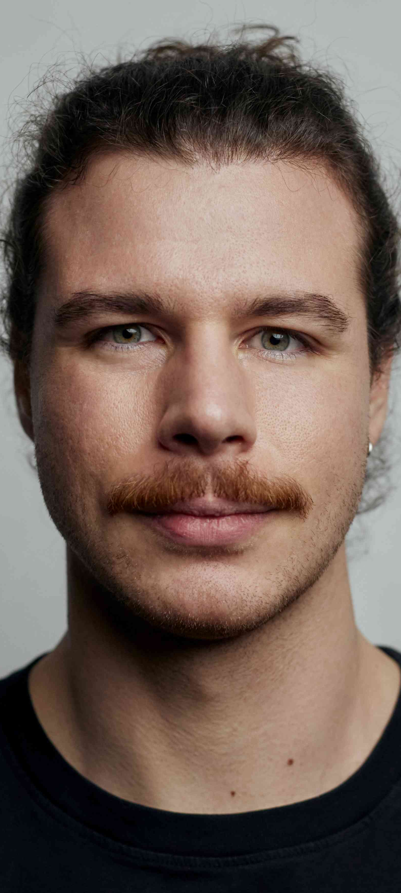
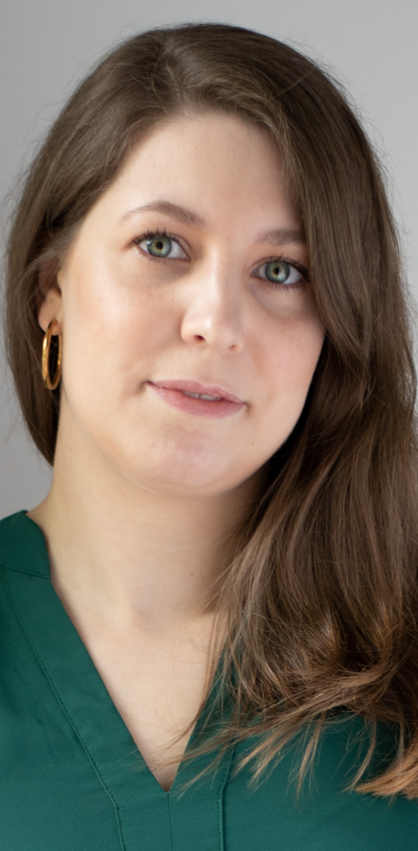
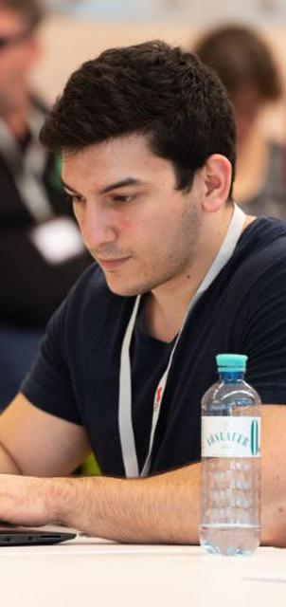

Large-scale Data Engineering: Module Overview
20 seats in total
bachelor + master
#41086: LDE Seminar + Project (12 ECTS)
10 students
10 students
#41095: Seminar LDE (3)
#41183: Project LDE (9 ECTS)
7 students
bachelor-only
bachelor-only
Mon, 14:00-16:00
MAR 0.010 & zoom
Seminar LDE
Reading & writing scientific papers
Giving presentations on papers
Summary paper
Presentation
Lecturer & seminar mentor
Project LDE
Building & evaluating prototypes
Giving presentations on prototypes
Prototype design/impl/tests/doc/eval
Presentation
Project mentors
Mon, 16:00-18:00
MAR 0.010 & zoom
In the context of systems for data engineering, data management, machine learning
In combination: Ideal preparation for a bachelor/master thesis with our group

Slide 8
Course Organization
General Contact Person
Dr.-Ing. Patrick Damme (patrick.damme@tu-berlin.de)
Course Website
https://pdamme.github.io/teaching/2025_summer/lde/lde_summer2025.html
One site for seminar and project
All material, schedule, deadlines
ISIS course
https://isis.tu-berlin.de/course/view.php?id=41969
Announcements, discussion forum, topic selection poll, submission of summary paper and presentation slides
Language
Lectures and slides: English
Communication: English/German
Submitted paper and presentation: English
Informal language (first name is fine), immediate feedback is welcome

Slide 9
Semester Schedule & Deadlines
Three Introductory Lectures (optional)
Apr 14: Structure of Scientific Papers
Apr 28: Scientific Reading and Writing
May 05: Experiments, Reproducibility, and Giving Presentations
Self-organized Seminar Work
Consultation hours for any questions (optional) (room B 120 and zoom)
Final Presentations (mandatory, in-person)
Jul 07, 12:00-16:00: Session #1
Jul 14, 12:00-16:00: Session #2
List of Seminar Topics
Presented today, take your time to select afterwards
Topic Selection
Deadline: May 02, 23:59 CEST (in 2½ weeks)
Ranked list of 5 topics via poll on the ISIS course
Global topic assignment based on preferences
Notification of assigned topics: May 05 (in 3 weeks)
Submission of Summary Paper
Deadline: Jun 23, 23:59 CEST (in 10 weeks)
Upload PDF in the ISIS course
Submission of Presentation Slides
Deadline: The day before you present, 23:59 CEST
Upload PDF in the ISIS course

Slide 10
Seminar Deliverables
Individual Seminar Work
1 student = 1 paper, no teamwork
Summary Paper (in English)
Read and understand selected paper
Search for related work to provide some context
Write summary paper (4 pages + unlimited refs) - including related work - make sure relation to umbrella topic is conveyed
LaTeX with given template
Presentation
Summarize your paper
15 min talk + 5 min discussion (stay in time)
Audience: engage in the discussion
Grading
Graded portfolio exam
#41086 (seminar + project)
25 pts: summary paper
15 pts: presentation
50 pts: design/impl/tests/doc
10 pts: presentation
#41095 (seminar-only)
65 pts: summary paper
35 pts: presentation
Academic Honesty / No Plagiarism implies that use of LLMs like ChatGPT is prohibited

Slide 11
LaTeX Paper Template
Obtain the Template
https://www.acm.org/publications/proceedings-template
Download the ZIP archive acmart-primary.zip and unpack it
Select the Right Template
The archive contains all ACM templates
Use the sigconf document class
The Easiest Way to Set up Your Own Document
Copy just the required files to a new directory
Rename the .tex and .bib file as you like (and adapt the \bibliography{})
Open the .tex file in a text/LaTeX editor
Remove example contents, replace it by yours (title, authors, sections, paragraphs, figures, etc.)
Replace the .bib contents by your BibTeX entries
acmart-primary/
samples/
sample-base.bib
sample-sigconf.tex
…
acmart.cls
ACM-Reference-Format.bst
…
lde-summary-paper/
literature.bib
summary-paper.tex
acmart.cls
ACM-Reference-Format.bst

Slide 12
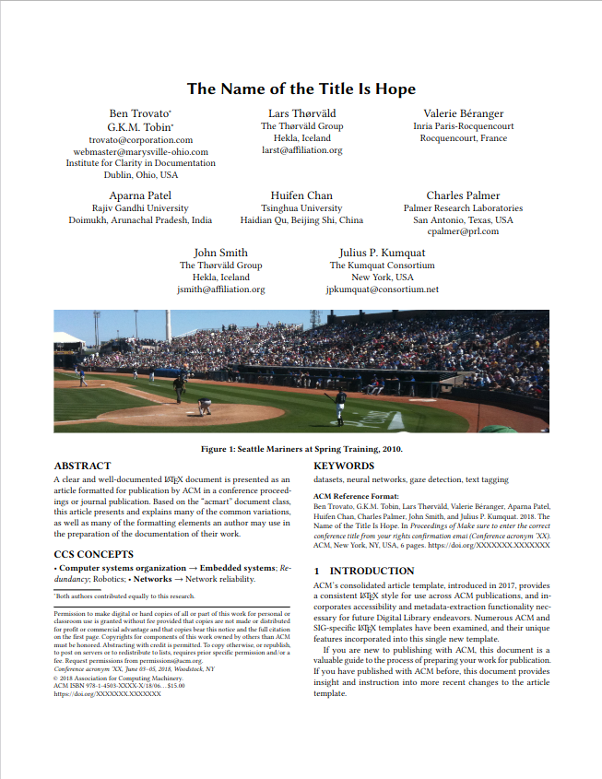
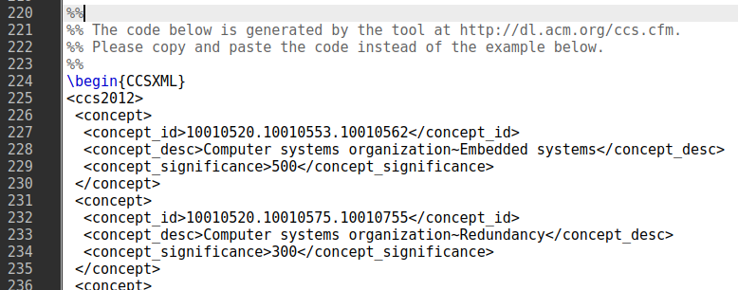
LaTeX Paper Template
ACM acmart template
document class sigconf (double-column)
CCS concepts
(ACM Computing Classification System)
Select concepts at https://dl.acm.org/ccs and insert generated code:
Teaser image
Not required (especially no photograph)
Keywords
Specify meaningful keywords
ACM reference format
Just keep as it is (ignore the dummy data)
Copyright notice
Just keep as it is (ignore the dummy data)

Slide 13
Portfolio Exam Registration
Portfolio exam registration: May 12 – Jun 09
Binding registration in Moses/MTS
Including selection of seminar presentation date (first-come-first-serve)
Portfolio exam de-registration
Until 3 days before the first graded exam part
Modules “LDE”/”Seminar LDE”: until Jun 20
Module “Project LDE”: until Jul 25
De-register yourself in Moses/MTS
With sufficient reason: Until the day of the exam
In case of sickness etc.
Modules “LDE”/”Seminar LDE”: until Jun 23/Jul 07/Jul 14
Module “Project LDE”: until Jul 28/Aug 04
Missing deadlines/exam without de-registration
Zero points in the respective exam part (!)
Approach us early in case of problems
If you don’t want to take LDE anymore
Let me know asap to give students in the queue a chance to fill in

Slide 14
Structure of Scientific Papers
In Computer Science (Data Management)
[Credit: Based on “Introduction to Scientific Writing”/ ”01 Structure of Scientific Papers” by Matthias Boehm (TU Graz, winter 2021/22)]

Slide 15
Overview Types of Scientific Writing
Classification of Scientific/Technical Documents
Formal vs informal writing, cumulative?, single vs multi-author, archival vs non-archival publications
Scientific Writing Skills are crucial
Different types of docs share many similarities
/
Monographs
Scientific Papers
Others
BS Thesis
by pub. channel
by contents
Grant Proposal
Preprint
Research
MS Thesis
Design doc
Conference
Industry
PhD Thesis
White Paper
Journal
Survey
Habilitation
Blog
Tech Report
E&A
Website
Vision
Demo

Slide 16
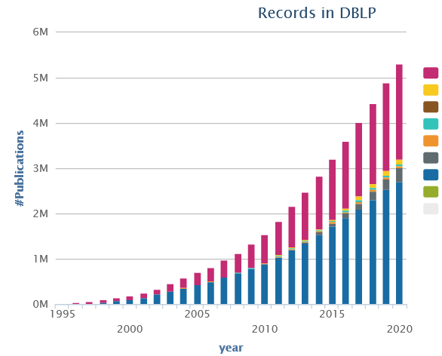
Preparation
Know your Audience
Get your Workflow in Order
Writing: LaTeX (e.g., Overleaf, TeXnicCenter), versioning (e.g., git), templates
Plotting: R (e.g., plot, ggplot), Python (e.g., matplotlib, seaborn), Gnuplot, LaTeX (e.g., pgfplots)
Figures: e.g., MS Visio/MS Powerpoint, Inkscape → pdf, eps, svg (vector graphics)
Mindset: Quality over Quantity
Aim for top-tier conferences/journals (act as filter)
Make the paper useful for others (ideas, evidence, code)

Slide 17

Paper Writing and Publication Process
Research – Writing Cycle
Read lots of papers
Idea → Research → Writing → Document
Idea → Writing/Research → Document
Incremental refinement of drafts
Paper Submission Cycle
Blind vs double-blind submission
Revisions and Camera-ready
Similar: bachelor/master thesis → drafts to advisor / final version
Example: SIGMOD 2025: Paper Submission Round 4
Oct 10, 2024: Abstract Submission & Declaration of COIs
Oct 17, 2024: Paper Submission
Nov 28, 2024: Notification of Accept/Review/Reject
Dec 05, 2024: Submission of Revision Plan
Dec 19, 2024: Revision Feedback
Submission of Revised Paper
Jan 30, 2025: Final Notification
Submission of Camera-ready Version
[Recommended Reading]
[Eamonn Keogh: How to do good research, get it published in SIGKDD and get it cited!, KDD 2009]
[Simon Peyton Jones: How to write a great research paper, MSR Cambridge]

Slide 18
Dealing with Feedback/Criticism
Different Kinds of Feedback
Casual discussion of early ideas
Comments on paper drafts
Reviewer comments (good and bad)
Paper Rebuttal and/or Revision
Rebuttal: seriously consider all feedback (in doubt agree), and answer with facts / ideas how to address the comments
Revision (conditional accept): address all revision requests
Always welcome feedback/criticism
Address all feedback w/ sincere effort

Slide 19
Running Example
Example paper used in the following
Ahmed Elgohary, Matthias Boehm, Peter J. Haas, Frederick R. Reiss, Berthold Reinwald: Compressed Linear Algebra for Large-Scale Machine Learning. PVLDB 2016
[Ahmed Elgohary, Matthias Boehm, Peter J. Haas, Frederick R. Reiss, Berthold Reinwald: Scaling Machine Learning via Compressed Linear Algebra. SIGMOD Record 2017 46(1)]
[Ahmed Elgohary, Matthias Boehm, Peter J. Haas, Frederick R. Reiss, Berthold Reinwald: Compressed Linear Algebra for Large-Scale Machine Learning. VLDB Journal 2018 27(5)]
[Ahmed Elgohary, Matthias Boehm, Peter J. Haas, Frederick R. Reiss, Berthold Reinwald: Compressed Linear Algebra for Large-Scale Machine Learning. Commun. ACM 2019 62(5)]

Slide 20
Prototypical Structure of a Scientific Paper
Title & Authors
Sections and Subsections
Abstract → short overview of problem and solution (part of meta data)
Introduction → context, problem, contributions
Background / Preliminaries → necessary background for understanding
Main Part → your technical core contributions
Main Part 2
Experiments → setting, micro benchmarks, end-to-end benchmarks
Related Work → areas of related work, differences to your own work
Conclusions → summary, conclusions, and future work
Acknowledgments → funding agencies, helpful people beyond co-authors
References → list of other works referenced throughout the paper
(Appendix) → any additional contents (e.g., proves of theorems, more results)

Slide 21

Title and Authors
List of Authors
E.g., by contribution (main, …, advisor)
E.g., by last name
Affiliations, contact (corresponding author)
Title
Descriptive yet concise
Short name if possible → easier to cite and discuss
[Credit: sliceline, Silicon Valley, HBO]

Slide 22
Abstract
% 1. State the problem
Large-scale machine learning (ML) algorithms are often iterative, using repeated read-only data access and I/O-bound matrix-vector multiplications to converge to an optimal model. It is crucial for performance to fit the data into single-node or distributed main memory.
% 2. Say why it's an interesting problem
General-purpose, heavy- and lightweight compression techniques struggle to achieve both good compression ratios and fast decompression speed to enable block-wise uncompressed operations.
% 3. Say what your solution achieves
Hence, we initiate work on compressed linear algebra (CLA), in which lightweight database compression techniques are applied to matrices and then linear algebra operations such as matrix-vector multiplication are executed directly on the compressed representations. We contribute effective column compression schemes, cache-conscious operations, and an efficient sampling-based compression algorithm. Our experiments show that CLA achieves in-memory operations performance close to the uncompressed case and good compression ratios that allow us to fit larger datasets into available memory.
% 4. Say what follows from your solution
We thereby obtain significant end-to-end performance improvements up to 26x or reduced memory requirements.
[Simon Peyton Jones: How to write a great research paper, MSR Cambridge]

Slide 23
Introduction
Prototypical Structure
Context (1 paragraph)
Problems (1-3 paragraphs)
[Existing Work (1 paragraph)]
[Idea (1 paragraph)]
Contributions (1 paragraph)
Introduction Matters
Anchoring: most reviewers reach their opinion after reading introduction and motivation and then look for evidence
[Eamonn Keogh: How to do good research, get it published in SIGKDD and get it cited!, KDD 2009]

Slide 24
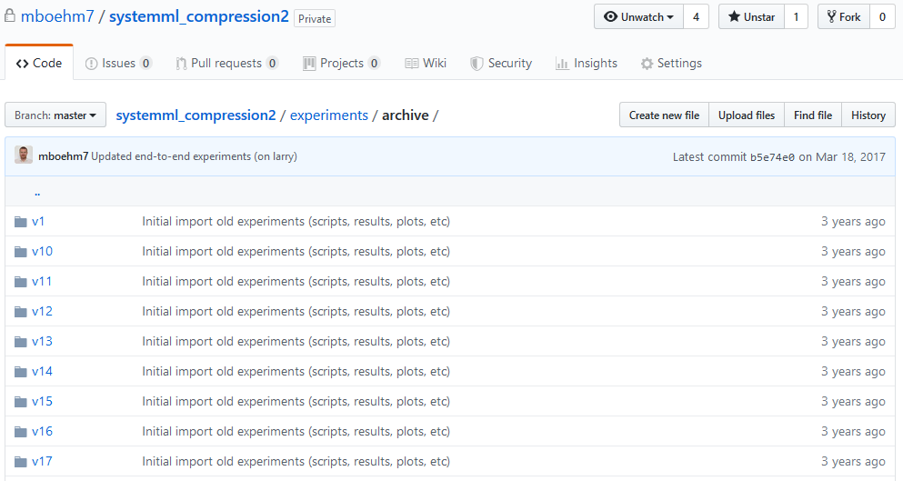
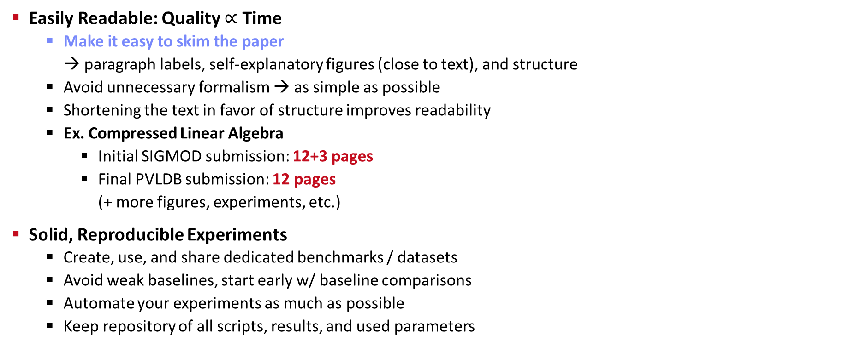
Writing the Paper (and more Experiments)
Easily Readable: Quality $∝$ Time
Make it easy to skim the paper → paragraph labels, self-explanatory figures (close to text), and structure
Avoid unnecessary formalism → as simple as possible
Shortening the text in favor of structure improves readability
Ex. Compressed Linear Algebra
Initial SIGMOD submission: 12+3 pages
Final PVLDB submission: 12 pages (+ more figures, experiments, etc.)
Solid, Reproducible Experiments
Create, use, and share dedicated benchmarks / datasets
Avoid weak baselines, start early w/ baseline comparisons
Automate your experiments as much as possible
Keep repository of all scripts, results, and used parameters
02 Scientific Reading and Writing
03 Experiments, Reproducibility, and Giving Presentations
https://github.com/damslab/ reproducibility

Slide 25
Related Work
Purpose of a “Related Work”-Section
Not a mandatory task or to show you know the field
Put you work in context of related areas (~ 1 paragraph each)
Discuss closely related work
Crisp separation from existing work (what are the differences)
Placement
Section 2 or Section n-1
Throughout the paper
Give Credit
Cite broadly, give credit to inspiring ideas, create connections
Honestly acknowledge limitations of your approach
[Simon Peyton Jones: How to write a great research paper, MSR Cambridge]

Slide 26
References
Setup
Use LaTeX \cite{} and BibTeX
Use a consistent source of bibtex entries (e.g., DBLP)
Different References Styles
But, not in footnotes (unless required)
inproceedings{StonebrakerBPR11,
author = {Michael {Stonebraker et al.}},
title = {{The Architecture of SciDB}},
booktitle = {{SSDBM}},
year = {2011}
}
\bibliographystyle{abbrv}
\bibliography{VLDB2016}
VLDB2016.bib

Slide 27
List of Seminar Topics
See list at https://pdamme.github.io/teaching/2025_summer/lde/SeminarTopics.pdf

Slide 28
Summary and Q&A
Course Organization, Outline, and Deliverables
Structure of Scientific Papers
List of Seminar Topics (Topic Selection by May 02)
Remaining Questions?
Next Lectures
Public holiday [Apr 21]
02 Scientific Reading and Writing [Apr 28]
03 Experiments, Reproducibility, and Giving Presentations [May 05]

