Slide 1

Project Large-scale Data Engineering (LDE)
Kick-off Meeting
Dr.-Ing. Patrick Damme
Technische Universität Berlin
Berlin Institute for the Foundations of Learning and Data
Big Data Engineering (DAMS Lab)
Last update: Apr 26, 2026

Slide 2


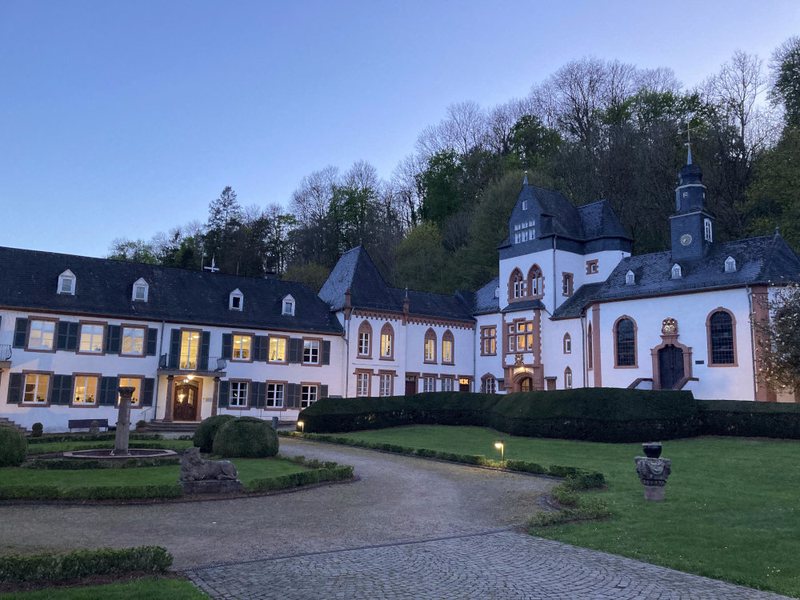
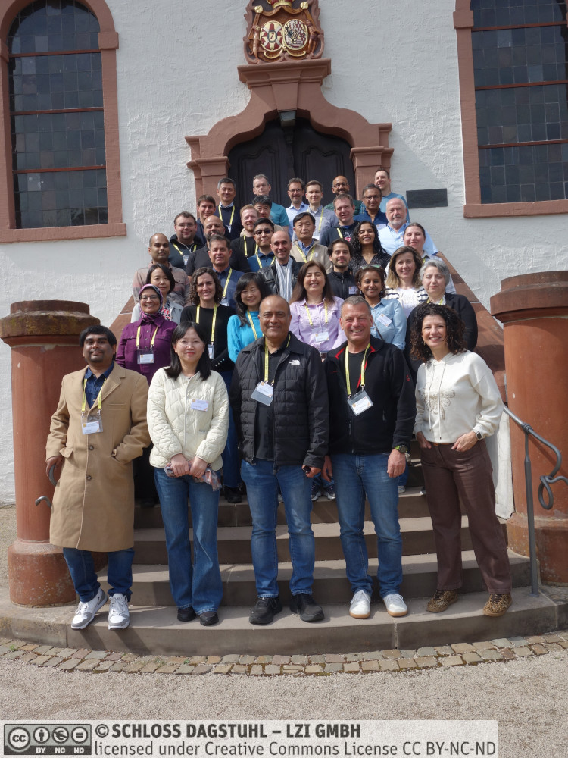
Announcements/Org
Hybrid Setting with Optional Attendance
In-person in MAR 0.008
Virtual via zoom https://tu-berlin.zoom-x.de/j/67376691490?pwd=NmlvWTM5VUVWRjU0UGI2bXhBVkxzQT09
Delayed Start of Introductory Lectures
Due to participation in Dagstuhl Seminar on “Managing Vector Data for Retrieval Augmented Generation”
But: No impact on your total working time, submission deadlines, etc.

Slide 3








About Me
Since 10/2022: Postdoc at TU Berlin, Germany
FG Big Data Engineering (DAMS Lab) headed by Prof. Matthias Böhm
Continuing work on integrated data analysis pipelines
Research interests in the fields of database and ML systems (especially compiler & runtime techniques, extensibility)
2021-2022: Postdoc at TU Graz & Know-Center GmbH, Austria
Data Management group headed by Prof. Matthias Böhm
Started work on integrated data analysis pipelines
2015-2020: PhD student at TU Dresden, Germany
Dresden Database Research Group headed by Prof. Wolfgang Lehner
PhD thesis on making complex analytical database queries more efficient through lightweight compression of intermediate results
MorphStore & TVL

Slide 4
FG Big Data Engineering (DAMS Lab) – Teaching
Successfully Established TUB Teaching Portfolio (modules, slides)
Architecture of Database Systems (ADBS, WiSe)
DB system internals + prog. project
Architecture of ML Systems (AMLS, SoSe)
ML system internals, data science lifecycle + prog. project
PR Project ML Systems (PMLS, WiSe)
Architecture of ML Systems (AMLS, SoSe)
SE Joint ML and DM (MLDM, SoSe+WiSe)
Master
Data Integration and Large-Scale Analysis (DIA, WiSe)
Data Integration and Large-Scale Analysis (DIA, WiSe)
Distributed Data Management
SE/PR Large-scale Data Engineering (LDE, SoSe+WiSe)
Bachelor
Intro to Scientific Methods (WiSe)
Data Management / Databases (DM, SoSe+WiSe)
Data management from user/application perspective
PP Prog.-Practicals Data Systems (PPDS, SoSe+WiSe)

Slide 5
Agenda
Course Organization, Outline, and Deliverables
How to Approach the Project
Projects in DAPHNE, Apache SystemDS, and TerseTS
List of Project Topics

Slide 6
Course Organization, Outline, and Deliverables

Slide 7
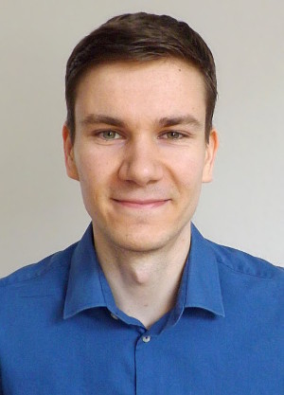
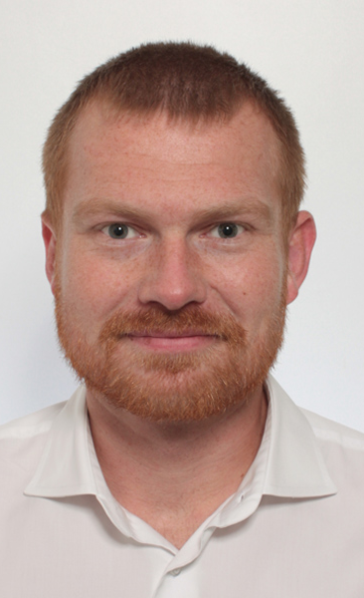
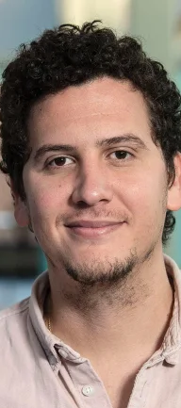
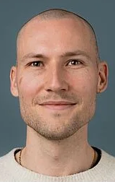
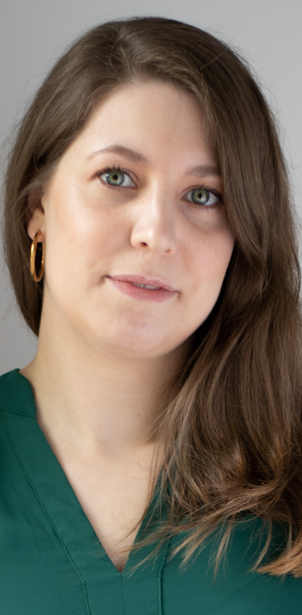
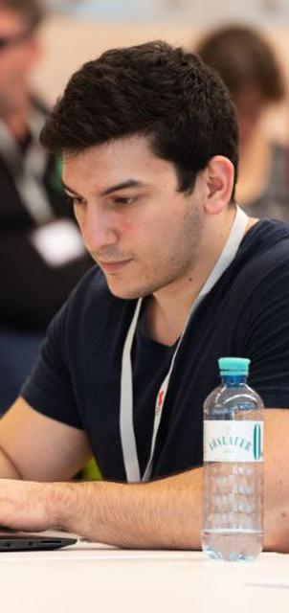
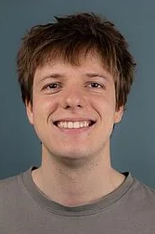
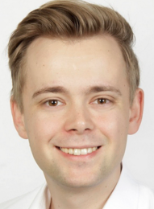
Large-scale Data Engineering: Module Overview
20 seats in total
master + bachelor
#41086: LDE Seminar + Project (12 ECTS)
10 students
10 students
#41095: Seminar LDE (3)
#41183: Project LDE (9 ECTS)
11 students
bachelor-only
bachelor-only
Mon, 14:00-16:00
MAR 0.008 & zoom
Seminar LDE
Reading & writing scientific papers
Giving presentations on papers
Summary paper
Presentation
Lecturer & seminar mentor
Project LDE
Building & evaluating prototypes
Giving presentations on prototypes
Prototype design/impl/tests/doc/eval
Presentation
Project mentors
Mon, 16:00-18:00
MAR 0.008 & zoom
In the context of systems for data engineering, data management, machine learning
In combination: Ideal preparation for a bachelor/master thesis with our group

Slide 8
Course Organization
General Contact Person
Dr.-Ing. Patrick Damme (patrick.damme@tu-berlin.de)
Course Website
https://pdamme.github.io/teaching/2026_summer/lde/lde_summer2026.html
One site for seminar and project
All material, schedule, deadlines
ISIS course
https://isis.tu-berlin.de/course/view.php?id=46572
Announcements, discussion forum, topic selection poll, submission of summary paper and presentation slides
Language
Lectures and slides: English
Communication: English/German
Submitted paper and presentation: English
Informal language (first name is fine), immediate feedback is welcome

Slide 9
Semester Schedule & Deadlines
Kick-off Meeting Apr 27 (optional)
Recommended Introductory Lecture (optional)
May 11, 14:00: Experiments, Reproducibility, and Giving Presentations
Self-organized Project Work
Consultation hours for any questions (optional)
Intermediate Presentations (prerequisite)
Jun 22, 16:00-18:00: All students
Final Presentations (mandatory)
Aug 03, 14:00-18:00: All students
List of Project Topics
Presented today, take your time to select afterwards
Topic Selection
Deadline: May 04, 23:59 (in 1 week)
Ranked list of 5 topics via poll on the ISIS course + pref on individual/team work [+ team members]
Global topic assignment based on preferences
Notification of assigned topics: May 11 (in 2 weeks)
Submission of Initial Prototype (prerequisite)
Implementation and tests
Deadline: Jun 21, 23:59 (in 8 weeks)
As a pull request on GitHub (exceptionally by email)
Submission of Final Prototype (mandatory)
Implementation, tests, docs, experiments
Deadline: Aug 02, 23:59 (in 14 weeks)
As a pull request on GitHub (exceptionally by email)
Submission of Pres. Slides (Intermediate & Final Pres.)
Deadline: The day before the presentation, 23:59
Upload PDF in the ISIS course

Slide 10
Portfolio Exam Registration
Registration: May 11 – Jun 08
Binding registration in Moses/MTS
Including selection of seminar presentation date (first-come-first-serve)
De-registration
Until 3 days before the first graded exam part
De-register yourself in Moses/MTS
Modules “LDE”/”Seminar LDE”: until Jun 12
Module “Project LDE”: until Jul 30
With sufficient reason: Until the day of the exam
In case of sickness etc.
Modules “LDE”/”Seminar LDE”: until Jun 15/Jun 29/Jul 06
Module “Project LDE”: until Aug 02/Aug 03
Missing Deadlines/Exam Without De-registration
Zero points in the respective exam part (!)
Approach us early in case of problems
If You Don’t Want to Take LDE Anymore
Let me know asap to give students in the queue a chance to fill in

Slide 11
LDE Project Goals and Mindset
Goals
Design/implement a prototype in DAPHNE/SystemDS/TerseTS
AND prove it is a valuable contribution to the system/library (tests, documentation, experiments)
Present and defend your work in a presentation & discussion
Focus on Methodology
LDE as a preparation for a bachelor/master thesis at the DAMS Lab
Mindset: Be Open Learn New Things and to Work on Any Part of the System
Whatever it takes to fulfill the task
Self-guided acquisition of required technical skills
Grading Criteria
Design/implementation (functionality)
Code quality + tests + documentation
Experiments
High-quality and convincing contribution to an open-source system

Slide 12
LDE Project Characteristics
Individual/Team Project Work
Teams of up to 3 students strongly encouraged
Unique topic for each individual/team
Ambitious Projects
9 ECTS (~270 h of work)
≈6.75 weeks of full-time work
Potential for Impact
Real open issues in existing systems
If successful: meaningful contributions that will be used by others
Remarks on Topic Descriptions
Many open topics in DAPHNE, SystemDS, and TerseTS
Initial topic descriptions of varying level of detail
During topic selection: Approach project mentor directly if interested in more details
After topic assignment: More detailed descriptions where necessary
We’re open to alternative topic proposals

Slide 13
Project Deliverables: Initial Prototype & Intermediate Presentation
Introduced in Response to Students’ Feedback (Course Evaluation)
Initial Prototype
≈67% functionally complete prototype including good set of test cases
Basis for further improvements driven by experiments and feedback
Intermediate Presentation
Slide presentation of 5-10 min per individual/team
Briefly present the problem you work on to your fellow students
Give an overview of your initial prototype (concepts and crucial changes to the code base)
Outline your planned experiments
Should be the result of prior discussions with your project mentor
Benefits for You
Improved time management (retain enough time for experiments)
Exchange with the other students in the project
Get feedback by project mentors and other students for improving the quality of your prototype
Ungraded prerequisites for the portfolio exam to be allowed make mistakes and learn from them

Slide 14
Project Deliverables: Final Prototype & Final Presentation
Final Prototype
100% functionally complete prototype including good set of test cases
Efficiency confirmed by experiments
Final Presentation
Summarize the problem and give an overview of your final prototype to your fellow students
Present your experimental results
1 student: 10 min talk + 5 min discussion = 15 min
2 students: 13 min + 7 min = 20 min
3 students: 16 min + 9 min = 25 min
Audience: Engage in the discussion
Academic Honesty / No Plagiarism
Develop your own coding/experimentation skills
Use of generative AI (ChatGPT etc.) is prohibited
Graded Portfolio Exam
#41086 (seminar + project)
25 pts: summary paper
15 pts: presentation
50 pts: design/impl/tests/doc
10 pts: presentation
#41183 (project-only)
85 pts: implementation/tests/documentation
15 pts: presentation

Slide 15
How to Approach the Project

Slide 16
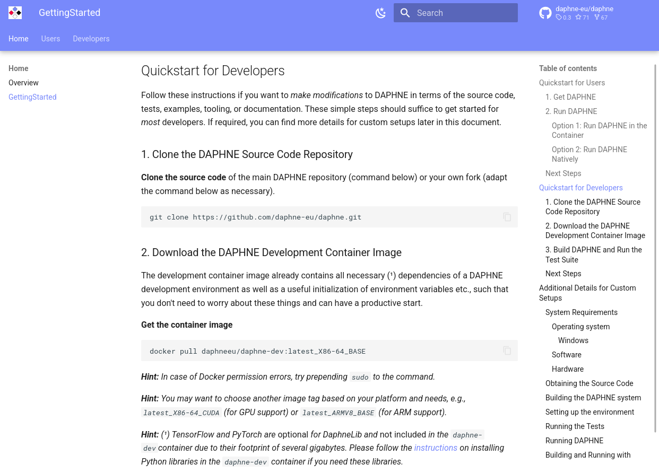
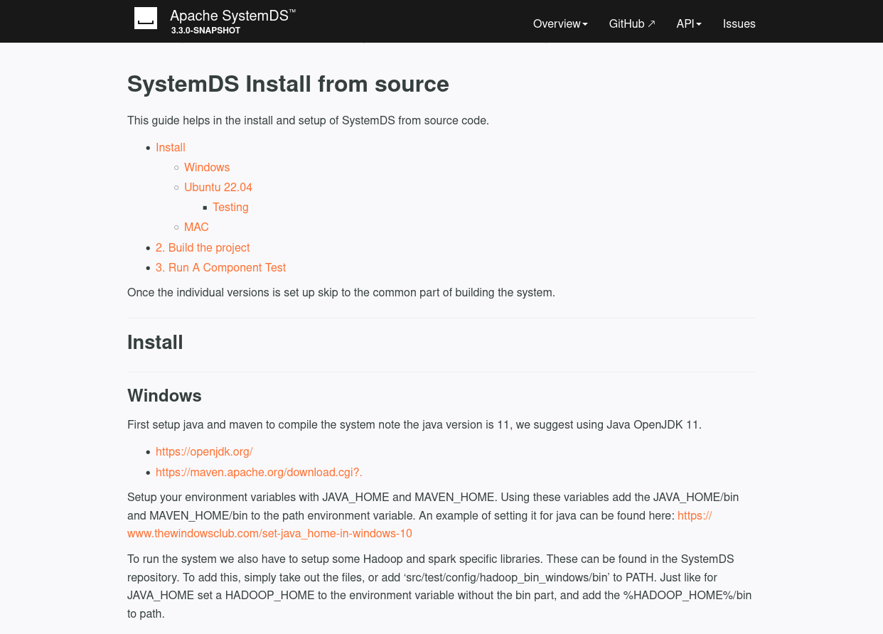
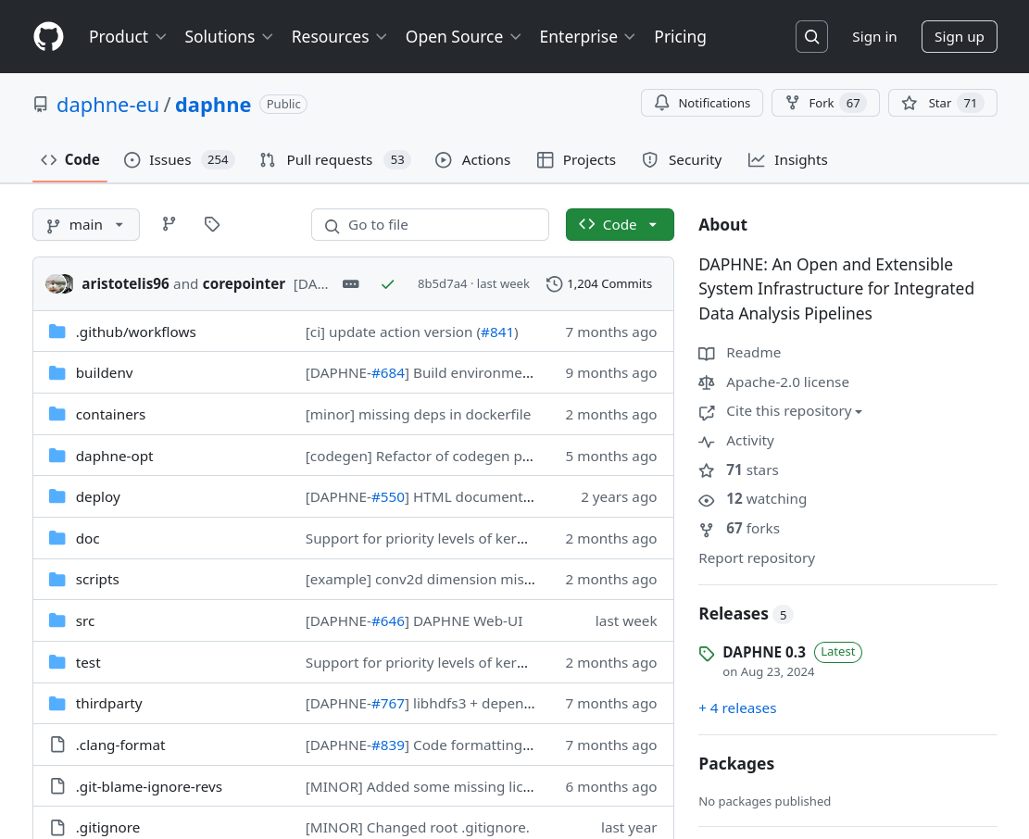
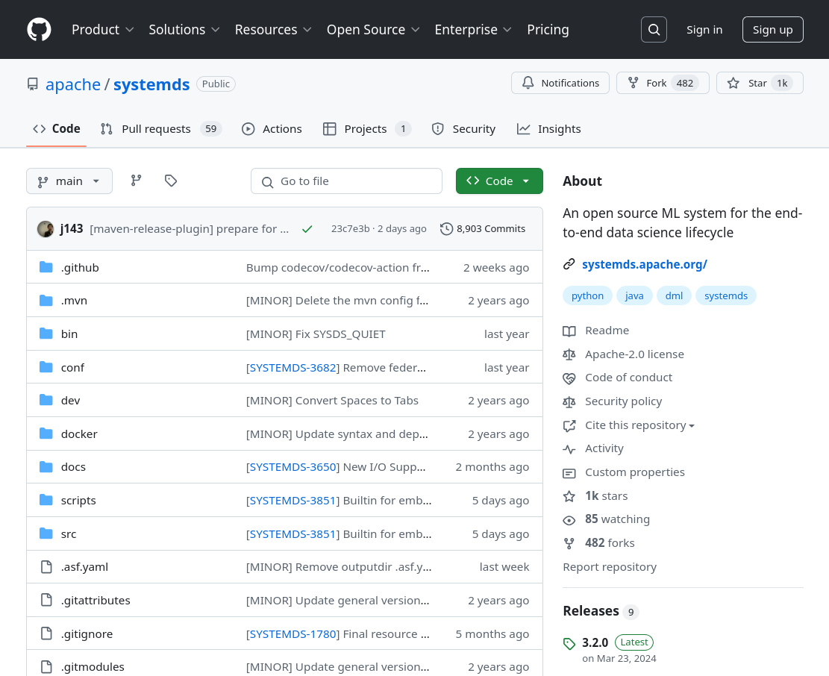
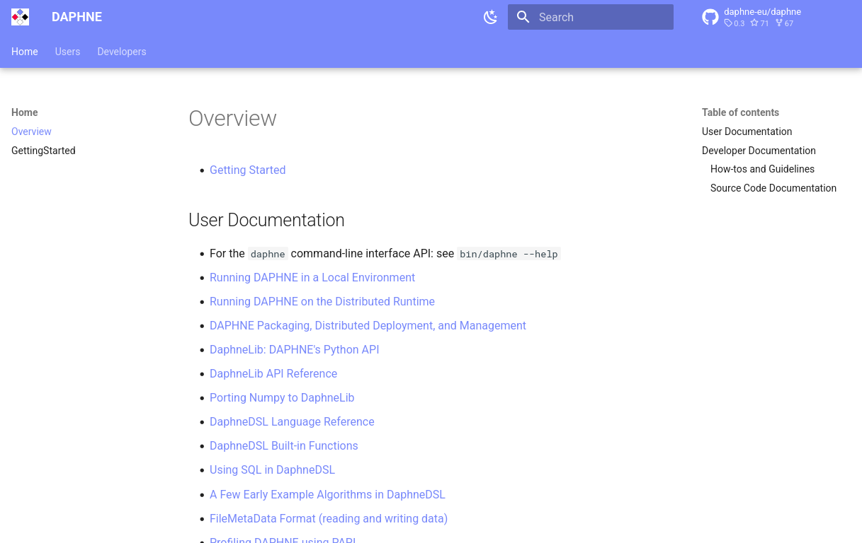
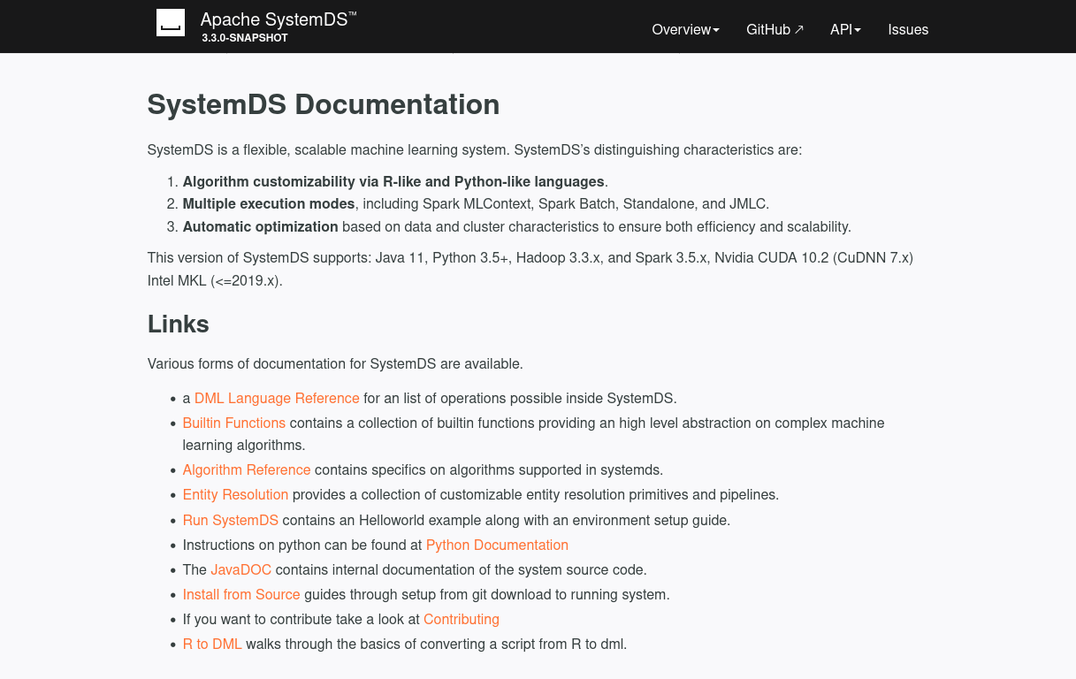
Getting Started: Setting Up Your Development Environment
Goals
Build the system from source
Successfully run the test suite
Navigate to the GitHub Repos
Know Where to Find the Documentation
Clone, Build, Test According to the Documentation
https://daphne-project.github.io/daphne/ GettingStarted/#quickstart-for-developers
https://apache.github.io/systemds/ site/install.html
https://github.com/daphne-eu/daphne
https://github.com/apache/systemds
https://daphne-project.github.io/daphne/
https://apache.github.io/systemds/

Slide 17
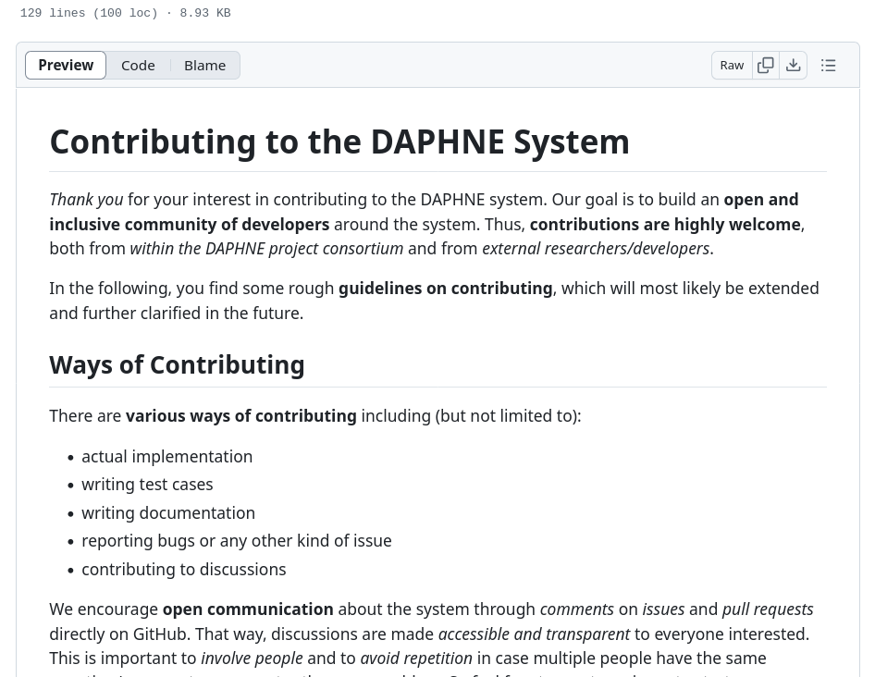
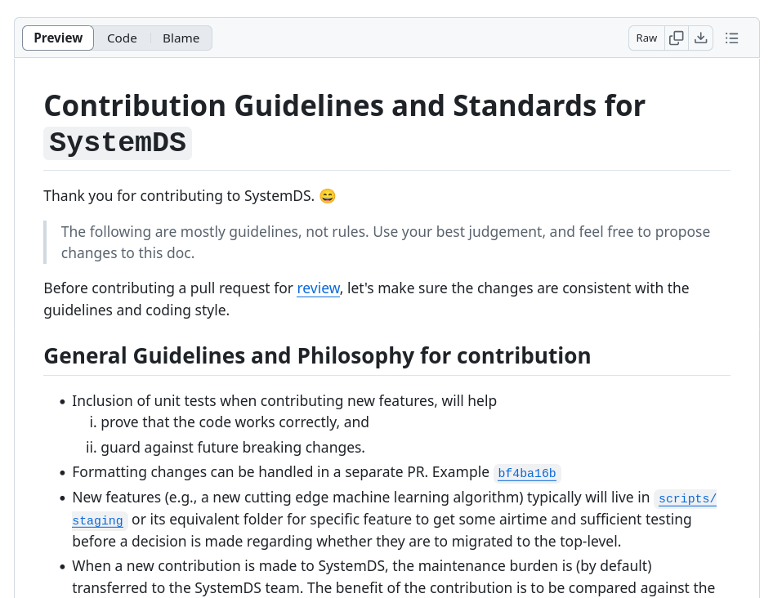
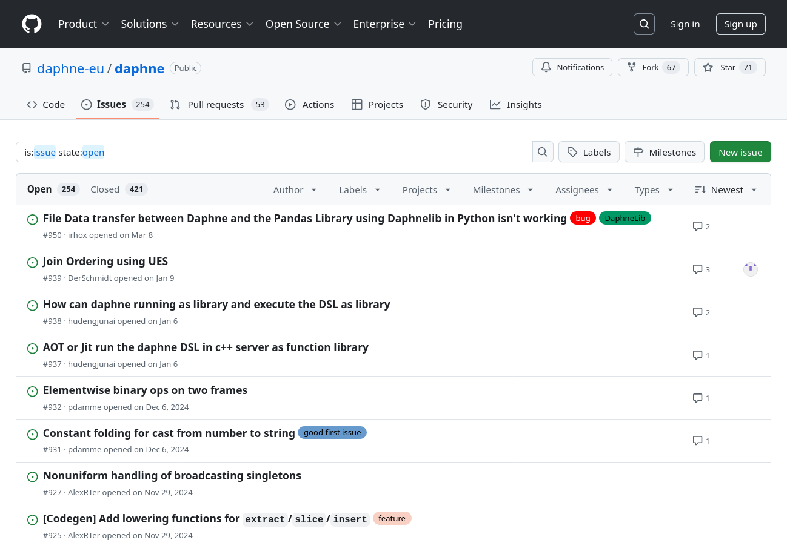
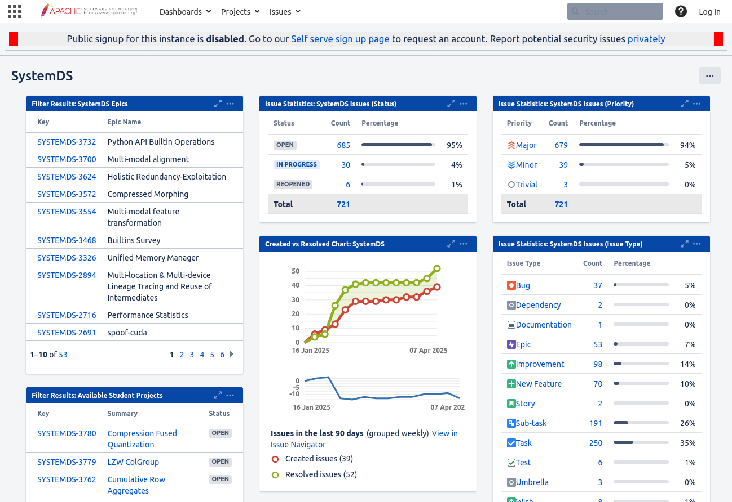
Getting Started: Preparing Your First Contribution
Goals
Ability to modify the source code and run/test it
Initial overview of relevant part of the code base
Set Up Your Editor/IDE etc.
Issue Tracking
Make Your First Modifications to the Code
DAPHNE: “good first issues”
SystemDS: Write initial test cases for your task
Read the Contribution Guidelines
https://github.com/daphne-eu/daphne/ blob/main/CONTRIBUTING.md
https://github.com/apache/systemds/ blob/main/CONTRIBUTING.md
https://github.com/daphne-eu/ daphne/issues
https://issues.apache.org/jira/secure/ Dashboard.jspa?selectPageId=12335852

Slide 18
Towards the Initial Prototype: Design/Implementation/Tests (≈1/2 of the semester)
Recap: Goals
≈67% functionally complete prototype including good set of test cases
Basis for further improvements driven by experiments and feedback
Mindset
Understand the topic (task description, mentor, additional material)
Understand the code base (overview and relevant parts)
Understand the employed libraries/frameworks
Design and implement step-by-step
Not always “the” right solution: explore alternatives
Recommendations
Start as soon as possible → Don’t underestimate the ramp-up effort
Actively approach your project mentor → Your mentor can give you valuable guidance

Slide 19
Towards the Final Prototype: Creating a Convincing Contribution (≈1/2 of the semester)
.
Recap: Goals
High-quality code contribution whose value can easily be appreciated and understood
Recommendations
Submit tidy, well documented, extensively tested code
View experiments as equally important as features, → Start initial experiments as soon as possible → Focus primarily on investigating and improving your initial prototype → after the intermediate presentation → Experiments show the value of your contribution → You need time to incorporate your insights Actively approach your project mentor → Your mentor can give you valuable guidance

Slide 20
Final Prototype: Code Quality
Goals
Make your code easy to read/understand
Others will have to maintain it after your contribution is merged
General Guidelines
Clearly structure your code into meaningful units (classes, functions, etc.)
Use clear yet concise identifiers (variable/function/class names)
Stay consistent with the existing code base (e.g., use the same patterns) OR refactor if necessary
Adhere to the code base’s coding style/formatting
Keep Your Pull Request Tidy
Stay focused: Avoid changes unrelated to your task (can be contributed as individual small pull requests)
Don’t submit anything that’s useless for others (e.g., build artifacts, generated files (e.g., logs), IDE projects)
Exclude specifics of your local setup: Avoid local paths, usernames, passwords, IP addresses etc.
Read your own pull request on GitHub (changed files)

Slide 21
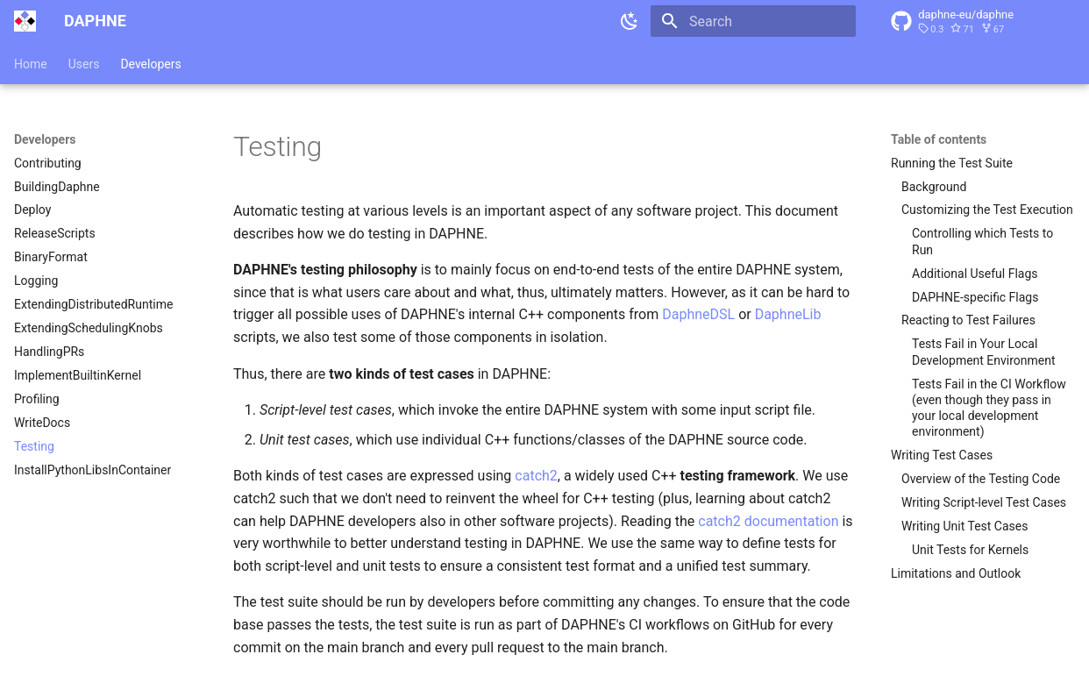
Final Prototype: Tests
Goals
Show functionally correct behavior
Experiments don’t make sense if prototype doesn’t do what it should
General Hints
Unit tests and script-level tests
Test cases that should work
Test cases that should not work (e.g., invalid DSL scripts, invalid input data, …)
Construct simple and complex scenarios
Think of corner cases
Small input data is often fine (but some bugs only triggered by large inputs)
Integrate with the Existing Test Suite
DAPHNE → directory: test/ → see the documentation on writing test cases
SystemDS → directory: src/test/
https://daphne-project.github.io/daphne/ development/Testing/

Slide 22
Final Prototype: Documentation
Goals
Make your contribution understandable for users and developers
User Documentation
What’s not documented doesn’t exist
Add high-level explanation of features and concepts behind them
Update documentation of language abstractions (e.g., new DSL built-in functions, new types, …)
Update documentation of user APIs (e.g., new command-line arguments)
Developer Documentation
Negative example: “The code is the documentation”
High-level explanation of your contribution; justify design decisions
API documentation of classes, functions, members, etc. (integrate with the existing source code documentation of the system, e.g., doxygen or javadoc style)
Comments within function bodies (e.g., high-level steps of an algorithm)

Slide 23
Final Prototype: Experiments
Goals
Understand your prototype to discover potential for improvement (e.g., performance bottlenecks)
Demonstrate functional improvements (new features)
Showcase non-functional improvements (performance compared to status quo and state-of-the-art baselines)
Design Experiments
Don’t just conduct any random experiments
Think about which questions you want/need to answer, design experiments accordingly
Types of experiments: Exploratory, micro benchmarks, benchmarks, end-to-end applications
Aspects of an experiment: Data, workload, baselines, hardware & software stack, metrics
Conduct Experiments
Automate as much as possible for repeatability (shell scripts etc.)
Visualize and Interpret the Results
Automate the visualization based on raw experimental data
Draw conclusions and react
See 3rd seminar intro lecture on “Experiments, Reproducibility”

Slide 24
Projects in DAPHNE, Apache SystemDS, and TerseTS

Slide 25




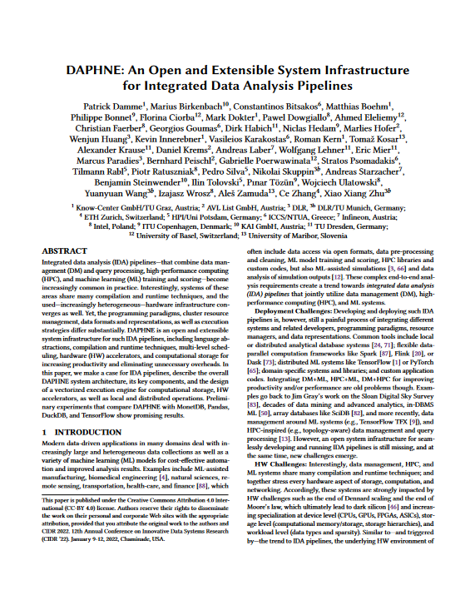
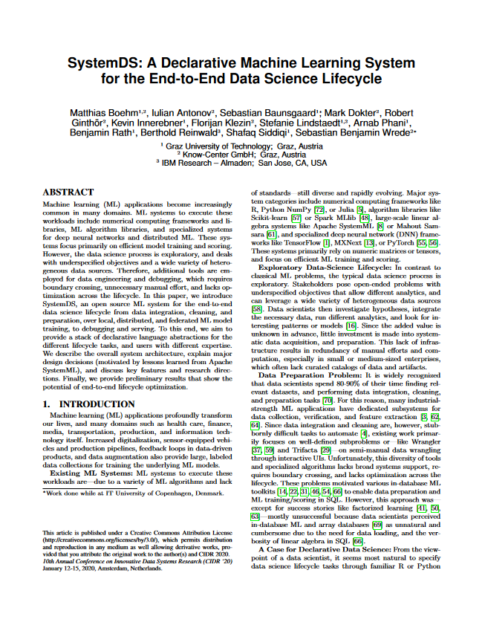
Overview (1/2): Two Systems Developed at the DAMS Lab
An Open and Extensible System Infrastructure for Integrated Data Analysis Pipelines
Intersection of data management, machine learning, high-performance computing
Open-source (Apache v2 license) https://github.com/daphne-eu/daphne
Originated from DAPHNE EU-project
Written mostly in C++, Python, DaphneDSL
Since 2020 (open-source since 2022)
A Declarative ML System for the End-to-End Data Science Lifecycle
Data integration/cleaning/prep, model selection/ training/validation/debugging/deployment/scoring
Open-source (Apache v2 license) https://github.com/apache/systemds
Originated from Apache SystemML (started at IBM)
Written mostly in Java, Python, and DML
Since 2010 (open-source since 2015) (as SystemML)
[Patrick Damme et al.: DAPHNE: An Open and Extensible System Infrastructure for Integrated Data Analysis Pipelines. CIDR 2022]
[Matthias Boehm et al.: SystemDS: A Declarative Machine Learning System for the End-to-End Data Science Lifecycle. CIDR 2020]

Slide 26






Simplified High-level Architecture of DAPHNE and SystemDS
…
neural networks
clustering
Program matrix/frame data types linear/relational algebra ops complex control flow
Input Data open file formats
data exchange with other systems/libs
regression
…
classification
…
relational queries
System
Language Abstractions & APIs
Domain-specific language (DSL), Python API
Optimizing Compiler DSL parser, Intermediate representation (IR), Compiler passes (lowering and optimization)
Architecture of ML Systems (AMLS): Lecture + Exercise by Prof. Matthias Böhm (every summer semester)
Other such systems (examples)
Runtime
Parallel local & distributed execution, Hardware accelerators (e.g., GPU)
Output Data

Slide 27
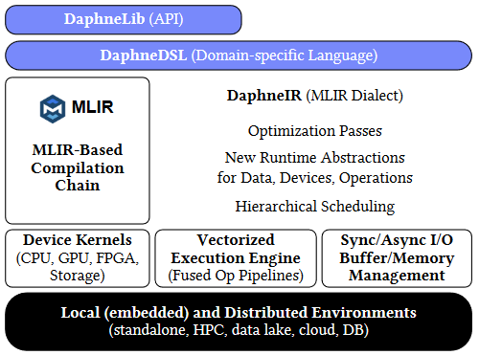
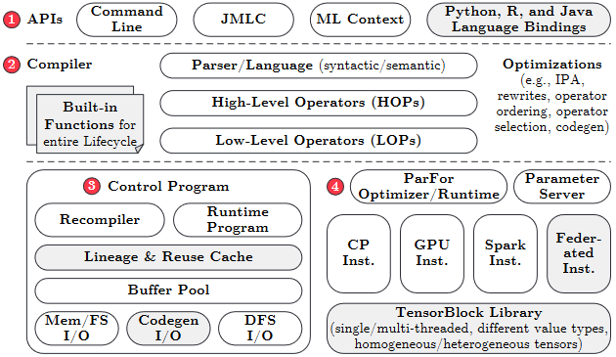
Simplified High-level Architecture of DAPHNE and SystemDS
Program matrix/frame data types linear/relational algebra ops complex control flow
Input Data open file formats
data exchange with other systems/libs
Language Abstractions & APIs
Domain-specific language (DSL), Python API
Optimizing Compiler DSL parser, Intermediate representation (IR), Compiler passes (lowering and optimization)
Runtime
Parallel local & distributed execution, Hardware accelerators (e.g., GPU)
Output Data

Slide 28
Kinds of LDE Project Topics in Daphne and SystemDS
End-to-end Experiments
typically required in any project topic
Reusable Data Science Primitives
Data analysis algorithms/applications
Mostly in DaphneDSL/DML
Program
Input Data
Language Abstractions & APIs
System Internals
Optimization and efficient execution of input programs (various aspects)
Mostly in C++/Java, some also in Python
External Tooling
Helpers in the ecosystem
Any suitable prog. lang.
Optimizing Compiler
Runtime
Openness to All Levels of the Stack to fulfill the task
Choose topic based on your interests and technical skills
Output Data

Slide 29


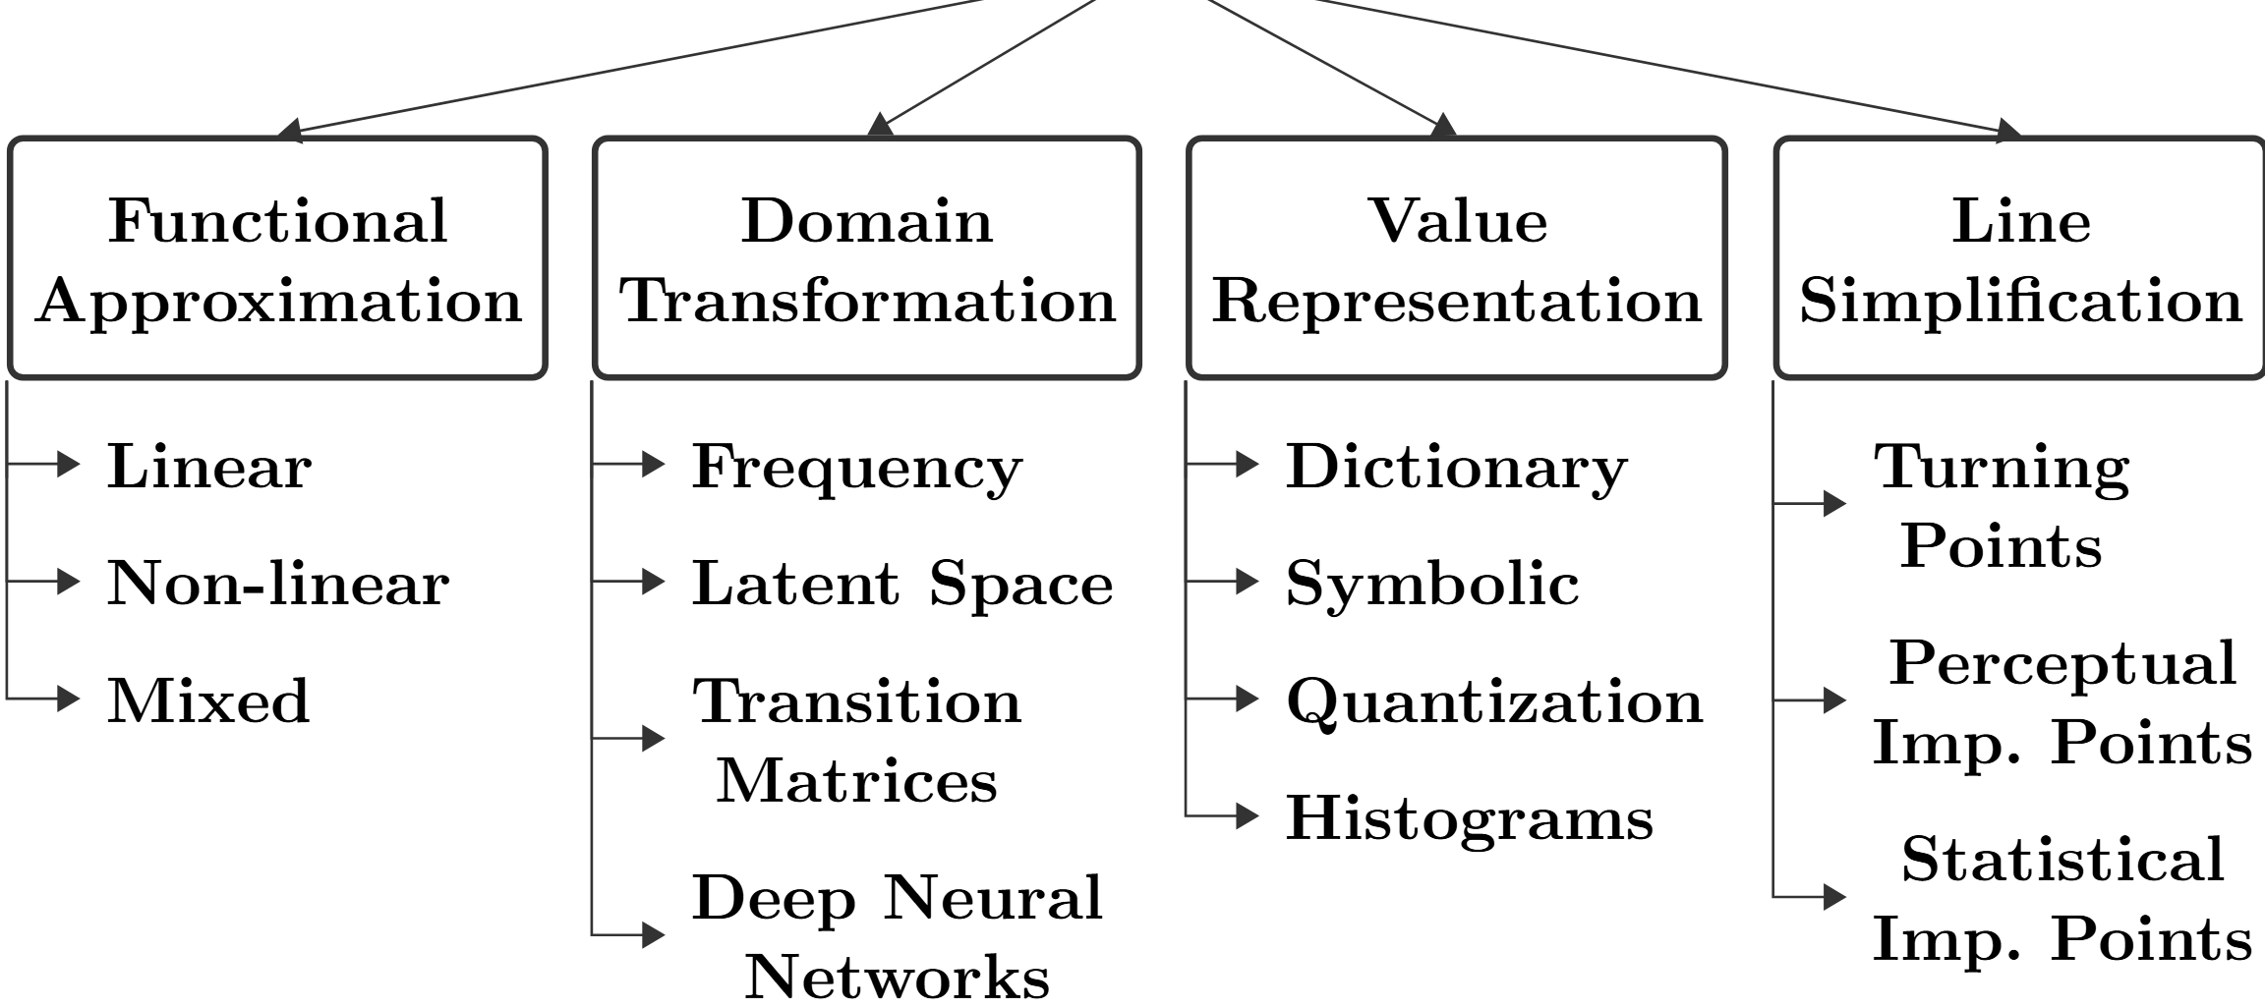
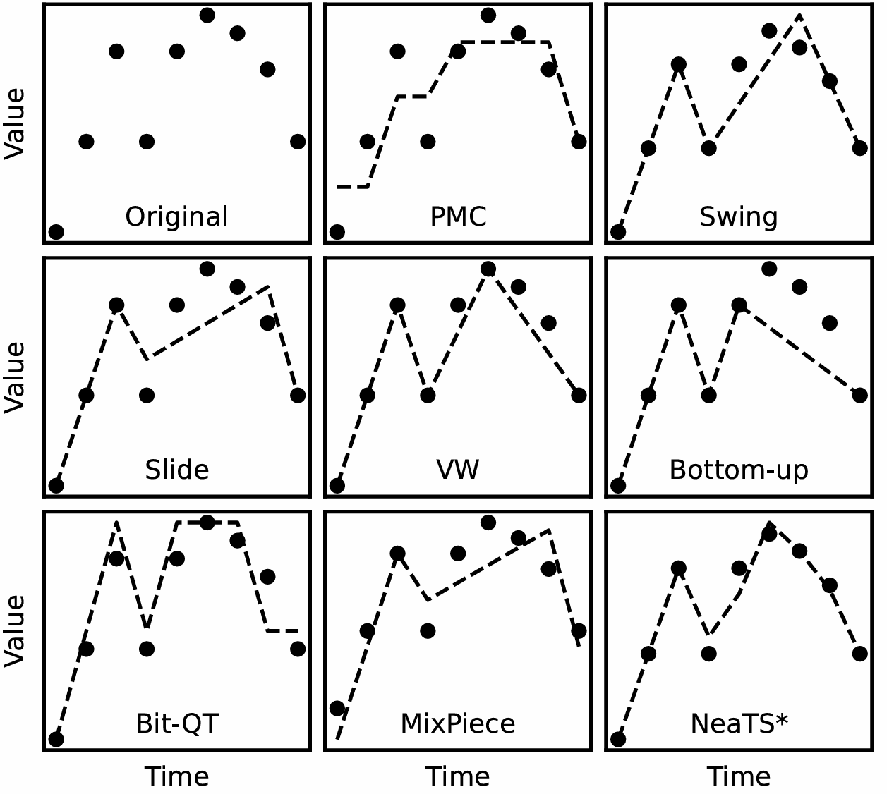
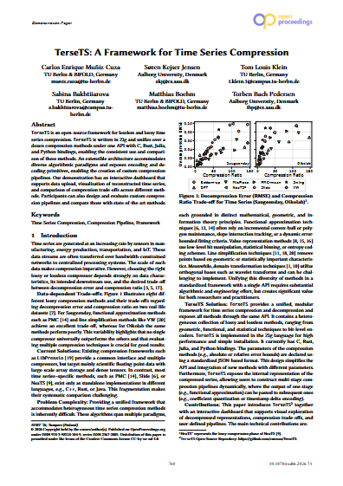
Overview (2/2): A Framework Developed at the DAMS Lab
A Framework for Time Series Compression
Native library for efficient time series lossy and lossless compression
Lowers the barrier for compression method evaluation, extension, and deployment while improving reproducibility in compression research
Open-source (Apache v2 license) https://github.com/cmcuza/TerseTS
Multi-platform: optimized for portability and efficiency on MacOS, Windows, and Linux
Written mostly in Zig, with bindings for C, Julia, Python, and Rust
[Carlos E. Muñiz-Cuza et al.: TerseTS: A Framework for Time Series Compression. EDBT 2026] EDBT 2026 Best Demo Award Honorable Mention

Slide 30
List of Project Topics (Proposals)
See list at https://pdamme.github.io/teaching/2026_summer/lde/ProjectTopics.pdf

Slide 31
Summary and Q&A
Course Organization, Outline, and Deliverables
How to Approach the Project
Projects in DAPHNE, Apache SystemDS, and TerseTS
List of Project Topics (Topic Selection by May 04)
Remaining Questions?
Reminder: Seminar Introductory Lecture Recommended for the Project
03 Experiments, Reproducibility, and Giving Presentations [May 11, 14:00]
See you during the consultation hours and intermediate presentations ☺

