Slide 1


Seminar Large-scale Data Engineering (LDE)
02 Scientific Reading and Writing
Dr.-Ing. Patrick Damme
Technische Universität Berlin
Berlin Institute for the Foundations of Learning and Data
Big Data Engineering (DAMS Lab)
[Credit: Based on “Introduction to Scientific Writing”/ ”02 Scientific Reading and Writing” by Matthias Boehm (TU Graz, winter 2021/22)]
Last update: Oct 22, 2023

Slide 2


Announcements/Org
Hybrid Setting with Optional Attendance
In-person in TEL 811 (~20 seats)
Virtual via zoom https://tu-berlin.zoom.us/j/67376691490?pwd=NmlvWTM5VUVWRjU0UGI2bXhBVkxzQT09
Reminder: Selection of Seminar and Project Topics
Seminar: ~5 preferred topics/papers
Project: ~5 preferred topics + preference on team work (encouraged) or individual work (feel free to approach us as a team, otherwise we help by grouping students)
Deadline: Oct 30 (next Monday), 23:59 CET
Added Discussion Forum in ISIS Couse
Feel free to use for any course-related questions

Slide 3
Agenda
Scientific Reading
Scientific Writing
Scientific Writing skills can only be learned hands on, and incrementally improved w/ experience

Slide 4
Scientific Reading
In Computer Science (Data Management)

Slide 5

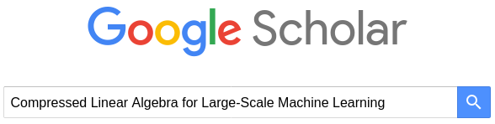
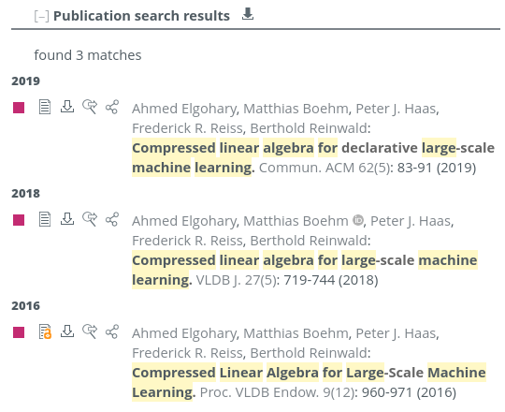
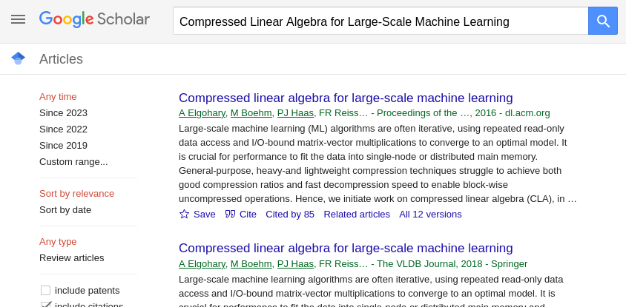


Obtaining the Full Text of a Paper
If you know the title[, author, venue, year] of a paper
Use search engines like DBLP (https://dblp.uni-trier.de/) or Google Scholar (https://scholar.google.com/)
Make sure to select the right version of the paper
If paper is not open-access, you typically need to be in the university’s VPN to access the PDF
paper
BibTeX entry

Slide 6
Finding Related Work
Motivation
Some research areas might be very large (e.g., index structures, compression)
How do you find relevant scientific papers/theses via multiple channels
Prefer Trustworthy Sources
Archival publications, awareness of peer-review
From right communities (e.g., ML systems vs ML algorithms)
Reputation of website, authors, etc.
Recap: Give Credit
Cite broadly, give credit to inspiring ideas, create connections
Honestly acknowledge limitations of your approach

Slide 7
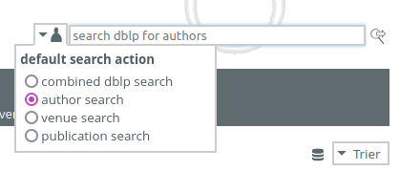

Finding Related Work, cont.
By Venue/Year
Start of top-tier conferences/journals and find latest work
E.g., SIGMOD, PVLDB, CIDR, ICDE, EDBT, CIKM, …
These papers’ related work should provide a good categorization and discussion of related work → recursive lookup
By Author
Sometimes there are well-known experts in a certain sub-area
Find author publications via DBLP and other libraries

Slide 8
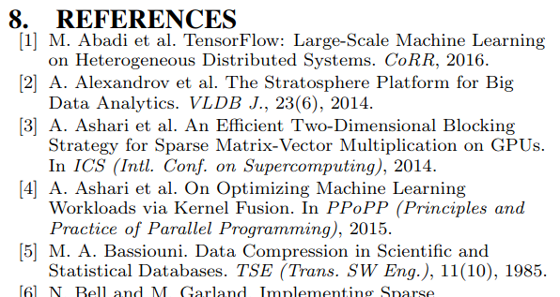
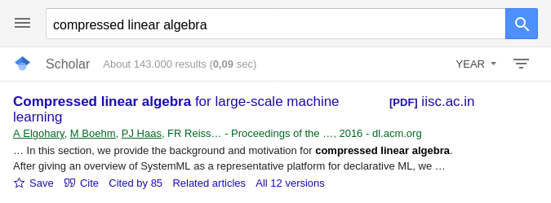

Finding Related Work, cont.
By References
Backwards (papers published before) & forwards (paper published after)
By Keywords
Broad survey of other related work, to augment the bias of the year/venue/author approach
Think of possible synonyms (e.g., “extensible”, “extendable”, “customizable”, …)

Slide 9
Types of Reading
Skimming
Goal: understand what the paper/thesis is about, judge relevance
Read abstract, and optionally introduction
Scan paper (sections/subsections, structure, figures)
Understanding
Goal: understand how the presented approach accomplishes the paper’s goals
#1 Skimming (see above)
#2 Read the whole paper sequentially, add notes/annotations
Reviewing
Goal: evaluate potential impact, and limitations
#1 Skimming (see above)
#2 Understanding (see above) + strengths and weaknesses
#3 Write summary, strong/weak points, detailed comments, overall recommendation ([strong/weak] accept/reject)
What?
How?
Good enough?
How to improve?

Slide 10
Process of Reading – Skimming/Understanding
Abstract and Structure
#1 Partial Reading (mostly skimming)
Read into each paragraph until you get what it’s about
1st sentence/label: topic sentence
#2 Fast Reading
Normal reading vs reading w/o vocalization
Avoid need for rereading text
Back/forward references,
Misplacement after distractions
Rereading due to lack of understanding
➔ Read according to your goals of reading

Slide 11
Process of Reading – Understanding/Evaluation
Skepticism
Critical reading is important for understanding and evaluation
#1 Start open-minded, listen to arguments and trust provided evidence
#2 Don’t accept superficial, contradictory, or unproven claims
#3 If there are problems, which constructive feedback could you give or how could the problems be addressed?
Questions to Ask Yourself?
What is the problem? Is it a real or artificial problem?
How would you solve the problem yourself?
How is the paper solving the problem?
Is this the simplest approach that yields these results (justified complexity)
Are there limitations that are not covered by the paper?
Is there existing work that already addresses the same problem?

Slide 12
Proofreading Your Own Paper
#1 Read Slowly & Carefully
Problem: Brain interpolates between words
Awareness of common syntactic issues (the the, missing/wrong articles, adapt/adopt)
Awareness of common semantic issues (missing reference, inconsistent / no logical consequence)
#2 Read Fully
Read and annotate issue, don’t fix immediately (destroys the flow)
Take annotated document and fix issues
#3 Ask Big Questions
Pitfall: Being overly focused on syntactic/local issues
Is the overall idea clearly communicated and does it make sense?
Are there missing pieces, missing experiments, missing related work?
→ Read out loud
→ Use PDF-to-Speech

Slide 13
Reviewing (how NOT to review a paper)
Paper Reviews
Goals: paper selection, ensure high quality, constructive feedback and recommendations, widen your own horizon
Lots of similarities to code reviews in OSS
Learning by What NOT to Do
Accept if no time to review
The Goldilocks Method (examples, proofs, theoretical analysis, experiments)
If you can’t say something nasty … (ignore good parts, focus on weaknesses)
Silent but deadly (low scores, no comments)
The Natives are Restless (recommend full rewrite by native English speaker)
The Referee Moves the Goalpost (changed problem)
Blind reviewing
[Graham Cormode: How NOT to review a paper: the tools and techniques of the adversarial reviewer. SIGMOD Rec. 37(4) 2008]
This paper leaves many questions unanswered.
Some claims are questionable.
The paper is of limited interest.

Slide 14
Reviewing, cont. (how NOT to review a paper)
Introduction
Disagree w/ “Interestingly...”, “Importantly...” or “In practice”,
Related Work
“Many important references are omitted”
Proposed Method
To simple, impractical, or well-known; correctness?
Experiments
Datasets synthetic/real, not all aspects evaluated, too small datasets
Conclusions
Disagree w/ every claim; future work can be dismissed
Adversarial Paper Summary
This paper attempts to address the well-studied problem of Graticule Optimization. It proposes the obvious approach of simply storing a set of reference points and calculating offsets. Such approaches are well known in this area. It goes on to propose some simple variations based on precalculating distances. This is an approach that I would expect any straightforward implementation to adopt. Some proof-of-concept experiments show that on a few data sets, the results are slightly better than the most naïve prior methods.

Slide 15
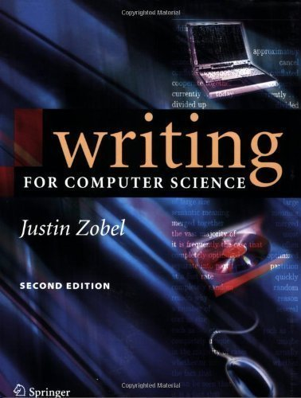
Scientific Writing
In Computer Science (Data Management)
[Justin Zobel: Writing for Computer Science, 2nd ed. Springer 2004, ISBN 978-1-85233-802-2]

Slide 16
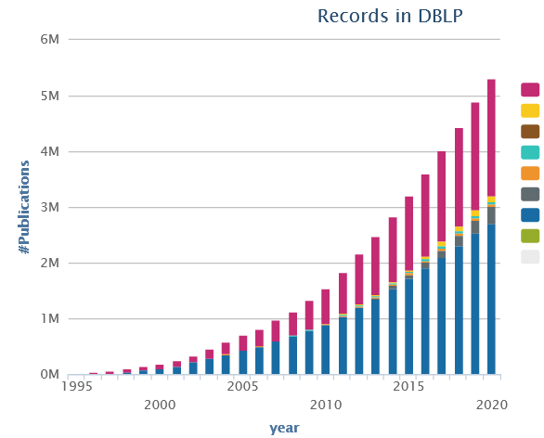
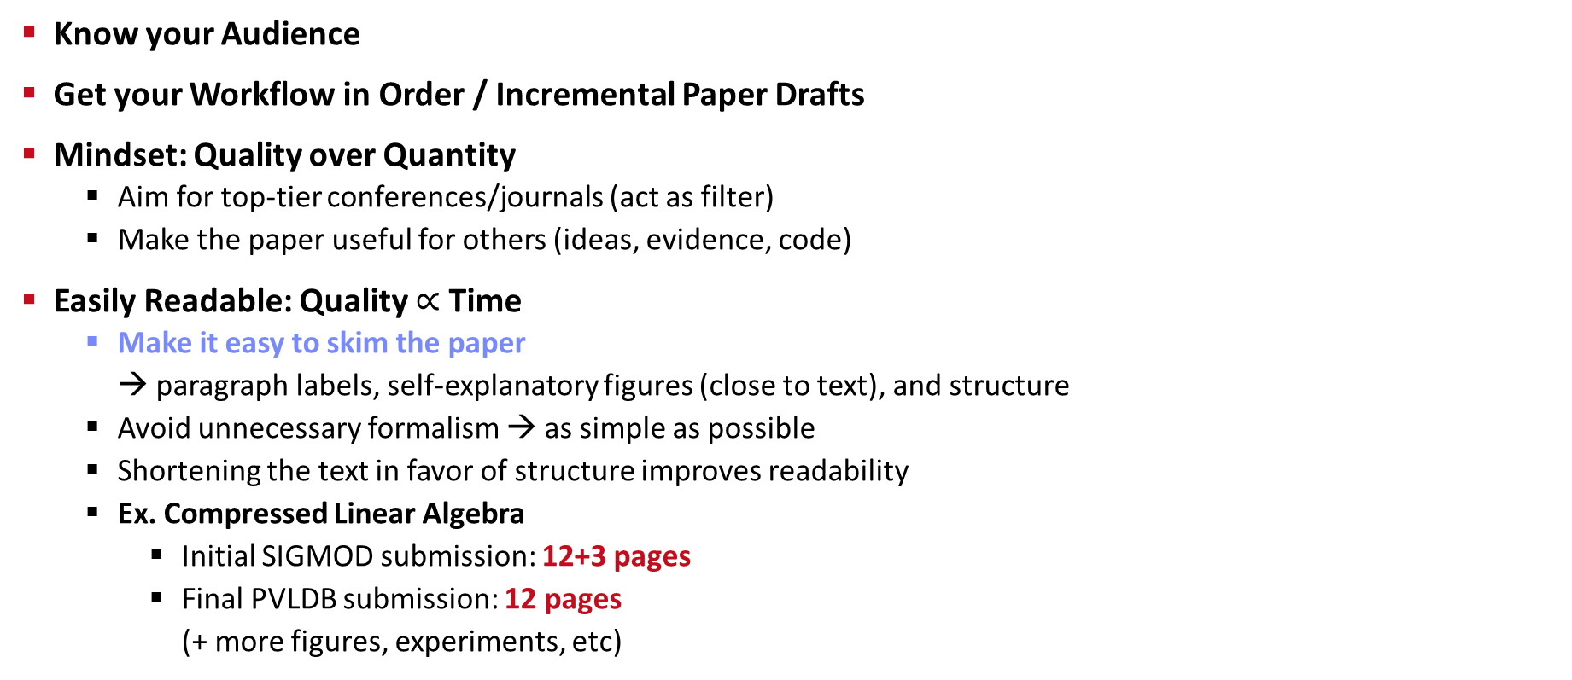
Recap: Writing the Paper
Know your Audience
Get your Workflow in Order / Incremental Paper Drafts
Mindset: Quality over Quantity
Aim for top-tier conferences/journals (act as filter)
Make the paper useful for others (ideas, evidence, code)
Easily Readable: Quality $∝$ Time
Make it easy to skim the paper → paragraph labels, self-explanatory figures (close to text), and structure
Avoid unnecessary formalism → as simple as possible
Shortening the text in favor of structure improves readability
Ex. Compressed Linear Algebra
Initial SIGMOD submission: 12+3 pages
Final PVLDB submission: 12 pages (+ more figures, experiments, etc)

Slide 17
Prototypical Structure of a Scientific Paper
Sections and Subsections
Abstract → short overview of problem and solution (part of meta data)
Introduction → context, problem, contributions
Background / Preliminaries → necessary background for understanding
Main Part → your technical core contributions
Main Part 2
Experiments → setting, micro benchmarks, end-to-end benchmarks
Related Work → areas of related work, differences to your own work
Conclusions → summary, conclusions, and future work
Acknowledgments → funding agencies, helpful people beyond co-authors
References → list of other works referenced throughout the paper
(Appendix) → any additional contents (e.g., proves of theorems, more results)
Recommendations
Avoid sections with only one subsection (e.g., 2 and 2.1)
Avoid more than two or at most three nesting levels
Clearly separate motivation/background from your own work
→ 01 Structure of Scientific Papers

Slide 18
Scope and Structure
Bullet Lists
begin{itemize} … \item \end{itemize}
begin{enumerate} … \end{enumerate}
Figures and Tables
Captions below figures, above tables
Theorem, Definition, Examples
Refine theorem environments as needed
Algorithms
Can be clearer than text, but not always
Carefully select the right level of abstraction
Code
\begin{verbatim} … \end{verbatim}
Refer to all figures, tables, algorithms in the text

Slide 19
Formatting
Motivation
A carelessly formatted paper (layout, figures, fonts, underlining) creates a bad first impression
Recap: skimming and anchoring
Figures
Use same font and font size as the main text / code in main paper
Avoid text overlap, too aggressive colors
Orphans and Widows
Imprecise definition
Avoid few words per line, single line at next page
Text Running over Column Margin (rephrase until it fits)
Highlighting
Use \emph{} (emphasize) over underlining or bold
“The paper’s approach is probably equally sloppy”
Looks ugly and wastes lots of space

Slide 20
Punctuation
Commas
Whenever a pause is appropriate, or required to avoid ambiguity
Lists: red, blue, black, and white (oxford/serial comma)
Special sentence start: However, Hence, Therefore, In this paper,
Semicolons
Divide a long sentence into sub-sentences, or separation for emphasis
Lists with sublists
Exclamations
Avoid exclamation marks! Never use more than one!!
When using disk[,] tree algorithms were found to be particularly poor.
A woman without her man is nothing.
A woman: without her, man is nothing.
We use index structures like b-trees, tries, and hash tables; as well as compression techniques like run-length encoding, dictionary encoding, and null suppression.

Slide 21


Writing Style
Goal: Clear, easy-to-read writing
Variation
Diversity (structure, length of sentences/paragraphs, choice of words, sentence beginning) helps keeping the reader’s attention
The system of rational numbers is incomplete. This was discovered 2000 years ago by the Greeks. The problem arises in squares with sides of unit length. The length of the diagonals of these squares is irrational. This discovery was a serious blow to the Greek mathematicians.
The Greeks discovered 2000 years ago that the system of rational numbers is incomplete. The problem is that some quantities, such as the length of the diagonal of a square with unit sides, are irrational. This discovery was a serious blow to the Greek mathematicians.

Slide 22
Writing Style, cont.
Prefer Active Voice
Easier to understand, shorter, more interesting
Use “we” over “I”
Don’t directly address the reader (no “you”)
Prefer Present Tense
Most content of a research paper can be described in present
Exceptions: user studies, (specific experimental setup), related work
Use of References
Use \cite{key1,key2} for multiple sources
Don’t use refs as nouns
Prefer primary sources
Use “et al.” for three or more authors
In this section, the background and motivation for compressed linear algebra is introduced.
In this section, we provide the background and motivation for compressed linear algebra.
Later, [40] investigated query processing on heavyweight Huffman coding schemes,
Later, Raman and Swart investigated query processing on heavyweight Huffman coding schemes [40],

Slide 23
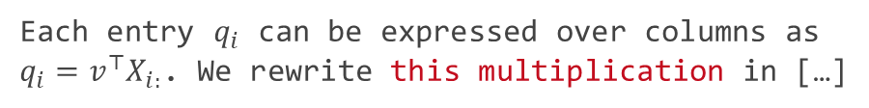
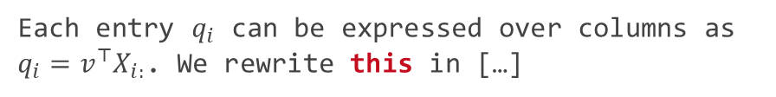
Writing Style, cont.
Articles and Spaces
Plural allows to drop articles
Use guarded spaces for references that should not appear on a new line
Clear References
Make sure there are no unclear “it” or “this” references
Add descriptive nouns
Titles and Names
Titles: capitalize meaning-carrying words
Names: capitalize, e.g., Bayesian, Euclidean
References like Figure 1, Table 2, Section 3, Chapter 4, Equation 5 are names as well
employ general-purpose compression techniques
employ a general-purpose compression technique
Each entry $q_{i}$ can be expressed over columns as $q_{i}=v^{⊤}X_{i:}$. We rewrite this in […]
Each entry $q_{i}$ can be expressed over columns as $q_{i}=v^{⊤}X_{i:}$. We rewrite this multiplication in […]
Figure~\ref{fig:exp1}
Equation~\eqref{eq:e1}

Slide 24
Writing Style: Diversity and Inclusion
[Credit: https://dbdni.github.io/]
Diversity, “the who”
Individuals from a wide variety of backgrounds and experience, different viewpoints/reasoning/approaches
Different cultures: e.g., use names from variety of languages, cultures, nationalities (not just Alice and Bob)
Differences in figures: e.g., people-like icons: use variety of gender, skin color, ability status, …
Gender diversity in pronouns: use variety of he/she/they, use gender-neutral nouns: “chairman” → “chairperson”
Increasing Awareness for D&I
Meanwhile part of the policies of all/most major publication venues (SIGMOD, VLDB, ICDE, EDBT, ADBIS, …)
D&I issues included in the review form
Inclusion, “the how”
Environment welcoming and embracing diversity; avoid language that furthers the marginalization, stereotyping, erasure of any group of people
Implicit assumptions: "Everyone has a mother and a father."
Oppressive terminology: e.g., “master-slave“ → “coordinator-worker” “orphaned object” → “unreferenced object” “blacklist/whitelist” → “blocklist/allowlist”
Marginalization of under-represented groups: e.g., “The Gender attribute is either Male or Female."
Lack of accessibility: e.g., color alone to convey info in a plot → use patterns, symbols, textures, etc.
Stereotyping: e.g., feminine names or presentations for personal secretary role

Slide 25
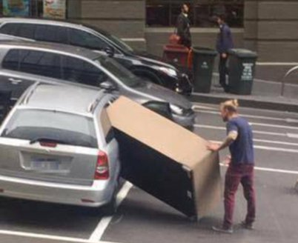
Page Limits
Most Conferences/Journals
Given predefined template, changes not permitted
SIGMOD/PVDLB: 12 pages + unlimited references
ICDE: 12 pages incl. references
Avoid Cheating
Don’t change the template, fonts, or margins (at least not too excessively)
Condensing more text into the paper will make it harder to read
Carefully Trim Down Draft
Write unlimited paper, then select, and revise
Write and revise section by section as you write
Never Excuse Missing Content by “lack of space”
[Credit: https://twitter.com/ fadeladib/status/1322646406088347649]
[Eamonn Keogh: How to do good research, get it published in SIGKDD and get it cited!, KDD 2009]
“Due to the lack of space, we omit [essential details] / [essential experiments]”

Slide 26

Plagiarism
Self-Plagiarism (Bad Idea)
Avoid reusing motivation, introduction, figures, and examples
Start writing every thesis / paper from scratch (unless thesis summaries/extends previous papers)
Figure Plagiarism (Bad Idea)
Never copy figures from other papers, web, etc
Create all figures yourself, even for surveys (can be based on ideas of existing papers)
Exceptions do exist w/ explicit references
Plagiarisms (Really Bad Idea)
Never copy figures or text from other peoples work and claim its yours (slight rewording does not change that)
For archival scientific publications, there is a high chance it will be detected

Slide 27
Plagiarism – Duplicate Submission
Example SIGMOD’21
A research paper submitted to SIGMOD 2021 cannot be under review for any other publishing forum or presentation venue, including conferences, workshops, and journals, during the time it is being considered for SIGMOD. Furthermore, after you submit a research paper to SIGMOD, you must await the response from SIGMOD and only re-submit elsewhere if your paper is rejected - or withdrawn at your request - from SIGMOD. This restriction applies not only to identical papers but also to papers with a substantial overlap in scientific content and results.
Every research paper submitted to SIGMOD 2021 must present substantial novel research not described in any prior publication. In this context, a prior publication is (a) a paper of five pages or more presented, or accepted for presentation, at a refereed conference or workshop with proceedings; or (b) an article published, or accepted for publication, in a refereed journal. If a SIGMOD 2021 submission has overlap with a prior publication, the submission must cite the prior publication, along with all other relevant published work, following the guidelines in the Anonymity Requirements for Double-Blind Reviewing section below.

Slide 28
Excursus: Automatic CS Paper Generation
SCIgen
Generates random CS research papers, including graphs and figures
Uses hand-written context-free grammar
Test for low-submission standards of conferences
Meaningless mix of sentences and technical terms
Generative AI (such as ChatGPT)
ACM Policy on Authorship (applies to, e.g., SIGMOD)
Generative AI tools may not be authors of publications
Using generative AI to create content is permitted
But: must be fully disclosed in the work
Basic word processing systems (e.g., spelling/grammar corrections) generally allowed, no requirement for disclosure
Policy updates expected due to blurring boundaries between generative AI and basic word processing systems
[Credit: https://pdos.csail.mit.edu/archive/scigen]
[Credit: https://www.acm.org/publications/ policies/new-acm-policy-on-authorship]
LDE seminar and project:
Use of generative AI not allowed

Slide 29
Summary and Q&A
Scientific Reading
Scientific Writing
Remaining Questions?
Seminar/Project Topic Selection by Oct 30, 23:59 CET
Final Introductory Lecture
03 Experiments, Reproducibility, and Giving Presentations [Oct 30] Also recommendable for participants taking only the project

