Slide 1


Seminar Large-scale Data Engineering (LDE)
03 Experiments, Reproducibility & Presentations
Dr.-Ing. Patrick Damme
Technische Universität Berlin
Berlin Institute for the Foundations of Learning and Data
Big Data Engineering (DAMS Lab)
[Credit: Based on “Introduction to Scientific Writing”/ ”03 Experiments and Reproducibility” by Matthias Boehm (TU Graz, winter 2021/22)]
Last update: May 8, 2023

Slide 2

Announcements/Org
Hybrid Setting with Optional Attendance
In-person in TEL 811 (~20 seats)
Virtual via zoom https://tu-berlin.zoom.us/j/67376691490?pwd=NmlvWTM5VUVWRjU0UGI2bXhBVkxzQT09
Finished Selection of Seminar Topics/Papers
All participants have selected their seminar topic
Exam Registration via MTS
For seminar-only, project-only, seminar+project modules LDE
Currently being set up, not open yet
Details will be announced on the ISIS page in the next days

Slide 3
Agenda
Experiments and Result Presentation
Reproducibility and RDM
Scientific Presentations

Slide 4
Experiments and Result Presentation
In Computer Science (Data Management)
[Credit: Ioana Manolescu, Stefan Manegold: Performance Evaluation in Database Research: Principles and Experiences, ICDE 2008]

Slide 5
Motivation
Worst Mistake: Schrödinger's Results
Postpone implementation and experiments till last before the deadline
No feedback, no reaction time (experiments require many iterations)
Karl Popper: falsifiability of scientific results
Continuous Experiments
Run experiments during survey / prototype building
Systematic experiments → observations and ideas for improvements
Don’t be afraid of throwing away prototypes that don’t work
Good Research Fires Itself
Initial experiments give directions for further improvements
Problem-oriented methodology

Slide 6
Types of Experiments
#1 Exploratory Experiments
Tests for functional correctness
Unstructured experiments for initial feedback → eval feasibility
#2 Micro Benchmarks
Measure specific aspects in controlled and understandable scope
Bottom-up approach
#3 Benchmarks
Evaluate on community/own benchmarks
Examples: TPC-C, TPC-H, TPC-DS, JOB, MLPerf
#4 End-to-end Applications
Evaluate in larger scope of real datasets and query workloads
Examples: Customer workload, ML pipelines (dataprep, training, eval)

Slide 7
[I. Manolescu, S/ Manegold: Performance Evaluation in Database Research: Principles and Experiences, ICDE 2008]
From Idea to Experiments
Overview
Proper planning helps to keep you from “getting lost”
Repeatable experiments simplify your own work
There is no single way how to do it right
There are many ways how to do it wrong
Basic Planning
Which data / data sets should be used?
Which workload / queries should be run?
Which hardware & software should be used?
Metrics: What to measure? How to measure?
Comparison: How to compare? CSI: How to find out what is going on?

Slide 8
Dataset Selection
Synthetic Data
Generate data with specific data characteristics
Systematic evaluation w/ data size, sparsity, etc.
“Real” Data Repositories
Wide selection of available datasets w/ different characteristics
UCI ML Repository: https://archive.ics.uci.edu/ml/index.php
Florida Sparse Matrix Collection: https://sparse.tamu.edu/
Google dataset search: https://datasetsearch.research.google.com/
Common Datasets in ML: ImageNet, Mnist, CIFAR, KDD, Criteo
Common Datasets in DM: Census, Taxi, Airlines, DBLP, benchmarks etc.
Representative of real data distributions?
Representative for variety of workloads / common case?

Slide 9
Benchmarks
Overview
Community- and organization-driven creation of agreed benchmarks
Benchmarks can define a field and foster innovation
#1 Data Management
Query processing: 007, TPC-C, TPC-E, TPC-H, TPC-DS (w/ audit)
Join ordering: JOB
#2 “Big Data”
MR/Spark: BigBench, HiBench, SparkBench
Array Databases: GenBase
#3 Machine Learning Systems
SLAB, DAWNBench, MLPerf, MLBench, AutoML Bench, Meta Worlds, TPCx-AI
[Michael J. Carey, David J. DeWitt, Jeffrey F. Naughton: The oo7 Benchmark. SIGMOD 1993]
[http://www.tpc.org/tpch/]
(See AMLS course for details)

Slide 10
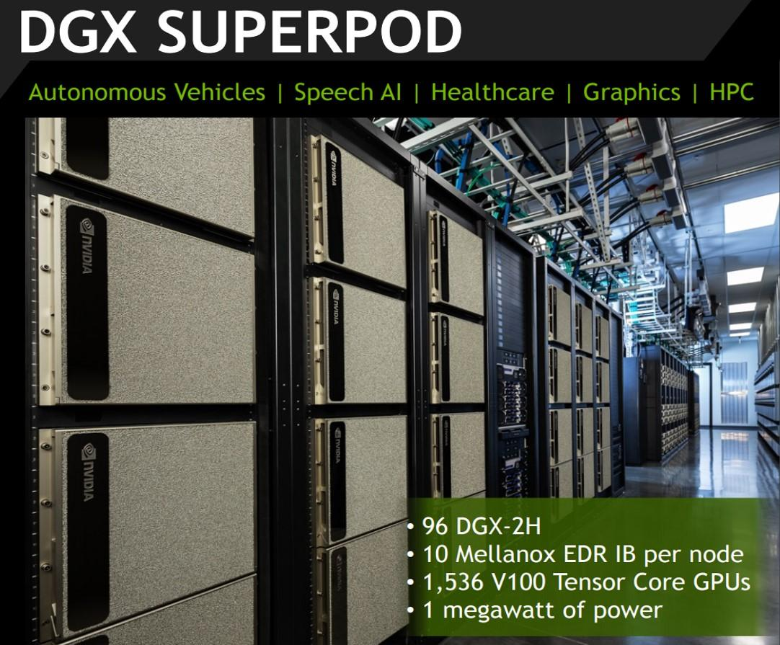
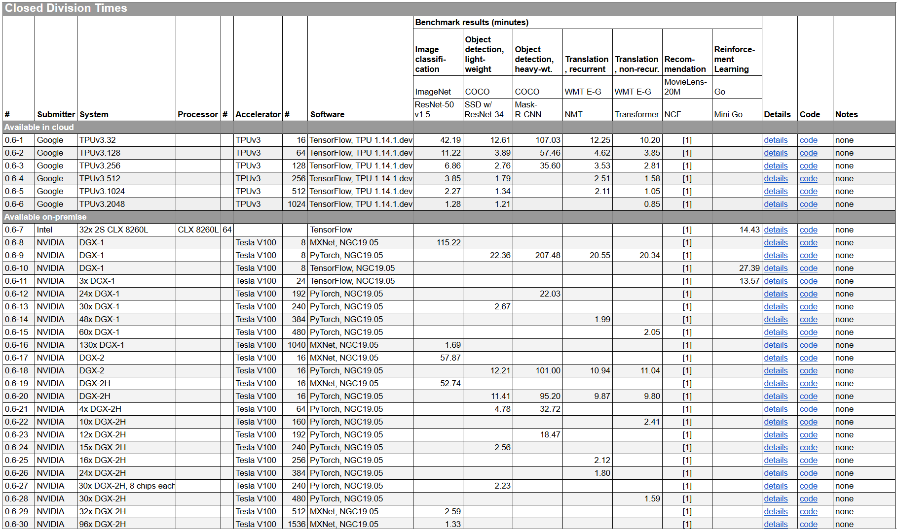
Benchmarks, cont.
[MLPerf v0.6: https://mlperf.org/training-results-0-6/]
96 x DGX-2H = 96 * 16 = 1536 V100 GPUs ➔ ~ 96 * $400K = $35M – $40M
[https://www.forbes.com/sites/tiriasresearch/2019/06/19/nvidia-offers-a-turnkey-supercomputer-the-dgx-superpod/#693400f43ee5]

Slide 11
Baselines
#1 Primary Baseline
Existing algorithm or system infrastructure
Main comparison point, usually with same runtime operations
Beware: Avoid speedup-only results (need absolute numbers for grounding)
#2 Additional Baselines
Alternative systems with different runtime and compiler
Usually, not directly comparable but important for grounding
E.g., SystemDS: R, Julia, Spark, TensorFlow, PyTorch
Potential hindering factors: commercial and closed-source systems, software licenses
Problem of Weak Baselines
Authors want to show improvements
Successive improvements over state-of-the-art don’t add up
[Timothy G. Armstrong, Alistair Moffat, William Webber, Justin Zobel: Improvements That Don't Add Up: Ad-Hoc Retrieval Results Since 1998. CIKM 2009]
[Maurizio Ferrari Dacrema, Paolo Cremonesi, Dietmar Jannach: Are We Really Making Much Progress? A Worrying Analysis of Recent Neural Recommendation Approaches. RecSys 2019]

Slide 12
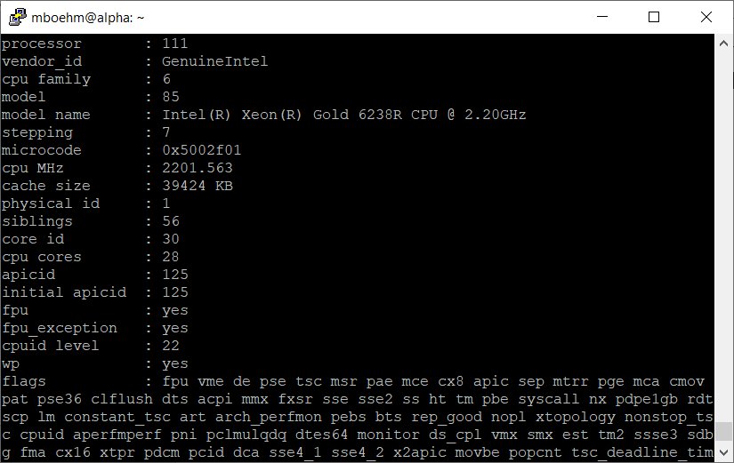
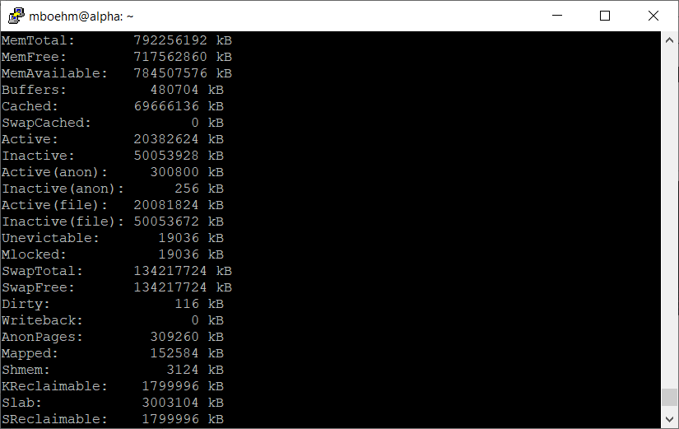
Presentation – Experimental Setting
Hardware Selection
Multiple nodes for distributed computation
Avoid too outdated HW (irrelevance)
Find Balanced Level of Detail
Underspecified: “We ran all experiments on an Intel CPU”
Over-specified: cat /proc/cpuinfo cat /proc/meminfo
Recommendation
HW components: #nodes, CPUs (#cores, clock freq., cache size), memory, network, I/O
SW components: OS, programming language, versions, other software, compiler flags
Baselines and configuration → Use recent versions of baseline systems
Data and workloads with data sizes, parameters, configurations

Slide 13


Presentation – Figures
Axes
Use informative axes labels with units (e.g., Total Execution Time [ms])
Don’t cheat or mislead readers and reviewers
Start y-axis at 0 for linear scale
100
Yours
100
Yours
Runtime
90
Mine
Runtime [s]
Runtime [s]
50
80
Mine
Aha, so 12%
0
1
2
3
What are the units? Where are the tics?
Misleading y axis

Slide 14
Presentation – Figures, cont.
Fair Ranges of Parameters
Evaluate common ranges of values
Don’t hide important information
[J. Sommer, M. Boehm, A. V. Evfimievski, B. Reinwald, P. J. Haas: MNC: Structure-Exploiting Sparsity Estimation for Matrix Expressions. SIGMOD 2019]
If there are multiple relevant parameters, show them all
For log-scale you can’t start at 0
Don’t limit range to make you look good

Slide 15
[I. Manolescu, S/ Manegold: Performance Evaluation in Database Research: Principles and Experiences, ICDE 2008]
Presentation – Figures, cont.
Plots Types
Barplot for categories
Plot + Line/linepoints for continuous parameters
Visible font sizes (similar to text)
Legends
Order them by appearance
Attach directly to graph
Human brain is a poor join processor
Humans get frustrated

Slide 16
Presentation – Figures, cont.
Diversity & Consistency
Diversity: if applicable use mix of different plot types and tables
Consistency: use consistent colors and names for same baselines
Labeling
Make the plots self-contained
Simplifies skimming and avoids join with text
[Matthias Boehm et al: SystemDS: A Declarative Machine Learning System for the End-to-End Data Science Lifecycle. CIDR 2020]

Slide 17
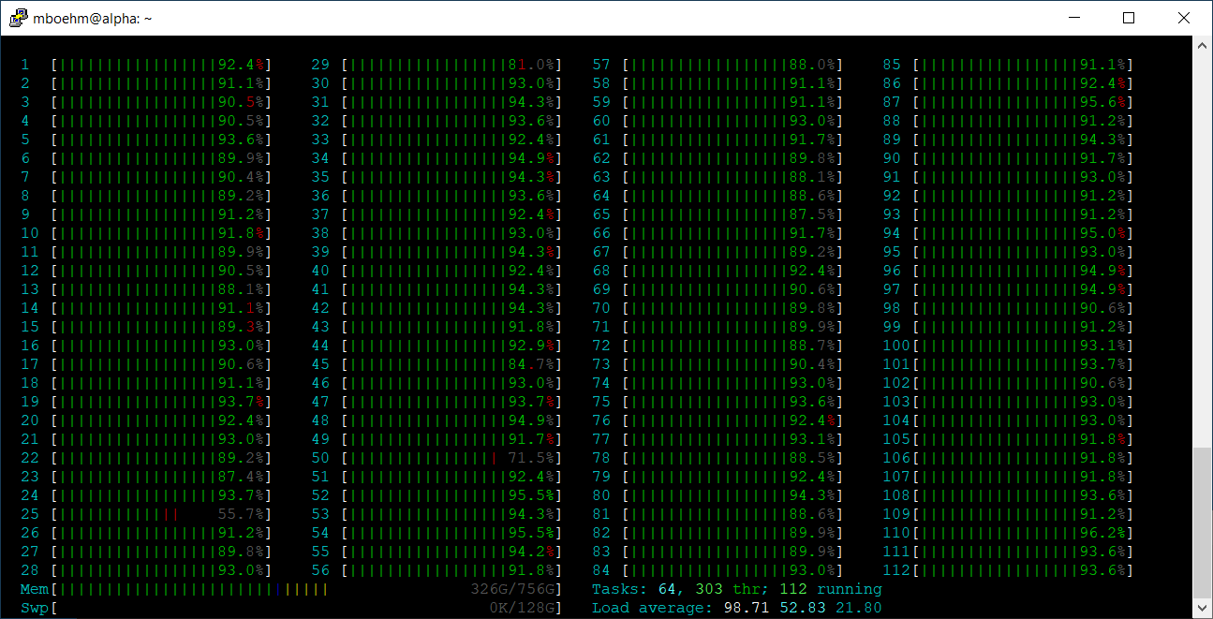
Presentation – Result Interpretation
Use the Right OS Tools
System-specific tracing/statistics
top / htop / iotop (looks CPU bound)
perf -stat -d ./run.sh (no, it’s memory-bandwidth bound)
Performance counter stats for './run.sh':
12721364.53 msec task-clock # 83.640 CPUs utilized
463352 context-switches # 0.036 K/sec
5455536095415 instructions # 0.14 insn per cycle (62.50%)
335314473273 branches # 26.358 M/sec (62.50%)
1463380955 branch-misses # 0.44% of all branches (62.50%)
2185062643097 L1-dcache-loads # 171.763 M/sec (62.50%)
142845949268 L1-dcache-load-misses # 6.54% of all L1-dcache hits (62.50%)
3375555316 LLC-loads # 0.265 M/sec (50.00%)
1016330404 LLC-load-misses # 30.11% of all LL-cache hits (50.00%)
152.096000108 seconds time elapsed
12052.466691000 seconds user
674.704421000 seconds sys
Don’t just report the results,
try to understand and explain them

Slide 18
Presentation – Result Interpretation, cont.
Use the Right PL Tools / Flags
E.g., Understanding Java JIT compilation -XX:+PrintCompilation
E.g., Understanding HW Cache Hierarchy (L1i 32KB) -XX:-DontCompileHugeMethods
[Matthias Boehm et al: On Optimizing Operator Fusion Plans for Large-Scale Machine Learning in SystemML. PVLDB 11(12) 2018]

Slide 19
Reproducibility and RDM (Research Data Management)
In Computer Science (Data Management)

Slide 20
Research Data Management (RDM)
Overview
Ensure reproducibility of research results and conclusions
Common problem: “All code and data was on the student’s laptop and the student left / the laptop crashed.”
Create value for others (compare, reuse, understand, extend)
EU Projects: Mandatory proposal section & deliverable on RDM plan

Slide 21

Excursus: FAIR Data Principles
[https://www.go-fair.org/fair-principles/]
#1 Findable
Metadata and data have globally unique persistent identifiers
Data described with rich meta data; registered/indexes and searchable
#2 Accessible
Metadata and data retrievable via open, free and universal comm protocols
Metadata accessible even when data no longer available
#3 Interoperable
Metadata and data use a formal, accessible, and broadly applicable format
Metadata and data use FAIR vocabularies and qualified references
#4 Reusable
Metadata and data described with plurality of accurate and relevant attributes
Clear license, associated with provenance, meets community standards

Slide 22
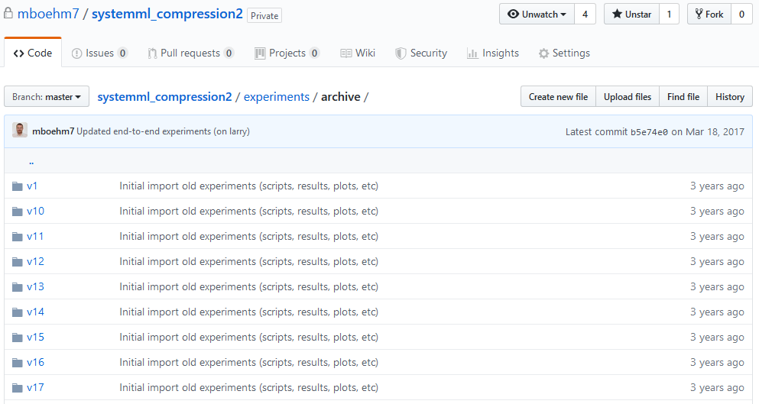
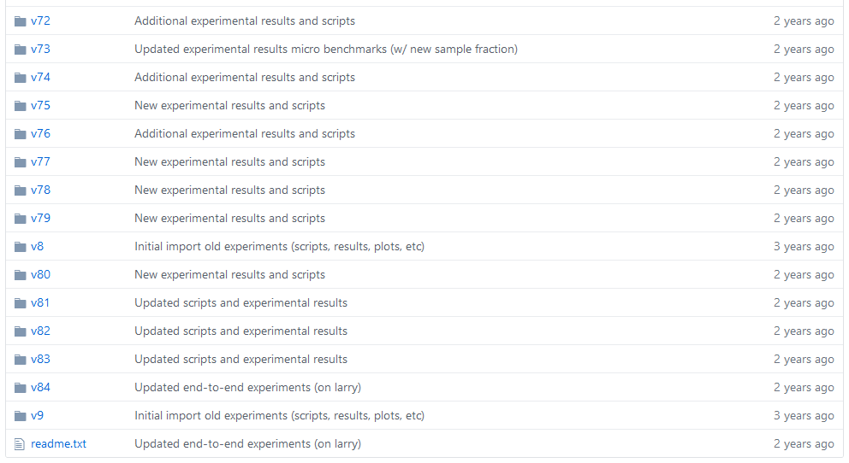
RDM in Practice @ DAMS Lab
Code and Artifacts
Open-source systems
Apache SystemDS: https://github.com/apache/systemds
DAPHNE: https://github.com/daphne-eu/daphne
Complete code history, src/bin releases
LDE/AMLS/DIA programming projects in SystemDS and DAPHNE
Additional private GitHub repos for student projects / prototypes
Reproducibility for publications: https://github.com/damslab/reproducibility
Central Paper Repository
All paper submissions with LaTeX sources, figures, reviews, rebuttals, etc.
All paper-related experiments
Archive: append-only experimental results
Plots: scripts and figures of plots
Results: latest results used for the current plots
Scripts: data preparation, baselines, benchmarks
Automate your experiments as much as possible

Slide 23


SIGMOD Reproducibility Process
Overview
Accepted papers can submit package, verified by committee
ACM Results Replicated / ACM Artifacts Available labels
Most Reproducible Paper Award ($750, visibility)
#1 Replicability (aka Repeatability)
Recreate result data and graphs shown in the final paper
Expected: same trend of baseline comparisons, parameter influence
#2 Reproducibility
Verify robustness of results wrt parameters and environments
Examples: different data and workload characteristics, hardware

Slide 24
SIGMOD Reproducibility Process, cont.
Ideal Reproducibility Submission
“At a minimum the authors should provide a complete set of scripts to install the system, produce the data, run experiments and produce the resulting graphs along with a detailed Readme file that describes the process step by step so it can be easily reproduced by a reviewer.
The ideal reproducibility submission consists of a master script that:
installs all systems needed,
generates or fetches all needed input data,
reruns all experiments and generates all results,
generates all graphs and plots, and finally,
recompiles the sources of the paper
... to produce a new PDF for the paper that contains the new graphs. “
Note: It takes time, plan from start
We prepared for SIGMOD 2019 Repro, but finally, not submitted (ran out of time)
[Credit: db-reproducibility. seas.harvard.edu/#Guidelines]
[J. Sommer, M. Boehm, A. V. Evfimievski, B. Reinwald, P. J. Haas: MNC: Structure-Exploiting Sparsity Estimation for Matrix Expressions. SIGMOD 2019]

Slide 25
Tools for Automation
Motivation
Tooling for running artifacts in a self-contained manner
Metadata storage in semi-structured formats like JSON/XML
Examples
Name | Target | Link
CK | ML Systems | http://ctuning.org
CWL | Analysis Workflows | http://commonwl.org
Popper | Container Workflows | https://github.com/systemslab/popper
ReproZip | General-purpose Bundles | http://reprozip.org
Sciunit | Self-contained Experiments Bundles | http://sciunit.run
Sumatra | Numerical Simulations | https://github.com/open-research/sumatra

Slide 26
Scientific Presentations
In Computer Science (Data Management)

Slide 27
Goals and Structure
Typical Goals of a Scientific Presentation
Make audience aware of and interested in your work → visibility, get your paper cited
Show that you made significant contributions to relevant research area
Discuss problem/topic, get feedback from audience, foundation for offline discussion
Structure
No single best structure, but best practices
Commonalities with scientific papers
Introduction/motivation (including necessary background and related work)
Main part (your own contributions)
Experimental results
Summary & outlook

Slide 28
Limit the Scope
Typical Duration
Lecture: ~90-120 min
Thesis defense: ~45 min
Seminar talk: ~20 min
Conference talk ~5-15 min
Limit the Scope, You Cannot Talk about Everything
In terms of breadth
E.g., focus on a subset of the contributions
E.g., not all experiments
But: give overview of everything
In terms of depth
I.e., don’t show all details
Present simplified results
Challenge: Usually not to fill the time, but to not go over time
Challenge: Select the most important aspects

Slide 29
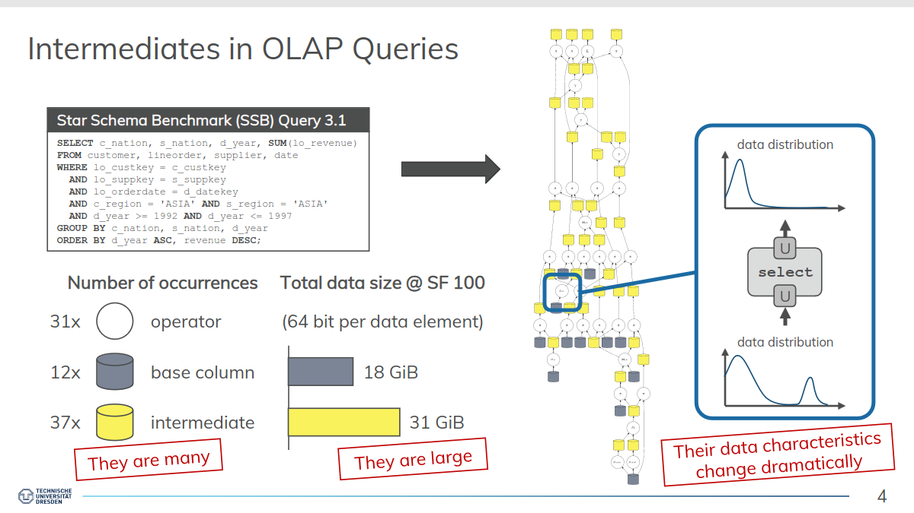
Know Your Audience
Audience Characteristics
How much can you expect them to know about your topic? Don’t assume too much…
Need to adjust to you as a speaker in the beginning
Help Audience Not to Get Lost
Clear motivation (don’t rush through it)
Clear presentation outline (after motivation, otherwise hard to comprehend)
Outline and current position again after each section of the talk
Repeat important assumptions
Illustrate theory with concrete (running) examples
Take necessary time for complex diagrams, formulas, etc.
Steer Audience’s Attention
Make the most important points pop out
(Simple) animations
Reveal complex slide contents incrementally
But: avoid “Powerpoint Poisoning”
“If you remember one thing from this presentation, it should be that ...”

Slide 30
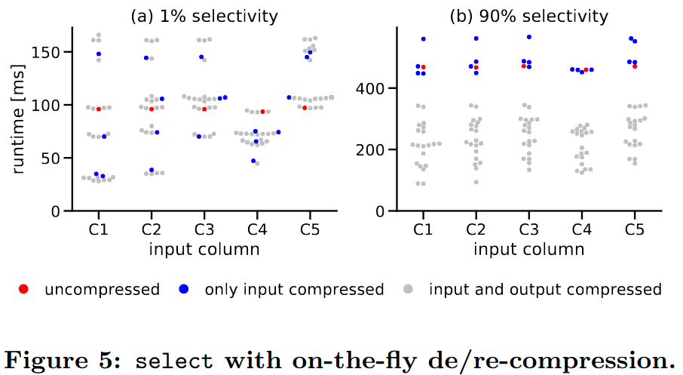
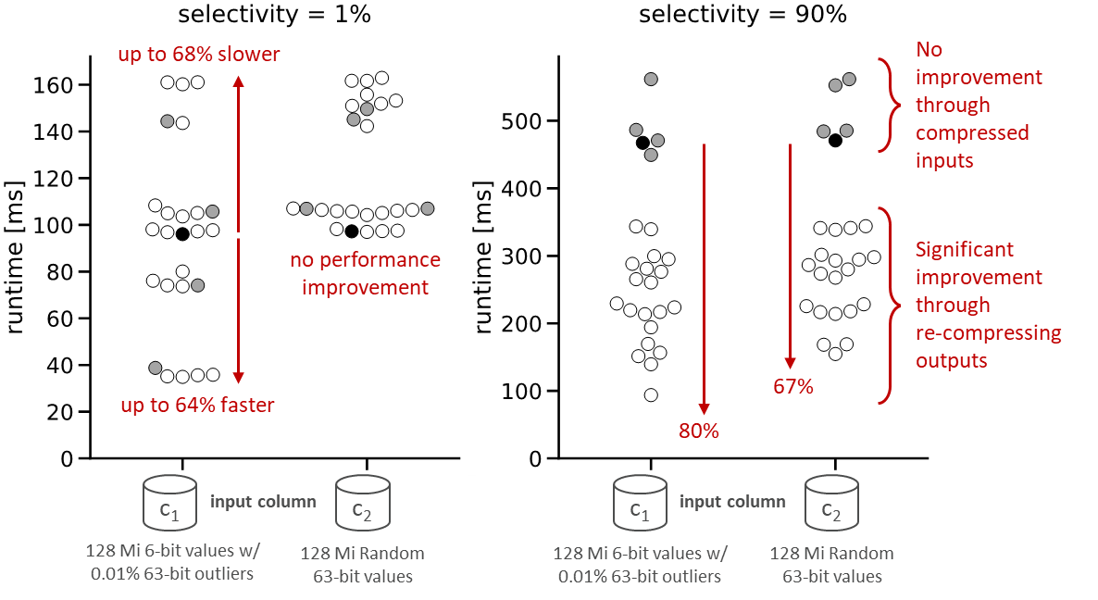
Slide Design
Avoid Slides Full of Text
Avoid Complex Formulas and Source Code
Unless they really contribute to the understanding
Avoid too Small Font Size
Avoid too Many Effects
Use Varied Layouts
Not just lists of bullet points
Convey information in diagrams, figures, etc.
Use Simple Set of Colors
Use Conscious Line Breaks
Don’t Simply Reuse the Figures from Your Paper
paper
slides

Slide 31
Preparing a Presentation
#1 Planning
What are the key takeaways you want to convey?
Structure of the talk, running examples
#2 Slide Creation
Create initial slide deck (doesn’t need to be pixel perfect yet)
Should contain all planned content, consciously divided into slides
#3 Practice
Rehearse aloud, ideally with audience (ask for maximum criticism)
Does the timing fit? Is the talk comprehensible?
#4 Slide Finalization
Make the slides pixel-perfect
Iterate steps if necessary

Slide 32
Handling Questions
Basic Mindset
Always welcome questions as well as feedback/criticism
Take all questions constructively
You Don’t Need to Always Have an Answer
Answer as good as you can
Honestly admit if you don’t know the answer, e.g., if it needs further investigation
Take longer discussions offline
Don’t bore the rest of the audience with too specific discussions
Page Numbers on Slides
Help audience to refer to specific point in your presentation
Prepare Back-up Slides
Extra slides not shown in the main presentation
Can be useful when answering questions

Slide 33
Summary and Q&A
Experiments and Result Presentation
Reproducibility and RDM
Scientific Presentations
Remaining Questions?
Summary Paper Submission: Deadline: Jun 19, 2023, 23:59 CEST
Optional Office Hours
Mondays 14:00 – 18:00 in TEL 811 (and zoom) → ask any seminar-related questions
Seminar Presentations
Starting June 26, 2023, in-person only (no zoom)

