Slide 1


Seminar Large-scale Data Engineering (LDE)
02 Scientific Reading and Writing
Dr.-Ing. Patrick Damme
Technische Universität Berlin
Berlin Institute for the Foundations of Learning and Data
Big Data Engineering (DAMS Lab)
[Credit: Based on “Introduction to Scientific Writing”/ ”02 Scientific Reading and Writing” by Matthias Boehm (TU Graz, winter 2021/22)]
Last update: Oct 19, 2025

Slide 2

Announcements/Org
Hybrid Setting with Optional Attendance
In-person in MAR 0.015
Virtual via zoom https://tu-berlin.zoom-x.de/j/67376691490?pwd=NmlvWTM5VUVWRjU0UGI2bXhBVkxzQT09
Reminder: Selection of Seminar and Project Topics Due Oct 31, 23:59
Polls in the ISIS course: seminar (already open) & project (opens by Oct 23)
Seminar: 5 preferred topics/papers
Project: 5 preferred topics + preference on team/individual work + optionally team members

Slide 3
Agenda
Scientific Reading
Scientific Writing
Scientific Writing skills can only be learned hands on, and incrementally improved with experience

Slide 4
Scientific Reading
In Computer Science (Data Management)

Slide 5
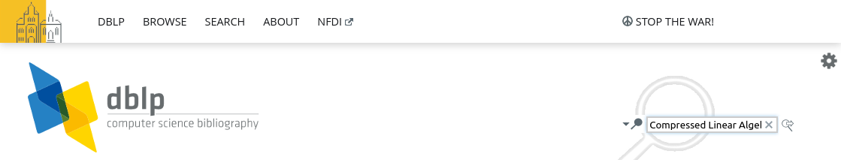
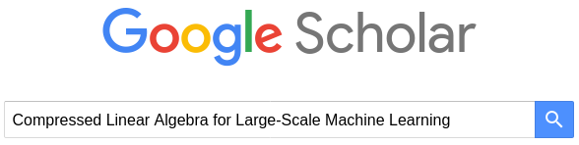
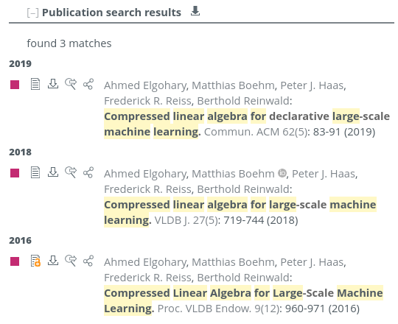
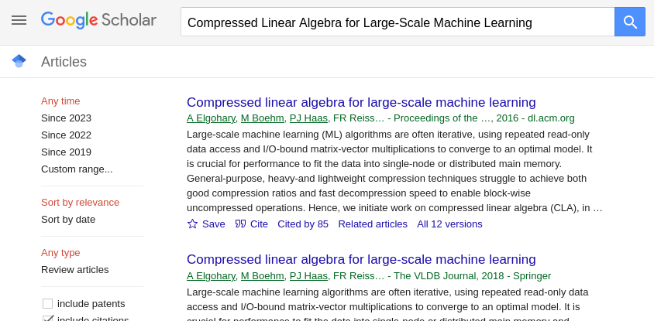


Obtaining the Full Text of a Paper
If you know the title[, author, venue, year] of a paper
Use search engines like DBLP (https://dblp.uni-trier.de/) or Google Scholar (https://scholar.google.com/)
Make sure to select the right version of the paper
If the paper is not open-access, you typically can access the PDF when you
are in the university VPN (e.g., ACM Digital Library), or
log in with your university account (redirect to TUB login page) (e.g., IEEE Xplore)
paper
BibTeX entry

Slide 6
Finding Related Work
Motivation
Some research areas might be very large (e.g., index structures, compression)
How do you find relevant scientific papers/theses via multiple channels
Prefer Trustworthy Sources
Archival publications, awareness of peer-review
From right communities (e.g., ML systems vs ML algorithms)
Reputation of website, authors, etc.
Recap: Give Credit
Cite broadly, give credit to inspiring ideas, create connections
Honestly acknowledge limitations of your approach

Slide 7
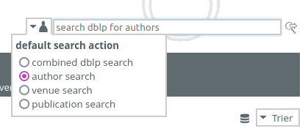

Finding Related Work, cont.
By Venue/Year
Start off top-tier conferences/journals and find latest work
E.g., SIGMOD, PVLDB, CIDR, ICDE, EDBT, CIKM, …
These papers’ related work should provide a good categorization and discussion of related work → recursive lookup
By Author
Sometimes there are well-known experts in a certain sub-area
Find author publications via DBLP and other libraries

Slide 8
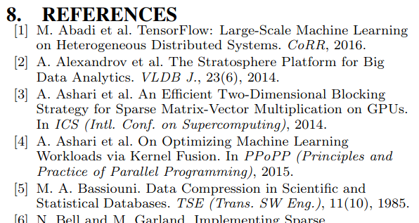
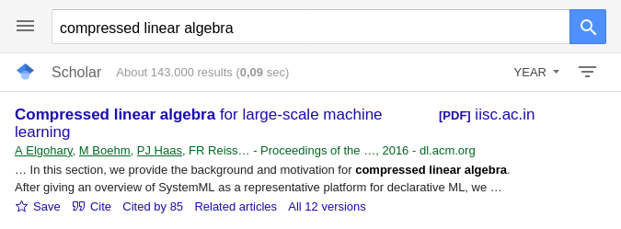

Finding Related Work, cont.
By References
Backwards (papers published before) & Forwards (papers published after the given paper)
By Keywords
Broad survey of other related work, to augment the bias of the year/venue/author approach
Think of synonyms (e.g., “adaptive”, “adaptable”, “dynamic”, “flexible” for this semester’s umbrella topic)

Slide 9
Types of Reading
Skimming
Goal: understand what the paper/thesis is about, judge relevance
Read abstract, and optionally introduction
Scan paper (sections/subsections, structure, figures)
Understanding
Goal: understand how the presented approach accomplishes the paper’s goals
#1 Skimming (see above)
#2 Read the whole paper sequentially, add notes/annotations
Reviewing
Goal: evaluate potential impact, and limitations
#1 Skimming (see above)
#2 Understanding (see above) + strengths and weaknesses
#3 Write summary, strong/weak points, detailed comments, constructive feedback, revision items, overall recommendation ([strong/weak] accept/reject)
What?
How?
Good enough?
How to improve?

Slide 10
Process of Reading – Skimming/Understanding
Abstract and Structure
#1 Partial Reading (mostly skimming)
Read into each paragraph until you get what it’s about
1st sentence/label: topic sentence
#2 Fast Reading
Normal reading vs reading w/o vocalization
Avoid need for rereading text
Back/forward references,
Misplacement after distractions
Rereading due to lack of understanding
➔ Read according to your goals of reading

Slide 11
Process of Reading – Understanding/Evaluation
Skepticism
Critical reading is important for understanding and evaluation
#1 Start open-minded, listen to arguments and trust provided evidence
#2 Don’t accept superficial, contradictory, or unproven claims
#3 If there are problems, which constructive feedback could you give or how could the problems be addressed?
Questions to Ask Yourself
What is the problem? Is it a real or artificial problem?
How would you solve the problem yourself?
How does the paper solve the problem?
Is this the simplest approach that yields these results (justified complexity)
Are there limitations that are not covered by the paper?
Is there existing work that already addresses the same problem?

Slide 12
Proofreading Your Own Paper
#1 Read Slowly & Carefully
Problem: Brain interpolates between words
Awareness of common syntactic issues (“the the”, missing/wrong articles, adapt/adopt)
Awareness of common semantic issues (missing reference, inconsistent / no logical consequence)
#2 Read Fully
Read and annotate issue, don’t fix immediately (destroys the flow)
Take annotated document and fix issues
#3 Ask Big Questions
Pitfall: Being overly focused on syntactic/local issues
Is the overall idea clearly communicated and does it make sense?
Are there missing pieces, missing experiments, missing related work?
→ Read out loud
→ Use PDF-to-Speech

Slide 13

Scientific Writing
In Computer Science (Data Management)
[Justin Zobel: Writing for Computer Science, 2nd ed. Springer 2004, ISBN 978-1-85233-802-2]

Slide 14
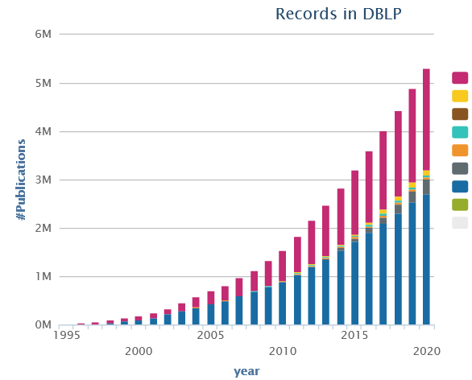
Recap: Writing the Paper
Know Your Audience
Get Your Workflow in Order / Incremental Paper Drafts
Mindset: Quality over Quantity
Aim for top-tier conferences/journals (act as filter)
Make the paper useful for others (ideas, evidence, code)
Make the Paper Easy to Read
Present Your Work with Appropriate Structure, Writing Style, and Formatting

Slide 15
Recap: Prototypical Structure of a Scientific Paper
Sections and Subsections
Abstract → short overview of problem and solution (part of meta data)
Introduction → context, problem, contributions
Background / Preliminaries → necessary background for understanding
Main Part → your technical core contributions
Main Part 2
Experiments → setting, micro benchmarks, end-to-end benchmarks
Related Work → areas of related work, differences to your own work
Conclusions → summary, conclusions, and future work
Acknowledgments → funding agencies, helpful people beyond co-authors
References → list of other works referenced throughout the paper
(Appendix) → any additional contents (e.g., proves of theorems, more results)
Recommendations
Avoid sections with only one subsection (e.g., 2 and 2.1)
Avoid more than two or at most three nesting levels
Clearly separate motivation/background from your own work
→ 01 Structure of Scientific Papers

Slide 16
Facilitating Structure through Formatting Elements
Goal: Easy Skimming
Guide the readers’ attention
Paragraph Labels
\paragraph{…} …
Bullet Lists
begin{itemize} … \item … \end{itemize}
begin{enumerate} … \item … \end{enumerate}
Figures and Tables
Should be self-explanatory
Captions above/below
Theorem/Definition/Example
Refine theorem environment as needed
Algorithms/Pseudo-Code
Can be clearer than text, but not always
Carefully select the right level of abstraction
Refer to All Figures, Tables, Algorithms in the Text & Place Them Close to the Text

Slide 17


Writing Style
Goal: Clear, Easy-to-Read Writing
Avoid unnecessary formalism → as simple as possible
Formal Language
Avoid contractions (“can’t”, “aren’t”, …)
No colloquial or slang language (“the whole thing works as follows”, “their approach is pretty interesting”, …)
Prefer Active Voice
Easier to understand, shorter, more interesting
Use “we” over “I”
Don’t directly address the reader (no “you”)
Prefer Present Tense
Most content of a research paper can be described in present
Exceptions: user studies, (specific experimental setup), related work
In this section, the background and motivation for compressed linear algebra is introduced.
In this section, we provide the background and motivation for compressed linear algebra.

Slide 18
Writing Style, cont.
Variation
Diversity (structure, length of sentences/paragraphs, choice of words, sentence beginning) helps keeping the reader’s attention
Use of References
Don’t use references as nouns
Use “et al.” for three or more authors
Use \cite{key1,key2} for multiple sources
Prefer primary sources
Avoid references in the abstract
The system of rational numbers is incomplete. This was discovered 2000 years ago by the Greeks. The problem arises in squares with sides of unit length. The length of the diagonals of these squares is irrational. This discovery was a serious blow to the Greek mathematicians.
The Greeks discovered 2000 years ago that the system of rational numbers is incomplete. The problem is that some quantities, such as the length of the diagonal of a square with unit sides, are irrational. This discovery was a serious blow to the Greek mathematicians.
Later, [40] investigated query processing on heavyweight Huffman coding schemes,
Later, Raman and Swart investigated query processing on heavyweight Huffman coding schemes [40],

Slide 19
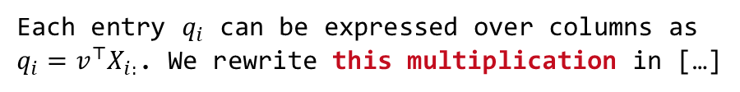
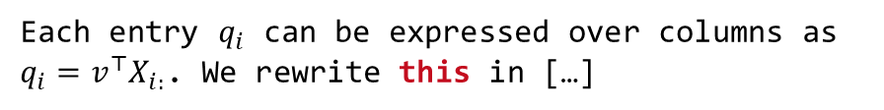
Writing Style, cont.
Singular/Plural and Articles
Plural allows to drop articles
Guarded Spaces
Use guarded spaces for references that should not appear on a new line
Clear References
Make sure there are no unclear “it” or “this” references
Add descriptive nouns
Capitalize Titles and Names
Titles: capitalize meaning-carrying words
Names: capitalize, e.g., Bayesian, Euclidean
References like Figure 1, Table 2, Section 3, Chapter 4, Equation 5 are names as well
employ general-purpose compression techniques
employ a general-purpose compression technique
Figure~\ref{fig:exp1}
Each entry $q_{i}$ can be expressed over columns as $q_{i}=v^{⊤}X_{i:}$. We rewrite this in […]
Each entry $q_{i}$ can be expressed over columns as $q_{i}=v^{⊤}X_{i:}$. We rewrite this multiplication in […]
Figure~\ref{fig:exp1}
Equation~\eqref{eq:e1}

Slide 20
Punctuation
Commas
Whenever a pause is appropriate, or required to avoid ambiguity
Lists: red, blue, black, and white (Oxford/serial comma)
Special sentence start: However, Hence, Therefore, In this paper,
Semicolons
Divide a long sentence into sub-sentences, or separation for emphasis
Lists with sublists
Exclamations
Avoid exclamation marks! Never use more than one!!
When using disk[,] tree algorithms were found to be particularly poor.
A woman without her man is nothing.
A woman: without her, man is nothing.
We use index structures like b-trees, tries, and hash tables; as well as compression techniques like run-length encoding, dictionary encoding, and null suppression.

Slide 21
Diversity and Inclusion
[Credit: https://dbdni.github.io/]
Diversity, “the who”
Individuals from a wide variety of backgrounds and experience, different viewpoints/reasoning/approaches
Different cultures: e.g., use names from variety of languages, cultures, nationalities (not just Alice and Bob)
Differences in figures: e.g., people-like icons: use variety of gender, skin color, ability status, …
Gender diversity in pronouns: use variety of he/she/they, use gender-neutral nouns: “chairman” → “chairperson”
Increasing Awareness for D&I
Meanwhile part of the policies of all/most major publication venues (SIGMOD, VLDB, ICDE, EDBT, ADBIS, …)
D&I issues may be included in the review form
Inclusion, “the how”
Environment welcoming and embracing diversity; avoid language that furthers the marginalization, stereotyping, erasure of any group of people
Implicit assumptions: "Everyone has a mother and a father."
Oppressive terminology: e.g., “master-slave“ → “coordinator-worker” “orphaned object” → “unreferenced object” “blacklist/whitelist” → “blocklist/allowlist”
Marginalization of under-represented groups: e.g., “The Gender attribute is either Male or Female."
Lack of accessibility: e.g., color alone to convey info in a plot → use patterns, symbols, textures, etc.
Stereotyping: e.g., feminine names or presentations for personal secretary role

Slide 22
Formatting
Goal: Emphasize Quality of Contents with Quality of Visual Presentation
A carelessly formatted paper (layout, figures, fonts, underlining) creates a bad first impression
Recap: skimming and anchoring
Figures
Use same font and font size as the main text / code in main paper
Avoid text overlap, too aggressive colors
So-called Orphans and Widows
Imprecise definition
Avoid few words per line, single line at next page
Text Running over Column Margin (rephrase until it fits)
Highlighting
\emph{…} (emphasize) over underlining or bold
\texttt{…} or \verb+…+ for inline code
“The paper’s approach is probably equally sloppy”
Looks ugly and wastes lots of space

Slide 23
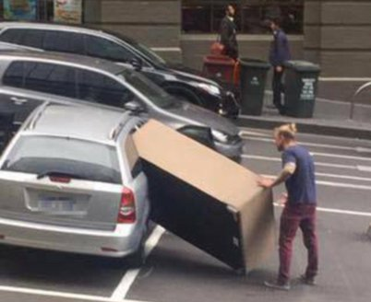
Page Limits
Most Conferences/Journals
Given predefined template, changes not permitted
SIGMOD/PVDLB: 12 pages + unlimited references
ICDE: 12 pages incl. references
Avoid Cheating
Don’t change the template, fonts, or margins
Condensing more text into the paper will make it harder to read
Carefully Trim Down Draft
Write unlimited paper, then select, and revise
Write and revise section by section as you write
Never Excuse Missing Content by “lack of space”
[Credit: https://twitter.com/ fadeladib/status/1322646406088347649]
[Eamonn Keogh: How to do good research, get it published in SIGKDD and get it cited!, KDD 2009]
“Due to the lack of space, we omit [essential details] / [essential experiments]”

Slide 24

Plagiarism
Self-Plagiarism (Bad Idea)
Avoid reusing motivation, introduction, figures, and examples
Start writing every thesis / paper from scratch (unless thesis summaries/extends previous papers)
Figure Plagiarism (Bad Idea)
Never copy figures from other papers, web, etc
Create all figures yourself, even for surveys (can be based on ideas of existing papers)
Exceptions do exist w/ explicit references
Plagiarisms (Really Bad Idea)
Never copy figures or text from other people’s work and claim its yours (slight rewording does not change that)
For archival scientific publications, there is a high chance it will be detected

Slide 25

Plagiarism: Duplicate Submission
[Credit: https://2025.sigmod.org/calls_papers_sigmod_research.shtml]
Example SIGMOD 2025
Submitted papers cannot be under review for any other publishing forum (conferences, workshops, journals)
Authors must await the response (only re-submit elsewhere if the paper is rejected/withdrawn)
Every research paper must present substantial novel research not described in any prior publication
A paper of 5+ pages presented/accepted at a refereed conference/workshop
An article published/accepted in a refereed journal
Requirement to cite prior publications in case of overlap
Violation of this policy
Immediate rejection of the submission
Notification of the chairs/committees of SIGMOD and the other involved forums

Slide 26
Plagiarism: Automatic CS Paper Generation
SCIgen
Generates random CS research papers, including graphs and figures
Uses hand-written context-free grammar
Test for low-submission standards of conferences
Meaningless mix of sentences and technical terms
Generative AI (such as ChatGPT)
ACM Policy on Authorship (applies to, e.g., SIGMOD)
Generative AI tools may not be authors of publications
Using generative AI to create content is permitted
But: must be fully disclosed in the work
Basic word processing systems (e.g., spelling/grammar corrections) generally allowed, no requirement for disclosure
Policy updates expected due to blurring boundaries between generative AI and basic word processing systems
[Credit: https://pdos.csail.mit.edu/archive/scigen]
[Credit: https://www.acm.org/publications/ policies/new-acm-policy-on-authorship]
LDE seminar and project:
Use of generative AI not allowed

Slide 27
Summary and Q&A
Scientific Reading
Scientific Writing
Remaining Questions?
Seminar/Project Topic Selection by Oct 31, 23:59
Final Introductory Lecture
03 Experiments, Reproducibility, and Giving Presentations [Oct 27] Also recommended for participants taking only the project

