Slide 1


Seminar Large-scale Data Engineering (LDE)
02 Scientific Reading and Writing
Dr.-Ing. Patrick Damme
Technische Universität Berlin
Berlin Institute for the Foundations of Learning and Data
Big Data Engineering (DAMS Lab)
[Credit: Based on “Introduction to Scientific Writing”/
”02 Scientific Reading and Writing” by Matthias Boehm
(TU Graz, winter 2021/22)]
Last update: Oct 19, 2026

Slide 2

Announcements/Org
Hybrid Purely Virtual Setting with Optional Attendance
  In-person in MAR 0.015
  Virtual via zoom
  https://tu-berlin.zoom-x.de/j/67376691490?pwd=NmlvWTM5VUVWRjU0UGI2bXhBVkxzQT09
Reminder: Selection of Seminar and Project Topics Due Oct 23, 23:59 (This Friday)
  Polls in the ISIS course
  Seminar: 5 preferred topics/papers
  Project: 5 preferred topics + preference on team/individual work + optionally team members

Slide 3
Agenda
Scientific Reading
Scientific Writing
Scientific Writing skills can only be
learned hands on, and incrementally
improved with experience

Slide 4
Scientific Reading
In Computer Science (Data Management)

Slide 5
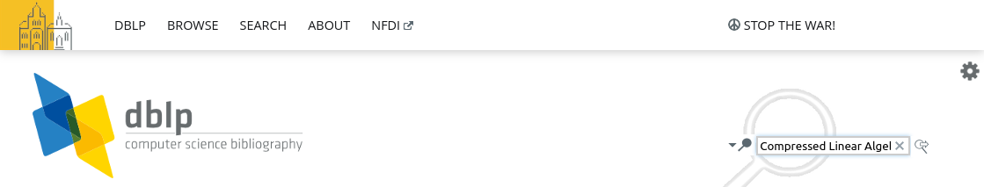
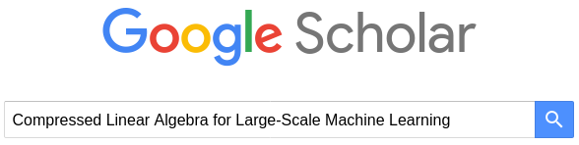
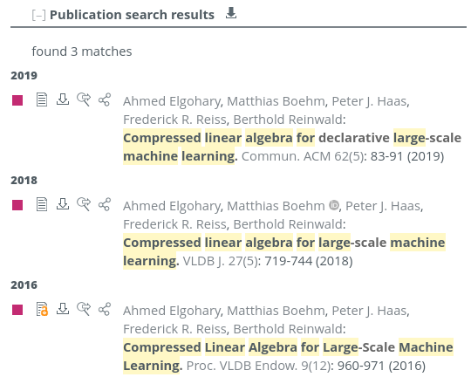
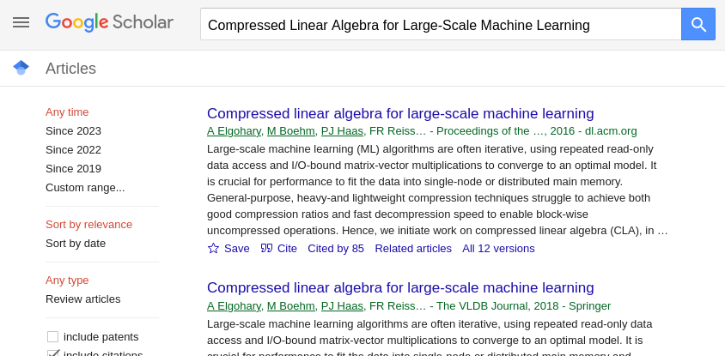

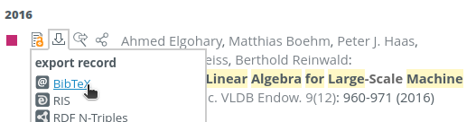
Obtaining the Full Text of a Paper
If you know the title[, author, venue, year] of a paper
  Use search engines like DBLP (https://dblp.uni-trier.de/) or Google Scholar (https://scholar.google.com/)
  Make sure to select the right version of the paper
  If the paper is not open-access, you typically can access the PDF when you
    are in the university VPN (e.g., ACM Digital Library*), or
    log in with your university account (redirect to TUB login page) (e.g., IEEE Xplore)
paper
BibTeX entry
* “January 2026, all ACM publications and related artifacts
in the ACM Digital Library will be made open access.”
[https://dl.acm.org/openaccess]

Slide 6
Finding Related Work
Motivation
  Some research areas might be very large (e.g., index structures, compression)
  How do you find relevant scientific papers/theses via multiple channels
Prefer Trustworthy Sources
  Archival publications, awareness of peer-review
  From right communities (e.g., ML systems vs ML algorithms)
  Reputation of website, authors, etc.
Recap: Give Credit
  Cite broadly, give credit to inspiring ideas, create connections
  Honestly acknowledge limitations of your approach

Slide 7

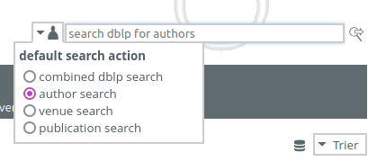

Finding Related Work, cont.
Example: SIGMOD 2025
[https://2025.sigmod.org/]
By Venue/Year
  Start off top-tier conferences/journals and find latest work
  E.g., SIGMOD, PVLDB, CIDR, ICDE, EDBT, CIKM, …
  These papers’ related work should provide a good categorization
  and discussion of related work → recursive lookup
By Author
  Sometimes there are well-known experts in a certain sub-area
  Find author publications via DBLP and other libraries
program (papers by topic sessions)
https://2025.sigmod.org/program_full_detail.shtml
accepted papers
https://2025.sigmod.org/sigmod_papers.shtml

Slide 8
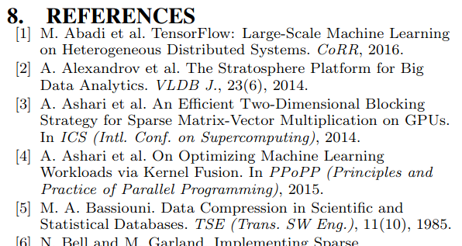
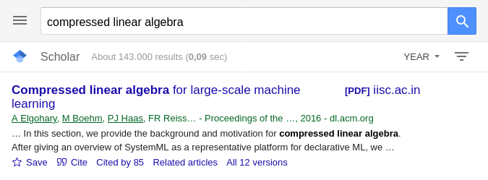

Finding Related Work, cont.
By References
  Backward (papers published before) & Forward (papers published after the given paper)
By Keywords
  Broad survey of other related work, to augment the bias of the year/venue/author approach
  Think of synonyms (e.g., “adaptive”, “adaptable”, “dynamic”, “flexible” for this semester’s umbrella topic)
By Reading Many Papers…
  …and finding related work in unexpected places (side contributions, references)

Slide 9
Types of Reading
Skimming
  Goal: understand what the paper/thesis is about, judge relevance
  Read abstract, and optionally introduction
  Scan paper (sections/subsections, structure, figures)
Understanding
  Goal: understand how the presented approach accomplishes the paper’s goals
  #1 Skimming (see above)
  #2 Read the whole paper sequentially, add notes/annotations
Reviewing
  Goal: evaluate potential impact, and limitations
  #1 Skimming (see above)
  #2 Understanding (see above) + strengths and weaknesses
  #3 Write summary, strong/weak points, detailed comments, constructive feedback,
  revision items, overall recommendation ([strong/weak] accept/reject)
What?
How?
Good enough?
How to improve?

Slide 10
Process of Reading – Skimming/Understanding
Abstract and Structure
#1 Partial Reading (mostly skimming)
  Read into each paragraph until you get what it’s about
  1st sentence/label: topic sentence
#2 Fast Reading
  Normal reading vs reading w/o vocalization
  Avoid need for rereading text
    Back/forward references,
    Misplacement after distractions
    Rereading due to lack of understanding
➔ Read according to your goals of reading

Slide 11
Process of Reading – Understanding/Evaluation
Skepticism
  Critical reading is important for understanding and evaluation
  #1 Start open-minded, listen to arguments and trust provided evidence
  #2 Don’t accept superficial, contradictory, or unproven claims
  #3 If there are problems, which constructive feedback could you give or how could the problems be addressed?
Questions to Ask Yourself
  What is the problem? Is it a real or artificial problem?
  How would you solve the problem yourself?
  How does the paper solve the problem?
  Is this the simplest approach that yields these results (justified complexity)
  Are there limitations that are not covered by the paper?
  Is there existing work that already addresses the same problem?

Slide 12
Proofreading Your Own Paper
#1 Read Slowly & Carefully
  Problem: Brain interpolates between words
  Awareness of common syntactic issues (“the the”, missing/wrong articles, adapt/adopt)
  Awareness of common semantic issues (missing reference, inconsistent / no logical consequence)
#2 Read Fully
  Read and annotate issue, don’t fix immediately (destroys the flow)
  Take annotated document and fix issues
#3 Ask Big Questions
  Pitfall: Being overly focused on syntactic/local issues
  Is the overall idea clearly communicated and does it make sense?
  Are there missing pieces, missing experiments, missing related work?
→ Read out loud
→ Use PDF-to-Speech

Slide 13
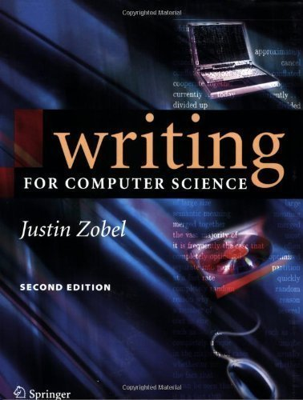
Scientific Writing
In Computer Science (Data Management)
[Justin Zobel: Writing for Computer Science,
2nd ed. Springer 2004, ISBN 978-1-85233-802-2]

Slide 14
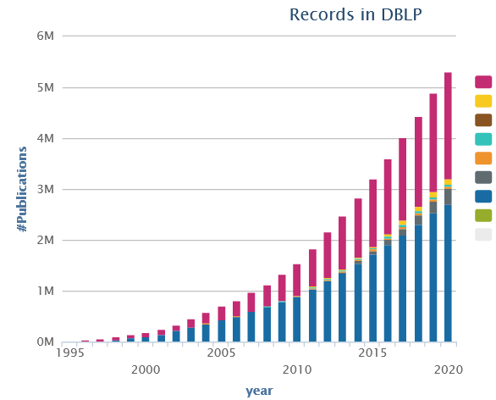
Preparation
Know Your Audience
Get your Workflow in Order
  Writing: LaTeX (e.g., Overleaf, TeXnicCenter), versioning (e.g., git), templates
  Plotting: R (e.g., plot, ggplot), Python (e.g., matplotlib, seaborn), Gnuplot, LaTeX (e.g., pgfplots)
  Figures: e.g., MS Visio/MS Powerpoint, Inkscape → pdf, eps, svg (vector graphics)
Mindset: Quality over Quantity
  Aim for top-tier conferences/journals (act as filter)
  Make the paper useful for others (ideas, evidence, code)
Make the Paper Easy to Read
Present Your Work with Appropriate Structure, Writing Style, and Formatting

Slide 15
Structure: Prototypical Structure of a Scientific Paper (Recap)
Sections and Subsections
  Abstract → short overview of problem and solution (part of meta data)
  Introduction → context, problem, contributions
  Background / Preliminaries → necessary background for understanding
  Main Part → technical core contributions
  Main Part 2
  Experiments → setting, micro benchmarks, end-to-end benchmarks
  Related Work → areas of related work, differences to your own work
  Conclusions → summary, conclusions, and future work
  Acknowledgments → funding agencies, helpful people beyond co-authors
  References → list of other works referenced throughout the paper
  (Appendix) → any additional contents (e.g., proves of theorems, more results)
Recommendations
  Avoid sections with only one subsection (e.g., 2 and 2.1)
  Avoid more than two or at most three nesting levels
  Clearly separate motivation/background from your own work
→ 01 Structure of
Scientific Papers

Slide 16
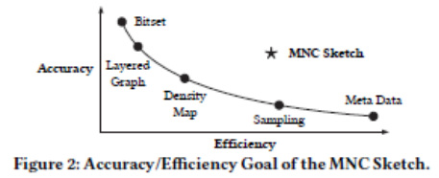
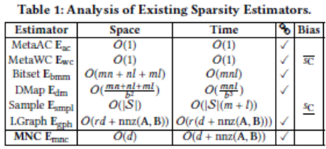
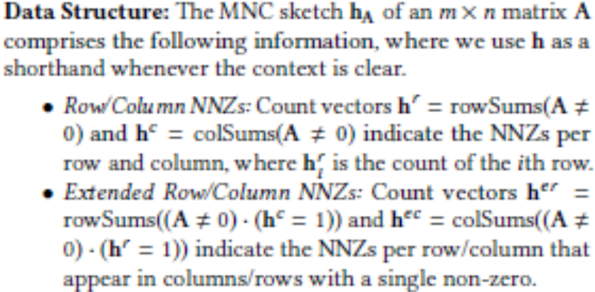
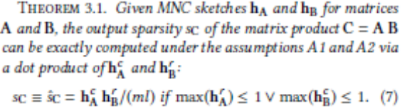
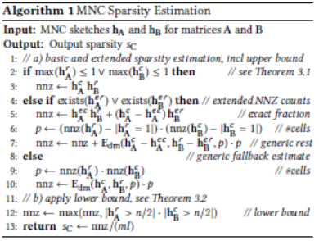
Structure: Facilitating Structure Through Formatting Elements
Goal: Easy Skimming
  Guide the readers’ attention
Paragraph Labels
  \paragraph{…} …
Bullet Lists
  begin{itemize} … \item … \end{itemize}
  begin{enumerate} … \item … \end{enumerate}
Figures and Tables
  Should be self-explanatory
  Captions above/below
Theorem/Definition/Example
  Refine theorem
  environment as needed
Algorithms/Pseudo-Code
  Can be clearer than text,
  but not always
  Carefully select the right
  level of abstraction
Refer to All Figures, Tables, Algorithms in the Text
& Place Them Close to the Text

Slide 17


Writing Style
Goal: Clear, Easy-to-Read Writing
  Avoid unnecessary formalism → as simple as possible
Formal Language
  Avoid contractions (“can’t”, “aren’t”, …)
  No colloquial or slang language (“the whole thing works as follows”, “their approach is pretty interesting”, …)
Prefer Active Voice
  Easier to understand, shorter, more interesting
  Use “we” over “I”
  Don’t directly address the reader (no “you”)
Prefer Present Tense
  Most content of a research paper can be described in present
  Exceptions: user studies, (specific experimental setup), related work
In this section, the background and motivation for compressed linear algebra is introduced.
In this section, we provide the background and motivation for compressed linear algebra.

Slide 18
Writing Style, cont.
Variation
  Diversity (structure, length of sentences/paragraphs, choice of words, sentence beginning)
  helps keeping the reader’s attention
Use of References
  Don’t use references as nouns
  Use “et al.” for three or more authors
  Use \cite{key1,key2} for multiple sources
  Prefer primary sources
  Avoid references in the abstract
The system of rational numbers is incomplete. This was discovered 2000 years ago by the Greeks. The problem arises in squares with sides of unit length. The length of the diagonals of these squares is irrational. This discovery was a serious blow to the Greek mathematicians.
The Greeks discovered 2000 years ago that the system of rational numbers is incomplete. The problem is that some quantities, such as the length of the diagonal of a square with unit sides, are irrational. This discovery was a serious blow to the Greek mathematicians.
Later, [40] investigated query processing on heavyweight Huffman coding schemes,
Later, Raman and Swart investigated query processing on heavyweight Huffman coding schemes [40],

Slide 19

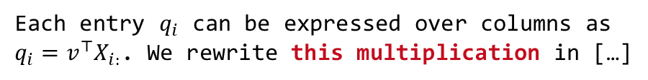
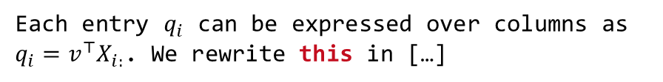
Writing Style, cont.
Singular/Plural and Articles
  Plural allows to drop articles
Guarded Spaces
  Use guarded spaces for references
  that should not appear on a new line
Clear References
  Make sure there are no unclear
  “it” or “this” references
  Add descriptive nouns
Capitalize Titles and Names
  Titles: capitalize meaning-carrying words
  Names: capitalize, e.g., Bayesian, Euclidean
  References like Figure 1, Table 2, Section 3,
  Chapter 4, Equation 5 are names as well
employ general-purpose compression techniques
employ a general-purpose compression technique
Figure~\ref{fig:exp1}
Each entry $q_{i}$ can be expressed over columns as $q_{i}=v^{⊤}X_{i:}$. We rewrite this in […]
Each entry $q_{i}$ can be expressed over columns as $q_{i}=v^{⊤}X_{i:}$. We rewrite this multiplication in […]
Figure~\ref{fig:exp1}
Equation~\eqref{eq:e1}

Slide 20
Writing Style: Punctuation
Commas
  Whenever a pause is appropriate, or required to avoid ambiguity
  Lists: red, blue, black, and white (Oxford/serial comma)
  Special sentence start: However, Hence, Therefore, In this paper,
Semicolons
  Divide a long sentence into sub-sentences,
  or separation for emphasis
  Lists with sublists
Exclamations
  Avoid exclamation marks! Never use more than one!!
When using disk[,] tree algorithms
were found to be particularly poor.
A woman without her man is nothing.
A woman: without her, man is nothing.
We use index structures like b-trees, tries, and hash tables; as well as compression techniques like run-length encoding, dictionary encoding, and null suppression.

Slide 21
Writing Style: Diversity and Inclusion
[Credit: https://dbdni.github.io/]
Diversity, “the who”
  Individuals from a wide variety of backgrounds and experience, different viewpoints/reasoning/approaches
  Different cultures: e.g., use names from variety of languages, cultures, nationalities (not just Alice and Bob)
  Differences in figures: e.g., people-like icons: use variety of gender, skin color, ability status, …
  Gender diversity in pronouns: use variety of he/she/they,
  use gender-neutral nouns: “chairman” → “chairperson”
Increasing Awareness for D&I
  Meanwhile part of the policies of all/most major publication venues (SIGMOD, VLDB, ICDE, EDBT, ADBIS, …)
  D&I issues may be included in the review form
Inclusion, “the how”
  Environment welcoming and embracing diversity; avoid language that furthers the marginalization, stereotyping, erasure of any group of people
  Implicit assumptions: "Everyone has a mother and a father."
  Oppressive terminology: e.g.,
  “master-slave“ → “coordinator-worker”
  “orphaned object” → “unreferenced object”
  “blacklist/whitelist” → “blocklist/allowlist”
  Marginalization of under-represented groups:
  e.g., “The Gender attribute is either Male or Female."
  Lack of accessibility: e.g., color alone to convey info in a plot
  → use patterns, symbols, textures, etc.
  Stereotyping: e.g., feminine names or presentations for personal secretary role

Slide 22
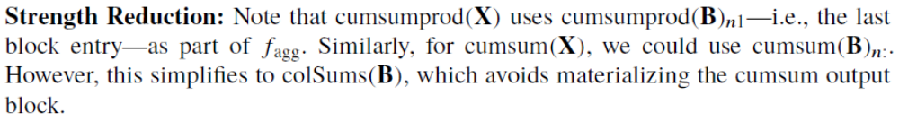
Formatting
Goal: Emphasize Quality of Contents with Quality of Visual Presentation
  A carelessly formatted paper (layout, figures, fonts, underlining) creates a bad first impression
  Recap: skimming and anchoring
Figures
  Use same font and font size as the main text / code in main paper
  Avoid text overlap, too aggressive colors
So-called Orphans and Widows
  Imprecise definition
  Avoid few words per line,
  single line at next page
Text Running over Column Margin (rephrase until it fits)
Highlighting
  \emph{…} (emphasize) over underlining or bold
  \texttt{…} or \verb+…+ for inline code
“The paper’s approach is probably equally sloppy”
Looks ugly and wastes
lots of space

Slide 23
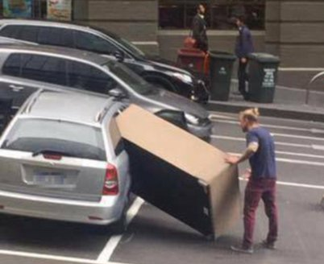

Formatting: Page Limits
Most Conferences/Journals
  Given predefined template, changes not permitted
  SIGMOD/PVDLB/EDBT/ICDE: 12 pages + unlimited references
Avoid Cheating
  Don’t change the template, fonts, or margins
  Condensing more text into the paper will make it harder to read
Carefully Trim Down Draft
  Write unlimited paper, then select, and revise
  Write and revise section by section as you write
Never Excuse Missing Content by “lack of space”
[Credit: https://twitter.com/
fadeladib/status/1322646406088347649]
[Eamonn Keogh: How to do good research, get it published in SIGKDD and get it cited!, KDD 2009]
“Due to the lack of space, we omit
[essential details] / [essential experiments]”

Slide 24
Dealing with Feedback/Criticism
Different Kinds of Feedback
  Casual discussion of early ideas
  Comments on paper drafts
  Reviewer comments (good and bad)
Paper Rebuttal and/or Revision
  Rebuttal: seriously consider all feedback (in doubt agree), and
  answer with facts / ideas how to address the comments
  Revision (conditional accept): address all revision requests
Always welcome feedback/criticism
Address all feedback w/ sincere effort

Slide 25


Plagiarism
Self-Plagiarism (Bad Idea)
  Avoid reusing motivation, introduction, figures, and examples
  Start writing every thesis / paper from scratch (unless thesis summaries/extends previous papers)
Figure Plagiarism (Bad Idea)
  Never copy figures from other papers, web, etc
  Create all figures yourself, even for surveys
  (can be based on ideas of existing papers)
  Exceptions do exist w/ explicit references
Plagiarisms (Really Bad Idea)
  Never copy figures or text from other people’s work and claim its yours (slight rewording does not change that)
  For archival scientific publications, there is a high chance it will be detected

Slide 26

Plagiarism: Duplicate Submission
[Credit: https://2025.sigmod.org/calls_papers_sigmod_research.shtml]
Example SIGMOD 2025
  Submitted papers cannot be under review for any other publishing forum
  (conferences, workshops, journals)
  Authors must await the response
  (only re-submit elsewhere if the paper is rejected/withdrawn)
  Every research paper must present substantial novel research
  not described in any prior publication
    A paper of 5+ pages presented/accepted at a refereed conference/workshop
    An article published/accepted in a refereed journal
  Requirement to cite prior publications in case of overlap
  Violation of this policy
    Immediate rejection of the submission
    Notification of the chairs/committees of SIGMOD and the other involved forums

Slide 27
Plagiarism: Automatic CS Paper Generation
SCIgen
  Generates random CS research papers, including graphs and figures
  Uses hand-written context-free grammar
  Test for low-submission standards of conferences
  Meaningless mix of sentences and technical terms
Generative AI (such as ChatGPT): ACM Policy on Authorship
  All authors must be identifiable human beings taking full responsibility for all content in the work (AI cannot be an author)
  Embrace new technologies to improve efficiency/productivity of research and writing
  But: Significant risks (e.g., plagiarism, inaccuracies, fabricated artifacts/citations, bias)
  → Questions about trust in scientific results
  Authors are in charge of responsible use and accountable for misuse of AI
  Disclosing all use of AI: Required for research, not required for writing
  Violation: Rejection of submission or retraction of publication (+additional penalties)
[Credit: https://pdos.csail.mit.edu/archive/scigen]
[Credit: https://www.acm.org/
publications/policies/new-
acm-policy-on-authorship]
LDE seminar and project:
Use of generative AI
not allowed

Slide 28
Summary and Q&A
Scientific Reading
Scientific Writing
Remaining Questions?
Seminar/Project Topic Selection by Oct 23, 23:59 (This Friday)
Final Introductory Lecture
  Hopefully back to hybrid setup…
  03 Experiments, Reproducibility, and Giving Presentations [Oct 26]
  Also recommended for participants taking only the project

