Slide 1
HoneyMod
Apache honeypot module
Popescu Daniel
Indrumator: Conf. Dr. Sabin Corneliu Burage

Slide 2
Cuprins (pt dev nu prezentare)
Introducere web sec and honeypot
Structure of entire application (the 3 modules)
Apache advantages and honeypot apache module structure
Analizing an attack
Demo

Slide 3
Web application security
Branch of Information Security applied specifically to Internet and Web systems.
Most popular and attacked branch
Why attack – ubiquity, simple techniques, anonymity, custom code, money
Hacking web apps – tampering with HTTP in the 3 categorized ways
OWASP TOP 10

Slide 4
HoneyPOTs
What is a honeypot
The 2 main reasons for setting up a honeypot
Gain insight into attack methodologies
Gather forensic info in order to apprehend intruders
Honeypot communities
Existing honeypots

Slide 5
HoneyMOd
Is built on Apache, and can handle all phases of a request
Main focus is to detect and classify attacks
Creates “bubbles” in which attackers can do their hacking while protecting the original site
Offers more freedom in content generators by default
Analyzes the output in case of an attack and offers help in patching the security holes
Main application is installable as a simple Apache module

Slide 6
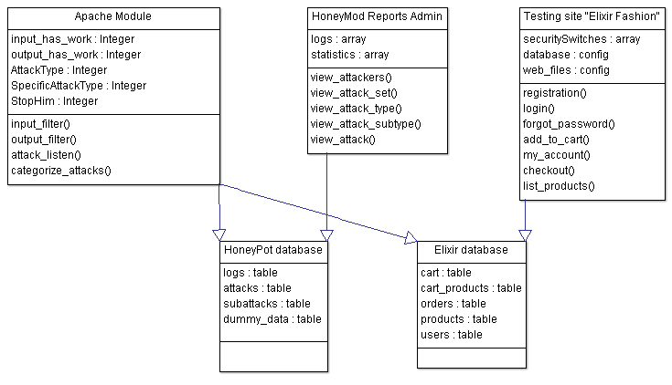
Application structure
Three main modules
The Apache Module
The Admin User Interface
The Dummy Test Site
Additional databases

Slide 7
Apache module advantages
Input and Output filters
Hooks available for any step of the request
Content generator language independency
C – faster then anything else
Broader zone of attacks

Slide 8
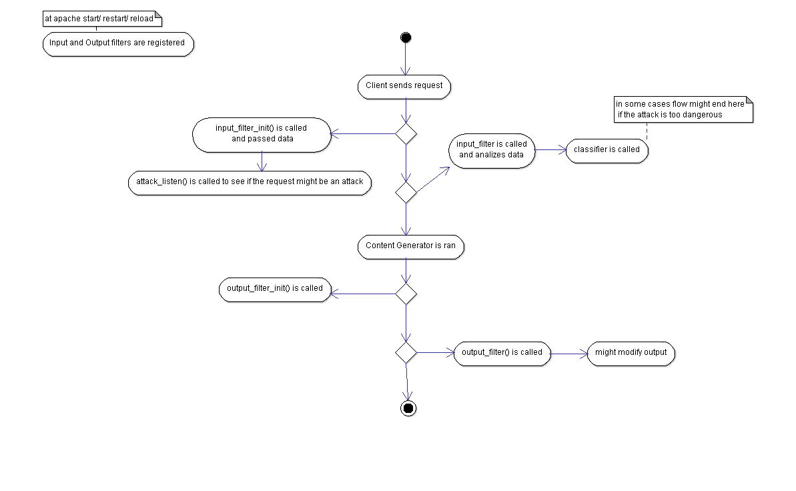
Apache module structure

Slide 9
Analyzing an Attack
Request parameters are analyzed
GET AND POST parameters are regex matched
Each parameter value is matched against regular expressions in attempts to classify the attack and sub-attack types
Lex&Yacc interpreters are applied to some attacks for better classification
Current attack is verified against past attacks
Output is checked to see if attack was successful

Slide 10
Demo Attack - SQL Injections
Tautology – “x' OR 1=1“
Logically incorrect query – ‘’
UNION – “x’ UNION SELECT * FROM users WHERE ‘x’=‘x”
Piggy-backed query – “x’; DELETE FROM users WHERE ‘x’=‘x”
Even more – “x’; SHUTDOWN;”

Slide 11

Demo Attack – SQl injection log

