Slide 1
Application Programming Interfaces
GEOLOCATION, GEO.JS & PRIVACY ISSUES
Margo Kabel • Libby Sanders • Andy Rosen • Karen Summerville
API BASICS, MASHABLES & ALTERNATIVES
Becca Rice • Esti Gerson • Scott Joyce
IDIA 619 – Spring 2011

Slide 2
GEOLOCATION
Application Programming Interfaces

Slide 3
Geolocation and HTML5
Geolocation is not part of HTML5 standards
Geolocation is being standardized by the Geolocation Working Group, which is separate from the HTML5 Working Group.
Geolocation support is being added to browsers now.

Slide 4
There are several ways to determine location:
Cell phone tower communication
Your IP Address
Wi-fi connection
Dedicated GPS that calculates latitude and longitude using satellites

Slide 5
IP Address Geolocation
Compatible with all browsers
No end user permission required
Accurate to the city/block level
TRADITIONAL USES:
Display native language and currency
Digital rights management
Reduce credit card fraud
Web log stats
Auto selection of country on forms

Slide 6
Geolocation API
GPS location provides latitude and longitude
End user must agree to share current location info with geo date provider (Google)
Because its very accurate!
TRADITIONAL USES:
Turn by turn navigation
Up-to-date local information
Location tagged status updates in social networking
Augmented reality (geotags)
Annotated content with location info (photos)

Slide 7
Geolocation Demo
HTML 5 geolocation is always opt-in to protect user privacy
“User Agents must not send location information to Web sites without the express permission of the user.”
http://html5demos.com/geo

Slide 8
Show me the code!
A SIMPLE GEOLOCATION API:
This code causes the info bar to appear that asks users permission to share location data
function get_location() {
If (Modernizr.geolocation) { //use modernizr to detect support for geolocation
navigator.geolocation.getCurrentPosition(show_map); //show_map is a call back function
else {
//no native support
}
}
This is a single function call which takes a callback function (show_map).
The call to getCurrentPosition() will return immediately, but that doesn’t mean that you have access to the user’s location.

Slide 9
The Infobar
INFOBAR FUNCTIONS:
Tells the end user which specific website wants to know their location
Provides them with a link to further understand the situation
Gives them the option to share or not
Allows them to tell the browser to remember their choice
The infobar is also
Non-modal which allows the user to switch to another browser or window
TAB SPECIFIC so it only exists on original tab
UNCONDITIONAL so it cannot be bypassed by the website
BLOCKING means location is not available while waiting for user response

Slide 10
Code continued
If the user gives permission, then run the call back function:
function show_map(position) { //show_map is the call back function
var latitude = position.coords.latitude;
var longitude = position.coords.longitude;
}
This is the first time you are guaranteed to have location information.
The callback function will be called with a single parameter, an object with two properties:
• coords- latitude and longitude, the users physical location in the world
• timestamp- the date and time when the location was calculated

Slide 11

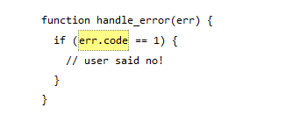
Error Handling
When users choose not to provide their location and deny permission, an error code of 1 is returned
Code properties may also be:
• POSITION_UNAVAILABLE (2)
• TIMEOUT (3)
• UNKNOWN_ERROR (0)

Slide 12
Mobile Devices give Two Methods for Geolocation
1. RELATIVE PROXIMITY TO CELLULAR TOWERS:
• Fast
• Does not require GPS hardware
• Dependent on the number of cellular towers in your area, only provides a rough idea of location
2. GPS HARDWARE
• Can be slower due to the fact that most mobile devices only activate this chip when its needed
• Pinpoints location within meters

Slide 13
PositionsOptions object an optional third argument for getCurrentPosition
PROPERTIES:
enableHighAccuracy- iPhones and Android phones have separate permissions for low and high accuracy positioning.
Timeout- the number of milliseconds your web application is willing to wait for a position. The timer starts once your user gives you permission, so you are timing the network, not the user.
maximumAge- allows the device to answer immediately with a cached position. This is used when you would be satisfied with knowing where the user was 75 seconds ago (75000 milliseconds) rather than where they are at that exact moment.

Slide 14
watchPosition()
If you need to find the users location continuously you must upgrade from getCurrentPosition() to watchPosition()
SIMILARITIES
It takes two callback functions, a required one for success and an optional one for error conditions
Takes an optional PositionOptions object that has all the same properties you just learned about
DIFFERENCES
Callback function will be called every time the user’s location changes
The device determines the appropriate interval and will call your callback function whenever it determines that the user has moved

Slide 15
IE
Like in many other circumstance, IE (below version 9) won't do what other browsers will. It has no API for geolocation.
And furthermore, many mobile browsers and phone interfaces have their own special ways of handling geolocation.
This makes it hard to write a program from scratch that everybody can use.
Give up, go home.
Unless...

Slide 16

Geo.js!
The good people at MIT have licenced an open-source library that we can use to smooth over the differences between the W3C geolocation API, the Gears API, and the APIs provided by mobile platforms.
http://code.google.com/p/geo-location-javascript/

Slide 17
How to run Geo.js
To pull up geo.js on a page, just insert this at the bottom of your page (not in the head, for speed). <!DOCTYPE html> <html> <head> <meta charset="utf-8"> <title>Dive Into HTML5</title> </head> <body> <script src="gears_init.js"></script> <!--start gears. This will allow geolocation on browsers w/o API--> <script src="geo.js"></script> <!--run geo.js. This smooths over the differences btw APIs.--> </body> </html>

Slide 18
How to use Geo.js
We have to call an init function to see if an API is available
if (geo_position_js.init())
Now we can try to get the location
geo_position_js.getCurrentPosition(geo_success, geo_error);
Can I use gears? Can I know where you are?
Let's find out.

Slide 19
Callback functions
WIN!
The success callback takes a single argument that contains the position information
function geo_success(p) {alert("Found you at latitude " + p.coords.latitude + ", longitude " + p.coords.longitude);
}
FAIL
no argument
function geo_error() {
alert("Could not find you!"); }

Slide 20

Geolocation and Privacy

Slide 21
Geolocation and Privacy
What is the hand-off between technological market and normal constraints?
Appropriateness: Is the application asking me for necessary/ appropriate information?
Minimization: Is this only asking me for what it really needs?
User Control: How much control do I have over location information?
Notice: Are there rules that I can add to the transmission of information?
Consent: Am I in control of disclosing location information?
Secondary Use: Is there use for my information for someone else? Oh boy!
Distribution: Is distribution limited to only that party I thought I was giving it to?
Retention: How long will this application actually keep my information?
Transparency and Feedback: Are rights information accessible and easy to understand?
Credit: Privacy Issues of the W3C Geolocation API Doty, Deirdre, Mulligan and Wilde of UC Berkeley

Slide 22
Geolocation and Privacy
Normative Requirements: specific steps of an algorithm for returning user location information. The user must express some type of permission to send info.
Users should be given “yes-or-no” control before info is obtained or revealed.
Notice of who is requesting the info: JavaScript may come from 3rd party. Most sites are requesting JavaScript coding from Google for common request like maps and weather.
“Prearranged trust relationship” with requester: VoIP telephones with E911 function transmit information without permission. It’s for your own good! So far no emergency location functions are set for common browsers like Firefox or Safari.
Browsers ask to keep information: no way for the browser to keep info if not asked to
Currently APIs to not support many “fuzzed” locations - possibly treds data minimization rules.
API must be used in JavaScript code or it breaks the “Privacy considerations for recipients of location information.” Most users are already (Apple. Google, Mozilla and Opera) already have to implement the API as part of their browsers.
Strict rules for including notices about “consent” and “usage.” Not included in the API, so websites are responsible for writing it into their HTML code.
Almost no sites prompt privacy policies before entry of information by user.
I Phone, permissions are automatically reset after 24 hrs.
Let’s check these two sites out: Our Airports BooRah

Slide 23
Geolocation and Privacy
Privacy also varies depending on devices used.
IP Address: if the IP address is known, a general geographical location can be identified.
Wi-Fi Networks: location from nearby network
Cell Tower: cell phone tower IDs and signal strength
GPS: receivers built in, producing accurate location info.
Thanks to W3C, policies are always in discussion!
W3C Device APIs and Policy Working Group (DAP) continues to work towards protecting us as well as developing convenient ways to share locations, calendars, photos, etc.

Slide 24
the BASICS of
Application Programming Interfaces

Slide 25
so what exactly is an API?
an interface between different software programs
that facilitates interaction
in the context of web development,
an API is typically
a defined set of Hypertext Transfer Protocol (HTTP) request messages
paired with a definition of the structure of response messages

Slide 26
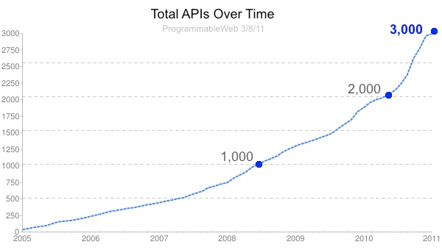

Slide 27
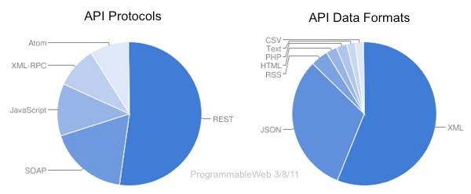

Slide 28
Simple Object Access Protocol (SOAP)
a protocol with official specifications by the W3C
method-driven approach
specification defines the messaging framework
a processing model which includes a sender and receiver
generally when using HTTP requests, these roles are fixed, meaning unidirectional information flow
a message structure

Slide 29
Representational State Transfer (REST)
an architecture without any official specifications
resource-driven approach
creating a model which includes
resources with unique identifiers
interacted with through HTTP requests

Slide 31












so what can we do with APIs?
the top five types of API in 2010 were…
Social Media
Internet Applications
Mapping
Search
Mobile

Slide 32
MASHING
Application Programming Interfaces

Slide 33
Mashables…What is it?
Wikipedia describes it as:
A service! A web page or an application that uses and combines data from 2 or more sources (internal or external).
To Create -- A New source of Data!

Slide 34

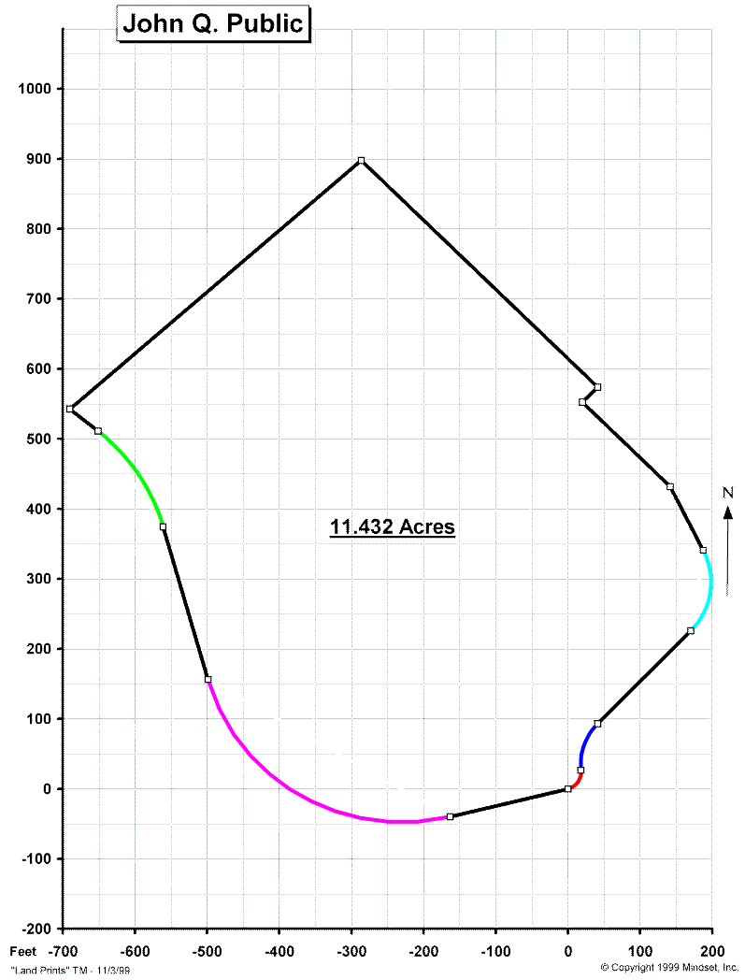
Example?
Notes:
Example: B&D wants to create a Mashup of real estate property land dimensions (public record) and match with B&D Mower database to see which mower is good for the size of your lawn

Slide 35
When we say Data Sources:
Data Sources could be:
From Internal or External Servers…
Databases
Spreadsheets
Websites
Feeds
and other APIs

Slide 36
Main Characteristics for Mashables
Visualization
Combination
Aggregation
Basically: Let’s make existing data better and more useful!
Efficiency is Key!
Notes:
The main characteristics to mashables can be described with 3 aspects:

Slide 37
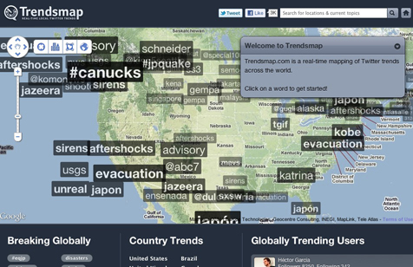
Visualization: The Presentation
The User Interface: what the end user sees.
Uses technologies such as Java, AJAX, XML, HTML and CSS to create.
Notes:
Trends map: twitter tags overlaid on a map to show what is trending where

Slide 38
Combination: Web Service Functionality
Combining the data
Functionality is accessed with APIs
Using technologies such as:
XML HTTP Requests
Json
Simple Object Access Protocol (SOAP) – a simple XML Based protocol created to communicate between applications over HTTP
Representational State Transfer (REST) - a web-specific network architecture, mainly using Web Services

Slide 39
Aggregation: Data Handling
Sending, Storing, and Receiving
Using Technologies such as:
XML
Json
KML
(Keyhole Markup Language - a file format used to specify a set of geographical features for display in Google Earth, Maps and Mobile, or any other 3D Earth browser. )

Slide 40
Make Your Own!
Use Some Tools:
Microsoft Popfly
As of 2009 defunct!
Google Mashups Editor:
As of 2009 defunct!
Word on the street was it was NOT user friendly…
Yahoo Pipes
“Composition tool to aggregate, manipulate and mashup content from around the web”
Use it to create custom feeds, widgets and badges, remix data sources, create custom search pages, etc…
Notes:
You have some choices here. A few years ago there were several browser applications available to mash your own APIs. As you can see here… there really is only one left!

Slide 41
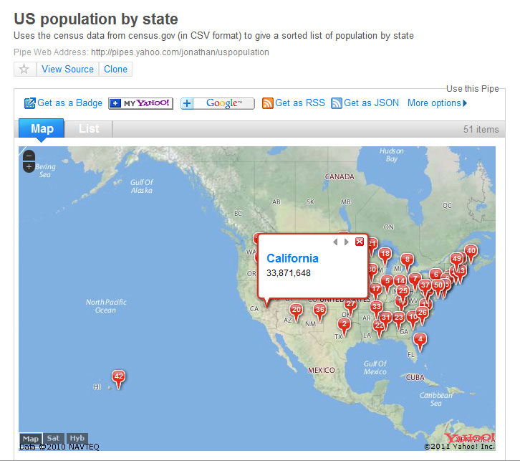
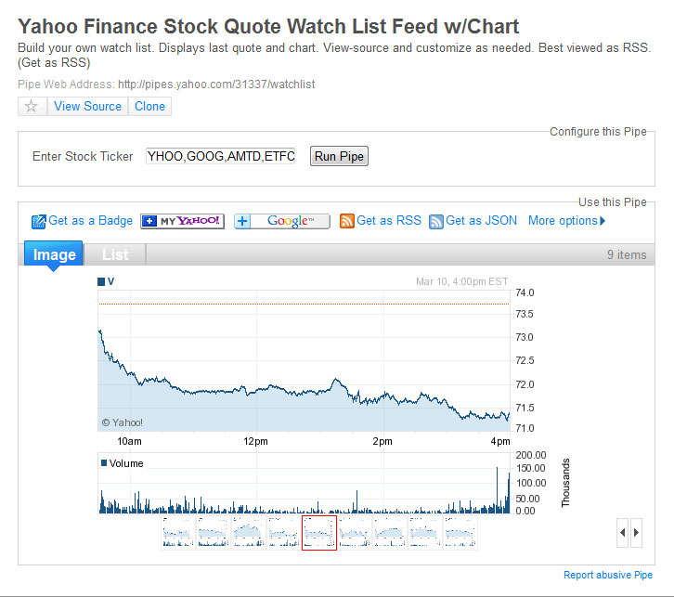
Mashups Created with Yahoo Pipes
Notes:
US population by state. Yahoo finance stock quote watch list feed and chart

Slide 42
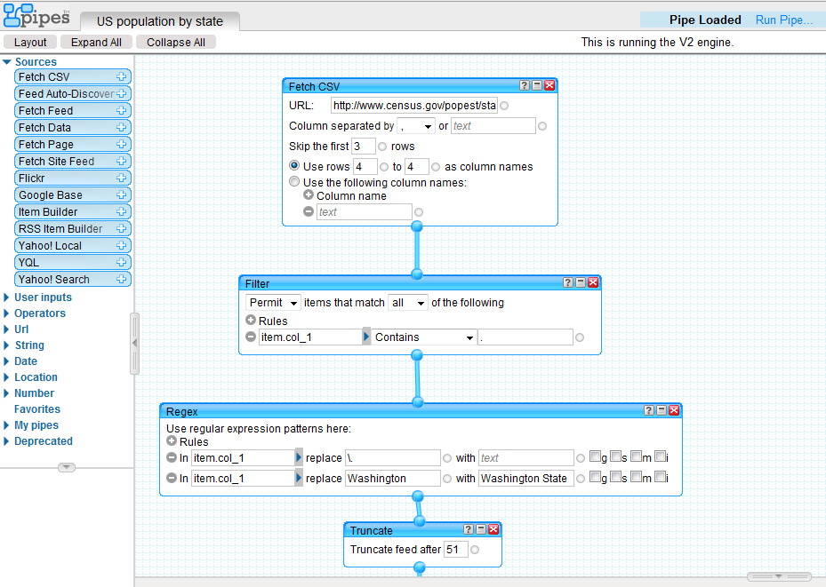
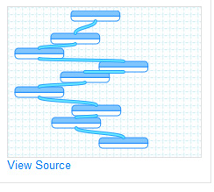
Yahoo Pipes Interface:
Notes:
Enter RSS feeds, Filters, Flickr, anything else you may want

Slide 43
Or Code Your Own
Decide where your data is coming from
Sign-up for any API services if required
Are you using Internal Spreadsheets or Databases?
Or using existing company external APIs like Flickr or eBay feeds?
For example:
Set up a mashable RSS Feed to use eBay APIs to filter a listing of cameras in your price range

Slide 44
Or Code Your Own
Are you running this on a Server?
Or dynamically with Javascript within the browser?
Or is it really advanced so you pull data from a web server you already have access to? (Like a company database, etc).

Slide 45
Or Code Your Own
Steal the Code from the ProgrammableWeb Mashups Directory! A very helpful site that steps you through the process of coding your own Mashup
Use Yahoo Pipes!

Slide 46
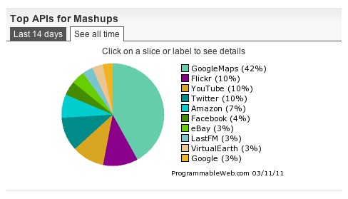
Trending
Notes:
According to Programmable Web: Top APIs for Mashups …. Google Maps 42%!

Slide 47
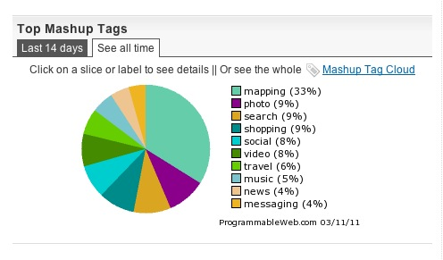
Trending
Notes:
According to Programmable Web: Top APIs for Mashups …..Mapping 33%!

Slide 48

The Open Mashup Alliance (OMA)
The Open Mashup Alliance (OMA)... an organization charted to promote the EMML – Enterprise Markup Mashup Language. (Available under the creative commons license).
EMML – an XML markup language
“has been developed to facilitate the creation of mashup services and applications. EMML is a Domain Specific Language (DSL).
Notes:
Some interesting trends!

Slide 49
EMML
Created in 2006
The EMML language provides ability to mix diverse data formats: XML, JSON, JDBC, JavaObjects, and primitive types.
EMML is not a general purpose language and does not attempt to do anything more than representing mashup processing.
The OMA is working to make EMML recognized as an industry standard.
Want to learn more?
Link for EMML in 15 Minutes:
http://www.jackbe.com/presto/emml15/

Slide 50
Sample Code
http://www.finance.yahoo.com/rss/headline?s=YHOO,GOOG
EMML script to invoke this RSS feed:
<mashup xmlns="http://www.openmashup.org/schemas/v1.0/EMML" name="StockNewsHeadlines">
<input name="symbol" type="string" default="YHOO,GOOG"/>
<output name="headlines" type="document"/>
<directinvoke endpoint="http://finance.yahoo.com/rss/headline?" s="$symbol" outputvariable="headlines"/>
</mashup>
Notes:
Fetch Yahoo News Headlines from Yahoo Finance RSS Feed. This feed is for Yahoo stock and google stock.

Slide 51
FINDING ALTERNATIVES with
Application Programming Interfaces

Slide 52
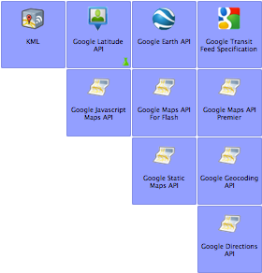
Another way to geolocate…
Google Maps API
Various uses
Browser and stand alone applications
Level of control - specificity
Notes:
http://code.google.com/more/table/

Slide 53
Show me the code deux!
Google maps API:
This calls the Google maps API
<script type="text/javascript"
src="http://maps.google.com/maps/api/js?sensor=false” //sensor = needs to be true or false – this references a GPS device

Slide 54
Show me the code deux! cont.
function initialize() {
var latlng = new google.maps.LatLng(39.306177, -76.616592); //UB Map Location
var myOptions = {
zoom: 18, //Level of zoom of the map
center: latlng, //center point of map
mapTypeId: google.maps.MapTypeId.ROADMAP//type of map
navigationControlOptions: {style: google.maps.NavigationControlStyle.SMALL}, //controls
};
var map = new google.maps.Map(document.getElementById("map_canvas"),
myOptions); //this call places the map in the canvas tag, then calls all options selected
}

Slide 55
“myOptions”
Map type – Ability to choose the viewable map (satellite, road, etc.)
Layers
Traffic
Bicycle
Controls – map controls, size, etc.
Overlays – shapes, markers, etc.
http://code.google.com/apis/maps/documentation/javascript/reference.html

Slide 56
Links & Credits
Excellent source for tutorials, API listings, etc.: http://www.programmableweb.com/howto
EMML in 15 Minutes:
http://www.jackbe.com/presto/emml15/
Sources for presentation:
Wikipedia, ProgrammableWeb, W3C Schools, Open Mashup.org
Images: Landprints, Black & Decker , Google Images

