Slide 1
CHAPTER 13
STATIONARY AND NONSTATIONARY TIME SERIES
Damodar Gujarati
Econometrics by Example, second edition

Slide 2
TIME SERIES
Most economic time series in level form are nonstationary.
Such series often exhibit an upward or downward trends over a sustained period of time.
But such a trend is often stochastic and not deterministic.
Regressing a nonstationary time series on one or more nonstationary time series may often lead to the phenomenon of spurious or meaningless regression.
Damodar Gujarati
Econometrics by Example, second edition

Slide 3
DIAGNOSTIC TOOLS
Time Series Plot
Autocorrelation Function (ACF) and Correlogram
  The correlogram will suggest if the correlation of the time series over several lags decays quickly or slowly.
  If it does decay very slowly, perhaps the time series is nonstationary.
Unit Root Test
  If on the basis of the Dickey-Fuller test or the augmented Dickey-Fuller test, we find one or more unit roots in a time series, it may provide yet further evidence of nonstationarity.
If after diagnostic tests, a time series is found to be stationary but trending, we can remove the trend by simply regressing that time series on the time or trend variable.
  The residuals from this regression will then represent a time series that is trend free.
Damodar Gujarati
Econometrics by Example, second edition

Slide 4
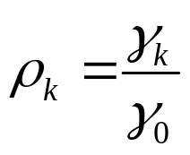
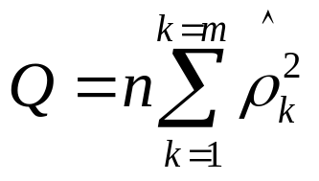
AUTOCORRELATION FUNCTION (ACF)
AND CORRELOGRAM
The ACF at lag k is defined as:
= covariance at lag k / variance
  Use the Akaike or Schwarz information criterion to determine the lag length.
  A rule of thumb is to compute ACF up to one-quarter to one-third the length of the time series.
  Test the statistical significance of each autocorrelation coefficient in the correlogram by computing its standard error.
  Alternatively, find out if the sum of autocorrelation coefficients is statistically significant (distributed as chi-square) using the Q statistic, where n is the sample size and m is the number of of lags (=df):
Damodar Gujarati
Econometrics by Example, second edition

Slide 5

UNIT ROOT TEST OF STATIONARITY
The unit root test for the exchange rate can be expressed as follows:
We regress the first differences of the log of exchange rate on the trend variable and the one-period lagged value of the exchange rate.
The null hypothesis is that B₃, the coefficient of LEX_{t-1}, is zero.
This is called the unit root hypothesis.
The alternative hypothesis is: B₃ < 0.
A non-rejection of the null hypothesis would suggest that the time series under consideration is nonstationary.
We cannot use a t test because the t test is valid only if the underlying time series is stationary.
  Use the τ (tau) test, also known as the the Dickey-Fuller (DF) test, whose critical values are calculated by simulations and modern statistical packages, such as EVIEWS and STATA.
Damodar Gujarati
Econometrics by Example, second edition

Slide 6
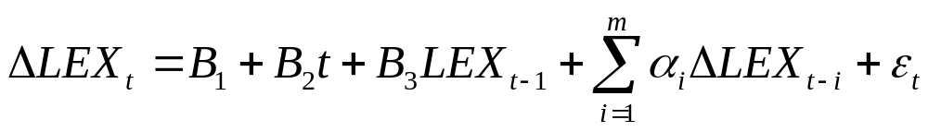
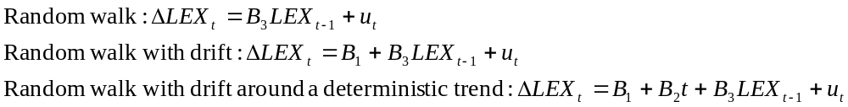
DICKEY-FULLER TEST (CONT.)
Augmented Dickey-Fuller (ADF) Test
If the error term u_{t} is uncorrelated, use the augmented Dickey-Fuller (ADF) test.
Add the lagged values of the dependent variable as follows:
The DF test can be performed in three different forms:
Damodar Gujarati
Econometrics by Example, second edition

