Slide 1
Modular Validation Architecture

Slide 2
Problem Statement
Appointment scheduling logic was tightly coupled.
New rules required code changes.
No clear separation of concerns.

Slide 3
Goals
Decouple validation logic from scheduling flow.
Enable dynamic rule composition.
Support configuration-based rule management.
Improve testability and extensibility.

Slide 4
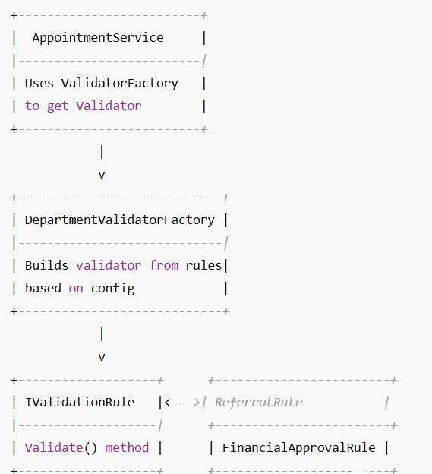
Architectural Overview

Slide 5
Patterns Used
Factory: Creates department-specific validators.
Strategy: Encapsulates rule logic.
Configuration: Defines rule-department mapping.
Dependency Injection: Injects services and rules.
SOLID Principles: Single Responsibility Principle (SRP) Open/Closed Principle (OCP)

Slide 6
Anticipated Questions - Design
Why a factory? For dynamic validator creation.
How to add a new rule? Class → Register → Config.
How to add a new department? Config.
What if config is wrong? Fails fast on startup.

Slide 7
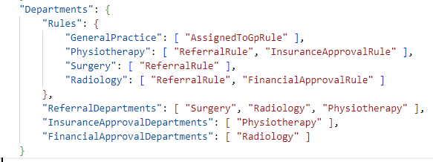
Configuration Example

Slide 8
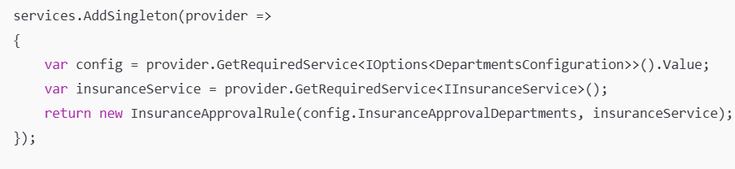
Extensibility
Support multiple departments per rule
Handle external services? Via constructor injection.
Modify AddValidationRules

Slide 9
Future Improvements
Add rule execution priority.
Use metadata/attributes for rule registration.
Integrate logging and telemetry.
Consider caching rule type lookups.

